Slide 1
IPAC’26 student tutorial lecture, Deauville, France, 15 May 2026
High-intensity High-Power Ion Accelerators
and Technical Challenge
Hongwei ZHAO
Institute of Modern Physics (IMP), Chinese Academy of Sciences
Lanzhou, China

Slide 2
Outline
High-Intensity High-Power Ion Accelerator （HIHPIA）
Brief introduction of HIHPIA
Key technologies and challenges
World-wide HIHPIA and HIAF&CiADS at IMP
Conclusion remarks

Slide 3
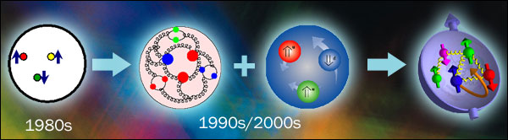
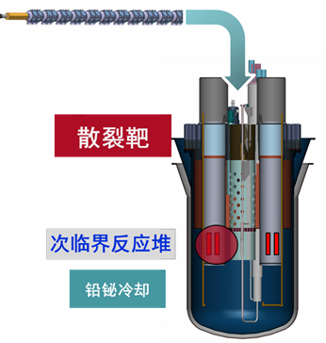
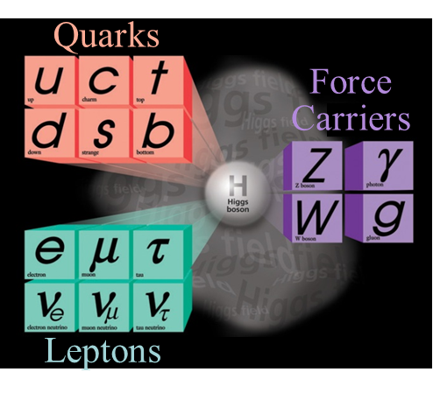
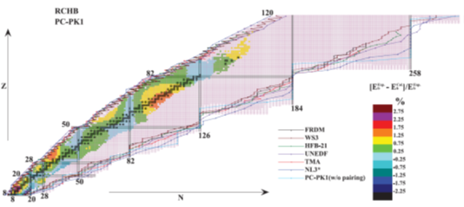
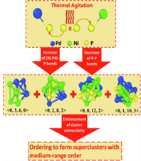
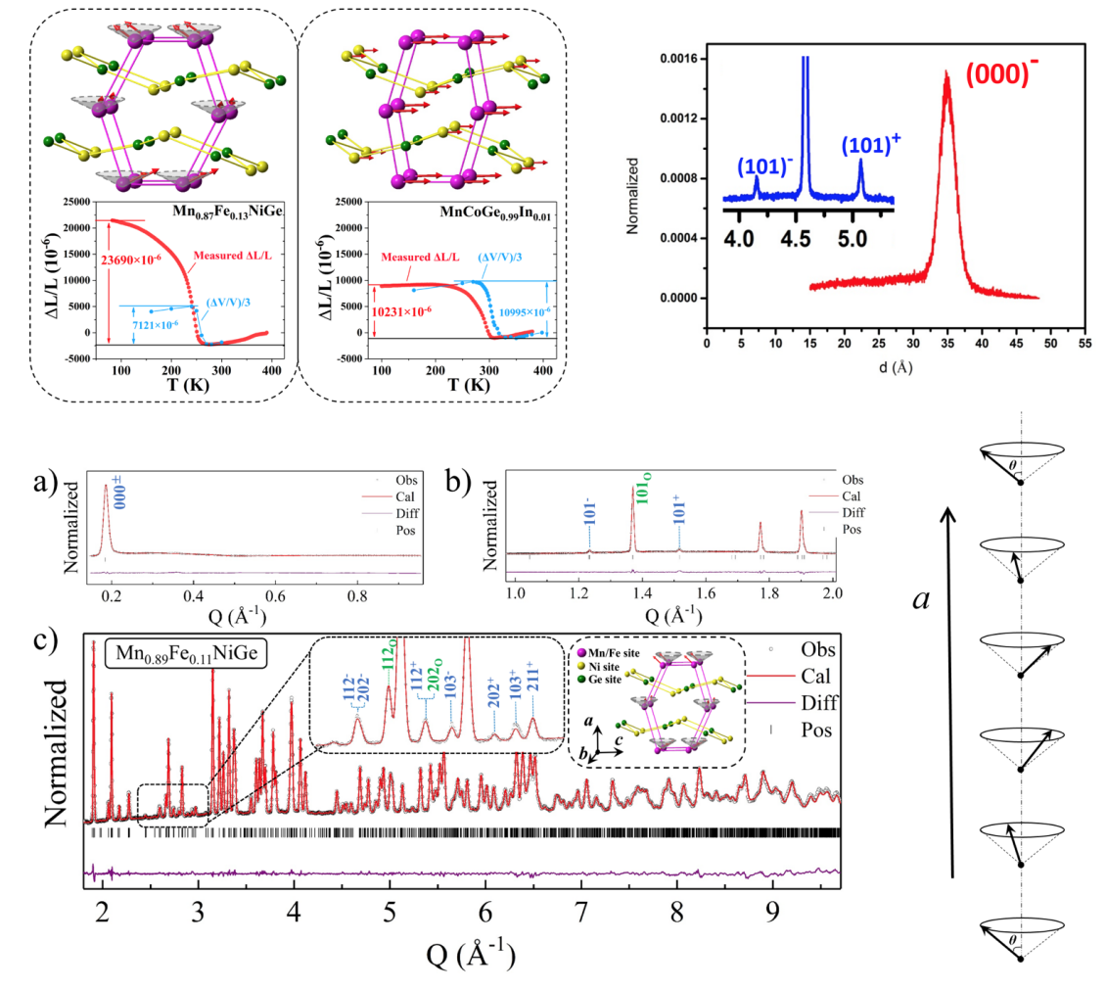
Applications of high-intensity high-power ion beams
Particle physics
Nuclear physics
HED physics
（Intens.& lumin. frontier）
Material science
Bioscience and medicine
Condensed matter physics
Advanced nuclear power
Neutron beam、neutron source
Muon beam and muon source
Detection and irradiation
Medical isotope production
Particle and radiation imaging
…..
ADS
Advanced nuclear-fission power
Heavy ion driven fusion
Neutral beam for MCF
Fusion material irradiation
…..
Neutrino factory
Muon source
Collider
Rare isotope facility
Secondary beam
…..
Notes:
Let me start with applications of high-intensity high-power ion beams。You know, main purpose for us to build hadron accelerators is to to deliver beams for users. High-intensity high-power ion beams can be used for fundamental physics research such as, …….

Slide 4
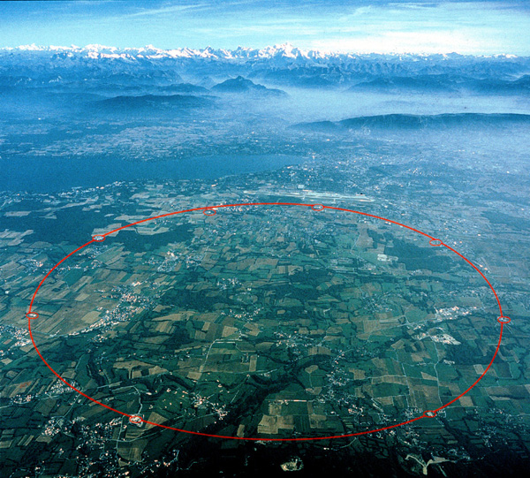
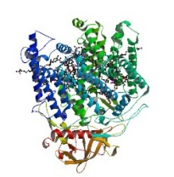
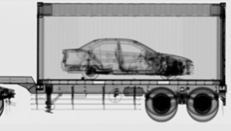


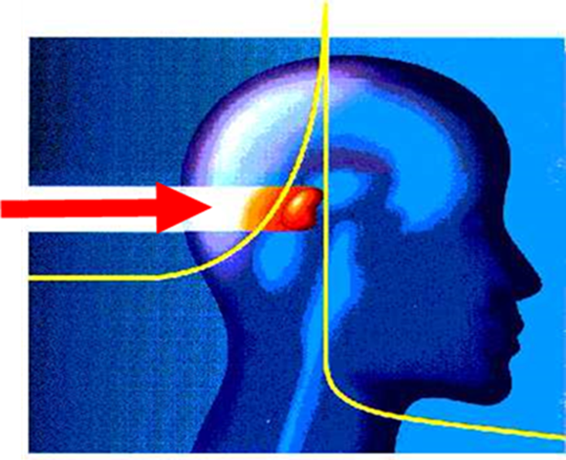
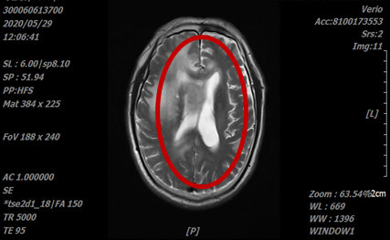

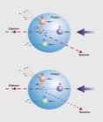

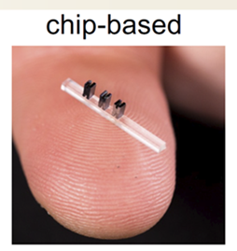
How can our users utilize the accelerator beams
Main parameters of ion beam
Ion species, beam intensity, kinetic energy,
time structure, repetition rate, bunch length,
emittance, beam loss…
LHC
Reaction products: secondary beams,
Photos,neutrons…
Rare isotopes, elementary particles
Quark,μ,τ,π…
Beam intensity determines reaction productivity or event numbers.
Beam energy is related to matter structure and hierarchy studied such as levels of the atom, nucleon, nucleus, elementary particle
Charge state of heavy ion beam is related to accelerator scale and performance-cost –effective.
Notes:
How can our users utilize the accelerator beams ? Main parameters of ion beam that our users usually concern about includes: ion species, beam intensity, …..
Typically the accelerator beam can be used as a projectile to bombard a target. This target could be a fixed target or moveable target, moveable target means beam-beam collision. Some sort of nuclear reaction may happen through collisions. If the beam energy is low, the reaction products could be ….,
If the beam energy is quite high, the reaction products could be …;
Generally speaking, Beam intensity determines reaction productivity ….

Slide 5
How to achieve high-intensity and high-power ion beam with radiation security
Raise beam intensity from ion source
Raise beam energy
Reduce beam loss as low as possible during transmission and acceleration
Raise intensity through beam accumulation and cooling for synchrotron and storage ring
Raise repetition rate, pulse peak intensity, pulse length for pulsed ion beam
Beam average power:
P = E_{kinetic} I_{average}
Beam average intensity:
I = f_{n}N_{p} e
f_{n} Repetition rate
N_{p} Number of particles per pulse
Significance of exposure to radiation
Occupational limit of radiation dose: maximum 50 mSv/year in US and China ( <20 mSv/year for 5 year)
Lab management guideline of radiation dose: 12.5 mSv in US DOE, 5 mSv in China
(Chest CT examination: 5-7 mSv; Whole body PET-CT scan: 15-25 mSv)
Notes:
How to achieve high-intensity and high-power ion beam with radiation security，
We need to raise ….;
For high high-intensity high-power ion accelerator, I would like to remind you significance of exposure to radiation

Slide 6
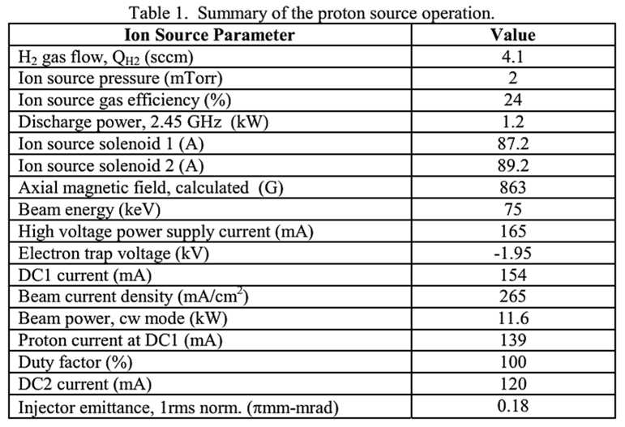
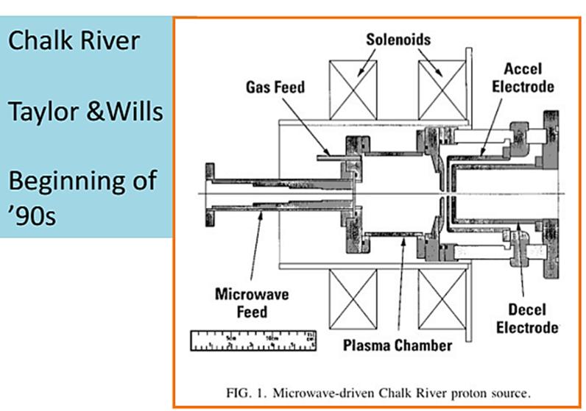
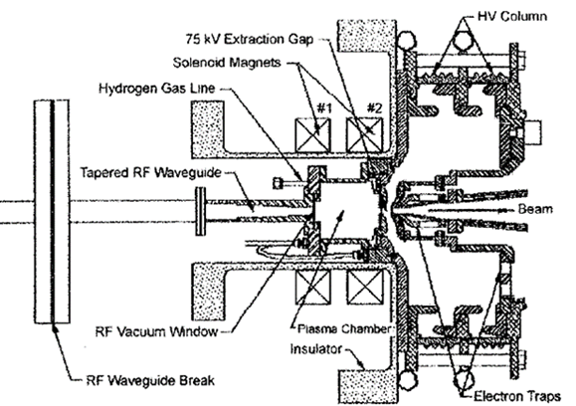
Production of high-intensity ion beams --Ion source
What is an ion source?
Ion source is a plasma device for producing ion beam. Ions can be produced by electron-impact ionization and the electrons are generated from plasma
What are the most important parameters for an ion-source user ?
Beam intensity and beam emittance(beam brightness): related to ion source itself
(plasma parameters), beam extraction system and LEBT.
2.45 GHz microwave-driven ion source for single-charged ion beam production
Los Alamos
T. Taylor and J. Wills, Proc. Linac’92, Ottawa
J. Sherman, et al., RSI, 69, 1003 (1998)
Notes:
How to produce high intensity ion beams? We need ion source, ion source is a plasma device ….
We usually use 2.45 GHz microwave-driven ion source for single-charged ion beam production
The pioneers of 2.45 GHz microwave ion source are Chalk River ion source group and LosAlamos ion source group in 1990’s,
The plasma is produced by 2.45 GHz microwave and confined by the axial magnetic field generated by the two solenoids.
Such ion source can produce 100 mA DC proton beam with emittance 0.1-0.2

Slide 7
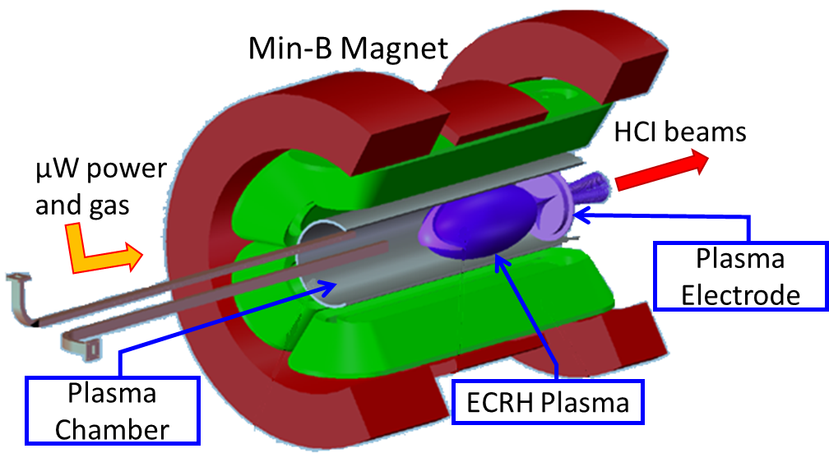
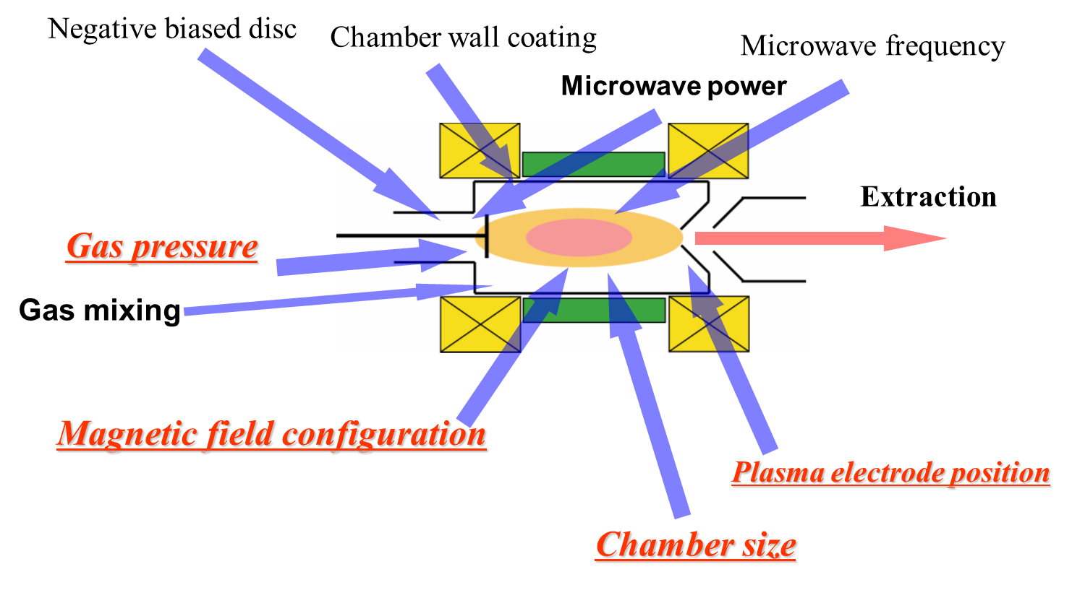
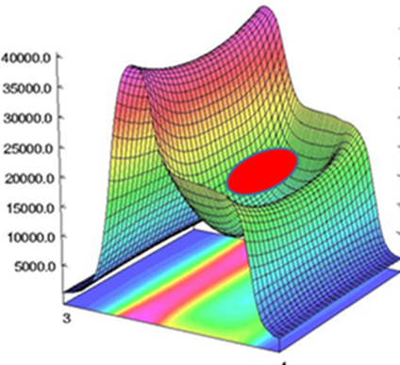
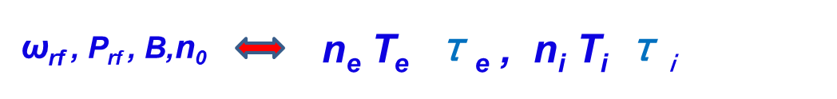
ECR ion sources for highly-charged ion beam production
ECR: Electron Cyclotron Resonance
ω_{rf} = 10-60 GHz
B_{max} =1-16 T
Multi-Mode Cavity ?
Confinement of high density highly-charged plasma
--- long-time confinement for electrons and ions ---Minimum B structure
Electron stepwise collisional ionization producing highly-charged ions
--- high density and hot elelctons with required energy distribution --- high power microwave ECR heating
Notes:
How to produce high intensity highly-charged heavy ion beams which are needed for all heavy ion accelerators?
So we need highly charged ECR ion source 。。。
Highly charged ECR ion source is a plasma device. The plasma is produced by 。。。
The ECR plasma is confined by so called minimum-B magnetic structure which is a superposition of 。。。。
Highly charged ions are produced by ….

Slide 8
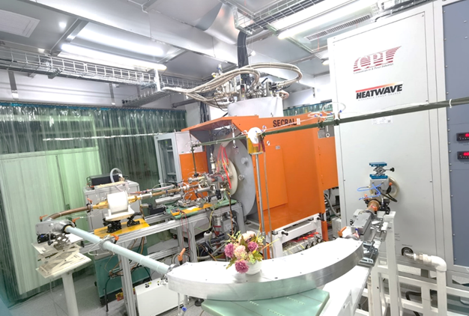
Record beam intensities produced by IMP SECRAL-II ECR ion source
Ion species | Charge state | SECRAL& SECRAL-II 24~28 +18 GHz 6-10 kW [eμA]
⁴⁰Ar | 12+ | 1420
 | 16+ | 620
 | 18+ | 15
⁷⁸Kr | 18+ | 1030
 | 28+ | 145
¹²⁹Xe | 26+ | 1100
 | 30+ | 365
 | 42+ | 16
²⁰⁹Bi | 31+ | 680
 | 41+ | 100
²³⁸U | 34+ | 620
 | 35+ | 545
 | 46+ | 61
 | 55+ | 13
24-28GHz SECRAL-II ECR ion source
More than 5000 hours operation each year in the past 10 years demonstrating high performance and long-term stability
Notes:
Almost all the world record beam intensities for HCI ion beams were produced , each year SECRAL-II operated more than 5000 hours in the past 10 years demonstrating high performance and long-term stability。。。

Slide 9
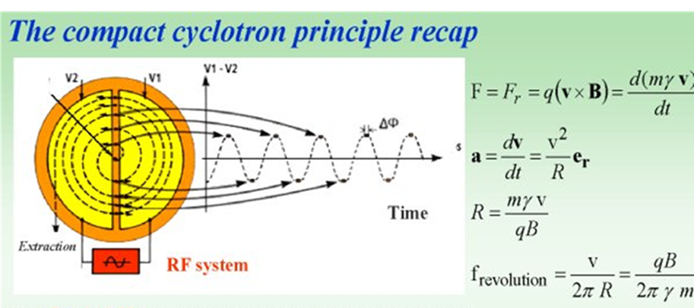

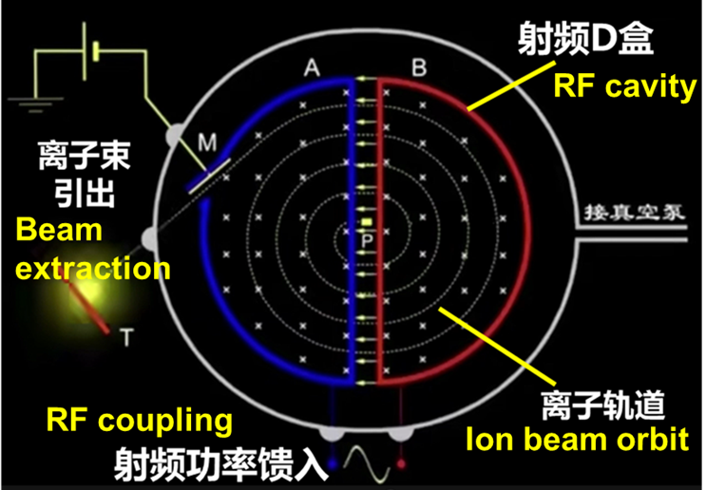
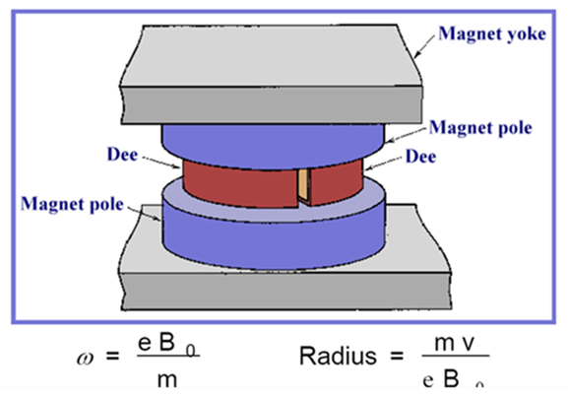
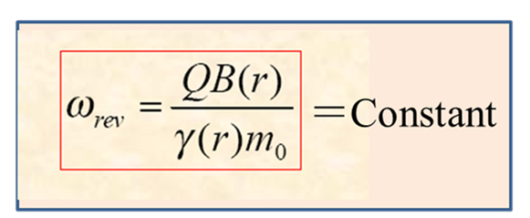
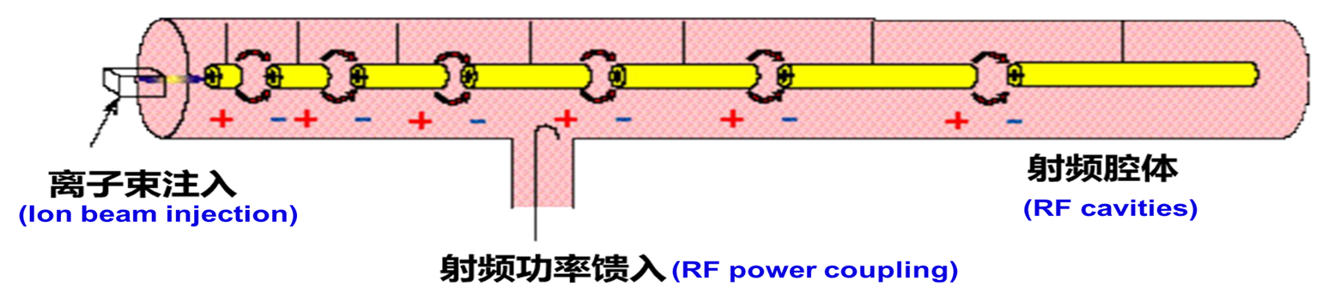
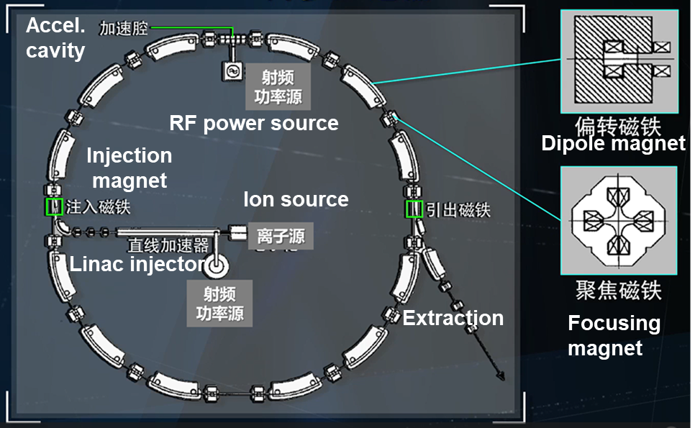
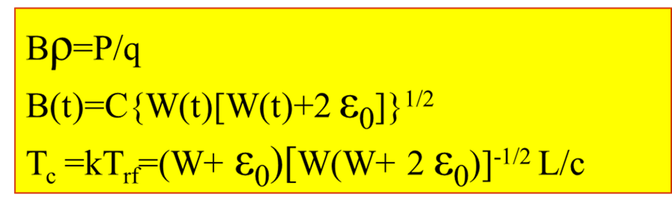
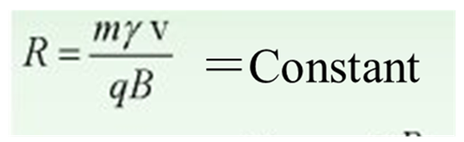
Typical accelerators for high intensity ion beam acceleration(1)
Cyclotron, compact, CW
Linac
CW or pulsed beam
Easy to adjust beam energy
Only pulsed beam
Easy vary beam energy
Synchrotron
Notes:
Three typical accelerators for high intensity ion beam acceleration.
Cyclotron, cyclotron is a sort of compact machine being able to deliver high intensity CW beam, but not easy to adjust beam energy.
Linac: Linac is able to accelerate high intensity pulsed or CW beam, and easy to adjust beam energy.
Synchrotron: Synchrotron is able to deliver only pulsed beam with low repetition rate, but easy to vary beam energy.

Slide 10
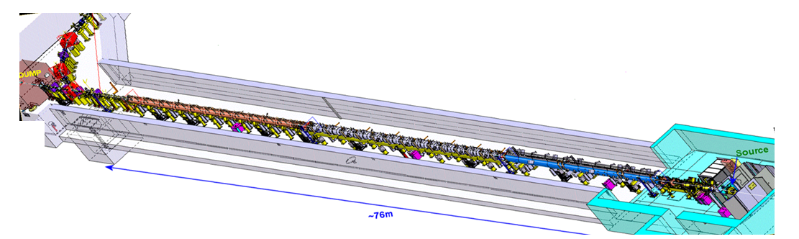
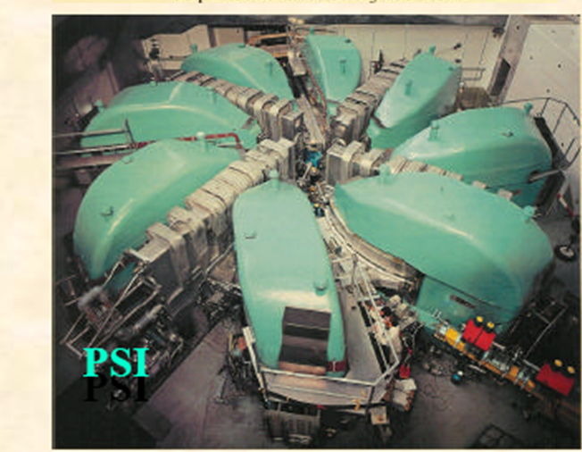
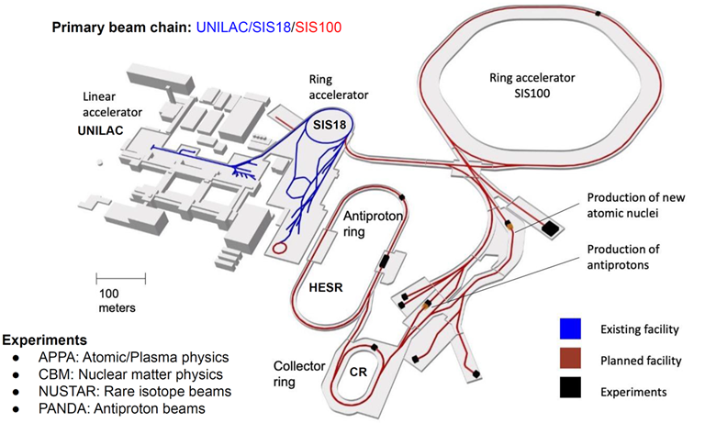
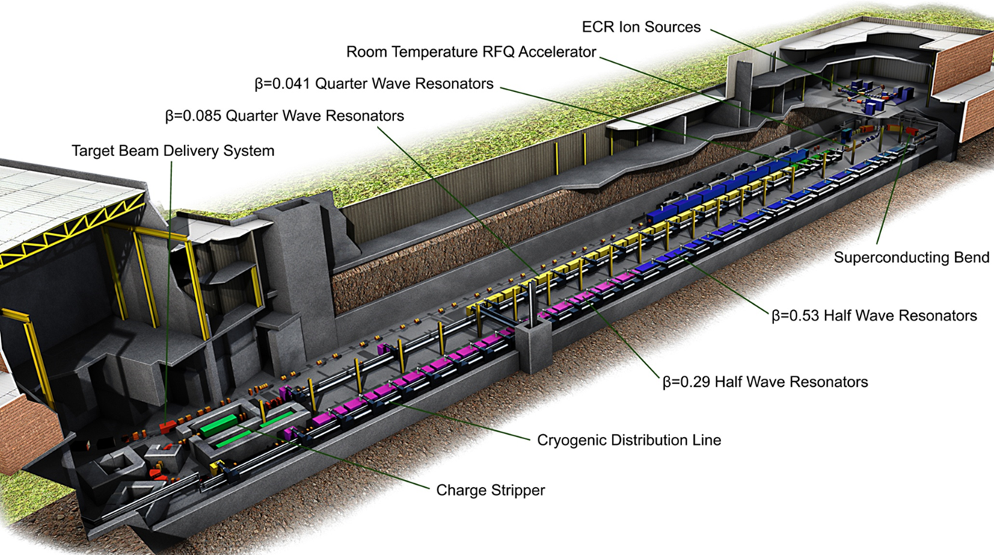
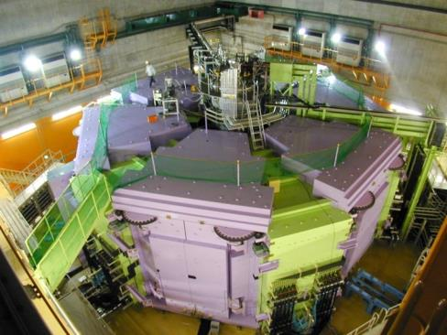
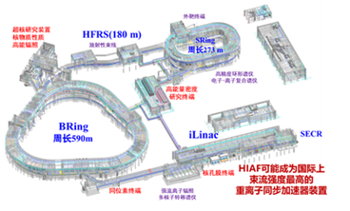
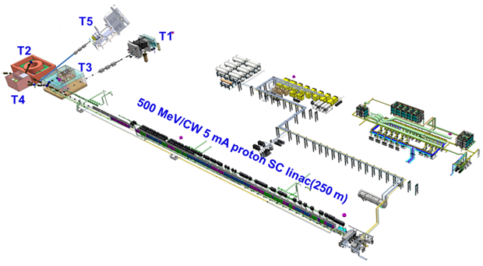
Typical accelerators for high intensity ion beam acceleration(2)
Linac4/CERN
FAIR/GSI
RIKEN-SRC
FRIB/MSU
CiADS/IMP
HIAF/IMP
Notes:
A few examples,

Slide 11
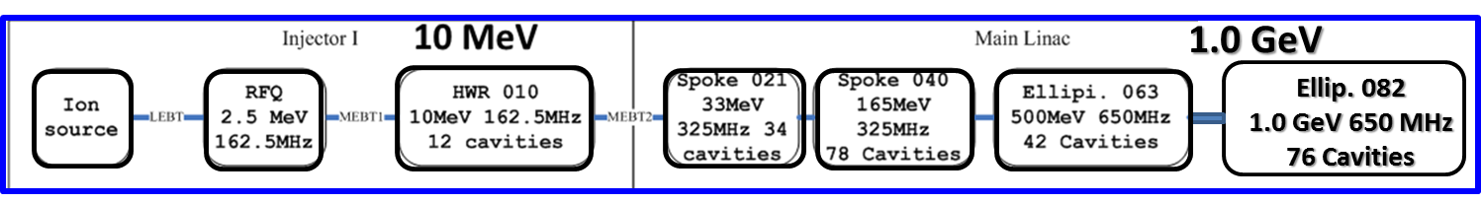
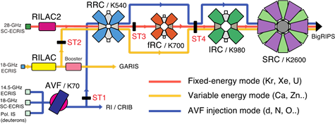
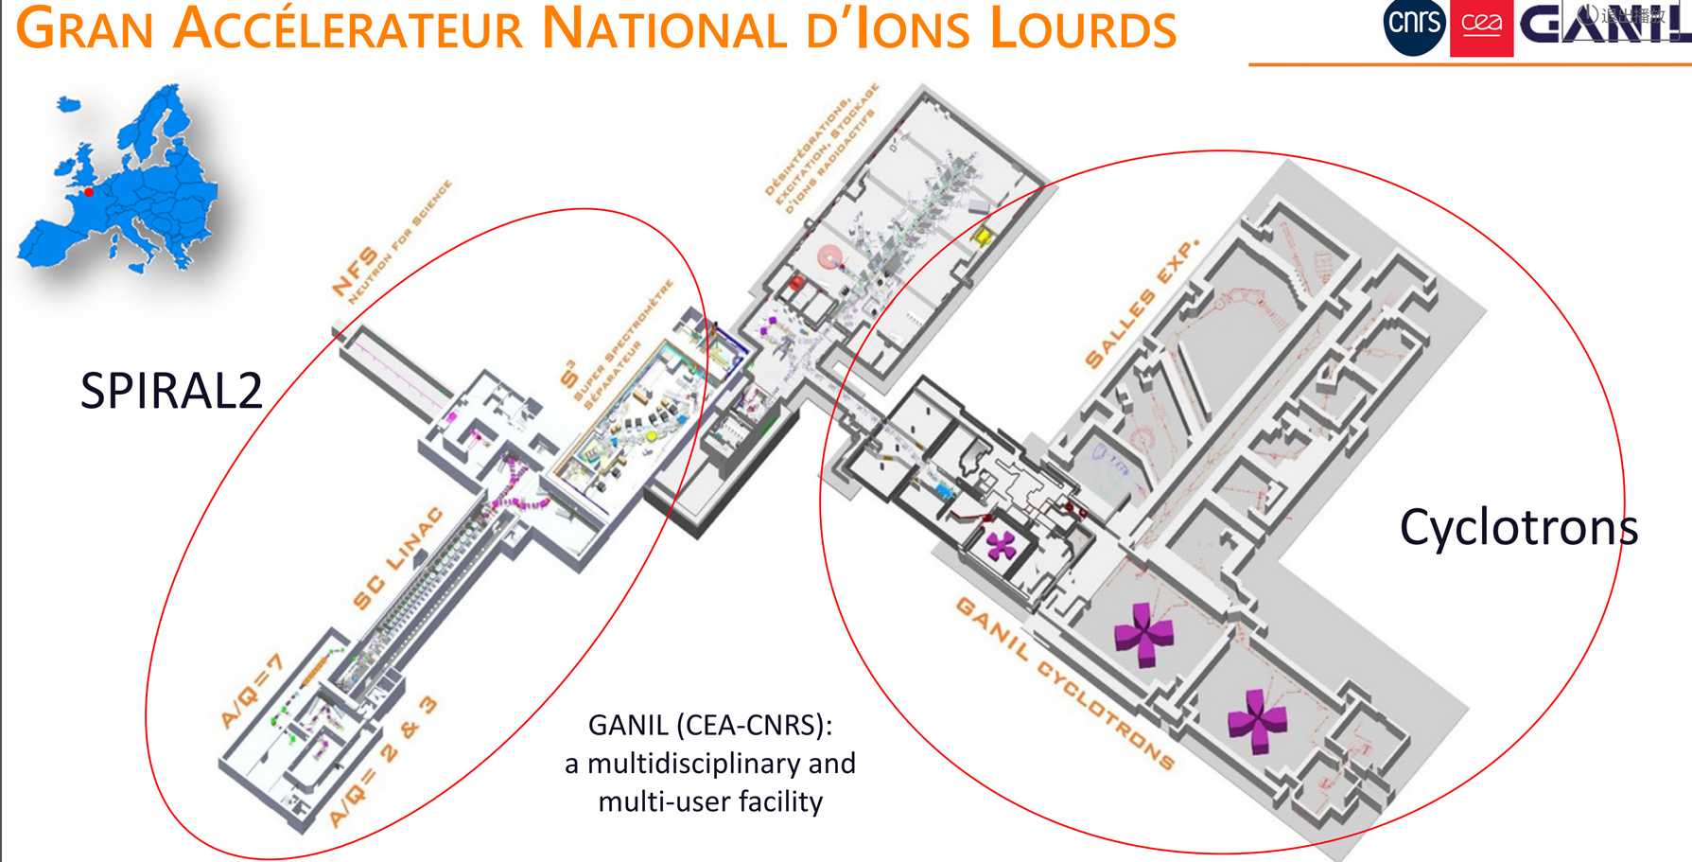
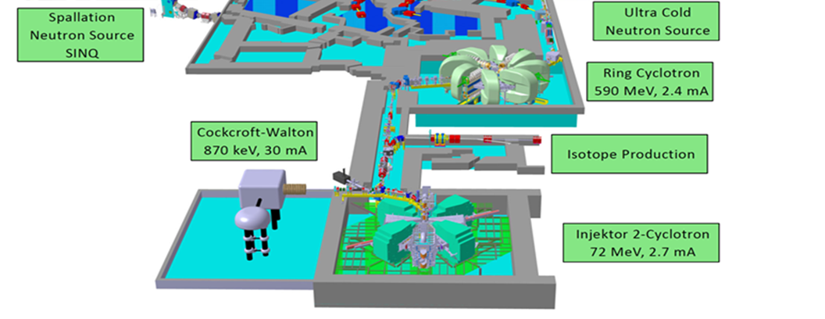
Technical approaches of high-intensity and high-power ion accelerators (1)
1. High-intensity and high-power（Frontier of intensity and luminosity）
-- SC ion linac (1-10 MW,< 3 GeV, 5-10 mA )
NC or SC
SC
SNS injector, ESS, CiADS, FRIB, SPIRAL2,IFMIF…
2. High-intensity and high-power cyclotrons (1-3 MW，< 1 GeV/A，<5 mA )
GANIL, PSI, RIKEN, IMP, TRIUMF…
PSI proton cyclotrons
RIKEN-RIBF—Heavy ion cyclotrons
GANIL –Heavy ion cyclotrons
Notes:
We may have three technical approaches for high-intensity and high-power ion accelerators according to the different applications.
If we need high intensity …, we may utilize SC ion linac

Slide 12
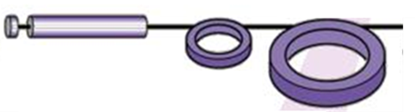
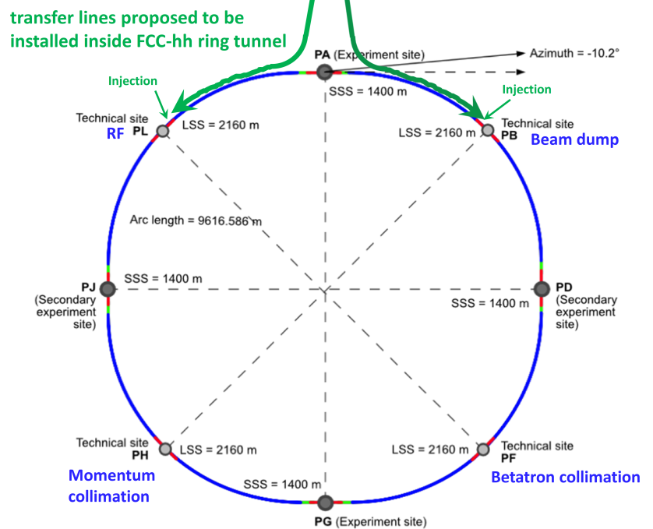
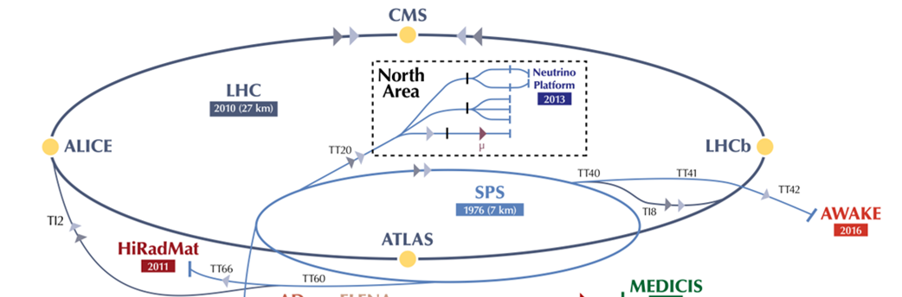
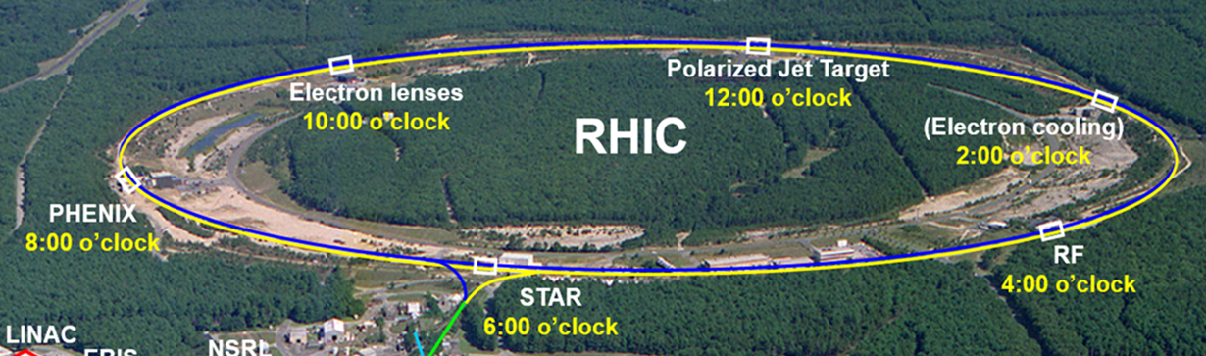
Technical approaches of high-intensity and high-power hadron accelerators (2)
3. High-energy and high-power（Frontier of high energy）
-- Linac+ synchrotrons (1-5 MW，>3 GeV/A )
SNS, JPARC, CSNS, HIAF, FAIR,FNAL proton complex, ….
Several synchrotrons
and storage rings for
acceleration and
accumulation, compression,
and finally to the target
Linac injector
Target
RCS booster
-- Linac+ RCS synchrotrons + colliders (1-3 MW，hundred GeV/A – TeV)
Ion beam-beam
collision
CERN LHC
BNL RHIC
FCC-hh/SPPC

Slide 13
Outline
High-Intensity High-Power Ion Accelerator （HIHPIA）
Brief introduction of HIHPIA
Key technologies and challenges
World-wide HIHPIA and HIAF&CiADS at IMP
Conclusion remarks

Slide 14
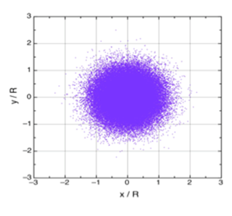
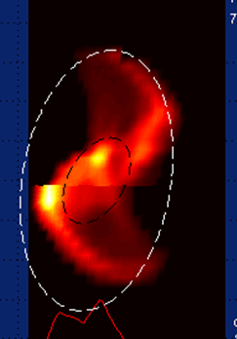
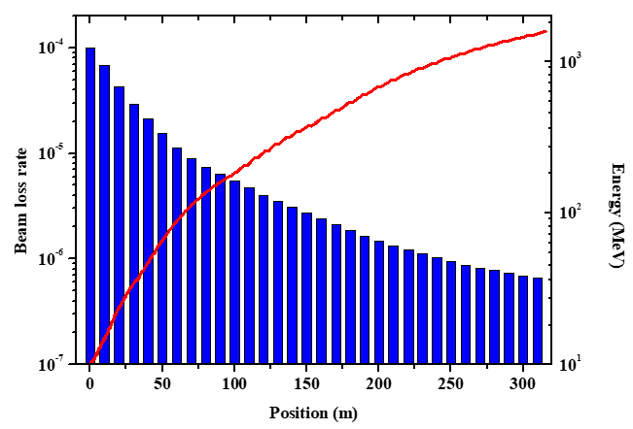
Key issues & challenges for HIHPIA
Key issues and challenges of beam dynamics
Interactions between charged-particles;
Interactions between ion beam and electric-magnetic elements
Space-charge effect, instabilities, collective effect, wakefields …
Extremely low beam-losses for HIHPIA ion beam, <1 W/m
Neutron Star Mergers
Technical challenges
A few accelerators coupled and connected together, or hundreds SRF cavities, stripping foil for H⁻ and heavy ions
Beam loss rate 10⁻⁴-10⁻⁶,
CW: 10¹⁵-10¹⁶ pps, pulsed: 10¹²-10¹⁵ ppp
Stabilization of RF frequency、phase and voltage amplitude (hundreds SRF cavities)
Beam dynamics--LLRF control--beam loss detection--machine protection-- automatic recovery of beam trips – fast feedback and diagnostics （tens μs）, for long-term operation
Long-term stability and availability with MW beam
AI&ML …..
Beam halo
Beam distortion
Notes:
I would like to address a few key issues and challenges particularly for HIHP ion accelerators.
Key issues and challenges of beam dynamics, because of high intensity, there must be strong interactions….
What is the most challenging for HIHP long-term operation is that we need to do engineering design by optimizing all these things together, beam dynamics, ….

Slide 15
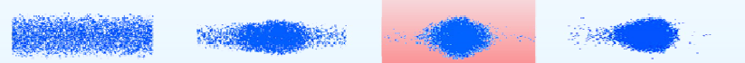
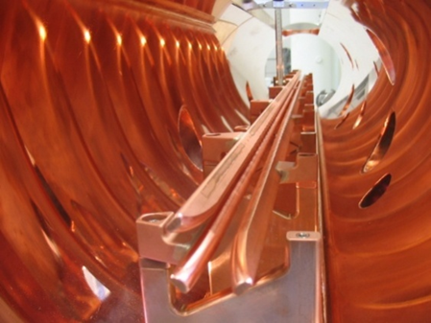
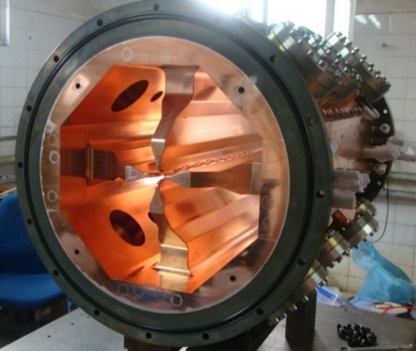
Acceleration of high-intensity low-energy ion beam by RFQ
RFQ is a typical low-energy accelerator for high intensity ion beam acceleration
Transversal
match
Beam Focusing
and shaping
Longitudinal
bunching
Acceleration
400MeV/u@1MW 重离子
总体设计
理论模拟
Beam match、focusing、bunching and acceleration in the RFQ cavity
Four rods
RFQ
Four vane
RFQ
Key issues
Stable and high-power electric-magnetic fields for beam focusing, bunching and acceleration
Interaction between the electric-magnetic fields and the high intensity ion beam in RFQ
Long-term operation (weeks) at CW 10 mA proton and 1 emA heavy ion beams not yet demonstrated
Notes:
After high intensity ion beam is produced, we usually need a RFQ for high-intensity low energy beam acceleration
RFQ is a typical

Slide 16






Proton and heavy ion RFQ accelerators developed by IMP
2.1 MeV/H⁺ 10 mA, 2011-2014, 3 such RFQs were built and being operated at IMP (collaborated with LBNL)
0.5 MeV/A, A/Q=2-7, 2015-2024, 1 mA O⁶⁺, 0.2 mA Bi³⁵⁺, 2 such heavy ion RFQs were built for LEAF and HIAF
CW 10 mA proton and 1 mA O⁶⁺ beams were demonstrated in hours
Notes:
What you see here are …

Slide 17





SRF cavities for high intensity beam acceleration achieving higher E
Key issues
Generate high electric-field gradient （E_{acc}）with high Q 、low RF power loss、low electric and magnetic peak field (E_{peak} 、B_{peak}) and stable RF frequency、phase and voltage amplitude by optimization of cavity structure and cavity surface processing.
Realize acceleration and transmission of high intensity ion beam almost no any beam loss.
400MeV/u@1MW 重离子
总体设计
理论模拟
THWR
Spoke
HWR
Typical SRF cavities for ion acceleration
with low and high β
QWR
Elliptical multi-cell
Notes:
We need SC RF cavities ,
These are typical SRF cavities….
Key issue is to

Slide 18






Low and medium β SRF cavity for proton and heavy ions
HWR010 by IMP
HWR015 by IMP
Gradient E_{acc} and Q₀ need to be improved for both bulk-Nb and thin film
New structure and new material need to be developed.
Recent surface processing and thin film advances (surface coating Nb & Nb₃Sn, electro-polishing, N-doping/infusion …) potentially enable much higher performance.
β= 0.82. 5-cell prototype built by IMP
Q₀ 1 x 10¹⁰, ~30 MV/m in VT. 650 MHz
Notes:
Future further development of Low and medium β SRF cavity for proton and heavy ions

Slide 19





SRF Cryomodule
Integration of SRF cavities, SC solenoids, BPM, powers couplers, frequency tuners, LHe vessel,
cavity support, magnetic shielding, multi-layer thermal shielding, …..
Notes:
One of technical challenges for SRF linac is cryomodule technology. We need integrate all SRF cavities, SC solenoids, ….

Slide 20

Accelerator high-B SC magnet：Development and State-of-the-Art
Two approaches
LTS (Nb3Sn)
HTS (REBCO) conductors
Demand and challenge
16-20 T dipole magnets
ϕ1-1.5 m, 30 T solenoids
100-kT/s fast ramping dipole
Nb₃Sn Q-magnet：11-12T，in series production；12-16T dipole in prototyping
HTS Bi2212、REBCO, solenoids >20T，16-20T dipole in prototyping
Notes:
Another technical challenge is high field SC magnet.
The driven forces and demands for high field SC magnet come from high intensity high power hadron colliders or accelerators, such as HL-LHC, FCC/SPPC.
This viewgraph shows development …in the last 40 years。。。

Slide 21


Nb₃Sn HL-LHC Quadrupole magnet

Slide 22


LTS Nb₃Sn dipole magnet
Nb₃Sn dipole demonstrator: 17 T achieved
Demonstrators: magnets not having all features of a short model, but proving a part of the technology (aperture 50 mm)
LTS Nb₃Sn R&D directions:
- Improve performance / cost
- Nb₃Sn / NbTi hybrid magnets at 1.9 K
- Reduce cryogenic system complexity and cost
for 4.5 K operation
- Need intensive R&D: verify reproducibility and
margins, reliable quench protection at high field
©D. Tommasini et al, CERN
14.5T Dipole by Fermilab

Slide 23

Future high field SC magnets: HTS magnet
Possible to realize J >1000 A/mm2 , B > 20T, T > 20K
HTS conductors: ReBCO, BSCCO(Bi-2223,2221), IBS
Key issues: degradation, quench losses and quench protection, cost
Accelerator demands: field quality, reproducibility, long-term stability, uniformity
HTS/LTS hybrid technology: Possible cost saving but still need 1.9 or 4.5K for LTS, strong interaction between the LTS coils and HTS coils.
Notes:
But for future high field ….
Probably HTS magnet is a only technical approach ….
Many laboratories over the world have been involved in key technology R&D for HTS magnets, it is important for future accelerators
We have to keep those accelerator demands in mind, field quality,

Slide 24



Beam Temperature and Beam Cooling
The beam particles are generated in a “hot” source
Longitudinal beam temperature
$$\frac{1}{2}k_{B}T_{∥}=\frac{1}{2}m\left\langle v_{∥}^{2}\right\rangle =\frac{1}{2}mc^{2}β^{2}{\left(\frac{δp_{∥}}{p}\right)}^{2}$$
Transverse beam temperature
hot beam
cold beam
$$\frac{1}{2}k_{B}T_{⊥}=\frac{1}{2}m\left\langle v_{⊥}^{2}\right\rangle =\frac{1}{2}mc^{2}β^{2}γ^{2}{θ_{⊥}}^{2}$$
$$θ_{⊥}\left(s\right)=\frac{v_{⊥}\left(s\right)}{βc}=\sqrt{\frac{ε_{⊥}}{β_{⊥}\left(s\right)}}$$
Beam temperature depends on “momentum spread” and “emittance”, the phase space volume
Liouville’s theorem (in Hamiltonian dynamics) states that the volume of phase space is invariant under time evolution (conserved).
Need beam cooling to reduce momentum spread and emittance.
Notes:
Let’s talk about beam temperature and beam cooling. As you know, the Longitudinal beam temperature can be described as this equation…
So this means beam temperature depends on ….

Slide 25



Typical beam cooling methods and technologies
Beam cooling methods are non-Liouvillean processes which are used for a reduction of beam temperature and improvement of beam quality
Electron cooling
Stochastic cooling
Laser cooling
Principle: momentum transfer by coulomb collisions between electron and ion
Principle: measurement of deviation from ideal orbit is used for correction kick (feedback)
Principle: directed excitation and random emission result in a transfer of momentum
for low or medium energy beams
strong cooling effects
very slow for high energy beam and high beam power.
Cooling time ~ γ³
for low intensity and hot beams
pre-cooling for secondary ions
limited by bandwidth and beam density, slow for high energy and high intensity beam
ultra fast cooling process
very strong cooling effect
quite particular method, limited by laser frequency
Coherent electron cooling : use electron beam as cooling media and to cool ions stochastically with bandwidth at f 1-100 THz
Notes:
There are three typical beam cooling methods and technologies. Electron cooling, stochastic cooling, Laser cooling.
Electron cooling is a kind of momentum transfer ….
Electron cooling is very effective for low or medium energy…., but cooling is very slow …..
Stochastic cooling is useful for low intensity and hot beams.

Slide 26





Beam cooling challenge
Key challenge and demand: - Fast beam cooling dedicated to particle beams with high energy,
high intensity and high momentum spread, such as for proton, heavy ion
or secondary ion beam, muon beam, not yet demonstrated successfully.
- New ideas， new technology, breakthrough needed urgently.
Coherent electron cooling, ionization cooling…, not yet demonstrated.
Muon ionization cooling for muon collider
Cooling for EIC high energy proton beam
©Vladimir N Litvinenko, SBU, HB2025.
©E. Métral, CERN, HB2025
Notes:
You may notice that we need fast beam cooling technology dedicated to。。。

Slide 27




Target for high power beam
Utilize high power beam on target to produce secondary particles
Target for spallation neutrons, ADS, μ and neutrino beam, ~ MW power
Target for radiactive isotope. tens kw-hundreds kW
Graphite, solid metal, flowing liquid metal, fluidised powders…
Fixed, rotating, Conveyors,…
Key issues:
- Rapid temperature cycling, active cooling e.g. forced flow Helium.
- Extreme high-radiation damage, swelling, structural degradationTarget
- Lifetime and beam window lifetime (Ti/Al, Be)
-
CSNS target(150-180 kW
PSI target for surface μ
ESS 5 MW target
SNS 2 MW target design
Notes:
When beam power is at hundreds kW or even MW level, target will be a great issue.
We utlize high power beam to produce secondary particles ….

Slide 28
Outline
High-Intensity High-Power Ion Accelerator （HIHPIA）
Brief introduction of HIHPIA
Key technologies and challenges
World-wide HIHPIA and HIAF&CiADS at IMP
Conclusion remarks

Slide 29

Evolution of proton and heavy ion beam power
Proton: 1-10 mA, 0.1-5 MW
Heavy ion: tens pμA, 10-400 kW
©J. Wei, FRIB/MSU, HB2023
Notes:
This slide shows status and evolution of proton and heavy ion beam power in the past 50 years.

Slide 30











World-wide high-intensity and high-power ion accelerators （kW-MW）
ORNL SNS
PSI cyclotrons
FNAL proton accelerator complex
JPARC
IMP CIADS（construction）
IHEP CSNS
ESS（construction and commiss.)
IFMIF（Plan）
RIKEN-RIBF
GSI FAIR（construction）
MSU FRIB
IMP HIAF（started operation）
Notes:
There are many HIHP ion accelerators over the world being operated, under construction and being planed for future…
Such as

Slide 31



ORNL-SNS average beam power 2 MW
To be upgraded to 2.8 MW
The world most powerful proton accelerator facility
https://status.sns.ornl.gov/beam.jsp
Notes:
The world most powerful proton accelerator facility is SNS accelerator which consists of …
What is amazing is its long-term operation with high power and high availability in the past 10 years…
Currently already achieved 1.7 MW for routine operation, and is being upgraded to 2.8 MW, just in this month, reached 2 MW …

Slide 32


PSI proton cyclotron complex 1.4 MW
©Joachim Grillenberger, PSI, talk at HB2023
Being upgraded to 1.8 MW
Notes:
PSI proton cyclotron complex consists of two cyclotrons, with proton energy 590 MeV， 1.4 MW CW beam power in routine operation, and being upgraded to 1.8 MW

Slide 33


ESS 5MW average beam power
Commissioning
SC linac 2 GeV/5 MW
2014 start construction, 3 phases.
Beam on target milestone requires capability for 1.4 MW at 571 MeV with nominal pulse structure
Start Of User Operation requires capability for 2 MW at 870 MeV with nominal pulse structure
Full scope is 5 MW at 2 GeV with 2.86 ms long pulses at 14 Hz
Commissioning
800 MeV beam on target in 2026
© Ciprian Plostinar, ESS,
HB2025
Notes:
ESS, is a high power pulsed linac, proton beam final energy 2 GeV…, average beam intensity 2.5 mA, beam power 5 MW.
ESS already started beam commissioning and the plan is to reach 800 MeV beam on target in 2026.
,

Slide 34


RIKEN RIBF heavy ion cyclotron complex
Highest energy of CW heavy ion accelerator complex
Used to be a highest power heavy ion accelerator
1) AVF-injection mode (< 440 MeV/u) : d, He, O, …
2) Variable-energy mode (< 400 MeV/u) : Ar, Ca, Zn, Kr, …
3) Fixed-energy mode (345 MeV/u) : Xe, U …
© H. Okuno, RIKEN, talk at HPTW2023
Notes:
RIKEN RIBF heavy ion cyclotron complex, which consists of 3 large heavy ion cyclotrons with 3 injectors,….

Slide 35

MSU-FRIB Heavy ion SC linac
200 MeV/A—400 kW heavy ion beam，now 30 kW
Designed U beam 8-10 pμA
Started routine operation in 2022
The world most powerful heavy ion accelerator!
Notes:
FRIB is a fully SC heavy ion linac which consists of highly-charged ECRIS, heavy ion RFQ,and SC acceleration sections with different beta ….
FRIB is The world most powerful heavy ion accelerator!
Designed beam energy….

Slide 36

GSI-FAIR accelerator complex
Construction
Operation
in 2030
²³⁸U²⁸⁺ 1.5 GeV/A, 5x10¹¹ ppp

Slide 37

HIAF&CiADS at IMP --- Brief introduction
HIAF: High Intensity heavy ion Accelerator Facility
CiADS: China Initiative Accelerator Driven System
Being built by IMP in Huizhou of Guangdong Prov.
Two of 16 large-scale scientific infrastructure facilities approved by China Government during the 12th 5-year-plan 2016-2020
HIAF: Nuclear physics research
Total budget: 2.8 B CNY ¥ (424 M USD $)
Schedule: 2018-2025
Construction started officially Dec. 2018
CiADS: Nuclear waste transmutation
Total budget: 4.0 B CNY ¥ (606 M USD $)
Schedule: 2021-2027
Construction started officially July. 2021
HIAF
CiADS
Notes:
HIAF is High Intensity heavy ion Accelerator Facility dedicated to Nuclear physics research , CiADS is China Initiative Accelerator Driven System dedicated to Nuclear waste transmutation. Both facilities are being built by IMP in Huizhou Guangdong province.
HIAF total budget roughly 2.8 B Chinese Yuan, 424 M USD, time schedule 2018-2025.
HIAF total budget roughly 2.8 B Chinese Yuan, 424 M USD, time schedule 2018-2025

Slide 38

HIAF&CiADS Construction Site
HIAF
CiADS

Slide 39

HIAF general layout and overview
HIAF is aimed to provide the highest intensity heavy ion beams in the world
HFRS: Radioactive beam line
6
Accelerator main components
2
3
4th ECR ion source (SECR)
Superconducting Linac (iLinac)
Fast ramping synchrotron (BRing)
L: 180m, Bρ: 25 Tm
4
5
SRing:
Spectrometer ring
Circumference: 273m
Rigidity: 15 Tm
Electron/Stochastic cooling
Two TOF detectors
Four operation modes
BRing
Experimental terminals in Phase-I
Fast cycle ring
Circumference: 570 m
Rigidity: 34 Tm
Large acceptance (250/120)
Two planes painting injection
Fast ramping rate（3-10Hz）
Low energy nuclear structure terminal
High energy experimental terminal
High energy fragment separator HFRS
High precision spectrometer ring SRing
Electron ion recombination terminal
Radioactive ion beam physics terminal
iLinac:
Superconducting linac
Length:100 m
Energy: 17-22 MeV/u(U³⁵⁺⁻⁴⁶⁺)
SECR:
Superconducting
ECR source
1
²³⁸U³⁵⁺ | 0. 8 GeV/u | 0. 5-2. 0×10¹¹ ppp
²³⁸U⁷⁶⁺ | 2. 45 GeV/u | 0. 25-0. 5×10¹¹ ppp
p | 9.3 GeV/u | 5×10¹³ppp

Slide 40
Major Challenges
HIAF Could be the world most intense pulsed heavy-ion facility
Challenge-1:
Beam dynamics
Institute | Machine | Planned | Achieved | Ion
BNL | AGS Booster |  | 5×10⁹ | Au³²⁺
CERN | LEIR |  | 9×10⁸ | Pb⁵⁴⁺
JINR | NICA Booster | 4×10⁹ | / | Au³²⁺
GSI | SIS18 | 1.0×10¹¹ | ~ 4×10¹⁰ | U²⁸⁺
FAIR | SIS100 | 4.0×10¹¹ | / | U²⁸⁺
IMP | HIAF-BRing | >1.0×10¹¹ | / | U³⁵⁺
IMP | HIAF-SRing | >5.0×10¹² | / | U⁹²⁺
IMP | HIRFL-CSR | 1.0×10⁹ | 1.0×10⁸ | U⁷⁴⁺
leads to
Nonlinear effects
Space charge effects
Collective effects
Dynamic vacuum
limits
Beam production
Low energy manipulation
Fast ramping acceleration
Challenge-2
Technology aspect
Beam intensity
Beam quality

Slide 41









HIAF project construction (1)
HiRIBL (HFRS)
SRing
Ion Sources
BRing
BRing Injection Line
iLinac
RFQ

Slide 42







HIAF project construction (2)
Radiation resistant dipoles
Warm iron SC-dipoles
Electron Cooler
Injection Kicker
Full energy storage PS
Extraction Kicker PS
RF Power Station

Slide 43


HIAF Beam Commissioning (1)
Typical nonmetallic ions ¹⁸O
New High Energy ¹⁸O Beam Intensity Record
BRing Test
Beam Intensity (ppp)
BRing Design
SIS18
Max. 3.0×10¹¹@2.6 GeV/u

Slide 44

HIAF Beam Commissioning (2)
Typical metallic ions ²⁰⁹Bi
New High Energy ²⁰⁹Bi Beam Intensity Record
HIAF design
Max. 3.4×10¹⁰ @ 850 MeV/u
SIS18 record (4×10⁹ppp)
刷新了国际 Bi 离子高能脉冲流强新纪录

Slide 45

CiADS-China Initiative Accelerator Driven System
Accelerator-driven subcritical systems (ADS) is considered to be the most effective and promising method to solve the nuclear waste. CiADS will be the world’s first prototype of ADS facility
• Beam Energy:
500 MeV (upgrade to 1.5 GeV)
• Beam Current:
5 mA (upgrade to 10 mA)
• Total Power: <10 MW
2.5 MW beam power,
7.5 MWth reactor power
High power lead-bismuth eutectic (LBE) spallation target
Sub-critical lead-bismuth eutectic (LBE) fast reactor
The experimental terminals
• High power Target experimental Facility；
• Muon experimental Facility；
• Multifunctional Irradiation Research Station；
• Nuclear Data Experimental Terminal
• ISOL for upgrade
The total budget is 4.0 billion CNY
Construction period:
2021-2027, 6 years
The same campus with HIAF
Superconducting proton linear accelerator

Slide 46

CiADS SC-linac and its challenge
Accelerator Length: ~300 m, Complex Cryogenic Distribution System
Beam Power: > 2.5 MW (500 MeV, 5 mA), Beam Loss: < 1 W/m
Machine Protection: < 20 µs response to prevent vacuum pipe damage.
Critical physics challenges
Ultra-low Beam Loss Control : < 10⁻⁶
Beam trip Availability: > 85%
Energy/MeV | 500~1000
Beam current/mA | 5 ~10
Operation mode | Pulse & CW
Current stability | ±2%@100ms
Cavity number | 151
CM number | 32

Slide 47


CiADS SC-linac installation
Ion source + LEBT + RFQ+
MEBT+11 cryomodules,
Installed at the tunnel.
Total CM numbers:32
18 kW at 4 k cryogenic
domestic-made refrigerator system installation and commissioning completed.

Slide 48
Conclusion remarks
HIHPIA, large-scale scientific facility, support for scientific research, the related technologies have a lot applications in our society. Facing many technical challenges, long-term reliable operation with high availability significant. Encouraging the young generation to get involved in HIHPIA.
Need very big team working together, efficient and strong collaboration with the team members
International communication and collaboration very important. “Standing on the shoulders of giants”.
Keep the major mission and objective in mind for years long-term and innovative R&D to achieve key technology breakthrough （3 examples）.

Slide 49







Development of IMP highly-charged ECRIS
2002-2016-2023
(24-28 GHz)
2015-2024-present
(45 GHz--)
IMP ECRIS
1996-2002- present
(14-18 GHz)
1986-1995
（10GHz）
SECRAL II
LECR3
LECR1
FECR
The world leading
>10 years
LECR2
LECR0
SECRAL
Notes:
In the past 30 years, we at IMP have put a lot of efforts for development of highly-charged ECR…
Particularly in the last 20 years, we developed and built a few high performance SC ECRIS, solenoids and sextupole both are SC coils,
Such as 28 GHz SECRAL SC ECRIS operating at 28 GHz 。。。
The world first fouth generation ECRIS operating at 45 GHz with Nb3Sn SC magnets…
Because of these SC ECRIS and stabe long-term operation, IMP is at the world leading position in the ECRIS community。。。

Slide 50
FECR Nb₃Sn magnet development
Key technologies
Coils fabrication
Keys & Bladder
½ Prototype Coldmass
Quench protection
Full Sized coldmass
Quality control of mass production
Quench protection
Quench protection
Know-how of Nb₃Sn coil
Quality control and analysis
SG assisted mechanical assembly
Reliability
Reliability
System integration
FECR Magnet
System integration
Coldmass alignment
Reliable operation
From prototyping to operational machine (2015-2024)
To demonstrate 80~85% of FECR coldmass performance
Operational FECR Nb₃Sn magnet
9 years R&D for FECR Nb₃Sn magnet

Slide 51



LEAF/HIAF - 45 GHz FECR
FECR-I with hybrid magnet
Nb₃Sn solenoids + NbTi sextupole
FECR-I already in routine operation since 05/2024
FECR-II Nb₃Sn magnet with
Nb₃Sn solenoids + Nb₃Sn sextupole
being tested at 4 k in 05/2026

Slide 52








10 years milestones of CW proton SC linac as R&D for CiADS
1
2009-2012, SRF and RFQ design, prototyping
2014， 2.1 MeV RFQ+single HWR cavity
CW 2.5 MeV/10 mA (RFQ collaboration with LBNL)
2
162.5 MHz HWR010
2014-2015，RFQ+6 HWR cavity
CW 4-5 MeV/4 mA
Collaborated with
many labs over the world
3
162.5 MHz HWR010
2016，RFQ+12 HWR cavity
CW 10 MeV/2 mA
The world first
demonstration
for high intensity
CW proton linac
4
162.5 MHz HWR010
2017-2019，RFQ+23 HWR cavity
CW 15-25 MeV/2 mA
5
2019-2021，RFQ+23 HWR cavity
CW 20 MeV/10 mA
7.3 mA@126 kW，108 hours
6

Slide 53



High power CW SC proton linac reliability demonstration
The world first demonstration
17.18MeV/CW 7.5mA
108 hours
17.27MeV/CW 10mA
Availability：126.1 kW，op. time 108 hs, availability 93.6%
Beam current：174.4 kW、10.08 mA，op. time 12 hs
High power：20.18 MeV、10.18 mA、beam power 205.5 kW
12 hours
Notes:
This slide shows details of High power CW superconducting proton linac reliability and availability demonstration achieved in 2021.
That’s the world first demonstration.
This is the beam intensity history from January 20 to March 10, proton beam intensity measured by a DCCT at the high energy beam line ,
In the very beginning from January to Feberuary, the beam intensity was around 2-5 mA, we ever reached 10 mA for short time ,
and then we had several attempts to keep long time beam operation at beam intensity around 7 mA,
finally we demonstrated successfully the beam reliability at 17.18 MeV CW 7.5 mA, continuously for 108 hours,
and then we switched the beam to CW 10 mA for 12 hours operation test continuously,
and the last step we raised the beam energy upto 20 MeV, beam intensity at CW 10 mA for a few miniutes, and reached maximum beam power 205 kW.

Slide 54


10 years R&D of large-size magnetic alloy core loaded RF for HIAF (1)
The BRing RF system can only be achieved by large-size magnetic alloy loaded cavity RF technology, the large-size MA core material is not available in China and forbidden sale to China.
Over 10 years R&D from small(Φ90mm), medium (Φ 460mm), to large (Φ 780mm
Ultrathin ribbons from 18 to 14 μm are getting thinner and have better performance
18um ribbon
18um ribbon
14um ribbon
95×65×25mm
460×230×25mm
780×360×35mm
Parameters of MA core
The key performance μQf value of the domestic large-sized magnetic alloy ring exceeds the internationally best FT3-L magnetic alloy by more than 30% (FT3-L Hitachi product).

Slide 55


10 years R&D of large-size magnetic alloy core loaded RF for HIAF (2)
Facilities | Voltage (kV) | Length (m) | Gradient(kV/m)
JPARC-RCS | 41 | 1.78 | 23
JPARC-MR | 46.7 | 1.78 | 26.2
SIS18 | 50 | 2 | 25
HIAF-BRing | 70 | 2 | 35
MA loaded RF system in the HIAF tunnel
Total RF voltage: 350kV

Slide 56
Thank you for your attention !

