Slide 1
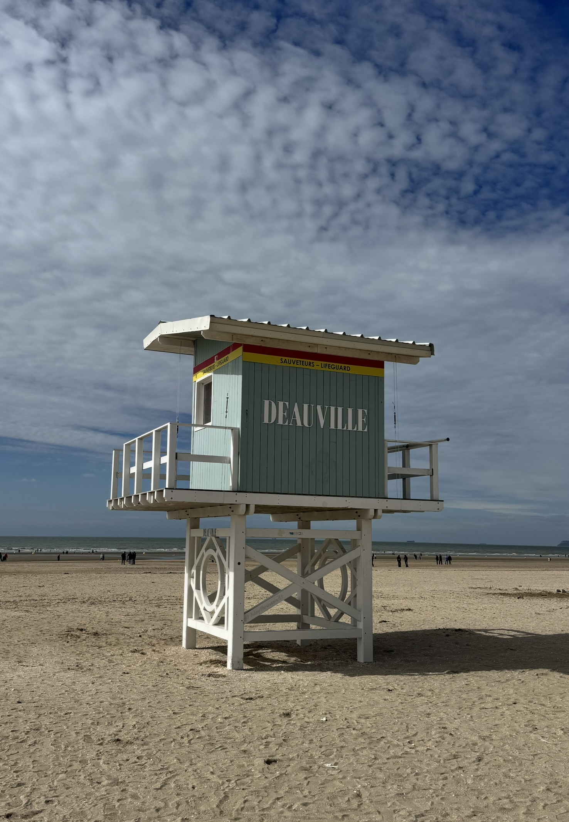

Advanced Acceleration Techniques and Novel Particle Sources
Edda Gschwendtner, CERN
IPAC’26 Student Tutorials
Deauville, France
17 May 2026

Slide 2
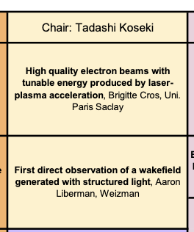
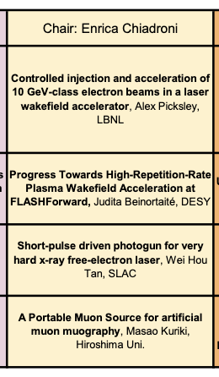
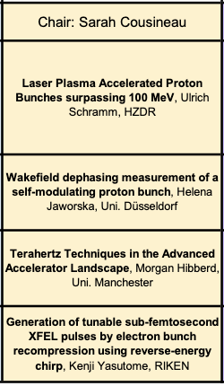
Advanced Acceleration Techniques and Novel Particle Sources
Talks at IPAC2026, Deauville, France
Tue, 19 May 2026
Wed, 20 May 2026
Thu, 21 May 2026
→ Topics on recent results and first applications

Slide 3
Outline
Introduction to plasma wakefield acceleration
State-of-the-art
Plasma wakefield acceleration applications

Slide 4
Introduction to plasma wakefield acceleration
State-of-the-art
Plasma wakefield acceleration applications

Slide 5
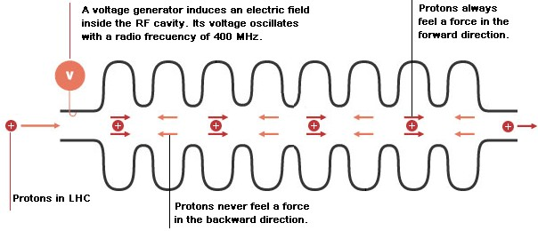
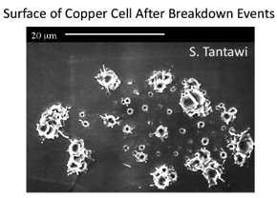
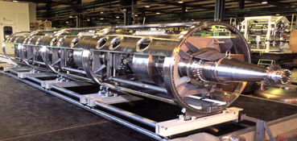
Conventional Acceleration Technology
Accelerating fields are limited to <100 MV/m
(invention of Gustav Ising 1924 and Rolf Wideroe 1927)
LHC cavity
Typical gradients:
LHC: 5 MV/m
ILC: 35 MV/m
CLIC: 100 MV/m
In metallic structures, a too high field level leads to break down of surfaces, creating electric discharge. Fields cannot be sustained; structures might be damaged.
Very successfully used in all accelerators (hospitals, scientific labs,…) in the last 100 years.
➔ More than 30000 accelerators worldwide!
E. Gschwendtner, CERN
5

Slide 6
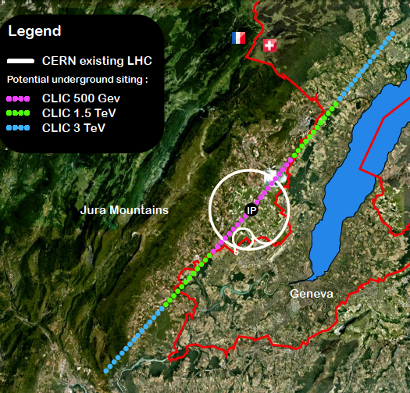
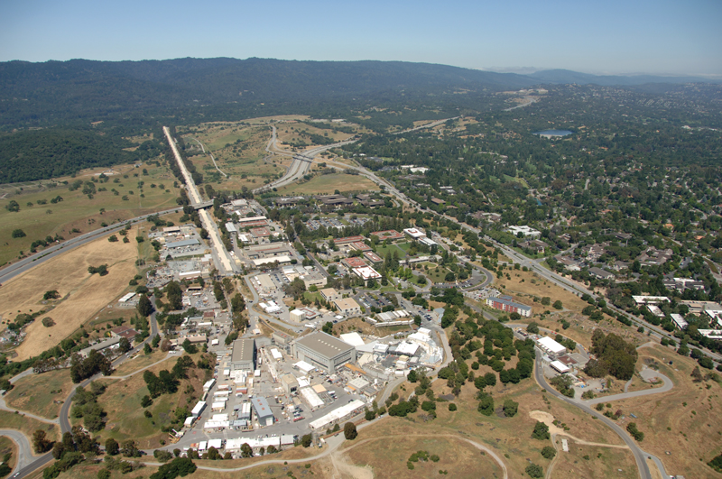
Linear Accelerators
→ 48 km
Accelerating cavities
Favorable for acceleration of low mass particles to high energies.
Limitations to linear colliders:
Linear machines accelerate particles in a single pass.
CLIC, electron-positron collider with 3 TeV energy
Stanford Linear Collider
50 GeV → 3.2 km
The higher the required particle energy, the longer (and more costly) is the accelerator.

Slide 7
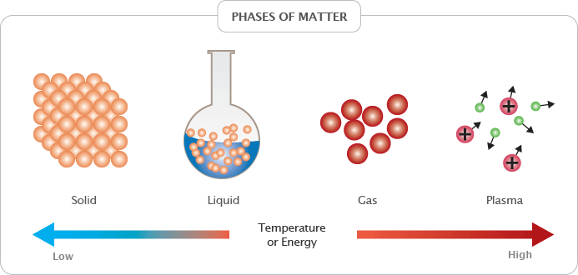
Plasma Wakefield Acceleration
Plasma is already ionized or “broken-down”
Can sustain electric fields up to three orders of magnitude higher gradients.
order of 100 GV/m.
~1000 factor stronger acceleration!
→ makes this technology very interesting for reducing the size (and cost) for future linear colliders.

Slide 8
Plasma Wakefield Acceleration
PLASMA is the 4th state of matter
Quasi-neutrality: the overall charge of a plasma is about zero. Collective effects: Charged particles must be close enough together so that each particle influences many nearby charged particles.
Electrostatic interactions dominate over collisions or ordinary gas kinetics.
Plasma WAKEFIELDS are the fields created by collective motion of plasma particles are called.
ACCELERATION of charged particles when they experience an electric field.
Strength of the acceleration:
‘Accelerating gradient’ : ~MV/m

Slide 9

How to Create a Plasma Wakefield?
Analogy:
lake → plasma
Boat → particle beam (drive beam)
Surfer → accelerated particle beam (witness beam)
E. Gschwendtner, CERN

Slide 10
Principle of Plasma Wakefield Acceleration
Drive beam:
Laser drive beam → LWFA
Charged particle drive beam → PWFA
e-drive bunch

Slide 11
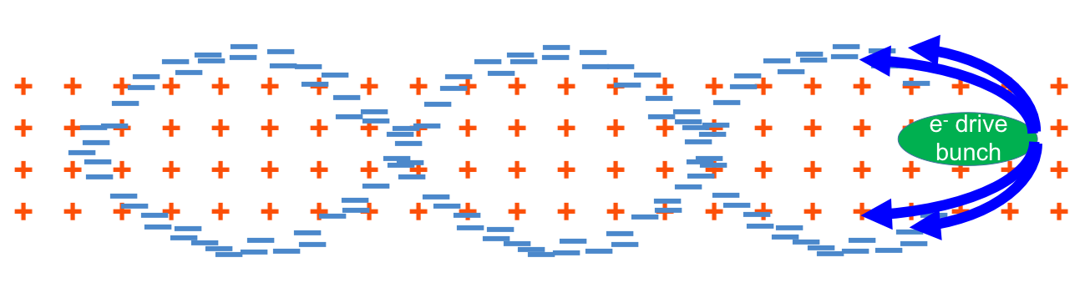
Principle of Plasma Wakefield Acceleration
Drive beam:
Laser drive beam → LWFA
Charged particle drive beam → PWFA
Plasma wave excited by relativistic particle bunch.
Plasma e⁻ are expelled by space charge force.
Plasma e⁻ rush back on axis.
Acceleration physics identical for LWFA, PWFA.
plasma wavelength λ_{pe} = mm-scale

Slide 12
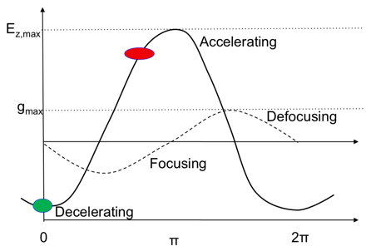
Where to Place the Witness Beam?
Accelerating for e⁻
Decelerating for e⁻
e⁻
Focusing for e⁻
Defocusing for e⁻
Longitudinal and transverse wakefields are π/2 out of phase.
➔ Only ¼ of the electron oscillation length is focusing and accelerating for charged particles!

Slide 13
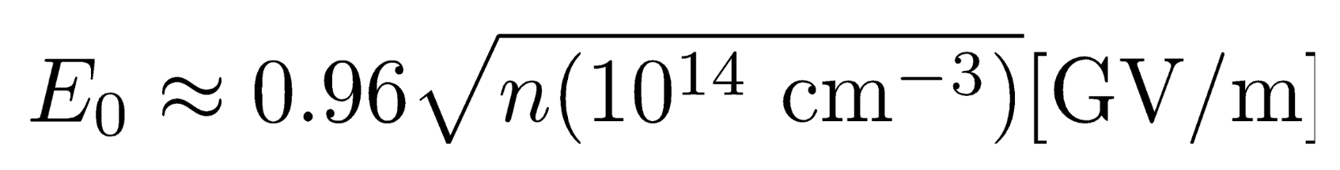
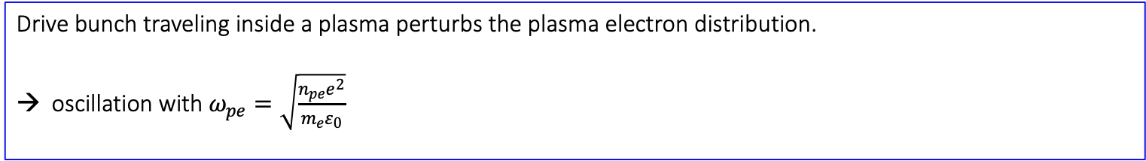
Plasma Wakefield, Density Scaling
Drive bunch traveling inside a plasma perturbs the plasma electron distribution.
oscillation with $ω_{pe}=\sqrt{\frac{n_{pe}e^{2}}{m_{e}ε_{0}}}$
λ_{pe}
c
=
2π
ω_{pe}
→ Plasma electron wavelength decreases with increasing plasma density.
The plasma oscillation leads to a longitudinal accelerating field:
The maximum accelerating field (wave-breaking field) is:
Example: n_{pe} = 1x10¹⁸ cm⁻³ ➔ E_{WB} = ~100 GV/m ➔ λ_{pe} = ~30 µm
Example: n_{pe} = 7x10¹⁴ cm⁻³ (AWAKE) ➔ E_{WB} = 2.5 GV/m ➔ λ_{pe} = 1.2 mm
→ Maximum accelerating gradient increases with increasing plasma density.
Advantage of PWFA
LWFA: dephasing: laser group velocity depends on plasma density, is slower than c.
Electron energy reach is limited by dephasing: → move to lower densities and longer accelerators
Lower density needs higher laser power.

Slide 14

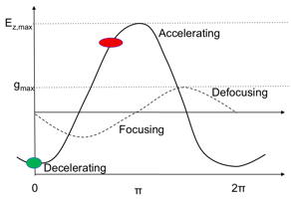
Linear Theory
(R. D. Ruth, P. Chen, SLAC-PUB-3906, 1986)
When drive beam density is smaller than plasma density (n_{b} << n_{p}) → linear theory:
Peak accelerating field in plasma resulting from drive beam with Gaussian distribution:
➔ eE_{z} ≈ N/σ_{z}²
B.E. Blue 2003
Wakefield excited by bunch oscillates sinusoidally with frequency determined by plasma density.
Fields excited by electrons and protons/positrons are equal in magnitude but opposite in phase.
The accelerating field is maximized for a value of
k_{pe} σ_{z} ≈ √2
k_{pe} σ_{r} ≤ 1
Example: n_{pe} = 7x10¹⁴ cm⁻³ (AWAKE), k_{pe} = 5 mm⁻¹ ➔ drive beam: σ_{z} = 300µm, σ_{r} = 200µm

Slide 15
Linear Theory
Accelerating for e⁻
Decelerating for e⁻
Focusing for e⁻
e⁻
Defocusing for e⁻
Linear Theory: Maximum accelerating electric field reached with drive beam of N and σ_{z}:
MV
N/(2 x 10¹⁰)
← Driver must be short compared to plasma wavelength, easy for laser and electron bunches.
E_{acc}=
110
m
(σ_{z} / 0.6mm)²
Examples of accelerating fields for different beam parameters and plasma parameters fields:
N = 3x10¹⁰, σ_{z} = 20µm, n_{pe}= 2x10¹⁷ cm⁻³ ➔ E_{acc} = 15 GV/m

Slide 16
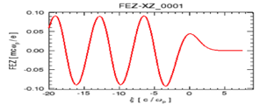
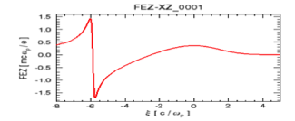
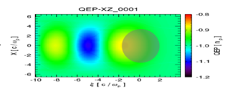
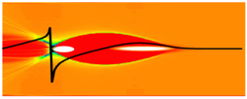
Different Regimes, Quality
Linear regime: n_{beam} << n_{pe}
Blow-out regime: n_{beam} >> n_{pe}
Beam loading (Simon van der Meer, 1985)
E_{z}
Narrow sheaths of excess
plasma electrons
Accelerating
cavity
z = s -ct
Ions only
Typical bubble length scale:
fraction of a mm
lower wakefields
transverse forces not linear in r
Symmetric for positive and negative witness bunches
Well described by theory
Higher wakefields
transverse forces linear in r (emittance preservation)
High charge witness acceleration possible
Requires more intense drivers
Not ideal for positron acceleration
Reduce energy spread
Sufficient charge in the witness bunch to flatten the accelerating field

Slide 17
Plasma Acts Like a Transformer
→ Drive beam deposits energy, witness beam gains energy
3 Ds
Acceleration distance (and witness energy) typically limited by one of the
witness
driver
Depletion: The drive bunch/pulse running out of energy.
→ Solution: couple in a new driver or use a more energetic driver.
witness
driver
Dephasing: The witness bunch outruns the driver.
→ Solution: couple in a new driver or change plasma parameters.
witness
driver
Diffraction: (mainly for laser pulses): Drive beam evolution.
→ Solution: Guiding.

Slide 18
Introduction to plasma wakefield acceleration
State-of-the-art
Plasma wakefield acceleration applications

Slide 19
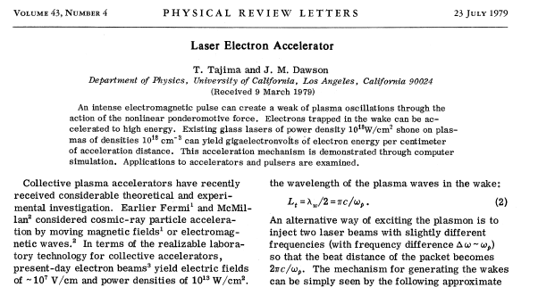
Seminal Paper 1979, T. Tajima, J. Dawson
Use a plasma to convert the transverse space charge force of a beam driver into a longitudinal electrical field in the plasma.

Slide 20
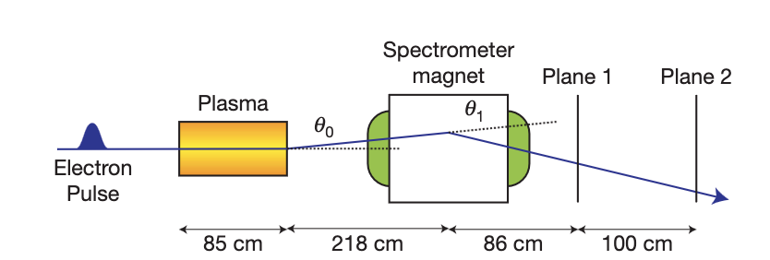
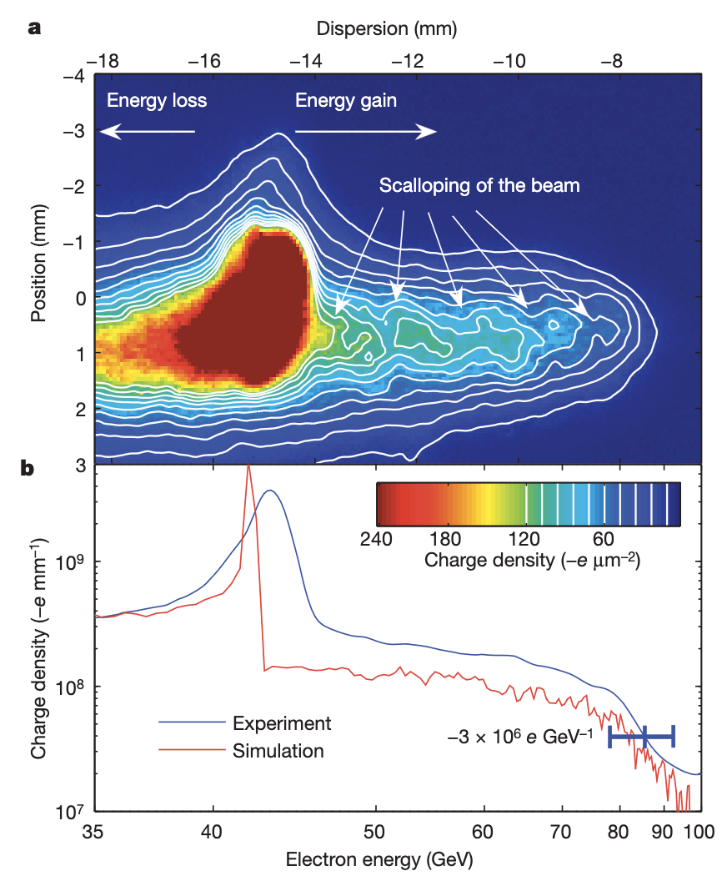
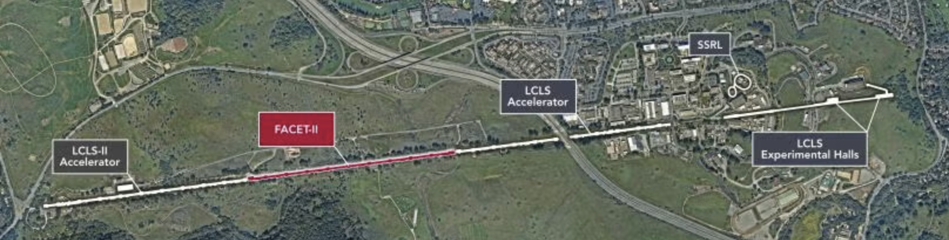
Electron-Driven, SLAC
85cm Lithium vapour source, 2.7x10¹⁷cm⁻³
➔ Accelerated electrons from 42 GeV to 85 GeV in 85 cm.
➔ Reached accelerating gradient of 52 GeV/m
I. Blumenfeld et al, Nature 455, p 741 (2007)
Final Focus Test Beam Facility, FFTB at SLAC

Slide 21

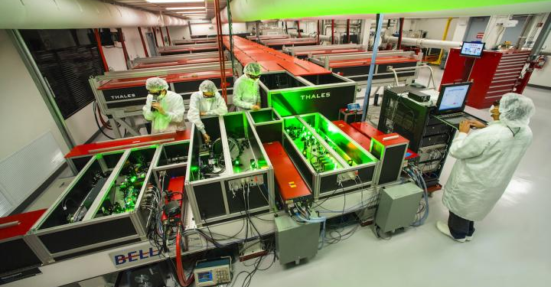
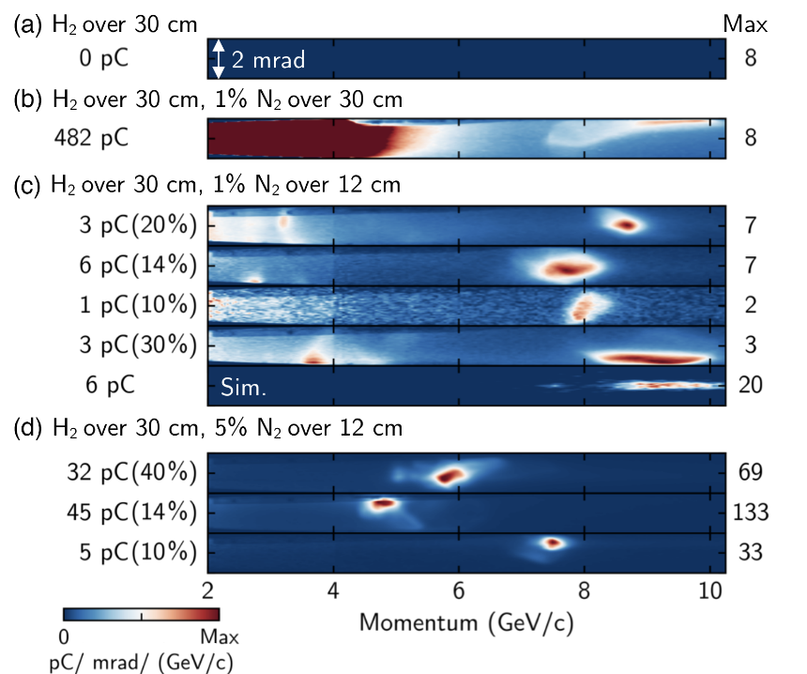
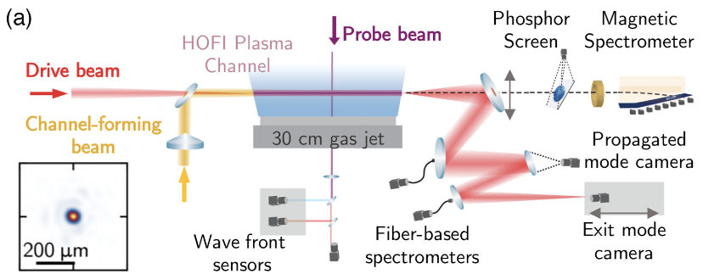
Laser-Driven, BELLA, Berkeley
BELLA, Berkeley Lab, USA
40 J, 30 fs → 1.2 PW Focused to σ_{r} = 50 μm
Laser guiding
9.2 GeV in 30 cm of plasma
➔ 30.6 GeV/m
A. Picksley et al., PRL 133, 255001 (2024)

Slide 22
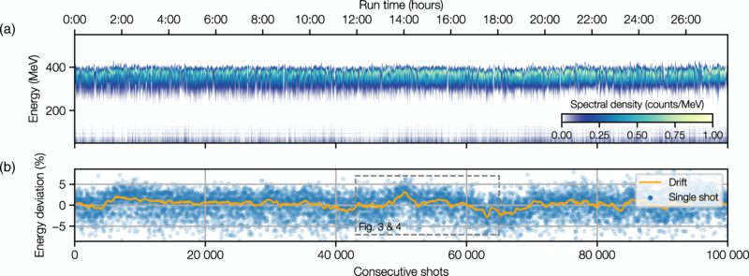
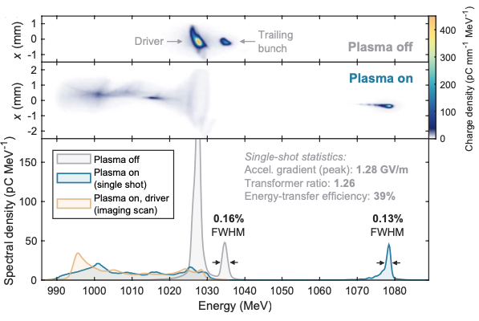
Quality
FLASHForward, DESY
LUX laser plasma accelerator, DESY
Up to 1 MHz repetition rate
Stable 24hr operation
A. Maier et al., Phys. Rev. X 10, 031039 (2020)
Transfer efficiency 42+/-4% with 0.2% energy spread, up to 70% with energy spread increase
C.A. Lindstrøm et al., Phys.Rev.Lett. 126, 014801 (2021)

Slide 23
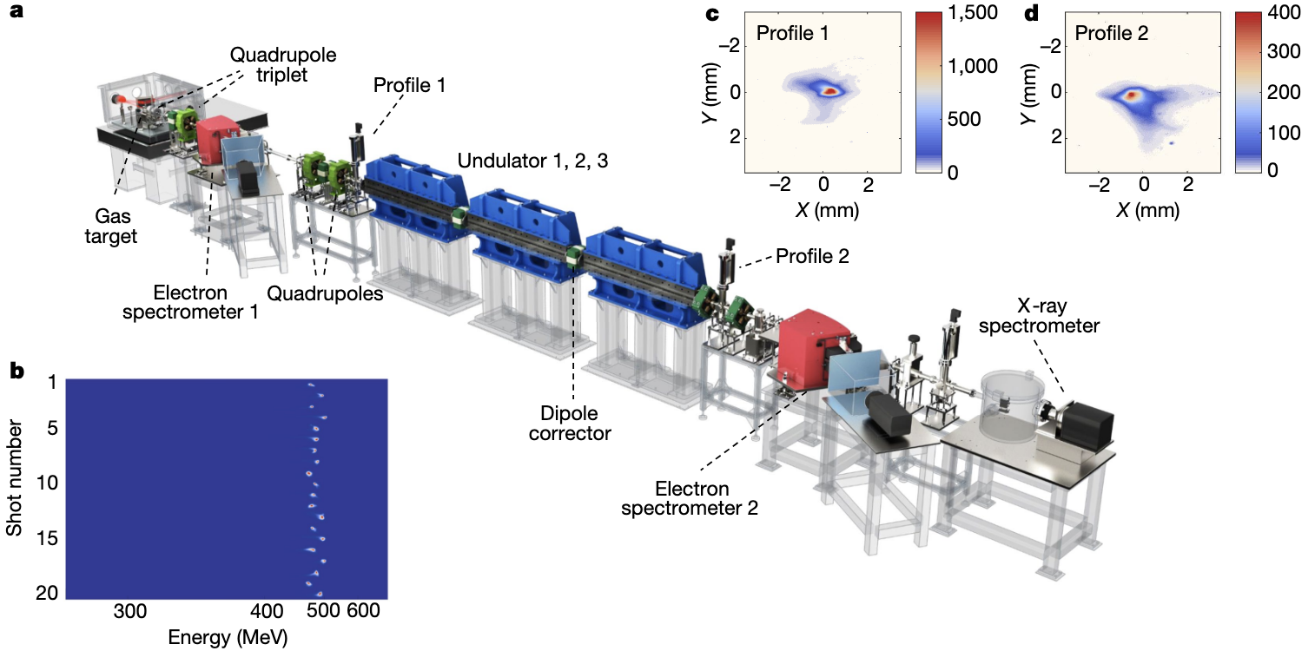
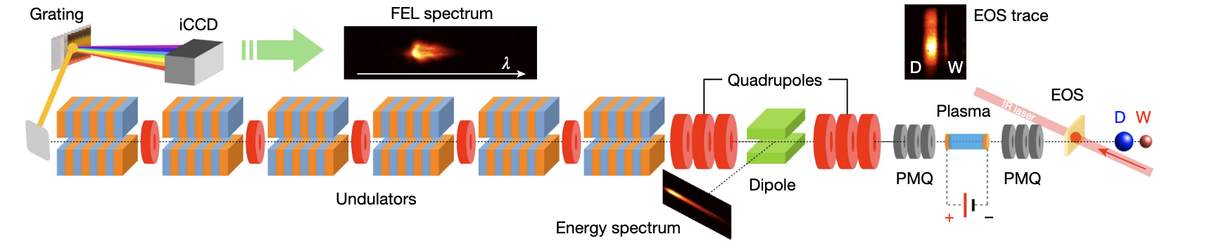
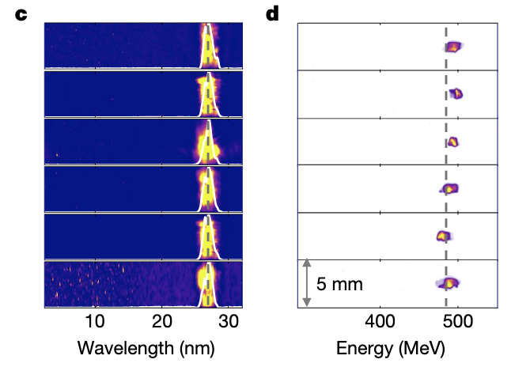
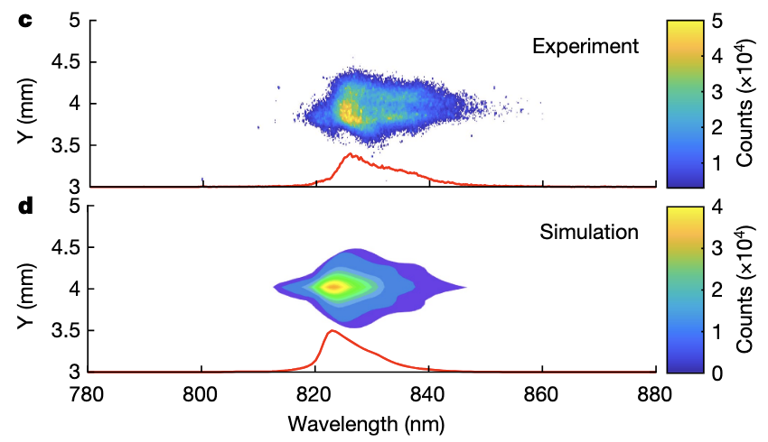
FEL Demonstration
Laser Driven based FEL: First demonstration
Electron Driven based FEL: First demonstration
SIOM, Shanghai, China
Sparc-Lab, INFN Frascati, Italy
500 MeV electrons from LWFA
FEL lasing amplification of 100 reached at 27 nm wavelength
94 MeV electrons from PWFA, FEL lasing at 830 nm
W.T. Wang, K. Feng, et al., Nature, 595, 561 (2021)
R. Pompili et al., Nature 605, 659-662 (2022)
Since then several more groups: Soleil/HZDresden, Berkeley

Slide 24
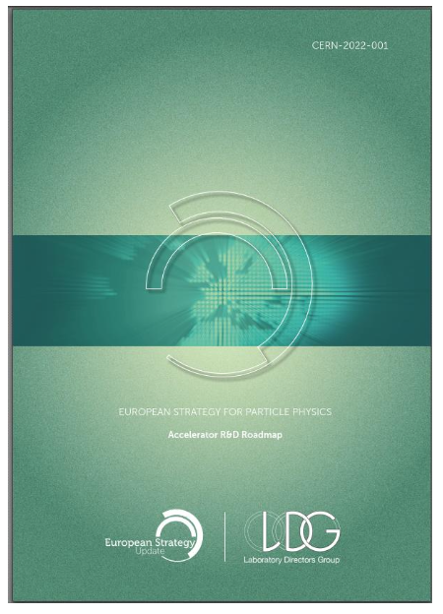

State of the Art and Goals towards HEP Collider
ESPP 2020:
Plasma R&D Roadmap
R&D Efforts
US Snowmass and P5
➔ Requires international, multi-dimensional R&D efforts.

Slide 25
Introduction to plasma wakefield acceleration
State-of-the-art
Plasma wakefield acceleration applications

Slide 26
Plasma Wakefield Acceleration Applications
Short-term
Mid-term
Long-term
HEP colliders
Particle physics applications
250 GeV
10 TeV
First Applications
O (~10s GeV)
O (~5 GeV)
Light Sources, FEL
Medical applications
National security
Radiation generation
Fixed target experiments
Injector for a synchrotron/collider
Collider components
Test beams
Higgs factories
Energy frontier linear collider (10 TeV)

Slide 27

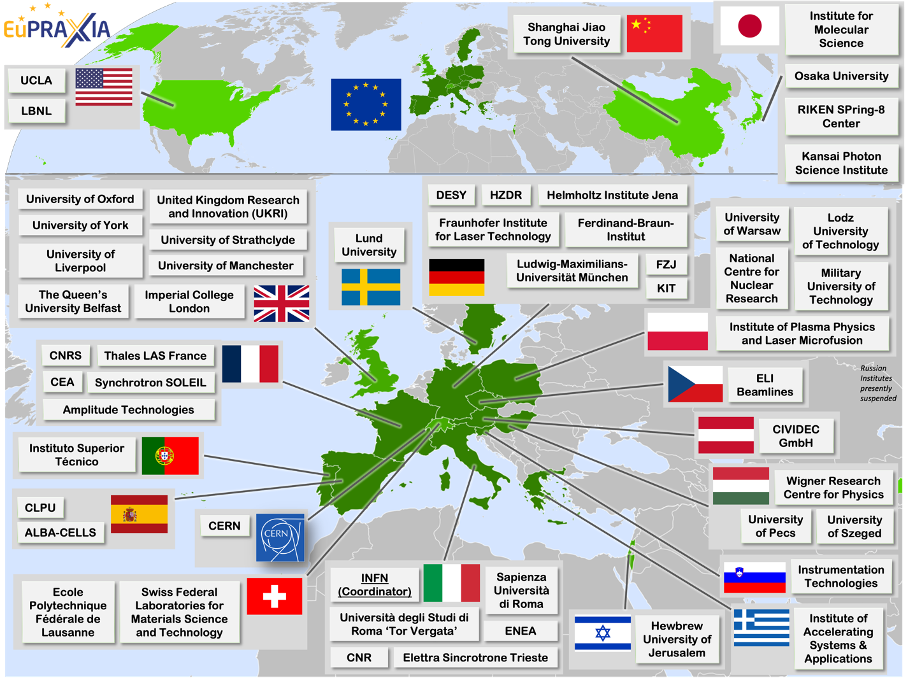
EuPRAXIA
European Plasma Research Accelerator with eXcellence in Applications
EuPRAXIA is a design and an ESFRI project for a distributed European Research Infrastructure based on novel plasma-acceleration concepts (1-5 GeV), building two plasma-driven Free Electron Lasers, FELs, in Europe.
Aims at offering a significant reduction in size and possible savings in cost over current state-of-the-art RF-based accelerators.
Site 1: EuPRAXIA FEL in Frascati LNF-INFN (beam-driven)
Site 2: EuPRAXIA FEL (laser-driven) at ELI-ERIC, Czech Republic.
Today: 54 institutes in Consortia
EuPRAXIA@SparcLAB in Frascati
Construction has started.
TDR published in Feb 2026.
First FEL user operation in 2031.
Combining X-band linac with beam-driven plasma acceleration.
Notes:
Parameter (AQUA)
Units
PWFA
Full RF
Electron Energy
GeV
1
1
Repetition Rate
Hz
100
100
Bunch charge
pC
30
200
Peak current
kA
3.3
3.4
RMS bunch length
μm
1.4
16.9
RMS norm.emitt. (x,y)
mm mrad
0.7,0.7
2.1,1.0
Radiation wavelength
nm
4.06
4.06
Photon per pulse
×10¹¹
3.2
31.3
Ph. pulse length (FWHM)
fs
2.33
33.0
Photon bandwidth
%
0.4
0.5

Slide 28
Plasma Wakefield Acceleration Applications
Short-term
Mid-term
Long-term
HEP colliders
Particle physics applications
250 GeV
10 TeV
First Applications
O (~10s GeV)
O (~5 GeV)
Light Sources, FEL
Medical applications
National security
Radiation generation
Fixed target experiments
Injector for a synchrotron/collider
Collider components
Test beams
Higgs factories
Energy frontier linear collider (10 TeV)

Slide 29
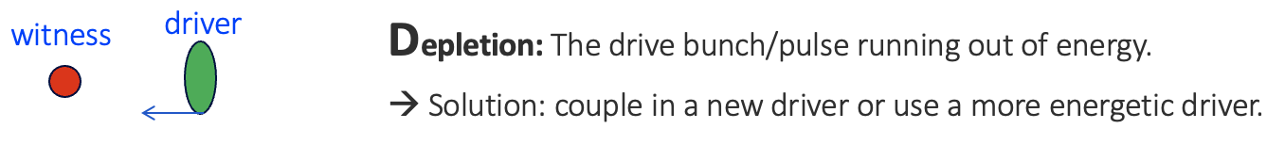
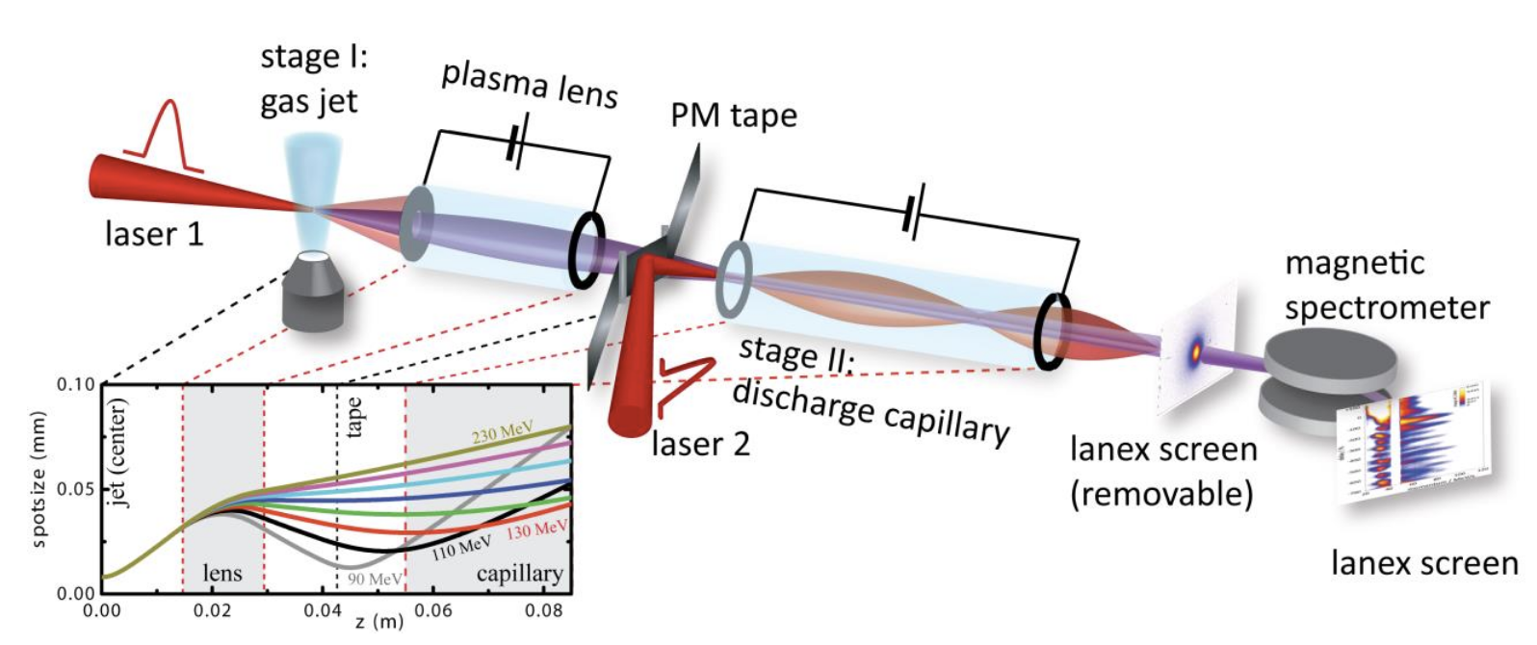
Towards Higher Energies
➔ Staging
Lasers or electron bunch drivers: ~10s of J/bunch
BELLA, Berkeley, LBNL
S. Steinke et al., Nature 530, 190 (2016)
Staging of 2 plasma cells demonstrated at 100MeVs level (laser driven).
Experiments ongoing at GeVs level.
Matching between stages with plasma lenses/conventional magnets.
No beam-driven staging yet demonstrated (no facility).

Slide 30
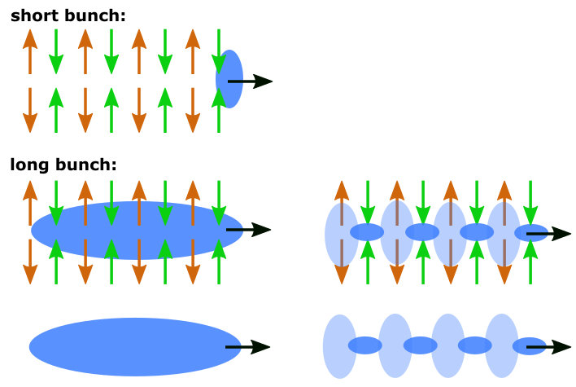
Towards Higher Energies
➔ single plasma cell
Proton bunch driver:
~SPS 19 kJ/bunch, LHC 112 kJ/bunch
→ Rely on self-modulation of the proton-bunch
p bunch
σ_{z} ~6cm
→ Micro-bunches resonantly drive strong wakefields
~1.2mm
With existing proton beams: reach energy frontier with electrons
SPS p⁺ (450 GeV): accelerate to 200 GeV electrons.
LHC p⁺ can yield to 3 TeV electrons.
➔ Immediate use of SPS proton bunch for driving strong wakefields!

Slide 31
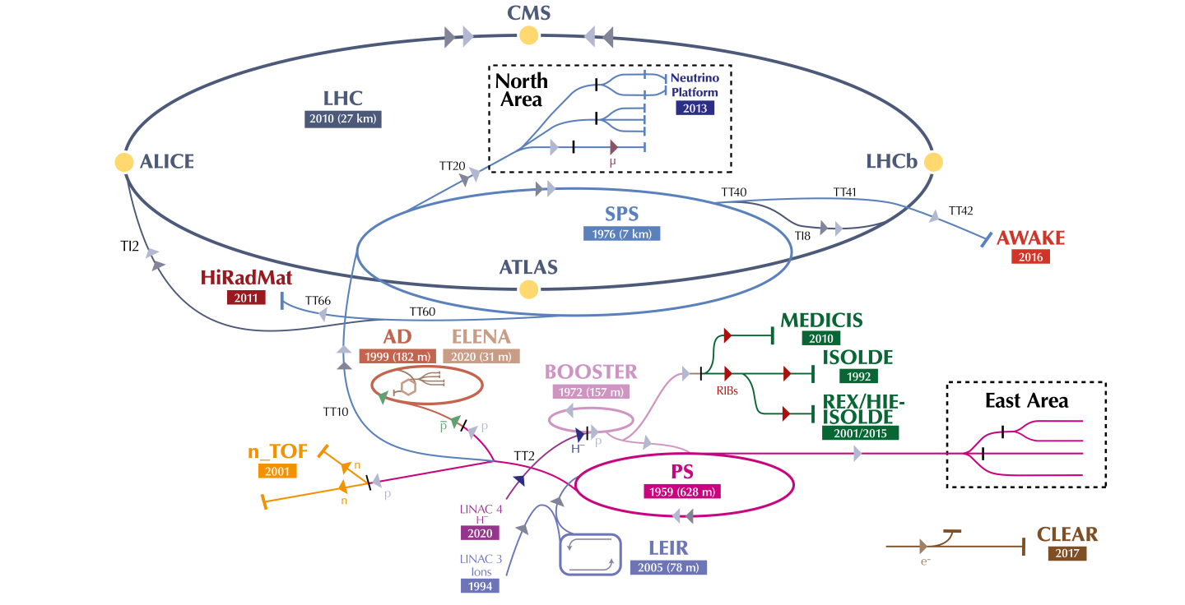
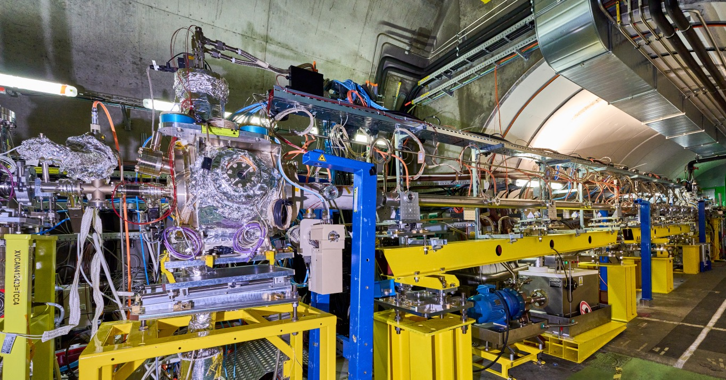
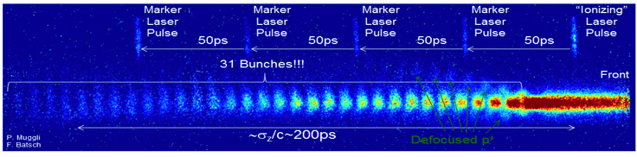
AWAKE at CERN
Advanced WAKEfield Experiment
Accelerator R&D experiment.
International collaboration with 19 institutes.
Unique facility driving wakefields in plasma with 400 GeV proton bunch from the SPS.
Accelerating externally injected electrons to GeV scale.
The only proton driven plasma wakefield acceleration experiment worldwide.
High energy gain possible because the high-energy driver is available today.
All milestones achieved.
More than 23 high-level publications such as Nature (1), Phys. Rev. Lett. (7), Phys.Rev. E (1), Physics of Plasmas (1), Phys. Rev. A&B (2),…
F. Pannell, UCL
AWAKE Collaboration, PRL 122, 054802 (2019)
M. Turner et al. (AWAKE Collab.), PRL 122, 054801 (2019)
AWAKE Collaboration, Nature, 561, 363 (2018)
E. Gschwendtner, CERN

Slide 32
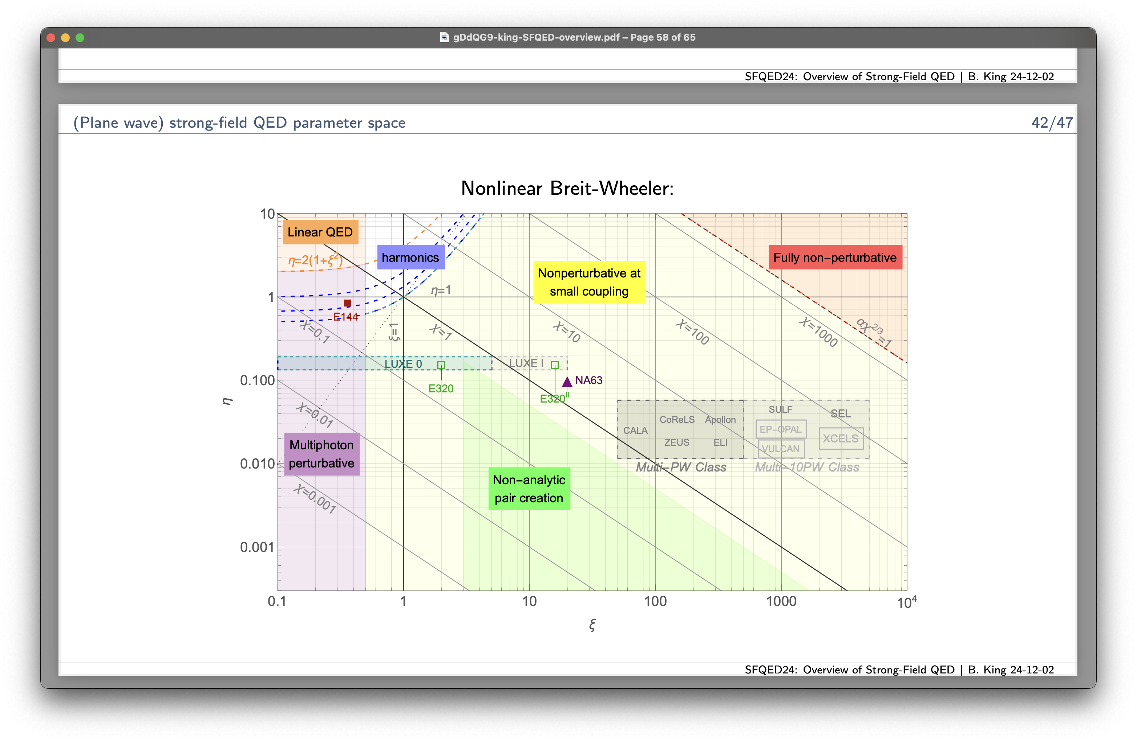
First Applications of AWAKE Technology
In AWAKE facility, could conceive of O(50 GeV) electrons.
Requirements on emittance are moderate for first applications.
High energy, ~50 GeV
First applications to high energy physics for 50 GeV beam:
Use for collider, e.g. ep collider, which would be like a low-luminosity LHeC.
Beam-dump experiments to e.g. search for dark photons.
Interaction with high-power laser to investigate strong-field QED.
Nonlinear Breit–Wheeler
Beam energy →
Strong-field QED could be the obvious first experiment.
Can investigate new region with high energy.
Currently no competitors.
Only modest laser needed.
Increasing laser power ➔ probe more phase space.
Credit: B. King
Laser intensity →

Slide 33
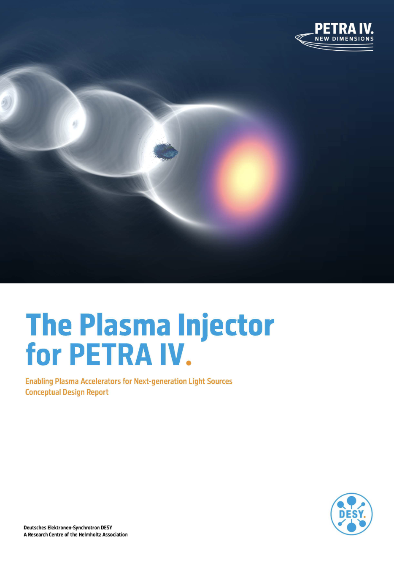
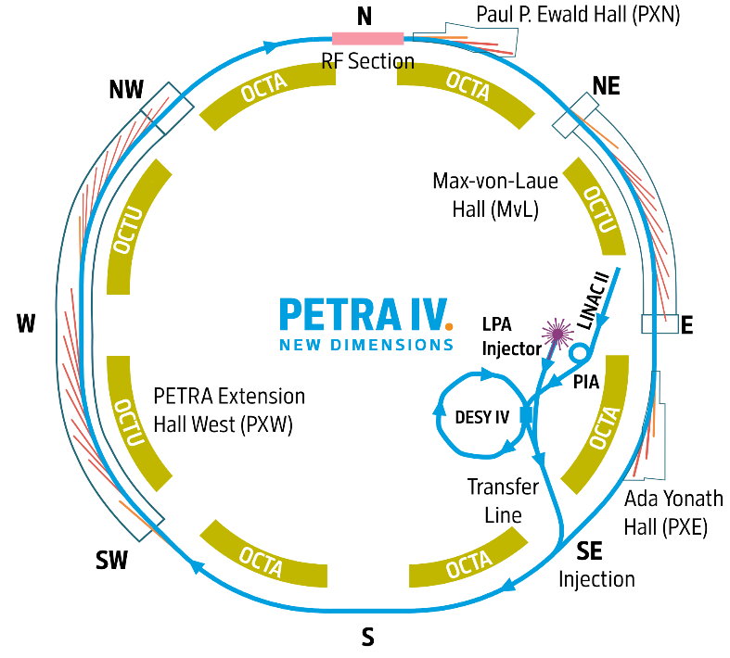
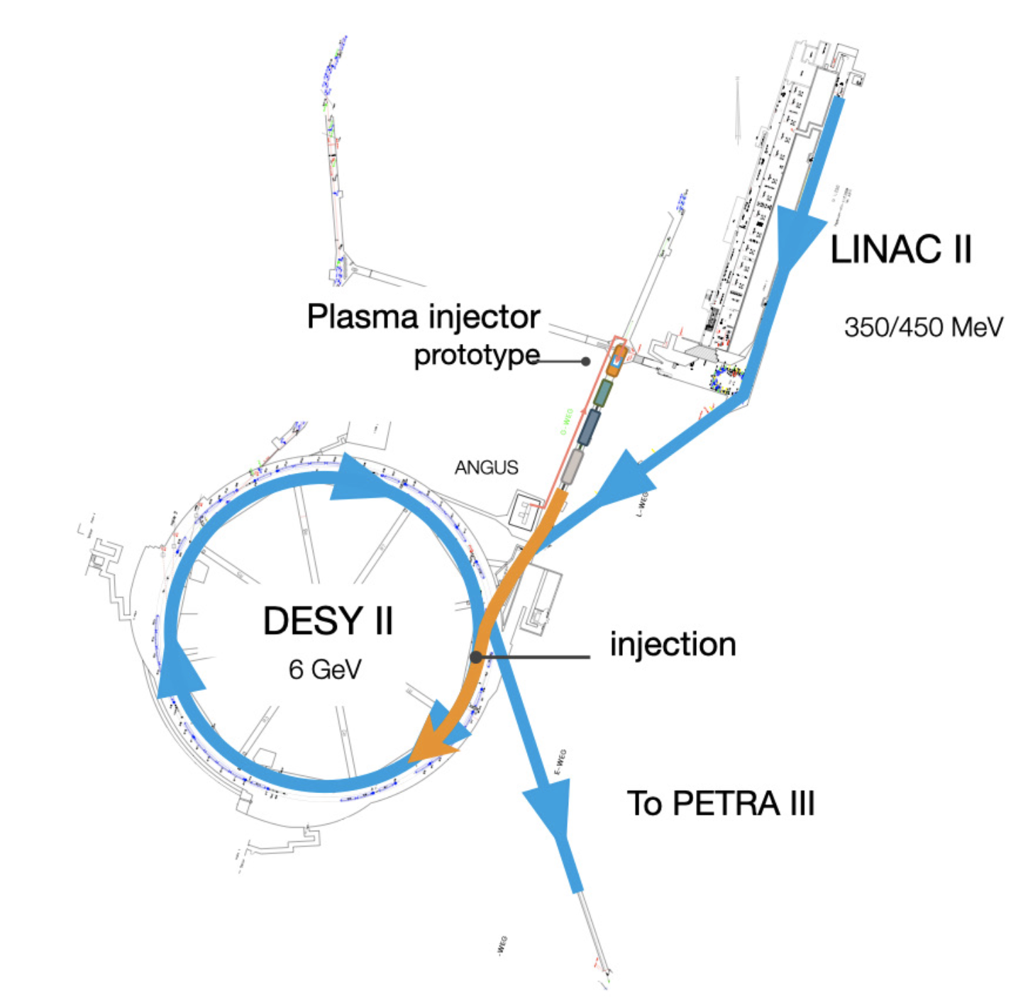
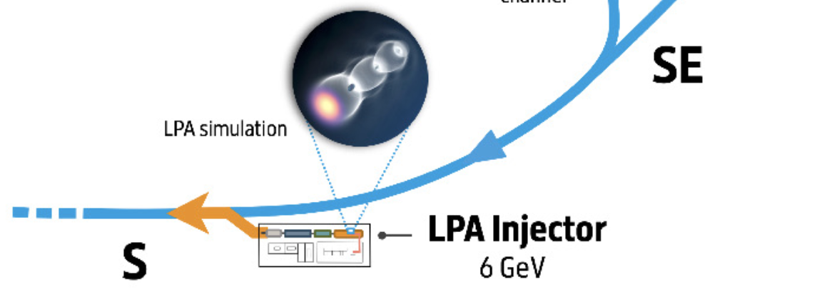
PETRA-IV Plasma Injector
A. Martinez de la Ossa et al., PETRA IV Injctor CDR
DESY/Hamburg
4th generation SR source:
PETRA III to PETRA IV upgrade
(6 GeV, 20 pm emittance)
Final decision for PETRA IV in 2026
PETRA IV Plasma Injector:
Alternative proposal to DESY IV injector
Dedicated injector
PW-drive laser
6 GeV HOFI-guiding assisted laser-plasma accelerator
Active energy compression scheme (X-band)
Demonstrate full technology chain:
injection studies into DESY II ongoing (350 MeV)

Slide 34
Plasma Wakefield Acceleration Applications
Short-term
Mid-term
Long-term
HEP colliders
Particle physics applications
250 GeV
10 TeV
First Applications
O (~10s GeV)
O (~5 GeV)
Light Sources, FEL
Medical applications
National security
Radiation generation
Fixed target experiments
Injector for a synchrotron/collider
Collider components
Test beams
Higgs factories
Energy frontier linear collider (10 TeV)

Slide 35
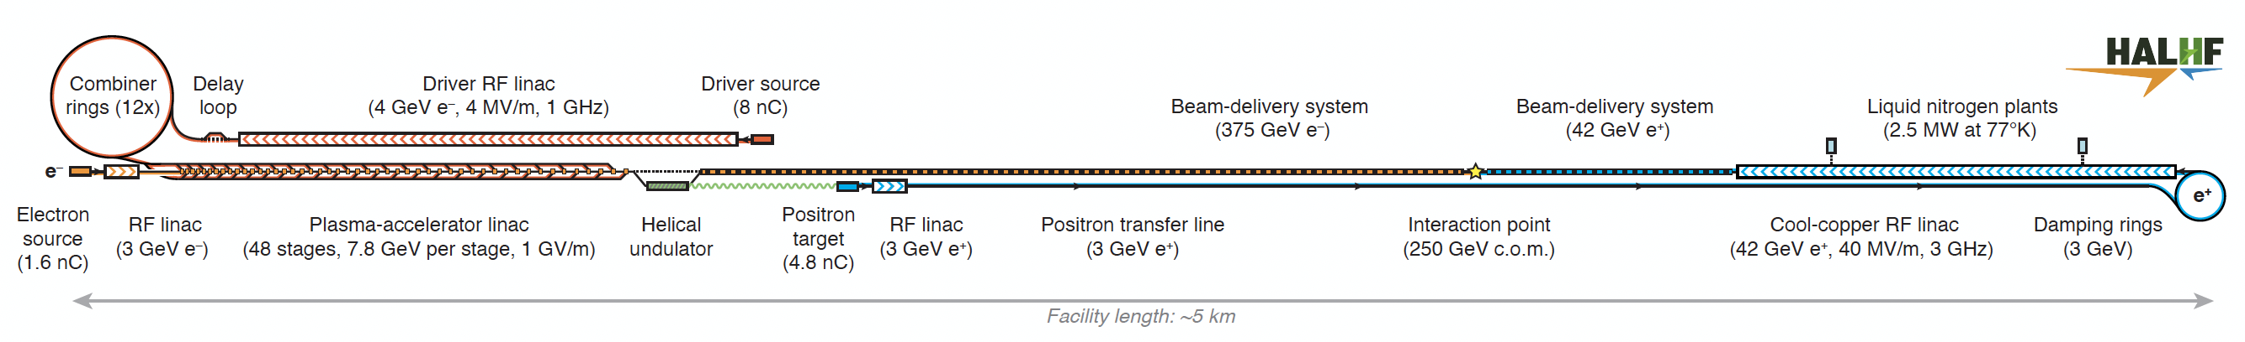
Higgs Factory Based on Plasma Wakefields - HALHF
New Baseline:
Electron driven plasma wakefield accelerator
B Foster et al 2023 New J. Phys. 25 093037 (2023)
250 GeV c.o.m., asymmetric collisions
Electrons at 375 GeV accelerated in electron driven plasma wakefields
Positrons at 42 GeV using conventional RF linacs
Estimated luminosity: ~1 x 10³⁴ cm⁻² s⁻¹
Length: 5 km
Technology choice: CLIC (power source) + PWFA (transformer) + cool copper technology (positrons)
PWFA Stages: 48 stages, 1 GV/m gradient, higher driver charge 5x10¹⁰ (8nC)
➔ Several key challenges still to be solved for PWA: staging, repetition rate, plasma temperature, cooling, beam jitter

Slide 36
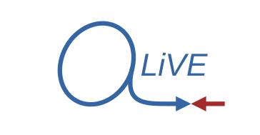
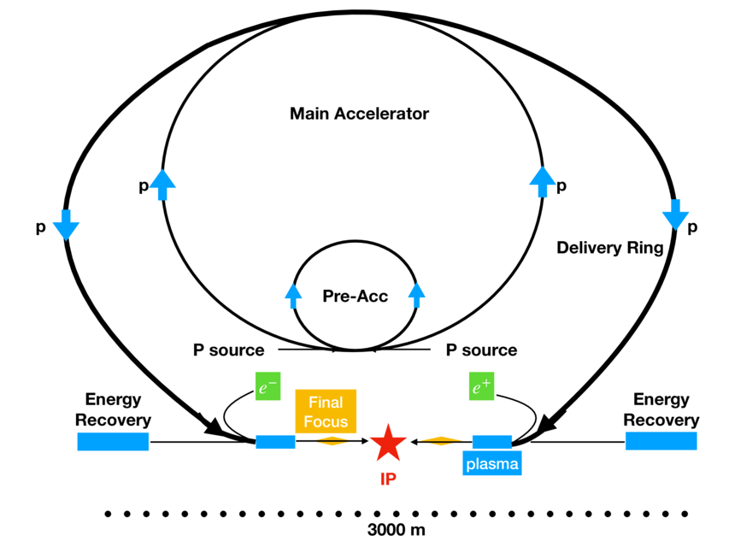
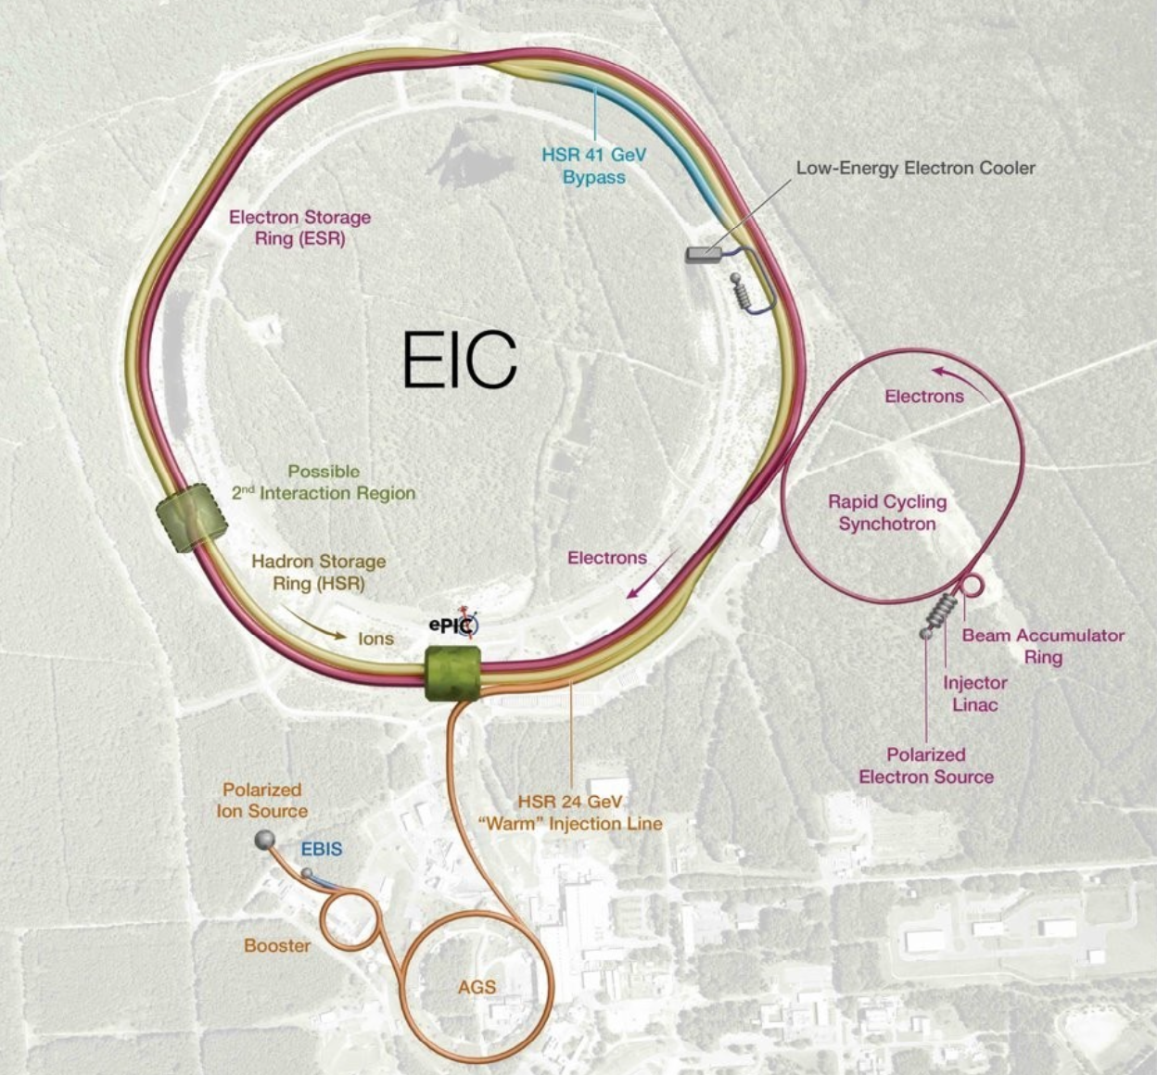
Higgs Factory Based on Plasma Wakefields - ALiVE
ALiVE: Advanced Linear collider for Very high Energy
Proton-driven plasma wakefield accelerator
Low repetition rate of high-energy proton bunches at CERN → limiting luminosity
ALiVE:
Collision energy: 250 (125 + 125) GeV, with upgrade to TeV range
Estimated luminosity: 1.7 x 10³⁴ cm⁻² s⁻¹
e.g. SPS
Proton drive bunches from fast cycling synchrotron (HTS magnets) or FFAG to reach competitive luminosity.
Short proton driver (s_{z} =150 µm); density gradient in plasma.
Electron and positron acceleration to very high energy in one single plasma (100s meter).
J Farmer, A. Caldwell, A. Pukhov, 2024 New J. Phys. 26 113011 (2024)
Key challenges: Short (sub-mm) driver, high (kHz) rep rate, positron acceleration in plasma.
Fewer challenges for e−p/e−A collider or asymmetric scheme.
Electron injector for the EIC based on p+ driven plasma wakefield acceleration
➔ These are exploratory studies
H. Jaworska et al., IPAC2026

Slide 37
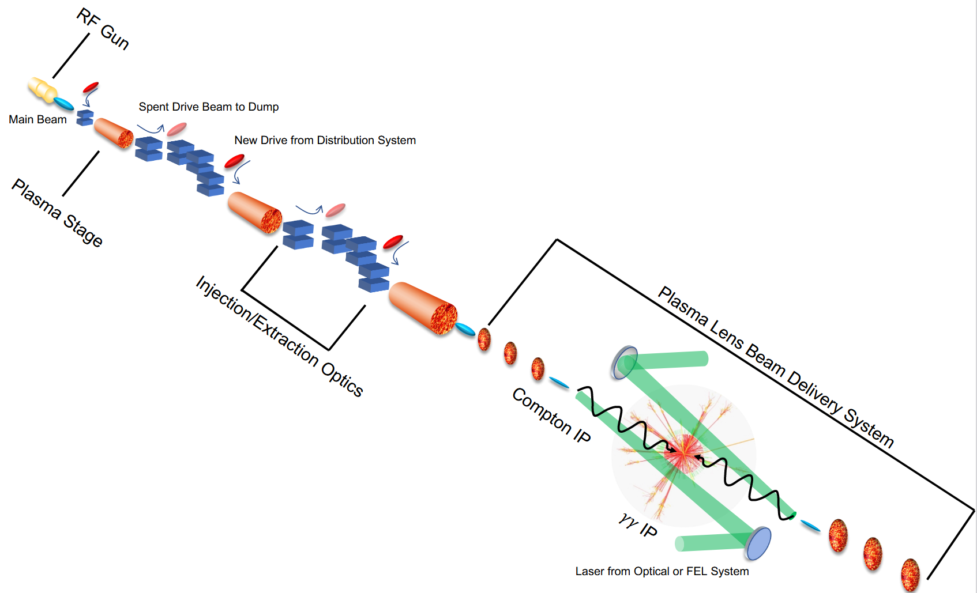


10 TeV pCM Collider
Ongoing design effort: 10 TeV parton-center-of-mass (pCM) collider based on wakefield accelerator (WFA) technology.
Delivery of an end-to-end design concept, including cost scales, with self-consistent parameters throughout.
Laser-driven
Beam-driven
Laser-plasma LC: C.B.Schroeder et al., 2023, JINST 18 T06001, arXiv:2203.08366
Collision:
e+e-
e-e-
γγ
International effort - working group conveners from the US and Europe are organizing the study, partner with ALEGRO and other R&D efforts.

Slide 38
Summary
1. Plasma wakefields offer a ~1000 × gradient advantage over conventional RF.
Allows smaller, potentially cheaper machines.
2. The field is moving from proof-of-principle to first applications.
Short-term applications at the O(5 GeV) scale – FELs, medical, radiation sources – are within reach now.
Mid-term particle physics applications (fixed-target experiments, synchrotron injectors) are the next step.
Concrete collider concepts at the energy frontier (HALHF, ALiVE, 10 TeV pCM) are under active design study.
3. Key R&D challenges remain, and investment is essential.
Continued support for high-gradient wakefield R&D is needed for this technology to contribute meaningfully to future particle physics programmes.

