Slide 1



MC2: Evolution and Future of Synchrotron Radiation Sources
RIKEN SPring-8 Center
Hitoshi TANAKA
2026/05/16@Deauville
History of synchrotron radiation source development
Diffraction-limited SR sources
Single-pass free-electron lasers
Future development direction with a few topics

Slide 2
Brilliance enhancement over the past century
Linac-based FELs
Ring-based SRLs
4th-gen
3rd-gen
2nd-gen
1st-gen
Makina Yabashi and Hitoshi Tanaka, Nat. Photon. 11 (2017) 12-14
Notes:
This shows the average brightness enhancement of SR sources to date. In the first generation, X-rays were used secondarily in lepton ring accelerators for high-energy physics. In the second generation, X-rays from bending magnets in dedicated storage rings were used, and in the third generation, undulators were used as the light source instead of bending magnets, enabling the generation of high-brilliant X-rays by utilizing single-electron interference conditions. We are now in the fourth generation, and brilliant X-rays with high transverse coherence are available. The average brilliance enhancement appears to have slowed down since 2000, which clearly indicates that beam emittance is approaching the diffraction limit condition. Blue symbols indicate linac-based FEL facilities.

Slide 3
Brilliance enhancement over the past century
Linac-based FELs
Ring-based SRLs
4th-gen
3rd-gen
2nd-gen
1st-gen
Makina Yabashi and Hitoshi Tanaka, Nat. Photon. 11 (2017) 12-14
Notes:
This shows the peak brilliance enhancement of SR sources to date. Peake brilliance enhancement looks almost saturated in the 3rd-generation. This is because, since the third generation, the beam emittance has decreased, making stable beam operation at high bunch currents difficult. On the other hand, linac-based FEL sources have achieved a significant performance improvement of several orders of magnitude by longitudinally coherent X-ray radiation. Next, let’s see the recent evolution of SR sources enclosed by red dashed line.

Slide 4
Recent evolution of SR sources
Performance index: Brilliance
Time axis
X-ray
sources
Pulse
SASE-type
XFEL
High Peak
Brilliance
Linac-based
Warm RF
Distinct operational domains
CW
High
Average
Brilliance
3rd gen.
SR
High
coherence
SR source
Ring-based
Notes:
Up to date, FELs and ring-type SR sources have been developed independently as pulse and CW sources, respectively as shown here.

Slide 5
Recent evolution of SR sources
Performance index: Brilliance
Time axis
X-ray
sources
Pulse
SASE-type
XFEL
High rep. rate FEL
High Peak
Brilliance
+
High
Average
Brilliance
Linac-based
Warm RF
Cold RF
FEL can provide not only “high peak brilliance” but also ”high average brilliance”
CW
High
Average
Brilliance
3rd gen.
SR
High
coherence
SR source
Coherent ring
source
Ring-based
Notes:
However, emergence of “super-conducting high-repetition-rate” FELs have changed the situation. This FEL system can provide not only high peak brilliance but also high average brilliance.

Slide 6
Recent evolution of SR sources
Performance index: Brilliance
Time axis
X-ray
sources
Pulse
SASE-type
XFEL
High rep. rate FEL
Multi-
BLs
High Peak
Brilliance
+
High
Average
Brilliance
Linac-based
Warm RF
Cold RF
Multi-user dream facility with both high peak and average brilliance
CW
High
Average
Brilliance
3rd gen.
SR
High
coherence
SR source
Coherent ring
source
Ring-based
Notes:
A dream machine composed of super-conducting linac with a high repetition rate of a few MHz, equipped with a pulse-by-pulse beam switching system and a few tens of FEL beamlines, can exceed than a ring-type SR in terms of peak and average brilliance, and can potentially provide the similar number of beam lines to that at ring-type SR.

Slide 7
Role sharing between FELS and ring-based SRs
Performance index: Brilliance
Image of multi-user dream facility
A few MHz SC RF Linac
FEL Beamlines
#1
#2
#3
Question:
Will a ring-based light source still be needed in the future?
Pulse-by-pulse switching system
.
.
#30
Notes:
This schematically shows the mentioned dream machine looks like. Here we naturally have the following question. Will a ring-based light source still be needed in the future? Of course, answer is yes!

Slide 8
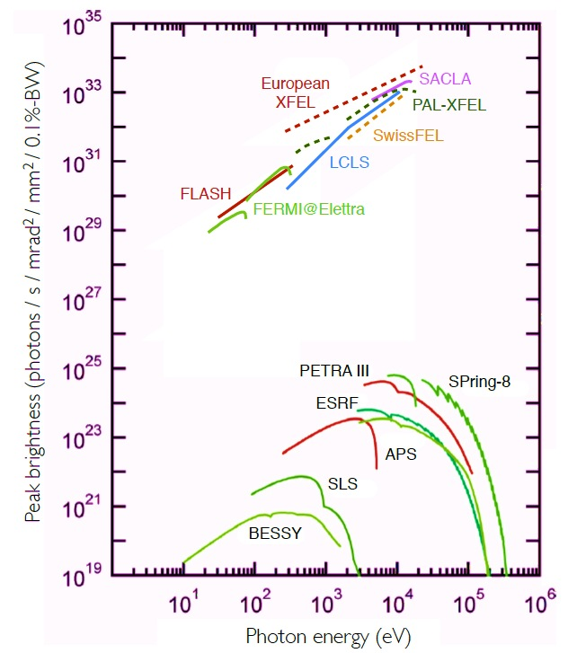
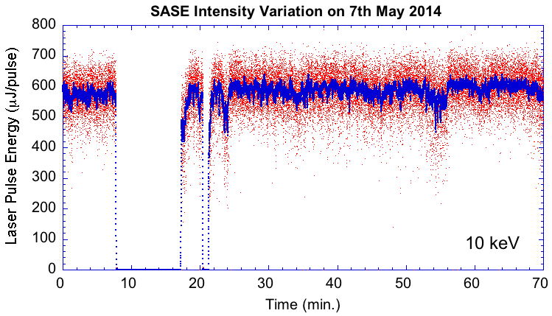
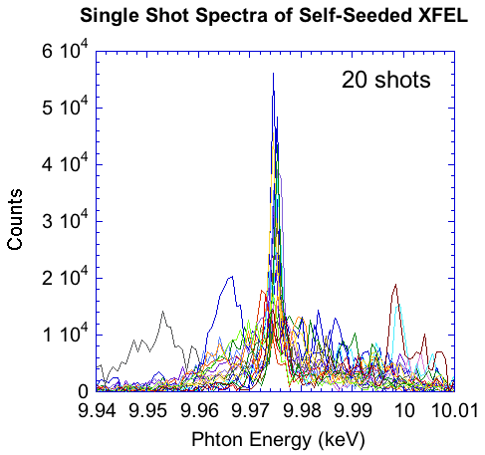
Role sharing between FELS and ring-based SRs
Performance characteristics of FELs
Limited photon energy from SX to X
High peak brilliance 10²⁹ to10³⁴
High coherence
Short pulse width sub to a few tens fs
Non-negligible shot by shot variations
Peak Brilliance
P. Schmuser, M. Dohlus, J. Rossbach, C. Behrens,
Springer Tracts in Modern Physics 258 2nd ed., p167.
Notes:
Let’s see the performance characteristics of a FEL source. It is characterized by the high peak brilliance, high coherence, and short pulse duration. On the other hand, compared with a ring type SR source, available photon energy and stability are currently restricted.

Slide 9
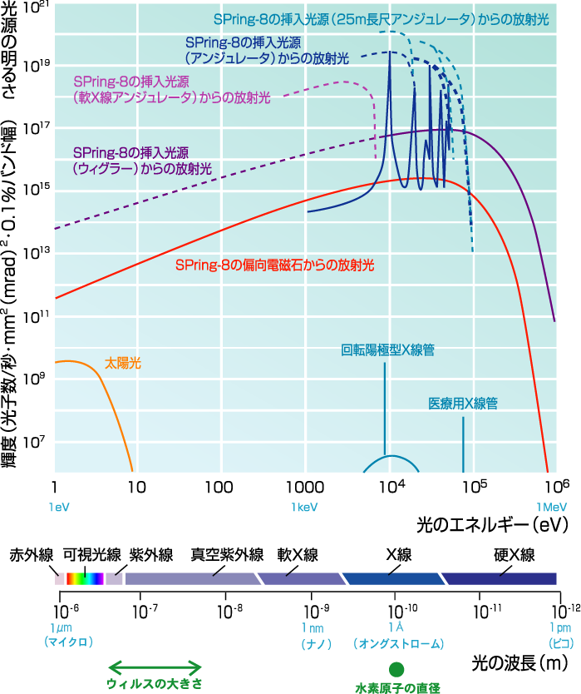
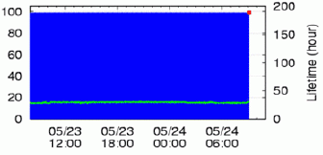
Role sharing between FELS and ring-based SRs
Performance characteristics of ring-based light source
Photon energy extended to a few 100 keV
Average brilliance from10¹⁸ to 10²¹
Low Coherence
Long pulse width a few tens ps
High stability and reproducibility
Average Brilliance
Photon Energy
ΔI/I~0.02%
ΔE/E< 0.001%
Notes:
Compared with a FEL source, a ring-based SR source has extremely high stability and reproducibility. Its low peak intensity conversely enables a correlation experiment with the same sample, which is quite important for most of experimental users.

Slide 10

Role sharing between FELs and ring-based SRs
Systems to be studied by SRs are complex and multi-scaled in time and space
Space
High peak brilliance is not a universal solution
High transverse and longitudinal coherence such as a laser is not essential for all experiments
Correlation measurements using the same sample are extremely useful in various experiments
The utilization of higher photon energy becomes increasingly important for various applications
Multi-scale in time and space
cm
1
mm
10⁻³
Ring-based
SRs
μm
10⁻⁶
nm
10⁻⁹
FELs
$$Å$$
10⁻¹⁰
10⁻¹⁸
10⁻¹⁵
10⁻¹²
10⁻⁹
10⁻⁶
10⁻³
1
as
fs
ps
ns
μs
ms
s
Time
Notes:
The necessity of light source is not simply determined in terms of brilliance only. Research objects of our experimental users are complex and multi-scaled systems in time and space as shown here on the left. Synergistic use of FELs and ring-type SR sources is crucial for fully research their multi-scaled objects across micro- to macroscopic phenomena.

Slide 11
History of synchrotron radiation source development
Diffraction-limited SR sources
Single-pass free-electron lasers
Future development direction with a few topics
Notes:
Next, we outline the diffraction-limited SR source, because this is a cutting-edge of a ring-based SR source.

Slide 12
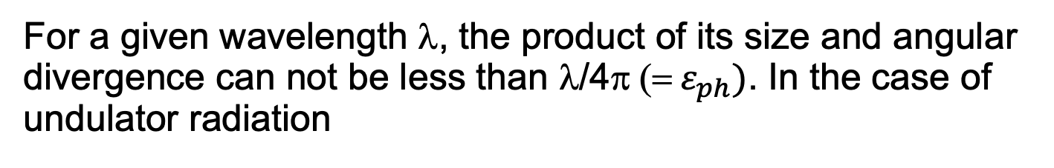
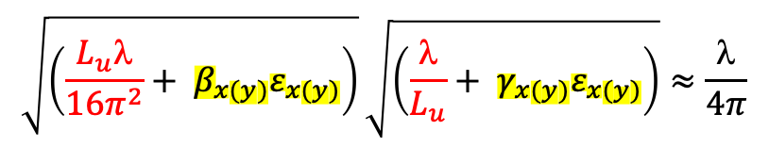
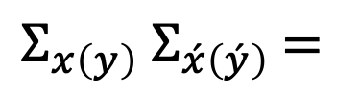
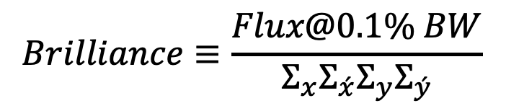
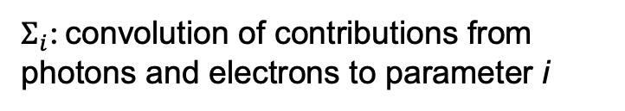
Diffraction limit
For a given wavelength λ, the product of its size and angular divergence can not be less than λ/4π (= $ε_{ph})$. In the case of undulator radiation
$$Brilliance≡\frac{Flux@0.1\% BW}{Σ_{x}Σ_{\acute{x}}{Σ_{y}Σ}_{\acute{y}}}$$
$Σ_{i}$: convolution of contributions from photons and electrons to parameter i
Electron
$$\sqrt{\left(\frac{L_{u}\text{l}}{16π^{2}}+ β_{x(y)}ε_{x(y)}\right)}\sqrt{\left(\frac{\text{l}}{L_{u}}+ γ_{x(y)}ε_{x(y)}\right)}≈\frac{\text{l}}{4π}$$
$Σ_{x\left(y\right)}$ $Σ_{\acute{x}\left(\acute{y}\right)}$ $=$
x’(y’)
Photon
size
Photon
1D phase space of light
angular divergence
When the horizontal and vertical phase space volumes of “light source” are nearly λ/4π, this radiation is called diffraction limited and it gives transverse full coherence.
1D phase space of
electron beam
x(y)
Notes:
Light with a wavelength of Λαμδα has an intrinsic volume in 2D phase space determined by the Heisenberg uncertainty principle. The brilliance of SR emitted from the electron beam is evaluated by the photon flux divided by the transverse phase volume. In the case where the transverse electron volume is negligibly small compared with photon volume, the transverse coherence becomes full and this condition, we call “diffraction limited”.

Slide 13
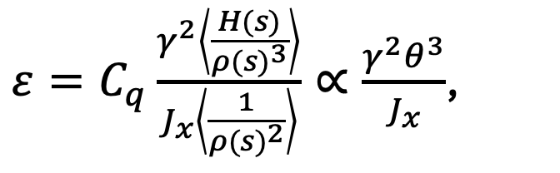
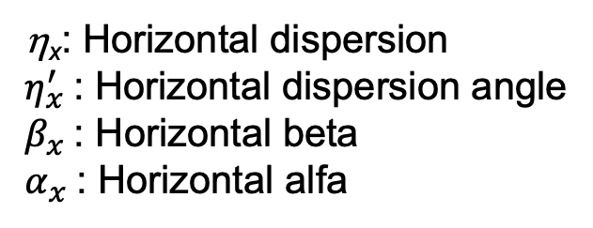
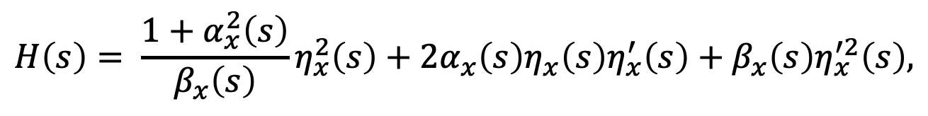
Scaling of natural emittance
$ε=C_{q}\frac{γ^{2}\left\langle \frac{H(s)}{{ρ(s)}^{3}}\right\rangle }{J_{x}\left\langle \frac{1}{{ρ(s)}^{2}}\right\rangle }∝\frac{γ^{2}θ^{3}}{J_{x}}$,
γ: Lorentz factor
θ: Bending angle
ρ: bending radius
H: H-function
J_{x}: Damping partition number
$$H\left(s\right)= \frac{1+α_{x}^{2}\left(s\right)}{β_{x}\left(s\right)}η_{x}^{2}\left(s\right)+2α_{x}{\left(s\right)η}_{x}{\left(s\right)η}_{x}^{′}\left(s\right)+β_{x}\left(s\right)η_{x}^{′2}\left(s\right),$$
η_{x}: Horizontal dispersion
$η_{x}^{′}$: Horizontal dispersion angle
$β_{x}$: Horizontal beta
$α_{x}$: Horizontal alfa
As the number of bending magnets increases, natural emittance
decreases inversely proportional the cubic of that number.
Notes:
To satisfy the diffraction limited condition in the X-ray wavelength range, we need an extremely small natural emittance. As shown here, natural emittance is expressed in terms of several beam and ring parameters. Of particular note is the fact that the emittance is proportional to the cube of the deflection angle. This scaling clearly shows that Multi-Bend Achromat configuration is an effective way to achieve low beam emittance.

Slide 14
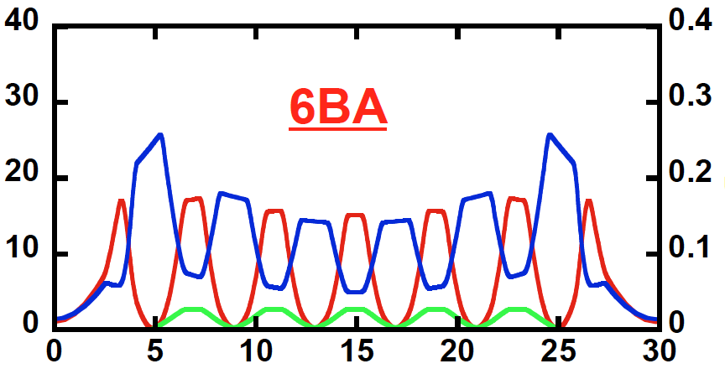
Suppression of radiation excitation to achieve lower emittance
The excited amplitude of a betatron oscillation is determined by the local energy dispersion.
The MBA lattice can effectively suppress the energy dispersion along the ring as shown below.
2BA
β_{x}, β_{y}
β_{x}, β_{y}
η_{x}
η_{x}
Notes:
This strong nonlinear dependence of the emittance on the bending angle can be explained as follows. The excitation of betatron oscillations is determined by local linear energy dispersion. Square of energy dispersion in the H-function is proportional to the 4th power of the deflection angle, but the number of dispersive arcs depends on the inverse of the deflection angle. Consequently, the H-function integrated over the ring is proportional to the cube of the deflection angle.

Slide 15
What breakthroughs made the MBA possible?
The following issues need to be overcome:
Narrow space issues
Strong nonlinearity from chromaticity correction sextupoles
Beam injection scheme applicable for a ring with a small dynamic aperture
Stable top-up beam injection compensating a short beam-lifetime and transparent against small emittance stored beam
Notes:
Why could we successfuly introduce the MBA configuration to the ring recently? The answer is we could resolve the four critical issues in designing the MBA lattice shown here; narrow spacing, instability due to the strong nonlinear fields, beam injection applicable for a ring with poor stability, i.e., small dynamic aperture, and transparent top-up beam injection compensating an extremely short lifetime.

Slide 16
What breakthroughs made the MBA possible?
Solving narrow spacing issues
Q1: The MBA lattice naturally requires the large number of focusing quadrupoles to focus the beam at each BM horizontally.
How can numerous magnets be accommodated within a limited space?
Q2: The shorter focal length and smaller energy dispersion increase the strength of both quadrupole and sextupole magnets.
How can extremely strong quadrupole and sextupole fields be achieved?
Notes:
Among four critical issues, here we only pick up the narrow space issue. Two main problems are there.

Slide 17
What breakthroughs made the MBA possible?
A1/A2: Adoption of the compact vacuum chamber w/wo NEG coating
Black: SPring-8 chamber designed 35 years ago
Red: SPring-8-II chamber designed recently
710
466
Bore radius
85 mm
Bore radius
34 mm
Notes:
A solution to these problems is to introduce compact vacuum chamber with a small cross-section as shown here. The compact chamber allows to install multi-pole magnets with smaller bore radii. This smaller bore radius enables a smaller magnet size with a higher magnetic field strength. Behind the successful introduction of this compact vacuum chamber, in my assessment, two important achievements are there; establishment of transparent top-up beam injection and precise beam handling using BBF systems.

Slide 18
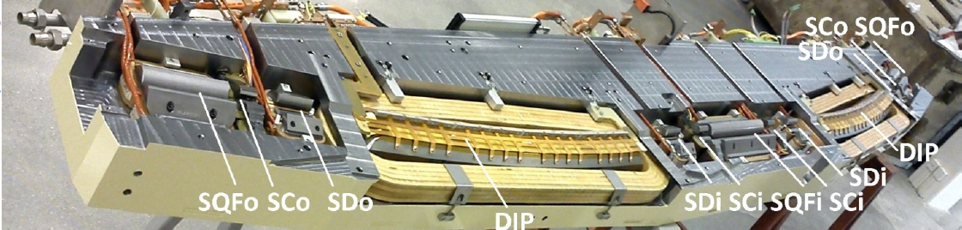
What breakthroughs made the MBA possible?
A1/A2: Adoption of a single-yoke composite magnet with a spaghetti-type chamber
M. Johansson et. al., Proc. of NAPAC2016, Chicago, IL, USA (2016) pp. 1058-1066
Notes:
Furthermore, as shown in this figure, a technique has been developed whereby different types of electromagnets—such as dipoles, quadrupoles and sextupoles—are integrated into a single magnetic yoke to maximize space efficiency. Of course, intermediate approaches between a discrete magnet system and an integrated single-yoke system are also employed. However, in such cases, significant magnetic field crosstalk occurs, which make system integration difficult and severely limits operational flexibility.

Slide 19
History of synchrotron radiation source development
Diffraction-limited SR sources
Single-pass free-electron lasers
Future development direction with a few topics
Notes:
Next, we move to another recent topic, single-pass FELs.

Slide 20
Brief history
The development of a single-pass FEL originated from the TTF (TESRA Test Facility), the test-bed for ILC at DESY and 1.3 GHz superconducting RF system was developed. In 2000, First SASE (Self-Amplified Spontaneous Emission) lasing was observed at 109 nm [1]. TTF demonstrated the SESE scheme operating in the short-wavelength region, thereby establishing the foundation for X-ray FELs subsequently constructed worldwide.
In 2009, LCLS (Linac Coherent Light Source) at SLAC achieved first SASE lasing at 0.12 nm using normal conducting S-band linac ( a part of Stanford two-mile linac), out-of-vacuum undulator, RF gun system and so on.
Era of single-pass FEL in short wavelengths was open-up.
[1] J. Andruszkow et. al., PRL 85(18) (2000) 3825-3829
[2] P. Emma et. al., Nat. Photon. 4 (2010) 641-547
Notes:
Let’s see the brief history.

Slide 21
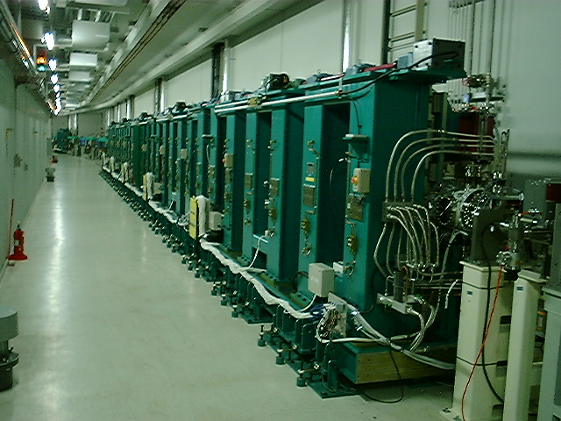
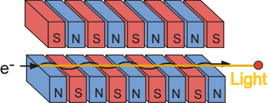
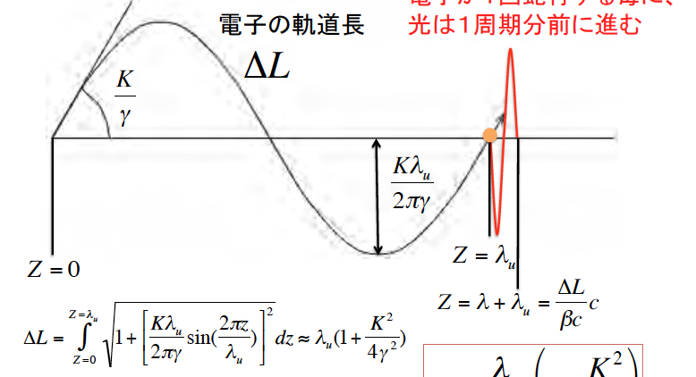


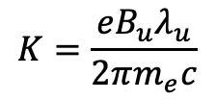
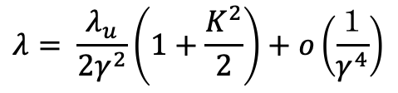
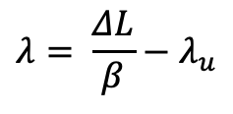
Self-Amplified Spontaneous Emission
Resonant Wavelength for Undulator
$$→$$
Resonant wavelength of
undulator
Electron trajectory
$$λ= \frac{ΔL}{β}−λ_{u}$$
$$→$$
$$λ= \frac{λ_{u}}{2γ^{2}}\left(1+\frac{K^{2}}{2}\right)+ο\left(\frac{１}{γ^{4}}\right)$$
$$K=\frac{eB_{u}λ_{u}}{2πm_{e}c}$$
Notes:
Resonant wavelength of undulator, in other words, a fundamental wavelength of undulator radiation satisfy the condition that the light of this wavelength overtakes electrons by one wavelength for every one undulation period of electron as shown here.

Slide 22
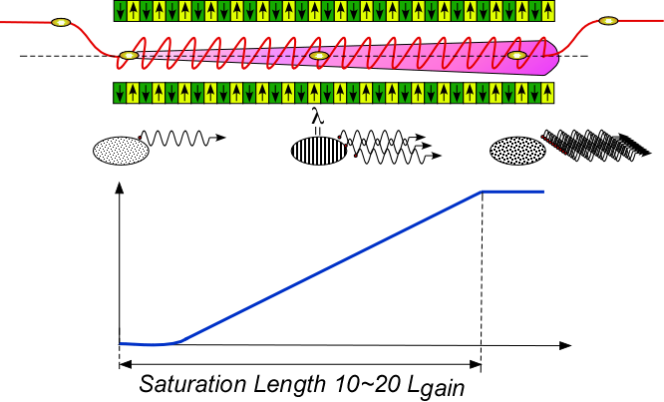
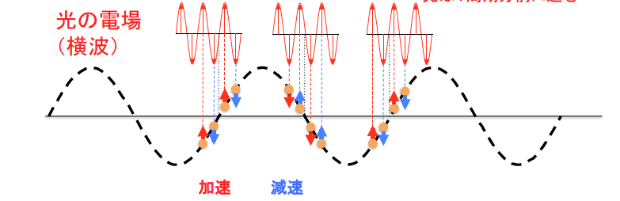
Self-Amplified Spontaneous Emission
Energy Modulation with Wavelength Interval
Undulator
Electron trajectory
Light overtakes electrons by one wavelength for every one undulation period
With the light of resonant wavelength, phase of acceleration and deceleration are maintained in the early stage of micro-bunching
Light electric field
(transverse wave)
Electron trajectory
Acceleration
Deceleration
Notes:
The vertical alternative magnetic fields along the undulator wiggle electron horizontally and this wiggling causes horizontal velocity components. Through these horizontal velocity components being parallel to light electric fields, electrons can exchange their energy with light of the resonant wavelength.
With the light of resonant wavelength, phase of acceleration and deceleration are maintained for electrons in the early stage of micro-bunching causing micro-bunches to form at intervals corresponding to the resonance wavelength, which in turn enhances the undulator radiation.

Slide 23
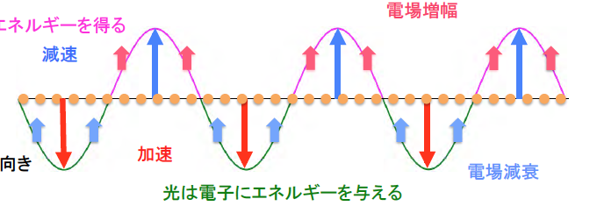
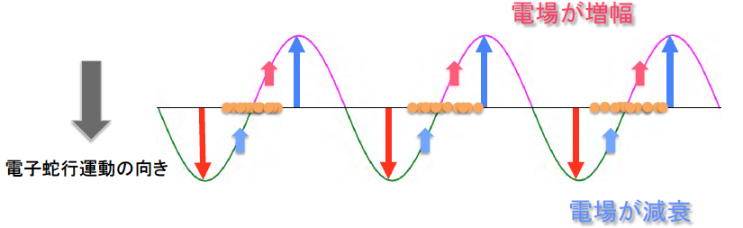
Self-Amplified Spontaneous Emission
Micro-bunching with Wavelength Interval
Undulator
Electron trajectory
Electrons gaining and loosing energy gather towards at the field zero crossing points
Electron deceleration side
Electron acceleration side
Lower energy trajectory
Design energy trajectory
Higher energy trajectory
Notes:
Electrons gaining energy from the light relatively advance in phase and Electrons losing energy relatively delay in phase. Finaly electrons gather towards at the field zero crossing points.

Slide 24
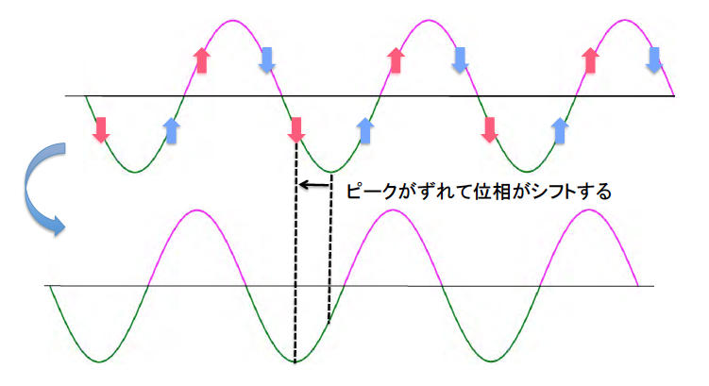
Self-Amplified Spontaneous Emission
Phase Shift of Light Electric Field
Undulator
Electron trajectory
Energy exchange with gradually bunching electrons modulates the phase of light
electric field
Peak(Phase) shifted
Electron deceleration side
Electron acceleration side
Notes:
In order to enhance the energy exchange between light and electrons, the converged phase should be moved from zero towards π over 2. As shown in the figure below, the energy exchange with electrons during the micro-bunching process shifts the phase of the light’s electric field due to an imbalance in electron density (bunching). Due to this phase shift, the electron bunches, which initially converge toward the zero-crossing point of the electric field, naturally begin to converge toward the electron deceleration region towards π over 2.

Slide 25
Self-Amplified Spontaneous Emission
Undulator
E-beam
SASE
Interaction with a built-up laser field
Energy modulation by
spontaneous
emission
Micro-bunching
Log(Gain)
P(z)=P₀exp(z/Lg)
Gain~10⁵
Notes:
Due to the formation of microbunching and the phase shift of the light electric field, the intensity of the electric field of light increases exponentially, as shown in the figure, and finally generate intense and spatially coherent SASE.

Slide 26

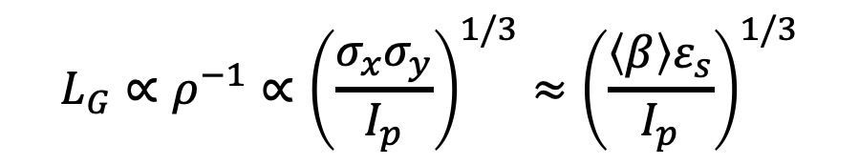
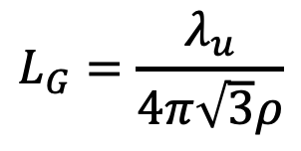
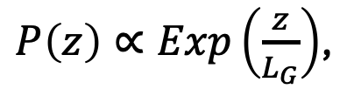
1D SASE gain length
The gain length${ L}_{G}$represents the undulator length enhancing the laser power by a factor of e (approximately 2.7).
Emittance
at the lasing slice
Averaged beta over
the undulator
$P\left(z\right)∝Exp\left(\frac{z}{L_{G}}\right)$,
$$L_{G}=\frac{λ_{u}}{4π\sqrt{3}ρ}$$
$$L_{G}∝ρ^{−1}∝{\left(\frac{{σ_{x}σ}_{y}}{I_{p}}\right)}^{1/3}≈{\left(\frac{\left\langle β\right\rangle ε_{s}}{I_{p}}\right)}^{1/3}$$
,
Peak current at the lasing slice
Notes:
The gain length${ L}_{G}$represents represents the undulator length enhancing the laser power by a factor of e is scaled by the peak current , inverse of emittance and inverse of transverse beam envelop function at the lasing slice as shown here. In order to shorten the gain length, high peak current, small beam size and small beam emittance are required.

Slide 27
Single-pass FEL system
Electron
Gun
Beam Switch
Yard
Multi-stage Bunch Compressor
Buncher
Undulator
Beamline
Main Acceleration
System
Experimental
Hutch
Chirp
Lineariser
T. Ishikawa et. al., Nat. Photon. 6 (2012) 540-544
Notes:
The system providing a highly brilliant electron beam is as following. An electron gun with a buncher generates a low emittance electron beam with a normalized emittance of 0.1 to 1 umrad. Because the initial electron beam density is not so high, the electron beam is compressed downstream by a multi-stage bunch compressor consisting of RF accelerators and magnetic chicanes. To compress linearly the bunch, the RF chirp linearizer, which is typically a third harmonic structure of the main RF frequency, is used to correct the nonlinear chirp upstream of the bunch compressor. The main accelerator system after the bunch compressor accelerates the beam up to the design beam energy. The beam is delivered to the undulator beam line via the beam switch yard and amplifies SASE XFEL.

Slide 28
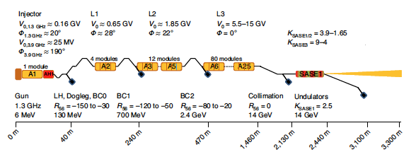
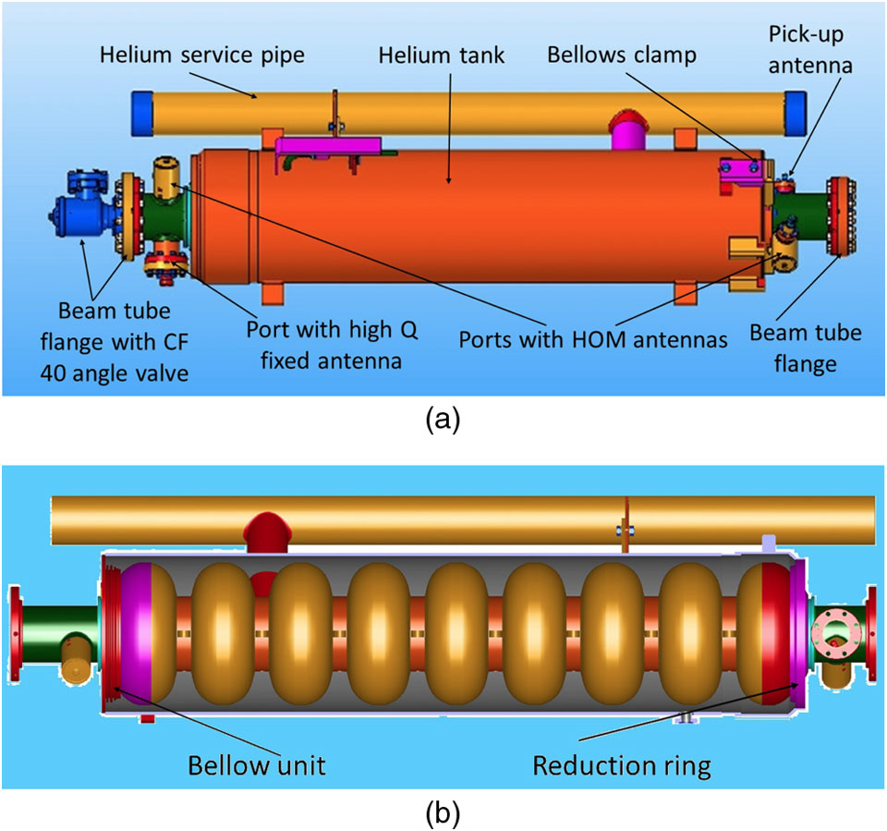

High repetition rate XFEL based on superconducting linac (mainstream)
W. Decking et. al., Nat. Photon. 14 (2020) 391-397
Notes:
The recent mainstream is a XFEL facility using a superconducting RF acceleration system, enabling a MHz XFEL pulse. Pioneer of this system is TTF and the developed technology has been taken over by its successor of European XFEL in Hamburg, Germany.

Slide 29
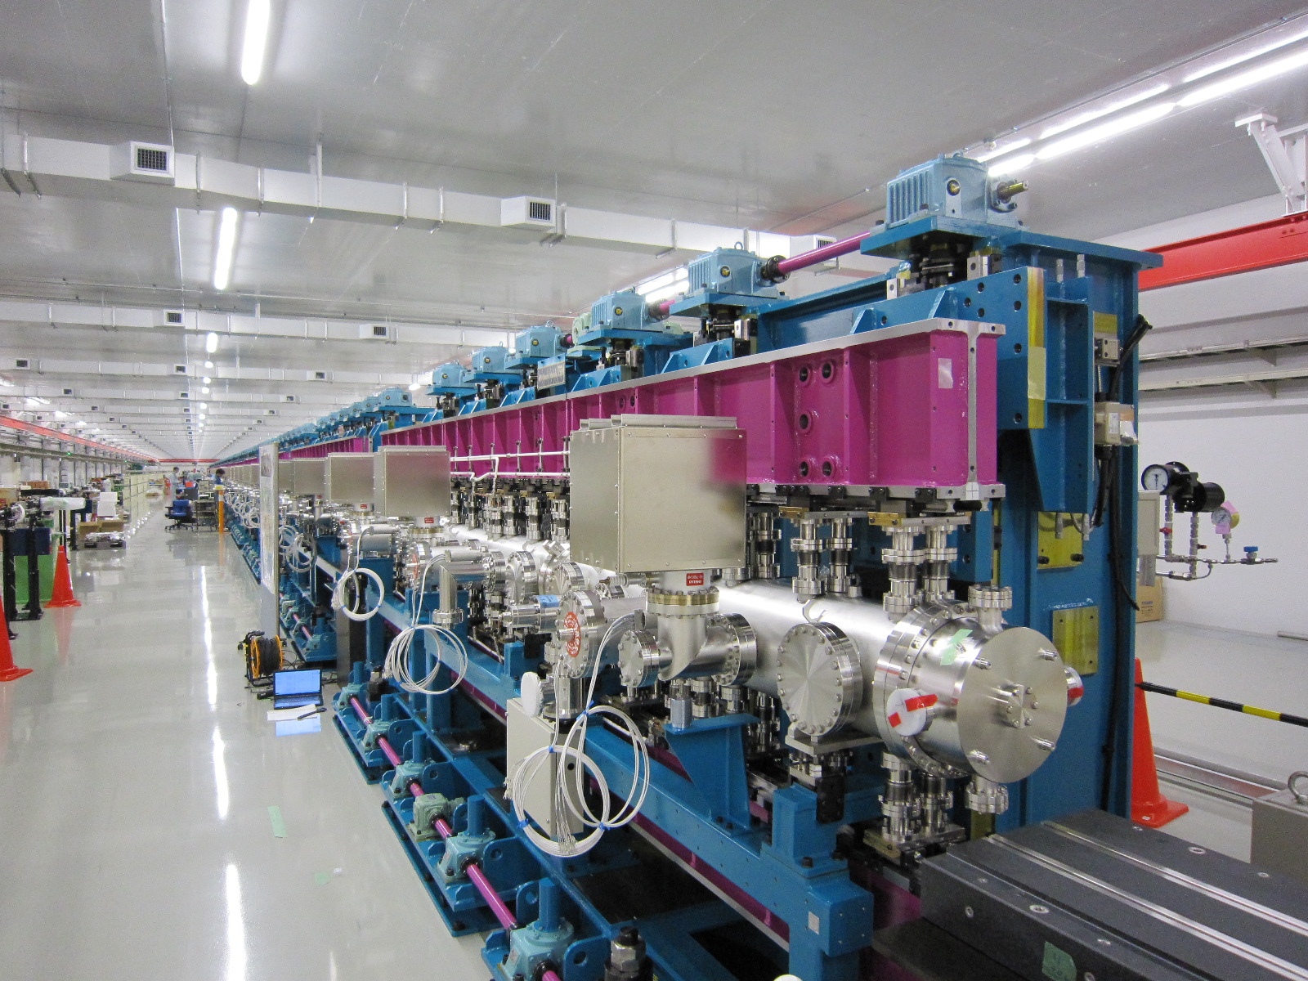
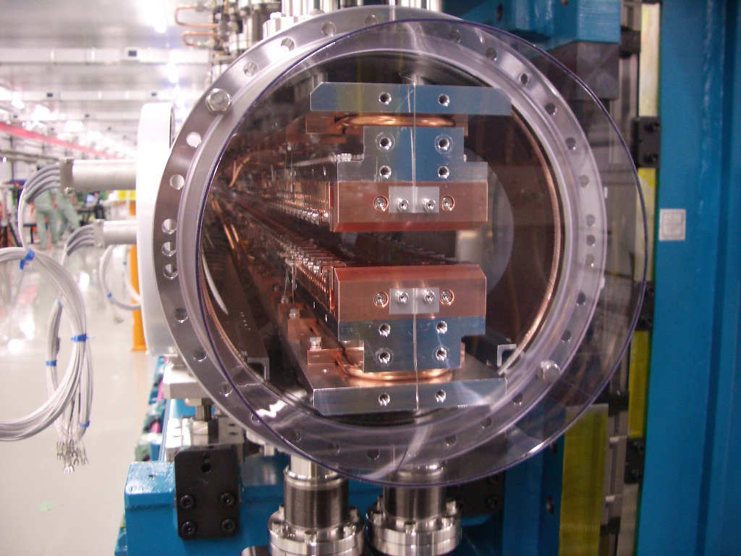
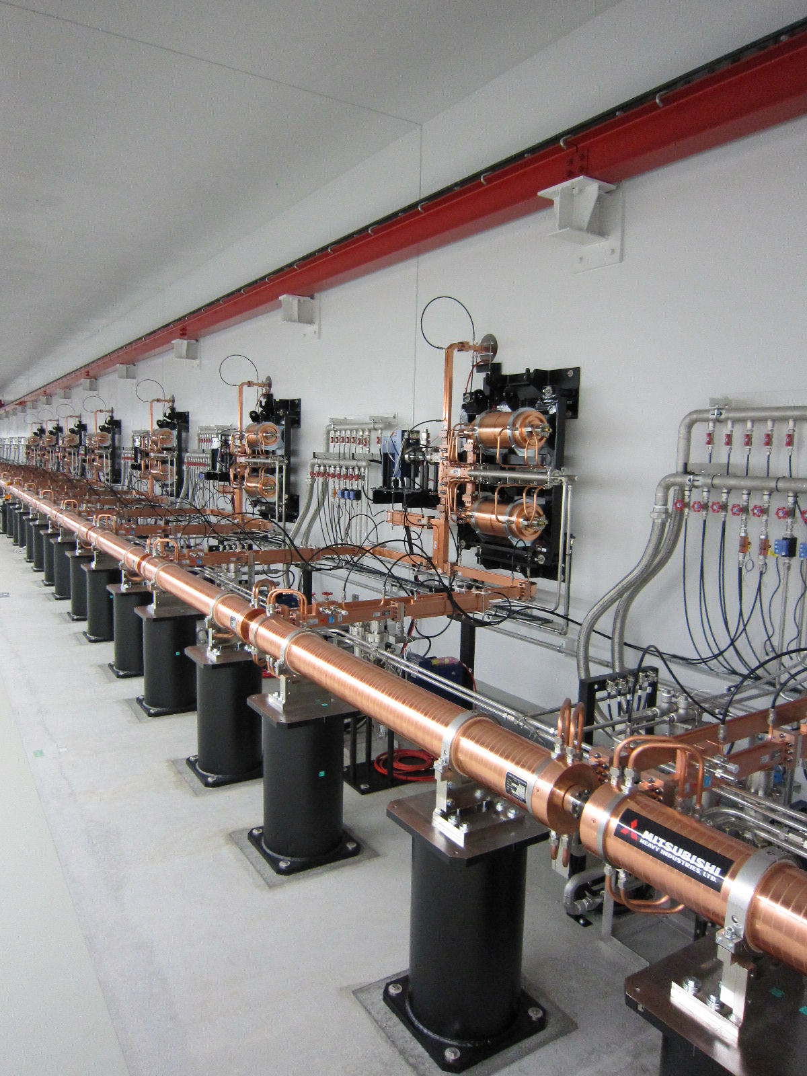
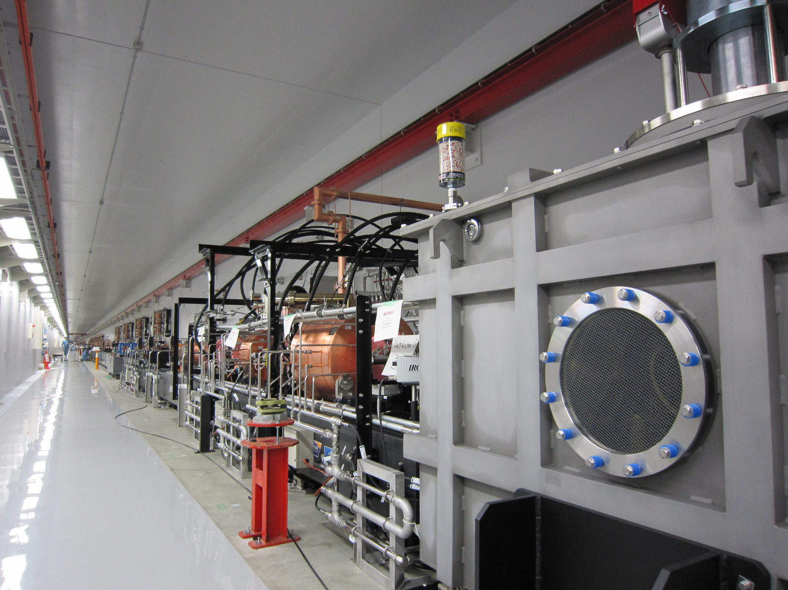
SPring-8 Compact SASE Source (SCSS)
Lower Beam Energy
Short period
in-vacuum
undulator
Size Reduction
Efficient Acceleration
C-band high
gradient
acceleration
system
Further Size Reduction
Smaller Normalized
Beam Emittance
Thermionic
gun based
low emittance
injector
T. Ishikawa et. al., Nat. Photon. 6 (2012) 540-544
Notes:
This is a completely different approach to a compact XFEL using a normal conducting C-band accelerators and in-vacuum short period undulators.

Slide 30
Variety of XFELs
Two-color FEL
Self-seeded FEL
Circular-/liner-polarized FEL
Extremely short-pulsed FEL
Notes:
Here, I would like to introduce variety of XFELs. Regarding the short-pulsed FELs, I will explain later as a future research subject for younger generation.

Slide 31
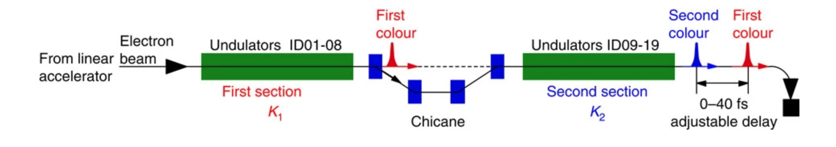
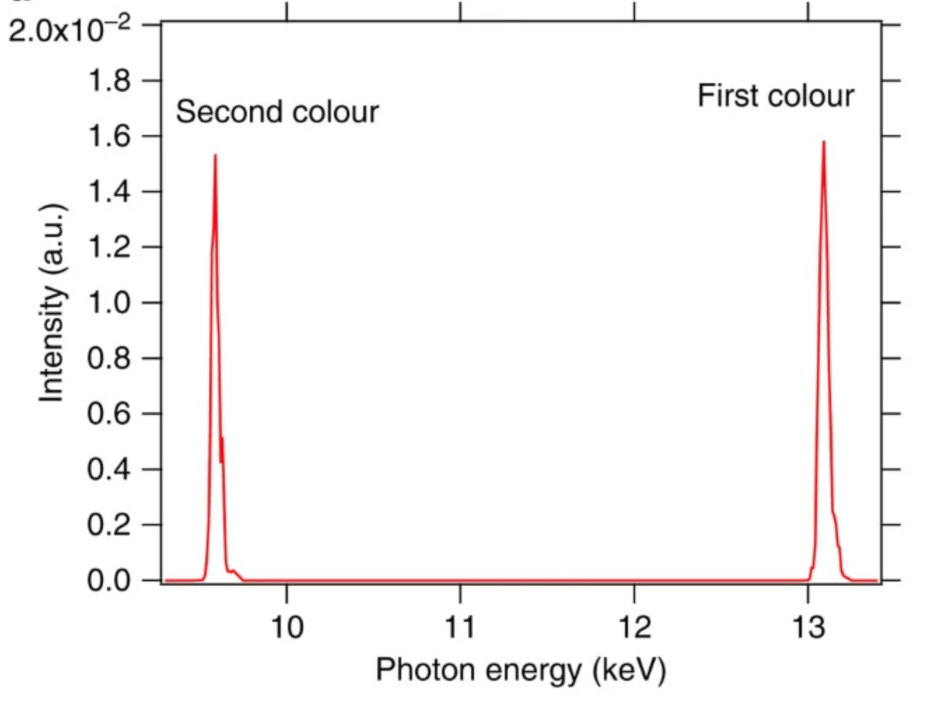
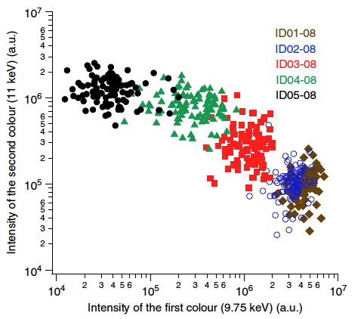
Two-color XFEL with wide tunability
K₂
K₁
K₂
K₁
T. Hara et. al., Nat. Commun. 4 (2013) 2919
Notes:
Currently, two-color XFELs are widely available for user experiments. A schematic drawing illustrates a configuration that enables a two-color XFEL with a wide range of adjustable photon energy and timing differences. In this configuration, two undulator sections are separated by an electron beam delay line, which adjusts the timing of the two colors. The two photon energies can be adjusted independently by changing the gap between each undulator.

Slide 32
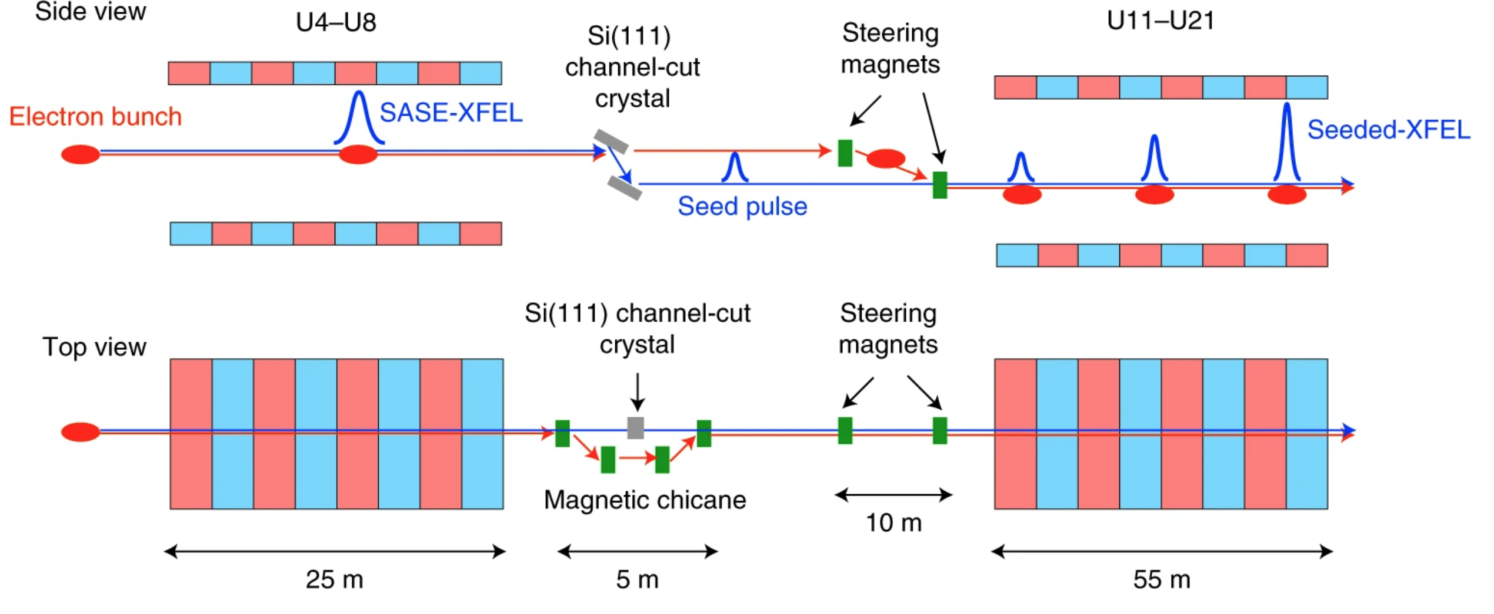
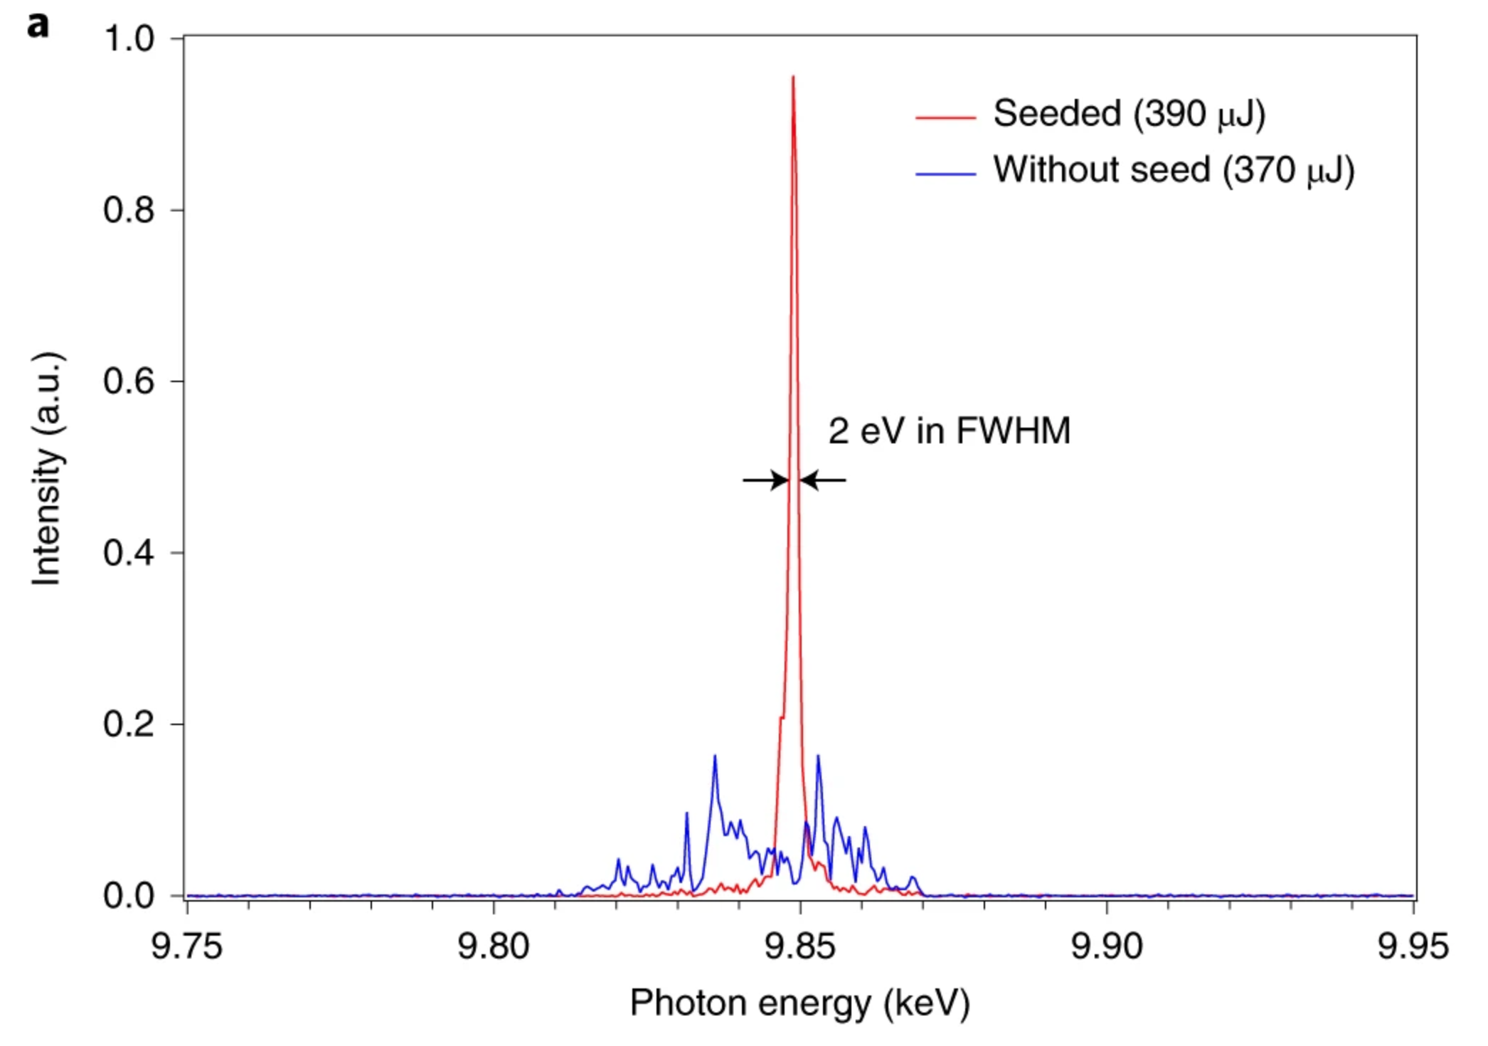
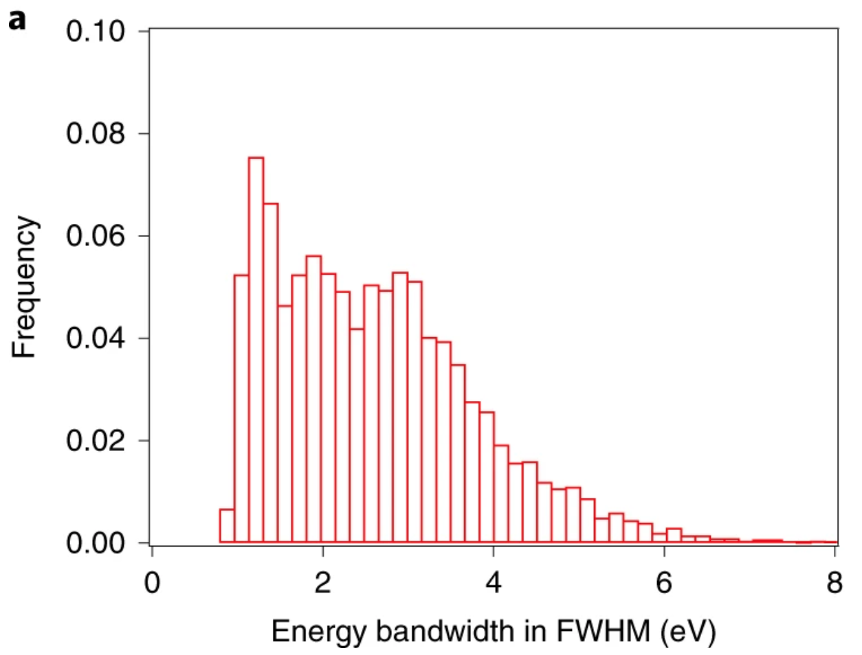
Self-seeding with reflective geometry
I. Inoue et. al., Nat. Photon. 13 (2019) 319-322
Notes:
In the X-ray wavelength range, we do not have an intense laser system available. Therefore, we usually use a self-seeding scheme in which SASE XFEL is purified into monochromatized laser and then, this monochromatized SASE is back to the electron beam to interacts the beam as a seed laser starting laser amplification. We have two kinds of schemes, reflective and transmission types and this slide shows the reflective geometry type self-seeding scheme.

Slide 33
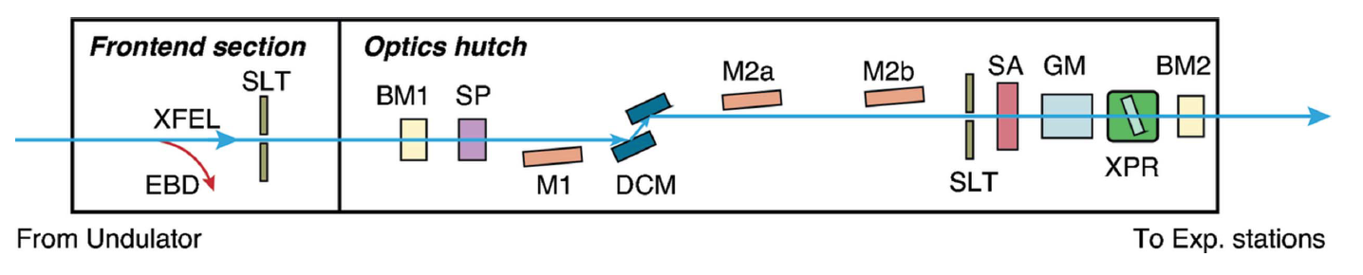
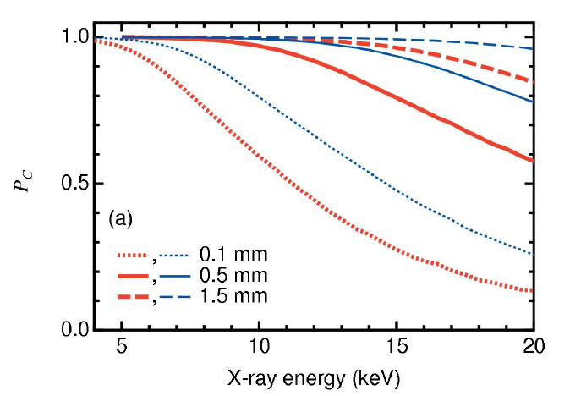
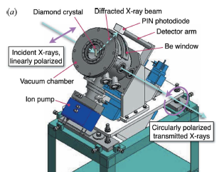
Circular-polarization XFEL
XPR(X-ray phase retarder)
σ-polarization
90 deg phase
difference
at the exit
π-polarization
M. Suzuki et. al., JSR 21 (2014) 466-472
Notes:
Circular-polarized FELs are also available in SX and HX wavelength range. In the SW wavelength range, Circular-polarized FELs are generated with circular polarized undulator. In the X-ray wavelength range, horizontally polarized XFELs are converted to arbitrary polarized XFEL such as a circular-polarization by using a diamond phase retarder as shown here. This system can generate arbitrary polarized XFELs, namely, elliptical polarization, right/left-hand circular polarization, vertical polarization, etc by adjusting retarder phase delay between σ and π polarization.

Slide 34
History of synchrotron radiation source development
Diffraction-limited SR sources
Single-pass free-electron lasers
Future development direction with a few topics

Slide 35
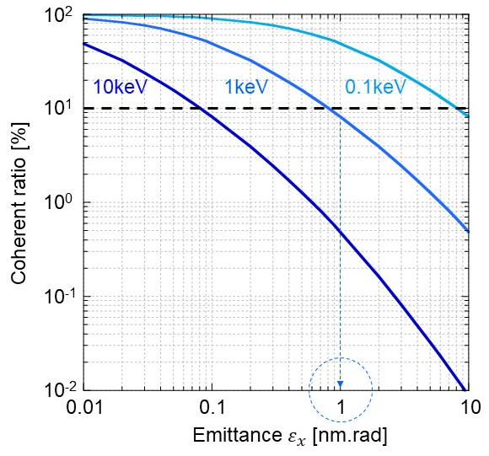
Post diffraction limited SR - Longitudinally coherent x-ray generation-
The diffraction limited condition means the X-ray brilliance by undulator radiation is no longer enhanced even when natural emittance is reduced.
To dramatically increase the brilliance, paradigm-shift from “spontaneous radiation” to “longitudinally coherent radiation” is required.
Notes:
A big challenge in a ring-based SR source is to develop a scheme generating longitudinally coherent X-rays. This is because we have currently reached the level of diffraction limited condition at X-ray wavelength range and we can not dramatically enhance the brilliance by reducing the beam emittance further.

Slide 36
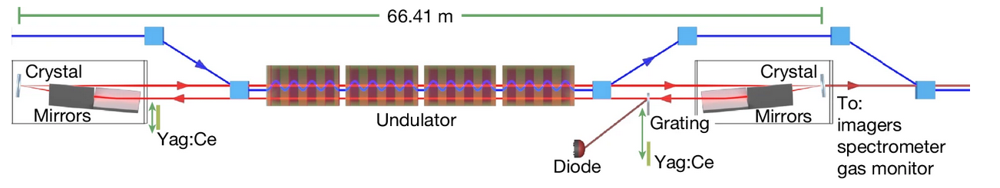
Cavity-based FEL in a diffraction-limited SR
The first proof-of principle Experiment was performed at the SASE1 undulator line of the European XFEL. The X-ray cavity consists of two diamond crystals in Bragg reflection working close to backscattering geometry. The elements in the retro-reflector are aligned such that the beam after reflection returns at a distance of 2.67 mm from the incident beam inside the same vacuum pipe. The downstream retro-reflector unit (on the right) is adjustable to tune the cavity length. The electron beam (blue) is injected from the left using a magnetic chicane, and the X-ray pulse (red) is circulating in the cavity, overlapping with electron bunches that pass the undulator at 2.23 MHz.
Patrick Rauer et. al., Nature 650 (2026) 93-96
Notes:
Recently, the DESY group achieved epoch-making result by using SASE XFELs with a MHz repitition rate at EuroXFEL. This result showed that a clear evidence of building-up SASE power in the optical cavity consisting of two diamond crystals. Although several challenges remain relating to the performance improvements, this result might be a first step towards at realization of a cavity-based XFEL in the ring.

Slide 37
Towards brilliant atto-second X-ray generation
A frontier of practical “single” atto-second brilliant X-rays remains.
Tuesday 19th afternoon: “Attsecond FEL Physics” by Agostino Marinelli (SLAC)
Thursday 21st, morning: “Generation of tunable sub-femtosecond XFEL pulses by electron bunch recompression using reverse-energy chirp” by Kenji Yasutome (RIKEN)
Notes:
Another big challenge is to generate FEL with a short pulse duration of atto-second, which is quite hot topic now. In this IPAC, two talks will be presented. One is an overview talk by Agostino on atto-second FEL physics. Another by Kenji Yasutome on generation of tunable sub-femtosecond XFEL by extra-compression using reverse energy chirp. Prior to these talks, I will give you a simple overview on approaches to the atto-second FEL generation.

Slide 38
Towards brilliant atto-second X-ray generation
A frontier of practical “single” atto-second brilliant X-rays remains.
ESASE(Enhanced SASE) scheme
A. Zholents and W. Fawley, PRL 92, 224801 (2004); A. Zholents and G. Penn, PRAB 8, 050704 (2005); A. Zholents, PRAB 8, 040701 (2005); E. Saladi et. al., PRAB 9,050702 (2006); Y. Ding et. al., PRAB 12, 060703 (2009); J. Duris et. al., Nat Photon 14, 30-36 (2020)
Slotted foil scheme
P. Emma et. al., PRL 92, 074801 (2004); A. Marinelli et. al., APL 111, 151101 (2017)
ESASE seeding scheme T. Tanaka, PRL 110, 084801 (2013)
Hard bunch compression scheme
S. Huang et. al., PRL 119, 154801 (2017); E. Prat et. al., APL Photonics 8, 111302 (2023); E. Prat et. al., PRRes 7, L042060 (2025)
Scheme using a reverse-chirp due to a space charge force
J. Yan et. al., Nat Photon 18, 1293-1298 (2024)
Scheme using slippage over the undulator T. Tanaka, PRL 114, 044801 (2015)
Notes:
Previous research works are roughly divided into these 6 categories. The researches of about 40% are on Enhanced SASE schemes. From now, we will see concept of each scheme.

Slide 39
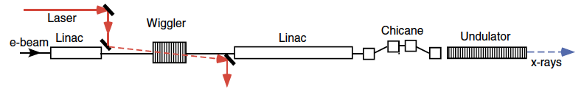
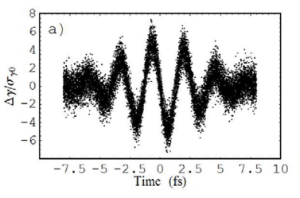
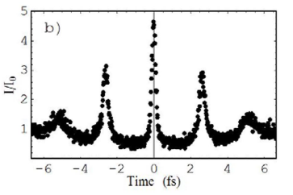
ESASE(Enhanced SASE) scheme
λ_{L}= 800 nm, P_{L}= ~6 GW, τ_{L}= ~5 fs
Compression of
current modulation
SASE radiator
Energy boosting
from 2 to 14,35 GeV
ε_{n}=1.2 μmrad
σ_{γ0/γx}=0.8E-4
I₀=3.4 kA
Energy modulation
E=14.35 GeV
E=2 GeV
λ_{w}=16cm
Κ_{w} =29 (Bp~2T)
Energy modulation by a high-power short-pulsed laser at the wiggler section
Converting the energy modulation to the density modulation at the chicane with help of R56(bunch compression)
Extracting a sub-femtosecond XFEL pulse from the largest current spike
A. Zholents, PRAB 8, 040701 (2005).
Notes:
This shows schematically the idea of an enhanced SASE scheme. By interacting a high-power short-pulsed laser with an electron beam through the wiggler section, energy modulation is generated. Then, this large energy modulation is converted to the density spike as shown here, generating sub-femtosecond to a few hundred attosecond FEL pulses.

Slide 40


Slotted foil scheme
Reversed taper
Simple scheme
Control the lasing beam slice into a short pulse duration
Low electron charge -> difficult to access high peak power
P. Emma et. al., PRL 92, 074801 (2004).
Notes:
This is a quite simple scheme to cut out electron beam into a sub-femtosecond time slice by using Energy and time correlation as shown here. The weak point is not to provide an intense short pulse.

Slide 41



ESASE seeding scheme
10 periods
This scheme enables 1) high peak laser power up to several TW and 2) pure single attosecond XFEL pulse
Demerit: too complicated system
λ_{L}= 800 nm, P_{L}= ~1GW, Δγ/σ_{γ}= ~5
E=8 GeV
ε_{n}=0.7 μmrad
σ_{γ0/γx}=1 E-4
I₀=3.5 kA
λ_{w}=18 mm
Κ_{w} =2.18
L_{u}= 5 m
Generating a series of electron density spikes by a
ESASE process with slotted foil
Generating a seed laser by a undulator radiator
Adjusting seed laser timing to the tail electron peak
Enhancing seed laser intensity
Adjusting the next upstream peak timing to seed laser
T. Tanaka, PRL 110, 084801 (2013).
Notes:
This scheme combines ESASE with slotted foil and seeding schemes to generate high-power atto-second XFEL. However, scheme is complicated as shown here. At first, a series of electron density spikes are generated here by a ESASE process with slotted foil. Then, these density spikes generate a series of seed laser pulses. Next, adjust the seed laser timing to the tail electron by the optical delay and increase seed laser power. Then, by using electron delay line, the enhanced seed laser timing is adjusted to the next upstream density peak as shown here.

Slide 42
Hard bunch compression scheme
Reversed taper
After BC2
L3 exit
DL2 exit
Simulated attosecond XFEL
Low charge of 20 pC -> difficult to access high peak power
Nonlinear hard bunch compression -> peaky peak
Shortening XFEL pulse by limiting lasing only at the reverse chirp part by using the undulator reverse taper
S. Huang et. al., PRL 119, 154801 (2017).
Notes:
This scheme is also simple using a longitudinal space-charge effect. Since the lasing charge is quite limited, the laser peak power is not high enough. The high electron peak current after hard bunch compression at BC2 develops a reverse chirp due to the longitudinal space charge effect in the main energy acceleration process L3 and generates a strong reverse energy chirp at the electron current spike. Only this high peak current with a reverse chirp can contribute to laser amplification under the revers undulator taper condition.

Slide 43

Scheme using a reverse-chirp due to a space charge force
Additional bunch compression with positive R56
Positive R56
Normal energy chirp
Reverse energy chirp
Self-energy chirp modulation due to SPC -> rather stable operation
Reverse-energy chirped electron bunch compressed using a positive R56 dogleg
Small emittance degradation by bunch compression at higher electron energy
Not optimized dogleg-> difficult accelerator parameter tuning
J. Yan et. al., Nat Photon 18, 1293-1298 (2024).
Notes:
This scheme utilize the reverse chirp in the previous scheme for the extra-bunch compression using a positive R56 at the dogleg.

Slide 44

Scheme counteracting the slippage effect towards “single attosecond pulse”
Limit of FEL pulse length determined by a period number of “radiator”
How do we generate a shorter-pulsed, single attosecond FEL?
Invited talk(TUZD1) at IPAC2025 given by T. Tanaka.
Notes:
This is only the scheme potentially generating a single attosecond XFEL pulse so far. To this end, we have to suppress the slippage effect. Even when we introduced a high-power single cycle femtosecond laser in the seeding process, amplified laser is not a single cycle, but N cycle reflecting the period number of radiator.

Slide 45


Scheme counteracting the slippage effect towards “single attosecond pulse”
Chirped micro-bunching with the separation varied from λ₁ to λ₁₀
Ten period tapered undulator with the slippage changing from λ₁ to λ₁₀
Dramatic pulse shortening effect by the phase cancellation
Chirped micro-bunching beam
Radiation from #1
10 period tapered
undulator
with slippages
of λ₁, λ₂, λ₃…λ₁₀
Radiation from #1+2
Radiation from #1+2+3
Radiation from #1+2+3+4
Radiation from #1+2+3+4
…..+10
T. Tanaka, PRL 114, 044801 (2015).
Damped by phase cancellation
Notes:
As the duration of the laser pulse decreases, the spectral bandwidth increases. To reproduce this relationship using seeding, we have to introduce a new concept of "spatially chirped micro-bunching". This slide shows that such a chirped microbunching electron beam, when interacting with a suitably tapered undulator, can generate a single cycle FEL radiation.

Slide 46


Scheme counteracting the slippage effect towards “single attosecond pulse”
Generating single cycle
density modulation
Single cycle
seed laser
Generating chirped
radiation seed pulse
Converting chirped
radiation pulse to
chirped micro-bunching
A few cycle short
pulsed radiation
T. Tanaka, PRL 114, 044801 (2015).
Notes:
The system that puts this concept into practice is shown here, but it’s incredibly complex. It would be wonderful if it could be made a bit simpler.

