Slide 1




Colliders and related accelerators
Yannis PAPAPHILIPPOU
Accelerator and Beam Physics group
Beams Department, CERN
IPAC’26 Student tutorials
Deauville, France
May 16th, 2026

Slide 2
Contents
Purpose of colliders
Colliders’ figures of merit
  c.m. energy and luminosity
Present-future hadron colliders and their challenges
  LHC, HL-LHC, FCC-hh
Present-future e⁺e⁻ colliders and their challenges
  Circular (SuperKEKb, FCCee, CEPC)
  Linear (CLIC, LCF, Plasma-Wakefield colliders)
Future electron-hadron colliders and their challenges
  EiC, LHeC
Future muon collider and its challenges

Slide 3
Purpose of colliders

Slide 4
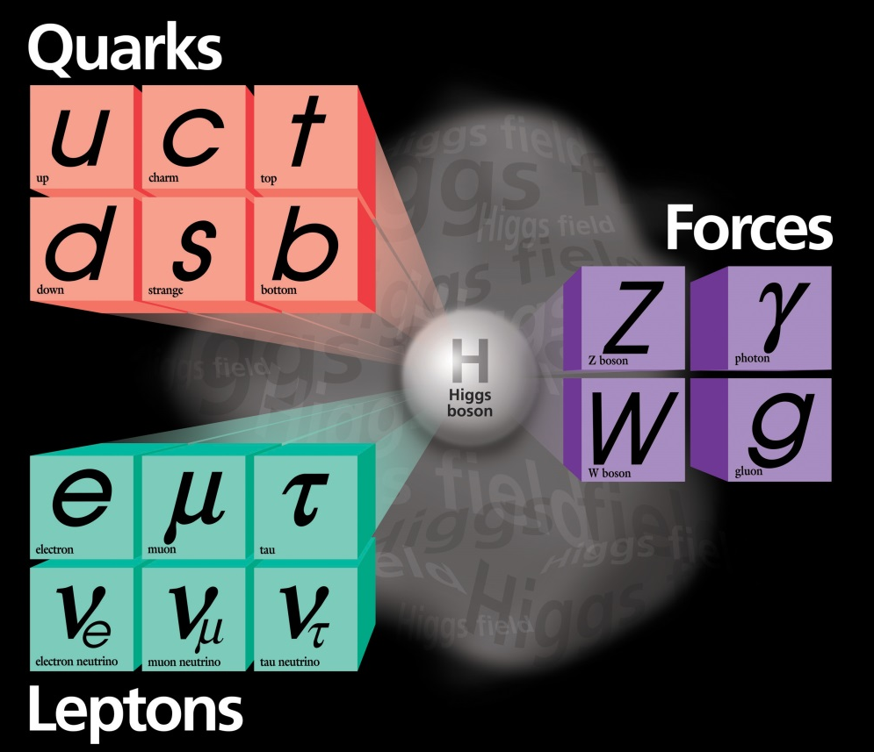
Discoveries by colliders
Standard Model
Particles and forces
LHC:
Higgs-boson
SppS:
Z-boson
W-boson
Tevatron:
top-quark
PETRA:
gluon
SPEAR:
charm quark
tau lepton
Colliders are powerful instruments in High Energy physics
for particle discoveries and precision measurements

Slide 5
Open questions
    Standard model describes known matter, i.e. 5% of the universe!
    what is dark matter?
    what is dark energy?
    why is there more matter than antimatter?
    why do the masses differ by more than 13 orders of magnitude?
    do fundamental forces unify in single field theory?
    what about gravity?
    Is there a “world equation – theory of everything”? …
Known Matter 4.9%
Dark Matter 26.8%
Dark Energy 68.3%
galaxy rotation curves, 1933 - Zwicky

Slide 6
Colliders’ figures of merit

Slide 7
Colliders: energy frontier
Figure of merit: c.m. energy and luminosity
Beam A
Target
Beam A
Beam B

Slide 8
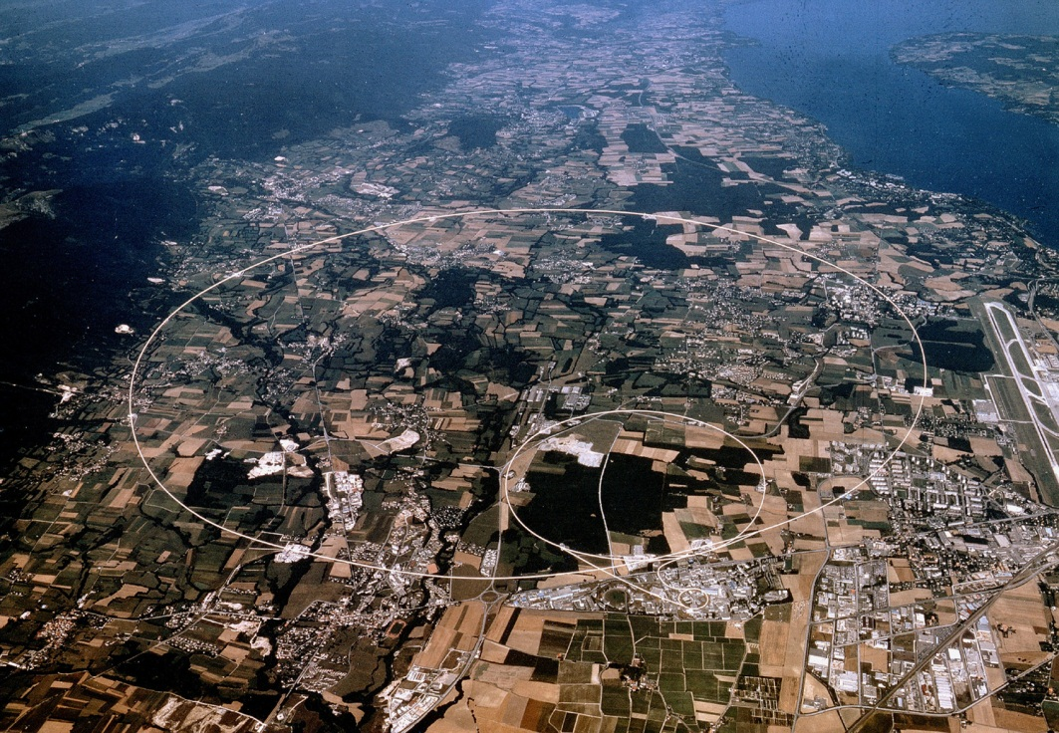
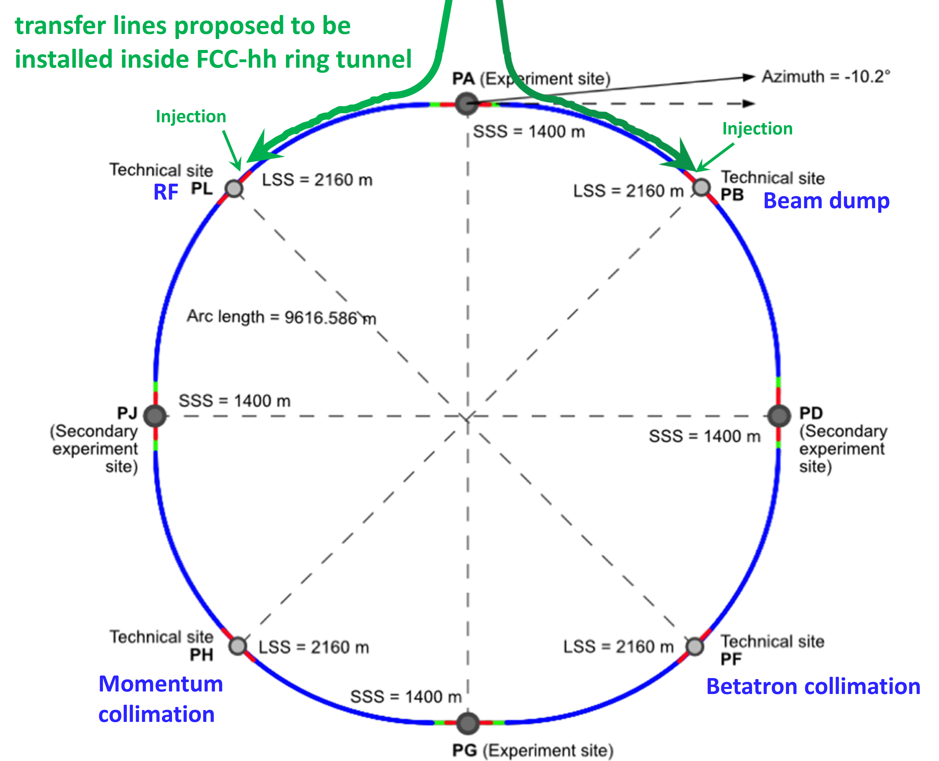
Colliders: energy frontier
Figure of merit: c.m. energy and luminosity
Higher energy means larger size (particularly for hadrons)
Drives key technologies: magnets (high-field), RF cavities (high-gradient),…
LHC
~14 TeV, ~27 km
FCC-hh
~85 TeV, ~91km
Beam A
Target
Beam A
Beam B

Slide 9
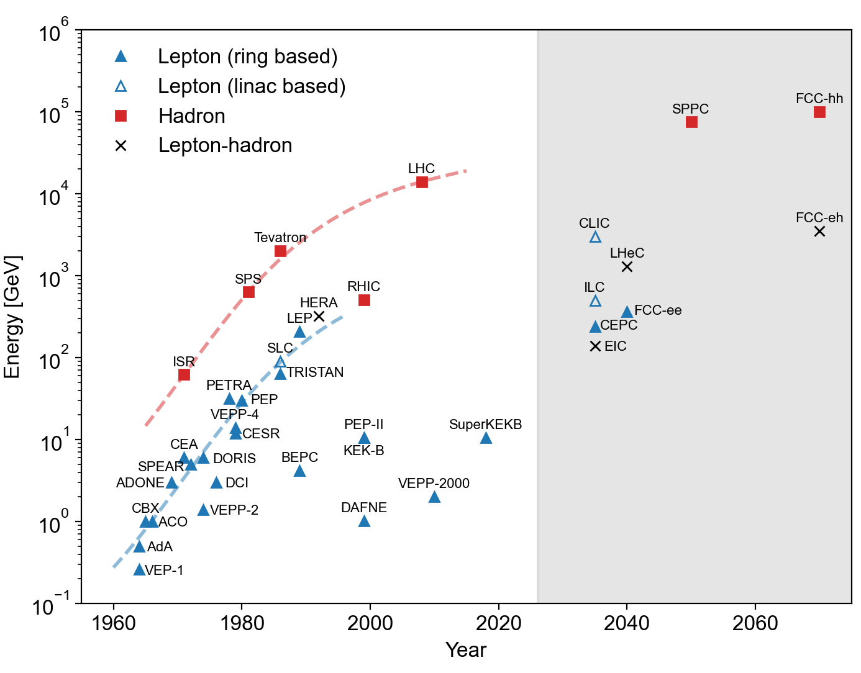
Colliders: energy frontier
Figure of merit: c.m. energy and luminosity
Higher energy means larger size (particularly for hadrons)
Drives key technologies: magnets (high-field), RF cavities (high-gradient),…
“Livingston chart” energy vs time shows succession of principles/technologies pushing energies over time (1.5 orders of magnitude/decade)
Present state of the art no longer supports past exponential growth in particle energy
Beam A
Target
Beam A
Beam B

Slide 10
Luminosity
Luminosity: rate of particle production, i.e. proportionality factor connecting number of events per unit time and cross section
Beam
Beam

Slide 11
Luminosity: colliders
Beam
Beam
Luminosity for two identical “round” Gaussian colliding beams
  Ν_{b} bunch population
  k_{b} number of bunches
  f_{rev} the revolution frequency
  γ relativistic reduced energy
  ε_{n} normalized emittance
  β* “betatron” amplitude function at collision point
  R(φ) geometric reduction factor due to crossing angle

Slide 12
Luminosity: colliders
Beam
Beam
Proportional to square of bunch intensity
Proportional to number of bunches (or total intensity/beam)
Inversely proportional to square of beam size
Brightness reach
depends on injector chain while brightness preservation depends on
collider

Slide 13
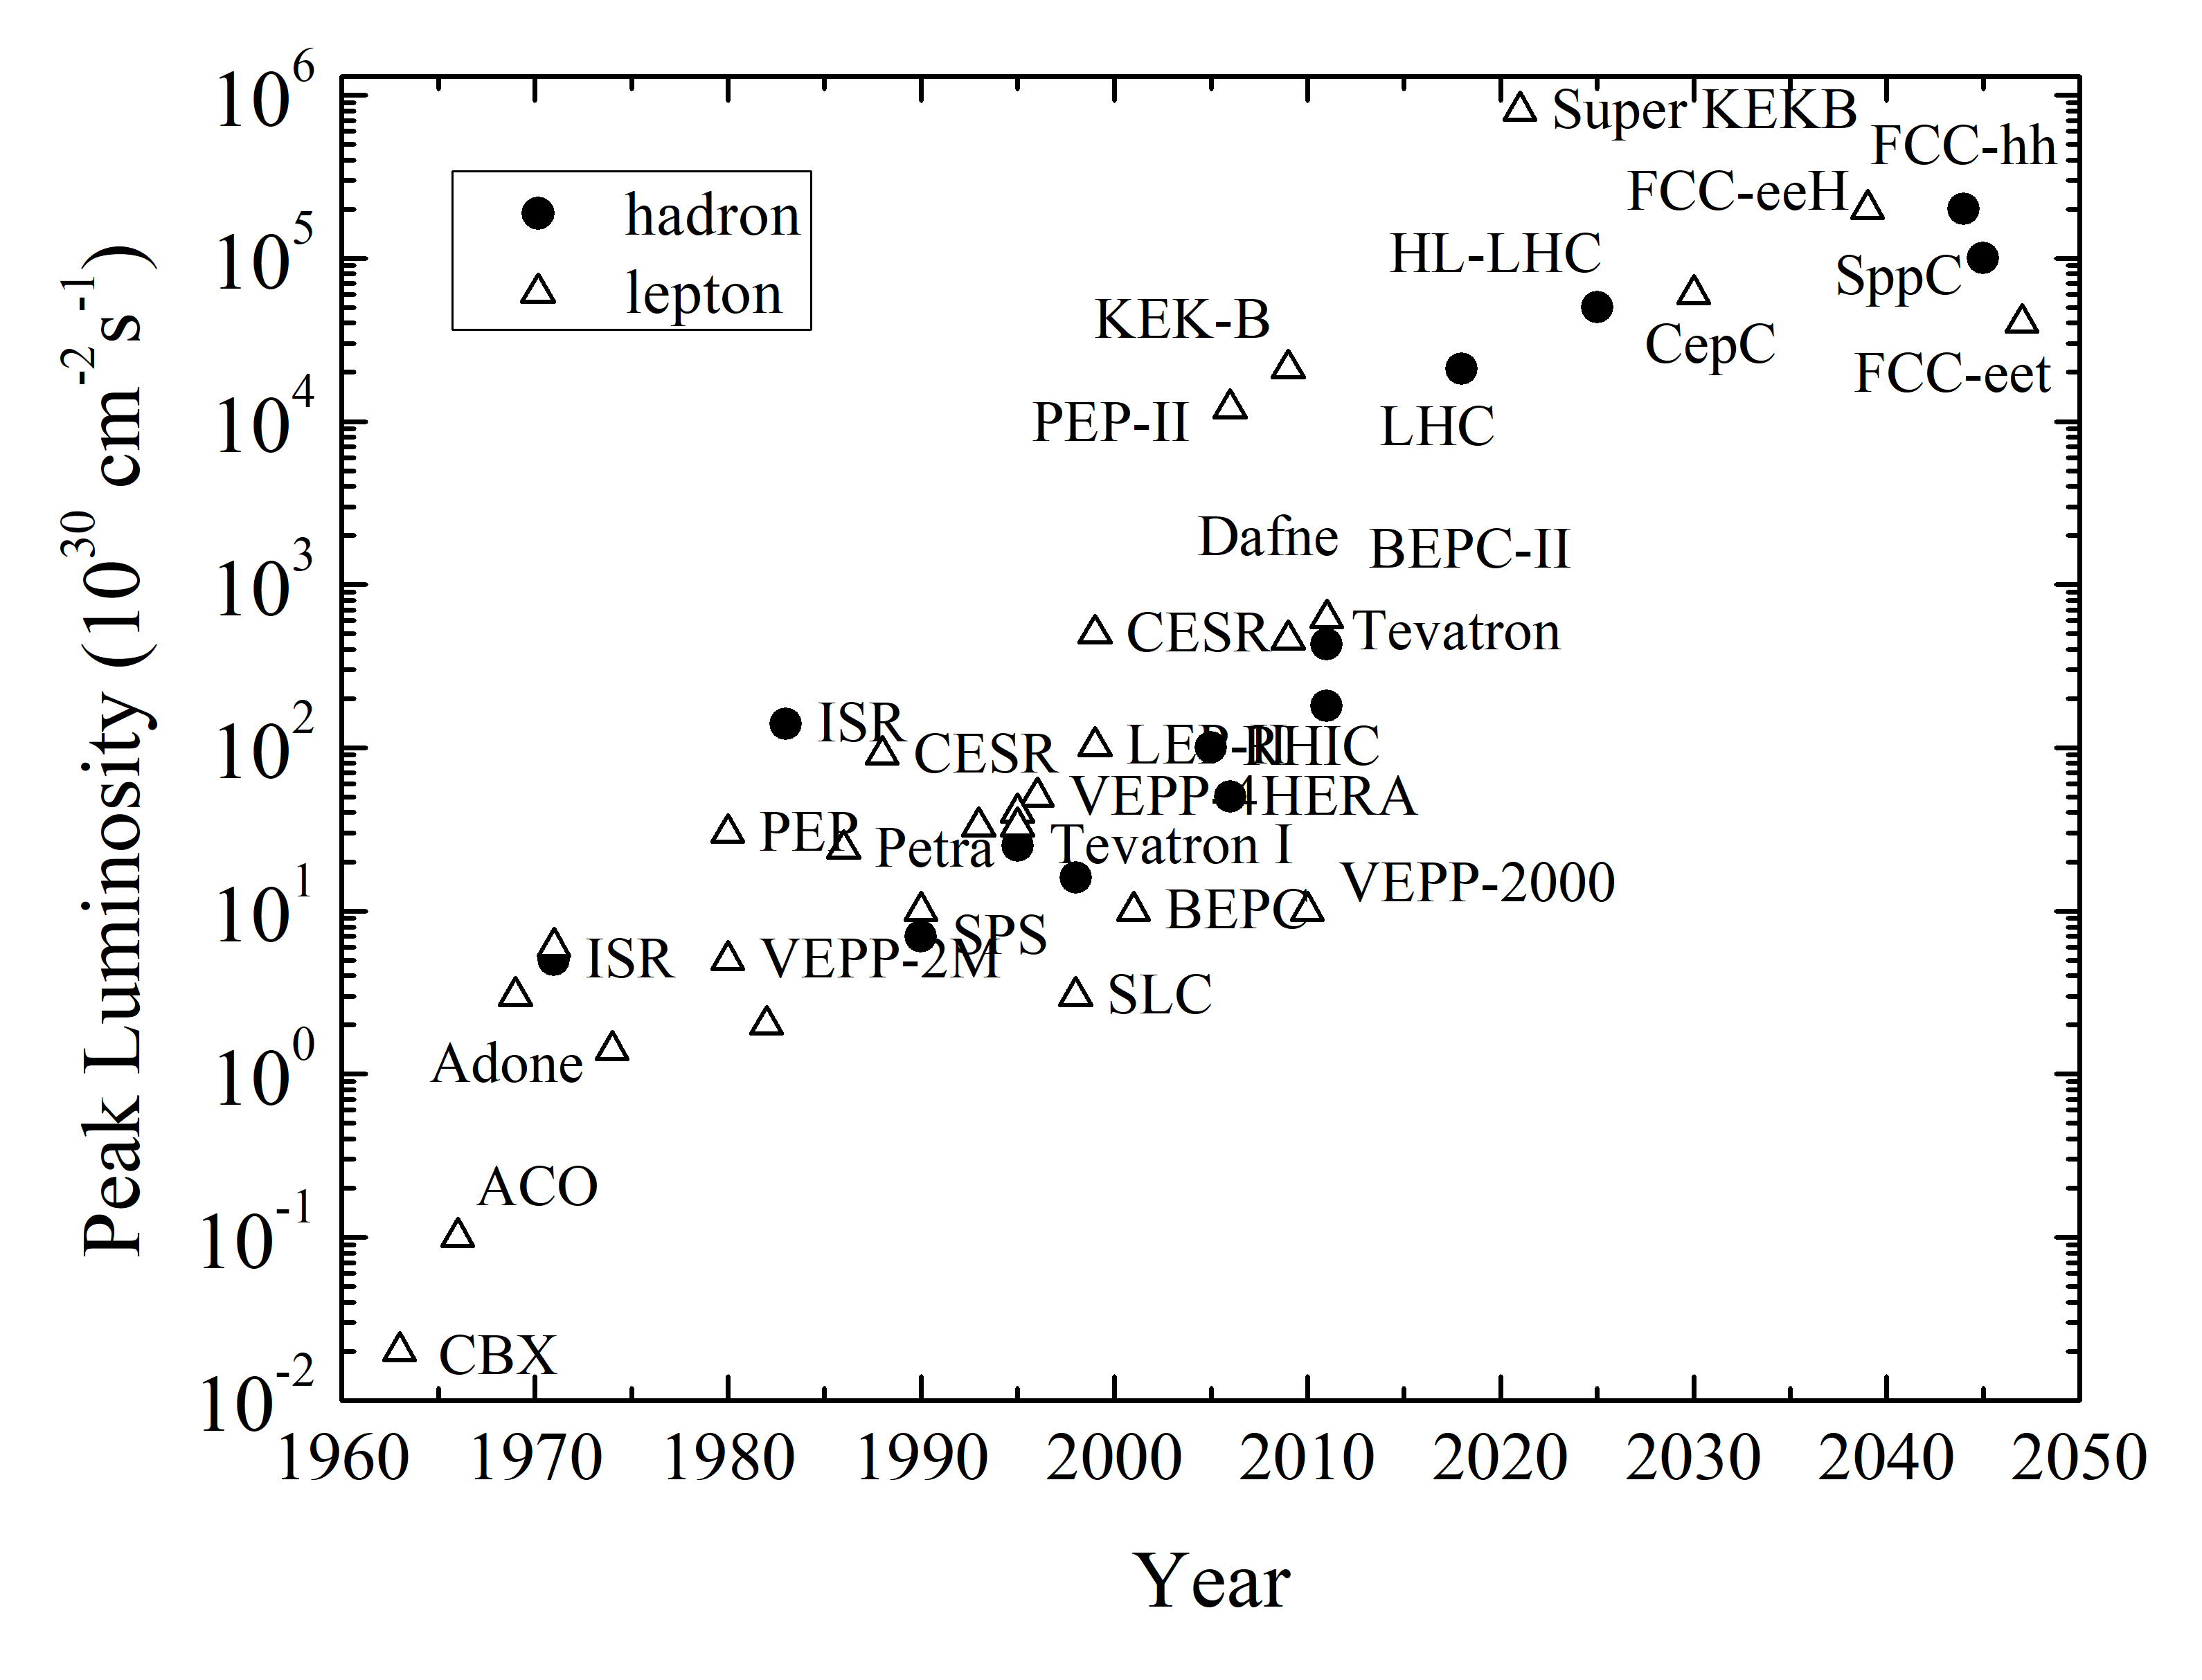
Luminosity optimization
Logarithmic increase of peak luminosity over time
Recipe for luminosity increase
Beam dynamics and HW implications
V. Shitsev, F. Zimmermann, 2021

Slide 14
Luminosity optimization
Logarithmic increase of peak luminosity over time
Recipe for luminosity increase
  maximize intensities, minimize emittance
  minimize beam size
  compensate for geometric reduction factor
  maximize number of bunches (beam power)
  improve machine efficiency i.e. maximize integrated luminosity
Beam dynamics and HW implications
Brightness reach (injectors) and preservation (collider)
Optics and magnet technology
Crabbing, beam-beam
Minimise bunch spacing
V. Shitsev, F. Zimmermann, 2021

Slide 15
Hadron Colliders

Slide 16
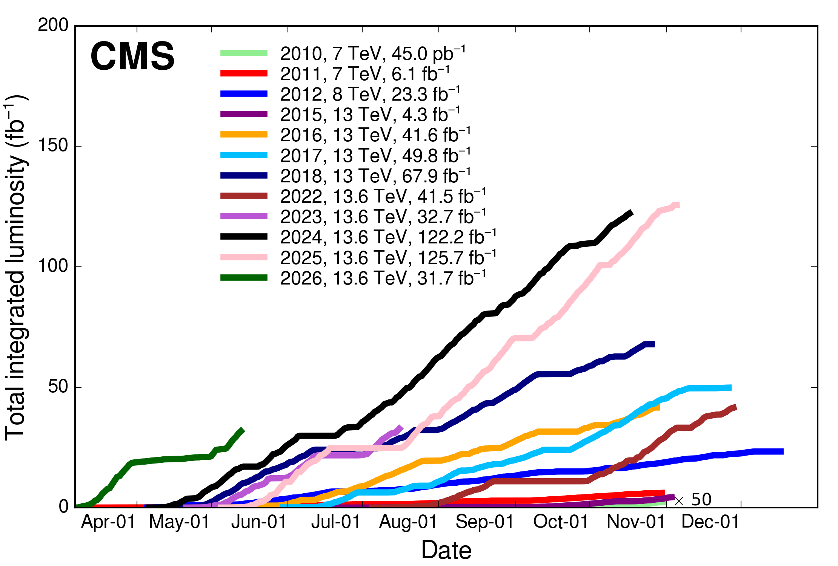
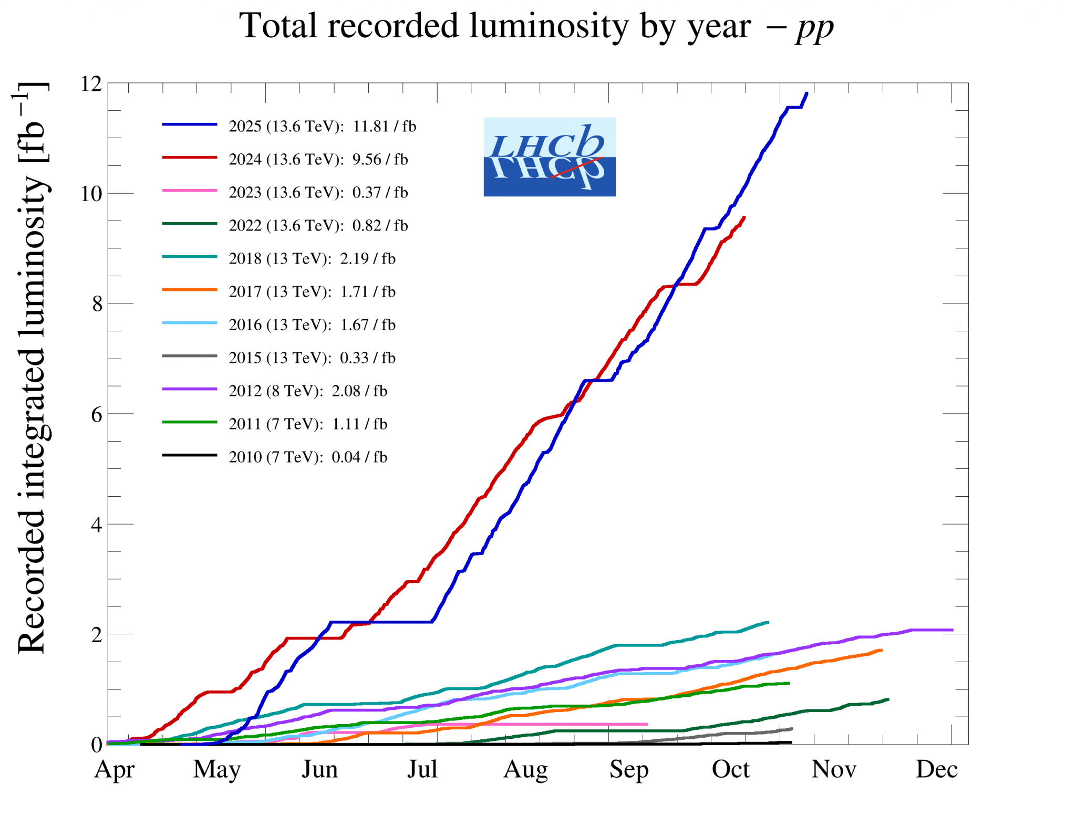
LHC success story (for protons)
ATLAS / CMS
LHCb
LHC intensity increased from 1.1e11 (design) to 1.8e11 ppb, while β* reduced down to 15cm (flat optics and luminosity leveling) more then doubling peak luminosity
2025 was the single most productive year in LHC history so far!
Over 500 fb-1 delivered to both ATLAS and CMS since 2010
LHCb more then doubled their Run 1 + Run 2 + Run 3 data set
… despite limitations from e-cloud (heat load and cryo capacity), beam induced heating due to impedance (vacuum modules’ RF fingers)
Reached 1.8e11 ppb by end of Run3 (2026) for physics conditions and HL-LHC intensities of 2.3e11 ppb in machine studies

Slide 17
Performance optimisation example: HL-LHC
Injector complex Upgrade LIU
triplet aperture
25ns
Crab Cavities
minimize number of unscheduled beam aborts
  1) maximize bunch intensities
  2) minimize the beam emittance
3) minimize beam size (constant beam power);
4) maximize number of bunches (beam power);
5) compensate for ‘F’;
6) Improve machine ‘Efficiency’

Slide 18
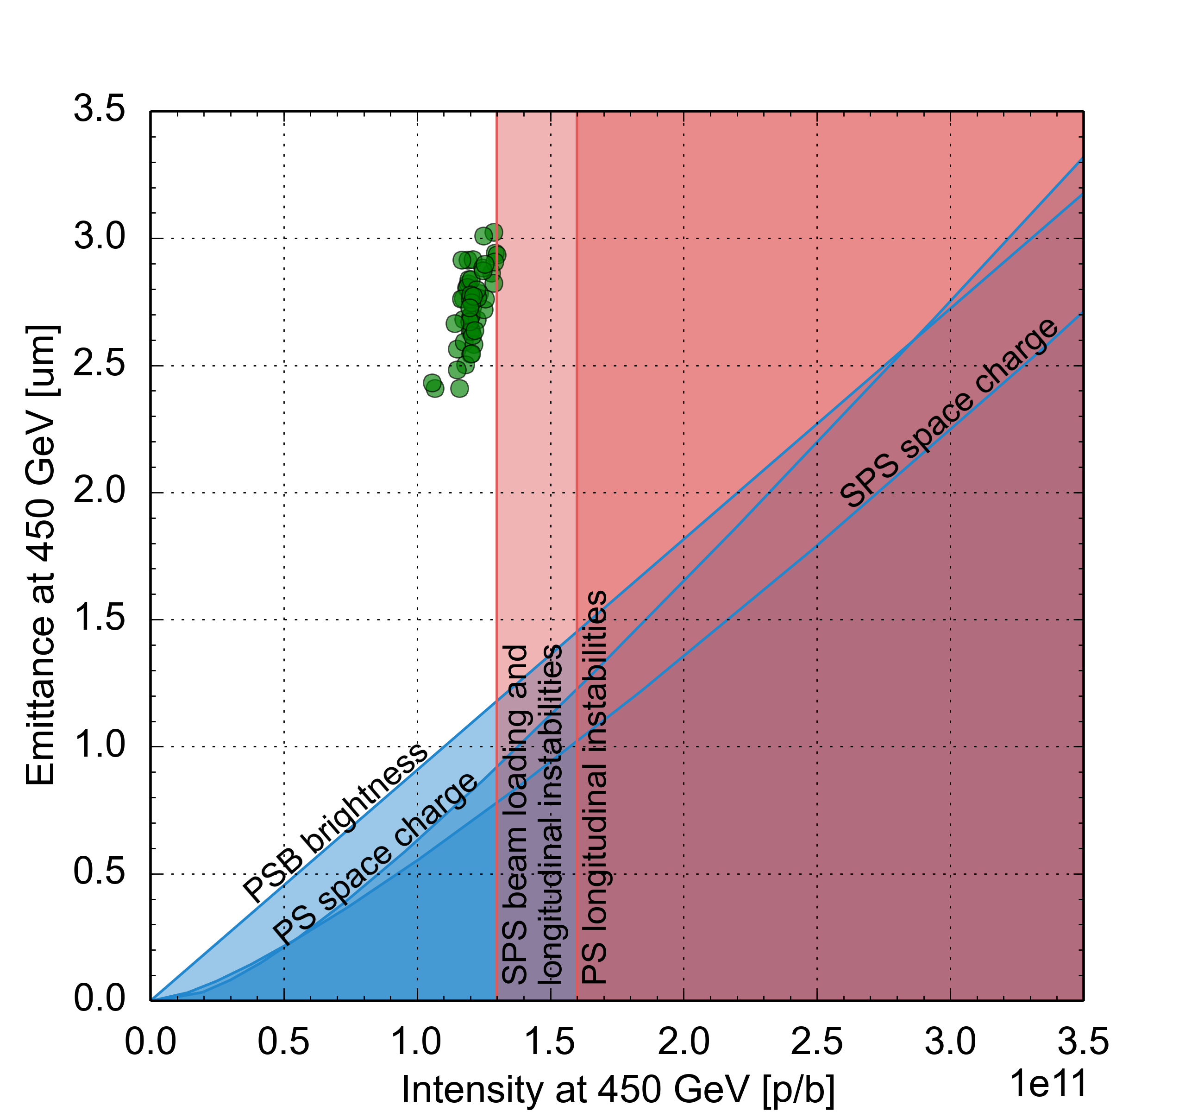
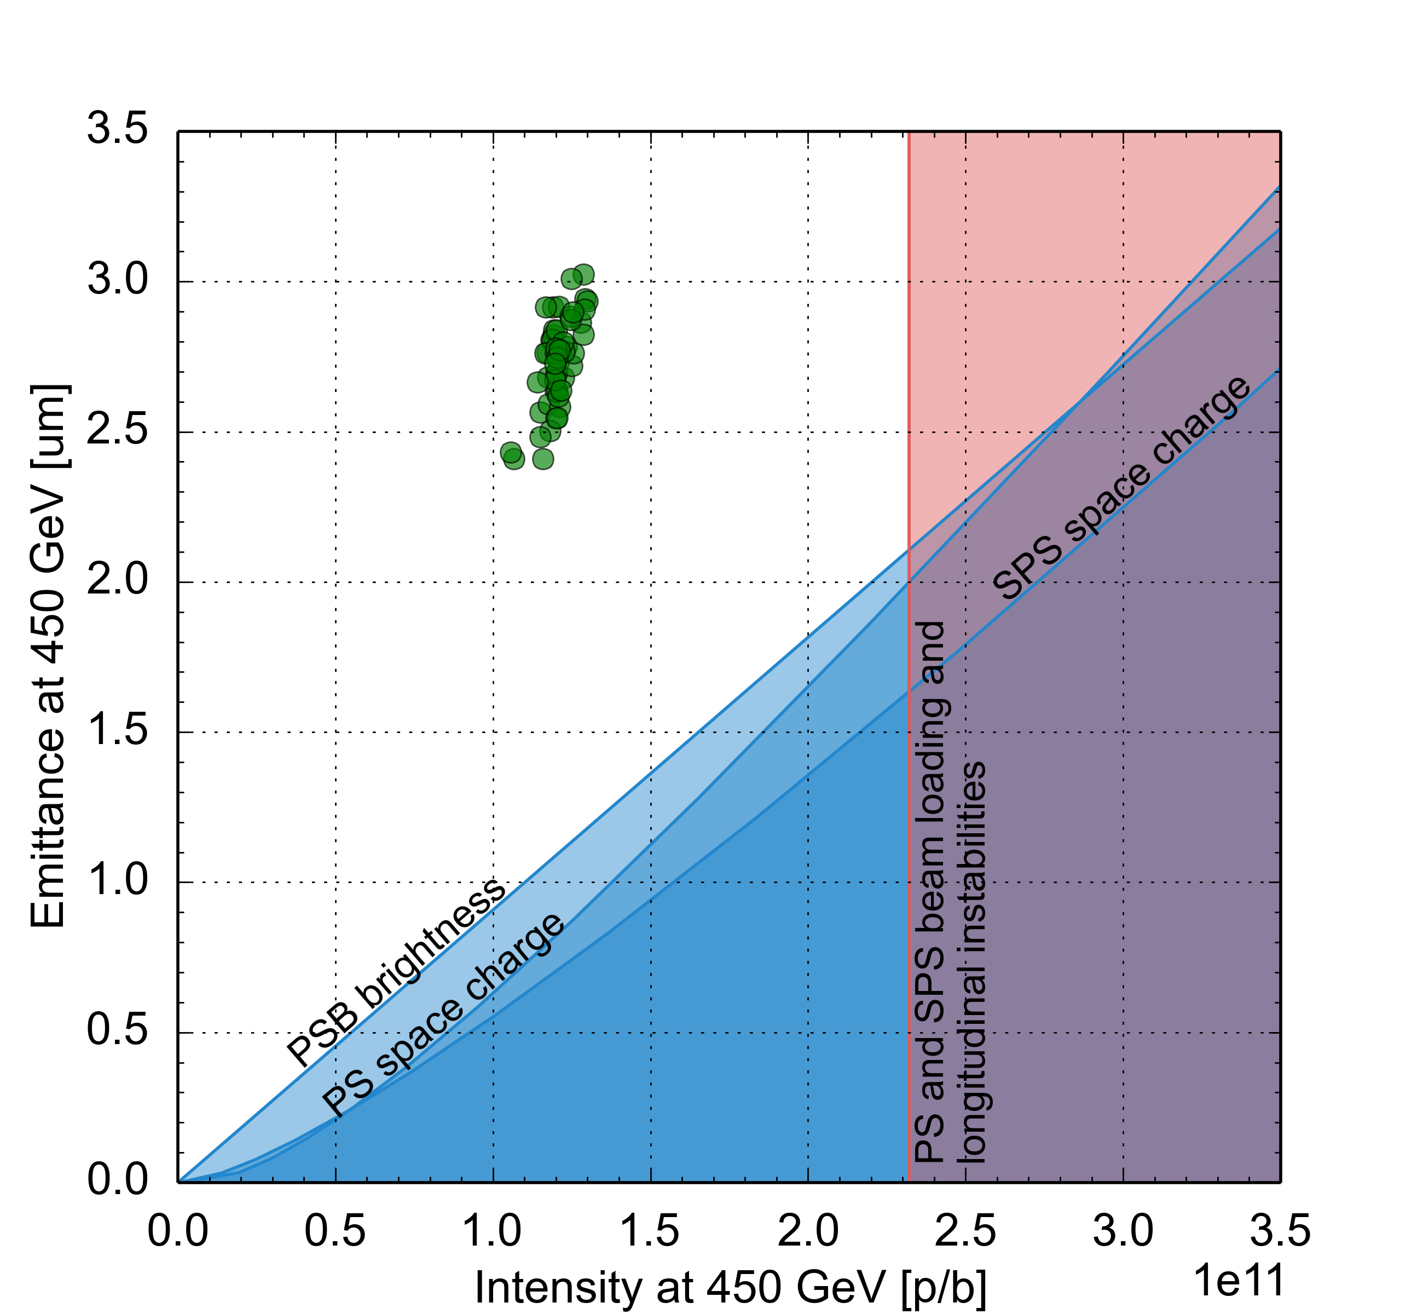
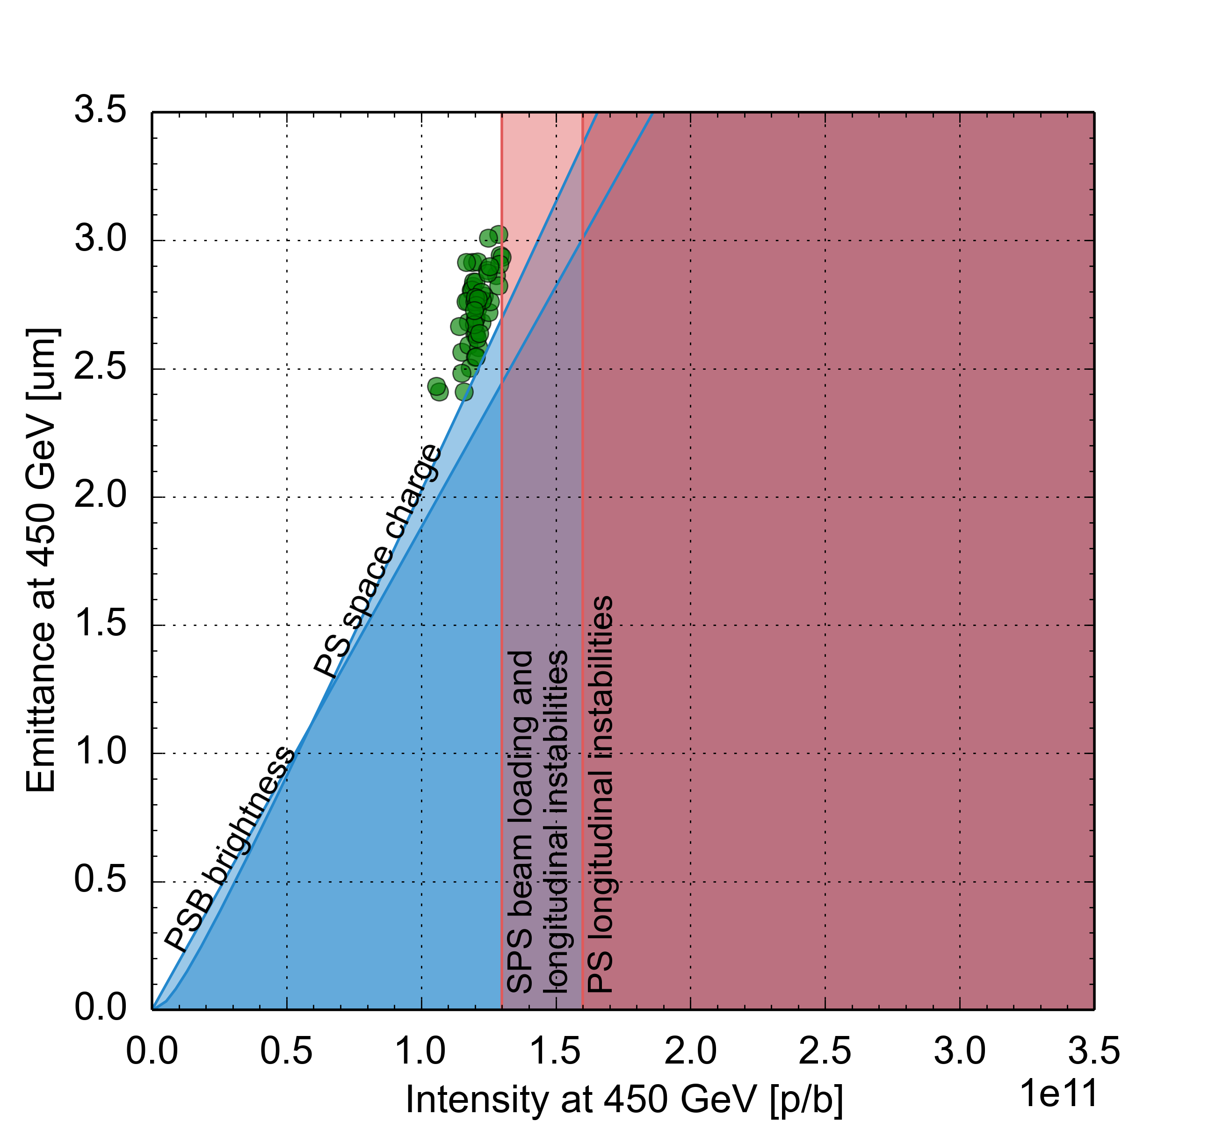
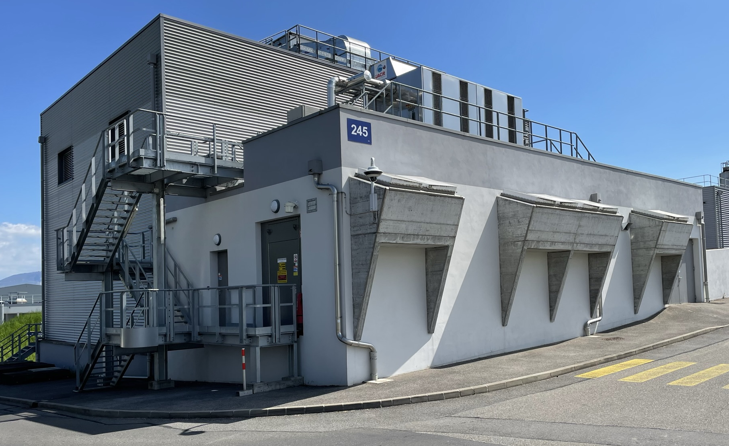
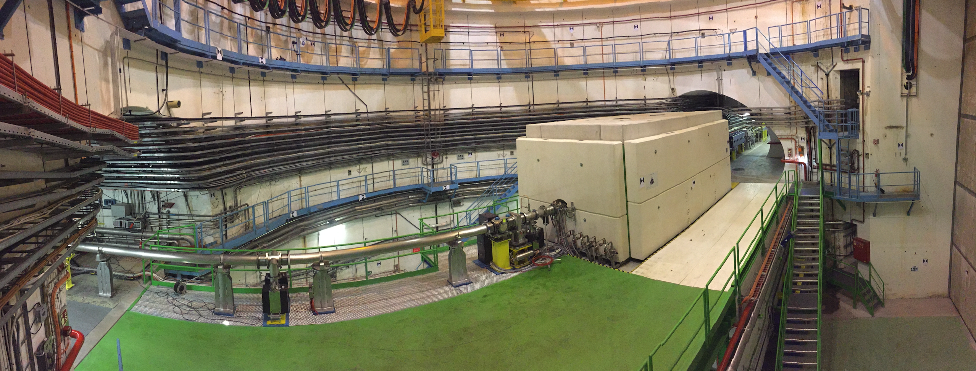
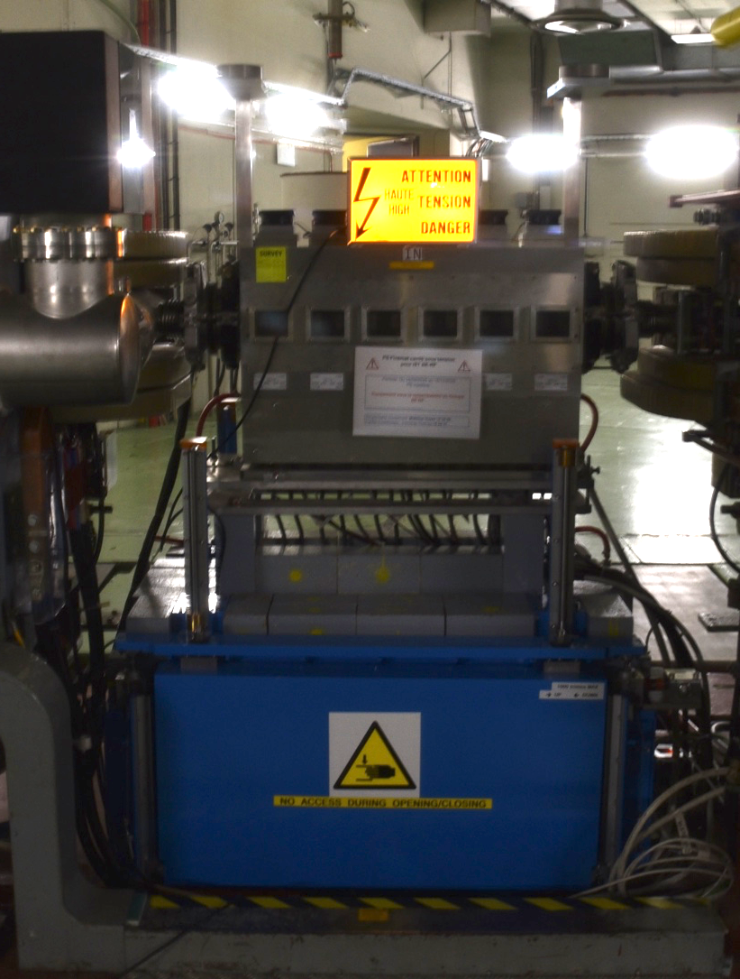
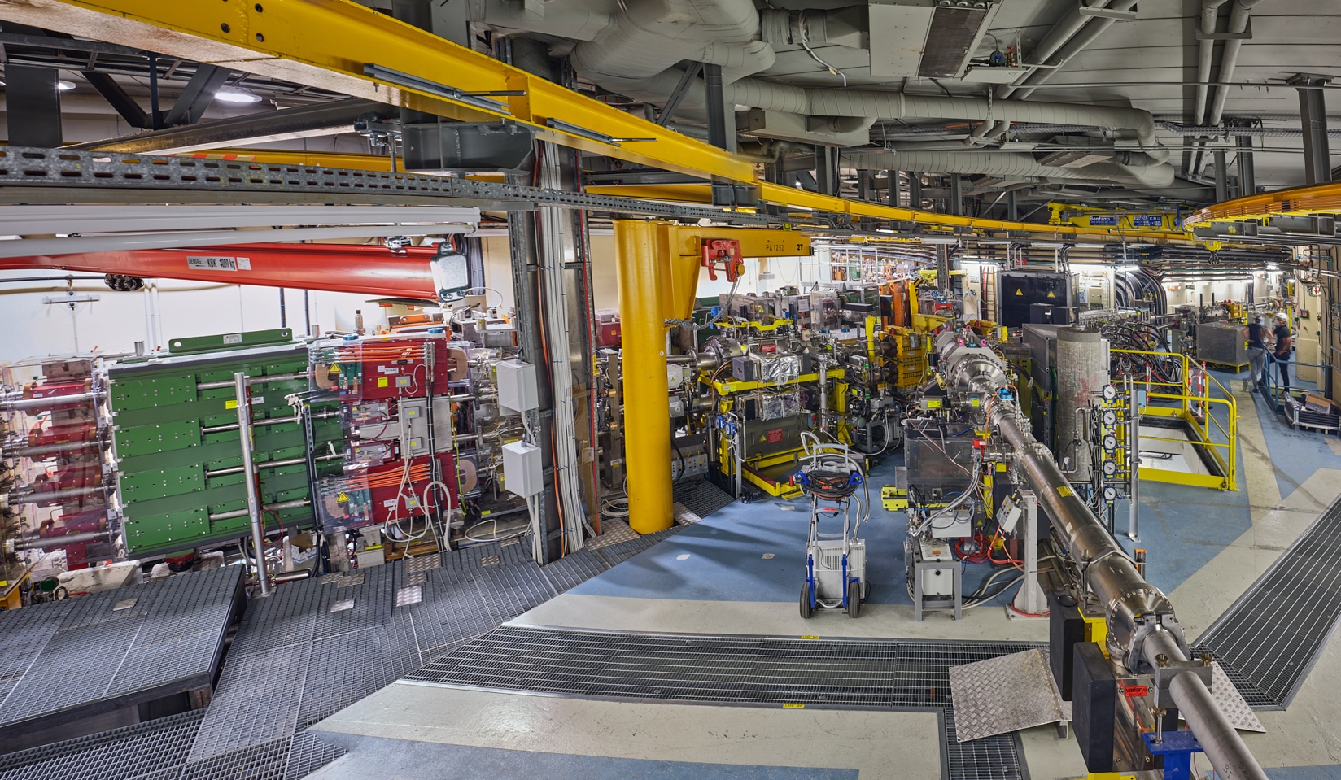
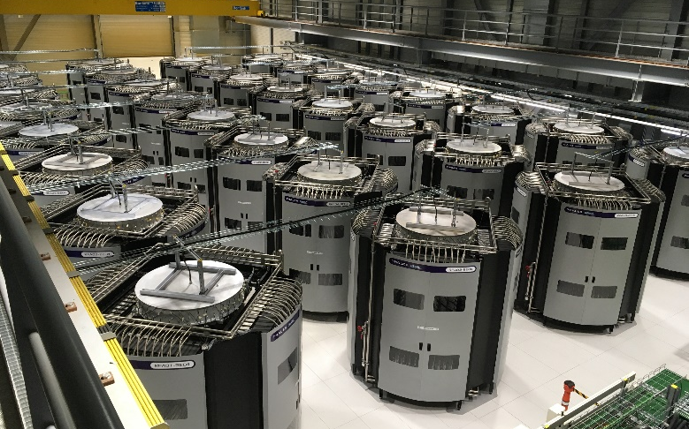
Route to high hadron brightness: LIU (LHC injector upgrade)
Connection of PSB to Linac4 and acceleration to 2 GeV in PSB
PS & SPS RF upgrades + e-cloud & impedance reduction, new SPS optics, new dumps & stoppers,…
New SPS beam dump
PSB new power supply building
PS longitudinal damper
PSB injection Line from Linac4
New SPS RF amplifier towers
G. Rumolo et al., HB 2023

Slide 19
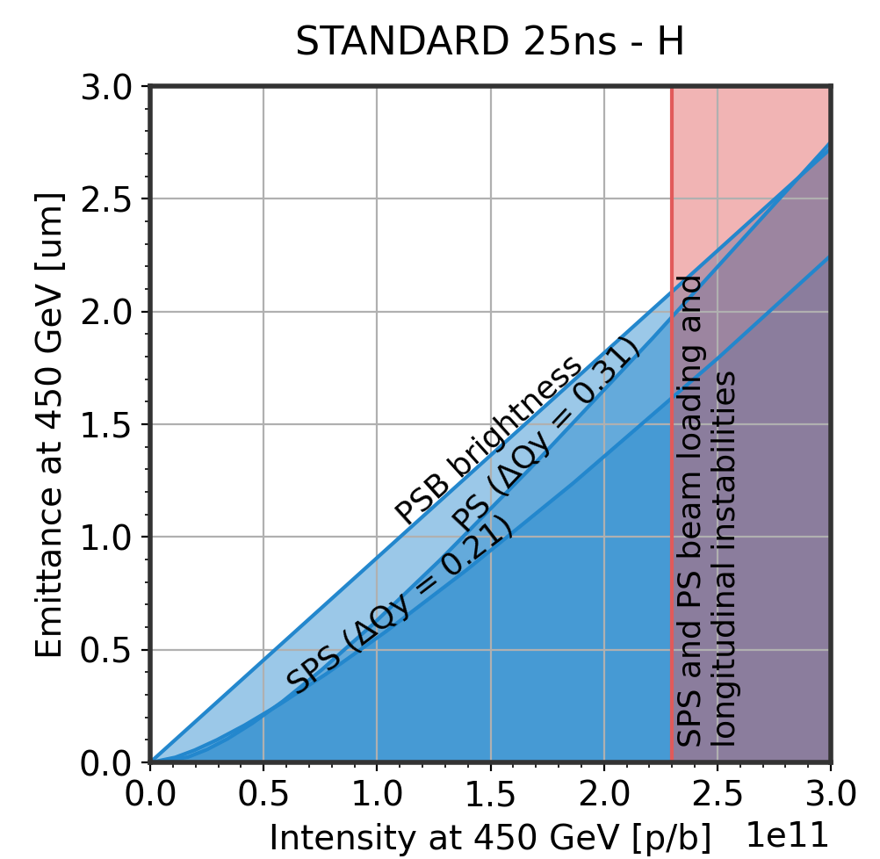
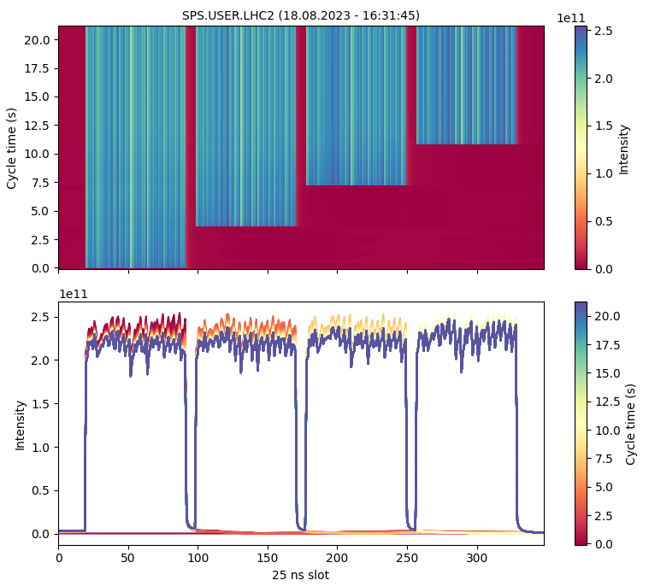
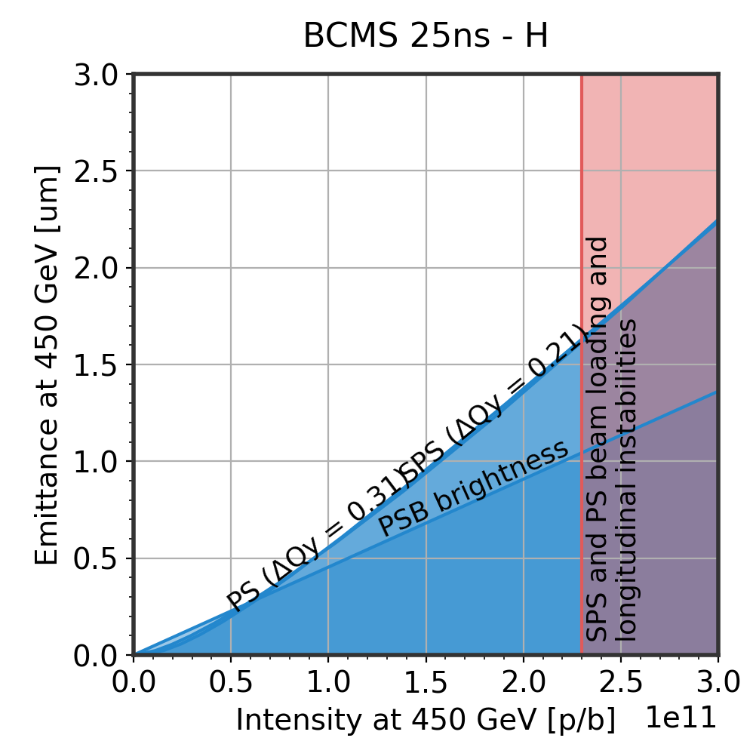
LIU achievement
LIU beam intensity reached during scrubbing run (e-cloud)
Established ~LIU parameters, repeatedly, with 25 ns standard @ 4 x 72 bunches and with BCMS @ 5 x 48 bunches
I_{FB} = 2.3e11; eps_{avg} = 1.9 um
H. Bartosik, K. Li, G. Rumolo et al.
I_{FB} = 2.3e11; eps_{avg} = 1.5 um

Slide 20
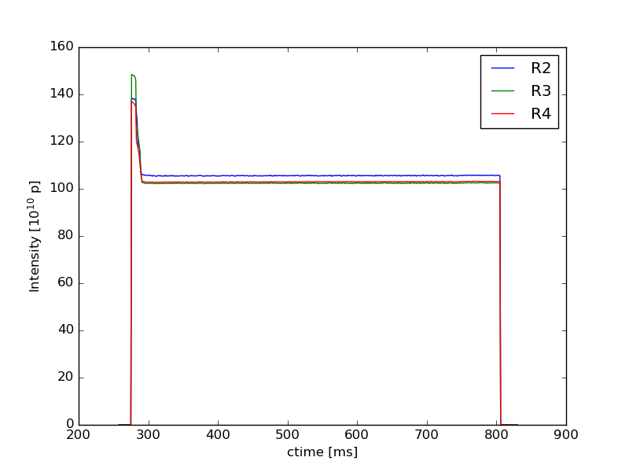
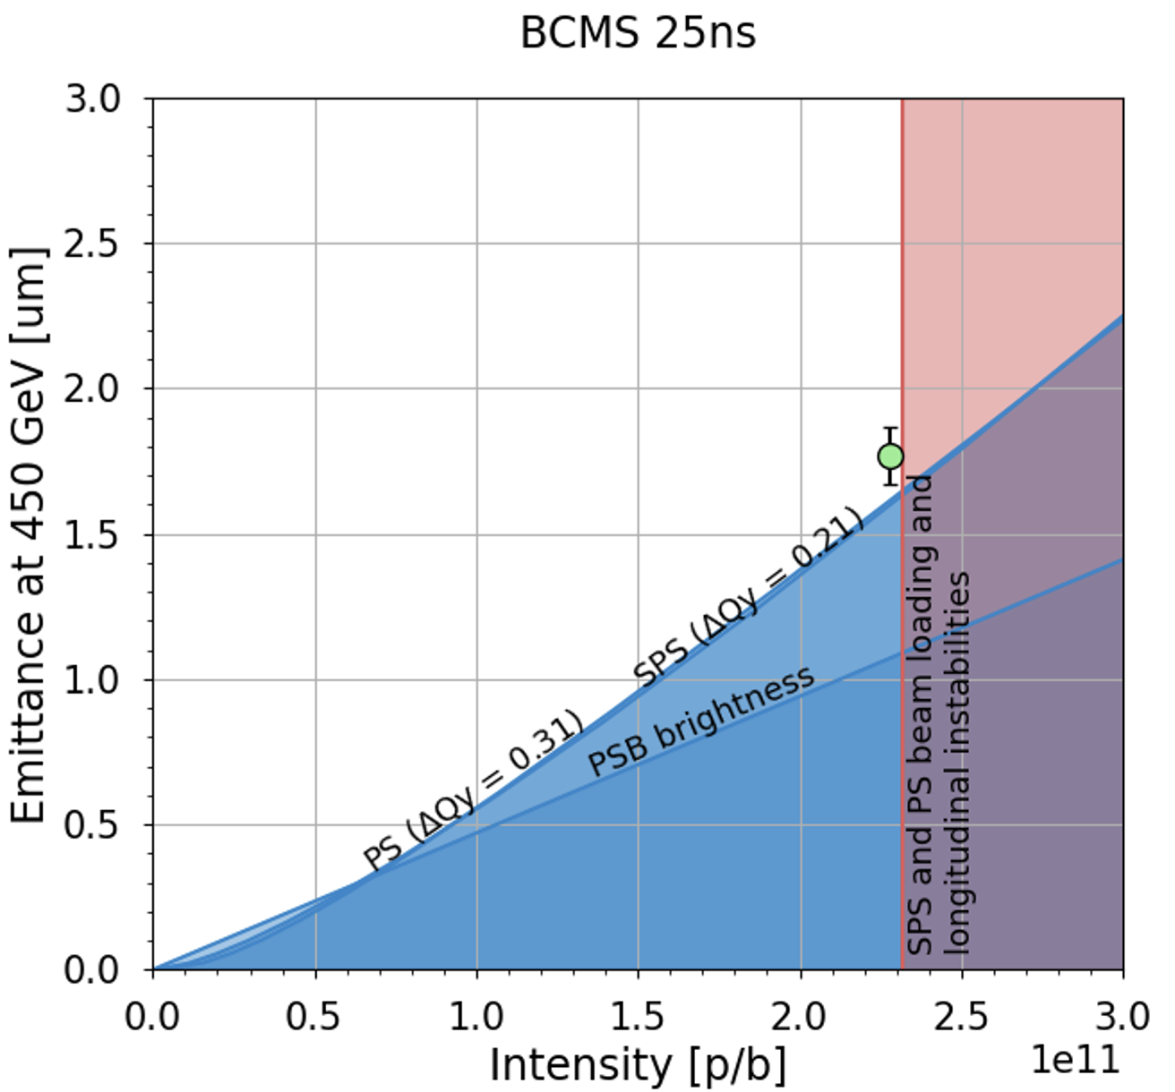
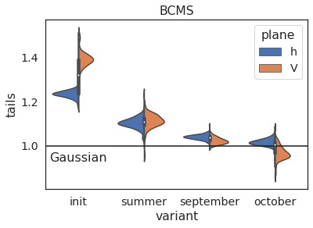
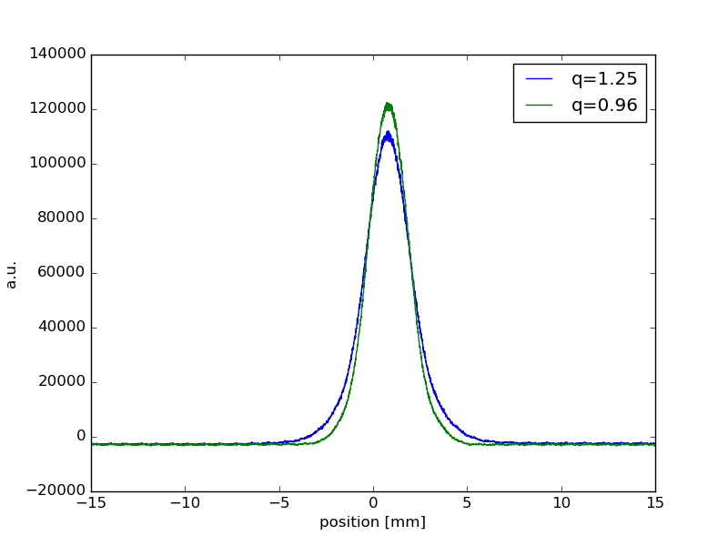
LHC brightness towards HL-LHC
LHC beam quality optimization along injector chain for increasing brightness and reducing losses
PSB
Introduced transverse scraping at low energy to maintain Gaussian profiles
PS
Working point optimization, around transition crossing, to maintain Gaussian profiles along the year
SPS
Working point optimization and Laslett correction to push brightness → ~LIU BCMS target
After scraping
H. Bartosik, G. Rumolo et al.

Slide 21
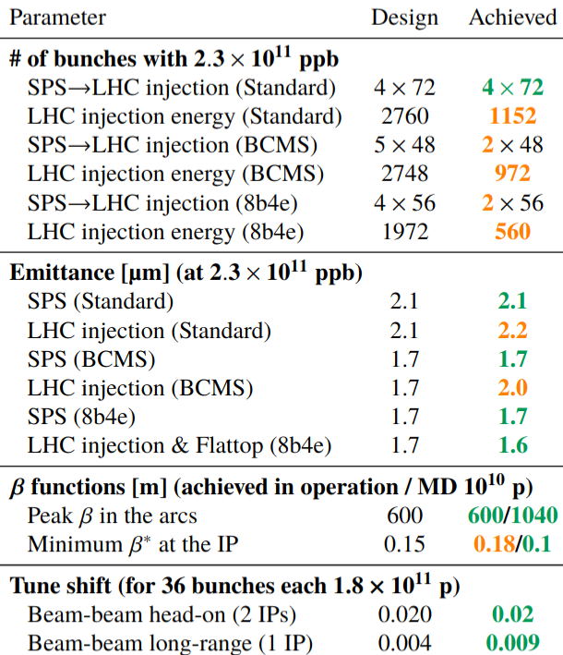
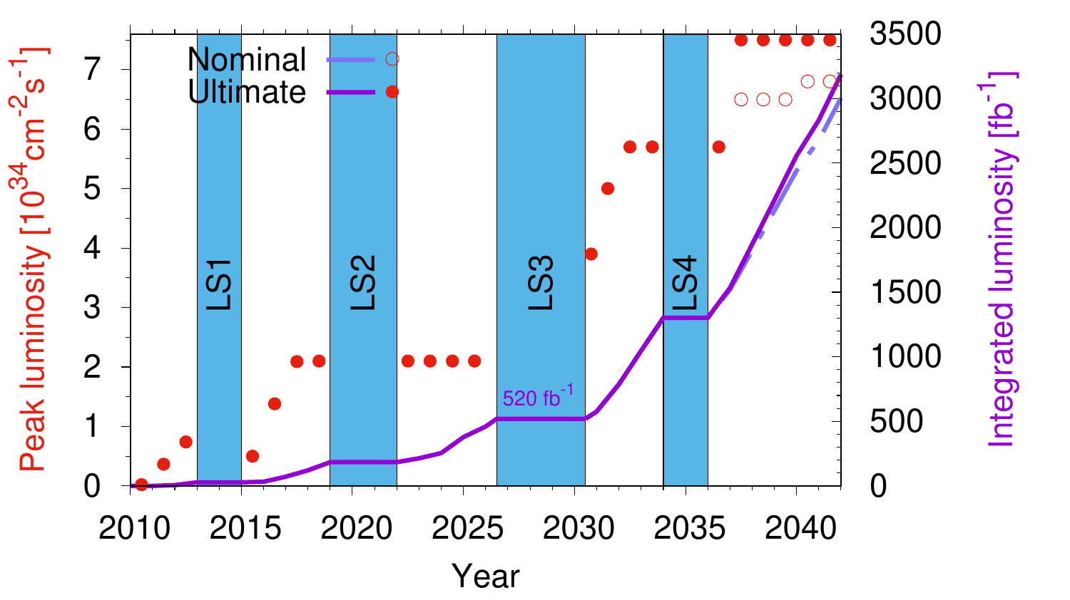
Experimental status of HL parameters
Experimental status of HL parameters
HL-LHC new baseline

Slide 22
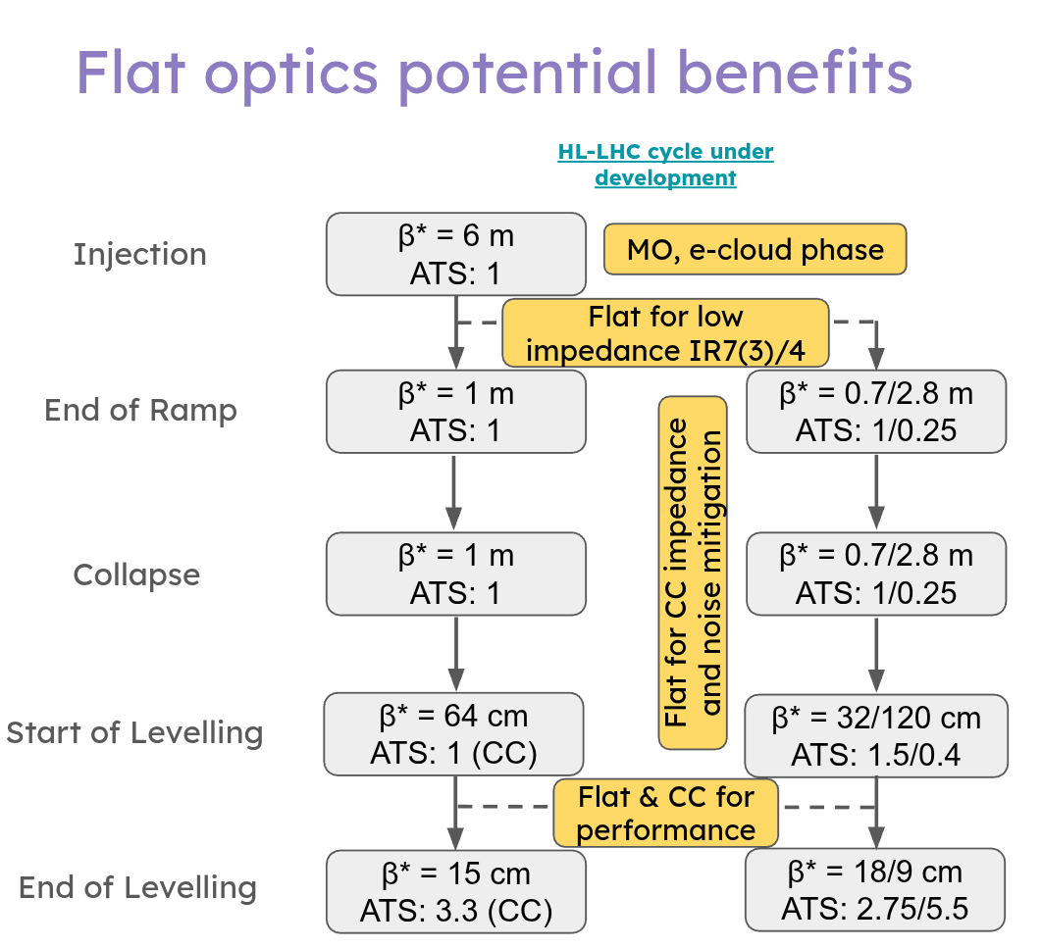
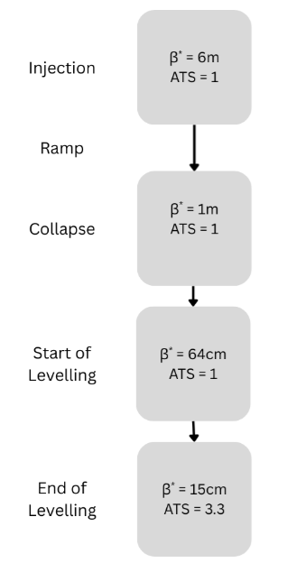
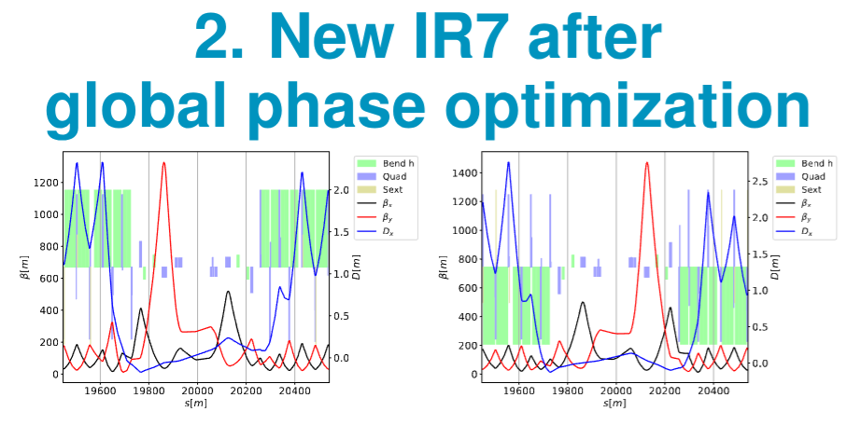
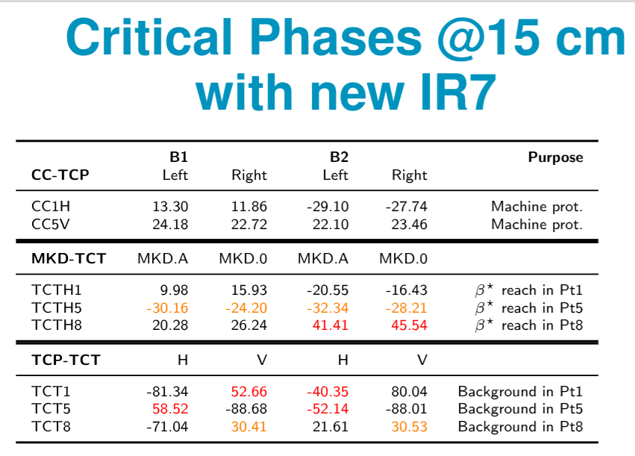
HL-LHC optics cycle
Round Optics baseline

Slide 23
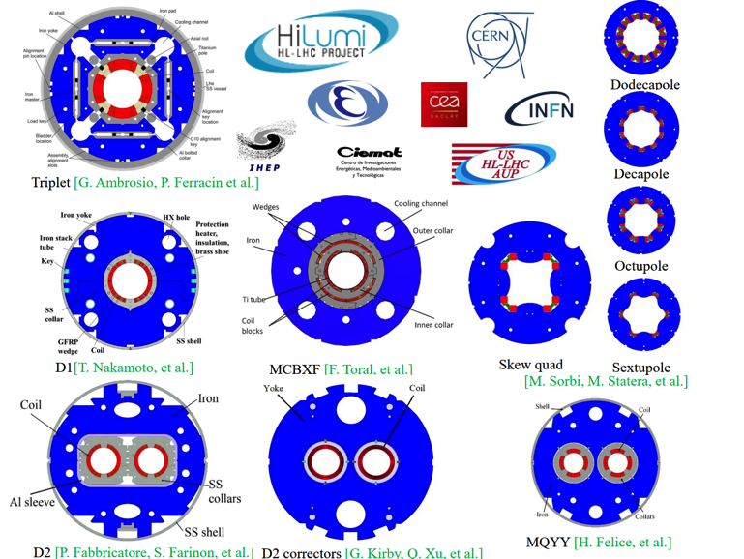
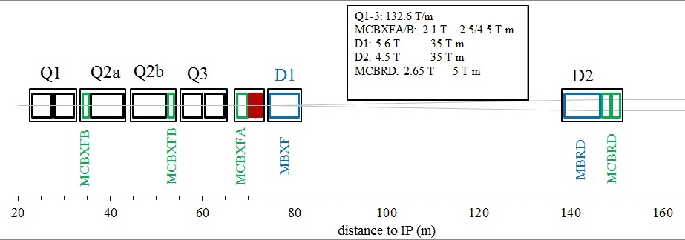
HL-LHC magnet types
Design, engineering, construction, test and installation the Insertion Region (IR) magnets of IR1 and IR5 for the HL-LHC upgrade.
  Q1/Q3 cryoassemblies: from AUP (US)
  Q2: from CERN
  MCBXF nested corrector magnets: from CIEMAT (Spain)
  HO corrector magnets: from INFN-LASA (Italy)
  D1 cold masses: from KEK (Japan)
  D2 magnets: from INFN-Ge (Italy)
  D2 corrector magnets: from IHEP (China)
  Interconnection modules DCM/DQM: from CERN
Refurbishment LHC Q4, Q5 and Q10 during LS3

Slide 24
Limitations: Beam-beam effect
E/M interaction due to crossing of two beams in collision point (head-on) but also while separated in common beam pipe (long-range) induces
Long-range
head-on
Notes:
Tabor 53-54

Slide 25
Limitations: Beam-beam effect
E/M interaction due to crossing of two beams in collision point (head-on) but also while separated in common beam pipe (long-range) induces
  Coherent instabilities
  Incoherent effects, i.e. beam losses and slow emittance growth
Long-range
head-on
Notes:
Tabor 53-54

Slide 26
Limitations: Beam-beam effect
E/M interaction due to crossing of two beams in collision point (head-on) but also while separated in common beam pipe (long-range) induces
  Coherent instabilities
  Incoherent effects, i.e. beam losses and slow emittance growth
Mitigation methods
  non-linear magnets, e-lenses, DC wires and crab cavities
Long-range
head-on
Notes:
Tabor 53-54

Slide 27
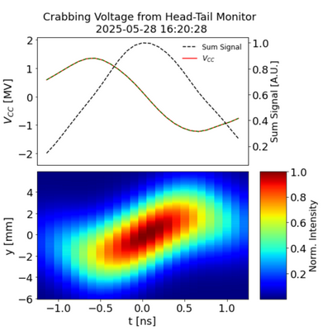

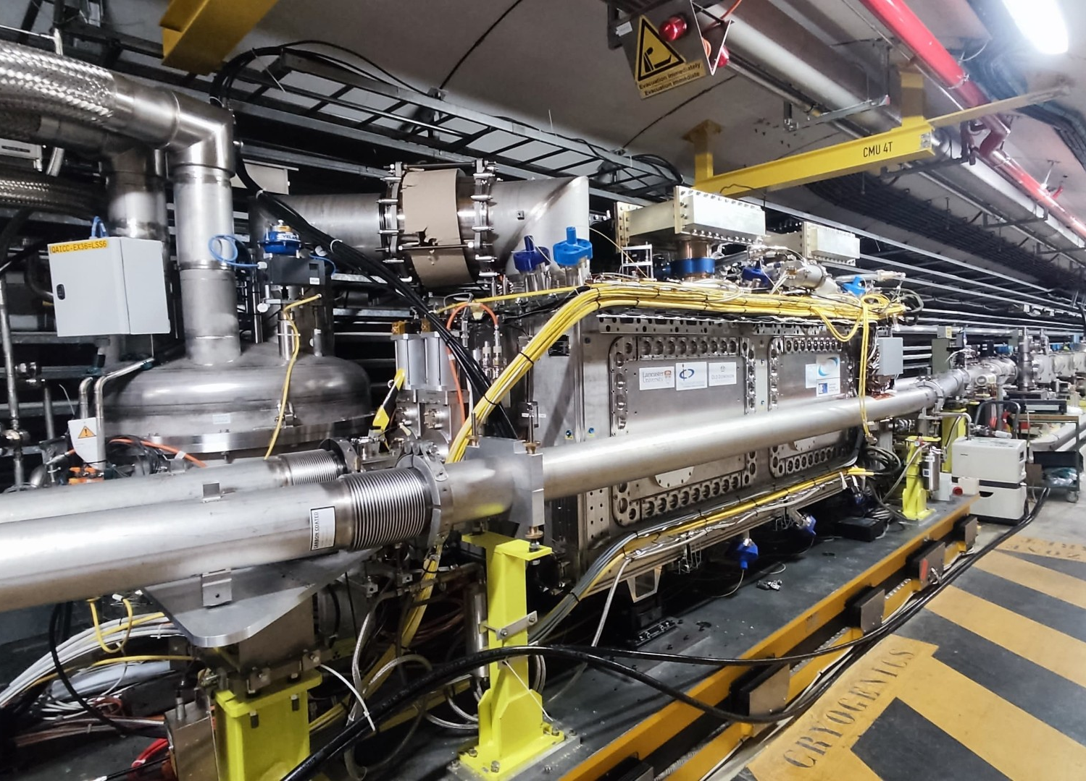
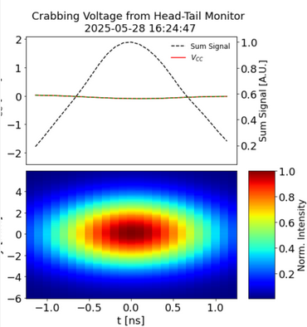
Crab Cavities
Tilt beams longitudinally for increasing overlap with crab cavities
CC tests in the SPS demonstrated crabbing with protons – for the first time !
Notes:
Tabor 53-54

Slide 28
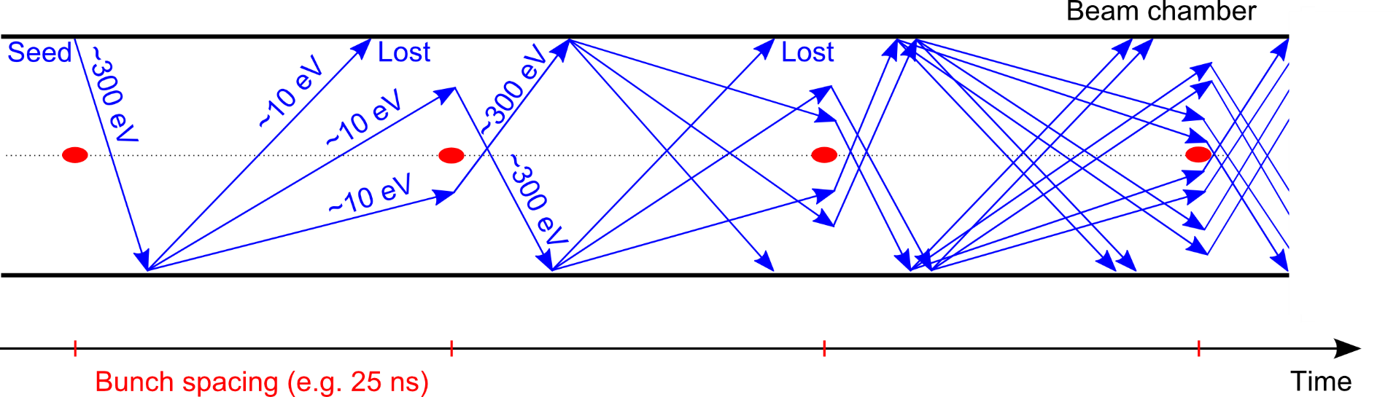
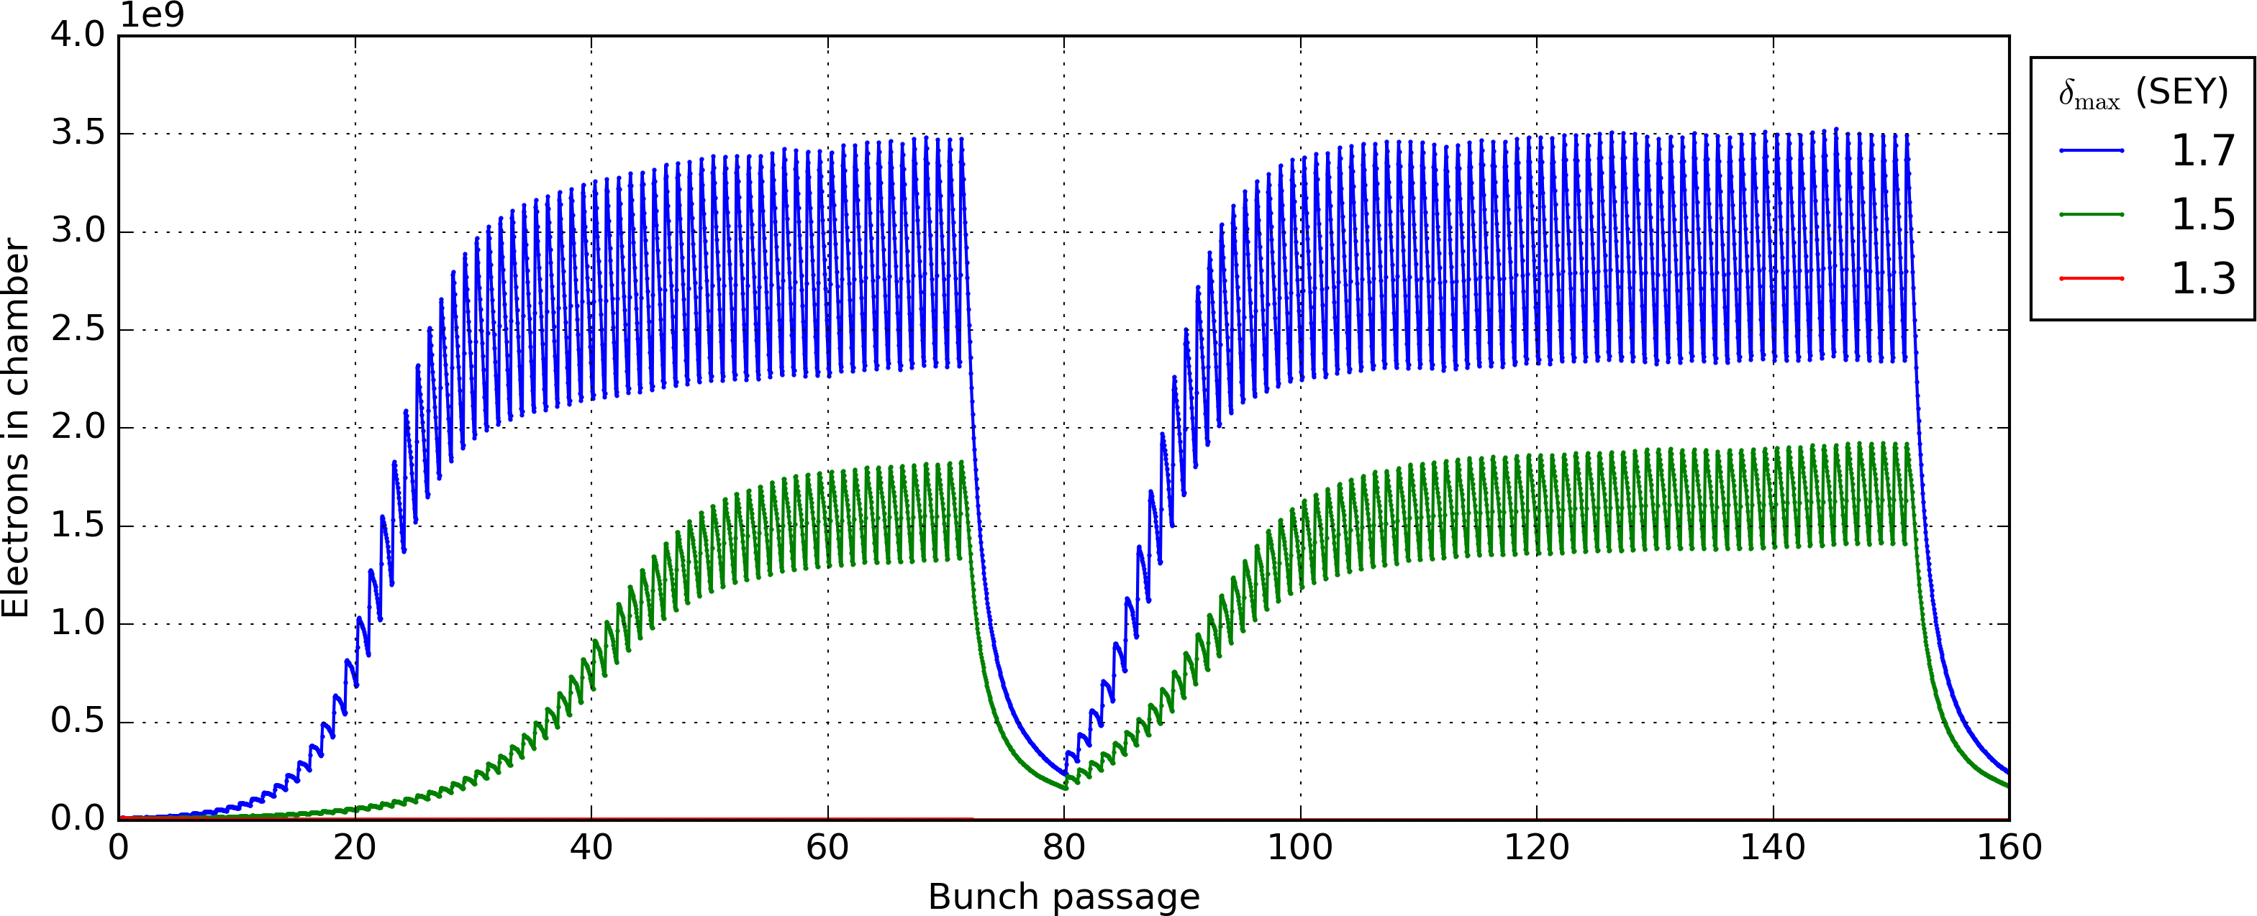
Limitations: e-cloud
Generation of charged particles inside the vacuum chamber
(primary, or seed, electrons)
Acceleration of primary electrons in the beam field
Secondary electron production when hitting the wall
Avalanche electron multiplication if SEY > 1
Notes:
Tabor 53-54

Slide 29
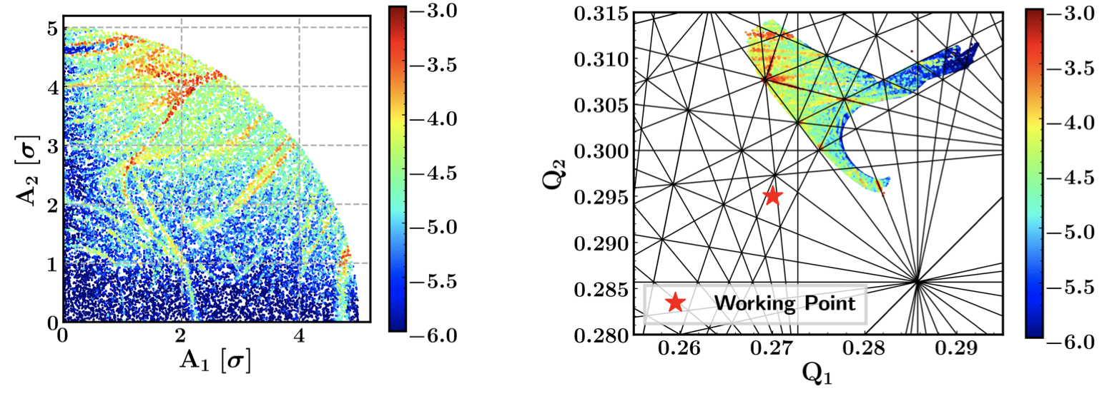
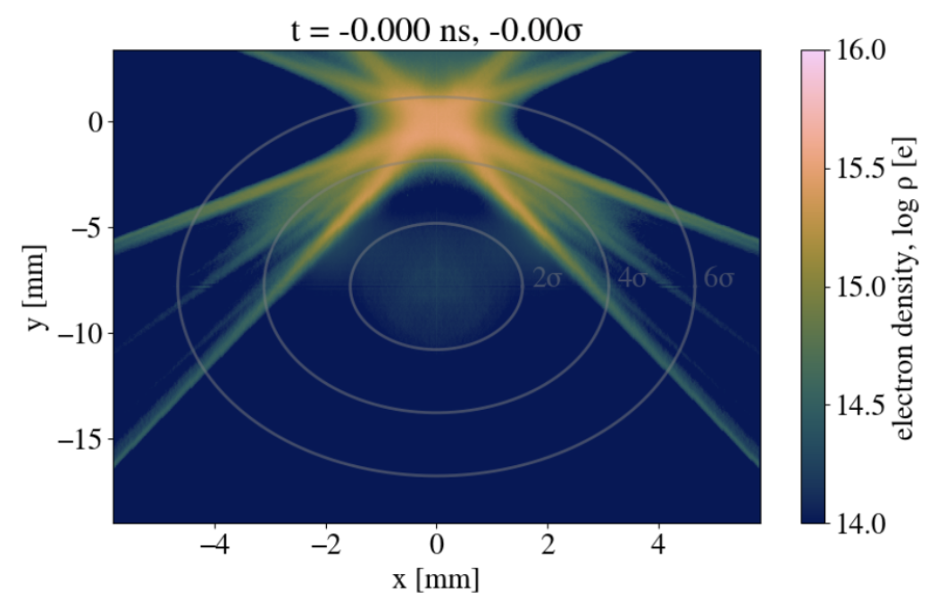
Limitations: e-cloud
Generation of charged particles inside the vacuum chamber
(primary, or seed, electrons)
Coherent instabilities
Incoherent effects, i.e. beam losses and slow emittance growth
Acceleration of primary electrons in the beam field
Secondary electron production when hitting the wall
Avalanche electron multiplication if SEY > 1
Effective electron cloud in triplets
Notes:
Tabor 53-54

Slide 30
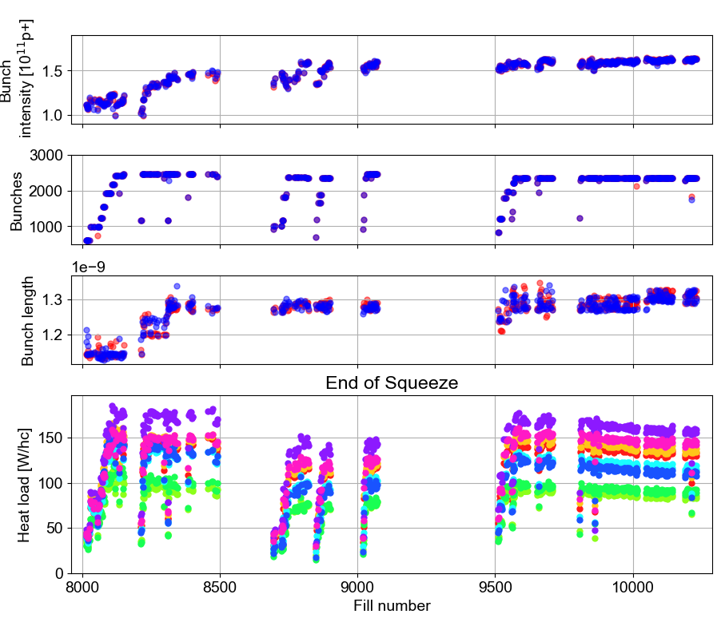
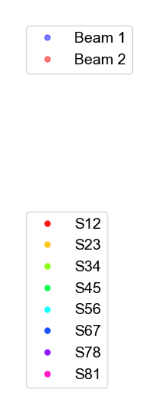
Limitations: e-cloud
Coherent instabilities
Incoherent effects, i.e. beam losses and slow emittance growth
Pressure rise, heat load
Mitigation methods
  Non-linear magnets, bunch spacing increase/variation, coatings, scrubbing
5x48b
5x36b
Hybrid 36b
3x48b
3x36b
2022
2023
2024
Notes:
Tabor 53-54

Slide 31
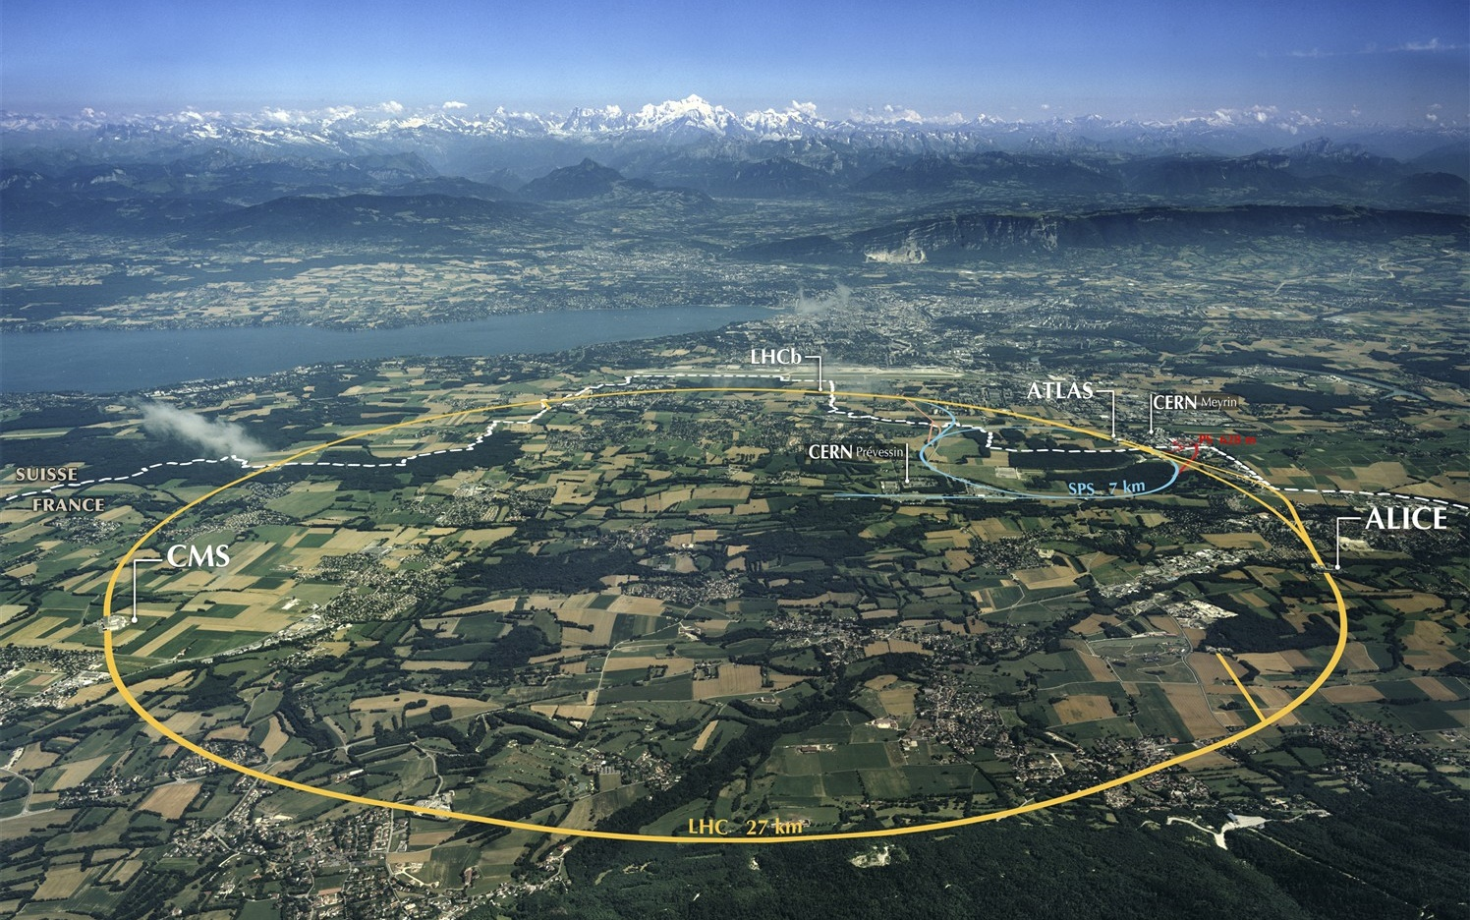
Beam Screen Treatment in LHC arcs
Issue
Non-uniform heat load in LHC arcs, degradation observed following each Long Shutdown
Origin
Presence of CuO oxide and reduced carbon concentration at beam screen surface
→ reduced conditioning efficiency
→ Secondary Electron Yield > e-cloud threshold
Mitigation strategy
Deposit a thin amorphous carbon layer on the beam screens of 120 selected arc half-cells
→ recover conditioning efficiency
→ ensure surface robustness against ventings (LS)
In. Triplets IP2/8
In-situ
190 m total
In. Triplets IP1/5
Ex-situ
320 m total
Matching sections
Ex-situ, in magnet
20 m total
Arcs
In-situ
≈ 12 km total
BST
31
Notes:
Tabor 53-54

Slide 32
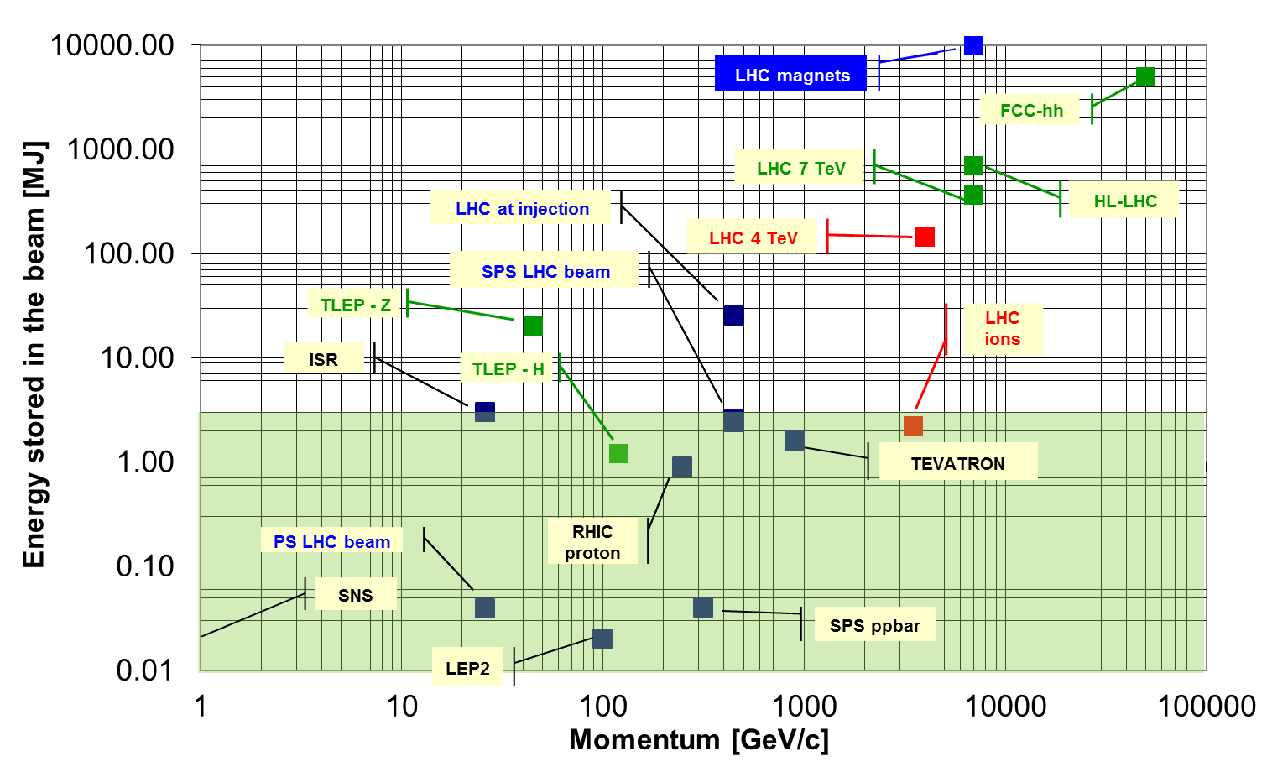
Stored energy
S. Redaelli, CAS2024
Notes:
Tabor 53-54

Slide 33



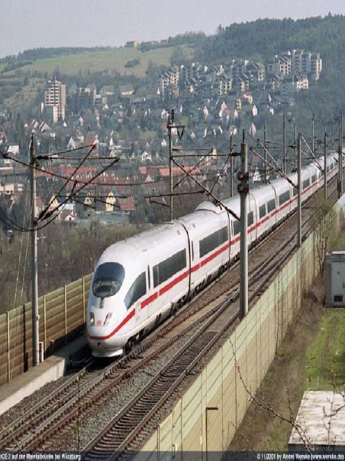
Stored energy
90kg of TNT
8L of gasoline
200m train @ 155 km/h
15kg of chocolate
S. Redaelli, CAS2024
Notes:
Tabor 53-54

Slide 34
LHC multi-stage collimation
Multi-stage collimator system
Total of 118 two-sided collimators
S. Redaelli, CAS2024
Notes:
Tabor 53-54

Slide 35
LHC multi-stage collimation
Multi-stage collimator system
Total of 118 two-sided collimators
S. Redaelli, CAS2024
Loss maps achieving a few 10⁻⁵efficiency
Notes:
Tabor 53-54

Slide 36
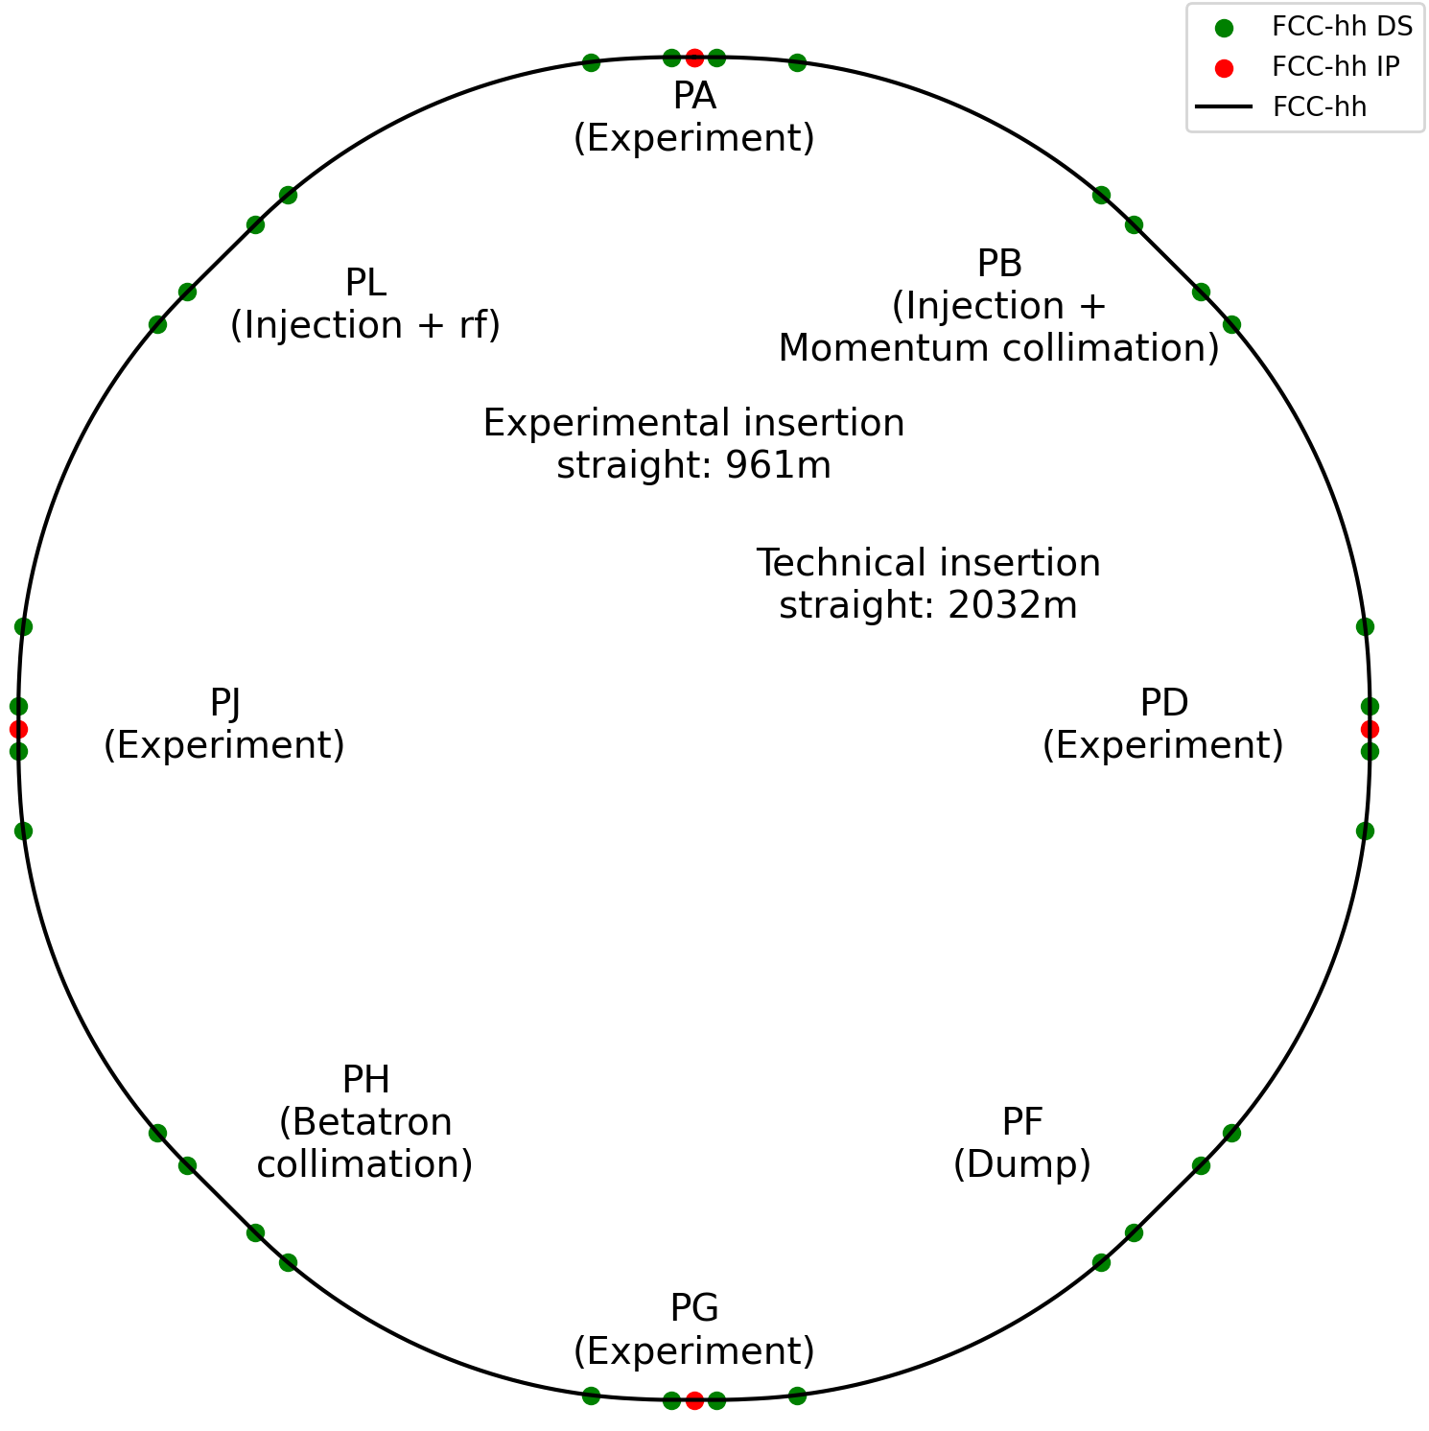
FCC-hh: from CDR to current baseline
  Main geometrical differences:
  Circumference length
  Straight section length
  Arc length
  Symmetry of experimental insertions
  Transverse position of interaction points
  Functional organisation of straight sections
Circumference: 97.75 km
Circumference: 90.66 km
Parameter | Value
CoM energy [TeV] | 84.6 – 120.8
Dipole field [T] | 14 (Nb₃Sn/HTS) - 20 (HTS)
Dipole length [m] | 14.187
Number of dipoles | 4464
Circumference [km] | 90.657
Maximized dipole filling factor to maximize collision energy
M. Giovannozzi, et al.
Notes:
Tabor 53-54

Slide 37
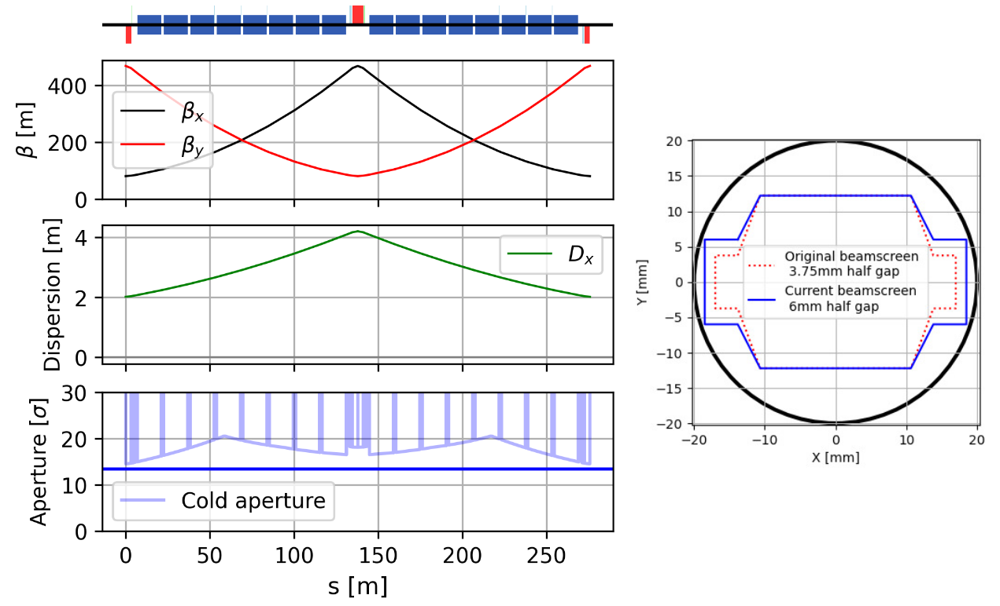
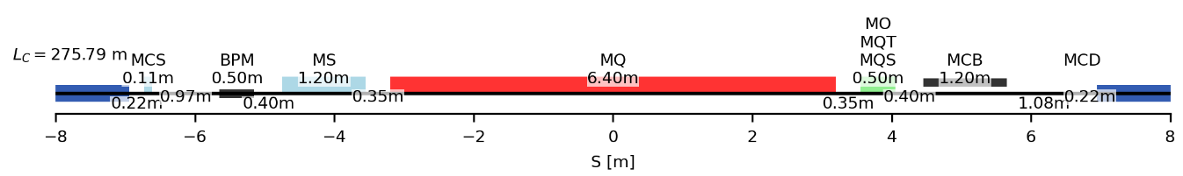
Regular arc cell of FCChh
Parameter | CDR cell 12-dipole | 12-dipole | 16-dipole
Number of dipoles | 4668 | 4288 | 4464
Cell length [m] | 213.030 | 213.030 | 275.792
Circumference [km] | 97.75 | 90.657 | 90.657
CoM energy @14 T [TeV] | 88.48 | 81.28 | 84.61
~275m
Short Straight Section
M. Giovannozzi | FCC-hh studies: improving and ensuring continued compatibility with FCC-ee
M. Giovannozzi, et al.
Notes:
Tabor 53-54

Slide 38
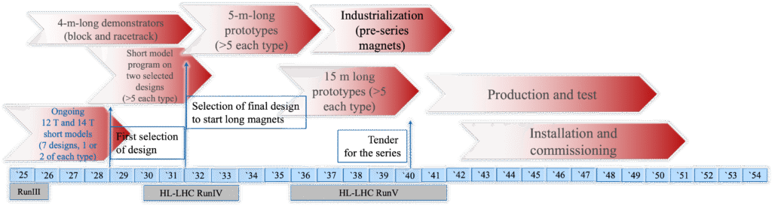
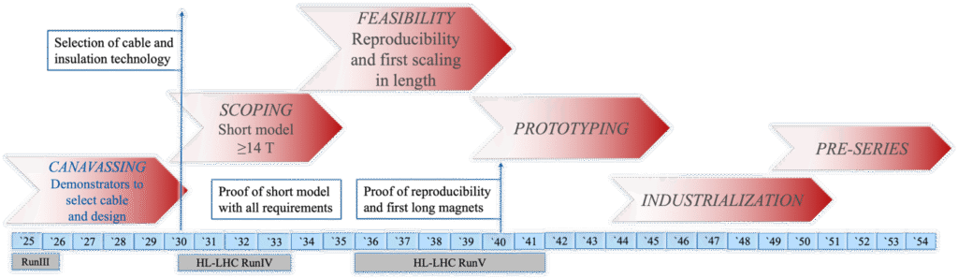
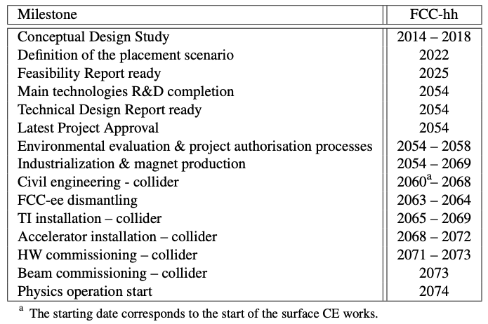
High-field magnets for FCChh
Development of Nb₃Sn magnets
Development of HTS magnets
Full compatibility of the HFM activities with the FCC-hh schedule.
M. Giovannozzi,, E. Todesco, et al.
Notes:
Tabor 53-54

Slide 39
e⁺e⁻ Colliders

Slide 40


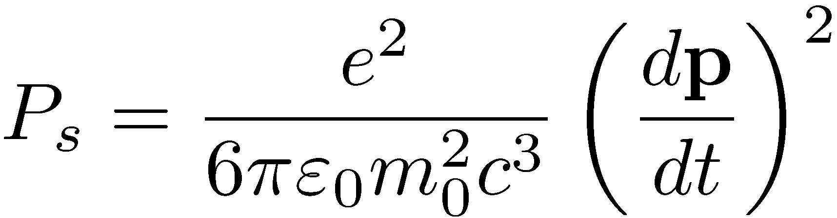


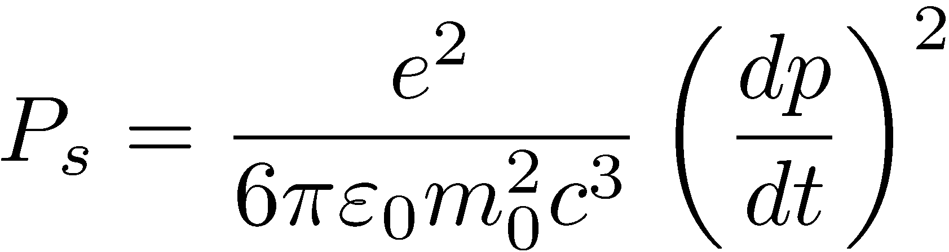

Synchrotron Radiation power
Larmor Power radiated by non-relativistic particles is very small
Power radiated by relativistic particles in linear accelerators is negligible
Power radiated by relativistic particles in circular accelerators is very strong (Liénard, 1898)

Slide 41

SR impact on colliders
Inversely proportional to 4th power of rest mass (e- mass ~2e3 x p mass), proportional to 4th power of energy, inversely proportional to 2nd power of bending radius
For multi TeV hadron colliders (LHC, FCChh) handling of SR still important (protection of SC magnets with beam screens)
Energy loss per turn obtained by integral of power over one revolution
ESRF storage ring (ESB, 6GeV): ~2.5 MeV/turn.
LEPII (120 GeV): ~6 GeV/turn, or FCCee (ttbar flavor at 175 GeV): 7.5GeV/turn
Circular e+/e- machines of ~100s GeV quite demanding with respect to RF power (and extremely long)

Slide 42
e⁺e⁻ colliders flavors
High-luminosity frontier
  Factories, high precision physics measurements

Slide 43
e⁺e⁻ colliders flavors
High-luminosity frontier
  Factories, high precision physics measurements
High-energy frontier
  Discovery measurements
  Before Higgs discovery
    LEP2 last large circular high-energy collider (120 GeV)
    Linear colliders (ILC, CLIC) considered for future (0.5 to 1.5 TeV)
  After Higgs discovery at 126 GeV
    Large circular colliders re-considered (FCCee, CEPC)
    Integrated programs from Z up to the top, with integrated programs

Slide 44
Beam-beam tune shift
Beam-beam tune-shift, i.e. 1st order approximation to betatron tune change
The luminosity becomes
For flat beams and
Horizontal tune-shift and vertical
one
Luminosity becomes

Slide 45
SuperKEKb luminosity
e+

Slide 46

FCCee key concepts
Very large 90.7 km circumference electron-positron collider to reach high luminosity (Z) and energy (top) with 4 IPs
  Reuse of tunnel for hadron collider
50 MW SR power per beam
  Main driver for beam intensity
Two separated rings for e+ and e-
  Large crossing angle of 30 mrad
Small equilibrium emittances reached with large tunes
  Different optics depending on energy
Top-up injection
  Full energy booster sharing tunnel with collider
Injector complex
  Linacs, positron conversion target, damping ring, transfer lines …
Many similarities with CEPC

Slide 47













Key concepts for e+/e-
Nano-Beam Scheme
P. Raimondi
Crab-Waist Scheme
$$β_{y}$$
"waist"
$$Δψ_{x}=πΔψ_{y}=π/2$$
$2\frac{σ_{x}^{∗}}{(θ_{c}/2)}$
< Focal Depth ($β_{y}^{∗}$)
Collision Region
$$σ_{z}θ_{c}$$
/2
Effectively Very Short Bunch $→$ "Hourglass"
Waist moves to
the opposite beam center.
e+
"Head-On Collision"
Suppression of Betatron Resonance
$$<1mm$$
$σ_{z}$ = 6 mm
SuperKEKB
Related to Beam-Beam Interaction
Key: Large Crossing Angle with Low $ε_{x}$
Key: Strong Sextupoles with Specific Optics
CW OFF
CW ON
D. Zhou, et al.

Slide 48


Beam-Beam Effect driving parameters
  Luminosity $L=\frac{γ}{2e r_{e}} \frac{I_{tot}{ ξ}_{y}}{β_{y}^{∗}} R_{G}$
    $R_{G}$ a geometric reduction factor
    Total intensity $I_{tot}$ given by SR power, assuming absence of other intensity limitations
    Maximized with large beam-beam tune shift $ξ_{y}$
      At Z mode $ξ_{y}=0.09$ per IP (compared with $ξ_{y}=0.045$ per IP achieved at Z energy in LEP)
    Maximized with small $β_{y}^{∗}≈1 \text{mm}$ creating
    challenges for lattice design
      Strong chromatic aberrations to be
      corrected locally
      Small Dynamic Aperture (DA) require
      small emittances
      For Z mode with “nano-beam” scheme
      Small peak bunch current
      Large number of long bunches required
      for large $I_{tot}$
      Maximum number of bunches limited
      by e-cloud build-up
  ”Nano-beam” collision scheme
    Kind of ribbons at the interaction point
    Only fraction of bunch interacts with opposite bunch at a given moment (large Piwinski angle)
C. Carli et al.
48

Slide 49

Minimum vertical beam size
R. Tomas

Slide 50


Other two-beam effects
  Beam-strahlung, i.e. SR due to field of opposing bunches, potential limitation
    Increase of equilibrium momentum spread and bunch length (beneficial at low energy)
    Interception of hard beam-strahlung photons challenging
  Limitations from beam-beam effects
    Synchro-horizontal betatron resonance and instability constraining synchrotron and horizontal tunes
  Flip-flop mechanism
    Low (high) intensity bunch with more (less) perturbation
    Asymmetric effect on bunches
R. Soos
1.05 N₀
0.95N₀
lower due to asymmetric setup
0.95N₀
N₀
50
P. Kicsiny

Slide 51



Vacuum system for SR absorption
  SR Absorbers (SRAs) intercept photons with 50 MW total power per beam
    Challenge to absorb power deposit on SRAs
    Optimized for high efficiency to limit generation of photo-electrons (e-cloud)
    At high beam energies, generation of neutrons
      Absorbed as much as possible by lead blocks inside magnet
      Residual radiation in tunnels
SR fan
SR fan
Beam
Beam
51

Slide 52

CEPC as a Higgs factory
J. Gao et al.
52

Slide 53

Compact Linear Collider - CLIC
Baseline
  √s = 380 GeV, 2 IPs
  Main Linac length: 11.4 km
  Option for 550 GeV: +5 km from start
  Using drive beam for increasing RF efficiency a@ high gradient (copper cavities)
Positives
• Polarization • Above ttbar threshold • Compact footprint, staged spending profile • Mature technology demonstrated at CTF3
Upgrade to 1.5 TeV
  After ~10 years at 380 GeV
  Tunnel length extended to 29.6 km
  New high-gradient (100 MV/m) modules added
  One IP (with push-pool detectors), two IPs with higher rep. rate
S. Stapnes, et al.
53

Slide 54

Linear collider facility - LCF
Baseline
  √s = 250 GeV, 2 IPs
  Total length: 33.5 km
  Phased through Low power (LP) to Full power (FP)
Upgrade to 550 GeV
  After ~10 years at 250 GeV
  Requires a 2-year long shutdown, installation of additional SRF cryomodules
  No additional Civil Engineering
Positives
• Mature technology (ILC…) • Polarised beams • Staged • Relatively small footprint
J. List, et al.
54

Slide 55

e+/e- colliders performance
Efficiency (≤300–350 GeV): FCC-ee delivers more luminosity per MW, more Higgs for shorter time
Flexibility: FCC-ee can scan 90→240 GeV @ very high luminosity
Polarisation: linear collider baselines include e⁻ polarisation; LCF can add e⁺ polarisation
55

Slide 56





Plasma-wakefield Collider Studies
Since 2023
Since 2024
Since 2025
HALHF
Hybrid, Asymmetric, Linear Higgs Factory
ALiVE
A Linear accelerator for Very high Energies
10 TeV
Design Initiative for a 10 TeV pCM Wakefield Collider
e⁻ acceleration in e⁻ beam–driven plasma wakefields
e⁺ acceleration in radiofrequency cavities (C³ technology)
To make most effective use of space → collision of polarised 375 GeV e⁻ with 42 GeV e⁺
e⁻ and e⁺ acceleration in single stage p⁺ beam-driven plasma wakefields
  Enabled by the energetic and short p⁺ drivers
  p⁺ drivers: high-rep.-rate 500 GeV synchrotron
Technology candidates:
Laser-Driven Plasma Wakefields
Beam-Driven Plasma Wakefields
Structure Wakefields
Collider type:
e⁺e⁻
e⁻e⁻
γγ
Advantages:
+ most advanced wakefield collider concept → avoids e⁺ acceleration in plasma
+ compact footprint, ~5 km
Advantages:
+ avoids staging
+ compact footprint
+ scaling to higher energies (10 TeV)
Goals include delivery of:
+ end-to-end design study report in 2028
+ roadmaps and resource estimates

Slide 57
Plasma-wakefield Collider Challenges
Since 2023
Since 2024
Since 2025
HALHF
Hybrid, Asymmetric, Linear Higgs Factory
ALiVE
A Linear accelerator for Very high Energies
10 TeV
Design Initiative for a 10 TeV pCM Wakefield Collider
Challenges:
High repetition rate plasma operation and cooling, Staging, Production and acceleration of polarized beams, BDS design,…
10-15 years of R&D
ESPP Input #57: HALHF: a hybrid, asymmetric, linear Higgs factory using plasma- and RF-based acceleration (link)
e⁻ and e⁺ acceleration in p⁺ beam-driven plasma wakefields
Single plasma stage per arm!
  Enabled by the energetic and short p⁺ drivers
  p⁺ drivers supplied by high-rep.-rate synchrotron
Challenges:
High power synchrotron, Proton Bunch Compression, Plasma Source Development, Positron Acceleration, Energy Transfer Efficiency, Beam Quality Preservation,…
ESPP Input #210: Proton-Driven Plasma Wakefield Acceleration for Future HEP Colliders (link)
Chosen design constraints:
E_{z,avg} > 500 MeV/m
ℒ/P_{tot} > 10³² cm⁻²s⁻¹ MW⁻¹
ESPP Input #98: Design Initiative for a 10 TeV pCM Wakefield Collider (link)
e⁻ acceleration in e⁻ beam–driven plasma wakefields
e⁺ acceleration in radiofrequency cavities
To make most effective use of space → collision of 375 GeV e⁻ with 42 GeV e⁺
Technology candidates:
Laser-Driven Plasma Wakefields
Beam-Driven Plasma Wakefields
Structure Wakefields
Collider type:
e⁺e⁻
e⁻e⁻
γγ
Advantages:
+ most advanced wakefield collider concept → avoids e⁺ acceleration
+ compact footprint, ~5 km
Advantages:
+ avoids staging
+ compact footprint
Goals include delivery of:
+ end-to-end design study report in 2028
+ roadmaps and resource estimates

Slide 58
electron-hadron Colliders

Slide 59



Electron-Ion collider
Hadron storage Ring (RHIC Rings) 40-275 GeV (existing)
  1160 bunches, 1A beam current (3x RHIC)
  bright vertical beam emittance 1.5 nm
  Strong hadron cooling
Electron storage ring 5–18 GeV, ~3.8 km
  many bunches (1160 – 290)
  large beam current, 2.5 A ➔ 9 MW S.R. power
  S.C RF cavities
  Polarized bunches (up to 70%)
Electron rapid cycling synchrotron 0.75- 18GeV
  1-2 Hz
  Spin transparent due to high periodicity
High luminosity interaction region(s)
  L = 10³⁴cm⁻²s⁻¹
  Superconducting magnets
  25 mrad Crossing angle with crab cavities
  Spin Rotators (longitudinal spin)
  Forward hadron instrumentation
59

Slide 60

LHeC challenges
50 GeV electrons on 7 TeV protons
Accelerator :
  3-turn high-current Energy Recovery Linac (ERL) in a new tunnel tangential to the LHC at IP2 (~9 km long)
  High-intensity operation to be demonstrated inn PERL, including challenges in recovery efficiency + beam-loss control
Performance:
  Total integrated luminosity ~1 ab⁻¹ over ~6 years
Jorgen d’Hondt
60

Slide 61
Muon Collider

Slide 62


Muon Collider
  A credible non-parton route to probing the “10 TeV energy scale” with lepton collisions, if the key feasibility issues can be cracked. Clean lepton initial state at multi-TeV; strong direct reach for heavy new states.
CERN implementation: reuse SPS & LHC tunnels for parts of the acceleration chain; could reach up to ~7.6 TeV c.m, with a practical first stage ~3.2 TeV
Protons produce pions which decay into muons which are captured
Short, intense proton bunch
Ionisation cooling of muon in matter
Acceleration to collision energy
Collision
Parameter | Unit | 3 TeV | 10 TeV | 3.2 TeV | 7.6 TeV
L | 10³⁴ cm⁻²s⁻¹ | 1.8 | 18.75 | 0.74 | 7.9
N | 10¹² | 2.2 | 1.8 | 2.2 | 1.8
f_{r} | Hz | 5 | 5 | 5 | 5
P_{beam} | MW | 5.3 | 14.4 | 5.3 | 11
C | km | 4.5 | 10.7 | 11 | 11
B_{dipole} | T | 11 | 15 | 4.8 | 11
Collider techn. |  | Nb3Sn | HTS | NbTi | Nb3Sn
62
D. Schulte et al

Slide 63




Muon Collider @ 10 TeV
More realistic constraints in the design
IR quadrupoles meet magnet requirements.
Assess impact of L*, shielding thickness, and interconnect length on optics and performance.
Proof of concept shows combined-function magnet constraints are manageable.
Vertical periodic machine deformation (spread neutrino radiation)
Implemented in regular arc cells, with cancellation of vertical dispersion.
Ongoing studies to evaluate feasibility in local chromatic correction sections.
M. Vanwelde, C. Carli, D. Schulte et al
63

Slide 64

Luminosity Summary
Angela Taliercio
Operation at 550 GeV or higher would offer competitive programmes in Higgs and top-quark physics,

Slide 65
Thank you for your attention…

