Slide 1
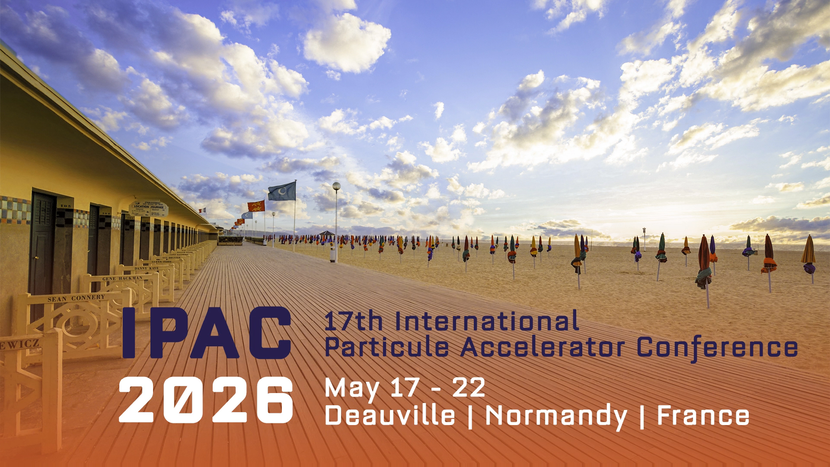
Opening of the Student Tutorials
Pierre Korysko (University of Oxford)
Julien Michaud (IJCLab)
Eduard Prat (PSI)

Slide 2
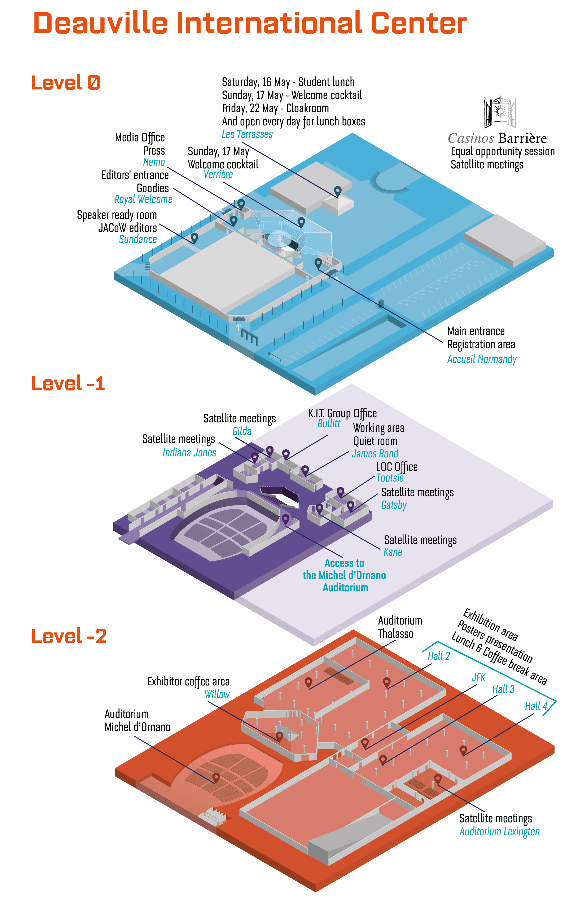
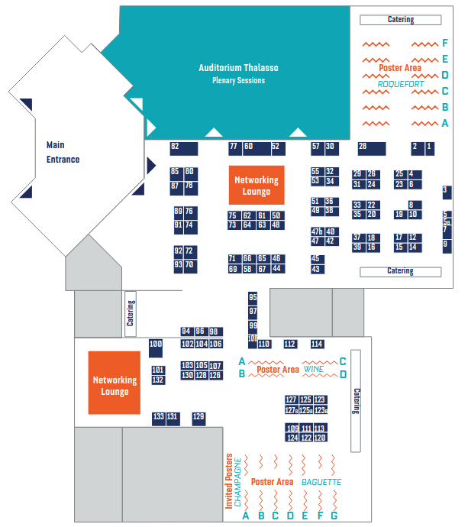

Map of the CID | Deauville Convention Center
Thalasso
Auditorium
Industrial Parters Area
Student Poster Area
Sunday 14:00 – 18:00
P. Korysko, J. Michaud – Student Tutorials

Slide 3
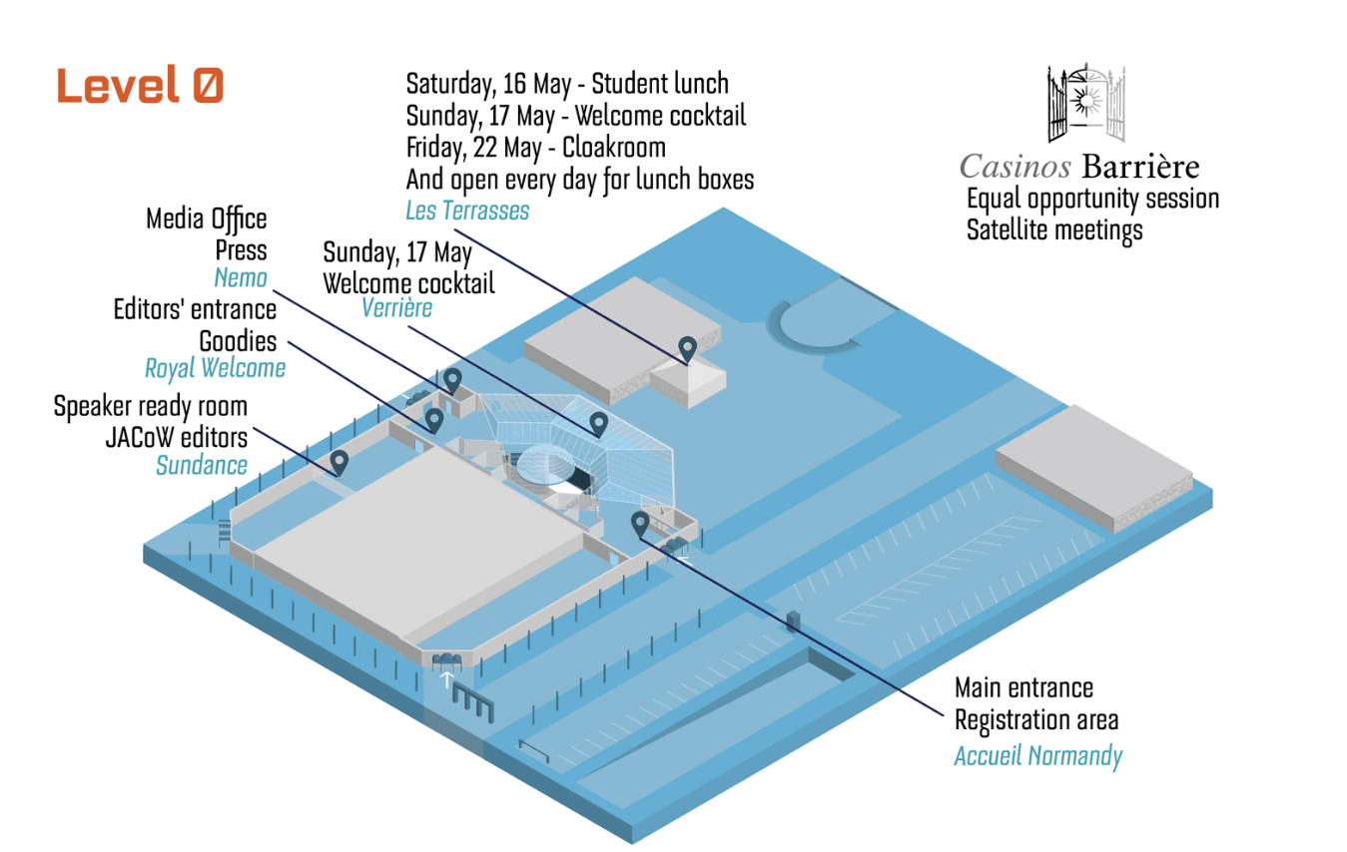
Lunch: Les Terrasses
What: Lunch Buffet
When: 12:10 - 13:30.
Where: Level 0 – Les Terrasses
Lunch
P. Korysko, J. Michaud – Student Tutorials

Slide 4
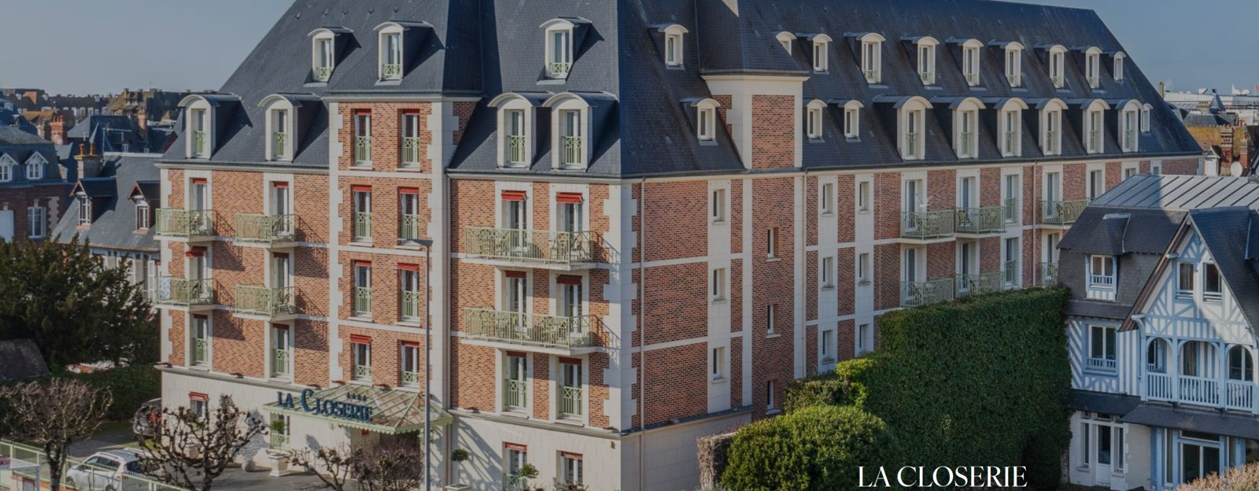
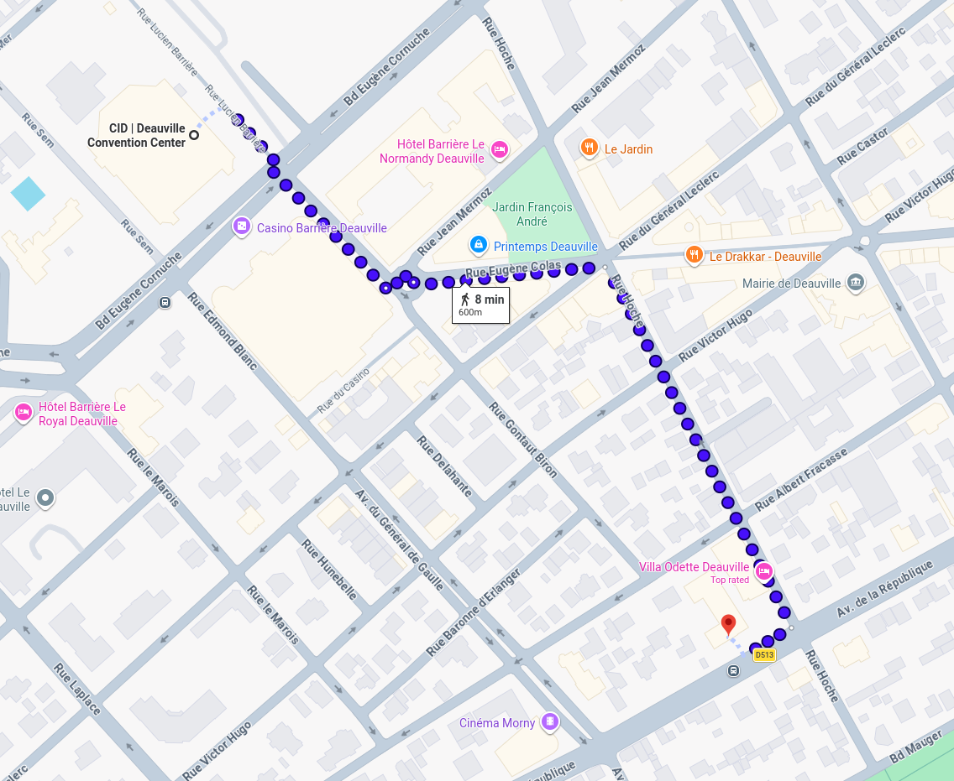
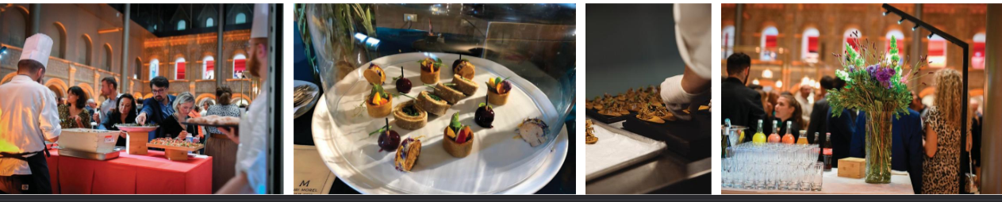
Tonight: Cocktail Dinner at "La Closerie"
What: Cocktail Dinner
When: Departure right after the last lecture (19:00).
Where: La Closerie Deauville, 156 Av. de la République
P. Korysko, J. Michaud – Student Tutorials

Slide 5
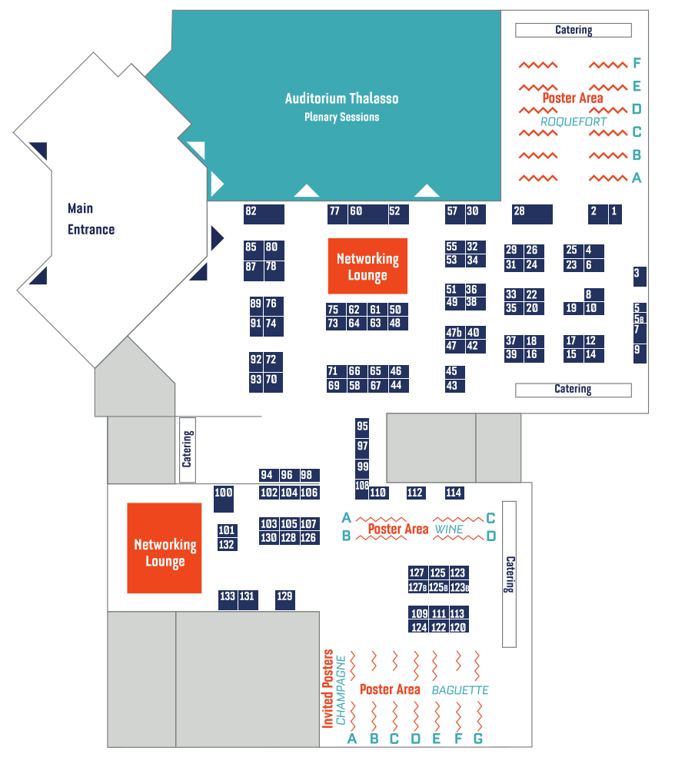
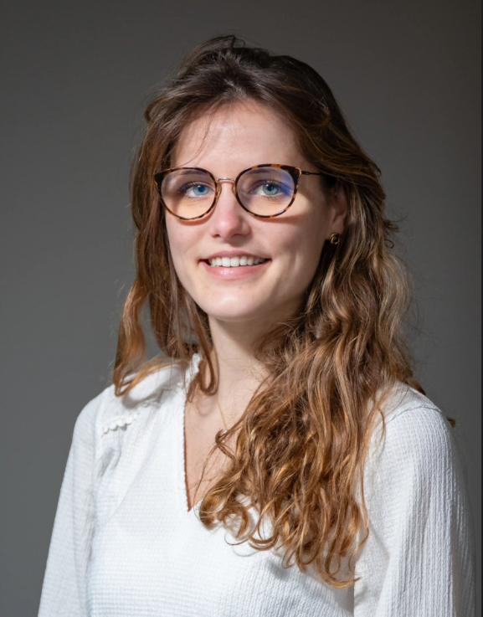
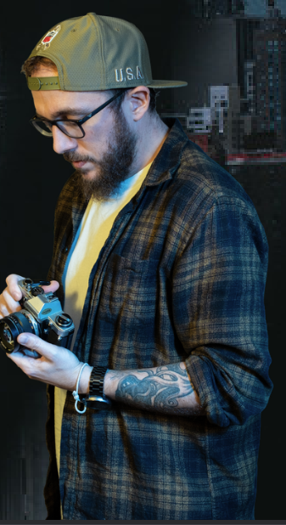
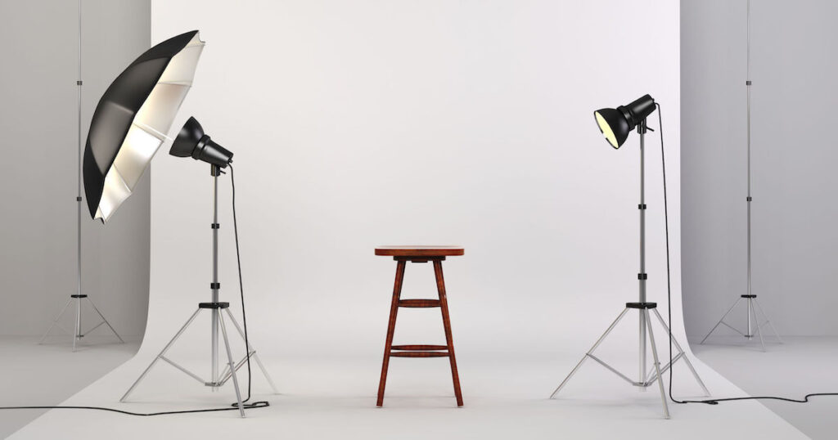
Sunday Activities: Photographer (1/3)
What: Photographer for professional portrait picture.
When: Sunday, May 17th from 11:15 to 13:15.
Where: CID – Demonstration (JFK) area
Free
Photographer
P. Korysko, J. Michaud – Student Tutorials

Slide 6
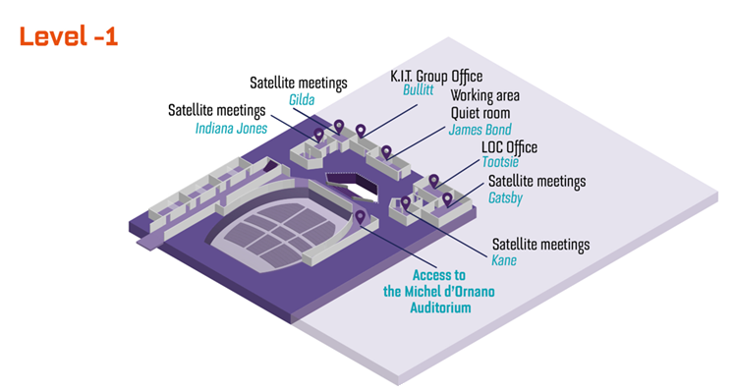

Sunday Activities: Hackathon (2/3)
What: IPAC’26 Hackathon.
When: Sunday, May 17th from 11:00 to 12:00
Where: Level -1 Gatsby Room.
Gatsby
Foster collaboration between Students and Industrial Partners, by addressing real-world challenges.
Key accelerator-related themes, including applications in Environment & Materials, Life Sciences and Energy.
Work with real datasets from ESS , MAX IV and CERN, ScandiNova , Cosylab , Hopsworks , etc.
P. Korysko, J. Michaud – Student Tutorials

Slide 7
Sunday Activities: Student Poster Session (3/3)
When: Sunday, May 17th from 14:00 to 18:00.
Where: Wine and Baguette Poster Areas.
Jury Process:
A jury composed of experts in the field will visit each student twice during the session to assess their poster presentation and work.
Presentation Format:
Each student will have 4 minutes to present their work.
The jury will have 4 minutes to ask questions about your work.
Awards Ceremony:
The best posters will be awarded on Thursday, May 21, 2026, during the Accelerator Prizes Special Session at 2:00 p.m. in the Michel d’Ornano Room (CID). Winning posters will be exhibited on Friday morning in the main hall.
P. Korysko, J. Michaud – Student Tutorials

Slide 8
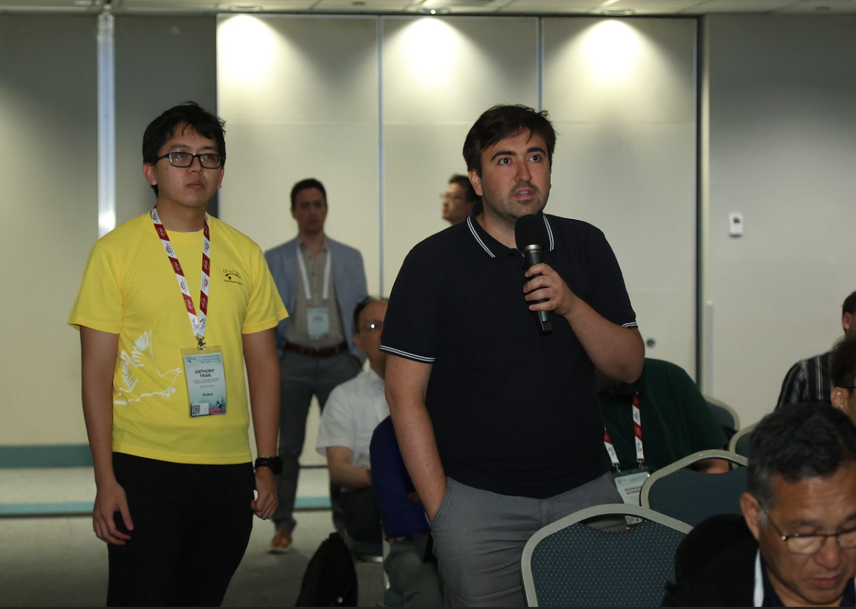
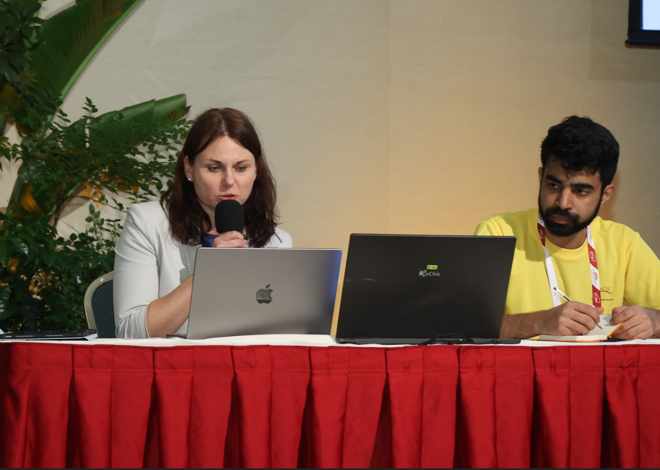
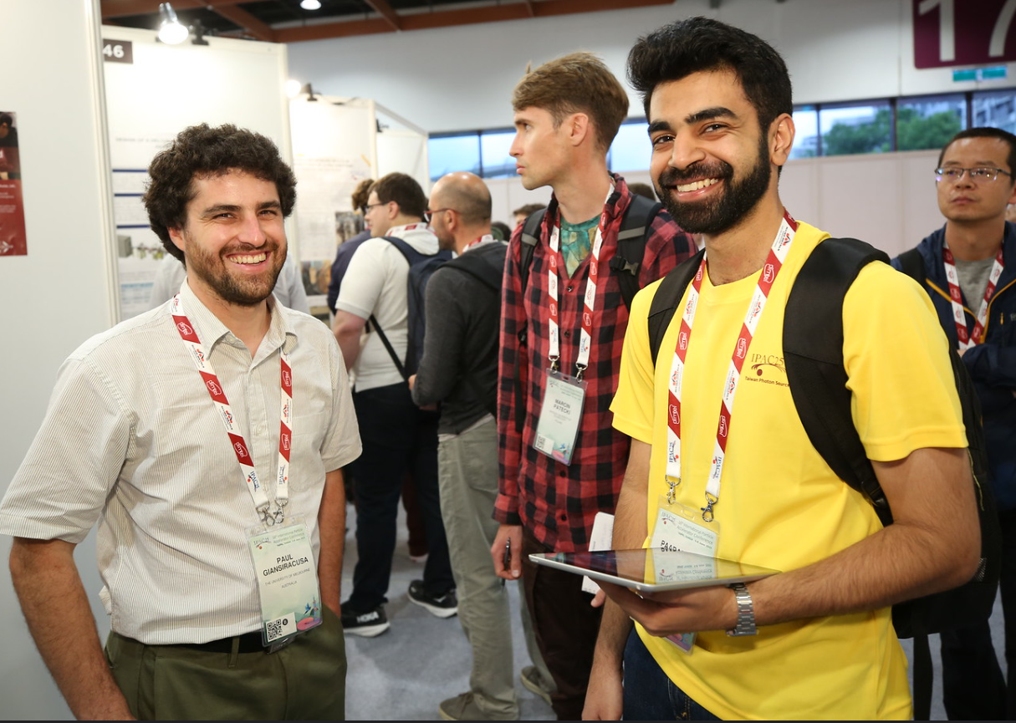
Training: Student with IPAC grants
What: Training for Student Duties
When: Sunday, May 17th from 09:30 to 11:00.
Where: Auditorium Thalasso.
Attendance:
All students receiving the IPAC grant are required to act as scientific secretaries.
3 Duties:
  Microphones
  Session co-chairing
  Poster Installation and Police
P. Korysko, J. Michaud – Student Tutorials

Slide 9
Summary
Students with grants Training:
Sunday 09:30 – 11:00
Lunch:
Today 12:10 - 13:30
Photographer:
Sunday 11:15 – 13:15
IPAC’26 Hackathon:
Sunday 11:00 – 12:00
Student Poster Session:
Sunday 14:00 – 18:00
Student Cocktail Dinner:
Today at 19:00 at la Closerie
P. Korysko, J. Michaud – Student Tutorials

