Slide 1

Welcome to the Student Tutorials
16 May 2026
IPAC26, Deauville, France
Eduard Prat, PSI
Student Tutorials Coordinator

Slide 2

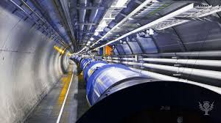
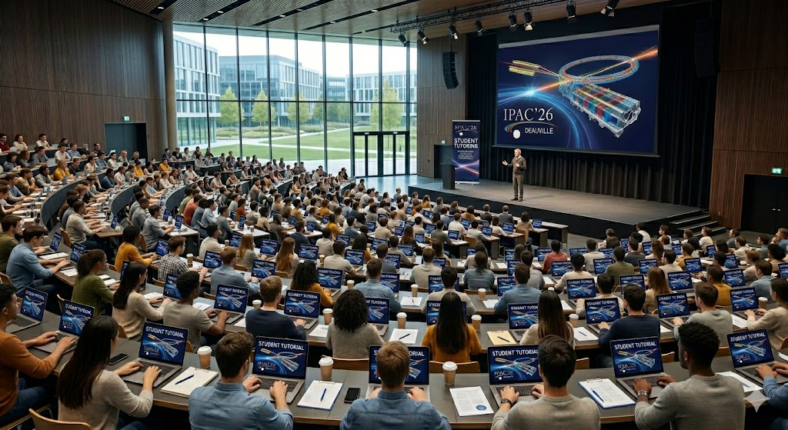
Objectives of the program
Summarize the main scientific and technological aspects of the conference.
Give a status and outlook of the different fields.
Provide a good basis for the students to better follow the conference.
Give the opportunity to the students to meet and ask questions to world-wide experts.

Slide 3
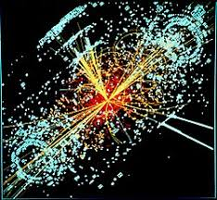
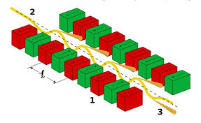
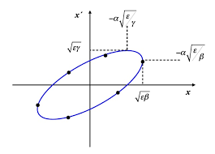
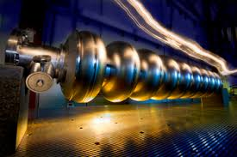
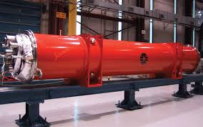
Topics
MC1 | Colliders and related accelerators
MC2 | Photon sources and electron accelerators
MC3 | Advanced acceleration techniques and novel particle sources
MC4 | Hadron accelerators
MC5 | Beam dynamics and EM fields
MC6 | Beam instrumentation, controls, feedback and operation aspects
MC7 | Acceleration technology and sustainability
MC8 | Applications of accelerators, engagement with industry, technology transfer and outreach

Slide 4
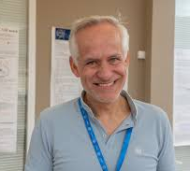
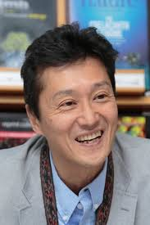
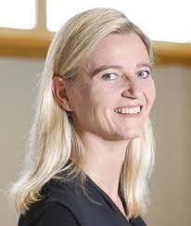
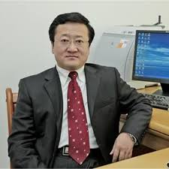
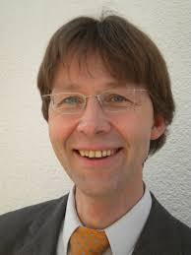
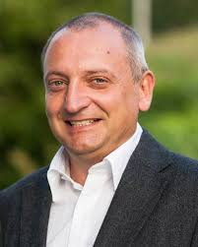
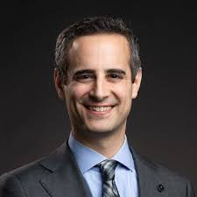
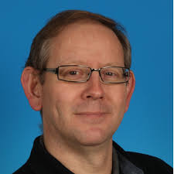
Lecturers
Worldwide top experts on the topics, we are very happy to have them with us!
MC1 | Yannis Papaphilippou (CERN, Switzerland)
MC2 | Hitoshi Tanaka (RSC, Japan)
MC3 | Edda Gschwendtner (CERN, Switzerland)
MC4 | Hongwei Zhao (IMP, China)
MC5 | Nicolas Pichoff (CEA, France)
MC6 | Peter Forck (GSI, Germany)
MC7 | Mike Seidel (PSI and EPFL, Switzerland)
MC8 | Sam Posen (Fermilab, USA)

Slide 5


Program
Time | Topic | Lecturer
9:10 | Colliders and related accelerators | Yannis Papaphilippou
10:10 | Photon sources and electron accelerators | Hitoshi Tanaka
11:10 | Advanced acceleration techniques and novel particle sources | Edda Gschwendtner
12:10 | Lunch buffet
13:30 | Hadron accelerators | Hongwei Zhao
14:30 | Beam dynamics and EM fields | Nicolas Pichoff
15:30 | Beam instrumentation, controls, feedback and operation aspects | Peter Forck
16:30 | Coffee break
17:00 | Acceleration technology and sustainability | Mike Seidel
18:00 | Applications of accelerators, engagement with industry, technology transfer and outreach | Sam Posen
https://indico.jacow.org/event/130/
Each lecture: 45 minutes talk + 15 minutes questions

Slide 6
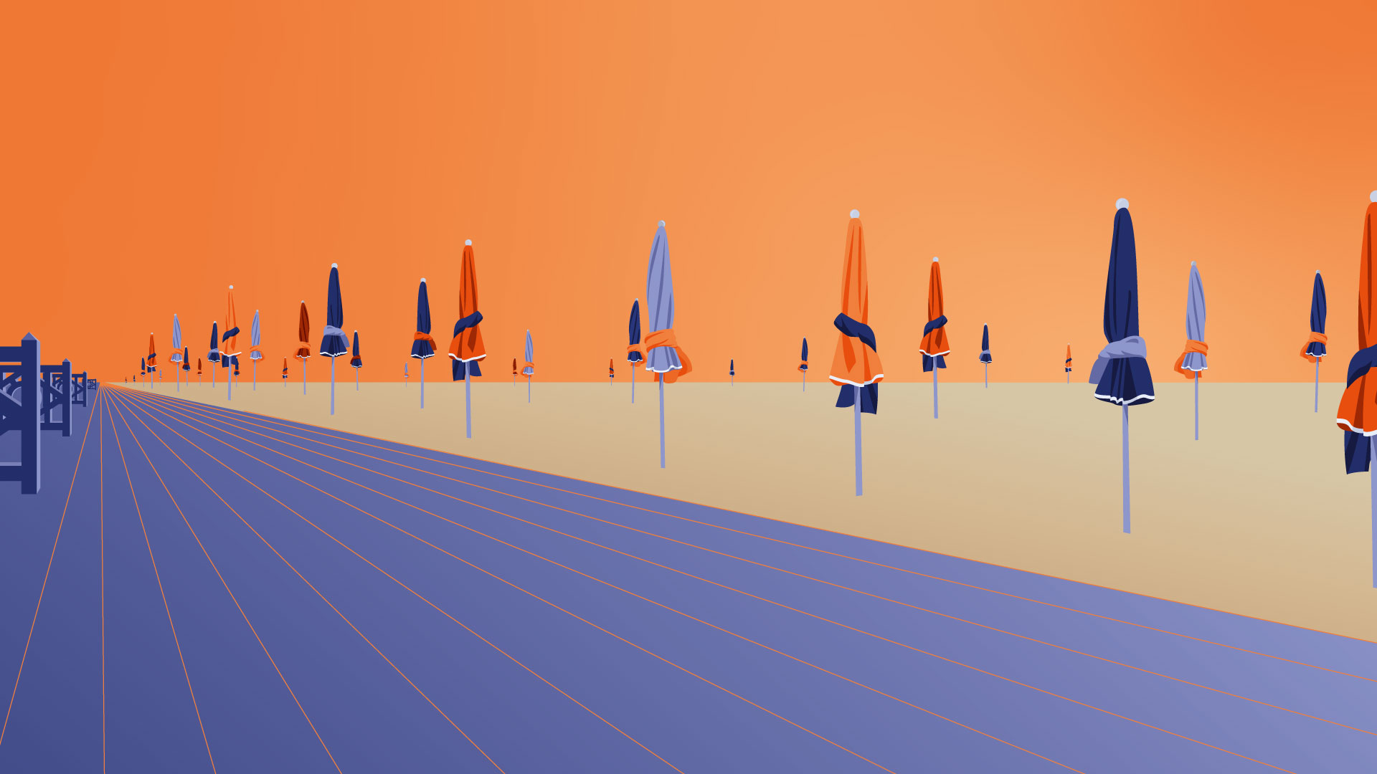
Special thanks to the SPC/OC members, Sabrina Lecerf, Pierre Korysko, Elias Metral, and Julien Michaud for their help
Thanks for your attention and enjoy the tutorial!

