Slide 1
Visites

Slide 2
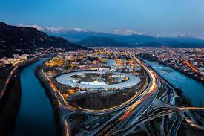
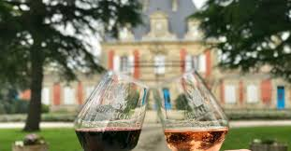

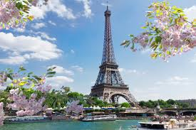
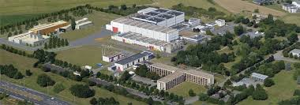
Laboratory Visits (Fri/Sat)
ESRF in Grenoble
NON organised travel
Saturday: arrival in Grenoble and visit
Free week-end to visit Grenoble and the mountains
Workshops and meetings early following week
SOLEIL south of PARIS
Departure on Friday by bus + visit
Visits to Paris afterward.
GANIL 1 hr by bus
Visit on Friday afternoon

Slide 3
Facility tours
GANIL
5 Bus departure from Deauville
250 persons maximum
13:30 -14:30 bus (groups will be made in the bus)
14:45 first departure group. 1h visite
Busses back to Deauville
SOLEIL
13:30 Departure from the conference by bus (packed lunch provided)
17:00 Arrival at SOLEIL
19:30 End of Visits followed by a buffet
20:30 Departure for Paris by bus
ESRF
No organised travel
Visite on Saturday, 23 May 2026 in the afternoon.
Welcome drink / coffee
Groups of 10 pers. each
Dedicated visits or meetings can be organised on request.

Slide 4
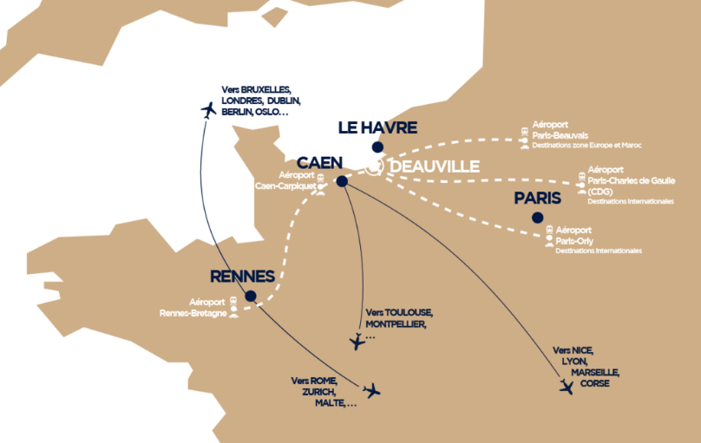
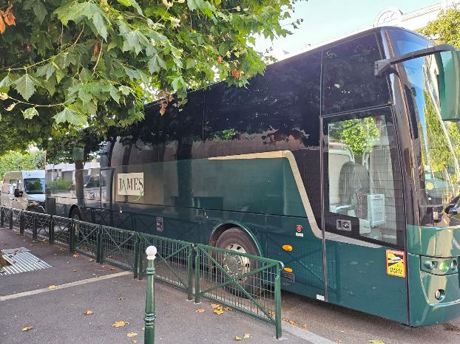
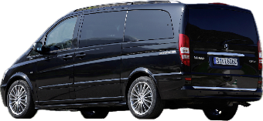
Delegate Transportation Provision
Saturday 16/5 - Sunday 17/5 - Friday 22/5
Distance from Paris: ~ 215km
Distance from Caen: ~ 50km - 50min
Bus Shuttles Proposed
CDG Paris/ORLY to Deauville: 3 h
Train-station Paris to Deauville: 2 h

Slide 5
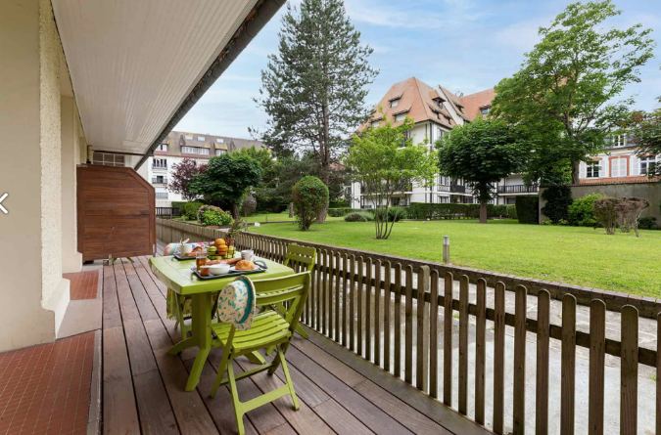
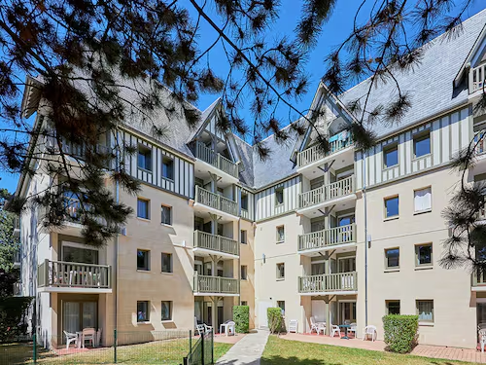
Hotel Preparations
Hotels for Students:
Residencies with kitchen:
2 persons ~ 120 €/apartment
2 persons ~ 142 €/apartment
Hotels for Editors:
Hotel and SPA Almoria
Hotels for Participants:
2* - 5* hotels: 118€ - 384€.

Slide 6
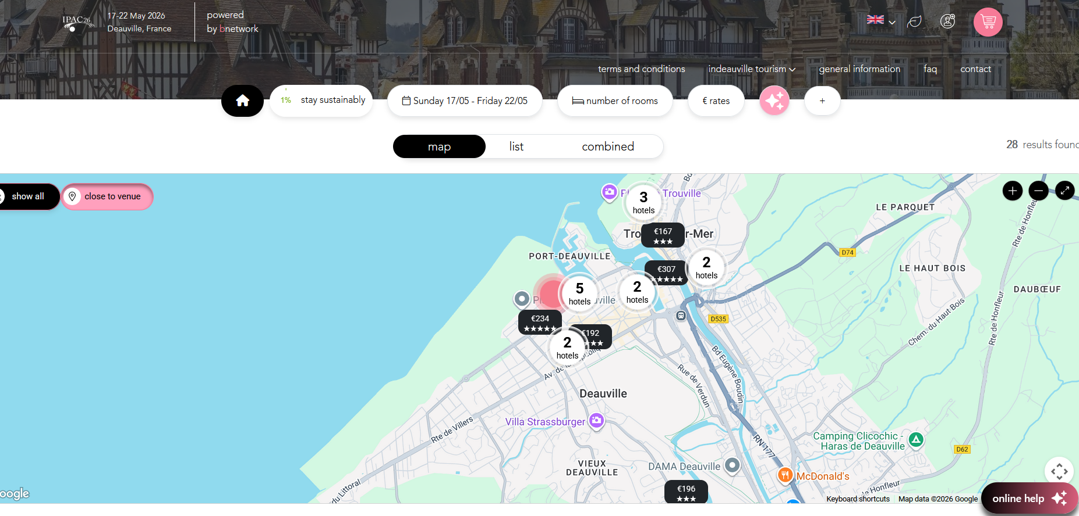
A website with CONFERENCE hotels
979 beds pré-reserved
~200 beds for students (shared rooms)
Hotel for LOC team and editors

Slide 7
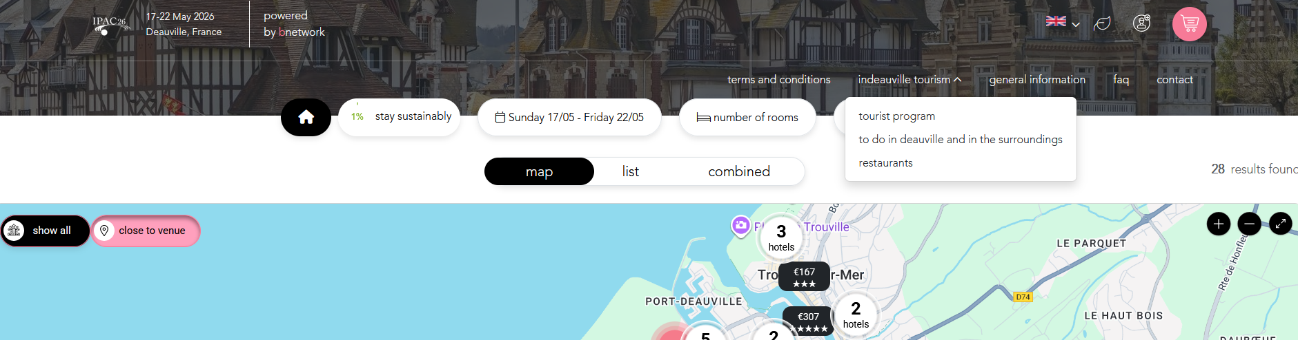

Tourist program

Slide 8
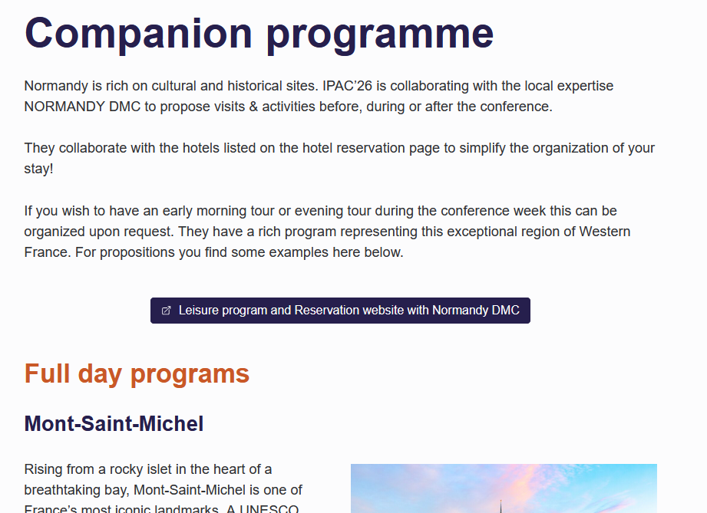
Social programs and accompanying program
Full day programs back to Deauville for dinner.
Half day programs
Visits before and after the conference is possible
Sports, morning programs !

