Slide 1
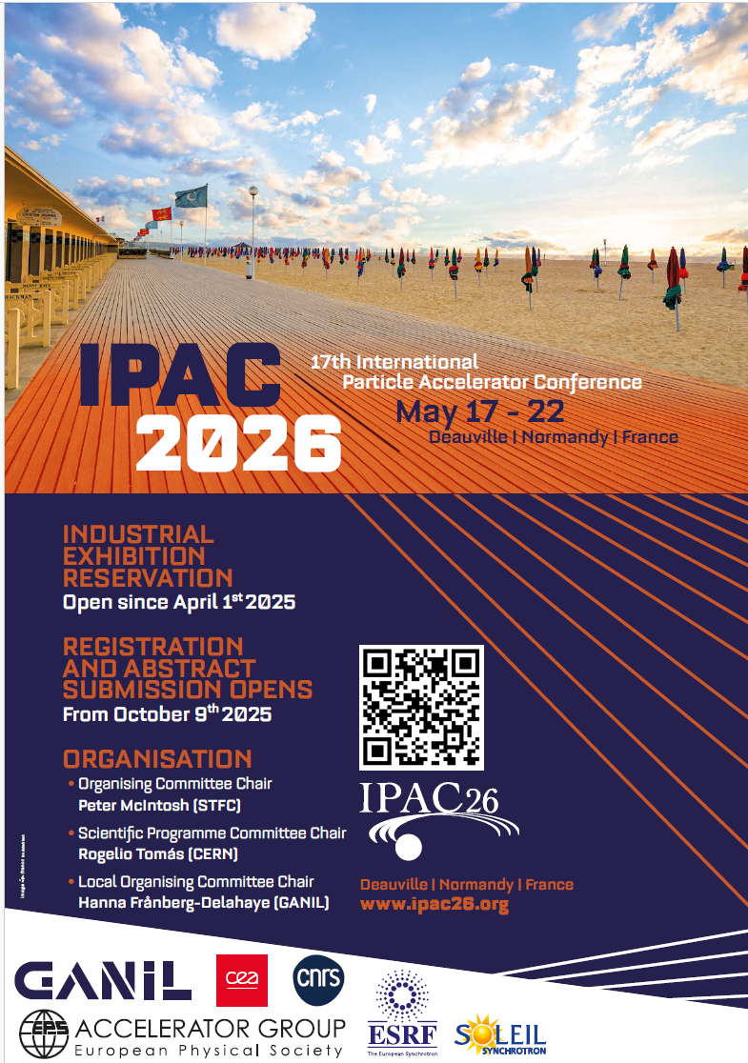
Status on Industry session at IPAC’26
IPAC’26 Industry session
The organisation of the session is progressing very well.
The program is very close to be complete
More information to be put on the WEB site

Slide 2




Status on Industry session at IPAC’26
Working group in the local organizing committee
Keihan TAVAKOLI (Soleil)
J-L. Revol (ESRF)
Nicolas Berton (CEA)
C. Barthe Dejean (GANIL)

Slide 3
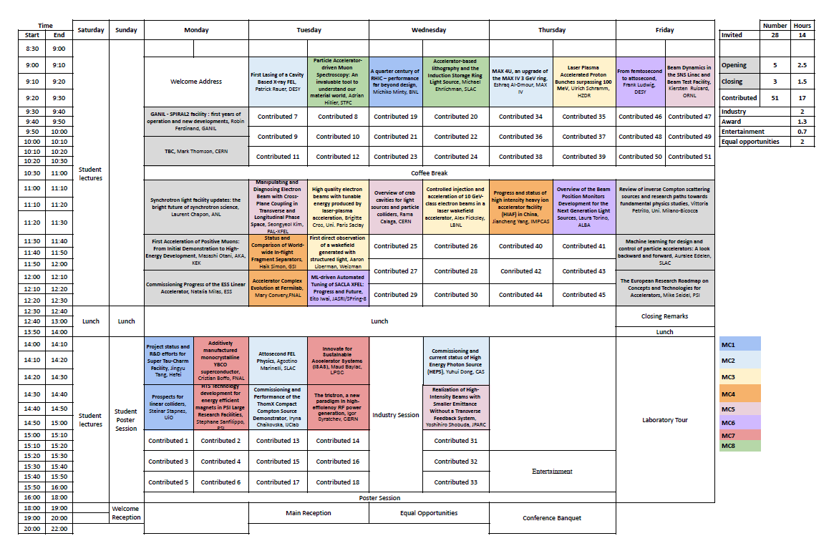
Scientific program
20 Mai

Slide 4
Scientific program
The Industrial Session is part of the scientific program Wednesday afternoon) and will last two hours, running in parallel with another standard scientific session. The industry session is organized by the LOC.
Habitually under-attended, the Industrial Session usually focuses on technology transfer or industry collaboration.
To make it more appealing and relevant to scientific participants, project leaders, directors, we are proposing two emerging and impactful topics:
20 Mai
Sustainability challenges for procurement
Training, recruiting and keeping the right staff in accelerator fields

Slide 5
latest updates regarding IPAC’26: Industrial session
Short introduction (5mn)
Topic 1: Sustainable Procurement and Project Lifecycle (1 hour or slightly more)
Sustainability is becoming a key requirement for projects and developments —from design and procurement to operation and end-of-life management. Direct and indirect emission, transport are two topics for which key performance indicators are today well identified. On the other end, procurement which contribute largely to green house gas emission is more difficult to manage.
This session will explore sustainability issues during the full project lifecycle including procurement and discuss how industry can provide essential lifecycle information and ensure compliance.
Part 1: Introduction and CERN experience – 20 mn Enrico Cenini, Environmentally Responsible Procurement at CERN
==> speaker confirmed
Part 2: The situation in ASIA – (or a contribution from EU) 20 mn ==> , speaker to be found, contact in progress
Ìf no speaker, This part could be cancelled, prog already charged
Part 3: Feedback from industry
  SIGMAPHI ==> participation confirmed 10 mn. SIGMAPHI is a magnet company already engaged in a corporate social responsibility approach.
  RI,.. ==> Participation TBC
Time for questions
Topic 2: Training, Recruiting, and Sharing Young Technical Staff (1 hour or slightly less)
This topic will address current challenges in attracting, training, and retaining highly skilled technical staff for accelerator development and operation. Insights will be shared by laboratories and industry. The intention is to discuss how laboratories, universities, and companies can encourage the next generation to pursue careers in accelerator-related fields. Statistics should be provide on how many students remains in the field after their training.
Part 1: Introduction by Elias Métral, Director of JUAS, agreed to present the situation for JUAS ==> speaker confirmed
Part 2: The situation in U.S. by John Bird director of USPAS , U.S. Particle Accelerator School ==> speaker confirmed
Part 3: Short contribution from industry (COSYLAB ) ==> speaker confirmed. CosyLab is working on services in software and electronics. Its is two topics in which it is difficult to recruit and get skilled and expertise staff. It is also topics which are evolving fast. In addition in the coming years, AI will have to be integrated in the job. Speaker will express on staff already well trained in accelerators could be a must, especially for supporting companies.
Time for questions
Contribution from ASIA still to be found for Topic 1, (US already present in Topic 2)

Slide 6
latest updates regarding IPAC’26: Industrial session
Short introduction (5mn)
Topic 1: Sustainable Procurement and Project Lifecycle (1 hour or slightly more)
Sustainability is becoming a key requirement for projects and developments —from design and procurement to operation and end-of-life management. Direct and indirect emission, transport are two topics for which key performance indicators are today well identified. On the other end, procurement which contribute largely to green house gas emission is more difficult to manage.
This session will explore sustainability issues during the full project lifecycle including procurement and discuss how industry can provide essential lifecycle information and ensure compliance.
Part 1: Introduction and CERN experience – 20 mn Enrico Cenini, Environmentally Responsible Procurement at CERN
==> speaker confirmed
Part 2: The situation in ASIA – (or a contribution from EU) 20 mn ==> , speaker to be found, contact in progress
Ìf no speaker, This part could be cancelled, prog already charged
Part 3: Feedback from industry
  SIGMAPHI ==> participation confirmed 10 mn. SIGMAPHI is a magnet company already engaged in a corporate social responsibility approach.
  RI,.. ==> Participation TBC
Time for questions
Topic 2: Training, Recruiting, and Sharing Young Technical Staff (1 hour or slightly less)
This topic will address current challenges in attracting, training, and retaining highly skilled technical staff for accelerator development and operation. Insights will be shared by laboratories and industry. The intention is to discuss how laboratories, universities, and companies can encourage the next generation to pursue careers in accelerator-related fields. Statistics should be provide on how many students remains in the field after their training.
Part 1: Introduction by Elias Métral, Director of JUAS, agreed to present the situation for JUAS ==> speaker confirmed
Part 2: The situation in U.S. by John Bird director of USPAS , U.S. Particle Accelerator School ==> speaker confirmed
Part 3: Short contribution from industry (COSYLAB ) ==> speaker confirmed. CosyLab is working on services in software and electronics. Its is two topics in which it is difficult to recruit and get skilled and expertise staff. It is also topics which are evolving fast. In addition in the coming years, AI will have to be integrated in the job. Speaker will express on staff already well trained in accelerators could be a must, especially for supporting companies.
Time for questions
Dedicated zoom meeting(s) foreseen per topic to prepare the sessions with all speakers to get coherency

Slide 7
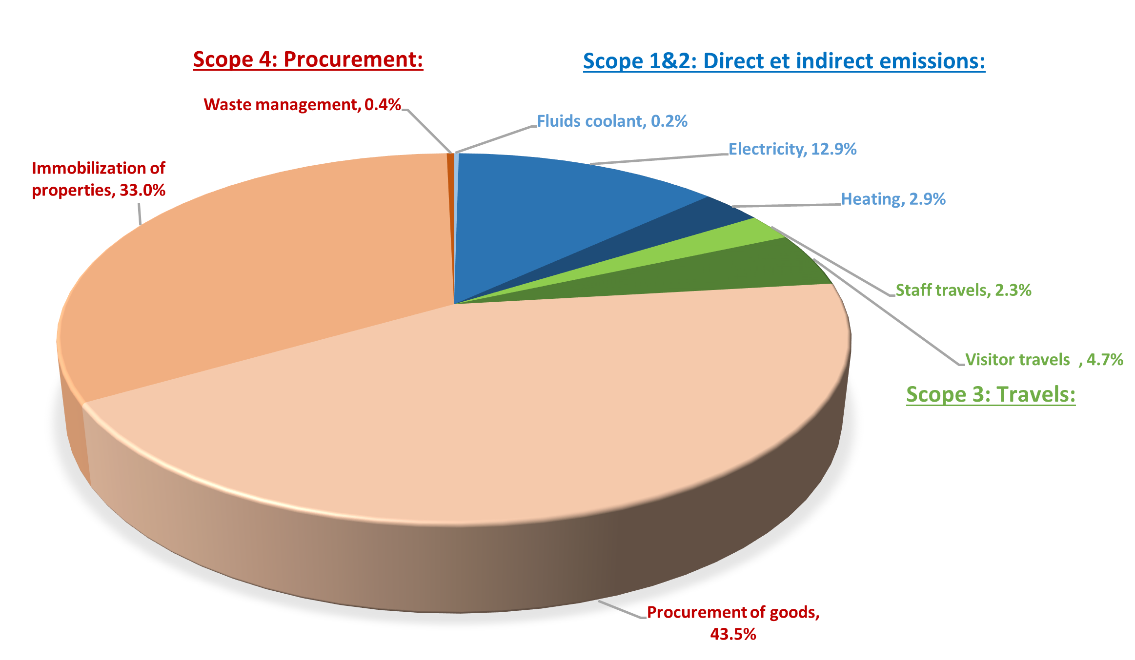
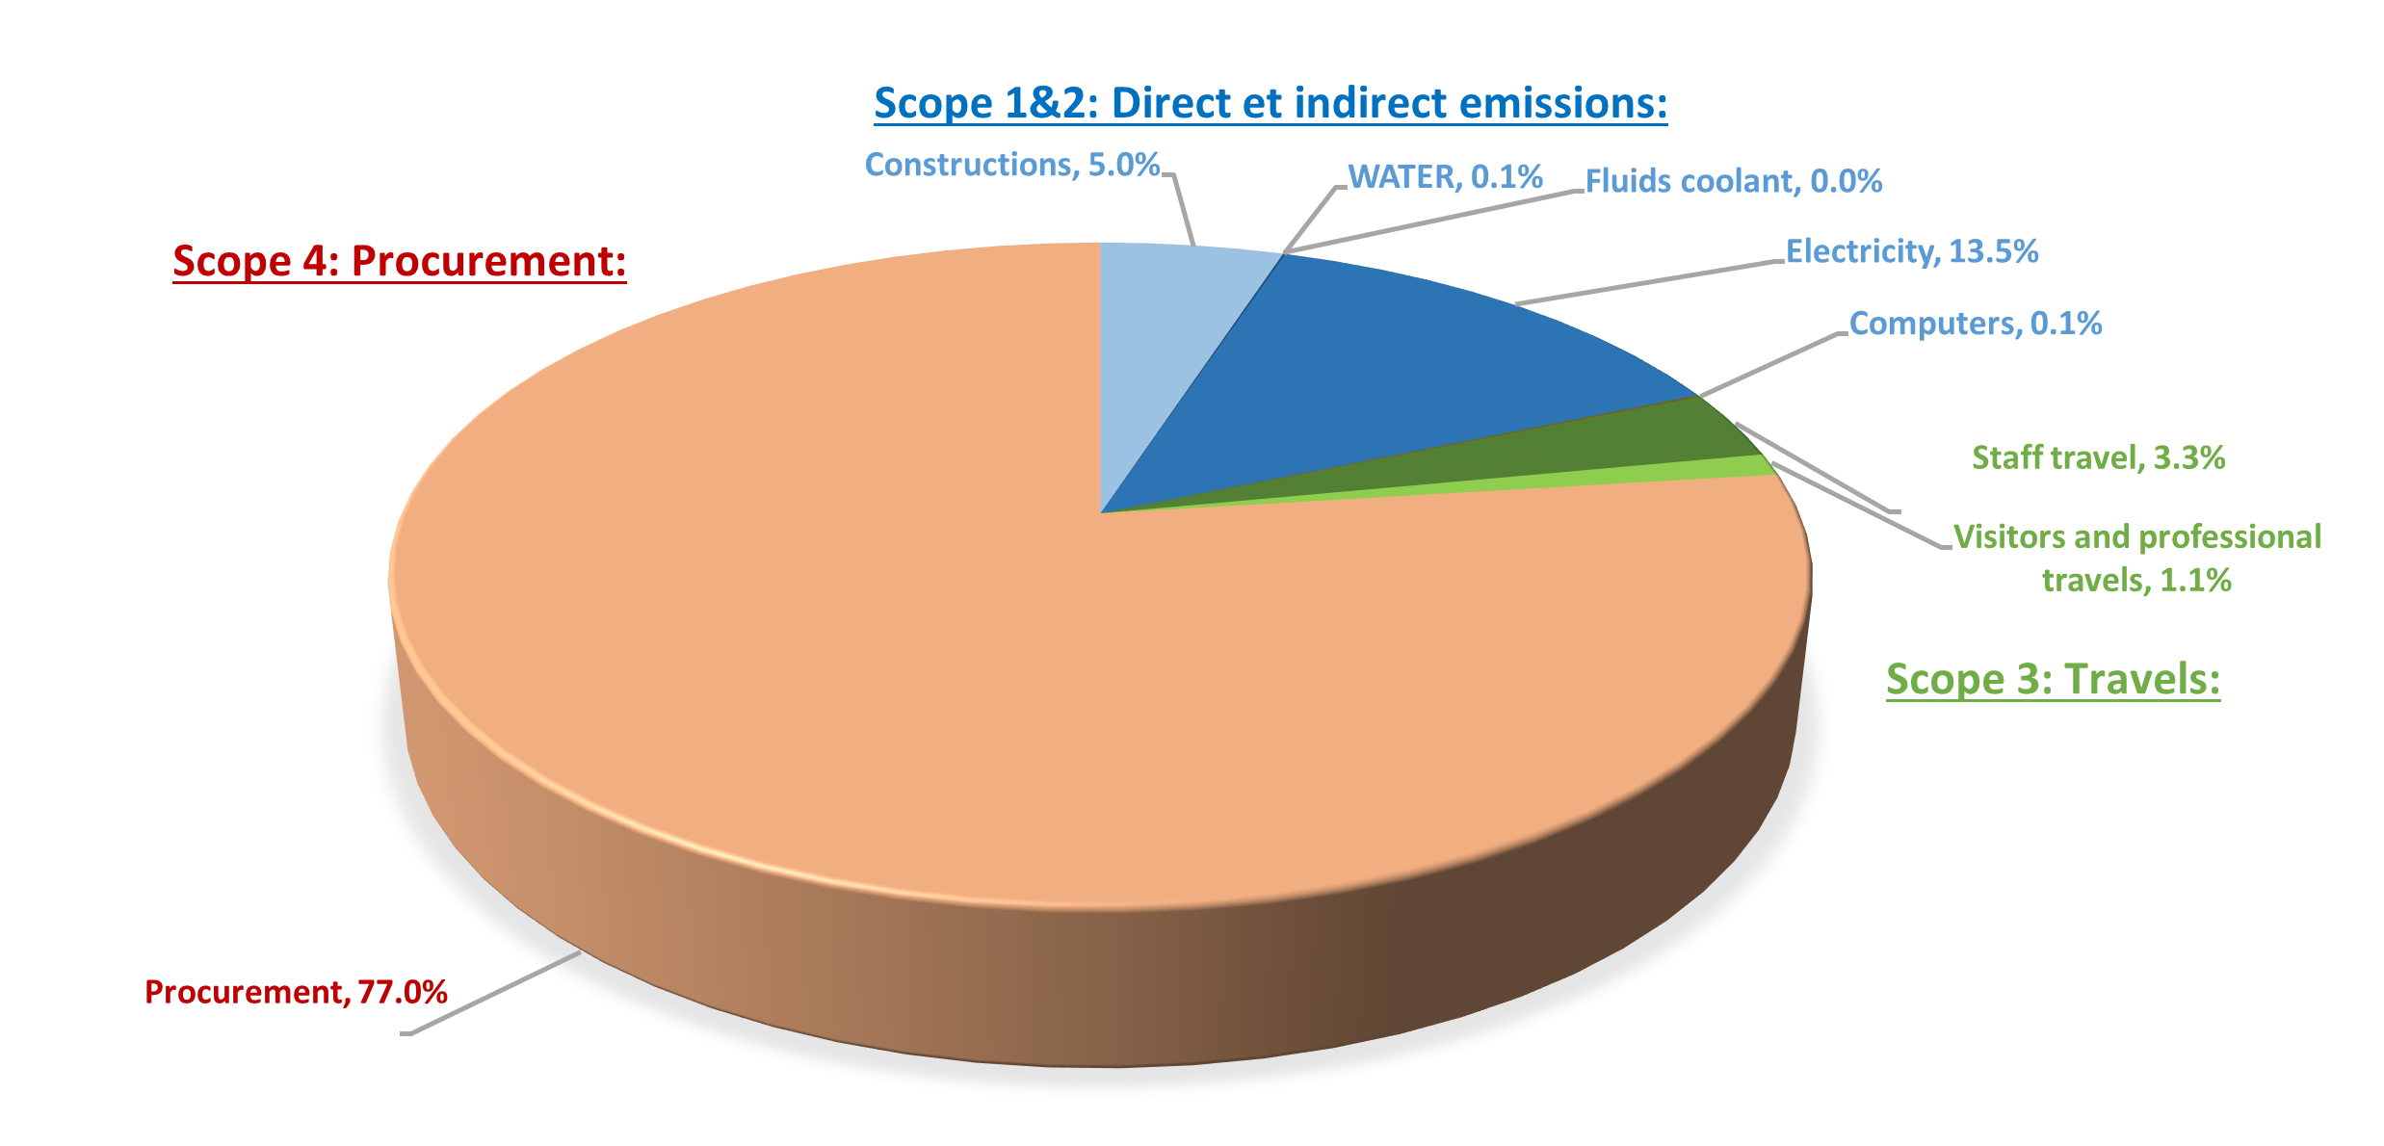
Green house gas emission for ESRF and SOLEIL
Contribution of procurement to greenhouse gas
Direct and indirect emission (energy consumption,..) (scope 1&2)
Professional and visitor travels (scope 3)
Procurement & recycling (scope 4)
ESRF
Difficult to define Key Performance Indicators
SOLEIL

Slide 8
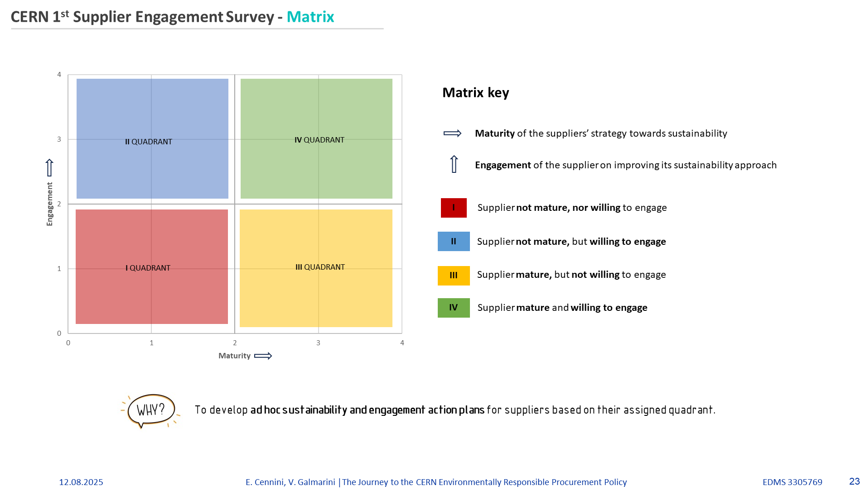
CERN supplier engagement

Slide 9
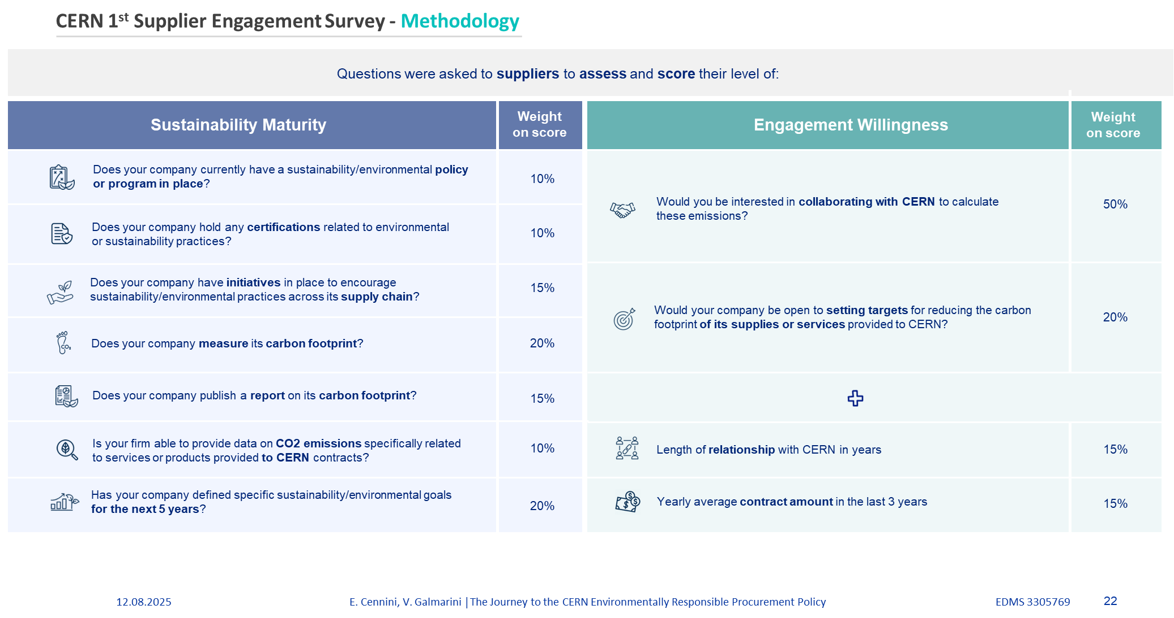
CERN supplier engagement

Slide 10
ESRF engaged in sustainable procurement
ESRF , Action Plan for 2030
In Calls for Tenders (CFT), include a clause in the specimen contract reminding the suppliers that Corporate Social Responsibility (CSR) and sustainability are integral evaluation criteria for bids. In the technical specifications, request bidders, to confirm their company’s commitment to CSR and, upon request, provide their CSR policy and carbon footprint assessment.
Systematically require a Life Cycle Assessment in all RFQs and CFTs, covering the stages of manufacturing and shipment, operation and disposal.
Systematically evaluate the sustainability criteria of the winning bidders during the Tender Commission (0 to 2 points).
Include criteria in the evaluation grid for CO₂ life cycle assessment, assigning 5 points and evaluating it using the same basis as the price.
When relevant, include the estimated energy costs (electricity, heating) over the expected life span of the equipment in the total price evaluation (TCO).
Add a field in the purchasing software to record each company’s average carbon footprint. This data will be linked to every purchase order placed to the company and, when available, replaced by the Life Cycle Assessment.
The full CO₂ impact of capital expenditure is to be included in the year of purchase (no amortization).
Consolidate parcel deliveries to the site
Difficult to define Key Performance Indicators

Slide 11
For topic2
It would be nice to see if the trained people are adequate to the needs.
Could we ask to the companies which have a booth to give:
Number of staff
Number of engineers and scientists
Number of engineers and scientists recruited per year (estimated 10%)
We could do the same for the labs (at least in Europe).

