Slide 1

Student Poster Session
Angie Orduz
Local Poster Session Manager
On behalf of the IPAC’26 Local Organising Committee

Slide 2
Outline
Student poster session
Student poster prize
Jury composition
Criteria for the jury
Poster rooms

Slide 3
Best Student Poster awards
The Best Student Posters
  2 students whose work, particularly meritorious, presented in the special student poster session.
  Sunday, May 17, between 2:00 p.m. and 6:00 p.m.
  The winners will be officially announced at the Accelerator Prizes Special Session during IPAC’26. Each winner will receive a cash prize of 500 €.
Student poster session
  The student poster session will be held in the Centre International de Deauville, Galerie Casino (Entrée Royal).
  Posters presented during this session will be considered for the best student poster prize.
  Students should attend their posters for interactions with judges and arriving conference delegates for the entire session.
  The students receiving a grant to attend the conference must present their work in this session and submit a contribution to the proceedings.
  All students are strongly encouraged to present their work during this session.

Slide 4
Student prizes
The student poster session will have 250 poster that need to be evaluated.
  1 team (2 judges)-> maximum 10 posters -> 25 evaluation teams.
There will be two rounds of evaluation.
  The first round will select the 20 top posters. (25 teams)
  The second round will choose the two best posters. (2 teams)
Meeting point: Poster coordination room
  Refreshments for jury members will be available!
Planning Sunday 17th May
1:00 p.m. | Latest arrival and registration at the Conference Center in Deauville
1:20 p.m. | Information meeting about the procedure of votes
2:00 p.m. | First round of votes — 20 posters per team
3:45 p.m. | First analysis of votes to select the top 10 posters and new assignment for the second round.
4:15 p.m. | Second round of votes
5:30 p.m. | Discussion to select the winners

Slide 5
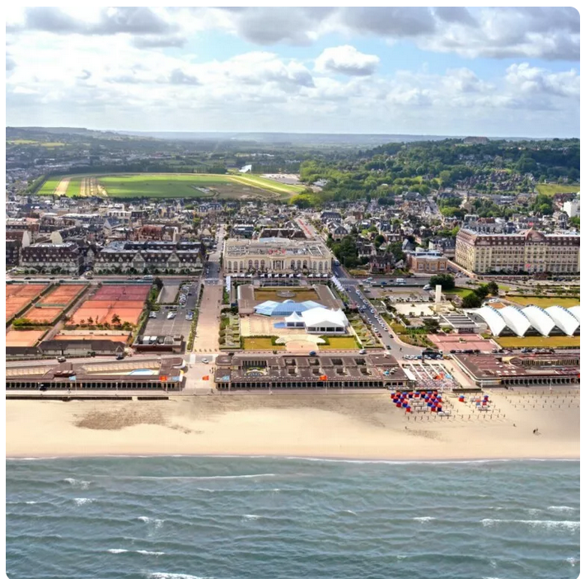
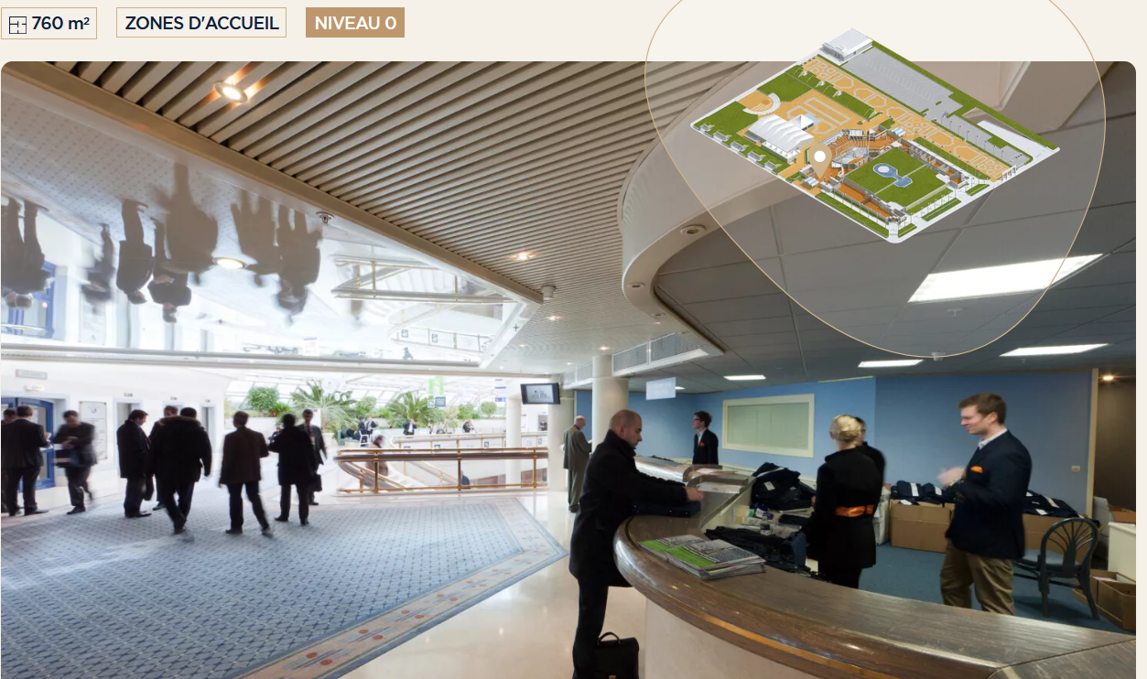
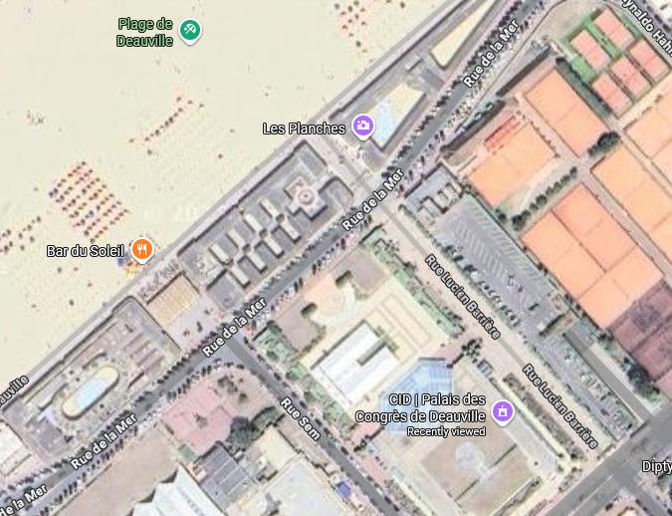
Centre International Deauville
Royal entrance

Slide 6
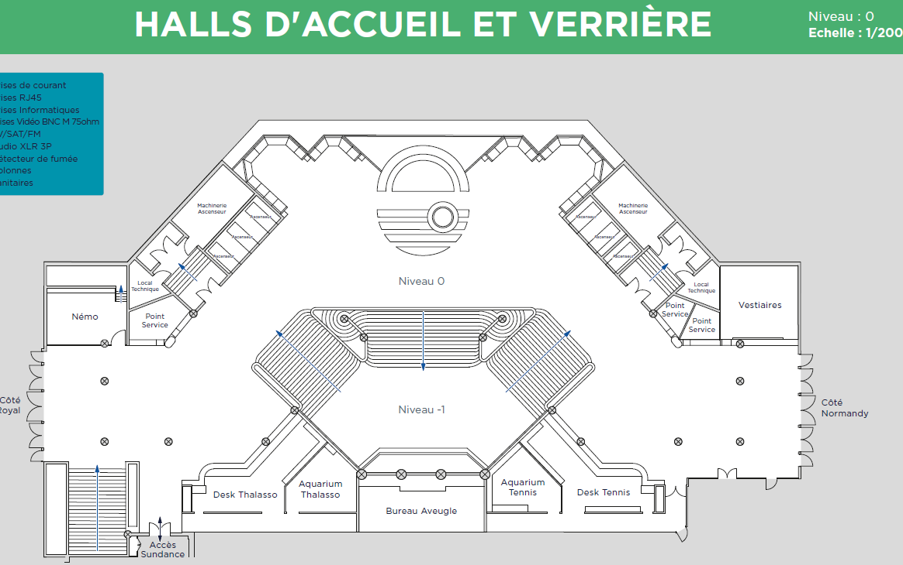
Royal entrance

Slide 7
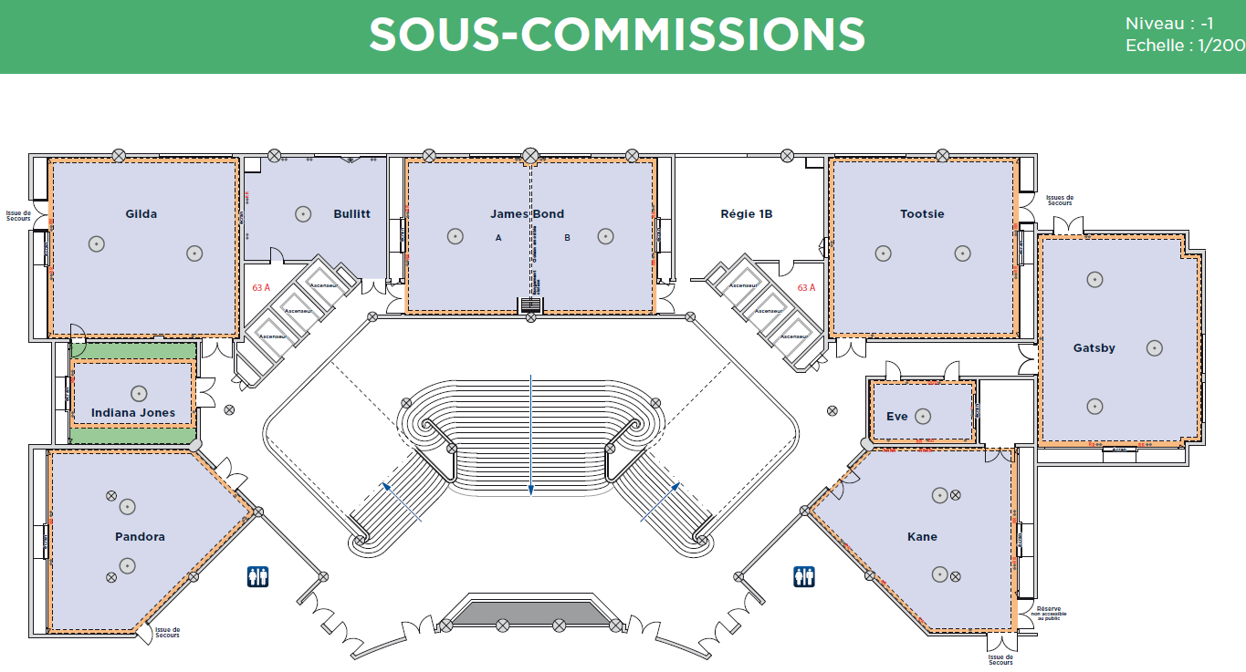
Poster coordination room

Slide 8
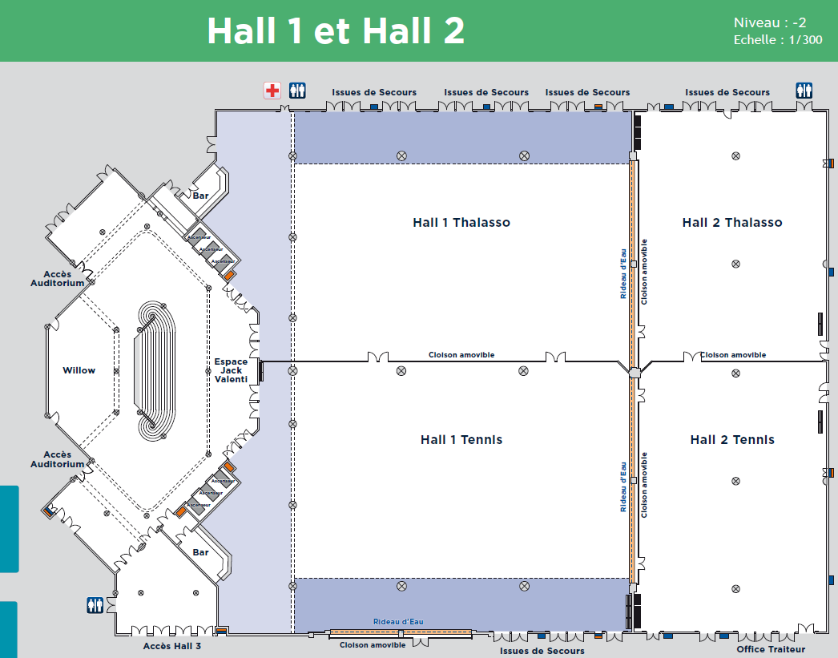
Student poster area

Slide 9
Jury composition
  ~250 student posters
  1 team (2 judges)-> maximum 10 posters -> 25 evaluation teams.
  We need 50 judges!
  Maximum participation by SPC members is strongly recommended (24). The invitations have already been sent.
  30 researchers in different fields have been identified as potential jury members, including professors from the student programme (8).
  The invitations that are still needed will be sent out starting next week to those who have confirmed their participation in IPAC'26.
  An review will be conducted in mid-March to verify that we have sufficient judges.
  Detailed information about the venue and the process will be sent to all jury members in early May.

Slide 10
Criteria for the Jury
Quality of poster
  Does the poster design help to understand it easier?
  Are the images, text and layouts clear, relevant and used effectively?
Quality of presentation
  Does the student explain concepts clearly and effectively?
Technical content
  Does the evidence presented effectively support the conclusions?
  Is the technical content clear, accurate, and reliable?
Contribution of the author
  Did the student contribute actively and significantly to this work?
Originality of the work
  Does this work offer new understanding or perspectives in the field of accelerator science and technology?
Relevant of the work
  Does this study make a relevant contribution to the field of accelerator science and technology?

Slide 11
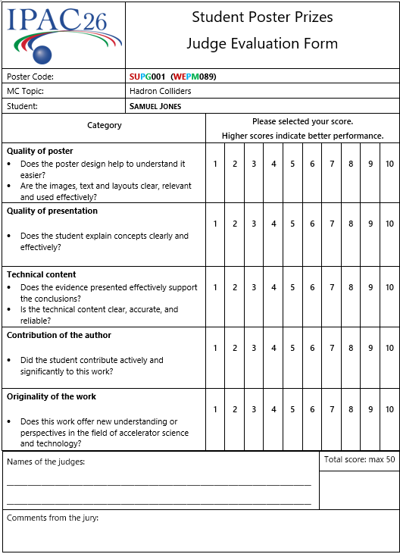
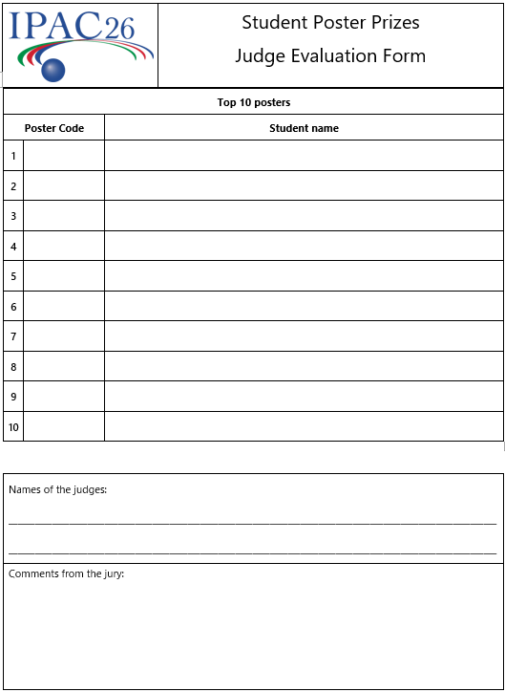
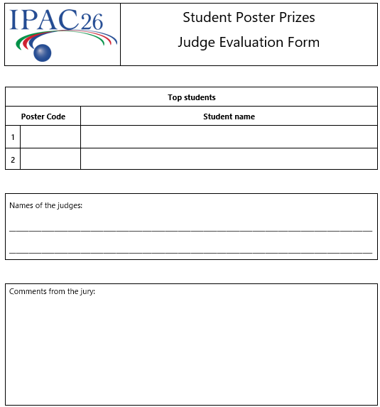
Evaluation Form

Slide 12
poster rooms
One student poster session room on Sunday.
Three general poster rooms (~460).
  1 VIP posters areas posters (10).
Roquefort, Wine, Baguette, Champagne, croissant.
SUPC001 / WEPR089
224
250
250
80
156

Slide 13
General Poster Session
Poster sessions
  Monday 18 to Thursday 21.
  4:30 to 6.30 p.m.
Training session Sunday morning
  Microphone assistance
  Chair assistants
  Poster Police
  Tablets for evaluation (14)
  Colourful T-shirts

Slide 14
Conclusions du SPC 1
The 2 winners will be posted in screens. Located in the invited poster session.
VIP posters : 5 pages for papier.
10 posters per day-40 posters in total.
Increase best posters to 20 in the first evaluation round ?
  Only those who are above 9?
  Only the first one?

Slide 15
Conclusions du SPC 2
Instructions for students, time, summary, etc
  4 minutes presentation, 3 minutes questions, email to the students.
Have different people in the first and second round groups.
  20 posters – 2 teams (10 posters par team), 4 people more!
  25 posters - 3 teams, (8/9 posters par team) 6 people more!
  Invited talks, contributions, invited posters
  Plan B, physicists.

Slide 16
Thank you for your attention!

