Slide 1
Organisation accueil

Slide 2
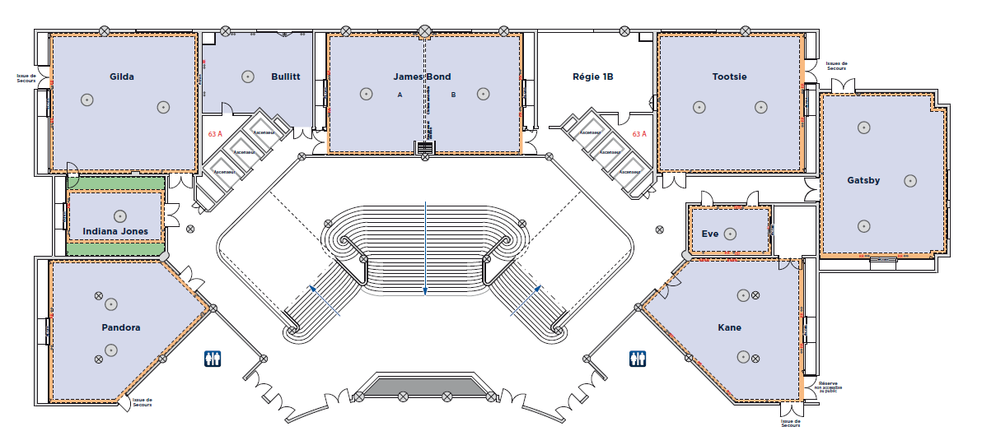
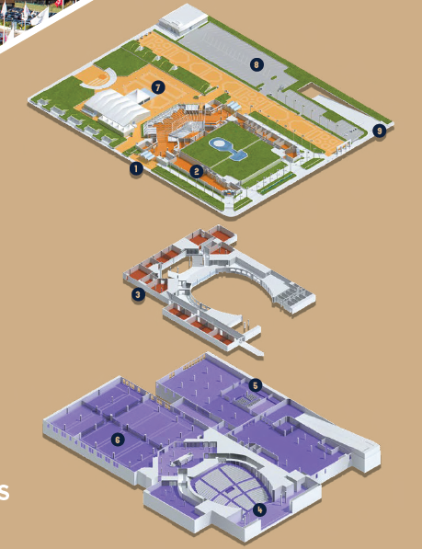
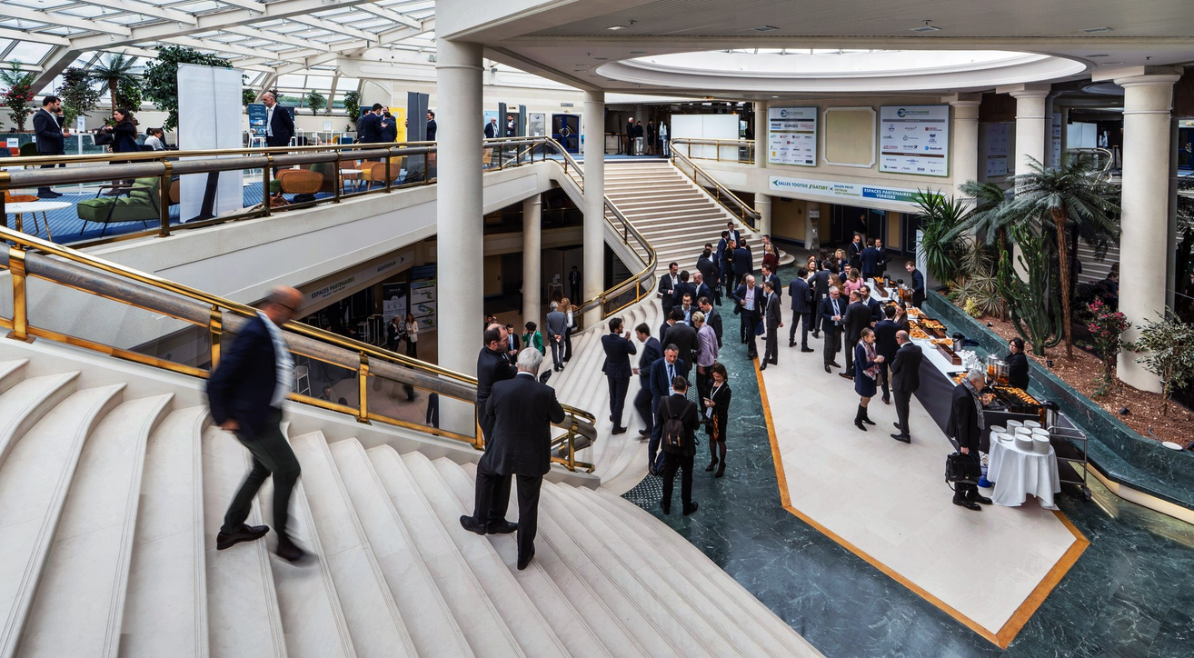
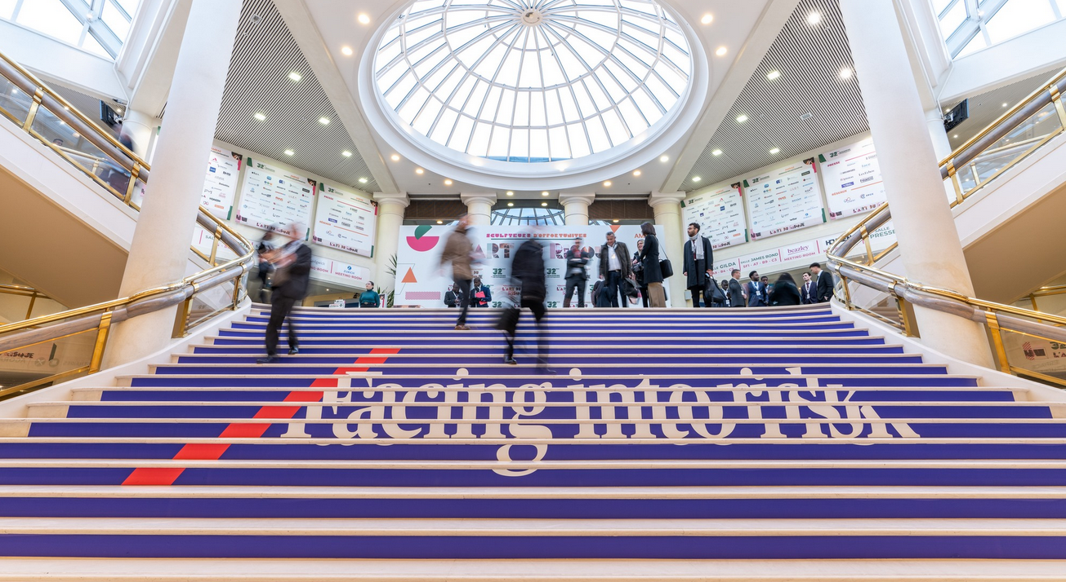
Conference venue
Satellite meeting room 1
Writing lounge
LOC room
Satellite meeting room 2
VIP room
Access from outside :
ground floor
Terrasse with lunch area
Speakers ready room
Intermediate floor:
Satellite meeting rooms
Auditorium access
-1 floor:
Main auditorium access
Industrial exhibition
Poster sessions

Slide 3
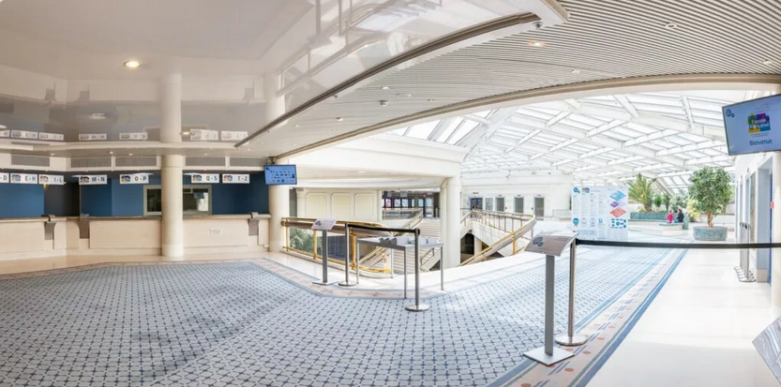
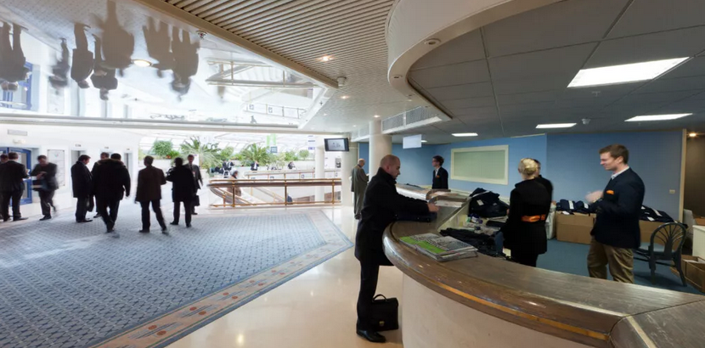
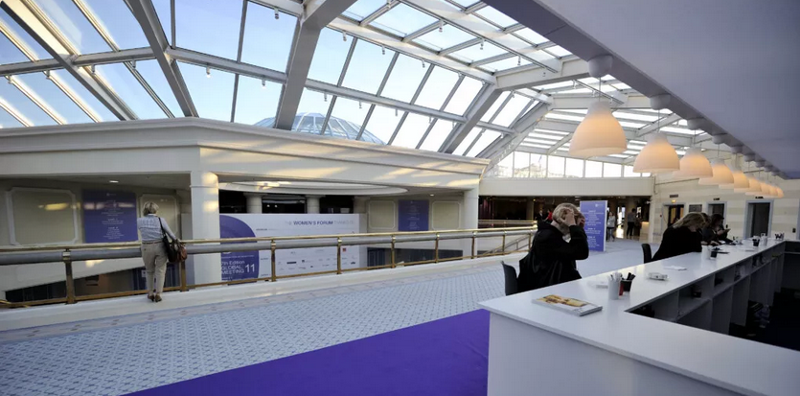
Registration desks entrances areas
Official registration desks
On site registration with the possibility of on site payment.
Conference bags and goodies
Information panels and dynamic teve screens

Slide 4
Check-in à faire
Lundi-Mercredi : organiser les badges
Jeudi: 40 éditeurs
Vendredi/Samedi et (dimanche) : 250 exposants industriels
Samedi:
8-9h : 150 étudiants + 10 professeurs
Dimanche
9h-12h: exposants
14h-18h : 900 participants (6-7 hôte d’Accueil à minima)
Lundi – Jeudi:
9h-16h Accueil ouvert (3-4 hôte d’Accueil)

Slide 5
Dimanche
2 bureaux: Goodies et enregistrements
Enregistrements + compta
4 personne côté sacs

Slide 6
Réunions satelites

Slide 7
Conference venue
Satellite meeting room 1
Writing lounge
LOC room
Satellite meeting room 2
VIP room
Access from outside :
ground floor
Terrasse with lunch area
Speakers ready room
Intermediate floor:
Satellite meeting rooms
Auditorium access
-1 floor:
Main auditorium access
Industrial exhibition
Poster sessions

Slide 8
Satellite meetings
Date | Time | Meeting name | Open or Closed (on invitation only) | Room
Fri May 15th – Sat May 16 | 8:30 - 18:00 8:30 – 12:30 | Insertion Devices for Future Light Sources Workshop - ID 26 | By registration | At the casino
Sunday, May 17th | 11:00 – 12:00 | IUPAP – Hackathonino | Open – students | Gatsby
Wednesday May 19th | 16:00 – 18:00 | JACOW BoD | On invitation | TBC
 | 16:00 – 18:00 | IUPAP WG14 meeting | On invitation | TBC
Thursday May 20th | 12:45 – 14:30 | JACoW Stakeholders Meeting | In invitation | TBC
 | 12:30 – 14:00 | IUPAP – Hackathonino | Inscription | Gilda
Friday May 21st | 14:00-19:00 | IPAC’27 Scientific Program Committee | By invitation | CID

