Slide 1
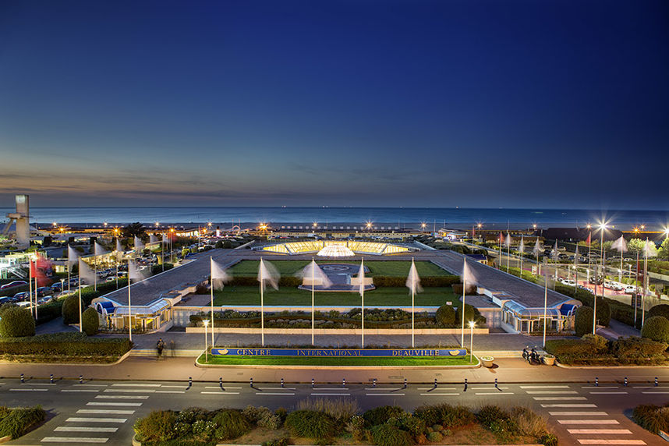
IPAC’26 Status report
Hanna Franberg-Delahaye
Local Organising Chair

Slide 2

Registrations Monday at 14:00
Female | Male | Totale | Paiements done
88 | 245 | 333 | 108
Scientific | Students | EPS members | Accompanying | Exhibitor extra
221 | 37 | 21 |  | 11
Cocktail Tuesday, Banquet Thursday: 319
84 invitation letter for VISA
80 bus tickets from Paris- Deauville Saturday/Sunday
40 bus tickets Deauville-Paris
Visites
SOLEIL: 46
ESRF: 9
GANIL: 51
100-113 lunches
15 printed versions

Slide 3
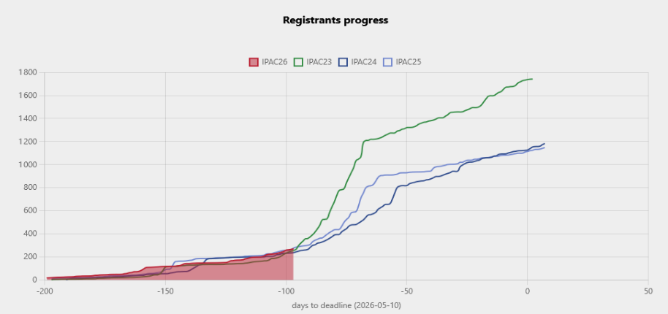
What to expect next couple of weeks:
18 Mars:
Changement tarif
Recencer les horaires de vols plannifiers les nombres de bus.

Slide 4
LOC
PCO
SPC
2025
LOC Meetings In-Person (April, September?)
2024
Nov.
Dec.
Jan.
Feb.
April
May
June
Jul.
Sep.
Oct.
Nov.
Dec.
1st announcement of IPAC26 to the industry
Website ready
Formation of the SAB
Deadline for submission of abstracts, grant applications and awards.
Classification in INDICO
Contr.
Transport
Sites
Caterers
Creation of registration and payment forms
Finalisation of the site for registrations and payments + tests
Invitation from the editorial team - JACOW
Contracting for accommodations
Posters to be sent
Call for oral contributions
Registration opens
+
Abstract submissions
SPC2
2 distance and 1 in Taipei
Selection of the featured speakers referred to as 'invited'
Website online
Summary programme +
Letter to the invited speakers
JACoW Meeting
16

Slide 5
2026
IPAC’26
LOC meetings
LOC
PCO
SPC
Jan.
Feb.
March
April
May
June
July
SPC3 Meeting – selection of oral presentations and session chairs
Announcement of the student grants
End of Early-Bird
Creation of edited documents
Submission of the proceedings
Debriefing notes
FAIT
Announcement of the posters
Number of posters per day.
Assignment of codes (presentations, posters…)
Set up the site
Budget closing
FAIT
FAIT
FAIT
Publication of the proceedings 'pre-press'
REX GANIL
Validation of the programme
Downloading of contributions
Information on future accelerator projects
FAIT
FAIT
Invitations to various VIPs
Decision on the number of student grants
Encours
Announcement of the awards
1st confirmation of estimated catering numbers
First release of hotel rooms
……..
FAIT
Encours
Preparation of the awards
Contracting PCs for editing and others
FAIT
Finalise the bus numbers
Define evening animations
Finalise the ceremonies:
of openings
Price
Closure
Programme validation
FAIT
Encours
24

Slide 6


IPAC Booklets
CONFERENCE GUIDE
PARTICLE ACCELERATOR
BOOKLET
+ Booklet
Student session and poster présentations
A questionnaire will be sent in a week or two to all laboratories.
In electronic PDF version.
+ printed copies can be ordered at the registration
Same chapters and structure as IPAC’23

Slide 7


Badge
Hanna
FRANBERG DELAHAYE
GANIL, FRANCE

Slide 8
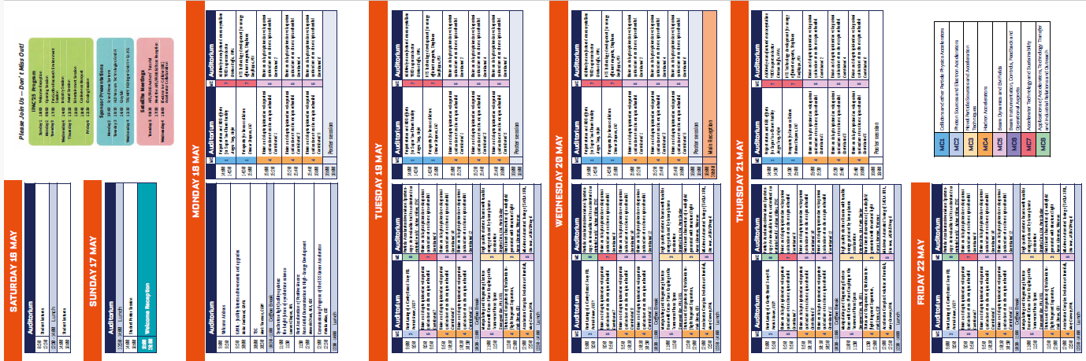

Pocket guide
Short Program and information folder

Slide 9
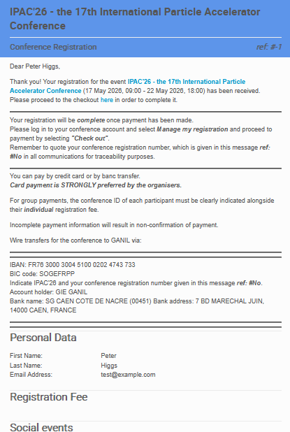
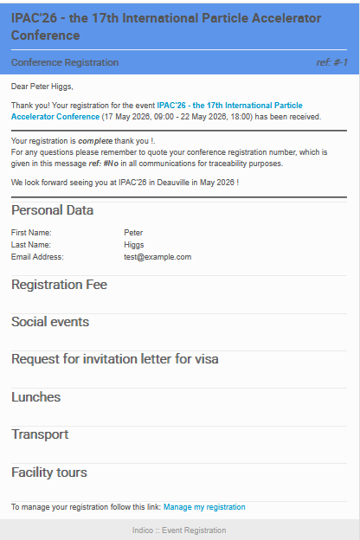
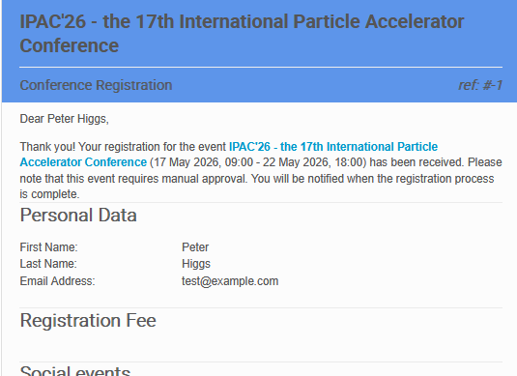
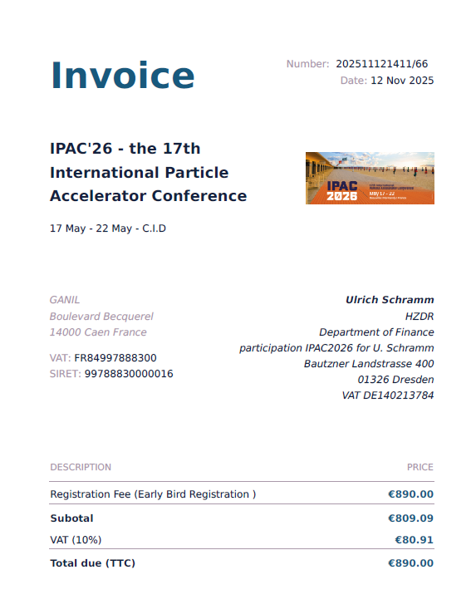
Register flow on INDICO
Email to: registration@ipac26.org
Manual verification
Indico
Confirmation and Payment
Manual verification if wire transfer
Indico
If modification manual modification
******
3 messages:
1st after registration – pending
2nd after verification → payment information
3rd after payment
If requested :

Slide 10
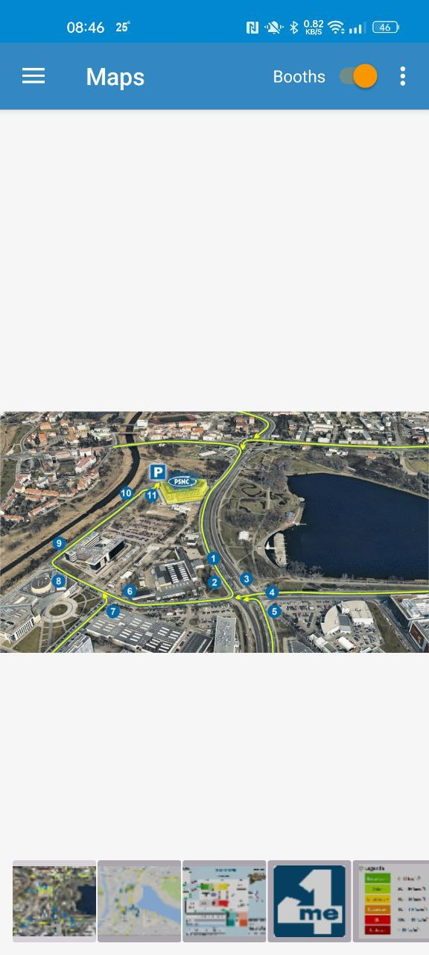
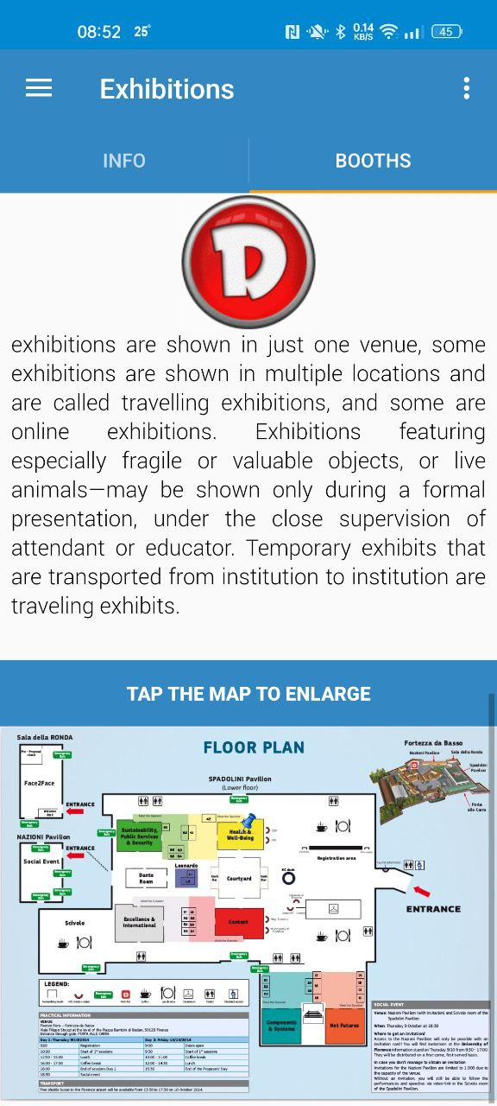
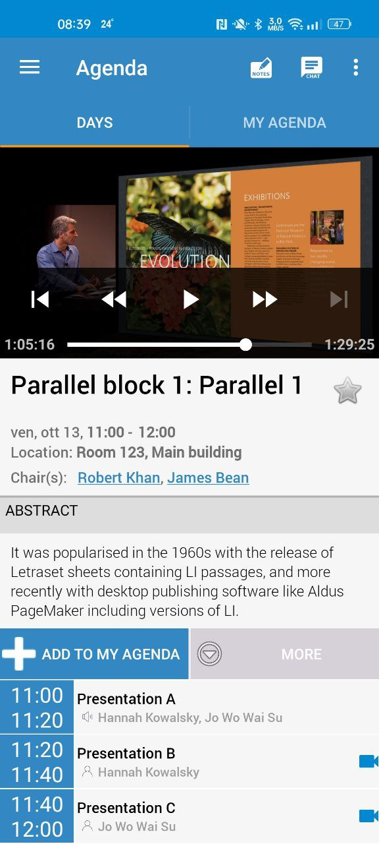
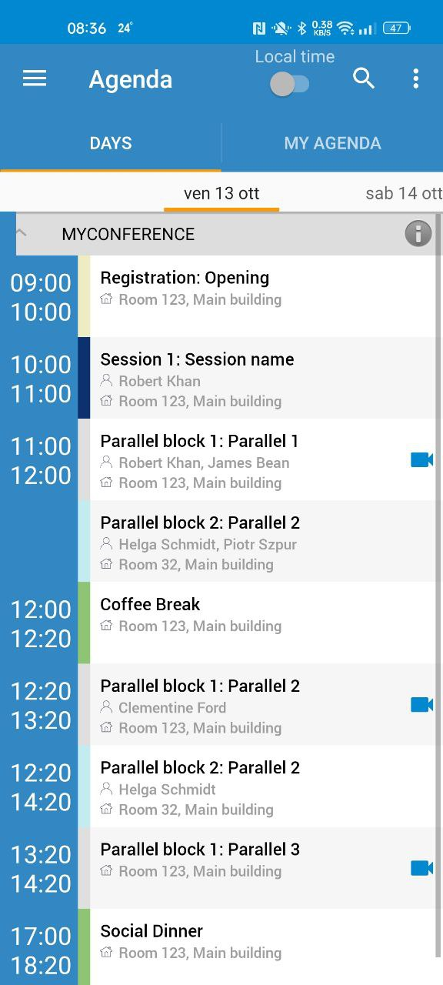
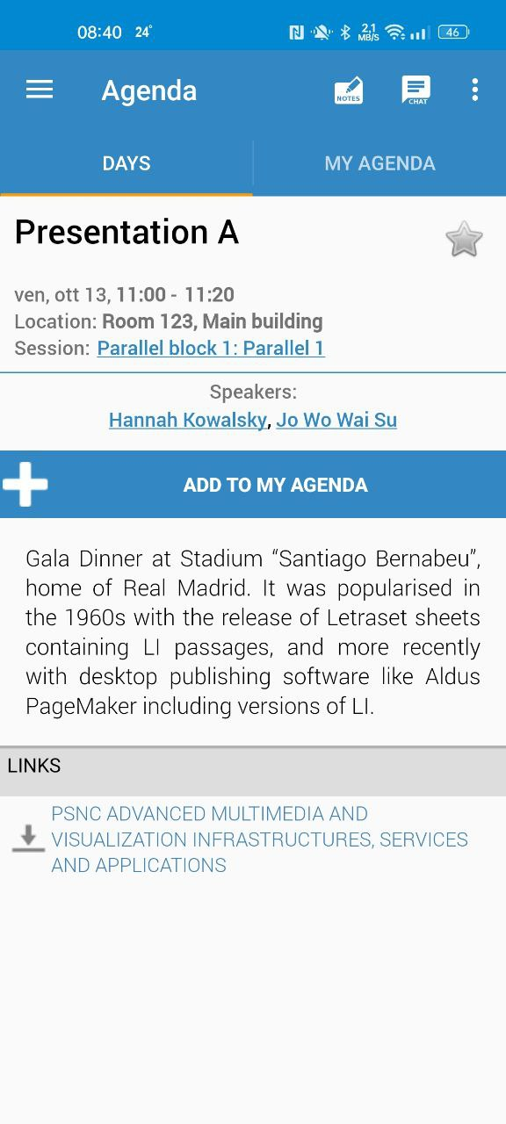
Mobile App / Info
Notes:
Slide 3 – (..) : Content of the presentation
Insert a new slide: Home > “New Slide” and choose a slide Layout:
For Title & Subtitle
For text with bullet points
For Text
For Picture, graphs, visuals
Two columns
Blank
If you want Copy & paste an element from the Clip Board to the particular slide:
1. Click on a box to mark it.
2. Position the mouse pointer on the box frame: Copy!
3. Click on the particular slide: Paste!
How you intend to use the elements is your choice.
You can combine the text block style with the background colour in different manner.

Slide 11
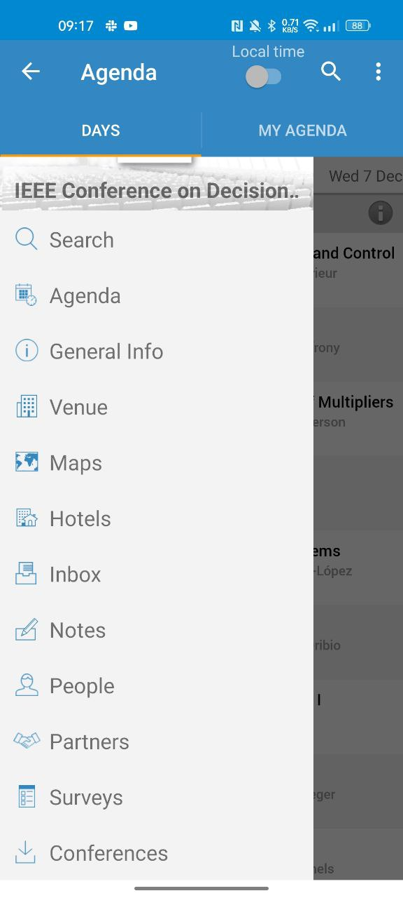
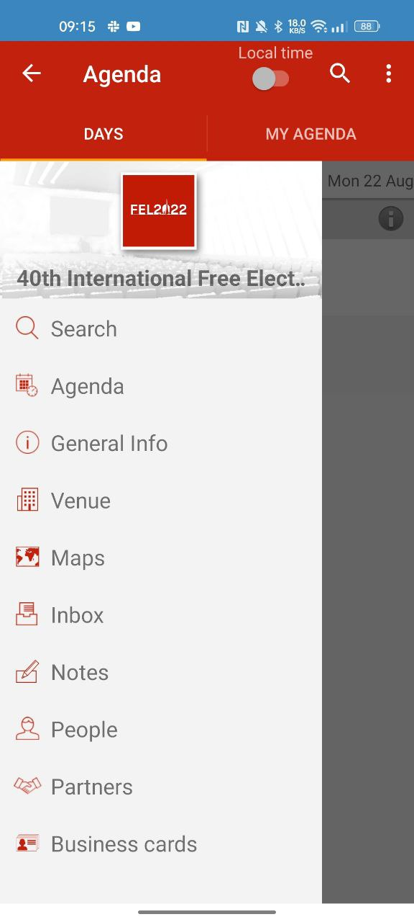

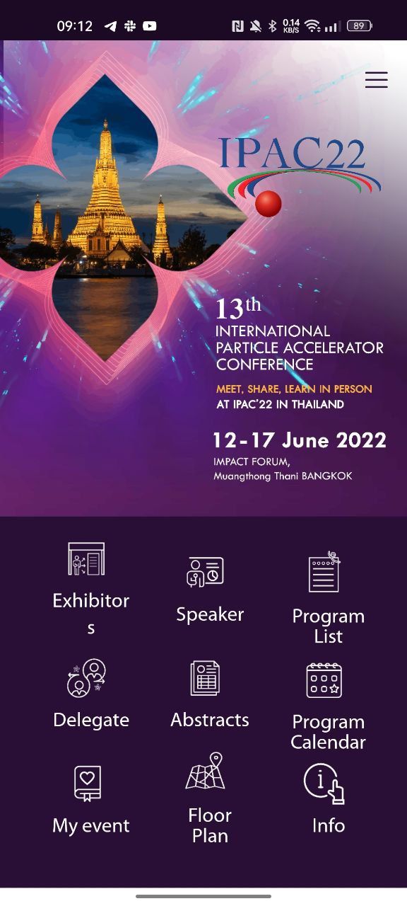
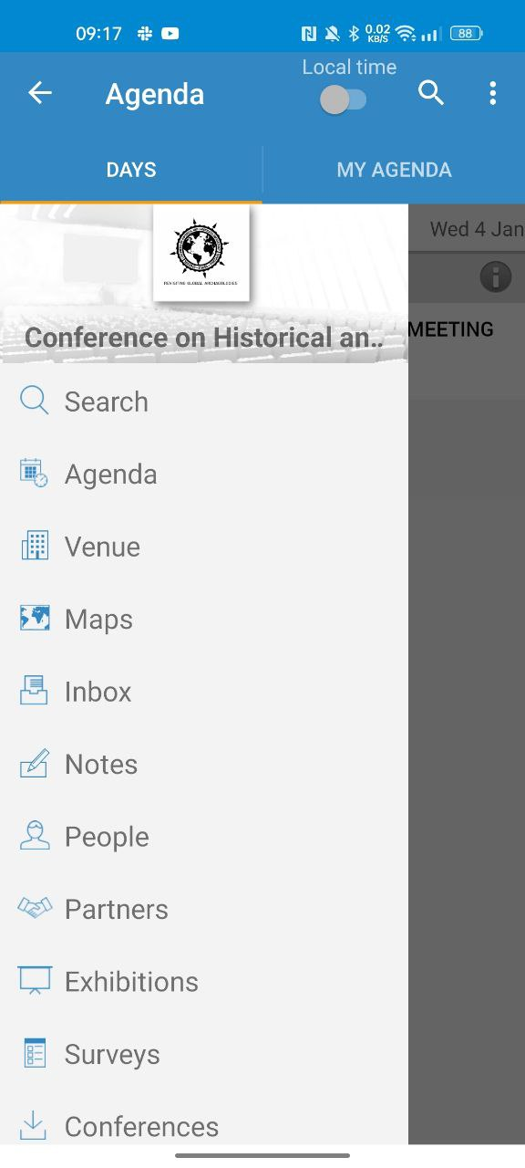
Same as other conferences

Slide 12
Codes wifis
?

