Slide 1






SUPO014
Experimental Validation of an X-Band LLRF Prototype for High-Gradient Linear Accelerators
Phani Deep Meruga, Borut Baričevič, et al.
August ${20}^{th}$, 2026
Daejeon, South Korea
Email: phanideep.meruga@i-tech.si
This project has received funding from the European Union‘s Horizon Europe research and innovation programme under grant agreement no. 101073480.

Slide 2
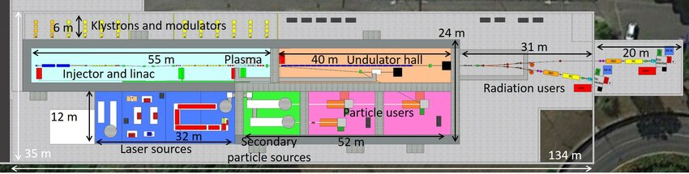
Motivation
  EuPRAXIA aims to develop a compact, high-performance FEL facility based on X-band linacs and plasma accelerators
  Designed to significantly reduce the size and cost of future accelerator facilities compared to conventional technologies
  Challenge of controlling RF parameters (amplitude and phase) at high frequencies and for very short pulses (~ 100ns).
  Development of an X-Band LLRF prototype system in the the context of EuPRAXIA-DN.
Reference: EuPRAXIA SPARC LAB
LINAC’26 Student poster prize · Daejeon, South Korea · August 20th, 2026
2

Slide 3
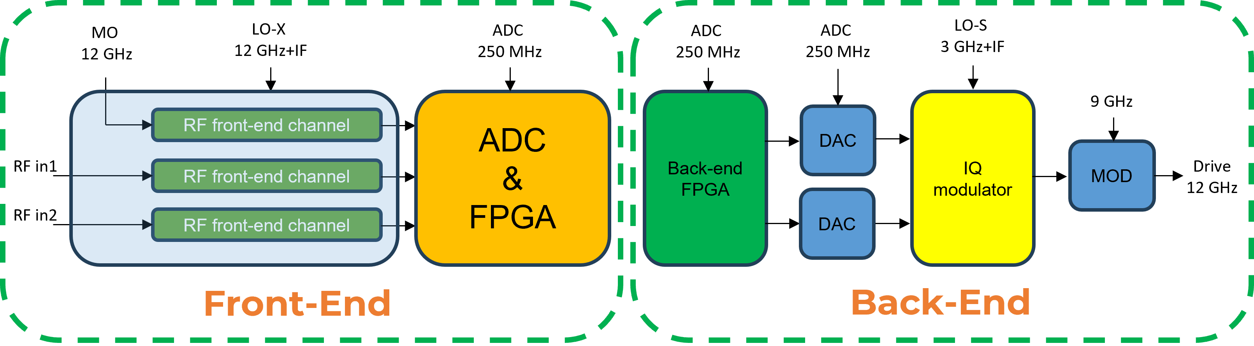
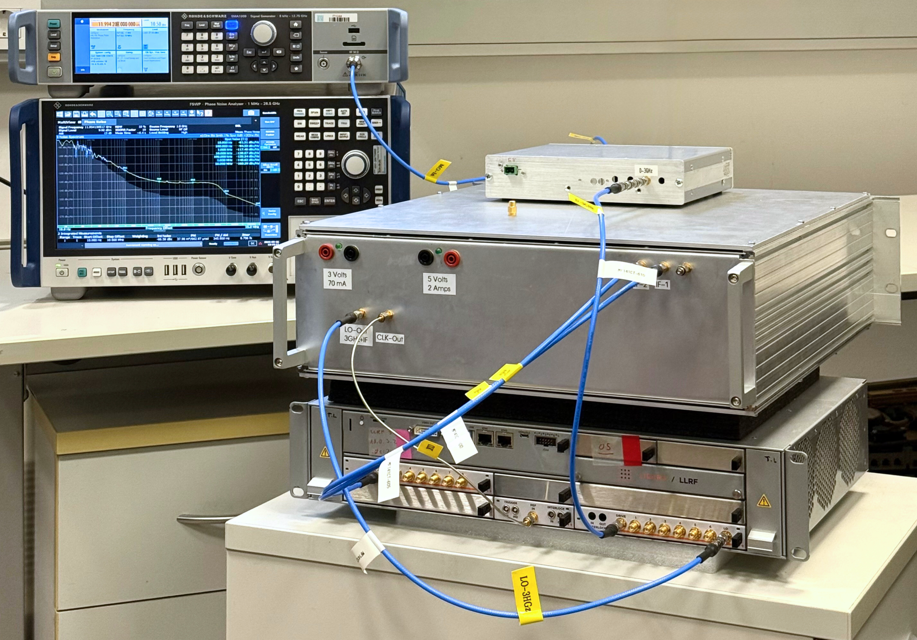
Prototype Block Diagram
  ¸Development approach for the prototype:
  Single stage down-conversion
  Double stage up-conversion
  Open loop prototype (separate front-end and back-end systems)
LO and ADC synthesis
MO 12 GHz
ADC
LO-S
LO-9 GHz
LO-X
MO
12 GHz
ADC
250 MHz
LO-S
3 GHz+IF
9 GHz
LO-X
12 GHz+IF
LINAC’26 Student poster prize · Daejeon, South Korea · August 20th, 2026
3

Slide 4
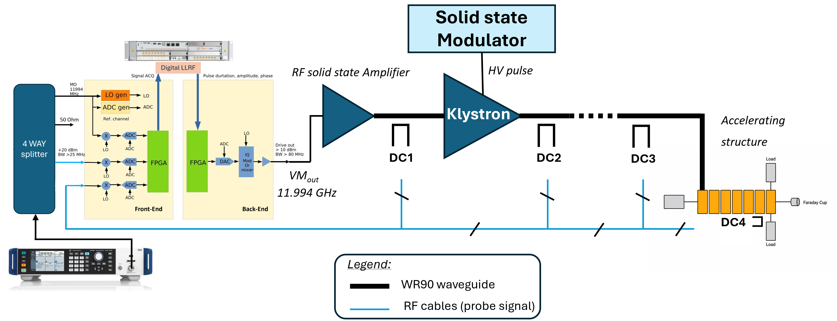
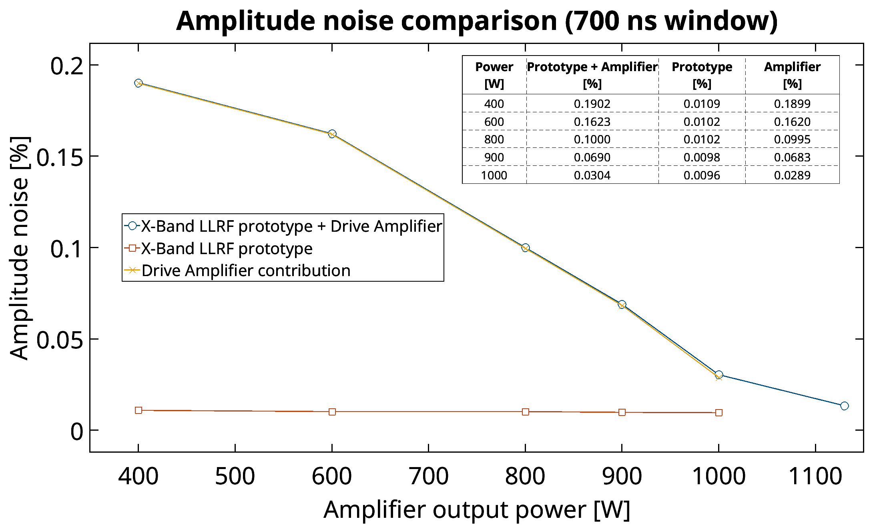
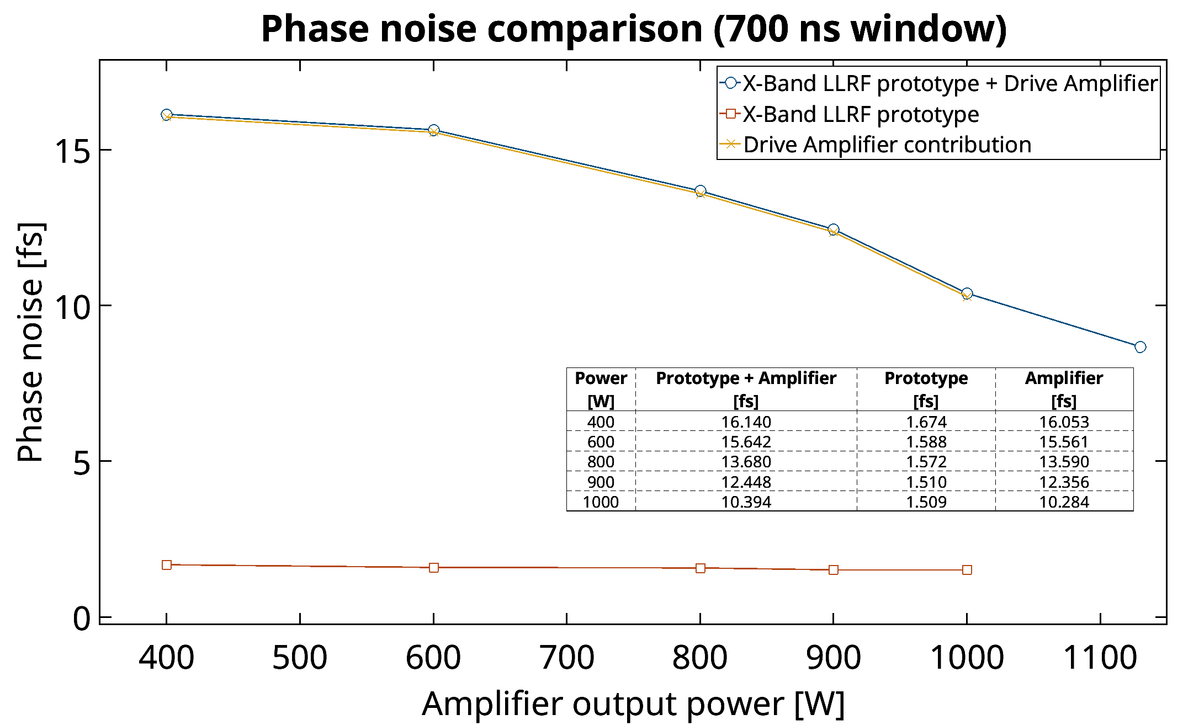
Drive Amplifier Tests at TEX Facilty - INFN
  No of Pulses : 6000 @ 50 Hz
  Pulse averaging window: 700ns
  Amplifier output: 400W → 1.1kW (saturation)
LINAC’26 Student poster prize · Daejeon, South Korea · August 20th, 2026
4

Slide 5
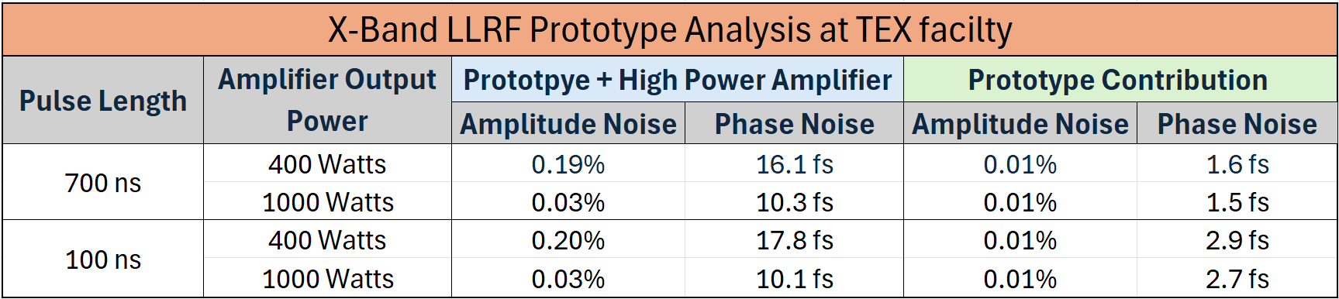
Drive Amplifier Tests at TEX Facilty - INFN
  No of Pulses : 6000 @ 50 Hz
  Pulse averaging window: 700ns
  Amplifier output: 400W → 1.1kW (saturation)
LINAC’26 Student poster prize · Daejeon, South Korea · August 20th, 2026
5

Slide 6
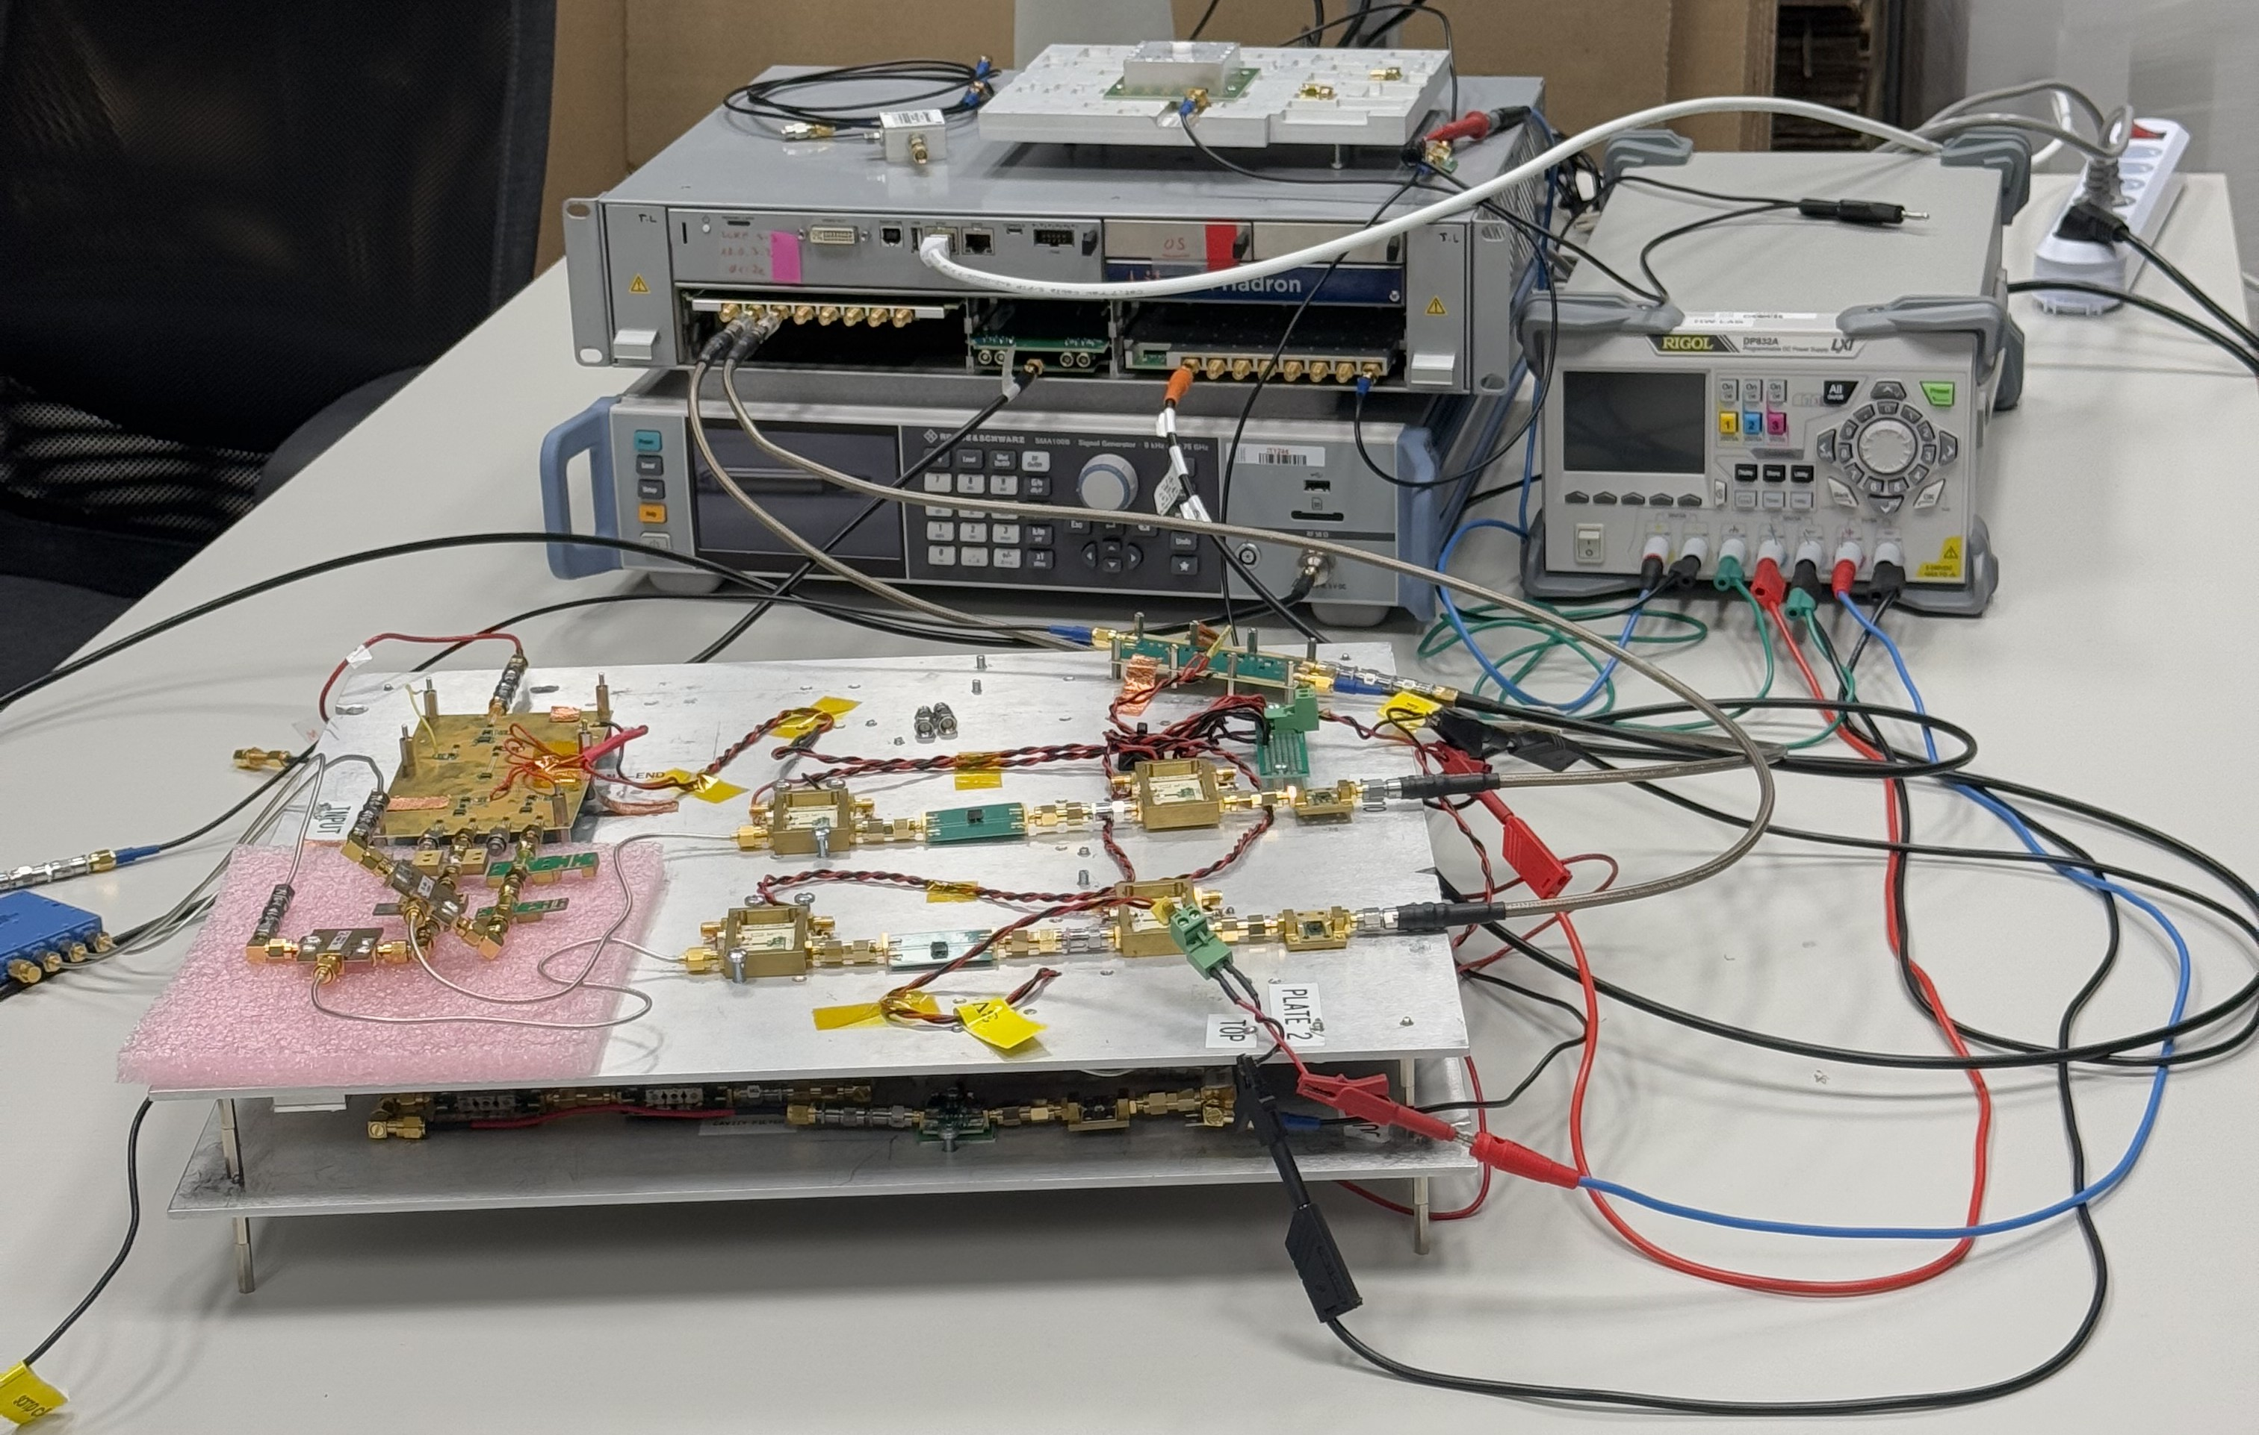
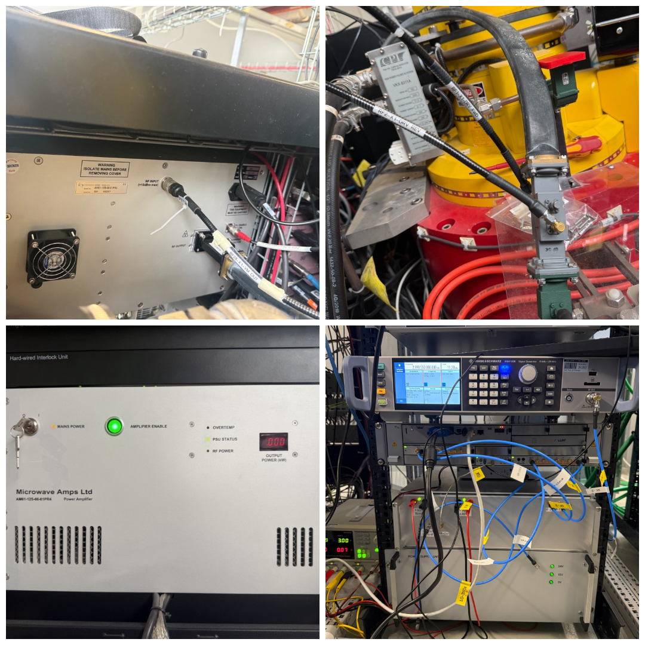
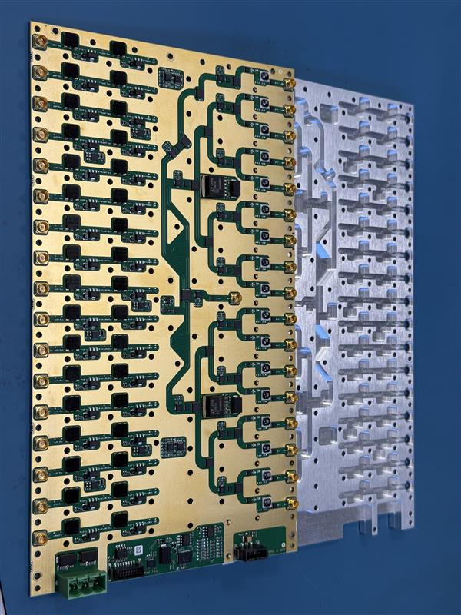
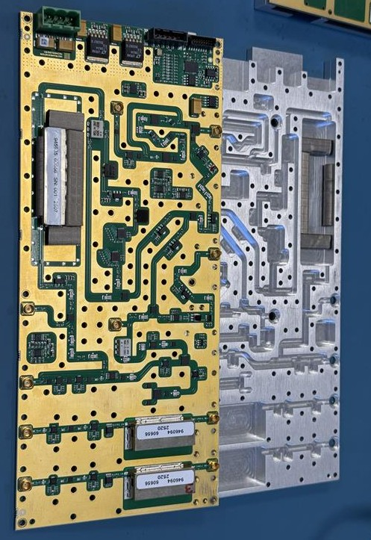
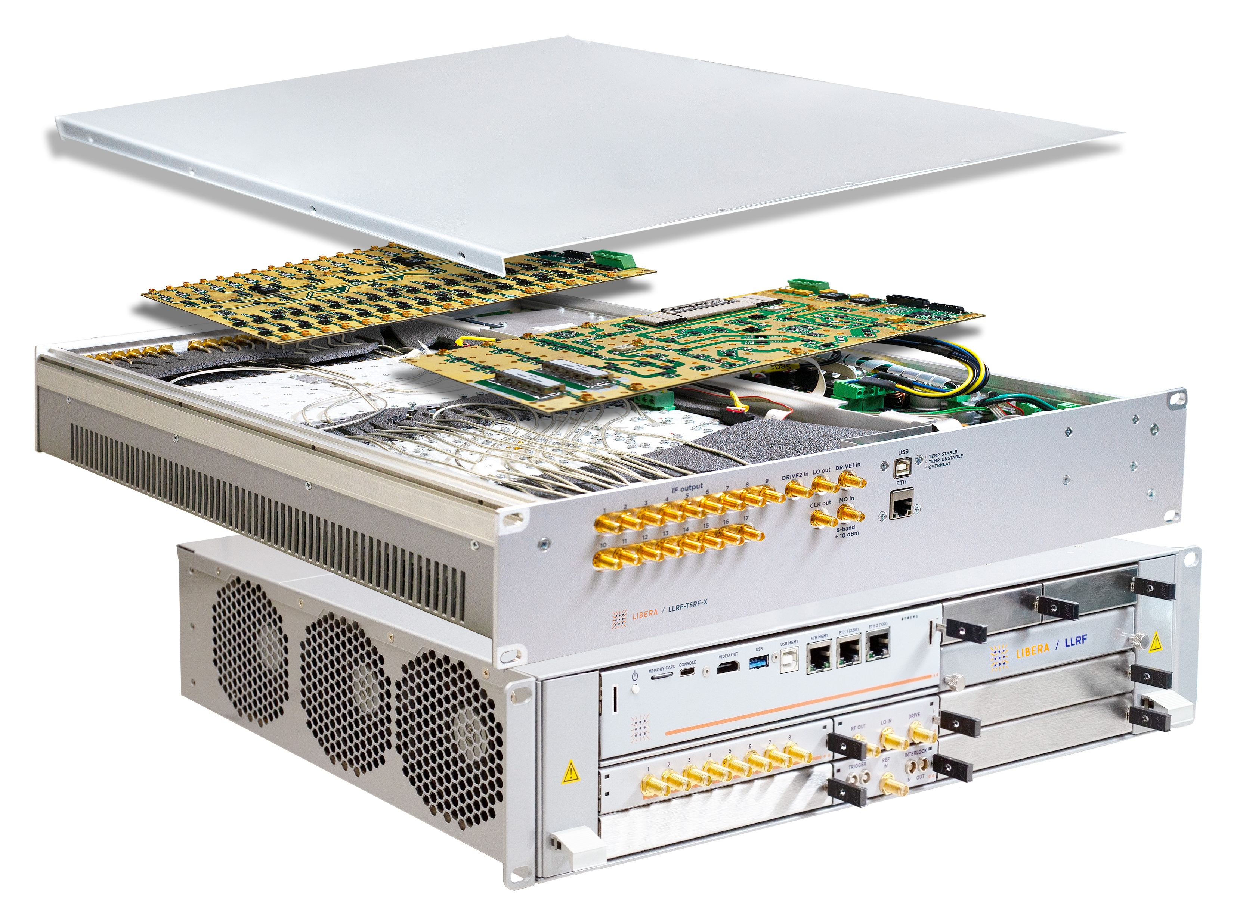
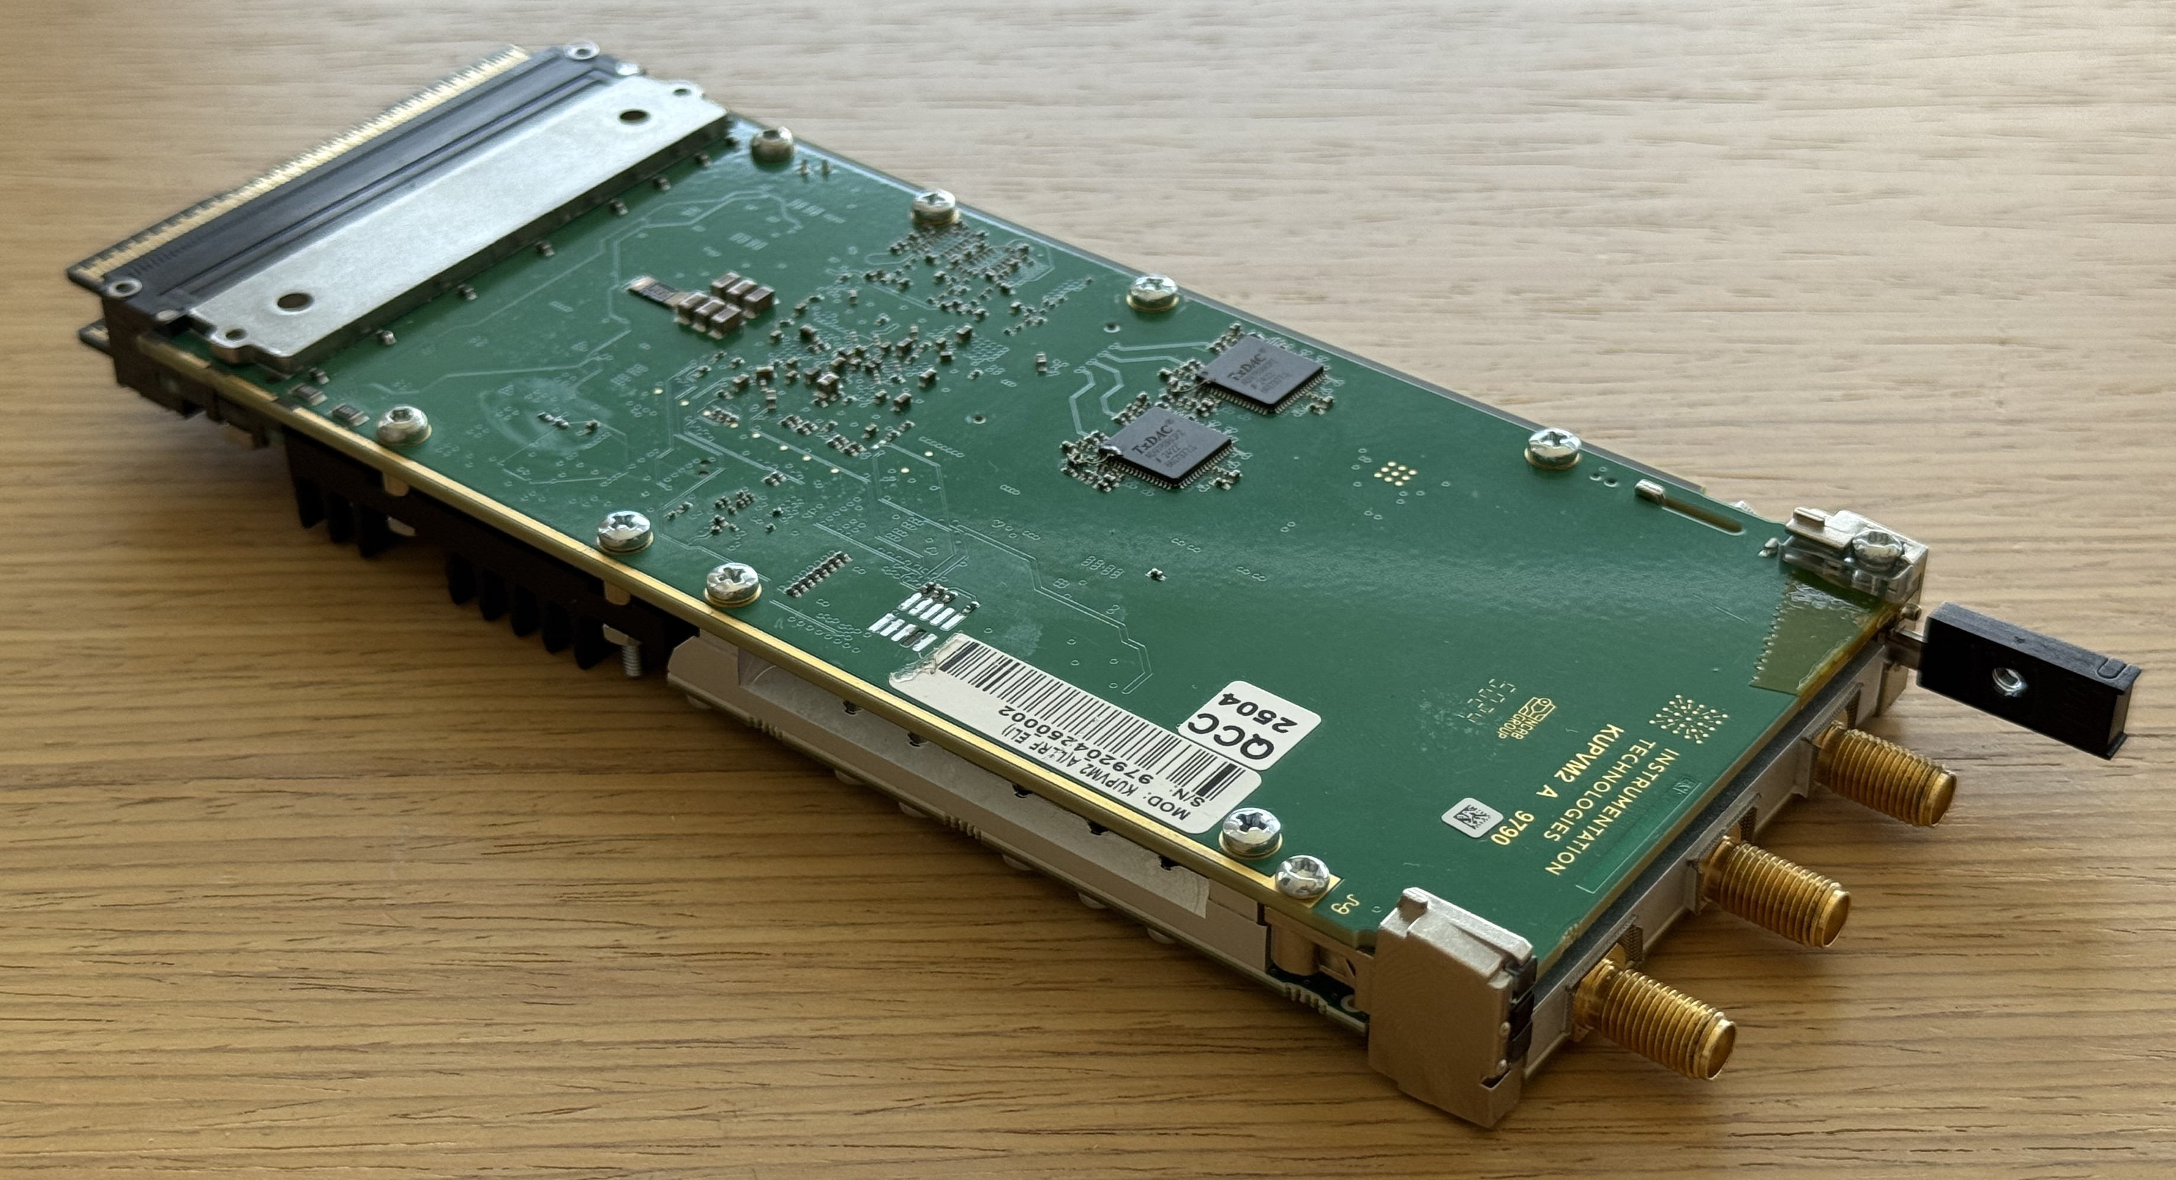
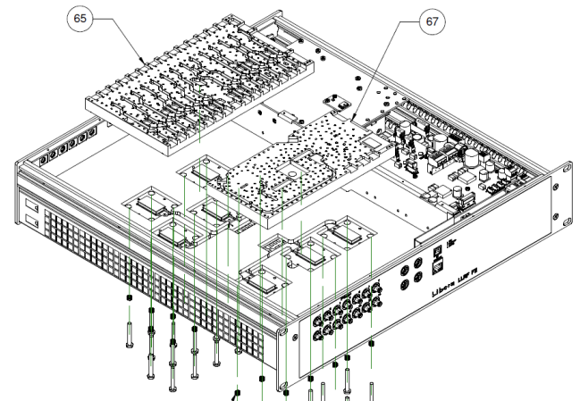
Project Overview:
VALIDATION – TEX facilty
2025-2026
LINAC‘2024
IPAC‘2025
LLRF‘2025
DESIGN & DEVELOPMENT
2023-2024
LINAC‘2026
INDUSTRIALIZATION - 2026
LINAC’26 Student poster prize · Daejeon, South Korea · August 20th, 2026
6

Slide 7
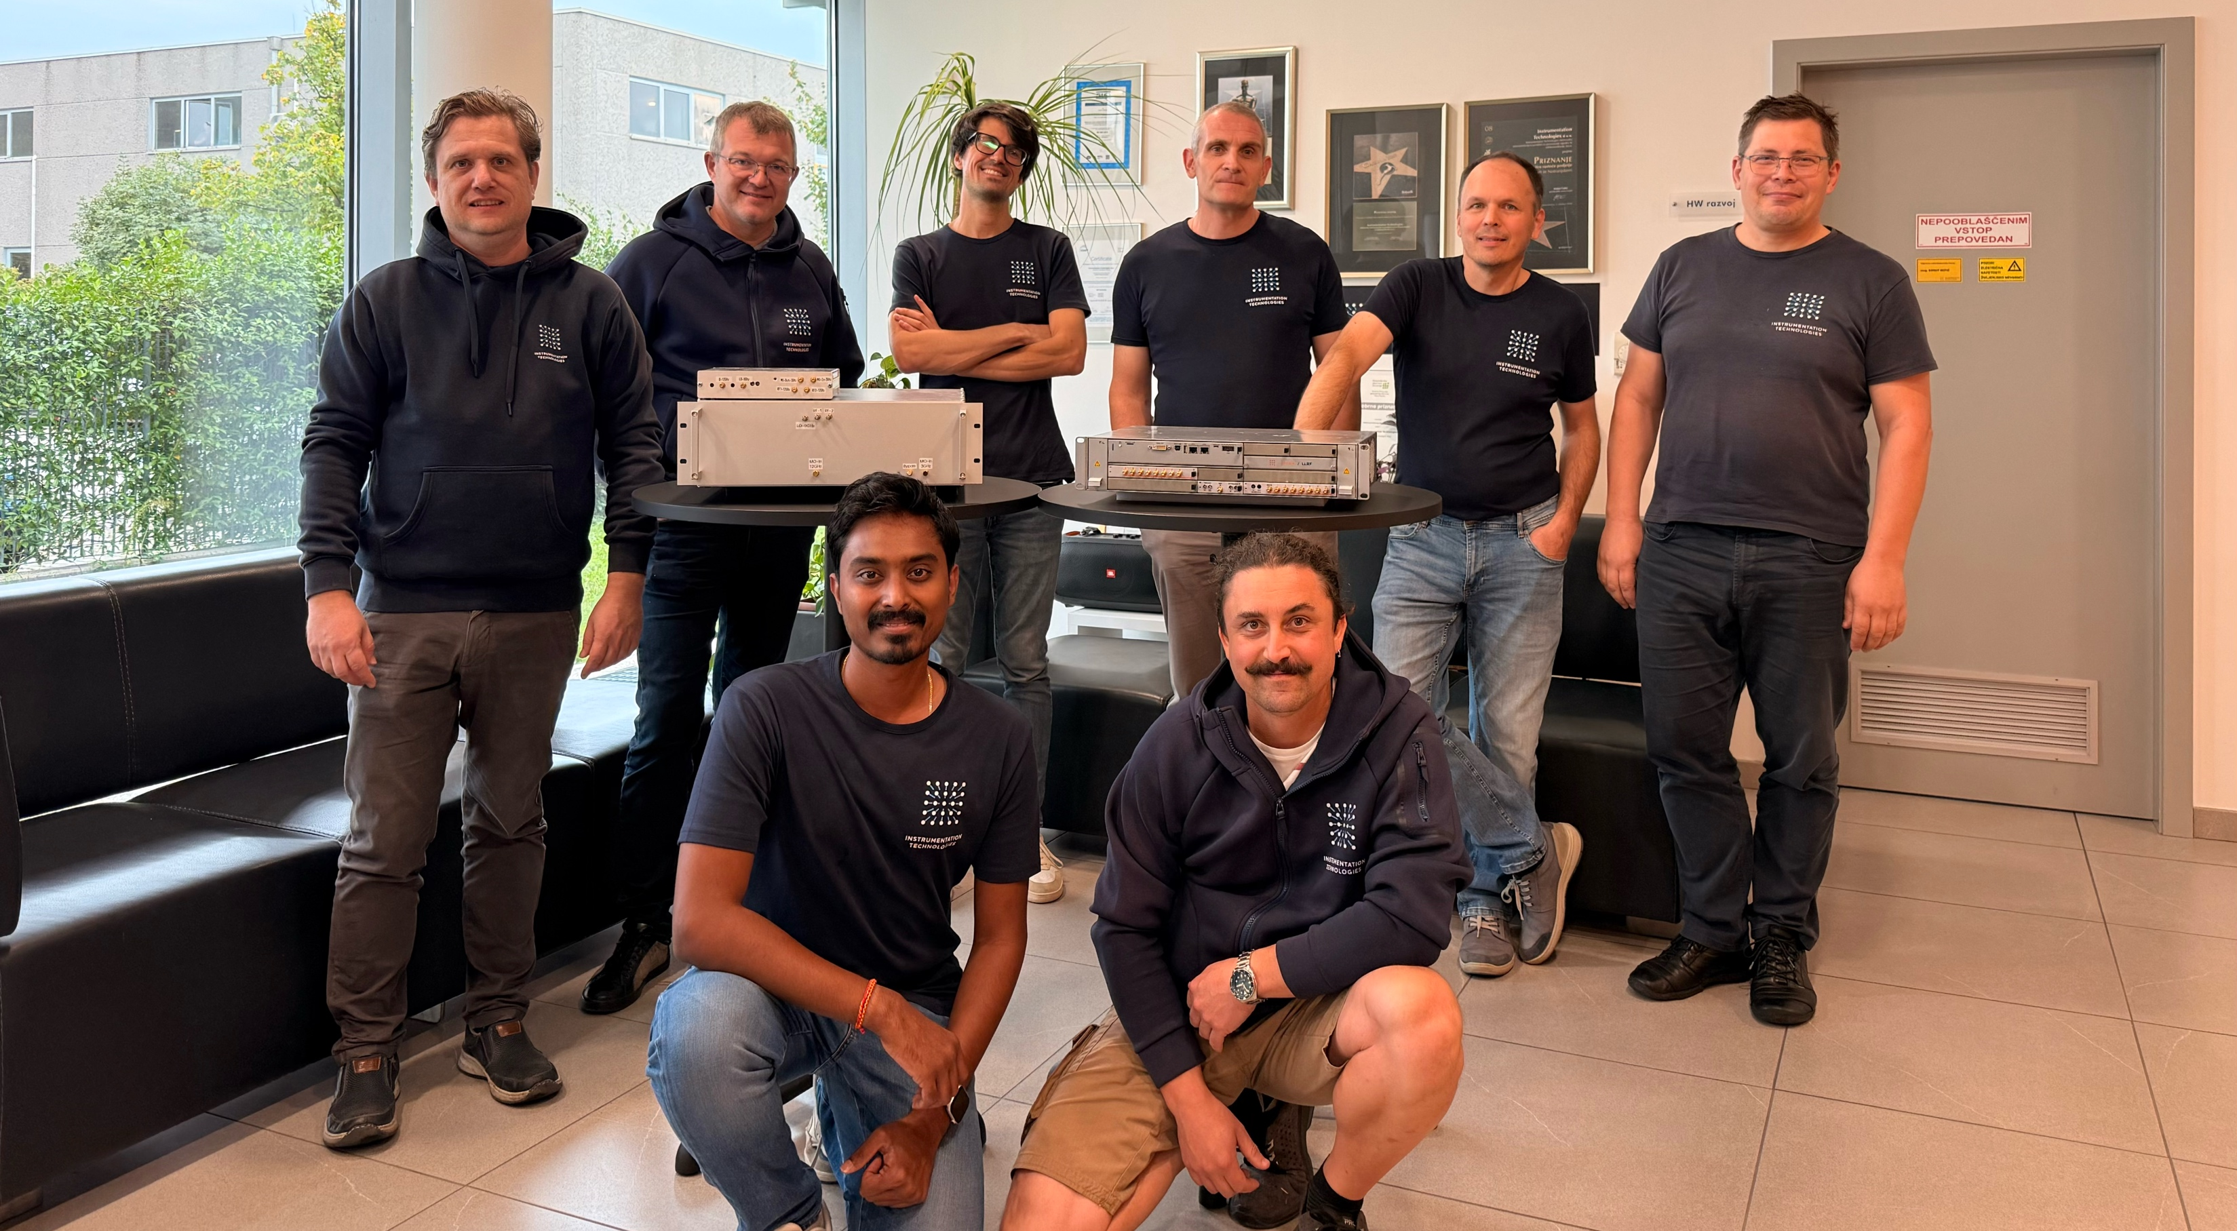
THPO057
Thank you!
Many thanks to HW, SW, FPGA colleagues at I-TECH
Special Thanks to RF group at TEX facility, INFN-LNF
Acknowledgements:
A. Mostacci², B. Serenellini³, B. Baričevič¹, F. Cardelli³, G. Latini³
L. Piersanti³, M. Cargnelutti¹, M. Bellaveglia³, S. Pioli³, X. Fang³
Instrumentation Technologies, Solkan, Slovenia
Sapienza University of Rome, Rome, Italy
Istituto Nazionale di Fisica Nucleare – Laboratori Nazionali di Frascati, Frascati, Italy
This project has received funding from the European Union‘s Horizon Europe research and innovation programme under grant agreement no. 101073480.
LINAC’26 Student poster prize · Daejeon, South Korea · August 20th, 2026
7

