Slide 1
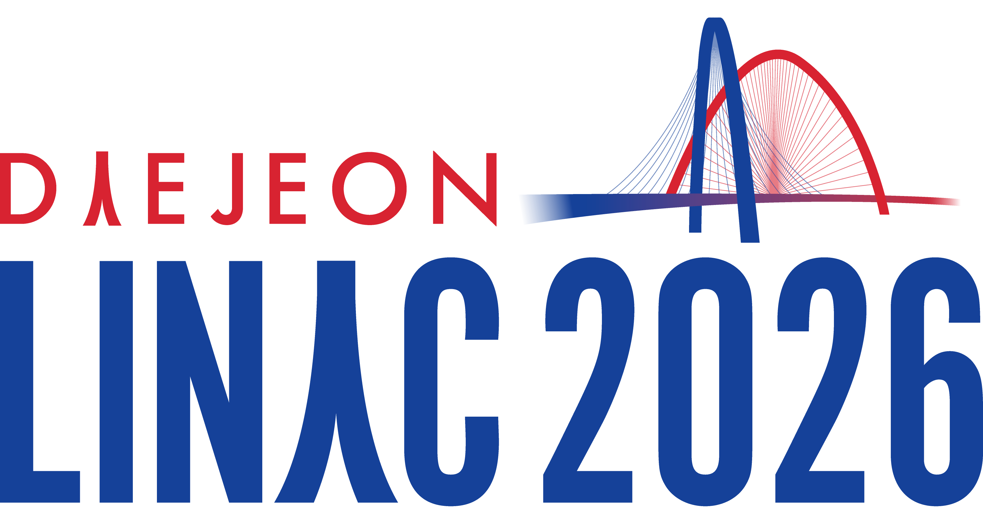
Charge carrier dynamics and emission from Cu and Cs₂Te cathodes in RF photoguns
Mikhail Vladimirov✉, Sergey Polozov, Vladimir Rashchikov
Dept. of Electrophysical Facilities, MEPhI, Moscow, Russia
Mikhail.Vladimirov.PhD@gmail.com
M. V. thanks the Organizing Committee of LINAC’26 for supporting his contribution (Student Grant Application #94, SUPO004)
Mikhail Vladimirov (MEPhI)
LINAC'26, Aug. 16 – 21, 2026. THPO086

Slide 2
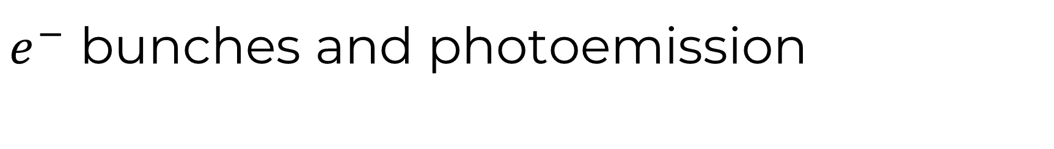
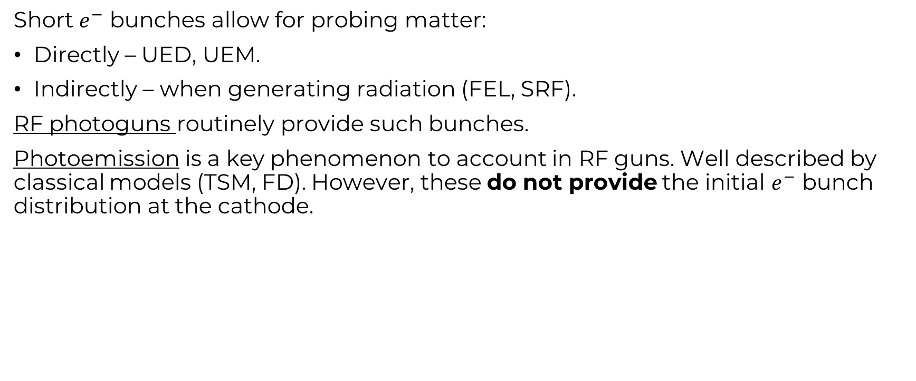
$e^{−}$ bunches and photoemission
Short $e^{−}$ bunches allow for probing matter:
Directly – UED, UEM.
Indirectly – when generating radiation (FEL, SRF).
RF photoguns routinely provide such bunches.
Photoemission is a key phenomenon to account in RF guns. Well described by classical models (TSM, FD). However, these do not provide the initial $e^{−}$ bunch distribution at the cathode.
Start-to-end modelling
The more correctly e-bunch distributions at the cathode surface are simulated, the more precisely we calculate beam dynamics and overall facility operation.
Mikhail Vladimirov (MEPhI)
LINAC'26, Aug. 16 – 21, 2026. THPO086

Slide 3
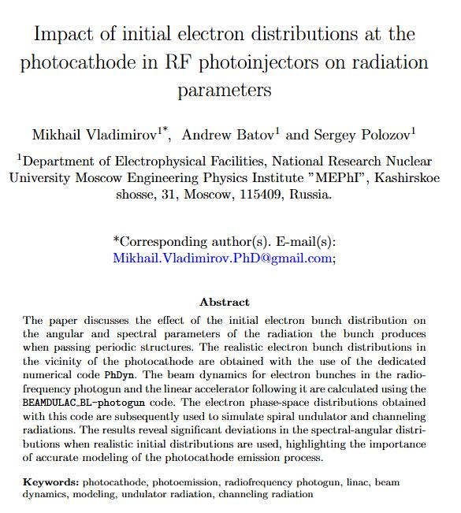
Transport equation formalism
In general: describing optoelectonic and photovoltaic applications.
We: transport equation formalism has been extensively used to study the photocathode physics:
M. Vladimirov, V. Rashchikov, S. Polozov, JINST, 19 (2024),
M.V. Vladimirov, S.M. Polozov, V.I. Rashchikov, JETP Lett., 120 (2024),
M. Vladimirov, V. Rashchikov, S. Polozov, NIM-A, 1045 (2025),
M. Vladimirov, V. Rashchikov, S. Polozov, EPJ ST, TBD (2026).
Submitted to EPJ D (Proc. of RREPS-25).1
Mikhail Vladimirov (MEPhI)
LINAC'26, Aug. 16 – 21, 2026. THPO086

Slide 4
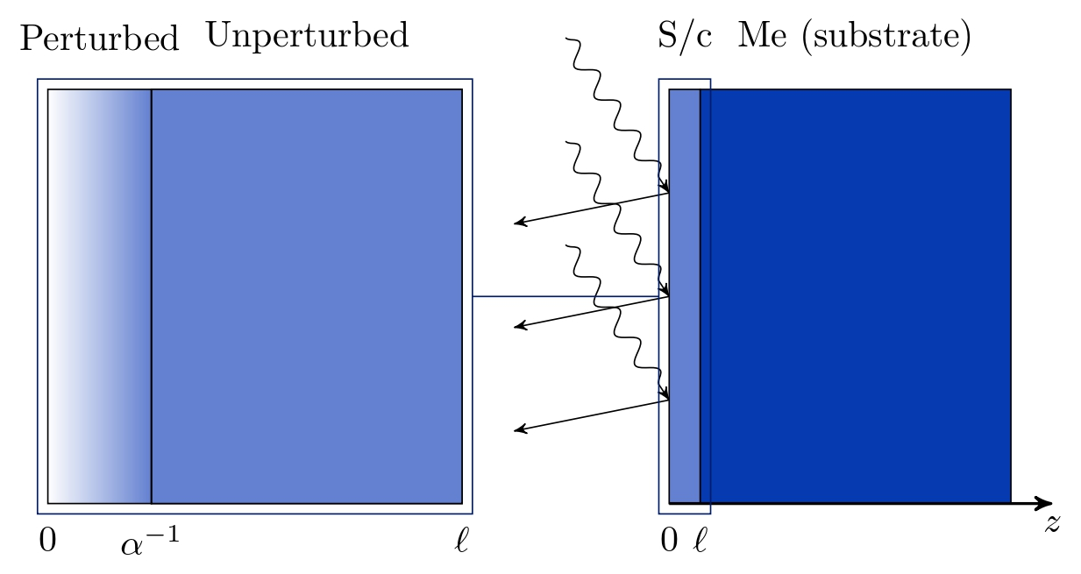
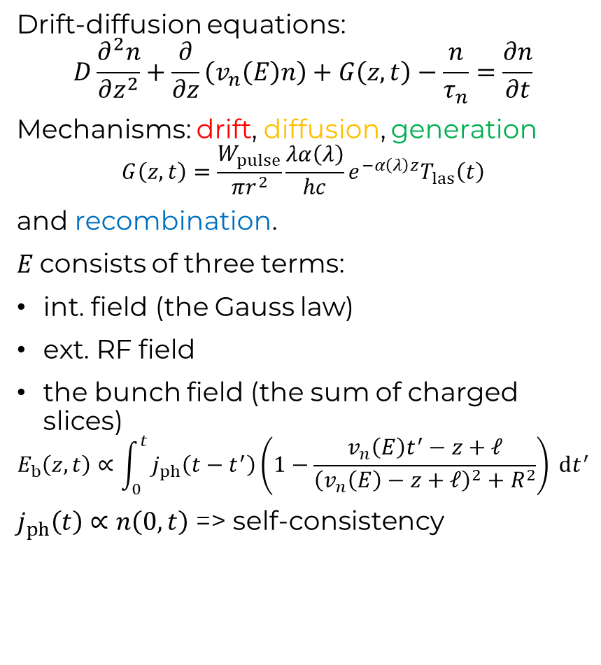
Theoretical framework
Drift-diffusion equations:
$$D\frac{∂^{2}n}{∂z^{2}}+\frac{∂}{∂z}\left(v_{n}\left(E\right)n\right)+G\left(z,t\right)−\frac{n}{τ_{n}}=\frac{∂n}{∂t}$$
Mechanisms: drift, diffusion, generation
$$G\left(z,t\right)=\frac{W_{pulse}}{πr^{2}}\frac{λα\left(λ\right)}{hc}e^{−α\left(λ\right)z}T_{las}\left(t\right)$$
and recombination.
$E$consists of three terms:
int. field (the Gauss law)
ext. RF field
the bunch field (the sum of charged slices)
$$E_{b}\left(z,t\right)∝\int_{0}^{t}{j_{ph}\left(t−t^{′}\right)\left(1−\frac{v_{n}\left(E\right)t^{′}−z+ℓ}{{\left(v_{n}\left(E\right)−z+ℓ\right)}^{2}+R^{2}}\right) dt^{′}}$$
$j_{ph}\left(t\right)∝n\left(0,t\right)$ => self-consistency
Semiconductor photocathode sketch. A perturbed region is the only one, where photoelectrons are generated (and, hence, the one of interest).
In this region DDP are posed and solved.
Mikhail Vladimirov (MEPhI)
LINAC'26, Aug. 16 – 21, 2026. THPO086

Slide 5
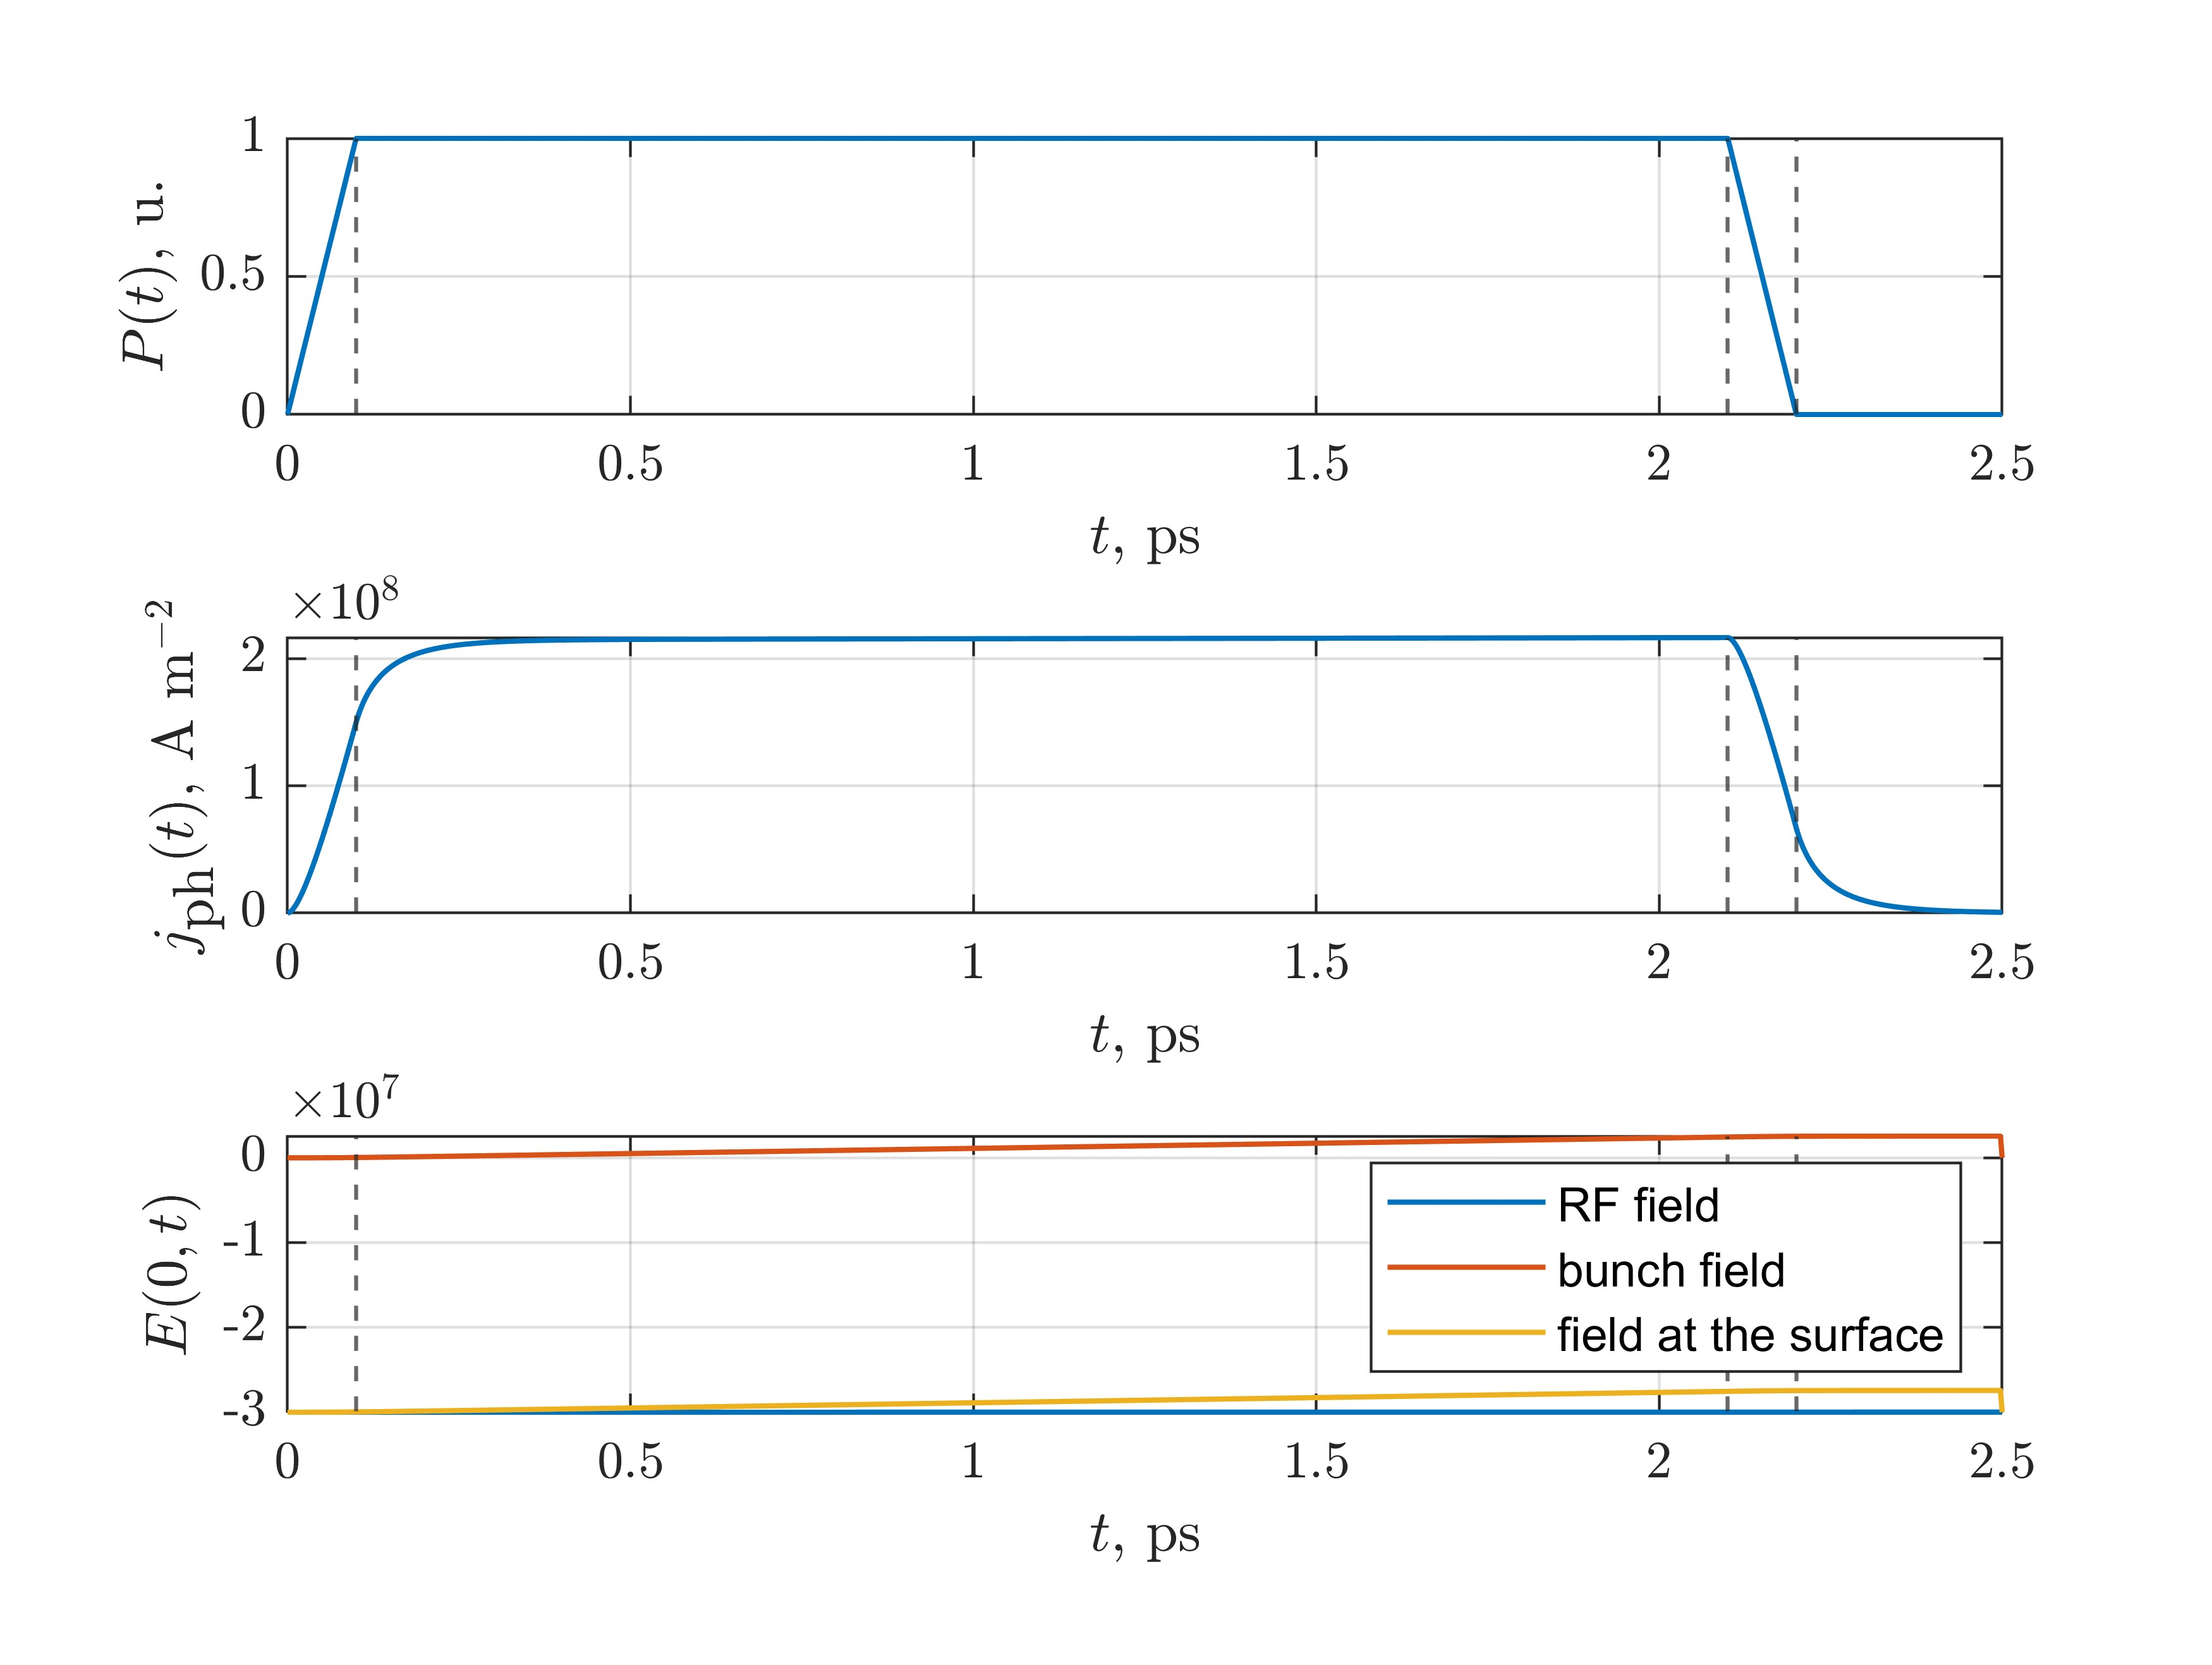
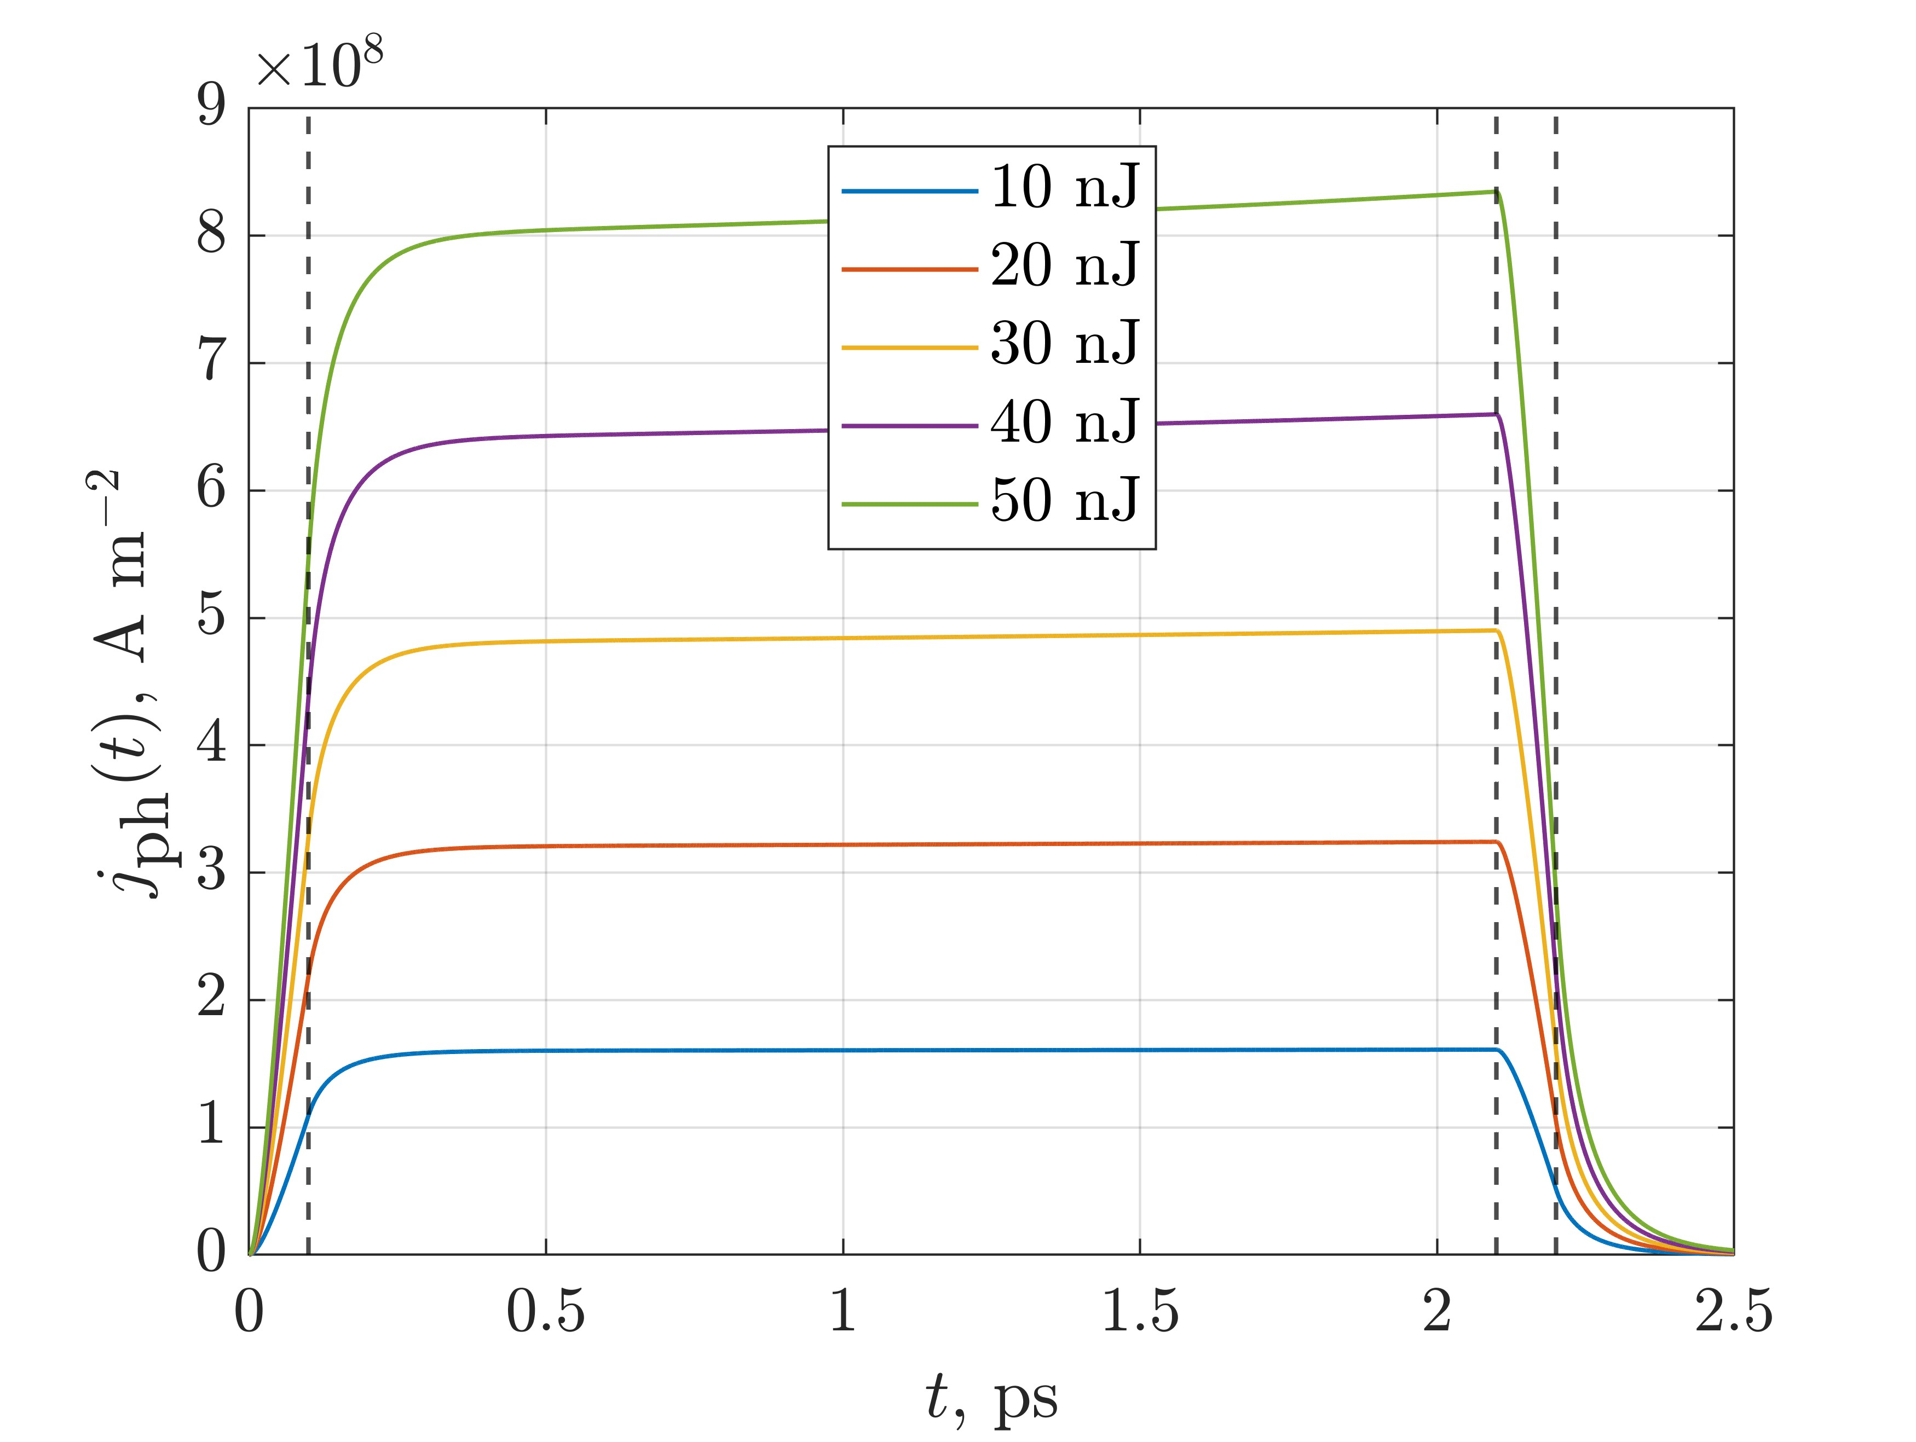
Linear regime
Vladimirov, M., Rashchikov, V. & Polozov, S. Self-consistent photocathode charge carrier dynamics in radiofrequency photoinjectors. Eur. Phys. J. Spec. Top. (2026). https://doi.org/10.1140/epjs/s11734-026-02273-3
Mikhail Vladimirov (MEPhI)
LINAC'26, Aug. 16 – 21, 2026. THPO086

Slide 6
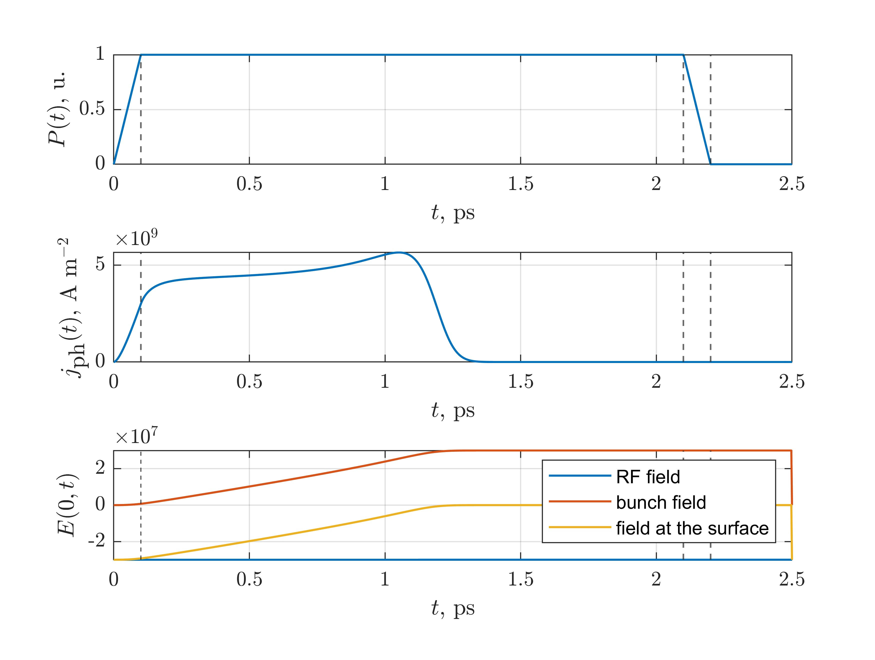
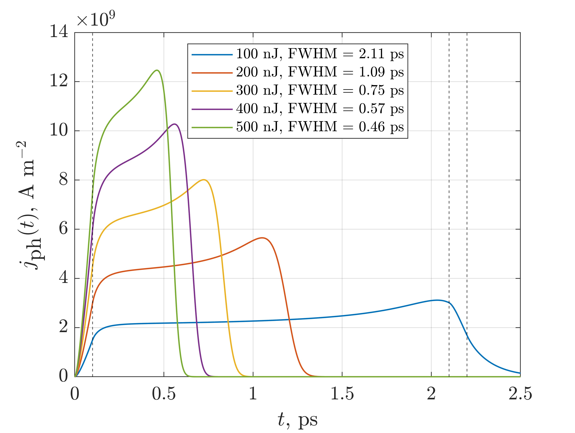
Saturated emission
Vladimirov, M., Rashchikov, V. & Polozov, S. Self-consistent photocathode charge carrier dynamics in radiofrequency photoinjectors. Eur. Phys. J. Spec. Top. (2026). https://doi.org/10.1140/epjs/s11734-026-02273-3
Mikhail Vladimirov (MEPhI)
LINAC'26, Aug. 16 – 21, 2026. THPO086

Slide 7
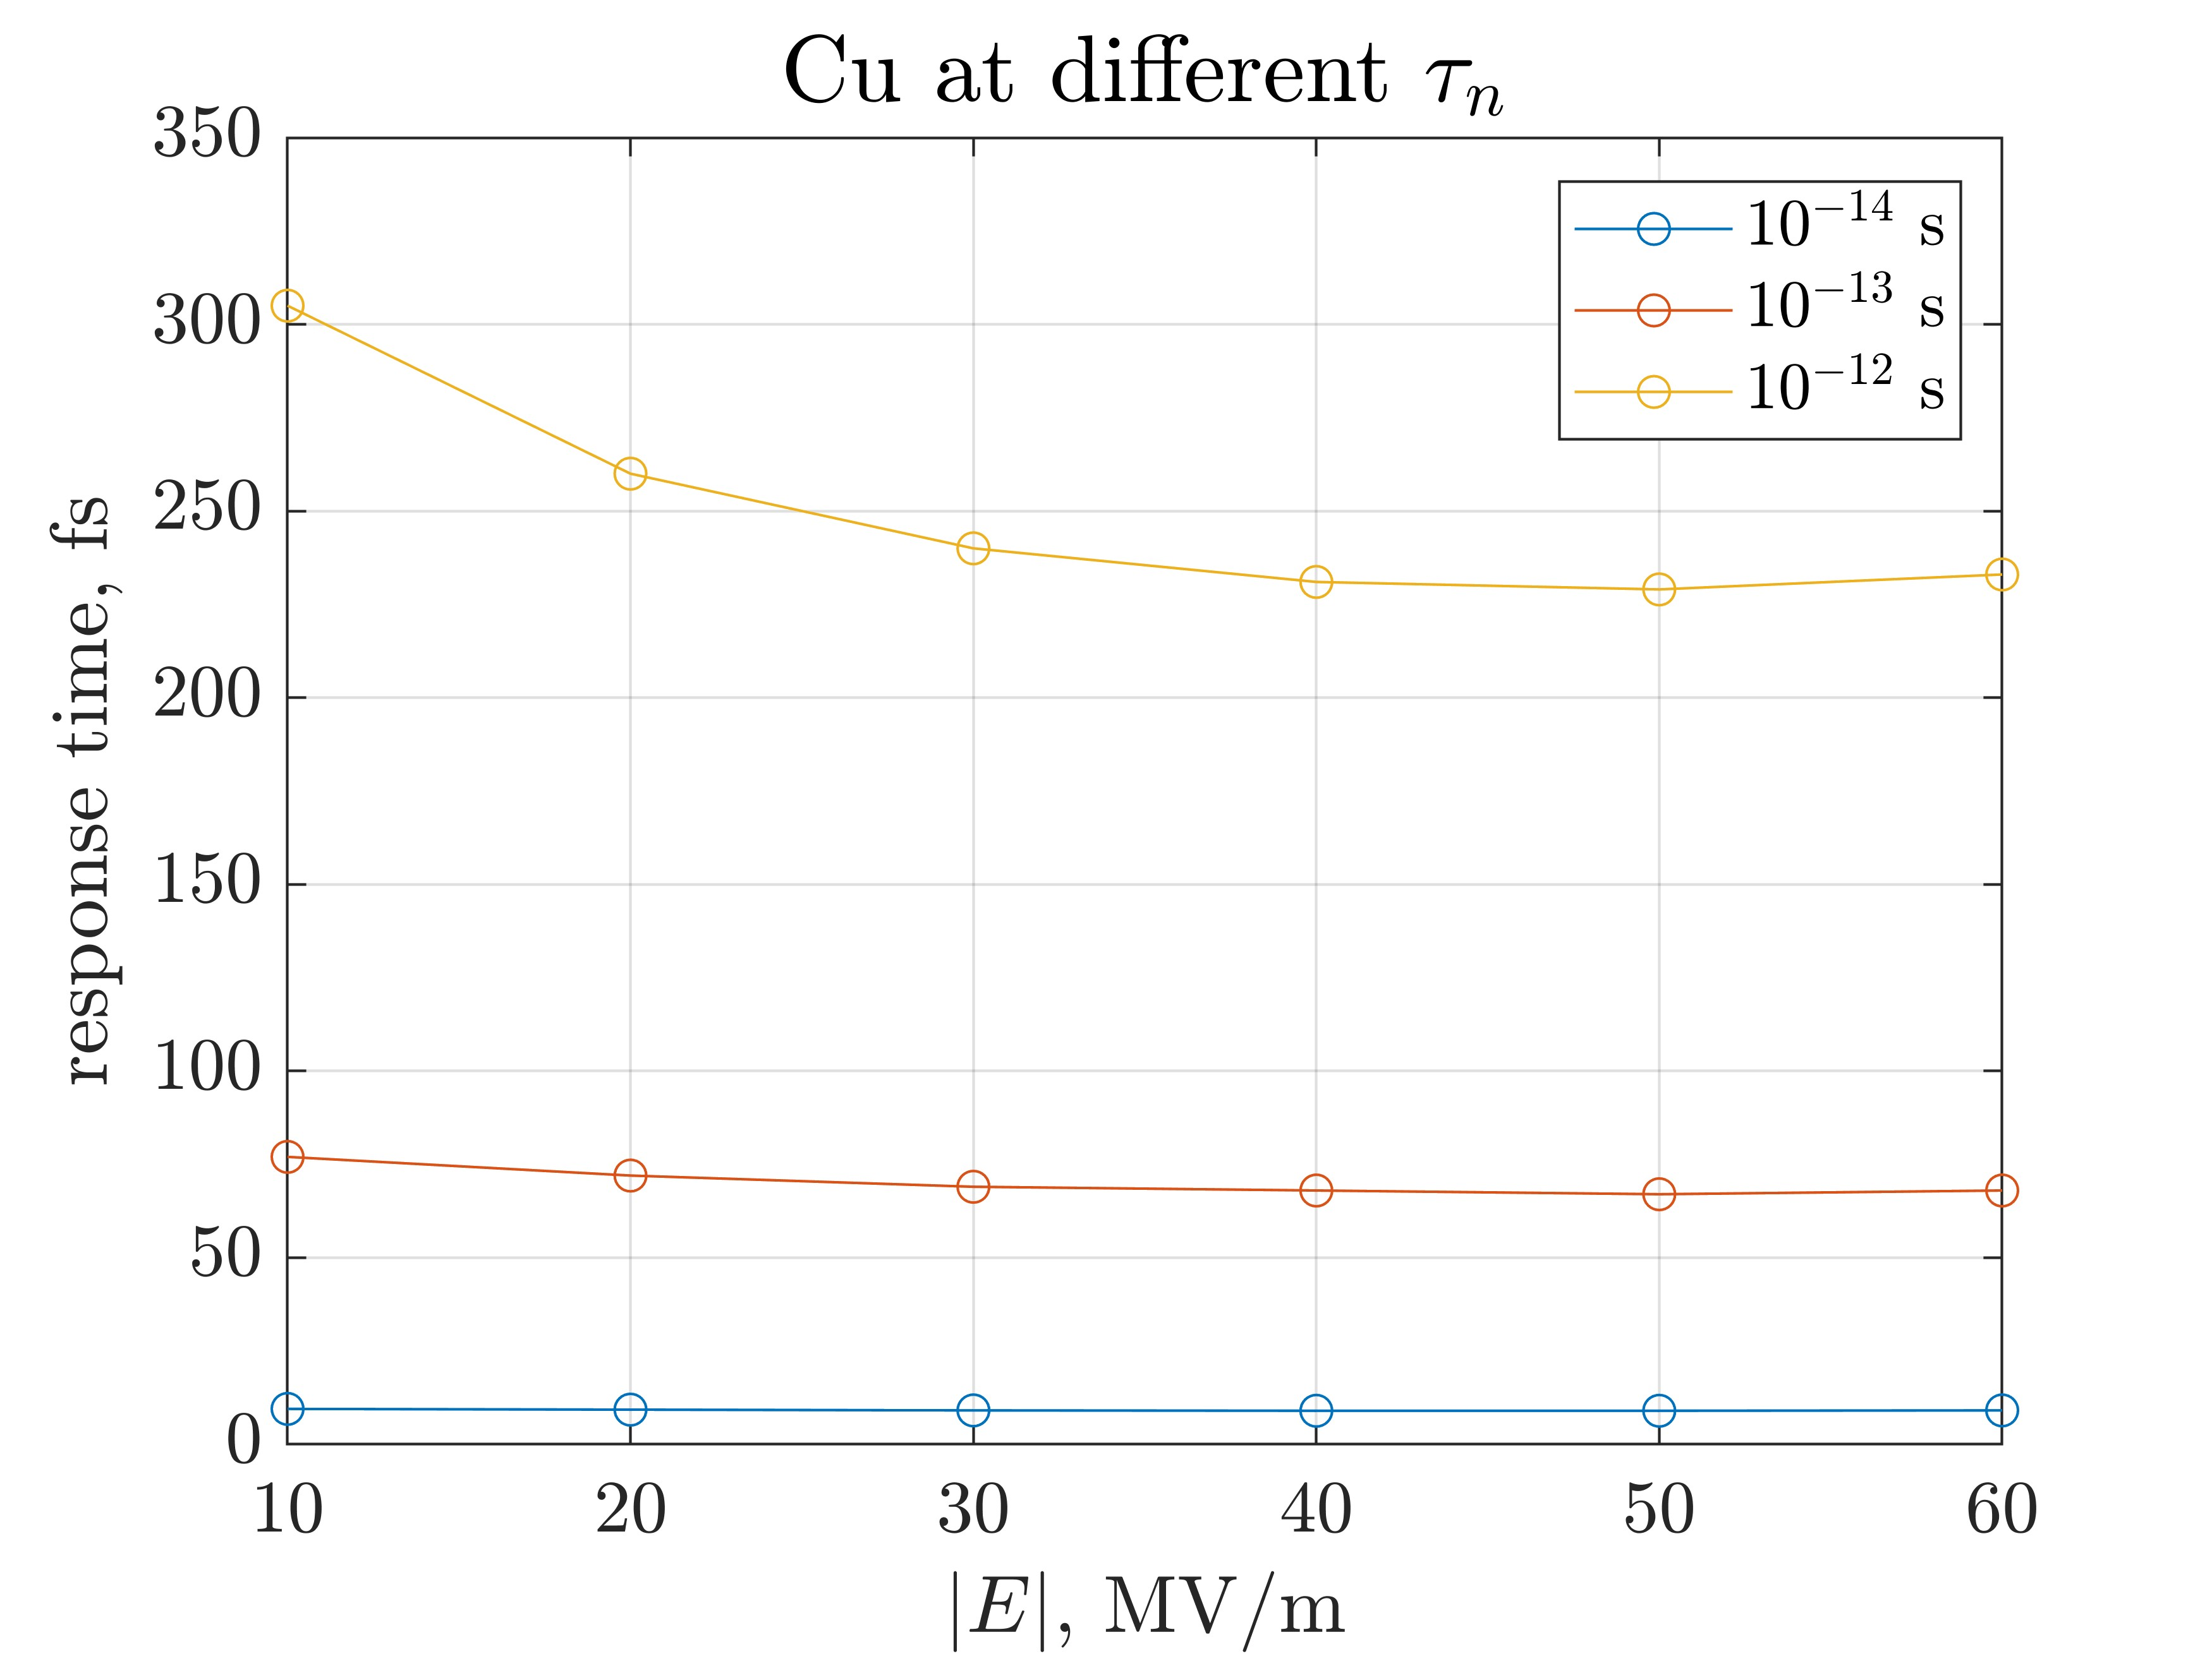
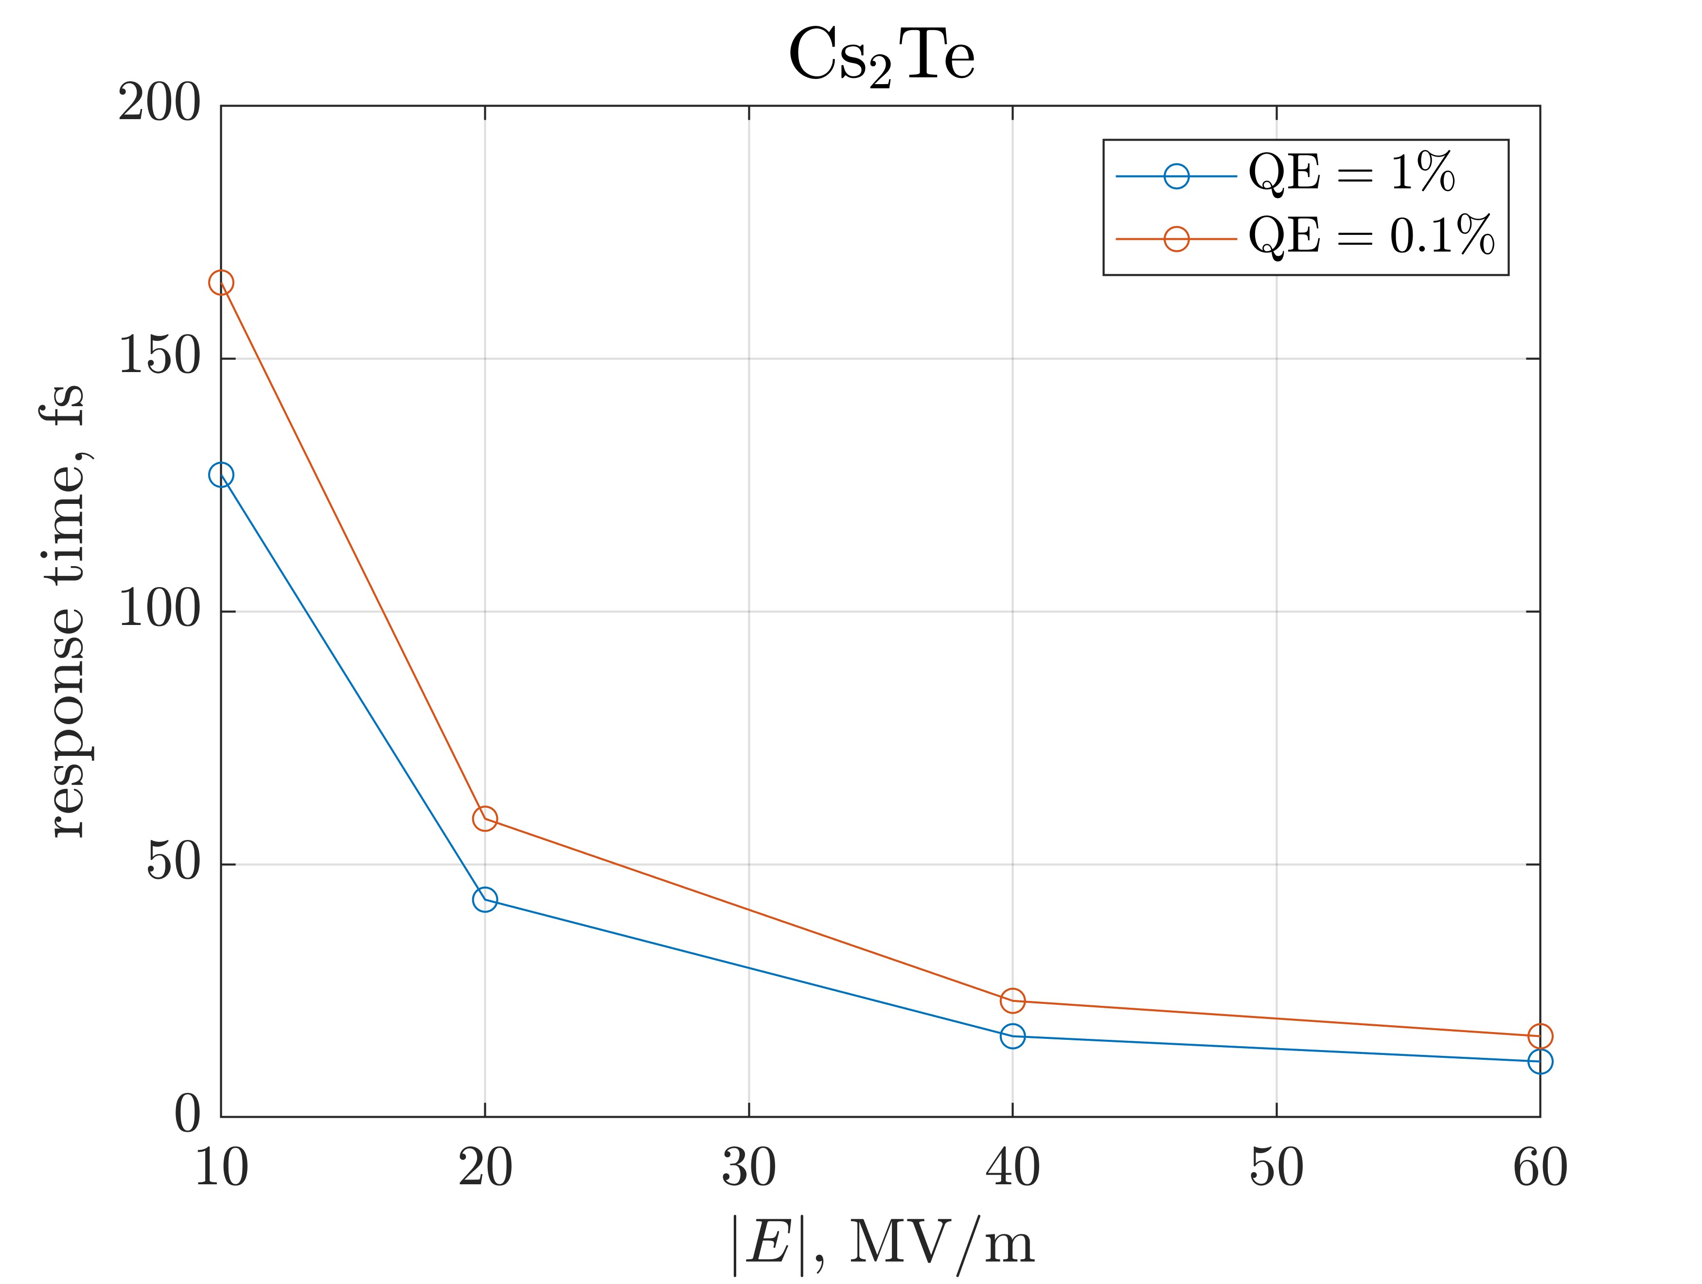
Response time estimations
Parameters for modelling can be found at the poster session (THPO086)
$t_{resp}$ is defined by the slowest mechanism. The greater $t_{n}$ is, the more $t_{resp}$ becomes field-dependent (drift)
Mikhail Vladimirov (MEPhI)
LINAC'26, Aug. 16 – 21, 2026. THPO086

Slide 8
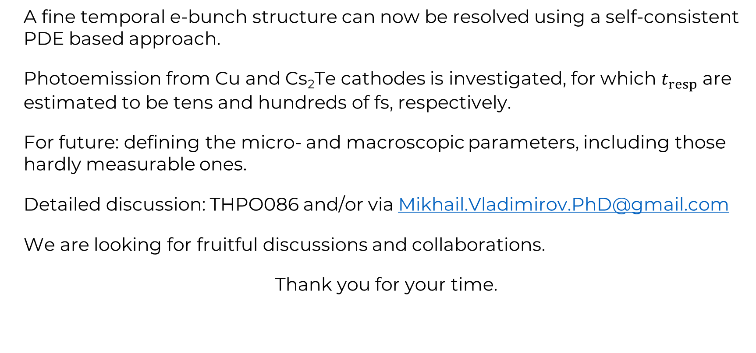
Summary
A fine temporal e-bunch structure can now be resolved using a self-consistent PDE based approach.
Photoemission from Cu and Cs₂Te cathodes is investigated, for which $t_{resp}$ are estimated to be tens and hundreds of fs, respectively.
For future: defining the micro- and macroscopic parameters, including those hardly measurable ones.
Detailed discussion: THPO086 and/or via Mikhail.Vladimirov.PhD@gmail.com
We are looking for fruitful discussions and collaborations.
Thank you for your time.
Mikhail Vladimirov (MEPhI)
LINAC'26, Aug. 16 – 21, 2026. THPO086

