Slide 1
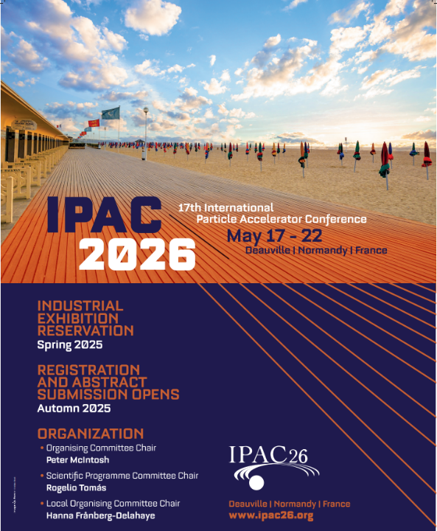
IPAC’26 Industry session

Slide 2




Working group in the local organizing committee
Keihan TAVAKOLI (Soleil)
J-L. Revol (ESRF)
Nicolas Berton (CEA)
C. Barthe Dejean (GANIL)

Slide 3
Industrial session -
Part of the scientific program for a duration of 2 hours ? in parallel to a standard scientific session. ➔ should not be cannibalize by the // session (could we adapt the scientific program?)
Traditionally under-attended, the industrial session often focuses on technology transfer or industry collaboration.
To make it more appealing and relevant to scientific participants, emerging and impactful topics are proposed:
Topic 1: Sustainable procurement and project lifecycle (1h):
Sustainability will be an essential specification and issue for new projects from design, procurement, operation to the end of life.
Explore sustainability requirements across the project lifecycle and how industry can provide necessary lifecycle information and compliance .
Topic 2: Code, simulation and characterization tool sharing (30 mn):
Focus on modern design and simulation technologies (e.g., AI, optimizing tools, twin simulators). Development of standards, IP, and knowledge sharing between labs and industry.
Topic 3: Training, recruiting and sharing young technical staff (30 mn):
Address current challenges in attracting and training high-level technical personnel for development and operations, with shared insights from labs and industry (JUAS,…). How can laboratories, universities and industries foster the young generation to work in accelerator fields. The situation in Europe, US and Asia
From our perspective, the topic of sustainability is the most compelling. we would like to push in that direction.
Other subjects for presentation under discussion:
The role of industry in particle Accelerator developments (already reviewed?)
Overview of European and international industrial capacity for accelerator development and projects (could be an alternative?)
How industry supports accelerator development and operation today and model(s) for the future (too general ?).
How can we, laboratories and industrial partners work together? (already reviewed and too general
Situation in Europe (CERN, DESY), US (DOE ?, xx) and Asia (xx) could be reviewed including speakers and participants of each country
➔ Need support to find speakers and participants

Slide 4
Industrial session -
Topic 1: Sustainable procurement and project lifecycle (1h … 1h10):
Sustainability will be an essential specification and issue for new projects from design, procurement, operation to the end of life.
Explore sustainability requirements across the project lifecycle and how industry can provide necessary lifecycle information and compliance .
Prog: Environmentally Responsible Procurement at CERN Enrico Cennini, 25 mn
The role of industry 30 mn
The opportunities for services TBD, 10 mn
Challenges for magnet procurement (SIGMAPHI ?), 10 mn
Challenges for raw material and vacuum equipment procurement (TBD: RI, FMB, ...), 10 mn
Contribution from ASIA to be… found
Topic 3: Training, recruiting and sharing young technical staff (50 mn – 1h):
Address current challenges in attracting and training high-level technical personnel for development and operations, with shared insights from labs and industry (JUAS,…). How can laboratories, universities and industries foster the young generation to work in accelerator fields. The situation in Europe, US and Asia
Prog: Education and job situation for Young scientist and engineer in Europe, Elias Metral director of JUAS , 25 mn
Situation in US from someone from U.S. Particle Accelerator School (Steven Lund, director, contacted)

