Slide 1



IPAC'26
Organisation posters posters étudiants jury posters
Angie Orduz
LOC Réunion point organisation IPAC'26
angie.orduz@ganil.fr

Slide 2
Contenu
Poster session
  Student Poster Session
  Jury Student Poster Session
  General Poster Session
  Poster Police

Slide 3
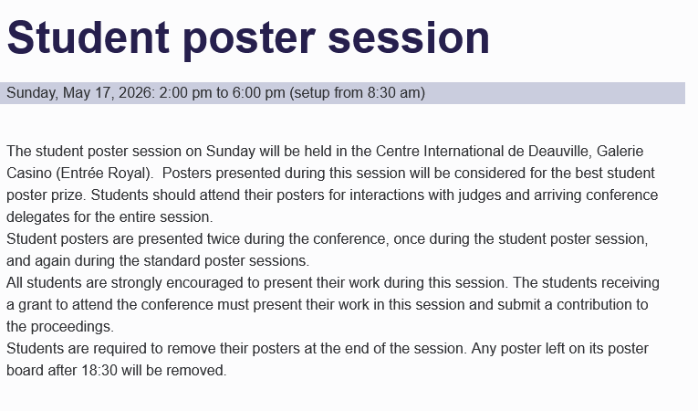
Student poster sesion
240 students in the student program
140 students with the grant: limitation ?
25 SPC + 3-5 people (example: organization ipac29). (OC=36)
20 evaluation teams => 12 posters pas team (40 people)
14 evaluation teams => 10 posters par team (28 people)
Procedure:
  14:00 -16h00: First round with a winner par team.
  16:00 - 16:20: Discussion to select the top 10 posters. (Room ?). 2 evaluation groups (5 posters pas team).
  16:20 – 17:30: Second round
  17:30 – 18:00: Discussion to select the winners.
Documents pour le reviewers:
  Student poster evaluation guide (email)
  Maps et general criteria
  Evaluation forms
  Prize winner form

Slide 4
Jury Student poster session

Slide 5
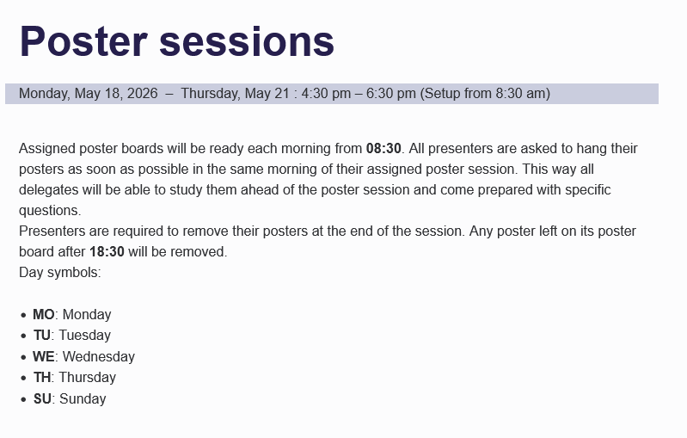
Standar poster session
400 posters par day (510 IPAC23)
LPR deadline to assing poster code (Aprox 1600 posters). Number of poster boards, re-arrange posters codes on boards every day.
Police = 140 students with grant
Tables nearby with tools (adhesive tape, scissors) for sticking up posters (CID).
2 zones, names ? Food
  Cammembert
  Cidre
  Pomme
  ----
Check posters at 18h30.
Others:
  Prize: Passport to be filled with stamps to guarantee visits to the industrial’s stands.
  Eventments

Slide 6
Poster police
Location: Poster police desk (bureau fixe pendant la conférence)
Dates & Time:
- Mon. to Wed. (May 18–21): 3:40 PM
Beginning of Duty :
- Contact “Angie Orduz” at the scheduled time and location
- Receive inspection iPad/paper and assigned poster area
Duties:
Inspect approx. 400 posters par day (510 IPAC23), 20/140 students
10 students par section (20 posters/student)
Verify poster titles and presenters
Presenters may occasionally need to step away from their poster, or be responsible for multiple posters, so please check back periodically if needed.
End of Duty:
- Mon. to Wed.: Return iPad by 5:30 PM
400 poster/day | Poster police
Monday (June 2nd) | 16:00 -18:00
Tuesday (June 3rd ) | 16:00 -18:00
Wednesday (June 4rd ) | 16:00 -18:00
Thursday (June 5th ) | 16:00 -18:00
Friday (June 6th )

Slide 7
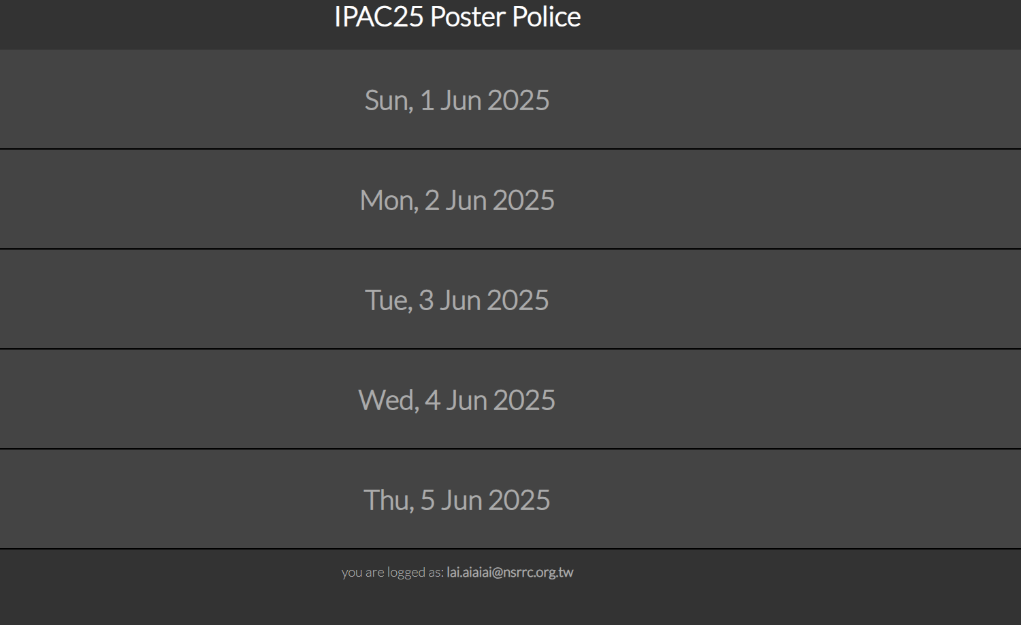
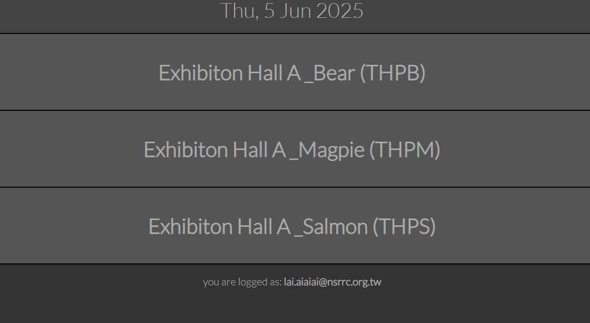
App Instructions
1. Login to the Poster Police App
2. Select the date (e.g., "Thu, 5 Jun")

Slide 8
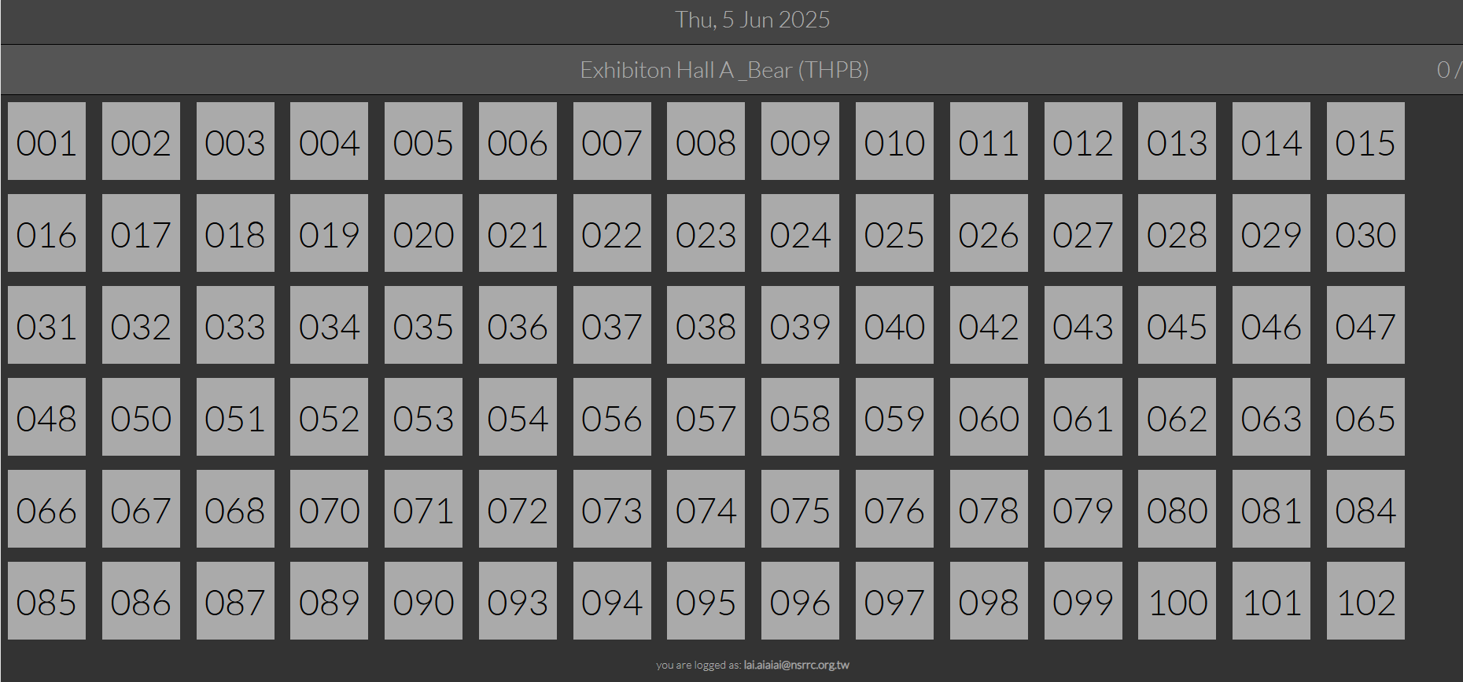
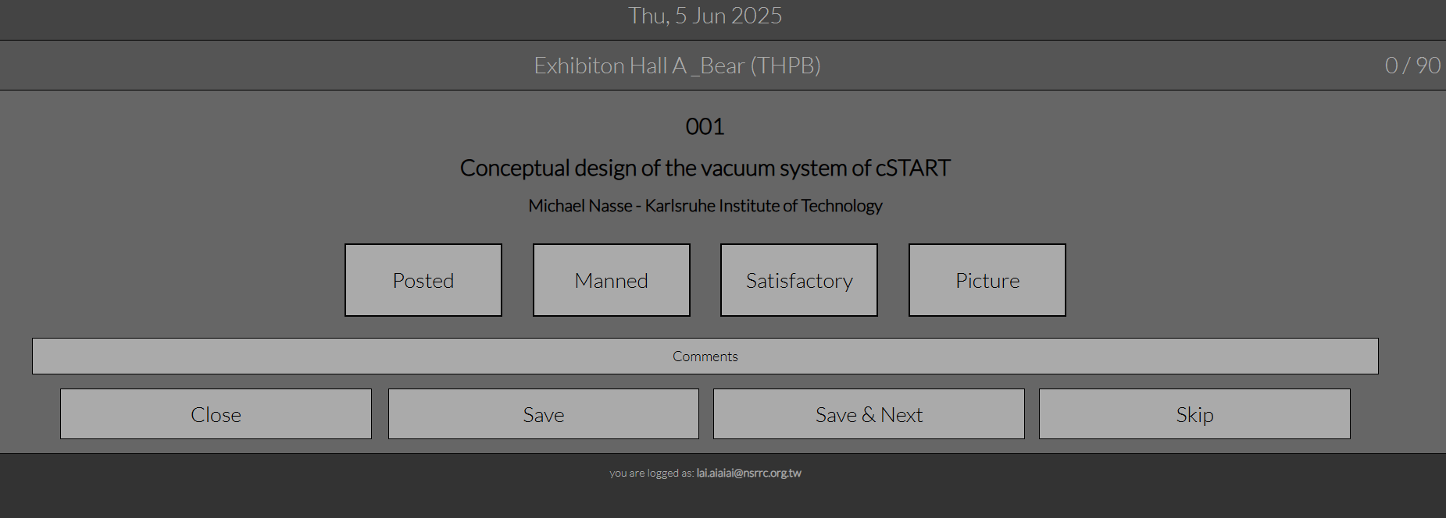
App Instructions (cont.)
3. Choose section (e.g., "THPB")
4. Tap the assigned poster number (e.g., "001")

Slide 9
App Evaluation Buttons
Posted:- Title matches or is similar to the assigned
abstract
Manned:
- Speaker is near the poster
- Please confirm whether the speaker is
responsible for more than one poster.
Satisfactory:
- Format meets conference standards
Picture:
- Unknown purpose
Title
Speaker

Slide 10
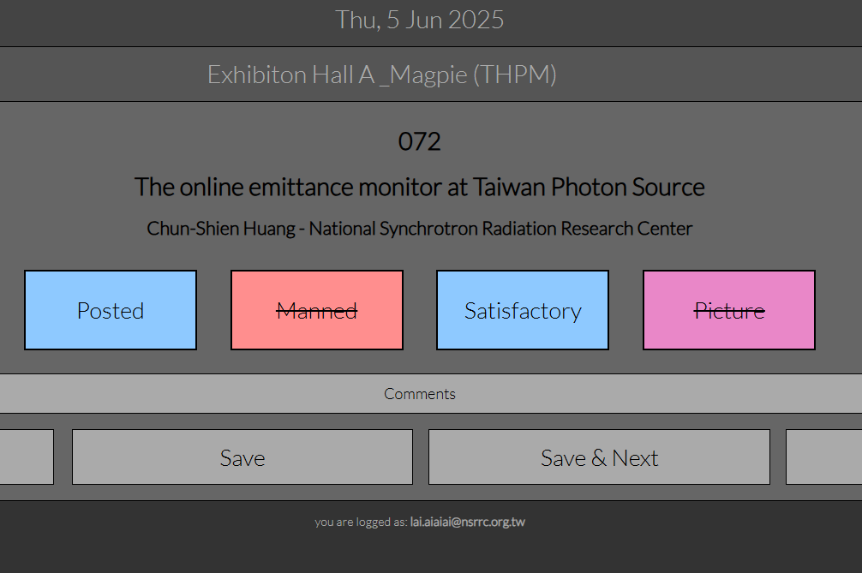
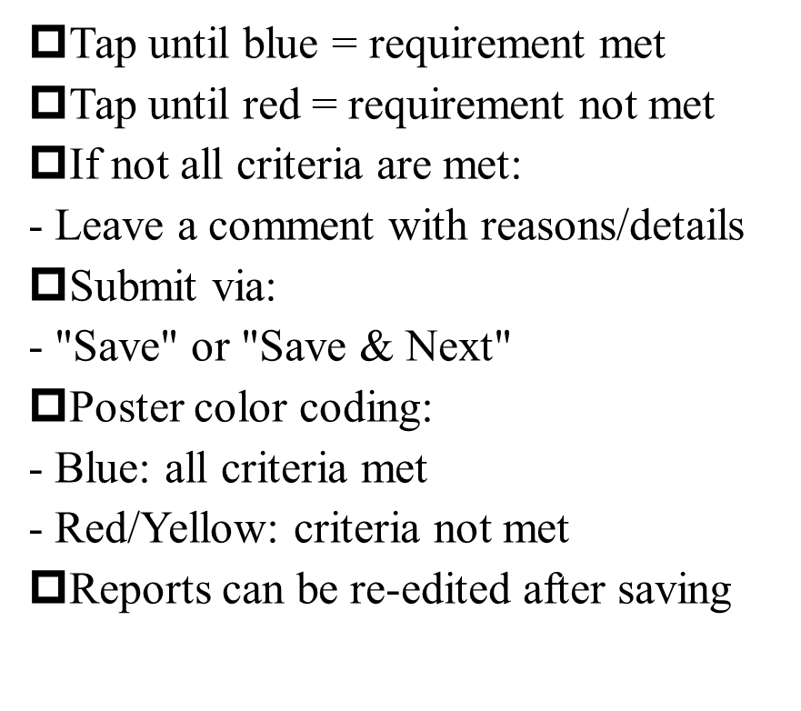
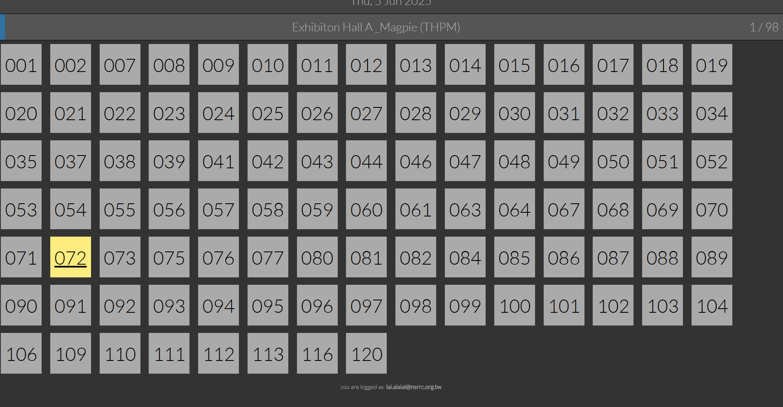
Button Interaction & Submission

Slide 11
Poster preparation guidelines
General requirements
Each poster will be presented on a single board, whose dimensions are 100 cm (39.4 inches) wide x 200 cm (78.7 inches) high.
We recommend to prepare and print a poster of size ISO A0 (84.1 cm x 118.9 cm) or US Arch E (36 in x 48 in) in PORTRAIT orientation on the board.
Note: Avoid landscape orientation for the A0/Arch E formats, as it will be too wide to fit the poster boards.
The Conference Organisers will provide all necessary supplies for mounting the posters (tape, etc).
Poster preparation guidelines are the same for the standard Poster Sessions and the Student Poster Session.
The Scientific Program Committee reserves the right to reject publication of papers that have not been properly presented or manned in the poster sessions. Manuscripts of your contributions to the proceedings (or enlargements of them) are not considered as posters and papers presented in this way will not be accepted for publication.
Due to the ongoing conflict in Ukraine, IPAC’26 is unable to accept any organisations based in Russia or Belarus (as mentioned on the registration page).
This is applied also to the poster presentation for the person who present the poster.
However, poster with references of co-authors affiliated with Russian and Belarusian institutions are allowed.
Poster display times
Assigned poster boards will be ready each morning from 08:45. All presenters are asked to hang their posters as soon as possible in the same morning of their assigned poster session. This way all delegates will be able to study them ahead of the poster session and come prepared with specific questions.
Presenters are also asked to remove their posters at the end of the session. Any poster left unmanned on its poster boards after 18:30 will be removed.
IPAC26 logo
You can use the IPAC’26 logo available from the IPAC’26 logo page.

Slide 12
Thank you for your attention!

Slide 13
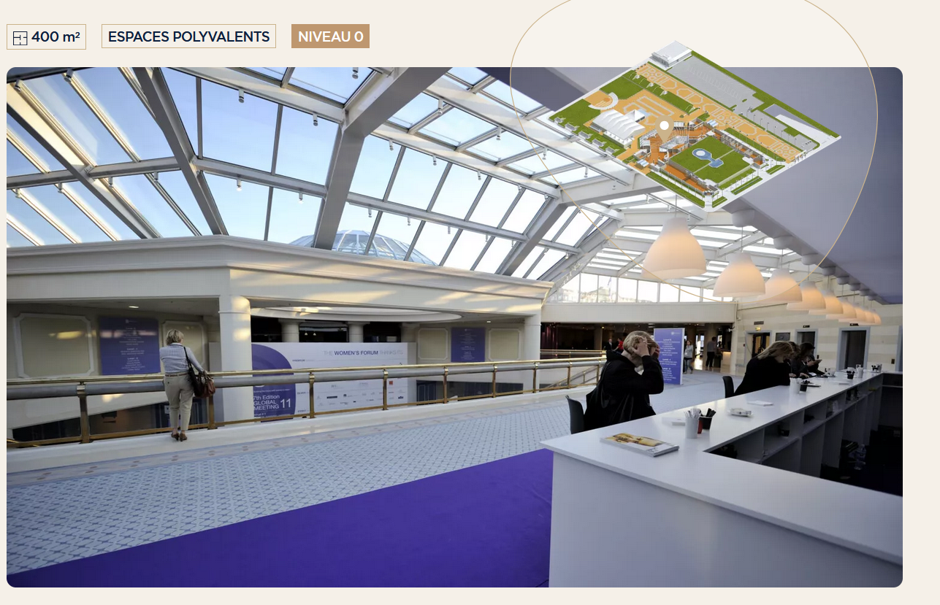
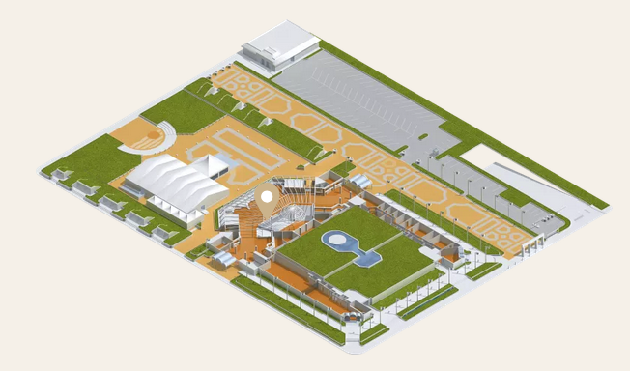
Verrière posters

Slide 14
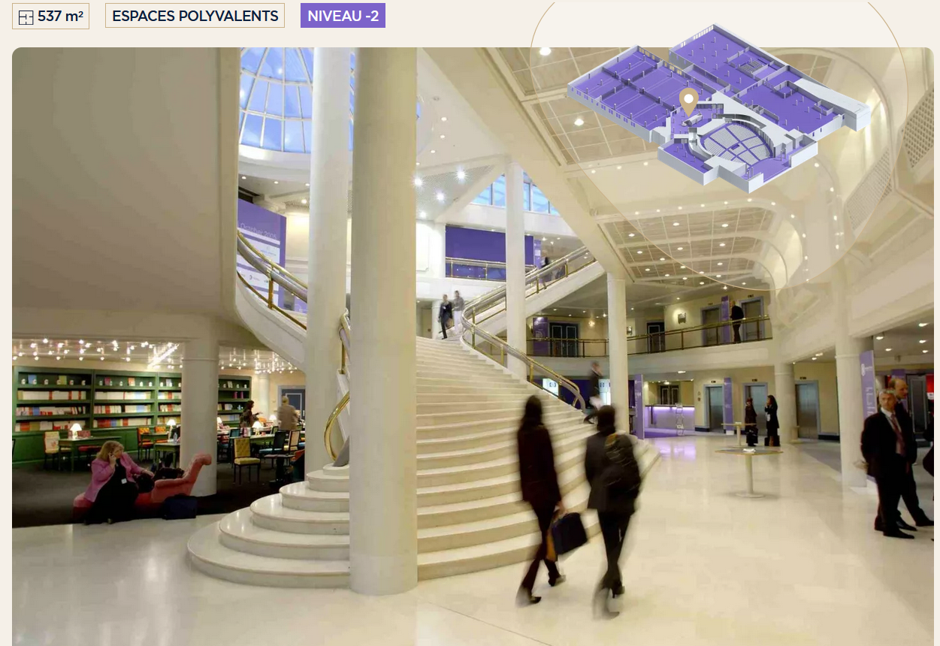
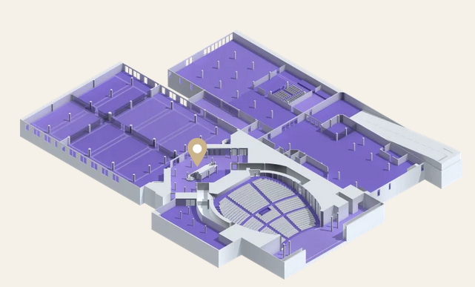
niveau 2 Posters

