Slide 1
Beam Halo Formation in Continuous-Wave Photoinjectors
Longitudinal–transverse coupling below 1 MeV
Zhen Zhang
SLAC National Accelerator Laboratory
42nd International Free Electron Laser Conference (FEL2026)
August 23 – 28, 2026
Li Ka Shing Center, Stanford University

Slide 2
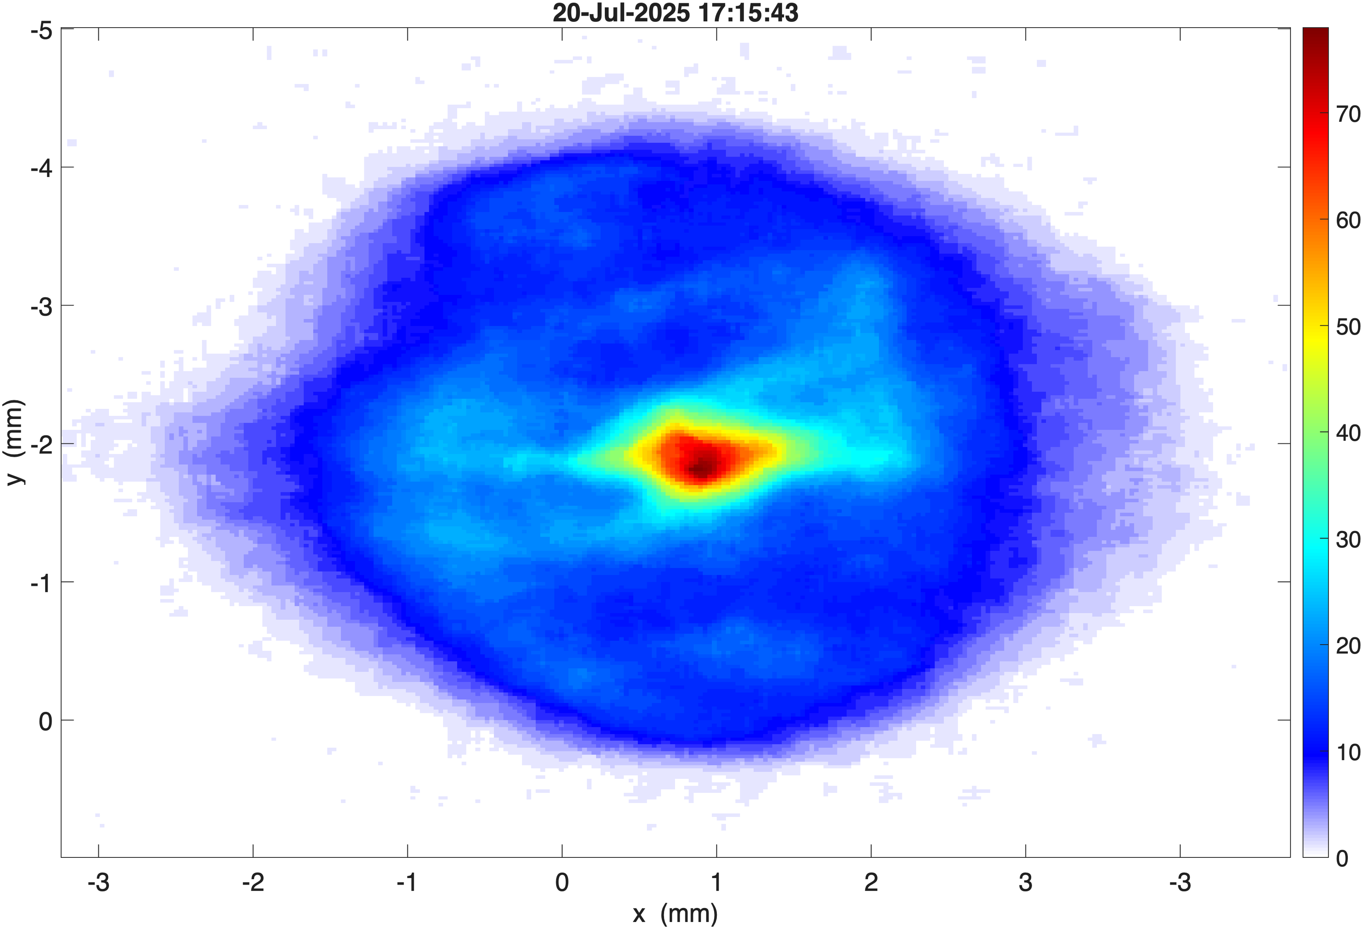
Outline
From an operational nuisance to a quantitative mechanism
Why beam halo limits CW FEL operation
What we saw during LCLS-II injector commissioning
A three-step mechanism from longitudinal–transverse coupling
  r-dependent chirp → hollow bunch ends → over-focusing
Experimental validation
  solenoid scans, controlled ring formation
Mitigation: buncher compression tuning, now used in operation
Halo around the core, measured at LCLS-II injector

Slide 3
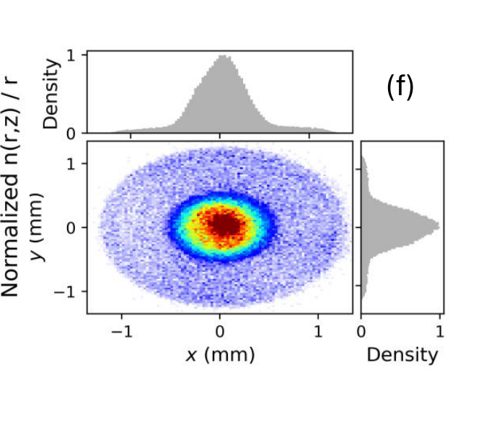
Why beam halo matters for CW FELs
High average current plus tight loss budgets
Superconducting FELs — LCLS-II, SHINE, European XFEL— run at MHz rates and high average current
Halo causes uncontrolled loss, component activation and a machine-protection burden that interrupts operation
It also degrades brightness and makes matching and emittance measurement unreliable
Well studied elsewhere, but not here:
  hadron beams: space-charge resonances, particle–core models
  ERLs and rings: mismatch, nonlinear RF, diffusion, scattering
  single-pass photoinjectors: little attention so far
Simulated core–halo profile after the cryomodule
The dominant halo mechanism of CW photoinjectors had not been identified — that is the gap this work closes.

Slide 4
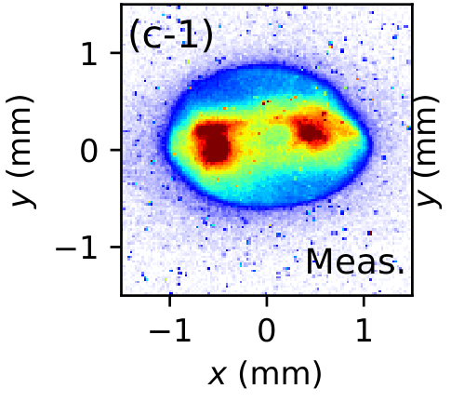
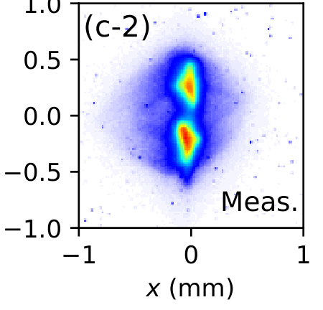
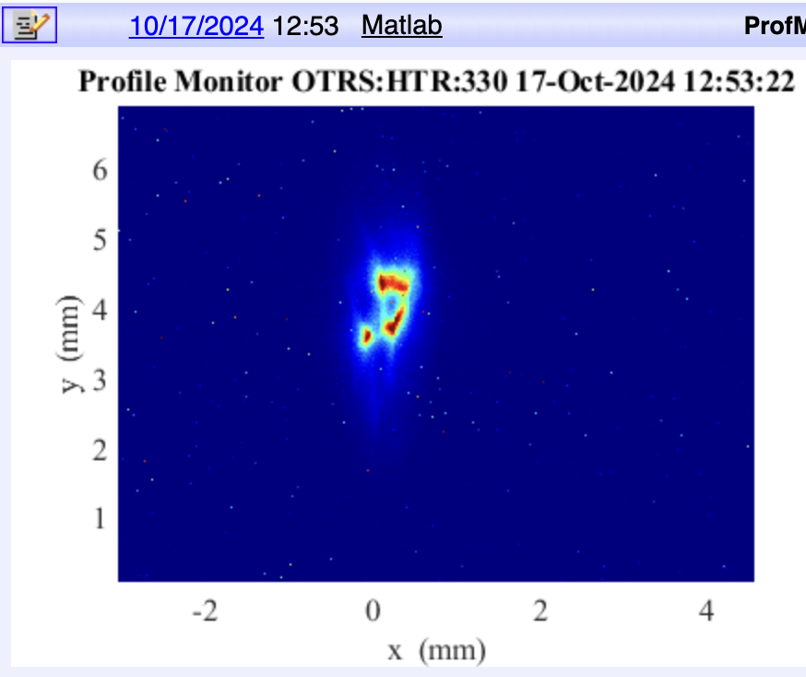
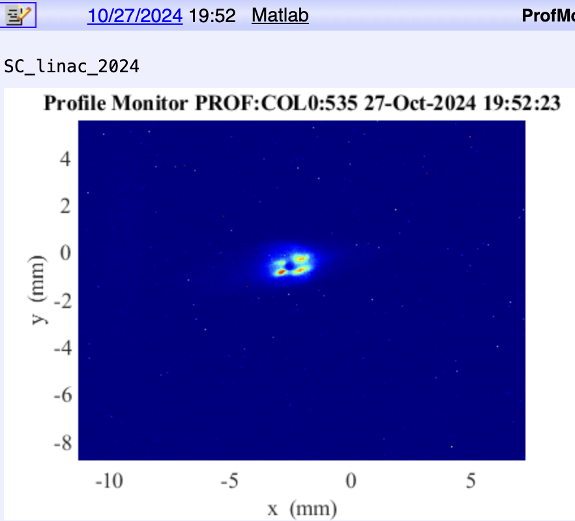
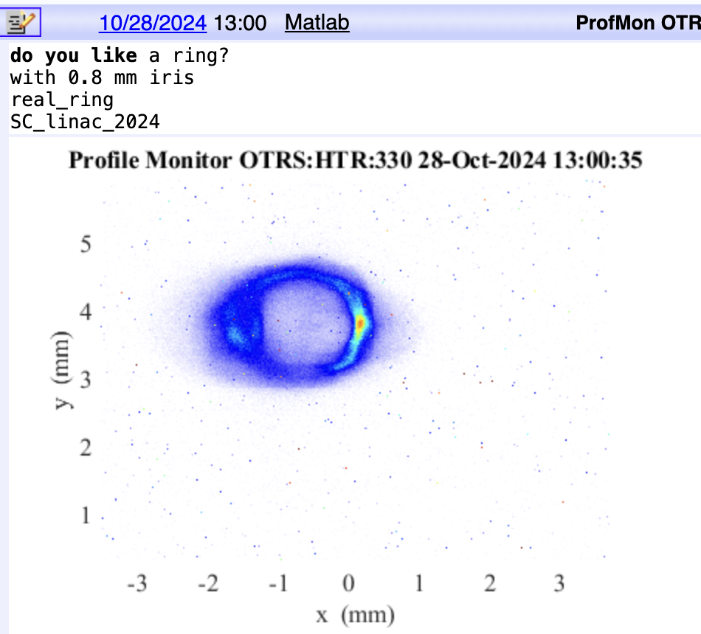
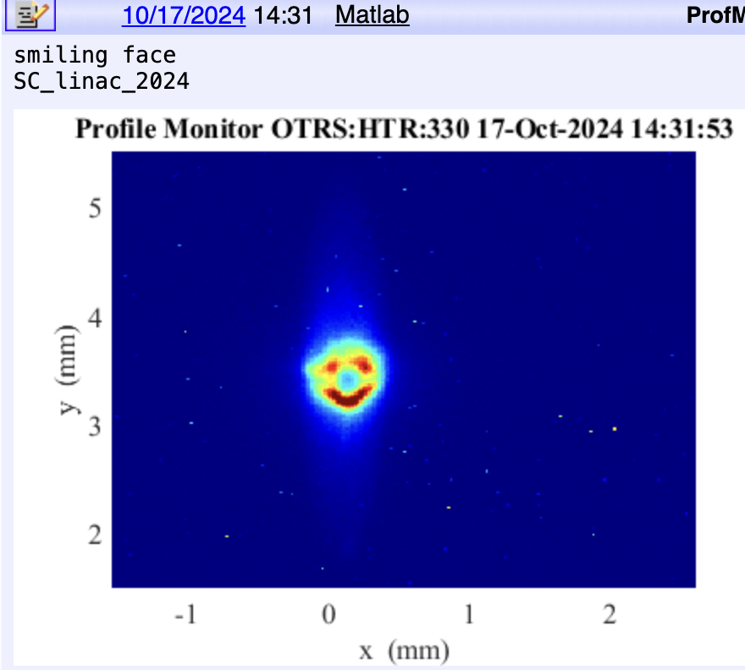
What we saw during LCLS-II commissioning
Non-Gaussian transverse profiles downstream of the injector
two horizontal lobes
two vertical lobes
Four spots
Diamond ring
Smiling face
Blame the laser!!!
• Bright compact core wrapped in a diffuse outer population; the shape follows the optics
• Reproduced later in dedicated experiments with nominal laser, cathode and RF settings
• Intrinsic to core–halo dynamics, so it cannot be tuned away by cleaning up the laser or the cathode

Slide 5
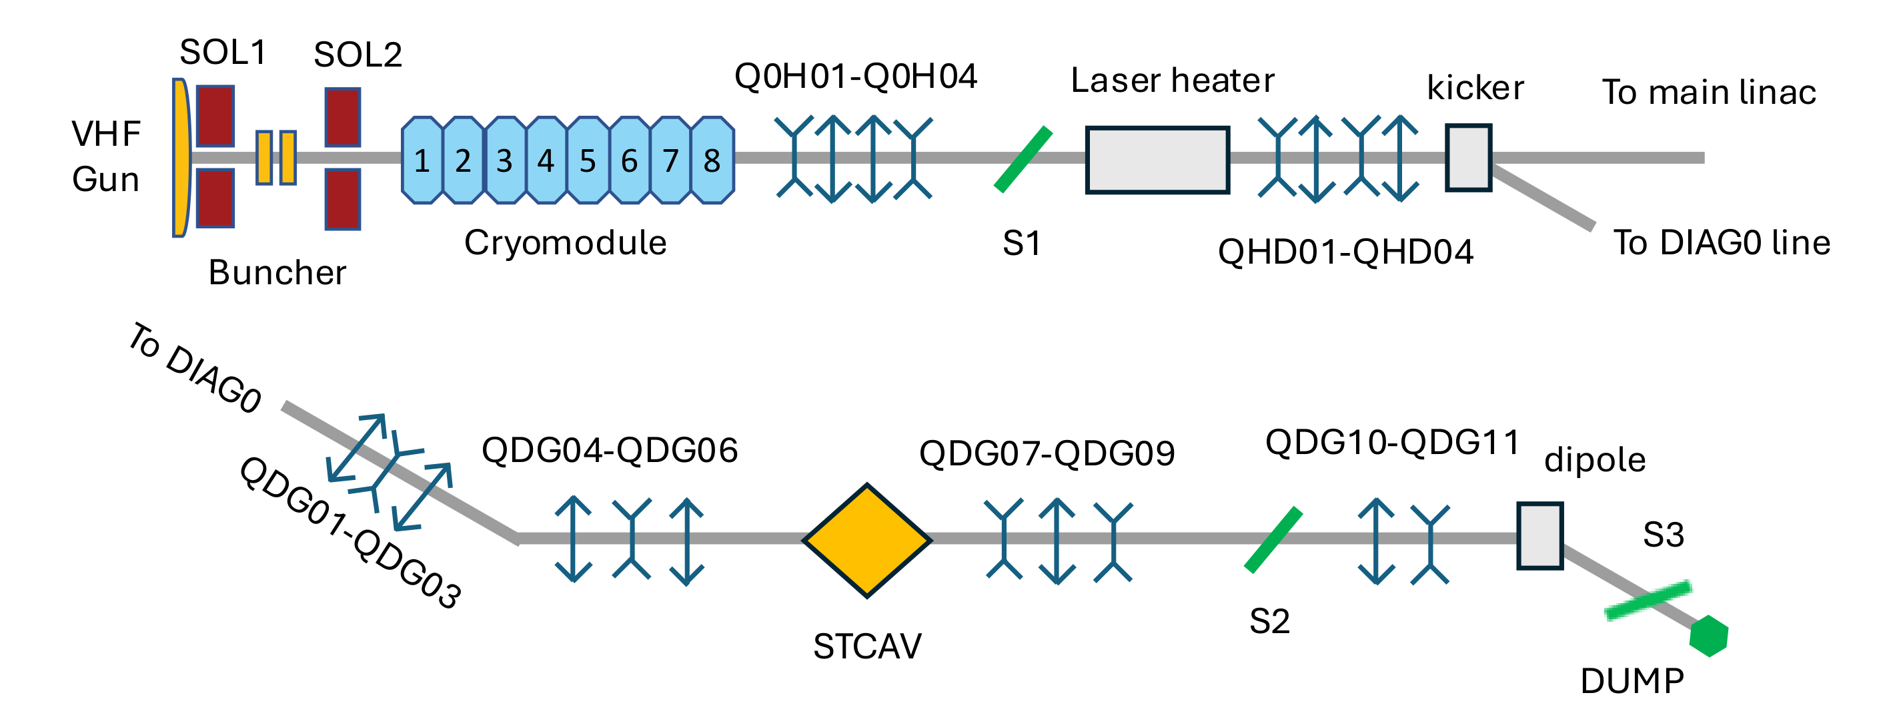
The LCLS-II CW photoinjector
Velocity bunching at sub-MeV energy, then acceleration to 75 MeV
• 70 pC from a VHF normal-conducting RF gun, ≈650 keV after the gun
• SOL1 for emittance compensation, SOL2 matches into the cryomodule
• Buncher writes the chirp for velocity bunching — all below 1 MeV
• Halo screens S1, S2 (after TCAV) and S3; σz ≈ 0.9 mm

Slide 6
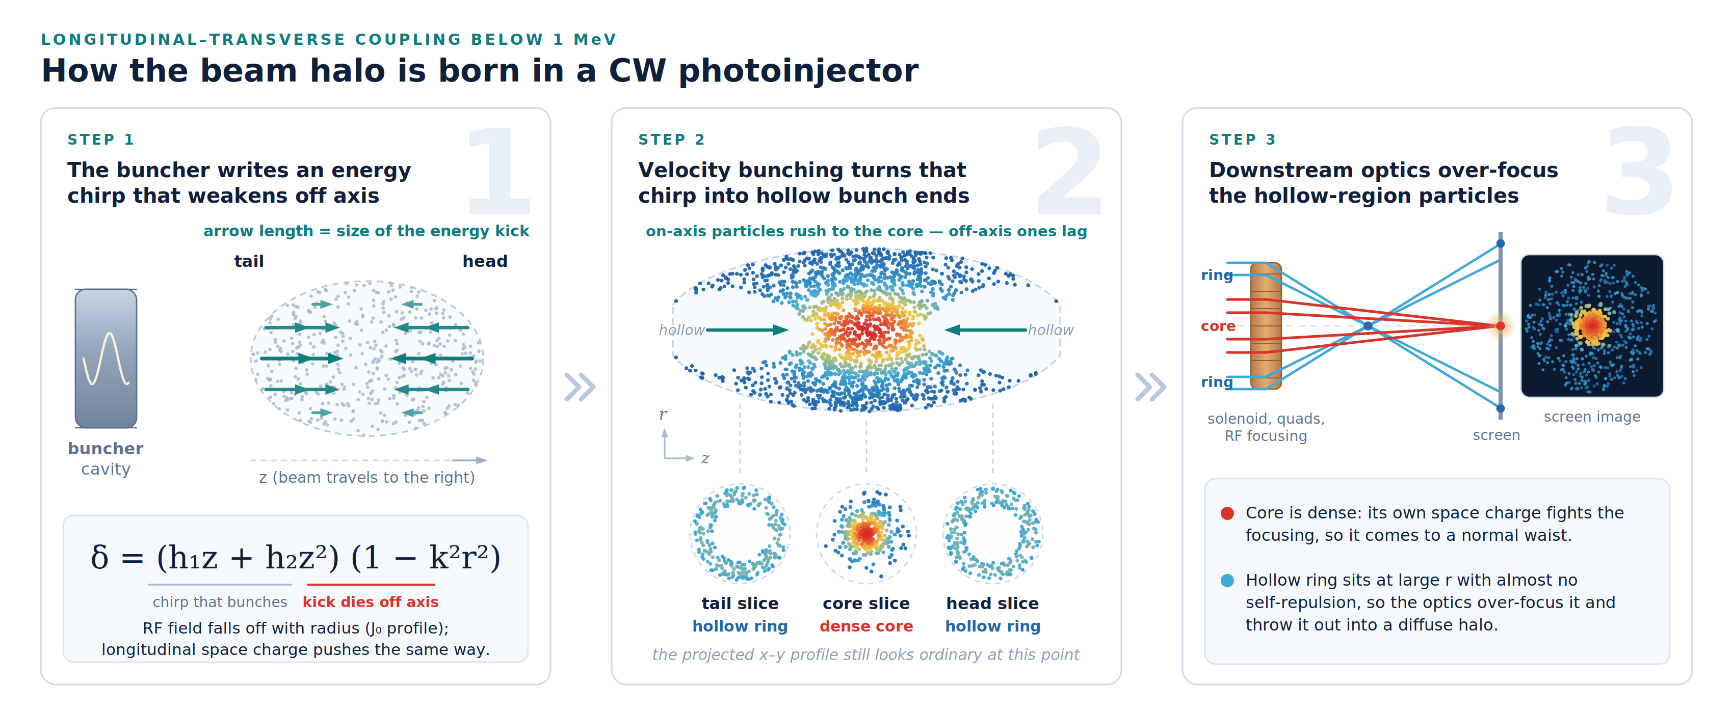
Three steps, one coupled mechanism
Longitudinal–transverse coupling below 1 MeV
Chirp that fades off axis → hollow bunch ends after velocity bunching → over-focused hollow regions = halo

Slide 7
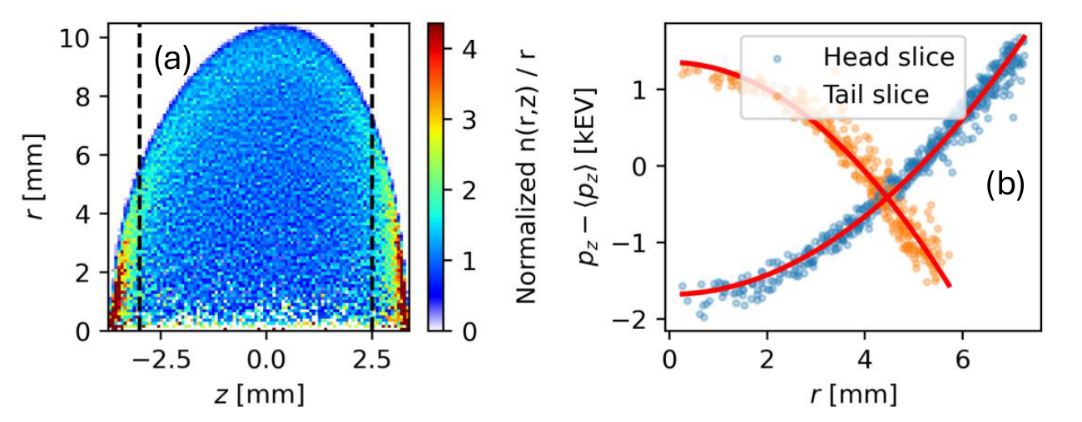
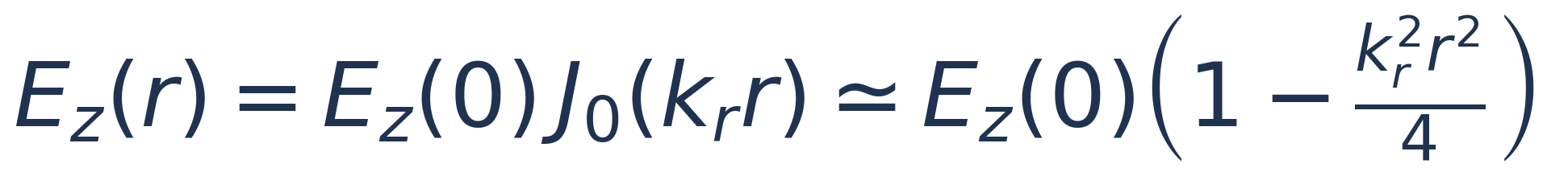
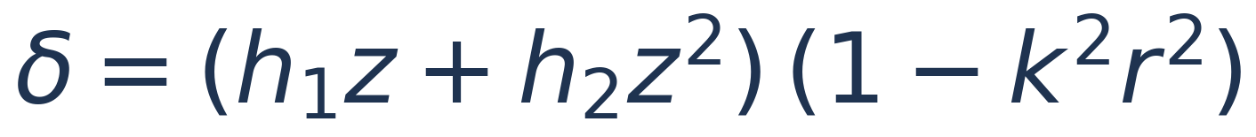
Step 1: the buncher writes an r-dependent chirp
The energy kick is strongest on axis and dies off axis
In the buncher the longitudinal field follows a Bessel profile: the amplitude falls quadratically with radius
Longitudinal space charge acts the same way — it accelerates the on-axis head and decelerates the on-axis tail more than off-axis particles
Both add up to a quadratic pz–r correlation inside every slice
Astra: density after the buncher (left) and pz vs r for head and tail slices (right)
Astra confirms the prediction: off-axis particles gain pz in the head and lose it in the tail.

Slide 8
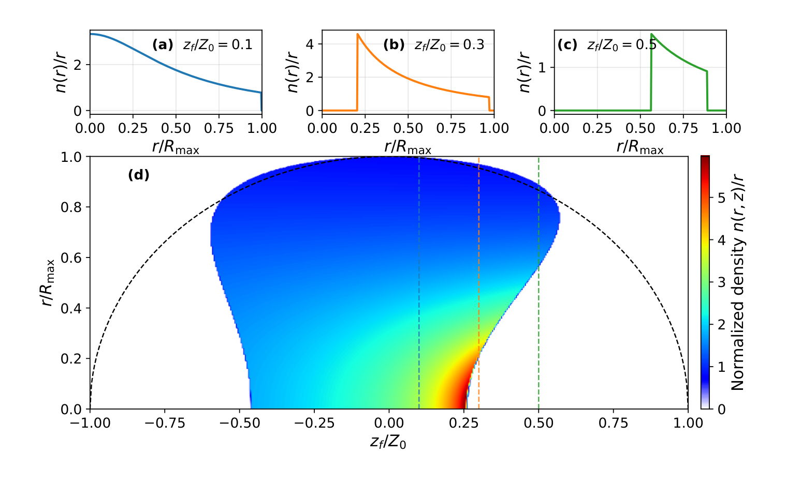
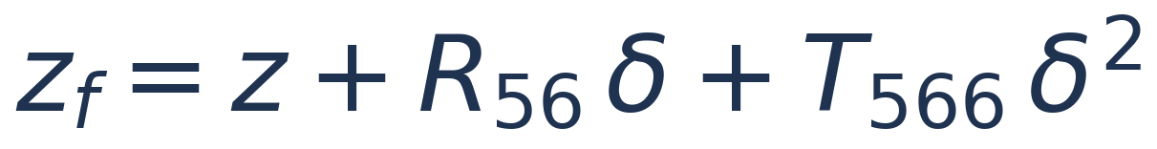
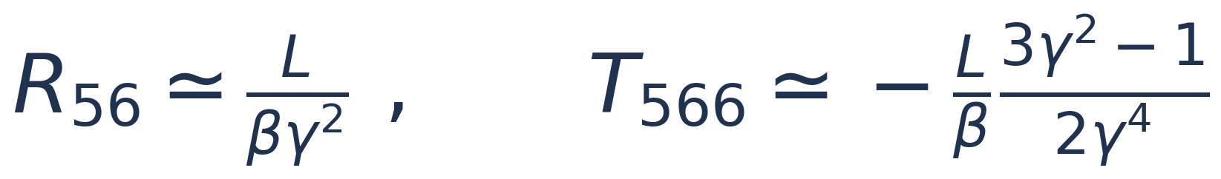
Step 2: velocity bunching hollows out the ends
An r-dependent chirp curves the compression surface in (r, z)
Below 1 MeV small energy differences change the drift velocity, so faster particles overtake slower ones
On-axis particles get the largest chirp and compress into the core; off-axis particles lag and stay at the ends
Head and tail therefore become hollow — ring-like in every slice
r is unchanged here, so the projected profile looks ordinary
Analytic model of a uniformly filled football bunch: hollow head and tail develop during bunching (head on the right)

Slide 9
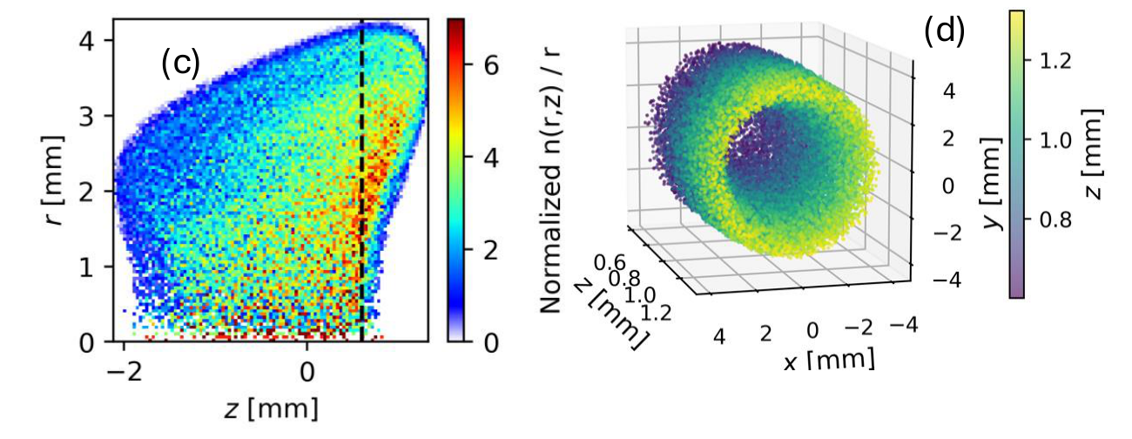
Step 2 in start-to-end simulation
Astra, 70 pC: hollowed structures at the cryomodule entrance
• The (r, z) curvature grows increasingly nonlinear along the drift to the cryomodule
• Hollowed regions appear at both ends — the 3-D view of the head shows a clear ring
• Space charge amplifies it: advancing or lagging off-axis particles get an extra push from their self-fields

Slide 10
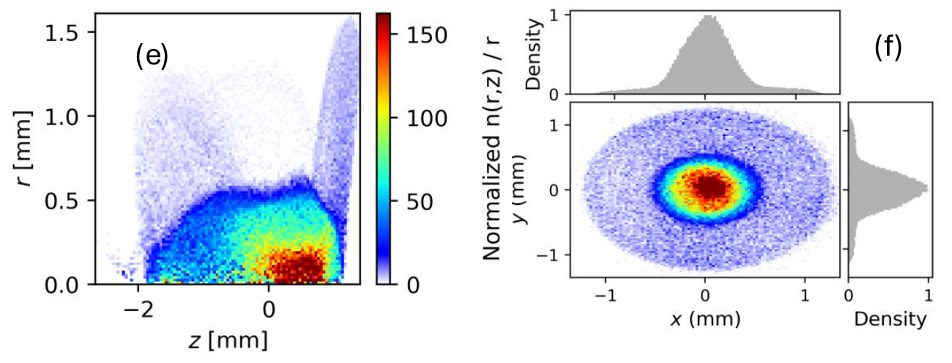
Step 3: the hollow regions get over-focused
Weak self-repulsion at large radius gives a diffuse halo
Inside a ring the net radial space-charge force is small: the inner edge encloses almost no charge, the outer edge far less than a dense core would
All hollow-region particles sit at large radii, so they see stronger external focusing from solenoids, quadrupoles and RF
Weakly repelled and strongly focused, they are over-focused and pushed to even larger radii
The result is a bright core enveloped by a diffuse halo
Mid-cryomodule (r, z) density and the final transverse profile with its projections
Simulation reproduces the whole chain — chirp, hollowing, halo — from the machine settings alone.

Slide 11
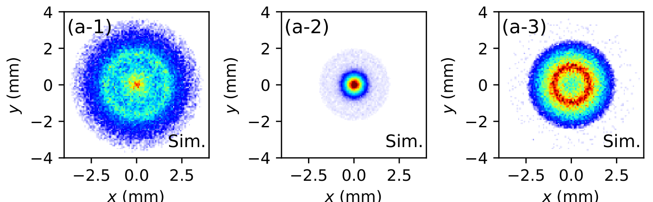
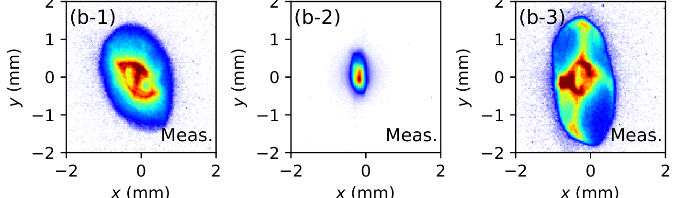
Experiment: core and halo focus differently
Matching quadrupoles off, buncher at −60°, SOL2 scanned
Simulation
increasing SOL2 strength →
Measured
Ring with a bright core → compact spot → over-focused ring: exactly the differential focusing the model predicts.

Slide 12
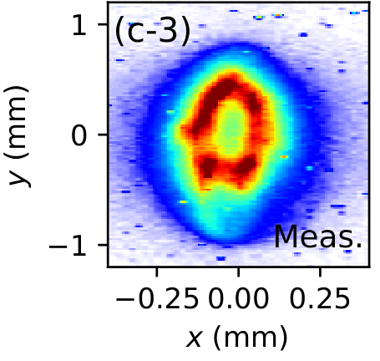
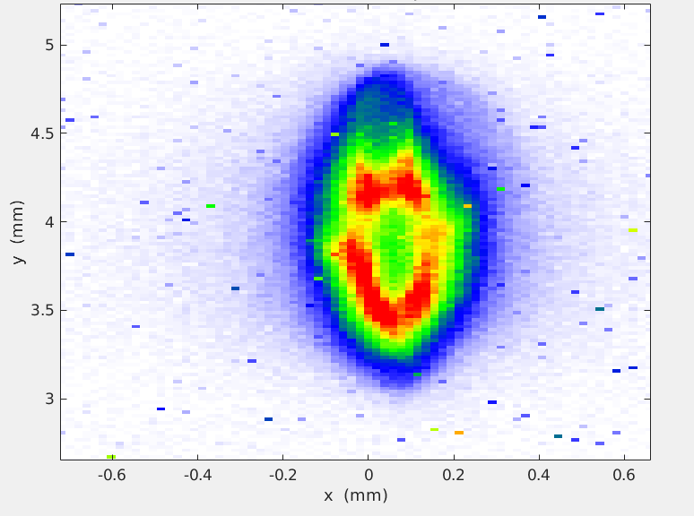
The halo can be reshaped on demand
Quadrupoles back on: horizontal lobes, vertical lobes, or a clean ring
We caught the smiling face as well.
Measured at S1; the same patterns first appeared during commissioning
• A strong halo component is what makes these shapes possible — they are now produced deliberately
• They appear with no special laser, cathode or field imperfection, so they are intrinsic to core–halo dynamics
• They corrupt emittance measurements and seed downstream beam loss

Slide 13
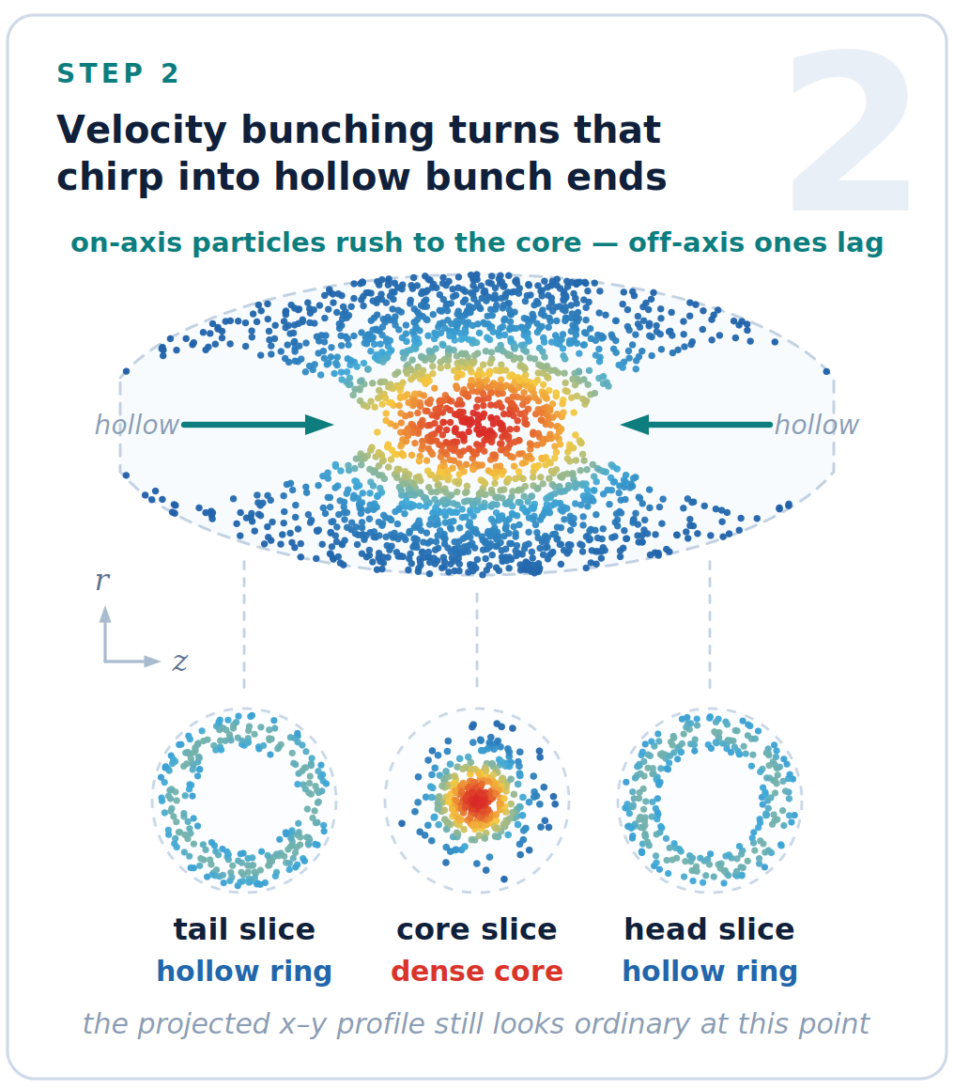
Mitigation: bunch less at low energy
Shallower hollowing means less halo
The model points straight at the knob: weaken the buncher compression, which limits the depth of the hollowed structures that seed the halo
Buncher phase moved from −55° to −46° and −40° from on crest
CAV2 at zero crossing then provides modest bunching at ≈7 MeV, where the beam is smaller and space charge weaker — same bunch length at the injector exit
Move the compression to where the beam is stiffer: same bunch length, much weaker coupling into the transverse plane.

Slide 14
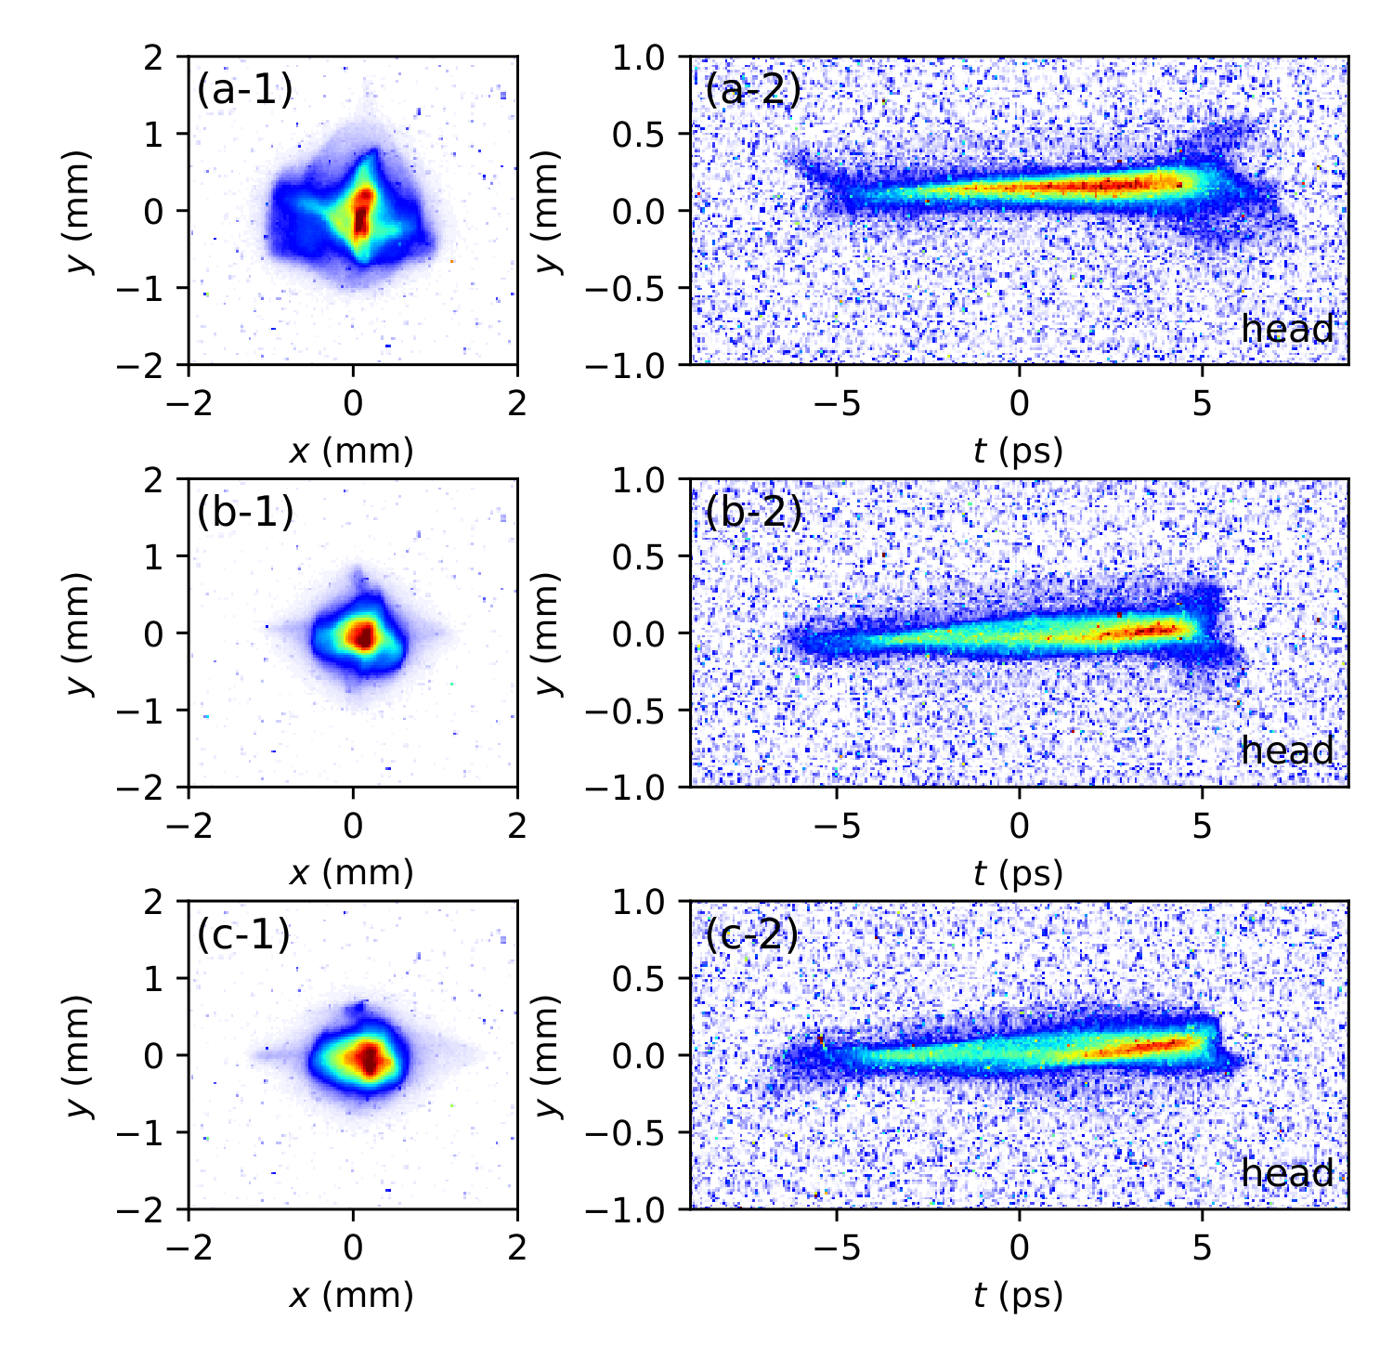
Mitigation works, in profile and in time
Halo at S1 and head/tail expansion at S2 shrink with weaker bunching
• Left: x–y at S1. Right: y–t streak images at S2 from the S-band TCAV, beam head on the right
• At −55° a diffuse halo surrounds the bright core, and the streak image shows pronounced head- and tail-side expansion
• Those expansions are the hollowed structures predicted by the model
• At −46° and −40° the halo features at both screens progressively diminish
−55°
strong
−46°
−40°
Reduced velocity bunching suppresses halo formation — the mechanism and its cure both confirmed.
weak

Slide 15
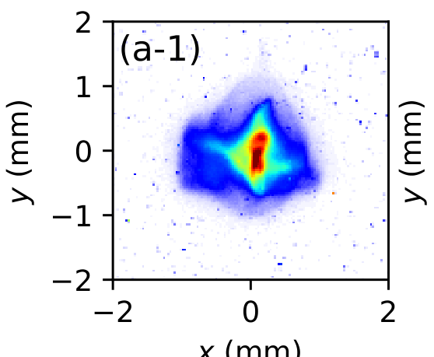
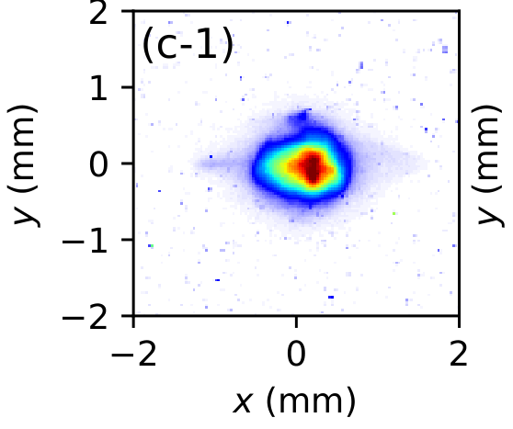
Now part of LCLS-II operation
From diagnosis to an operational recipe
The buncher-compression strategy has been implemented at LCLS-II
Result: a marked reduction in beam halo and in the associated downstream losses, supporting sustained high-repetition-rate operation
Halo became a controlled knob — buncher phase — instead of an unexplained feature of the injector
Practical guidance for tuning:
  watch the time-resolved image, not only the projected profile
  share the compression between buncher and CAV2
  rematch the optics after each change so halo and mismatch are not confused
S1 profile before and after the change

Slide 16
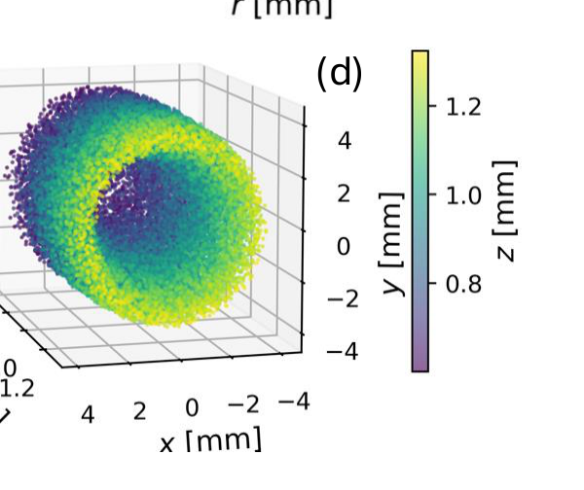
Generic to CW photoinjectors
The ingredients are shared by nearly every CW SRF FEL injector
All the mechanism needs is sub-MeV velocity bunching, a radially dependent chirp, and downstream focusing
That configuration is used at LCLS-II, SHINE, the European XFEL CW upgrade and VHF-gun ERL injectors
Design implications:
  minimize compression below ≈1 MeV; move it to higher energy where the beam is smaller and stiffer
  treat halo as a constraint on the buncher–solenoid working point, not only an operational issue
  include time-resolved transverse diagnostics early in the beamline
3-D view of the hollowed bunch head
Halo control belongs in the injector design loop for the next generation of high-repetition-rate FELs.

Slide 17
Summary
A previously unrecognized halo mechanism, validated and mitigated
Three coupled steps: r-dependent chirp, hollow bunch ends, over-focusing into a halo
Confirmed by an analytic model, Astra simulation and direct measurement at LCLS-II
Mitigated by weaker buncher compression — now standard in LCLS-II operation

Slide 18
Thank you
Questions welcome
Thanks to David Dowell, Theodore Vecchione and Jingyi Tang for their help and for many useful discussions
Supported by the U.S. Department of Energy under Contract No. DE-AC02-76SF00515
Zhen Zhang, Yuantao Ding, David Cesar, Feng Zhou, Ji Qiang and Zhirong Huang, "Beam halo formation via longitudinal–transverse coupling in continuous-wave photoinjectors" arXiv preprint arXiv:2511.05831 (2025).
zzhang@slac.stanford.edu
Simulated core–halo profile after the cryomodule

