Slide 1
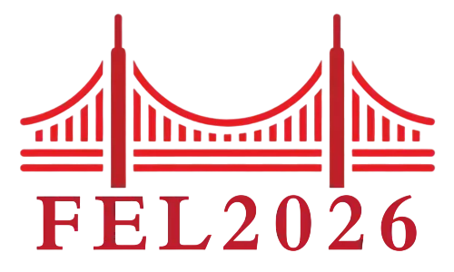
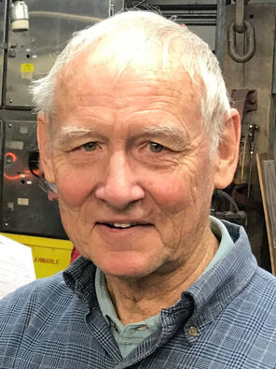
In Memoriam: Todd Smith
Alan Schwettman
Stanford University

Slide 2
The Rice connection
Todd and I first met in 1961 as graduate students at Rice University, working in the Rorschach low temperature physics group. Although we overlapped at Rice for only 12 months, we bonded through sharing a laboratory space, sharing a sense of humor (Todd was a pun master), and sharing a healthy respect for QUESTIONING the “accepted point of view.”

Slide 3
The move to Stanford
In 1962 I went to Stanford to join the Fairbank group that had just published a breakthrough measurement of Q in a superconducting radio frequency TE-mode cavity. The reported Q-value was an order of magnitude higher than had been achieved by an array of investigators in the previous decades.
(1962 Low Temperature Conference: Faibank, Pierce, and Wilson)

Slide 4
Todd’s move to Stanford in 1965
Important improvements in the experimental system described in the 1962 paper was implemented, and in 1964 Q-values another order of magnitude higher than the 1962 values were reported by our group. Importantly, the high Q-values were sustained at surface magnetic field level of interest for electron linacs.
(Schwettman, Wilson, Pierce, and Fairbank)
The high Q-values achieved in the 1964 paper set the stage for a detailed verification of the BCS Theory in the microwave region which became the Low Temperature Ph.D. thesis of John Turneasure.
The high surface magnetic fields opened a wide berth of novel accelerator physics issues available to Todd. Fortunately, Todd found these issues challenging and decide to join us at Stanford.

Slide 5
Todd’s accelerator physics contributions (1965-1968)
One of the important accelerator physics challenges facing our group was identifying a suitable standing-wave structure for a superconducting linac. Perry Wilson and Bill Vorkoeper embarked on construction of a 10-cell pi/2-mode structure, where the traveling wave group velocity is maximum, but the standing wave energy gain is modest. Todd was haunted by the accelerator community rejection of the pi-mode structure where the energy gain was maximum, but the traveling wave group velocity was zero.
I shared Todd’s concerns and being aware of the very imaginative standing wave structure design the proton linac group at Los Alamos had adopted, I arranged a meeting with Ed Knapp and Darragh Nagle at Los Alamos. At the Los Alamos meeting Nagle suggested to Todd that he use an electrical analog of the pi-mode structure and then do a detailed analysis. What Todd subsequently learned from detailed analysis was that, for a short (7 cell) pi-mode structure, the zero-traveling wave group velocity was a non-issue. (HEPL report: Smith)
At Stanford we incorporated Todd’s short pi-mode analysis in our structure design and his short pi-mode approach has been adopted in every superconducting linac since.

Slide 6
Setting the FEL stage
The circumstances surrounding the development of the superconducting accelerator at Stanford were unique and the opportunities enormous. We had a young and talented group who were not hindered by the “accepted point of view.” Everything was new.
A short list of Firsts
Short standing wave pi-mode structure Smith
Superfluid helium refrigerator Collins
High Q/high field niobium cavity Turneaure
Stabilization of accelerator rf fields Suelzle
External loading of HOMs Mittag
low emittance injector Group
(McAshan, Mittag, Schwettman, Suelzle, and Turneaure)

Slide 7
Early SCA discussions with Hofstedter
Schwettman suggested it might be possible to achieve 10⁻⁴ energy resolution in proposed 2 Gev linac, commenting that:
Superfluid Helium Providing large thermal reservoir
Standing Wave Structure Providing large rf energy reservoir
Continuous Wave RF System Providing Opportunity for Stabilization

Slide 8
Return to Stanford in 1973
After 5 years as an assistant professor at the University of Southern California, Todd returned to Stanford. It was desperation time for the Superconducting Accelerator Program, because Larry Suelzle had just decided to leave Stanford and join a start-up company in Los Angels. We needed to find someone to assume responsibility for operation of the accelerator.
Although I knew Todd quite well, it was not clear to me that he would fit into this role smoothly. I had not previously recognized that when Todd was engaged in an experiment his entire being was laser focused on the task at hand. Everthing moved forward in the direction of his immediate objective. His no-holds-barred mindset was not without risk, but it was essential to the ultimate success of the FEL program.

Slide 9
A few years later one of Todd’s graduate students captured the essence of Todd engaged in an experiment: “Todd was a genius at getting things to work, even when all hope seemed lost, and just like Indiana Jones, although you never knew what path he would take, you were confident he would find something. It seemed at times he was able to will the complicated machines around us to do his bidding. He was just that stubborn. And just that good.”
In 1973 Luis Elias also arrived at Stanford after completing his Ph.D. at the University of Wisconsin. Both Smith and Elias were deeply interested in the proposed FEL program.

Slide 10
The seminal FEL papers
The Free Electron laser concept originated with John Madey who developed a theory during his doctoral work at Stanford and published it in 1971. In the Madey theory a beam of relativistic electrons, passing through a long periodic transverse magnet field emits tunable coherent stimulated radiation whose wavelength depends on electron bean energy and magnet period.
In a March 1973 HEPL report Madey, Schwettman, and Fairbank described a proposed helically wound superconducting solenoid 5.2 meters in length with a period 3 cm that could be used in an experiment to observe stimulated emission. The bore diameter through which the electron beam was expected to pass was 8 mm.
With the arrival of Smith and Elias there was a natural division of responsibility in executing the FEL experimental plan: Smith was responsible for the electron beam system, Madey and Elias handled the construction and testing of the superconducting helical magnetic undulator, and Elias was responsible for the optics and signal diagnostic system.

Slide 11
First observation of Stimulated Emission (1976)
A pulsed low emittance electron beam from the superconducting accelerator at an energy of 24 MeV produced 7% gain per pass of 10.6 microns CO2 laser light as it co-propagated with the electron beam through the superconducting helical undulator.
Today we mark the 50th anniversary of this milestone paper!

Slide 12
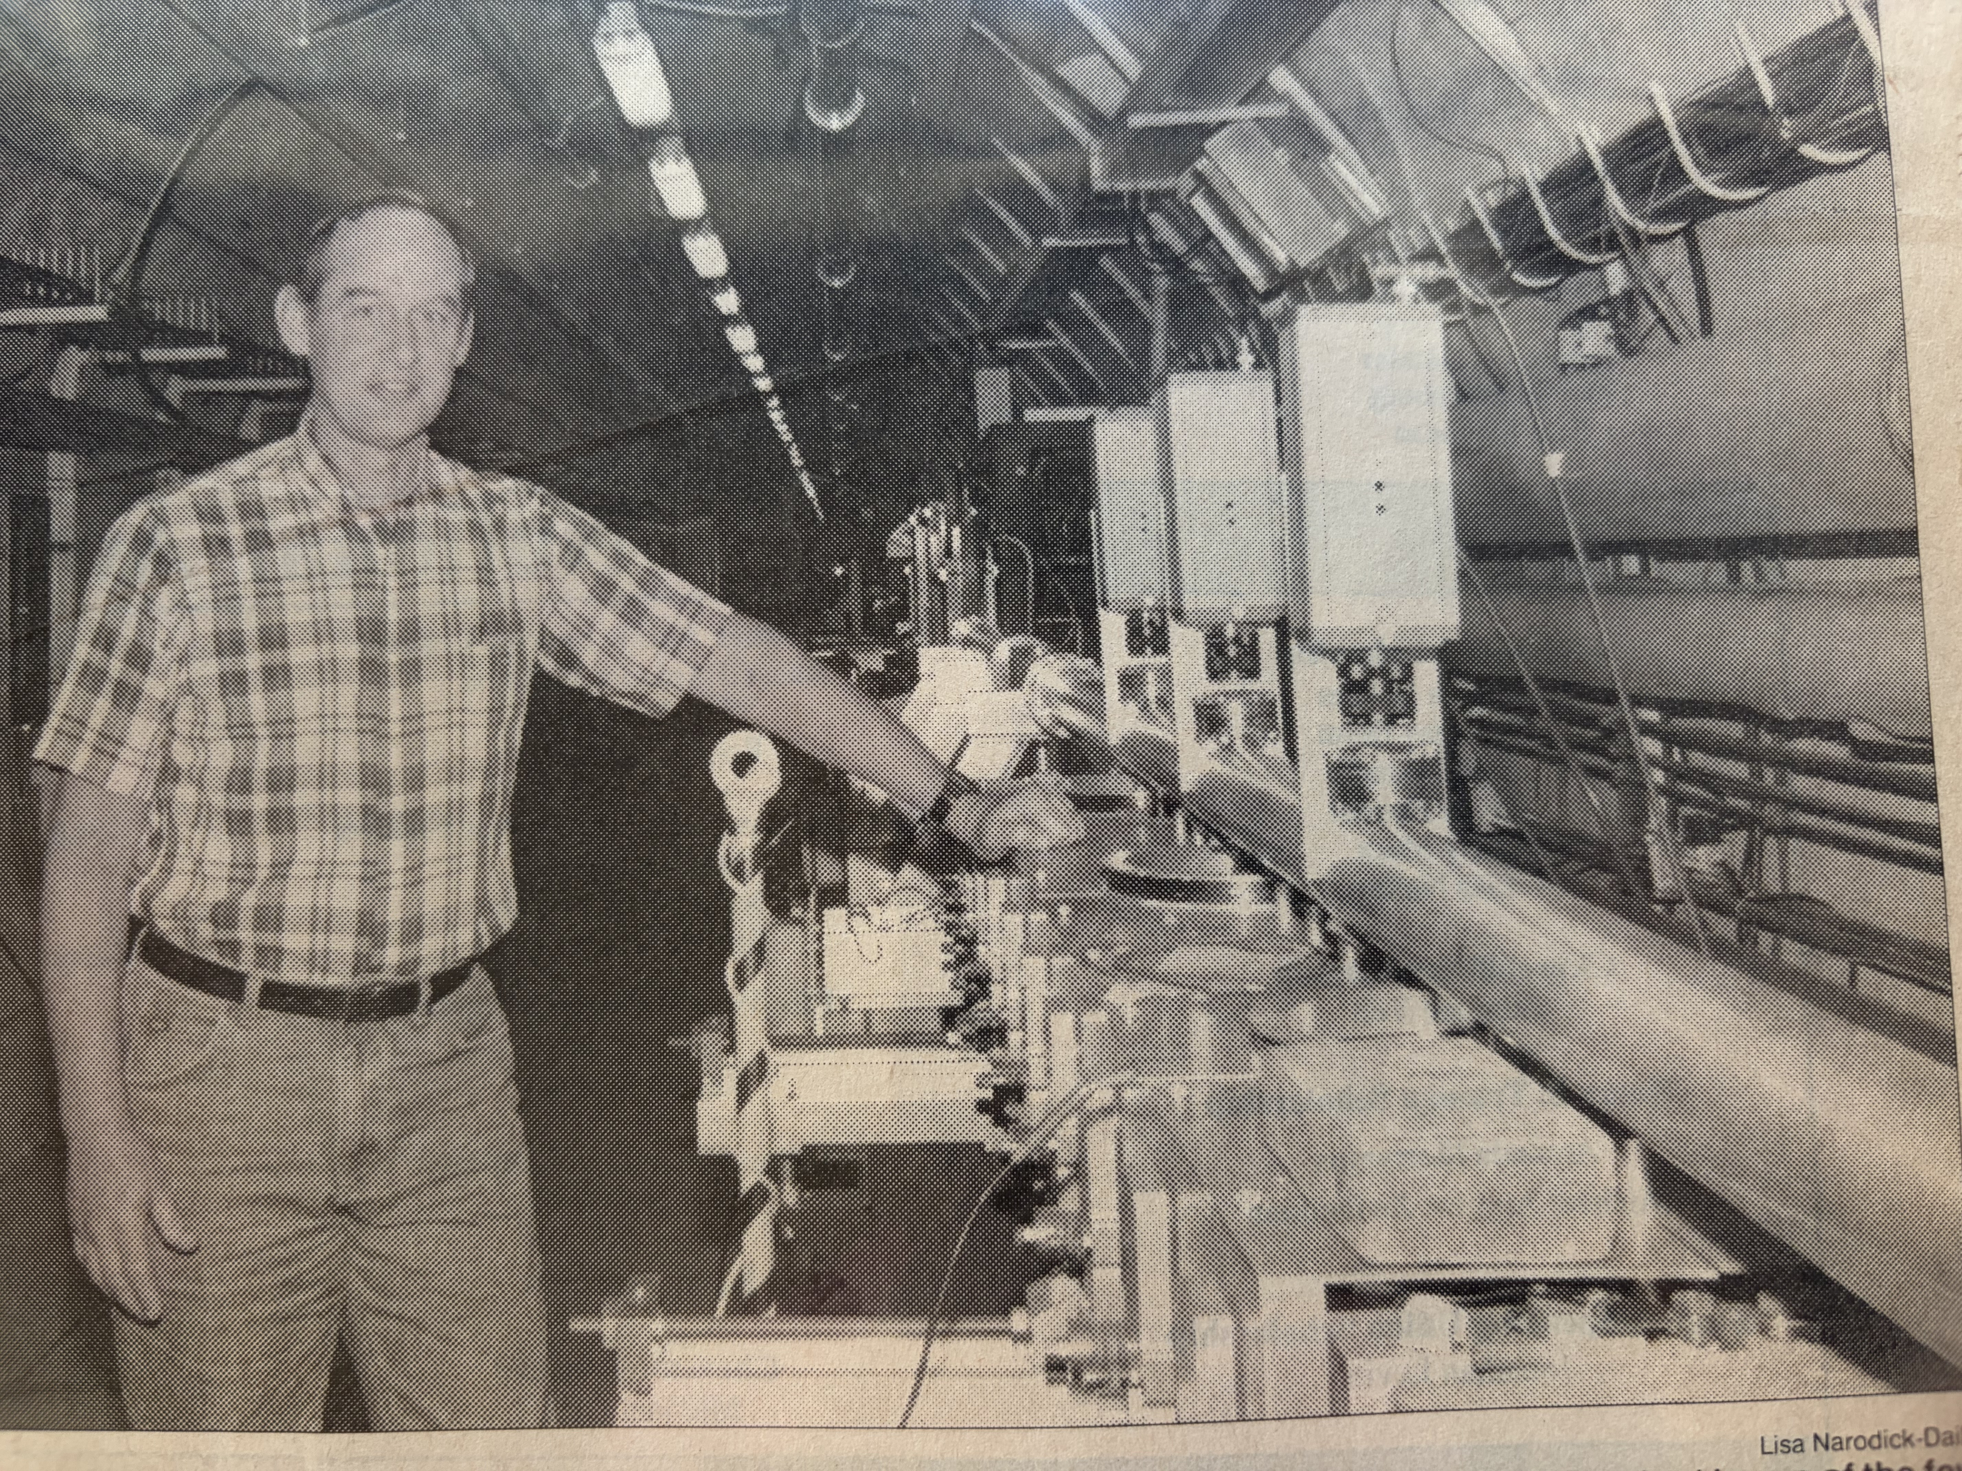
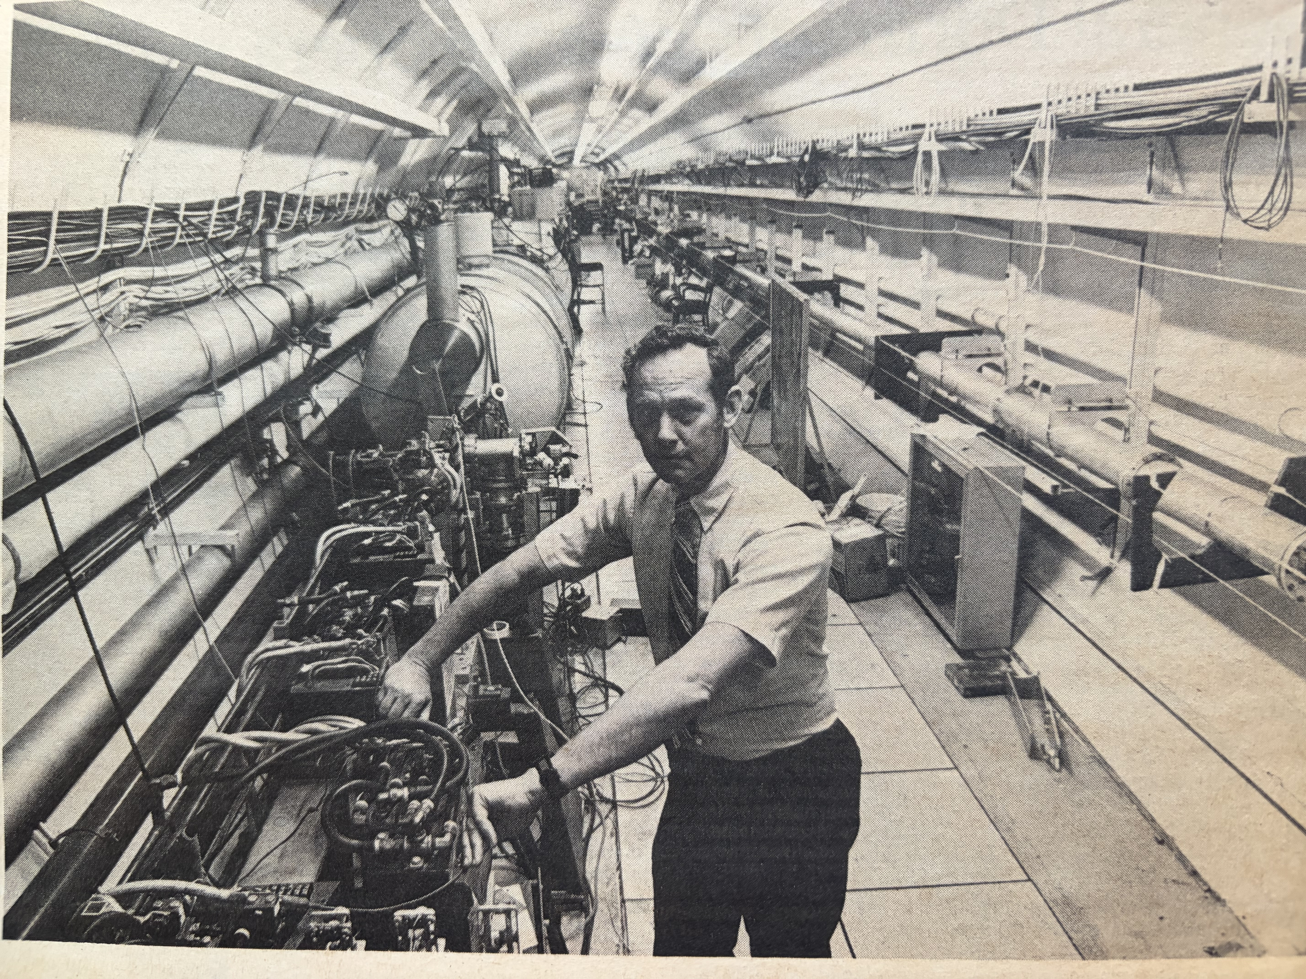
Todd Smith in action

Slide 13
First operation of a free electron laser (1977)
A pulsed low emittance electron beam from the superconducting accelerator at an energy 43.5 MeV produced radiation at 3.4 microns through spontaneous emission. Introducing two mirrors to form an optical cavity enclosing the superconducting undulator, the spontaneous radiation was amplified by repeated passes.

Slide 14
Parallel innovations
There is an important difference between recirculation in a long electron linac and the multi-pass Racetrack Microtron we described in 1965 by Wiik, Wilson, and Schwettman. The multi-pass Racetrack Microtron provides a large acceptance, while recirculation in a long linac demands a very small emittance, much like the FEL itself.

Slide 15
First Same-Cell Energy Recovery
In 19?? The group at Los Alamos described a proposed system to recover the electron beam energy in an FEL system by transporting the spent electron beam to a second linac structure. I never spent time to understand details of the proposed scheme, but I instantly understood how well a same-cell recovery scheme would play in a superconducting linac. During the next scheduled SCA run Todd adjusted the phase of the recirculated electron beam and demonstrated 98% energy recovery. This experiment was an early demonstration of what is now called an energy recovery linac (ERL).
Having demonstrated energy recovery, Todd and I outlined a plan for a superconducting linac driven FEL with same-cell energy recovery and this plan ultimately resulted in a successful George Neil TRW proposal. The system described in the TRW proposal was later executed by George Neil at Jefferson Laboratory, for which he was awarded the 2000 FEL prize.

Slide 16
The Stanford Picosecond FEL Center
In 1990 Schwettman and Smith established an FEL Center operating in the mid-infrared that provided Fourier-transform-limit picosecond pulses at an 11.8 MHz repetition rate to four experimental laboratories to support studies of proteins, semiconductors, and other condensed phase and biological materials. Most notable of the experiments performed were the first infrared photon echo experiments of Fayer and his graduate students. By the mid-nineties the Center provided 2000 hours per year, supporting sixteen faculty members, nine from outside Stanford.
Todd and one of his graduate students brought a second FEL, "FIREFLY', into service. The "FIREFLY' operated in the far-infrared. Subsequently, Schwettman and Smith co-authored a paper in the Journal of the Optical Society of America describing an FEL system that could provide two independently tunable synchronized picosecond pulses for pump-probe experiments.

Slide 17
Todd Smith’s legacy of giving
As Doctoral Thesis Advisor: Ken Berryman
”The relationship between a doctoral thesis advisor and a student is a complicated one: part mentor, part teacher, part motivator, and yes, part babysitter…To say that Todd was an exemplary advisor is an understatement….even today I can point to the many things I learned from him…An intuitive curiosity about the way things work. A dedication to measuring something – anything – to understand what is going wrong…A tinkerer’s mindset to always fiddle…because there is always a way to make things better.”

Slide 18
Todd Smith’s legacy of giving
As Scientific colleague: George Neil (TRW and Jefferson Lab)
”Science fiction authors like to write of seemingly innocuous events which alter the timeline of an entire universe. For me, that moment of serendipity happened when I met Todd Smith while planning a Free Electron Laser experiment on the Stanford Superconducting Accelerator. While the experiment turned out successfully, the more important result was that, as part of the planning, Todd taught me about superconducting rf accelerator technology.”

Slide 19
Todd Smith’s legacy of giving
As Palo Alto Community Member
After retiring from Stanford Todd channeled the practical ingenuity that had served him in the laboratory into community service. He participated in a volunteer-run program focused on repairing rather than discarding household items. On Tuesday mornings he fixed children’s toys, clocks, lamps, heaters and a wide range of other mechanical and electrical items for friends and strangers.

