Slide 1
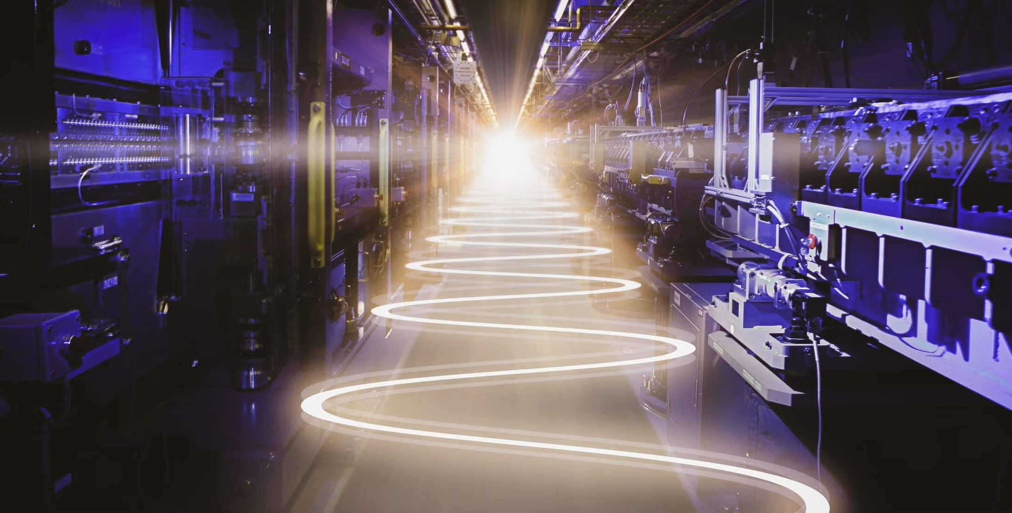
Building a better X-ray Laser for Operando Science
Kelly Gaffney
Director – Linac Coherent Light Source

Slide 2
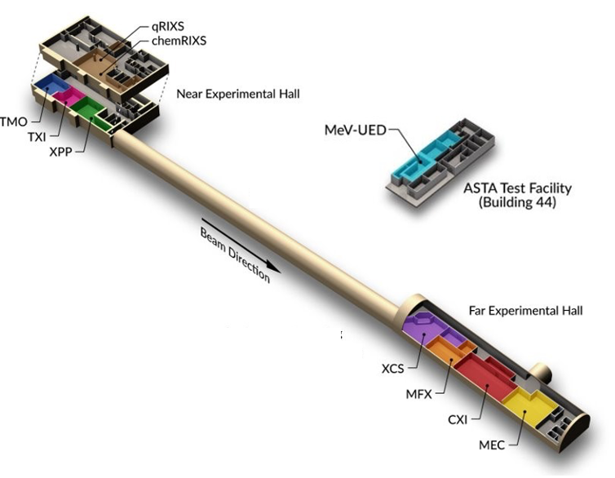
LCLS – a facility in transition
10 LCLS instruments
LCLS
LCLS-II-HE
LCLS-II
Second generation X-ray laser science builds on a strong research foundation
~500 users a year pushing the frontiers of X-ray laser science
Major transition to high repetition rate X-ray laser science enabled by
$2B investment in superconducting accelerator (LCLS-II & LCLS-II HE)

Slide 3
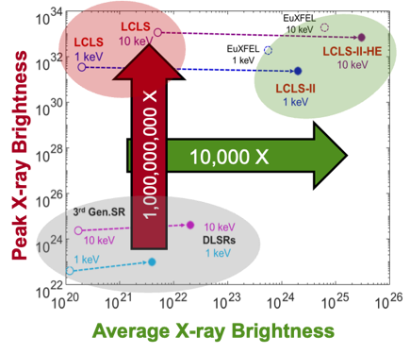
Research strategy focuses on four essential elements
1. Establish science mission with decadal-scale ambition
2. Driving leaps in source and facility performance (for LCLS-II, HE)
3. Foster a vibrant, integrated research ecosystem
4. Make multiplexed LCLS essential platform BES mission (LCLS-X)
These elements will maintain LCLS as a preeminent engine for discovery and
enable increased impact on use-inspired research

Slide 4
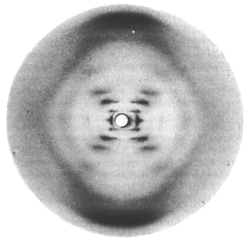
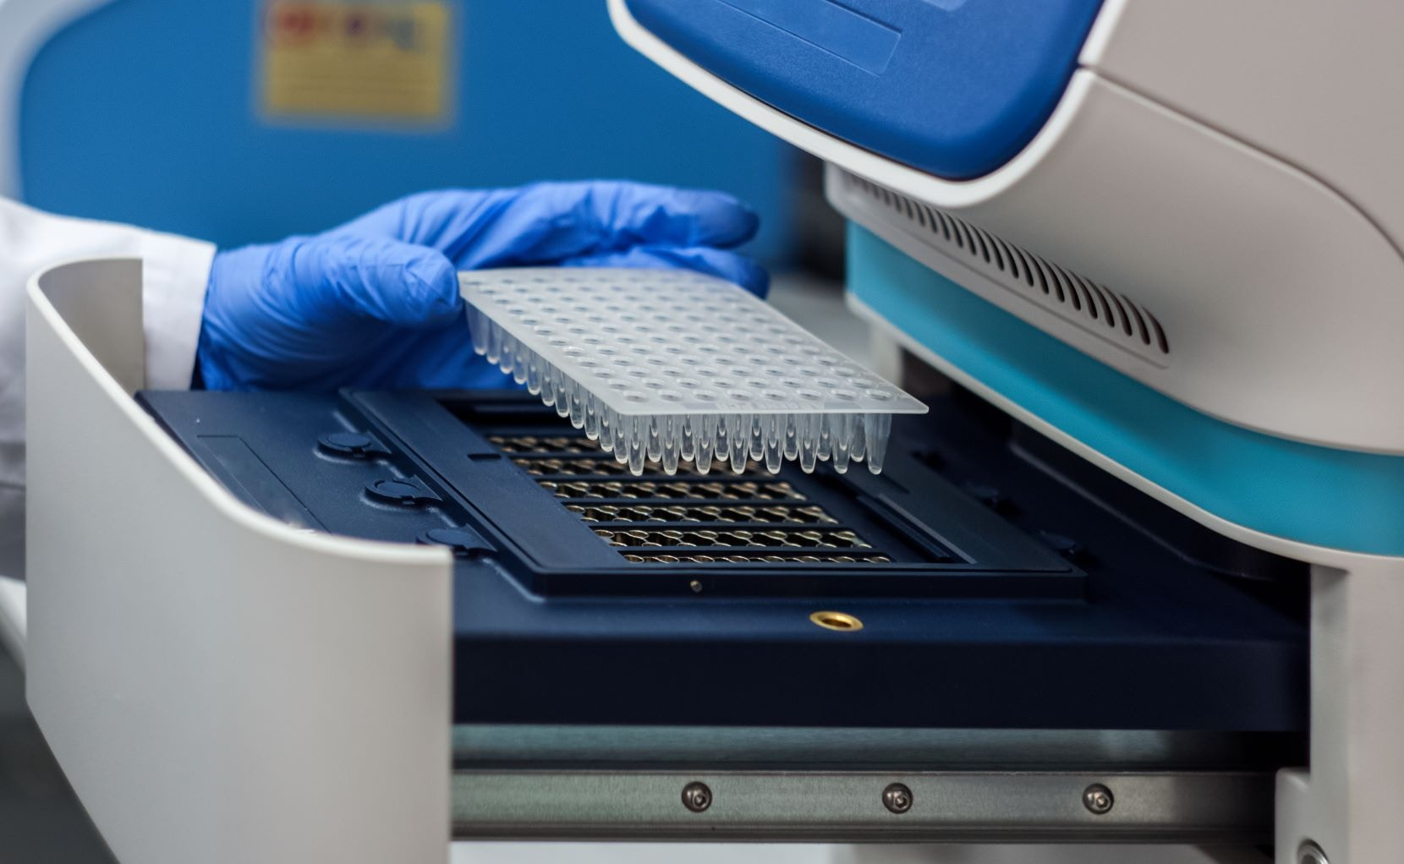
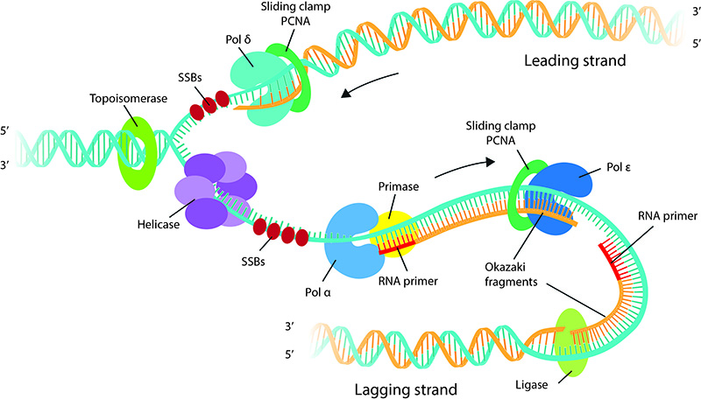

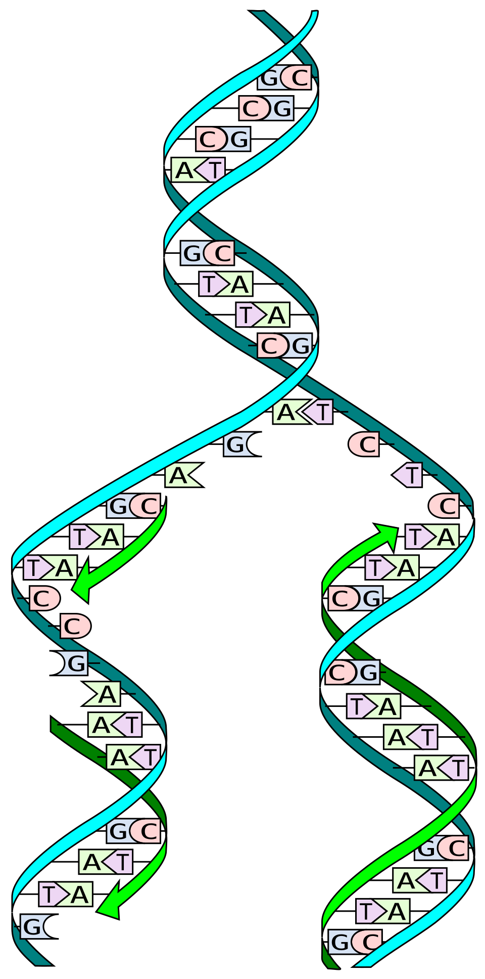
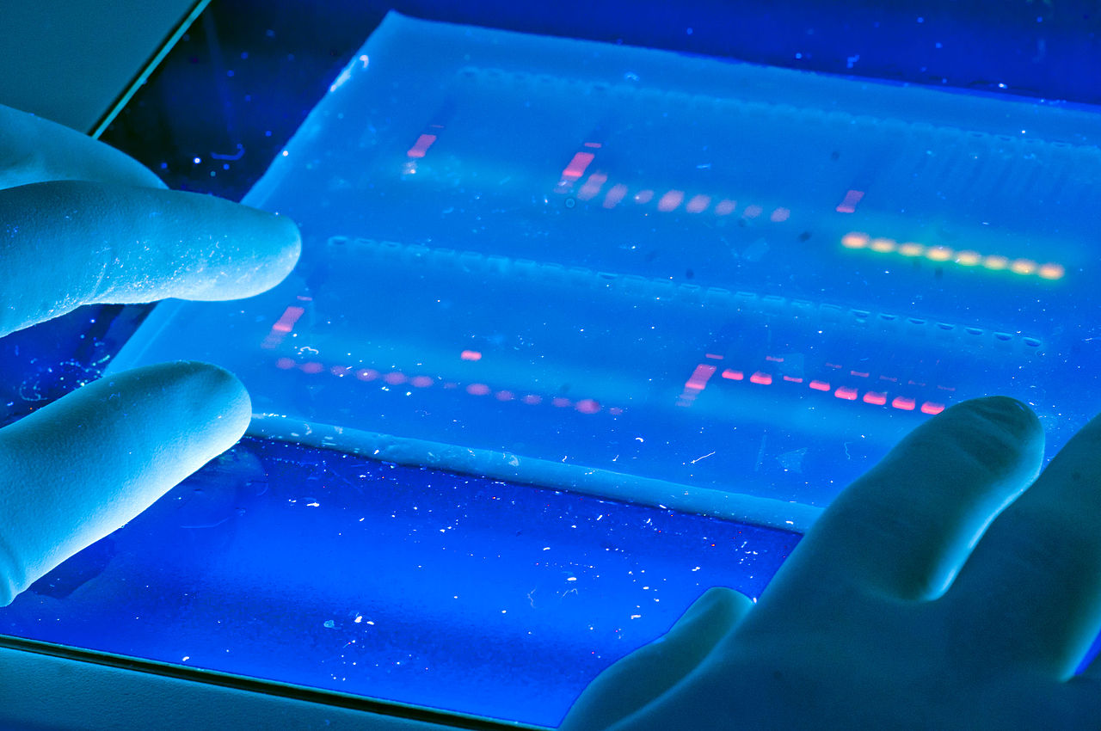
1. Science mission:
Reimagining structure-function relationship for 21st Century
Conception
Mechanism
Technology
DNA replication: Coordinated action of numerous biomolecules
DNA replication technology essential to all DNA testing
Accelerate discovery of design principles derived from mechanistic understanding
Facilitate development of new technology

Slide 5
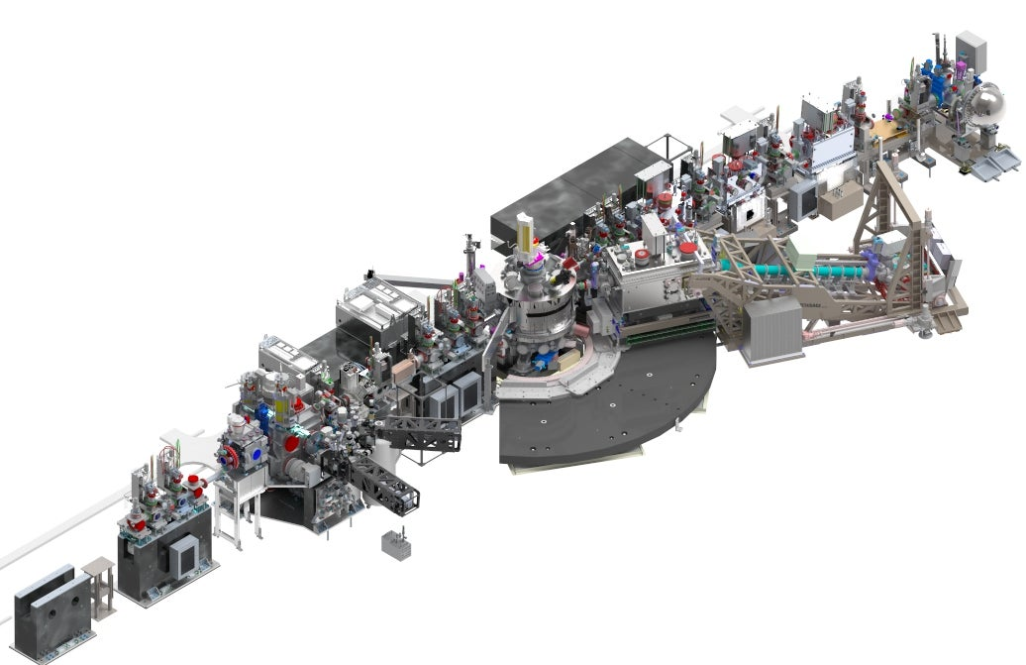
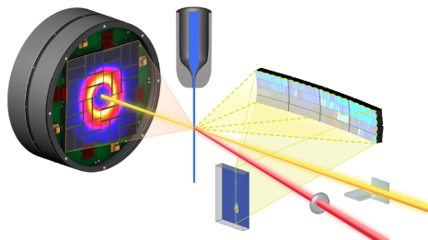
1. Science mission:
Advancing priority research directions at LCLS
LCLS will accelerate the discovery of design principles through state-of-the-art operando and time-resolved X-ray science
The unprecedented coherent flux and spectral brightness will enable:
Application of ultrafast X-ray science to a broad array of research challenges
Operando coherent diffractive imaging
Operando inelastic X-ray scattering & spectroscopy

Slide 6
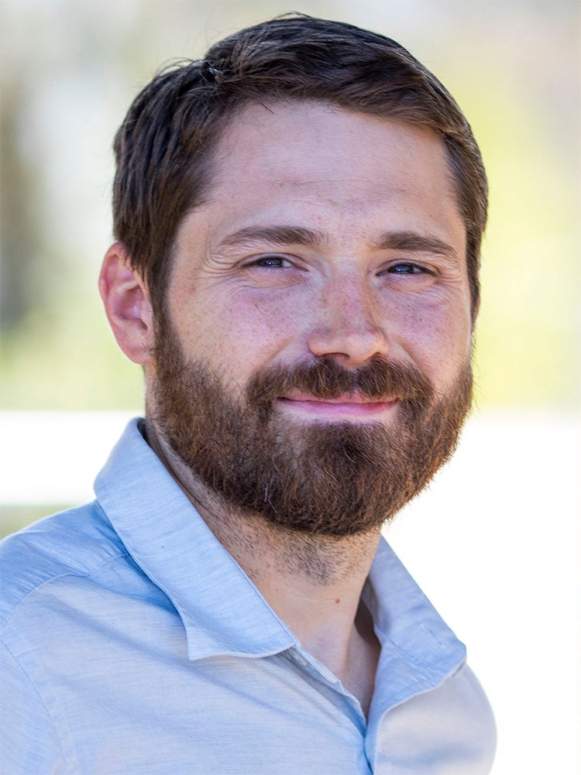
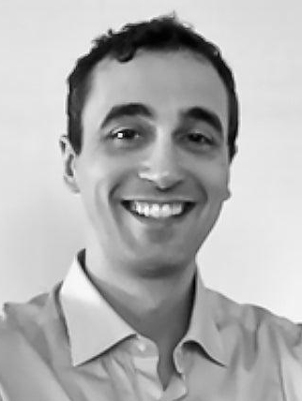
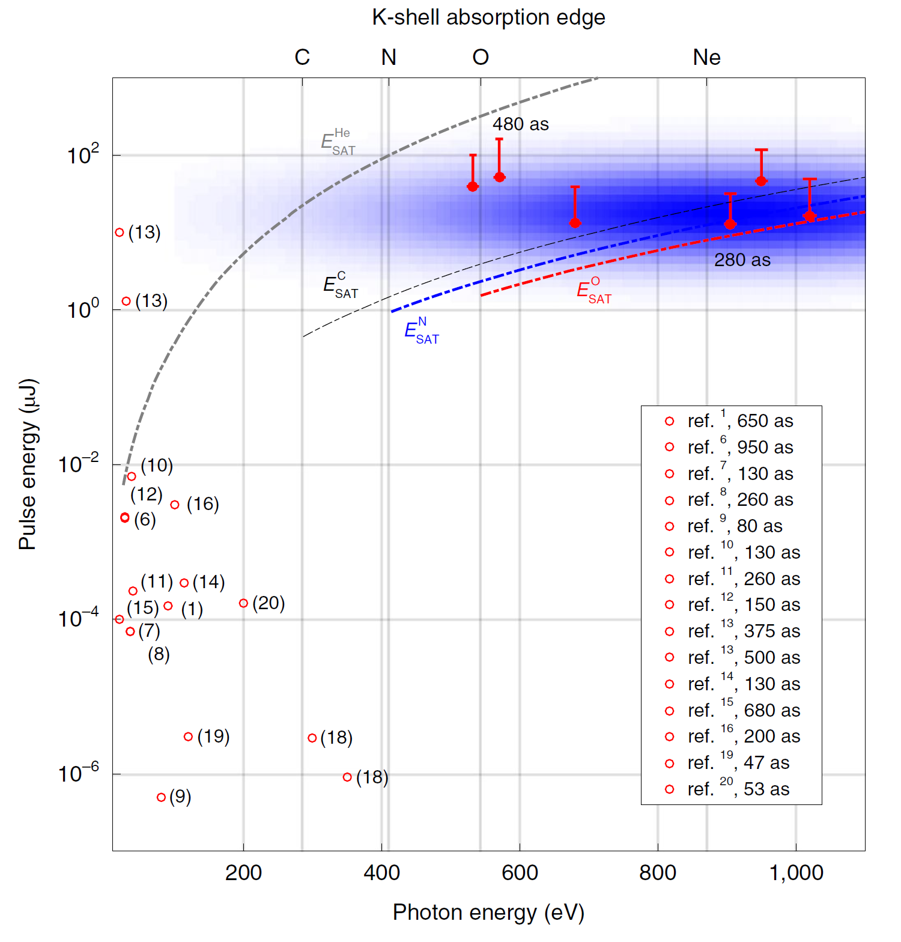
3. Fostering an integrated research ecosystem:
Pursuing new approaches to multi-disciplinary research teams
LCLS led, community driven attosecond science campaign
XFELs enable unique capabilities
Cryan
Marinelli
Attosecond campaign
World leading capabilities create compelling research opportunities
Internationally recognized staff
Engaging thought leaders in the field
Duris, et al. Nature Photonics 14, 30 (2020)
Driving community coordination to accelerate scientific impact
6

Slide 7
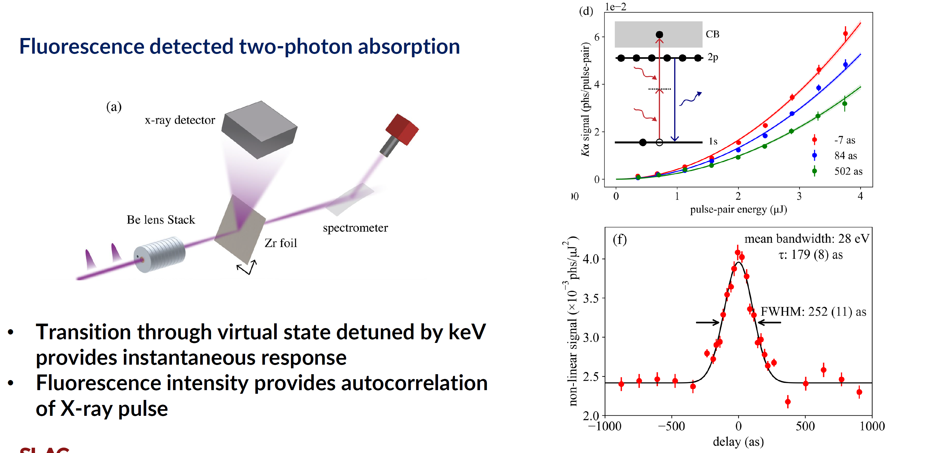
3. Fostering an integrated research ecosystem:
Extending attosecond metrology to hard X-ray regime
7

Slide 8
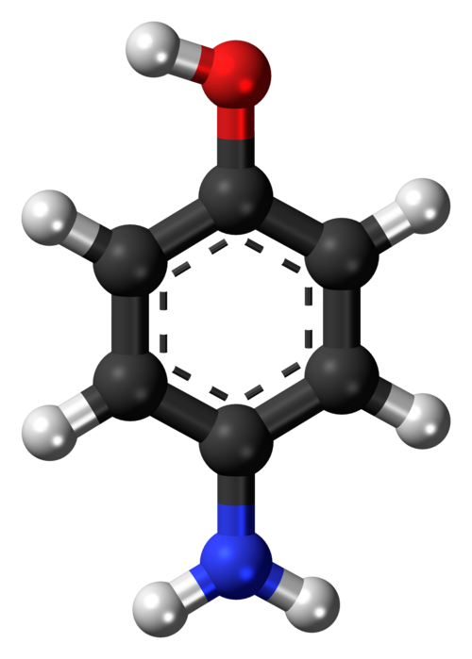
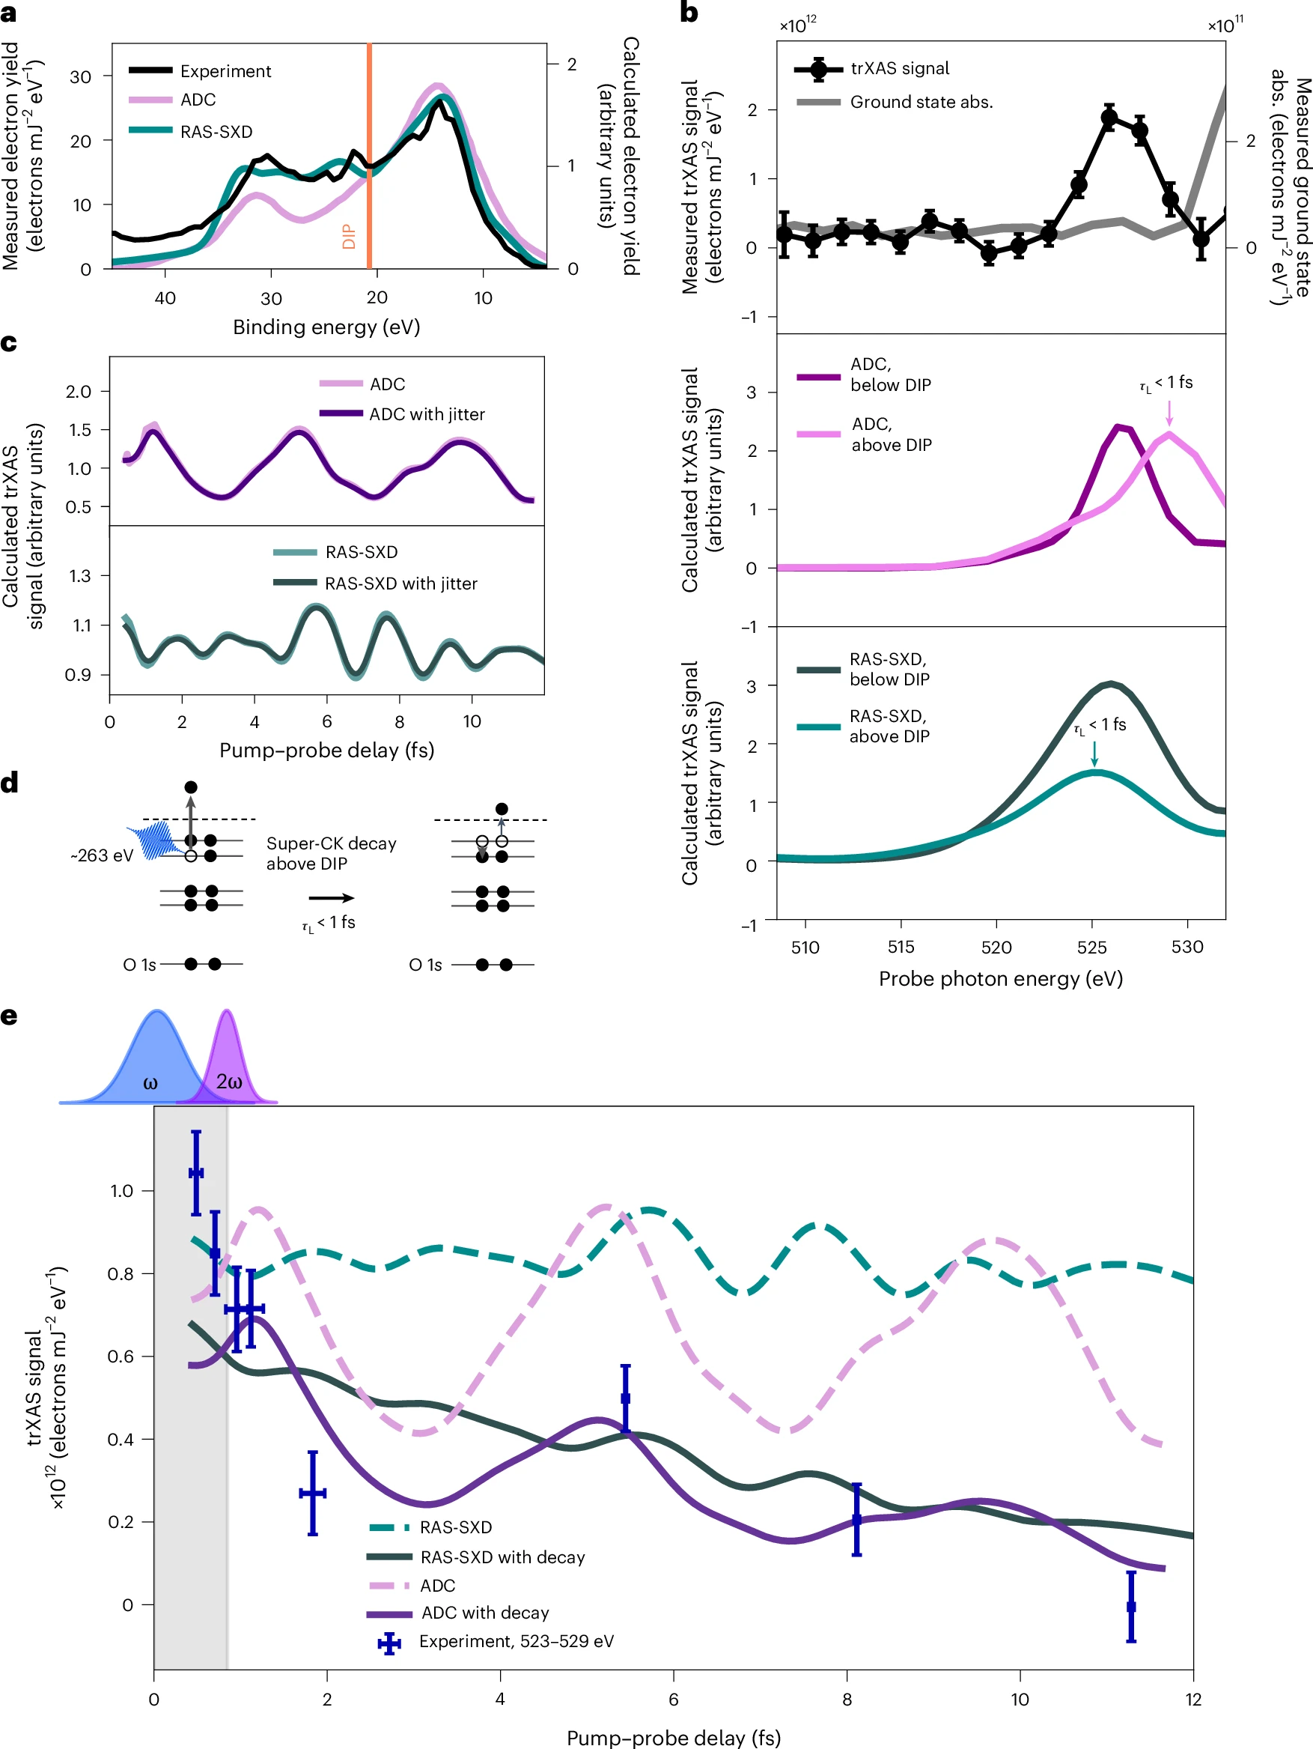
3. Fostering an integrated research ecosystem:
Attosecond science at high repetition rate
~5 minutes with SC-LCLS at the N K-edge
Electron dynamics initiated by inner valence ionization captured with X-ray absorption spectroscopy
O
Many hours with NC-LCLS at the O K-edge
aminophenol
N
Taran Driver et al. Nature Phys. DOI: /10.1038/s41567-026-03360-x
High repetition rate SC-LCLS will transcend demonstration experiments

Slide 9
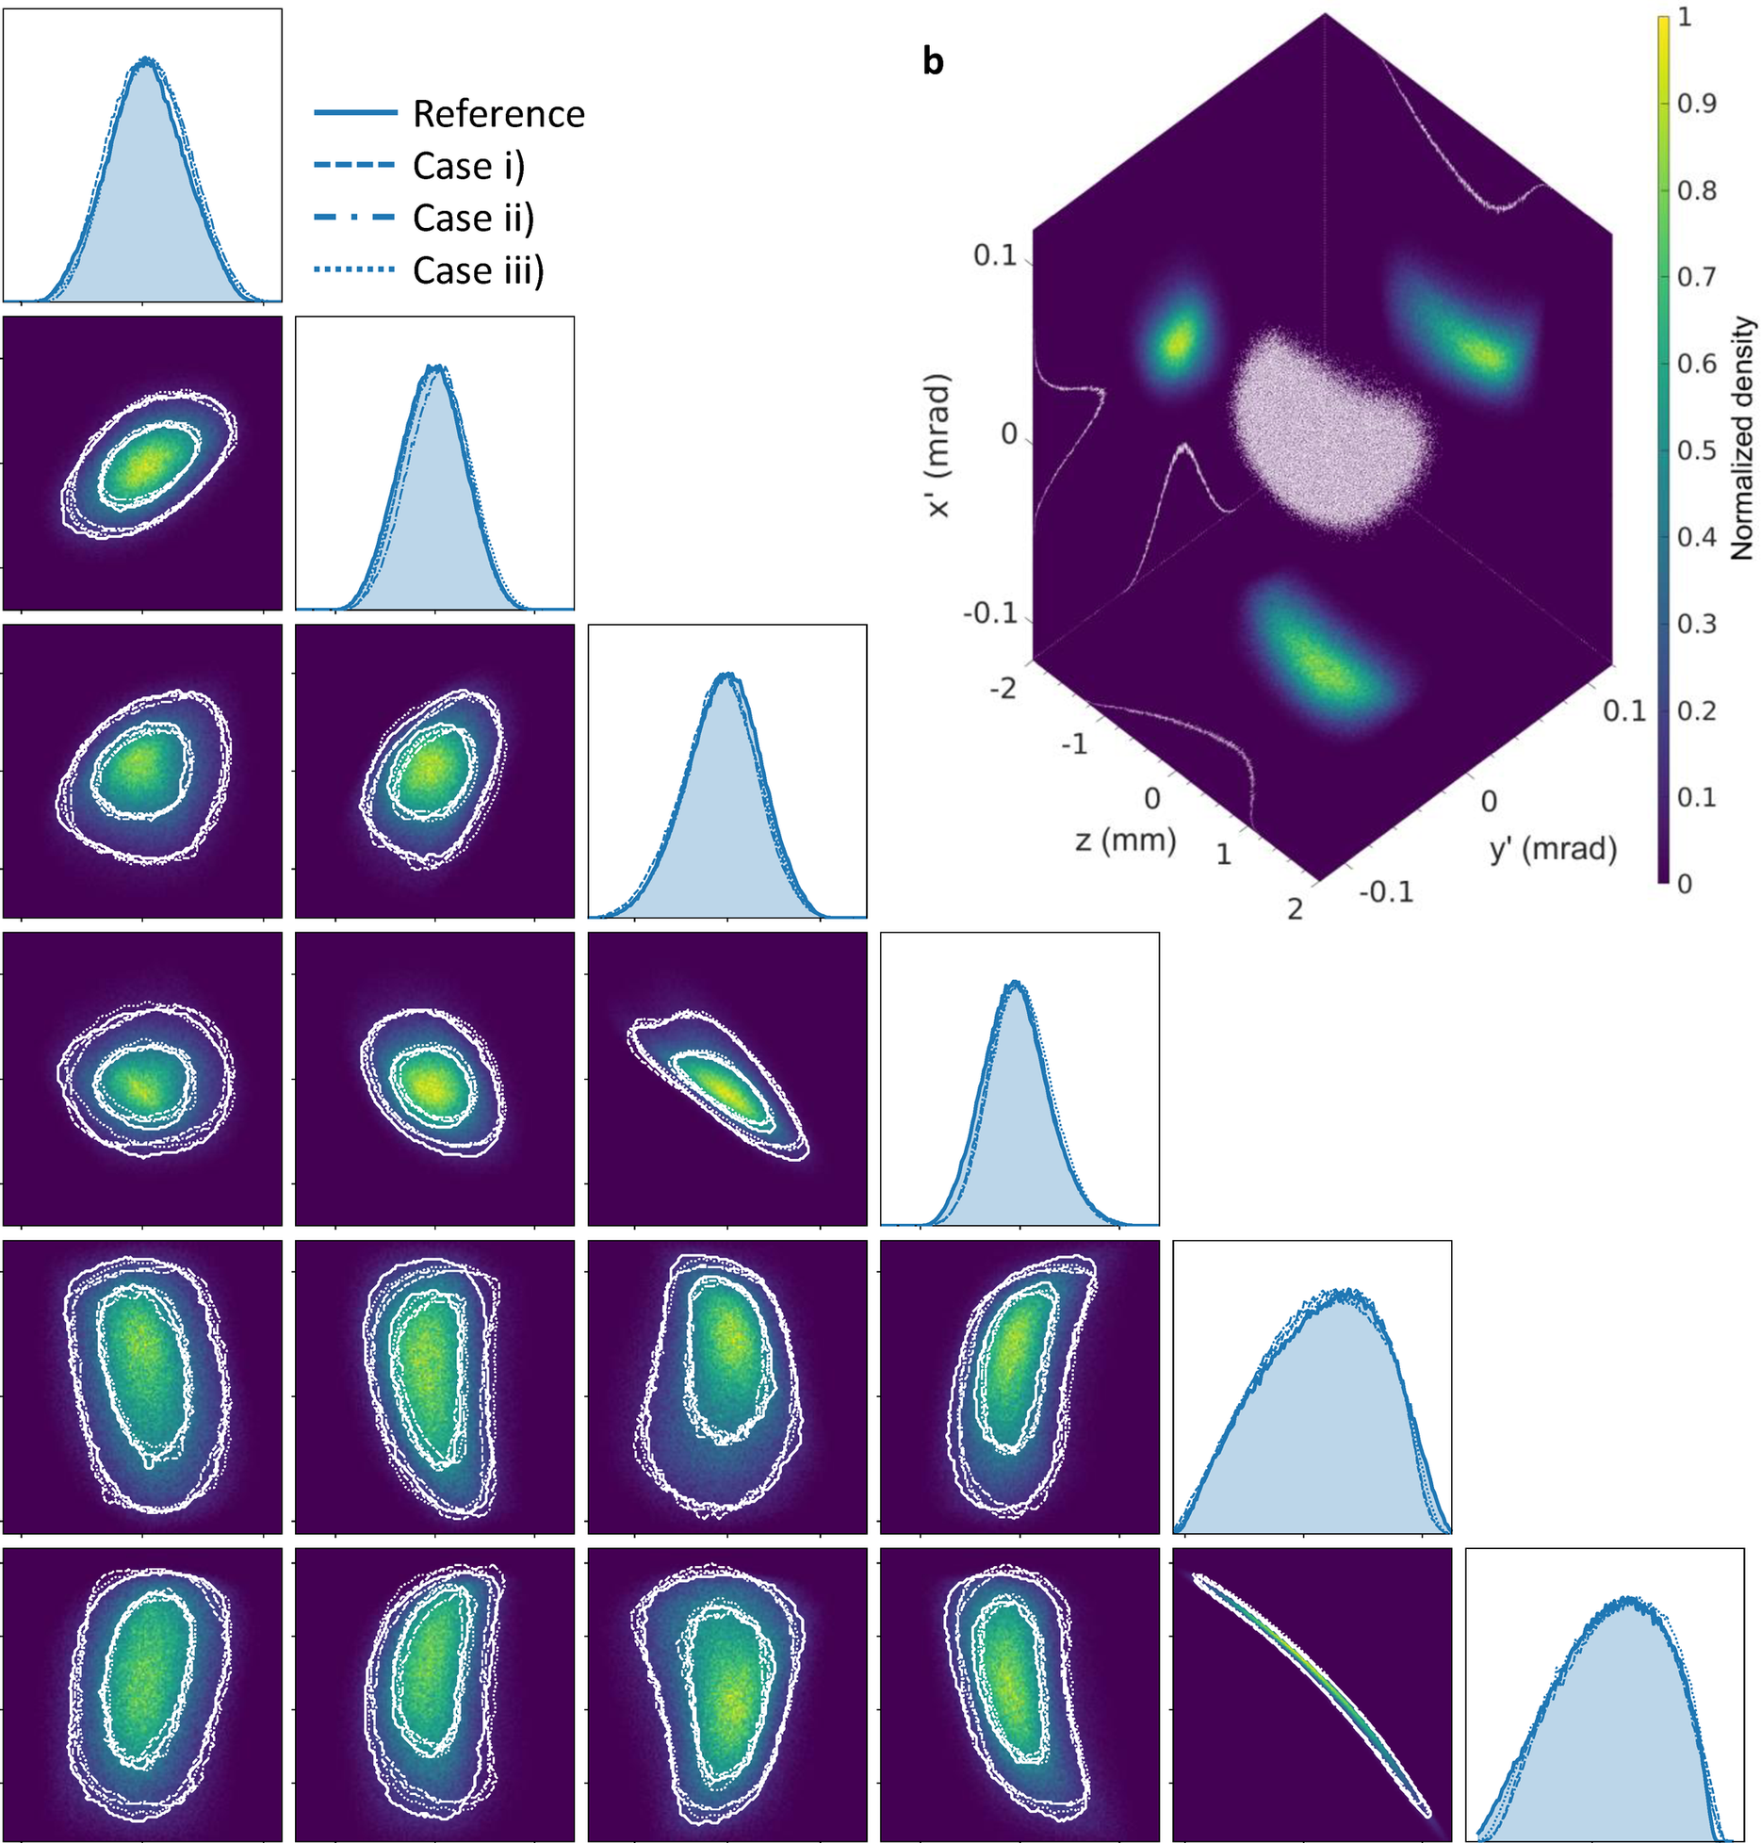
3. Fostering an integrated research ecosystem:
Accelerator & X-ray science R&D collaboration essential
Ever increasing control over the six-dimensional phase space of the X-ray beam
  Improvements in e⁻ beam brightness to extend the photon energy reach to harder X rays
  Spectral phase manipulation for novel X-ray spectroscopies
  Wavefront phase manipulation for X-ray imaging applications
A non-experts view of research priorities
Photoinjectors: photocathode design, optical laser pulse shaping, fast feedback for optimization
X-ray cavity & seeding methods for enhanced spectral brightness
Collaboration between FEL science and X-ray optics for non-linear spectroscopy & imaging applications
A non-experts view of development priorities
AI enabled feedback focused on stability: spectral, temporal, & intensity stability
Science Reports 15, 43049 (2025)
The opportunity to develop the ‘next thing’ dependent on robust delivery of the ‘present thing’
9

Slide 10
Thank you and questions

Slide 11
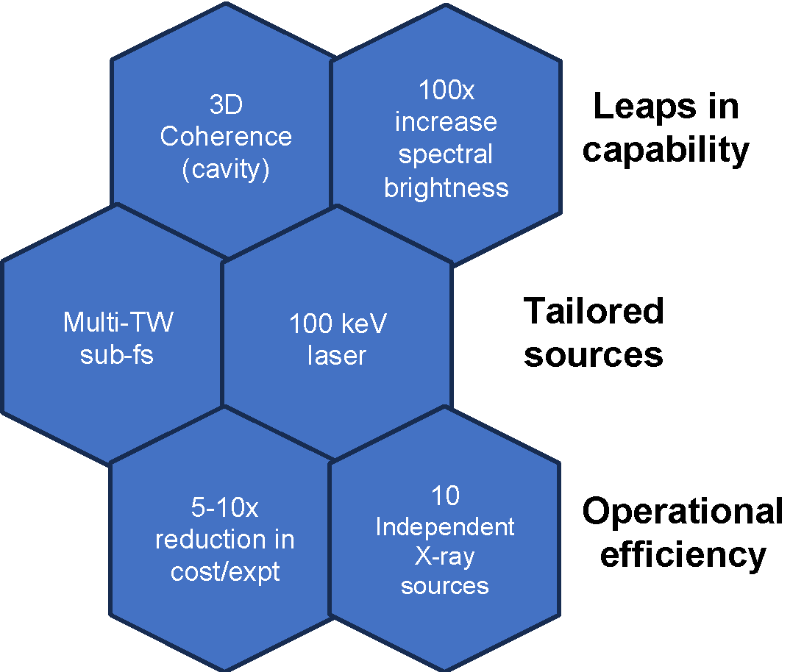

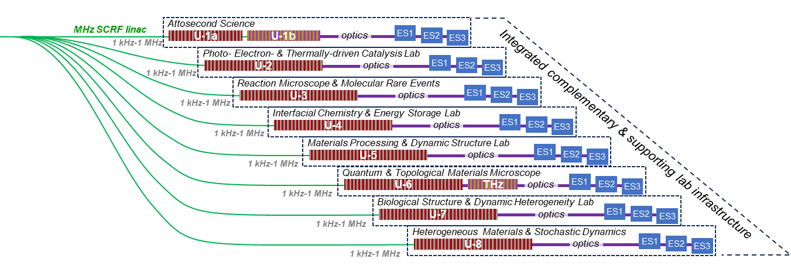
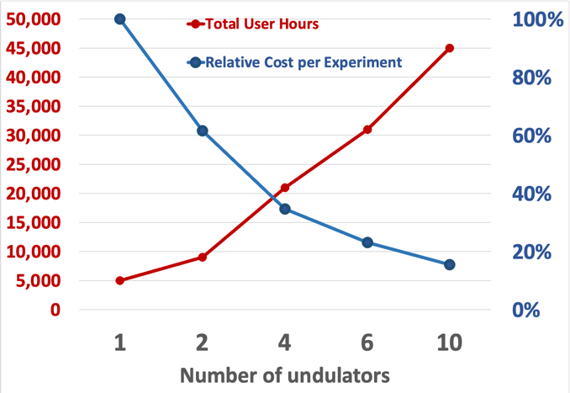
4. Multiplexed X-ray Laser:
Dedicated, specialized XFEL beamlines operated in parallel
Dedicated “X-ray observatories”
Multiplexed delivery of dedicated & specialized instrumentation: Necessary for the efficient delivery of scientific impact only achievable with X-ray lasers

Slide 12
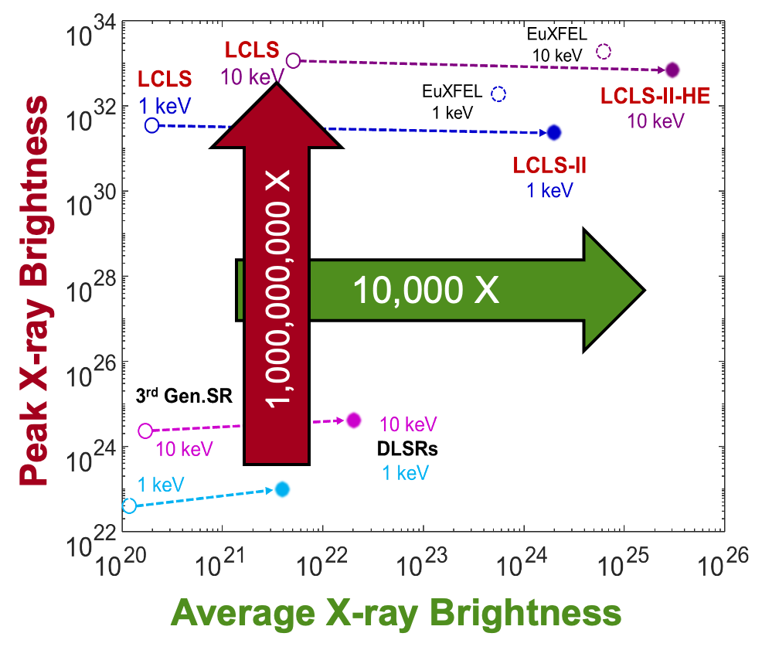
2. Leaps in LCLS capabilities:
High repetition rate X-ray laser game changer for science discovery
Phase 1 (2020): LCLS-II variable gap dual undulators
Phase 2 (2023-2025): LCLS-II 4 GeV SC accelerator
0.25 to 1.5 keV with up to 100 kHz
(CW, programmable)
Instruments: TMO IP1 + IP2, qRIXS, ChemRIXS
Phase 3 (2026-2029): LCLS-II-HE 8 GeV SC accelerator
0.25 to 10 keV with up to 100 kHz
Instruments: upgrades to XPP & MFX, plus RIX3 & TXI
Phase 4: LEI and Instrument Upgrades
0.25 to 20 keV with up to 1 MHz
Instruments: upgrades to CXI & XCS)
Commissioning of high repetition rate hard X-rays scheduled for Fall 2027
12

