Slide 1
Space Charge Studies for Enhanced SASE at the Soft X-ray Beamline Athos at SwissFEL
Free Electron Laser Conference
Sven Reiche
Palo Alto, 24th August 2026

Slide 2
Outline
I - The Soft X-ray Beamline Athos at SwissFEL
II - Modeling Space Charge
III - ESASE Performance at SwissFEL
IV - Simulations
V - Summary and Acknowledgment

Slide 3
I.1 - SwissFEL
First construction phase
2013–16
Second construction phase
2017–20
Athos 0.65 – 5 nm
user
stations
BC1
BC2
3.0–3.4 GeV
Injector
Linac 1
Linac 2
Linac 3
0.3 GeV
2.1 GeV
3.2 GeV
2.1–6.2 GeV
Aramis 0.1 (0.075*) – 0.7 nm
SwissFEL+ Upgrade (2029-33)
EEHG in Athos, Self-seeding, higher photon energies and polarization control in Aramis
Planned phase
2033+
Porthos 0.12 – 0.7 nm
Linac:
Pulse duration : 1–20 fs
Electron energy : up to 5.8 GeV
Electron bunch charge: 10–200 pC
Repetition rate: 100 Hz (2-bunches)
Aramis:
Hard X-ray FEL, λ=0.1–0.7 nm
*Lasing observed down to 0.75A
Linear polarization, variable gap,
in-vacuum undulators
Athos:
Soft X-ray FEL, λ=0.65–5.0 nm
Variable polarization, Apple-X undulators
Upgraded to ESASE/EEHG with ext. laser
Porthos:
Hard X-ray FEL, λ=0.05–0.7 nm
Variable polarization, fix gap,
super conducting undulators
Start of construction: 2033+

Slide 4
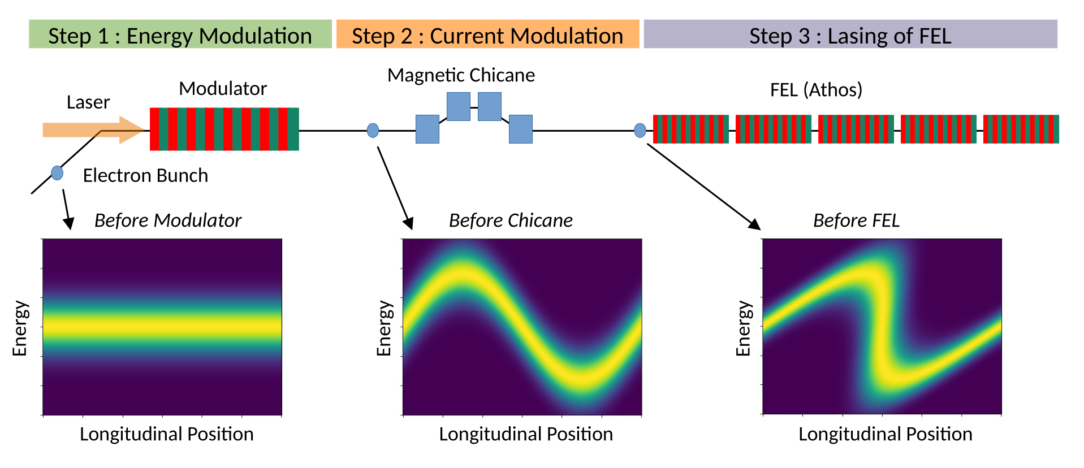
I.2 – Enhanced SASE at Athos
Upgrade of Athos beamline with external laser, modulator and chicane
The first step was the demonstration of Enhanced SASE to produce a train of sub-femtosecond X-ray pulses.
[Idea: A. A. Zholents, Physical Review Special Topics - Accelerators and Beams 8, 040701 (2005)]

Slide 5
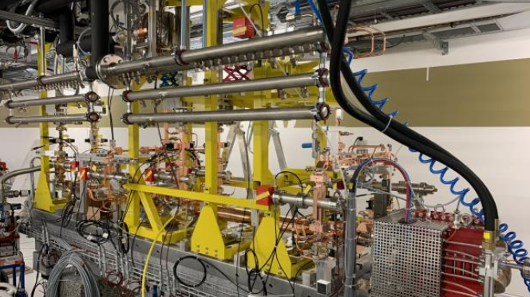
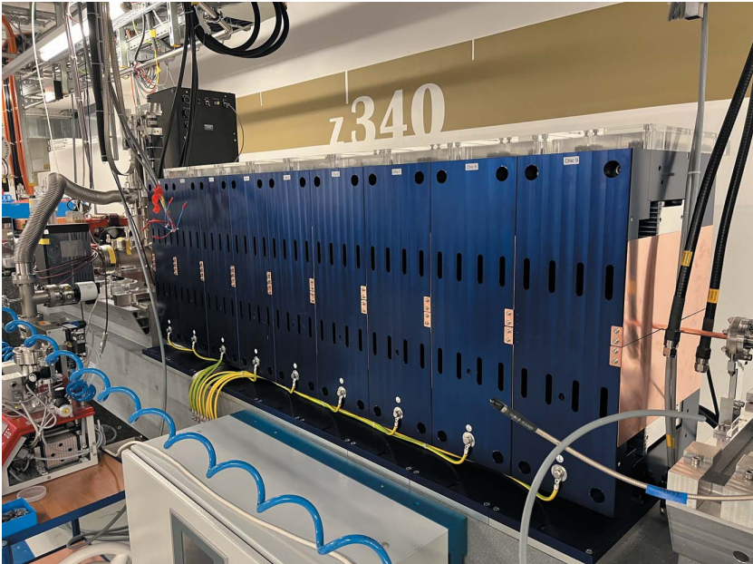
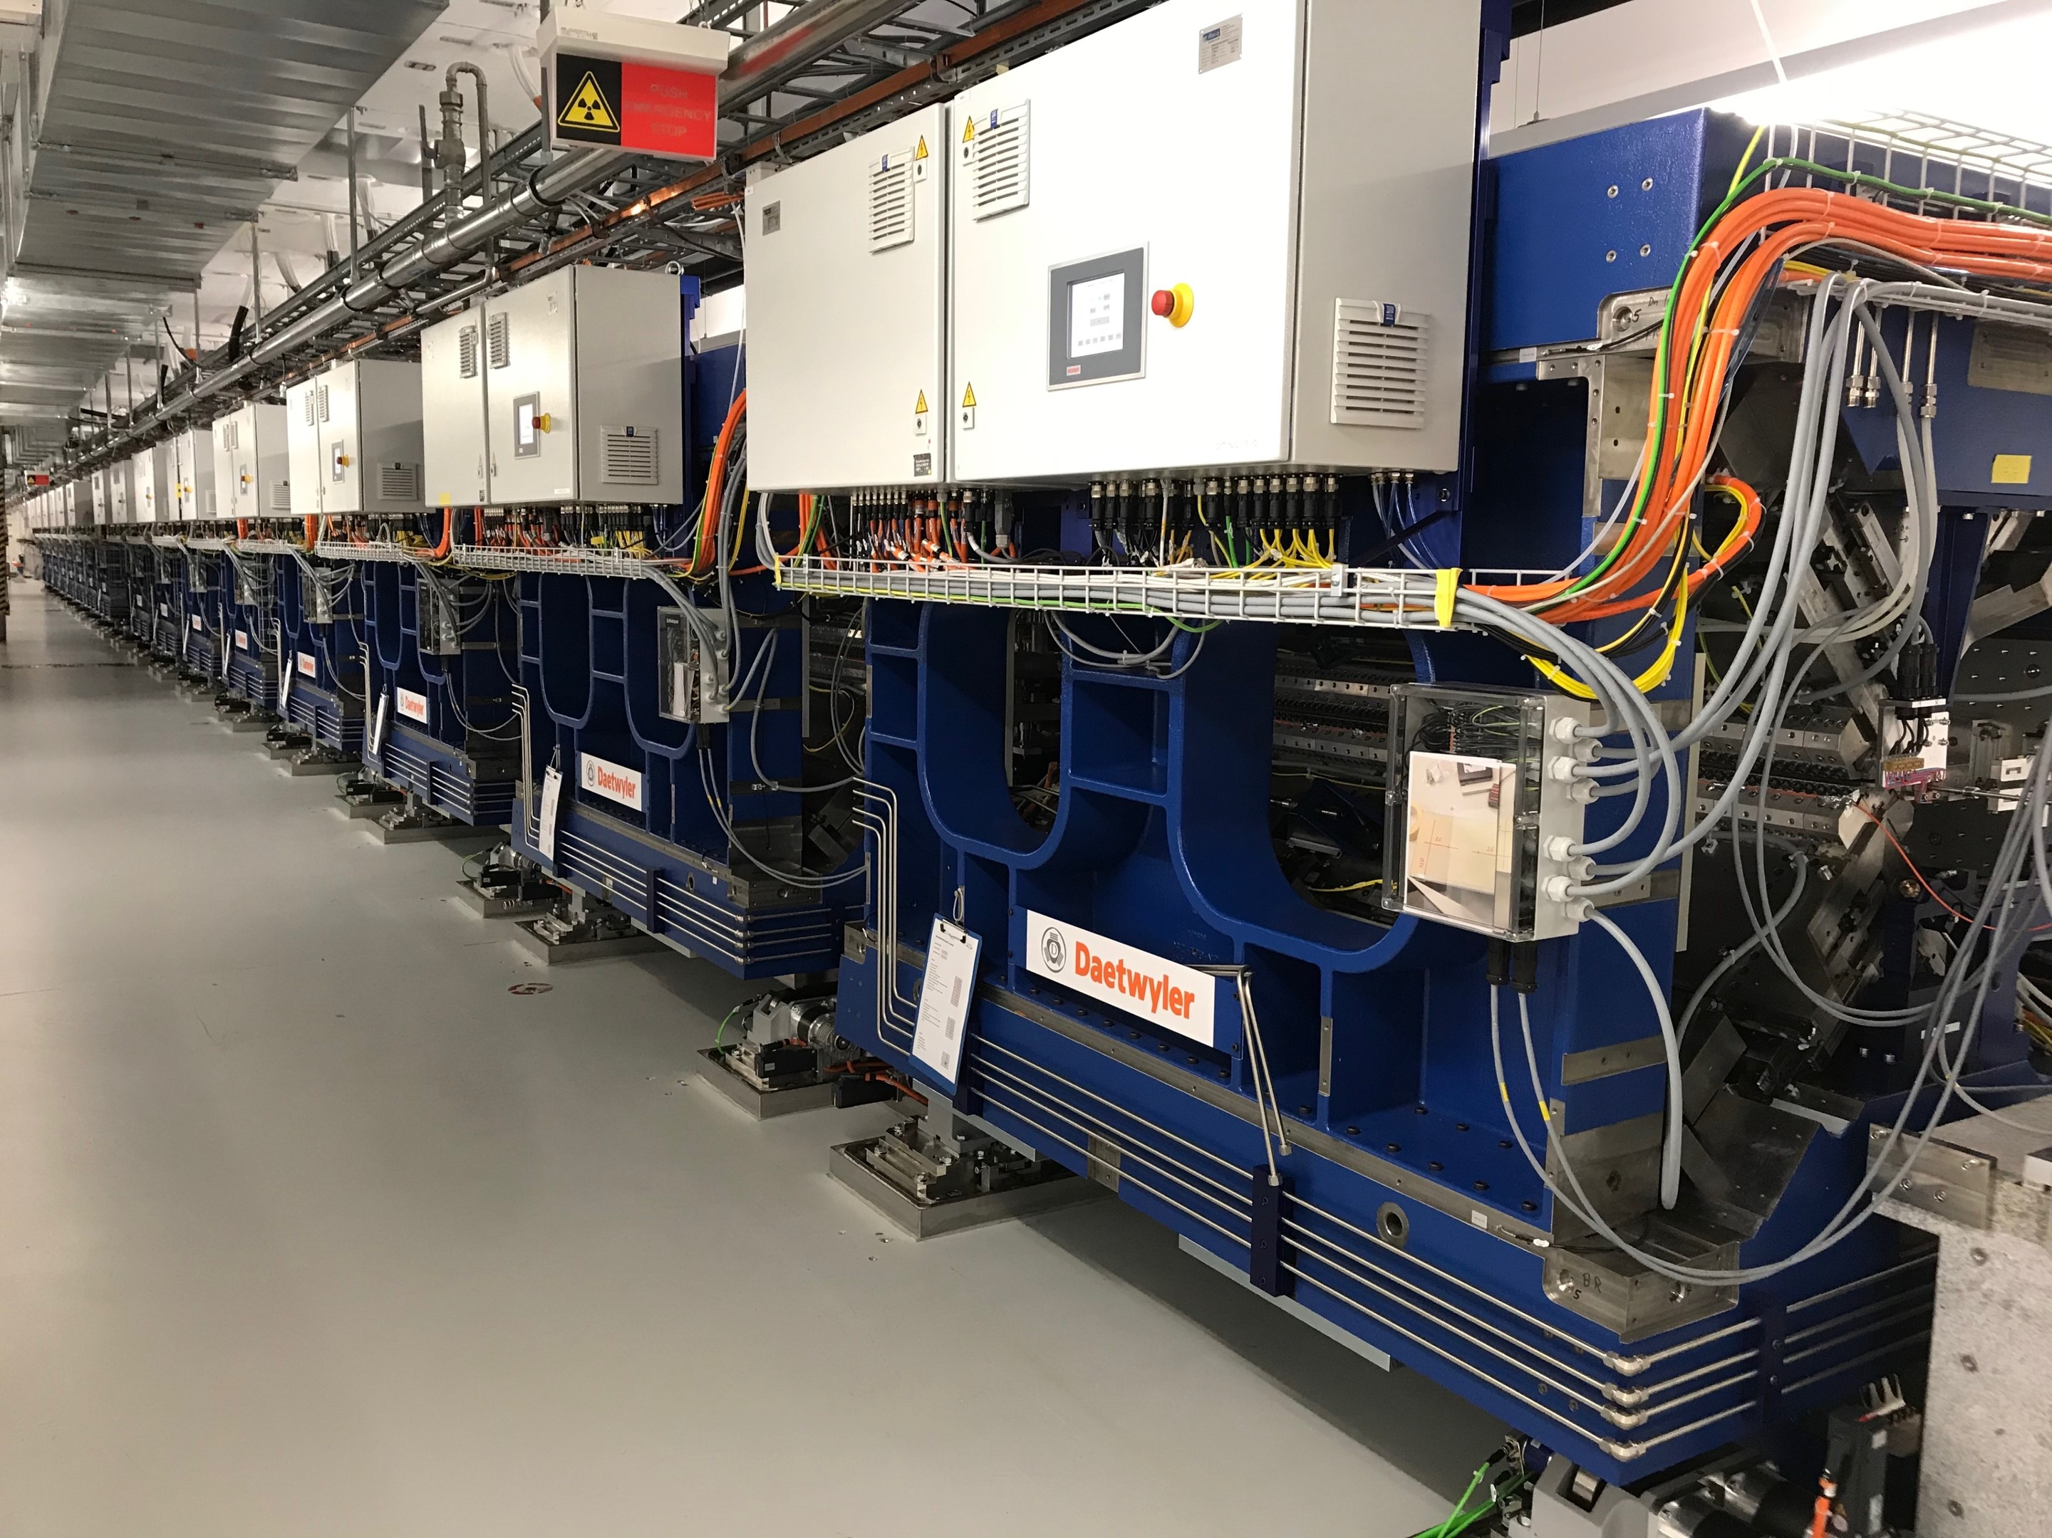
I.3 – Infrastructure
Measurement of the longitudinal phase space distribution after the undulator with an X-band transverse flector.
Laser Beam:
Wavelength: 800 nm
Pulse Energy: up to 5 mJ
Duration: 20+ fs
Rayleigh Length: ~ 0.5 m
Electron Beam:
Current: 2.5 kA
Charge: 200 pC
Emittance: ~300 nm
Energy: 3.3 GeV
Spread ~ 1 MeV
Transverse Deflecting
Structure:
Frequency: X-Band
Polarization: variable
Resolution: < 1 fs
Magnetic Chicane
Two-Color Chicane
(ESASE: R56 = 0 m)
Laser
Modulator
Screen
Athos Beamline
Post Undulator Diagnostics
Modulator:
Period Length: 20 cm
Active Periods: 8
K-Value: 1-34
Polarization: planar
Athos Beamline:
E. Prat et al,
Nature Communications 14, 5069 (2023)
Transverse Deflector:
P. Craievich, et al, Physical Review Accelerators and Beams 23, 112001 (2020).
Athos Beamline:
Modules: 16
Module Length: 2 m
Total Length: 53.2 m
K-Value: 1 – 3.7

Slide 6
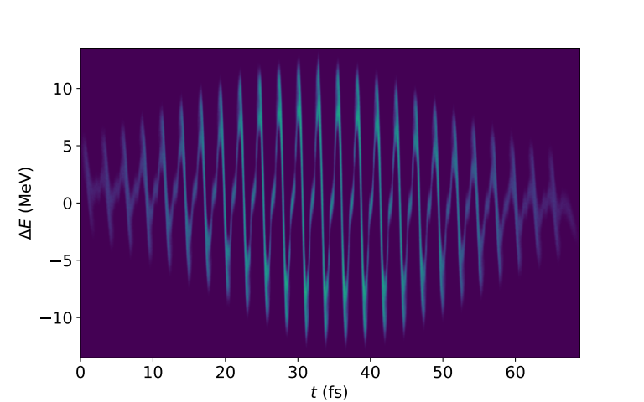
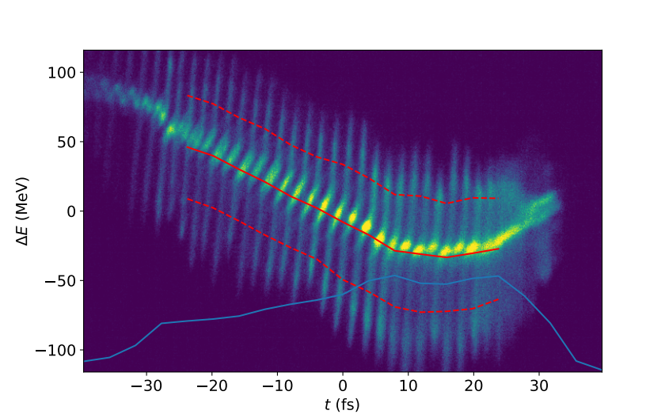
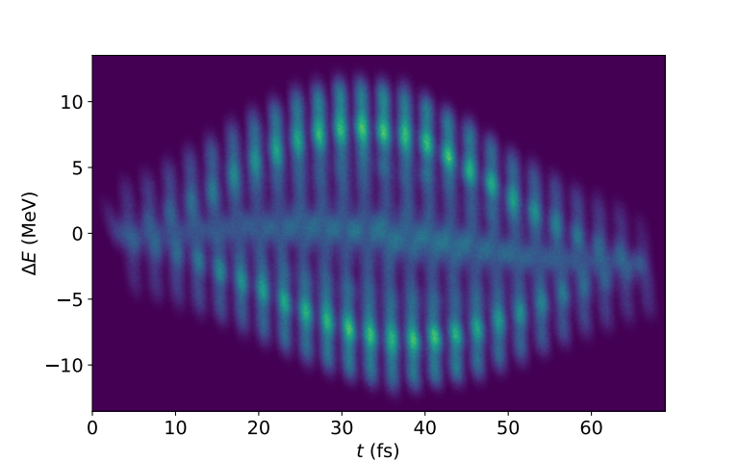
I.4 – Measuring the Energy Spread
Transverse deflector resolution sufficient enough (< 1 fs) to resolve the individual modulation by the 800 nm ESASE laser.
Arc-tangents chirp is an artifact by the blur of the intrinsic beam size and is reproduced by Elegant tracking
Large energy modulation samples the magnet field of dump dipole outside the good field region, causing non-linear term in dispersion
Large spreads difficult to analyze due to background threashold, causing systematic smaller values.
True LPS Distribution in Elegant
ESASE LPS Measurement at SwissFEL
RMS Slice energy spread
Reproduced LPS Measurement in Elegant

Slide 7
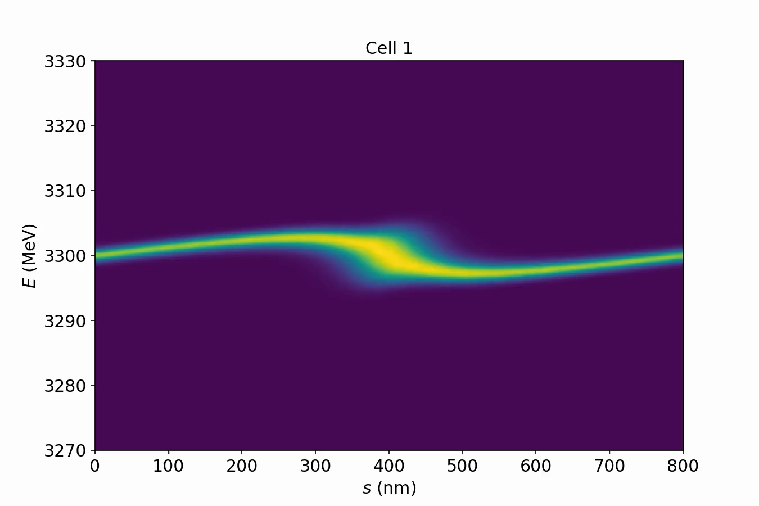
II.1 – Space Charge Models
Frequency Domain
Impedance of longitudinal space charge:
For periodic problem (ESASE) calculation can be restricted to one period.
Numerical method similar to Microbunching Instability (MBI)
Space Charge Simulation for Athos
Tracking the longitudinal phase space distribution of one ESASE spike over the 19 cells of the Athos undulator.
Initial chirp for compression to ESASE spike gets quickly inverted and grows significantly larger then initial energy modulation
The current spike gets elongated, reducing the space charge field along the undulator line
Time Domain
For SwissFEL-like parameter, the space charge calculation is in good approximation a 1D Problem. A good approximation is the on-axis field of a charged disk.
Space charge field is rather “local” around the individual ESASE current spikes. However, it is in a transient regime, since it requires km of undulator to have a static solution for whole bunch
800 nm (Lab Frame)
Beam Size:
rb ~ 20 μm
2.4 mm (Rest Frame)

Slide 8
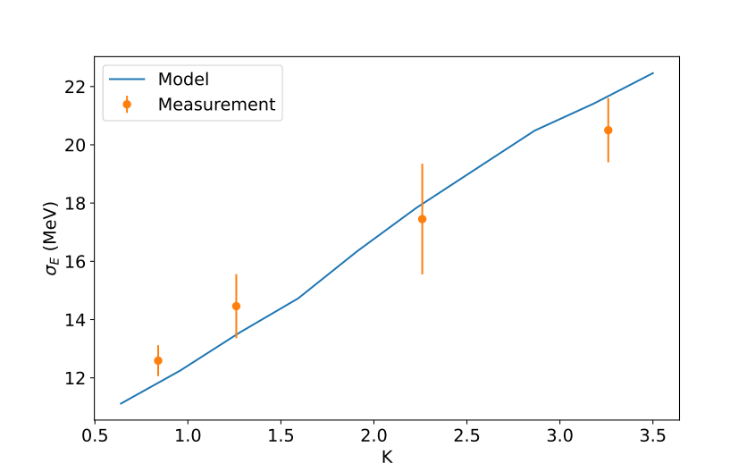
II.2 – Space Charge and the Undulator Field
Using a Lienard-Wichert potential approach, the calculation of the retardation time should be “in average” scale with the FEL resonance condition:
One radiation wavelength per undulator length
Thus one should take the reduced beam energy for the space charge calculation:
Space charge depends on undulator field
In addition, the run-time difference for different energies scales accordingly:
Induced RMS energy spread vs undulator field strength
Space charge field dependence on undulator field observed
For larger values dispersion elongates current spike, reducing the space charge field.
Theory: G. Geloni, E. Saldin, E. Schneidmiller, and M. Yurkov, Nuclear Instruments and Methods in Physics Research Section A: Accelerators, Spectrometers, Detectors and Associated Equipment 583, 228 (2007)

Slide 9
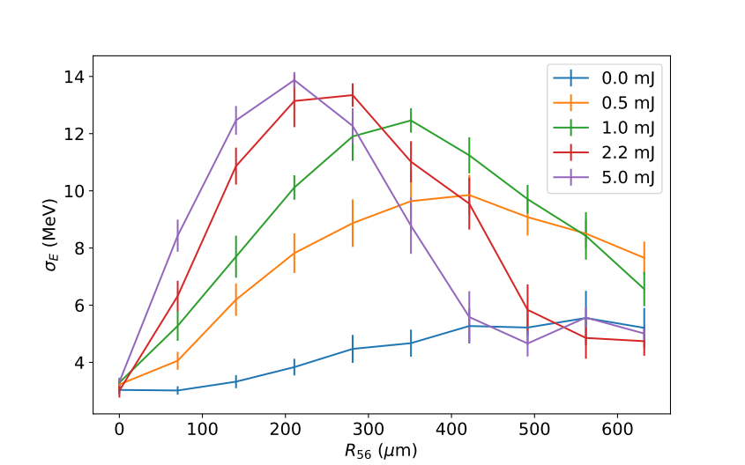
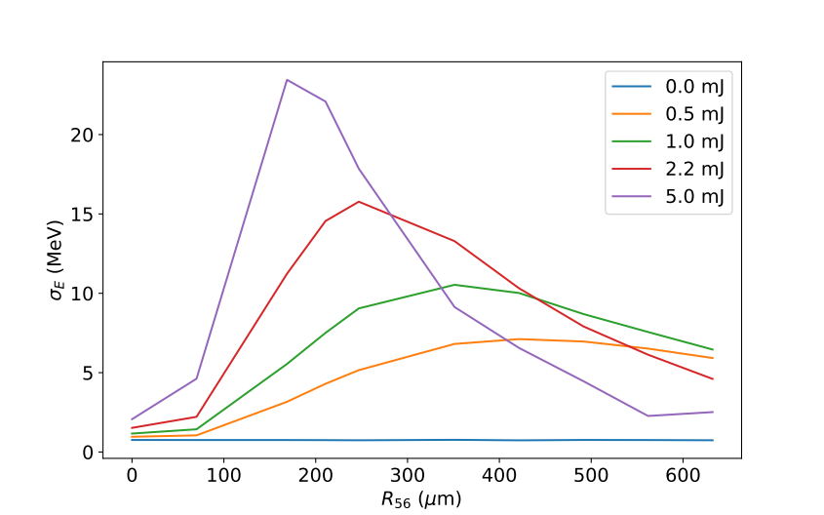
II.3 – Space Charge Studies for ESASE
Measurements
Measurement of the induced rms energy spread for different energy modulation and chicane strength driven by the harmonics in the current profile:
For large energy modulation (δE > σE) the product of energy modulation and chicane strength should be constant.
Measurements:
Large energy modulation amplitude of space charge are smaller due to non-linear dispersion of spectrometer dipole and the diluted signal of the camera signal with respect to background.
Shift in maximum for 0.5 mJ laser power due to intrinsic energy spread gives an estimated value of 1 MeV in agreement with other methods (Optical klystron scan, LPS measurement without ESASE modulation and FEL amplification
Impact of micro-bunching instability obscures scan
Simulations

Slide 10
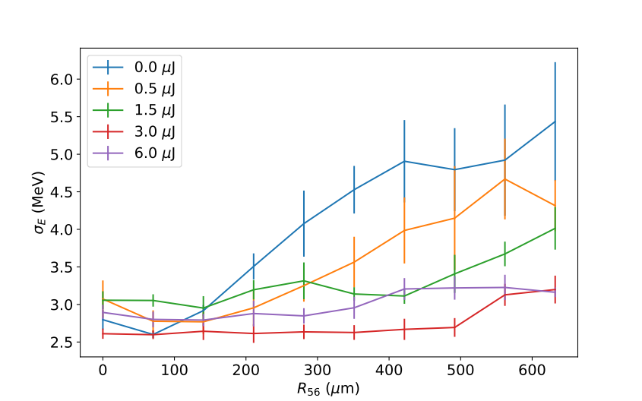
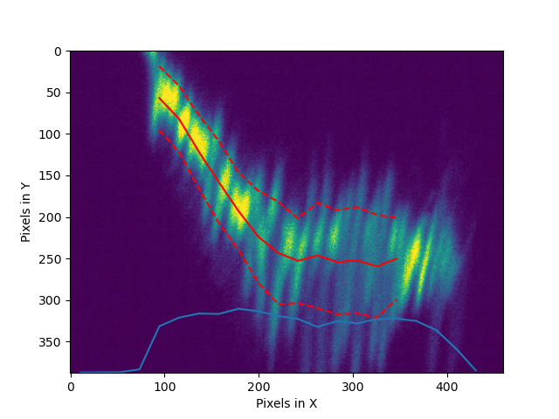
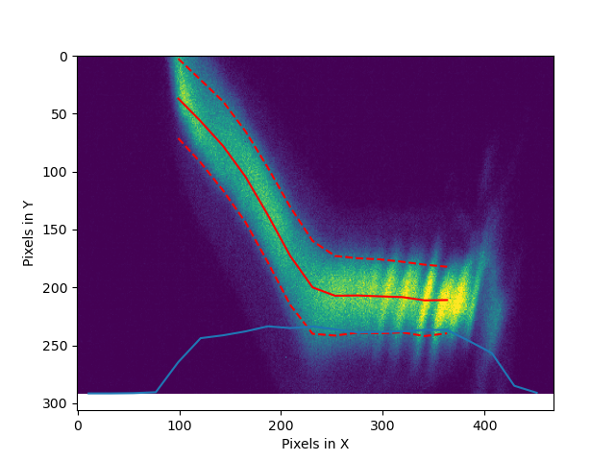
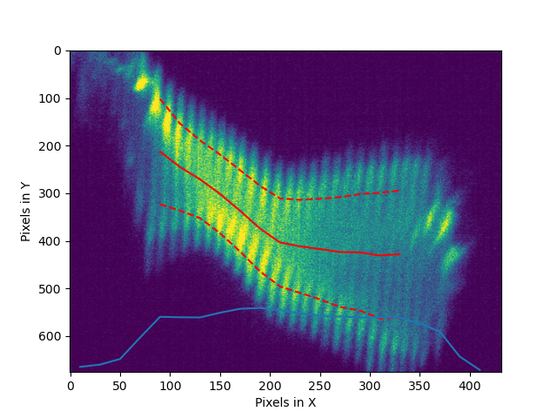
II.4 – Impact of Microbunching
Three-stage compression for ESASE mode generates strong micro-bunching. Central frequency is around 1 micron thus comparable with ESASE modulation.
It can drive space charge modulation, even if ESASE laser is turned off.
Effect can be mitigated with enabling laser heater. Best performance at 3 uJ pulse energy of leaser heater. Beyond it heats up the beam unnecessarily
R56 scan for various LH pulse energies
Minimum Value
Active heating
Laser heater and ESASE Laser off
Laser heater on but ESASE Laser off
Laser heater and ESASE Laser on
LPS measurement
(raw data)
LPS measurement
(raw data)
LPS measurement
(raw data)

Slide 11
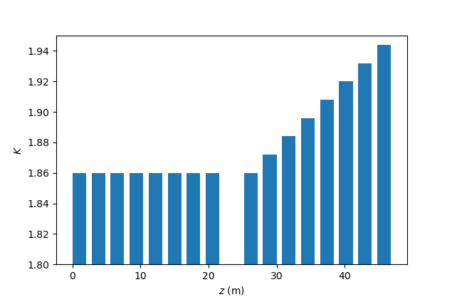
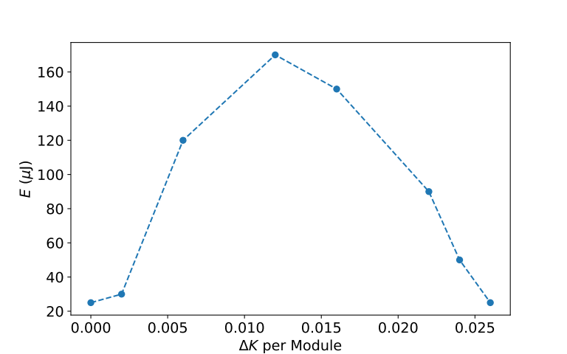
III.1 – ESASE Performance at 1 keV
Lasing in first half of Athos disabled (Inversion of chirp due to space charge)
Scan positive taper gradient (reverse tapering) in second half
Best performance for a taper of about ΔK=0.012 per module
Positive taper anticipated since radiation slips along a positive energy chirp.
Athos Taper Profile
FEL Output Power
Lasing Disabled

Slide 12
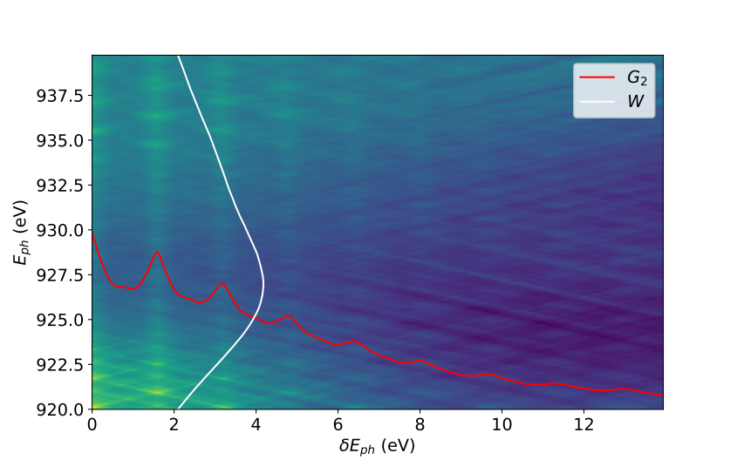
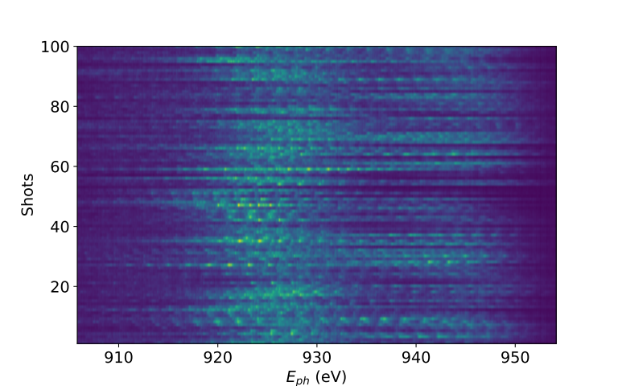
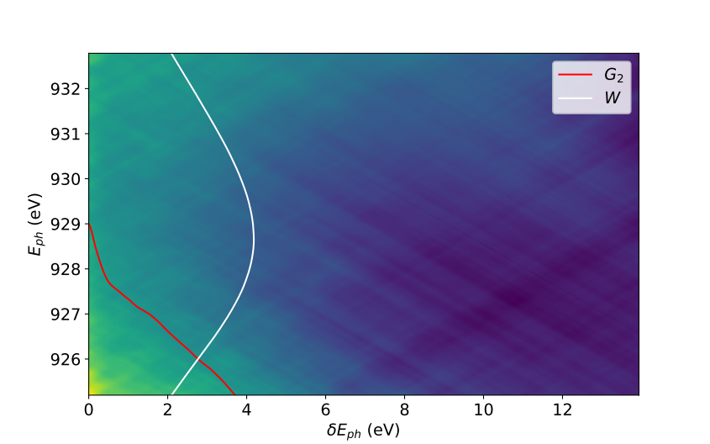
III.2 – ESASE Performance - Spectrum
Second Order Spectral Correlation
ESASE Operation
Strong modal structure, best visible in spectral auto-correlation function
[Method: R. R. Robles et al, PRAB 26, 030701 (2023)]
Up to 7 side bands visible in auto correlation
Average ESASE spectrum much wider than SASE spectrum
Shorter Spike Duration
Red Shift by about 60 eV
Starting at low energy part of space charge chirp (?)
100 consecutive spectra
SASE Operation

Slide 13
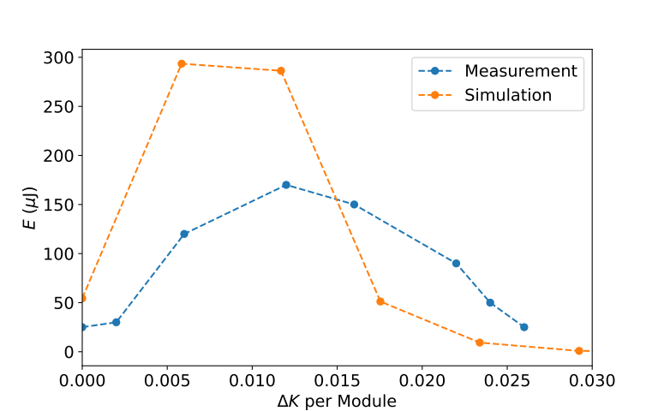
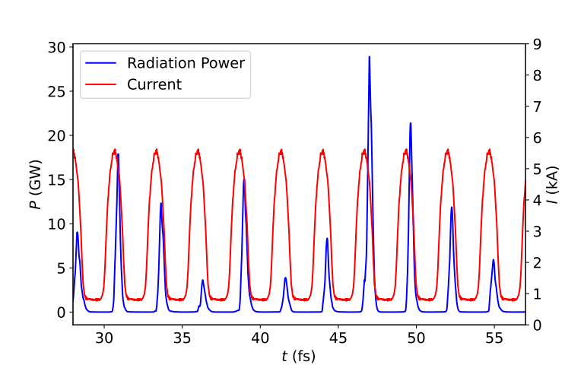
IV.1 – ESASE Simulations
3D simulation scan of over energy spread, chicane strength and taper gradient. Results for 1 MeV energy spread and nominal chicane strength and a taper gradient of about ΔK=0.01 per module are showing the best agreement (Maybe some fine tuning would improve)
Simulation do not include energy modulation by microbunching instabilty, which broadens the scan over the taper gradient and chicane strength.
Average rms pulse duration of ESASE spikes is 150 +/- 24 as
Rms Spectral width is 7.3 eV

Slide 14
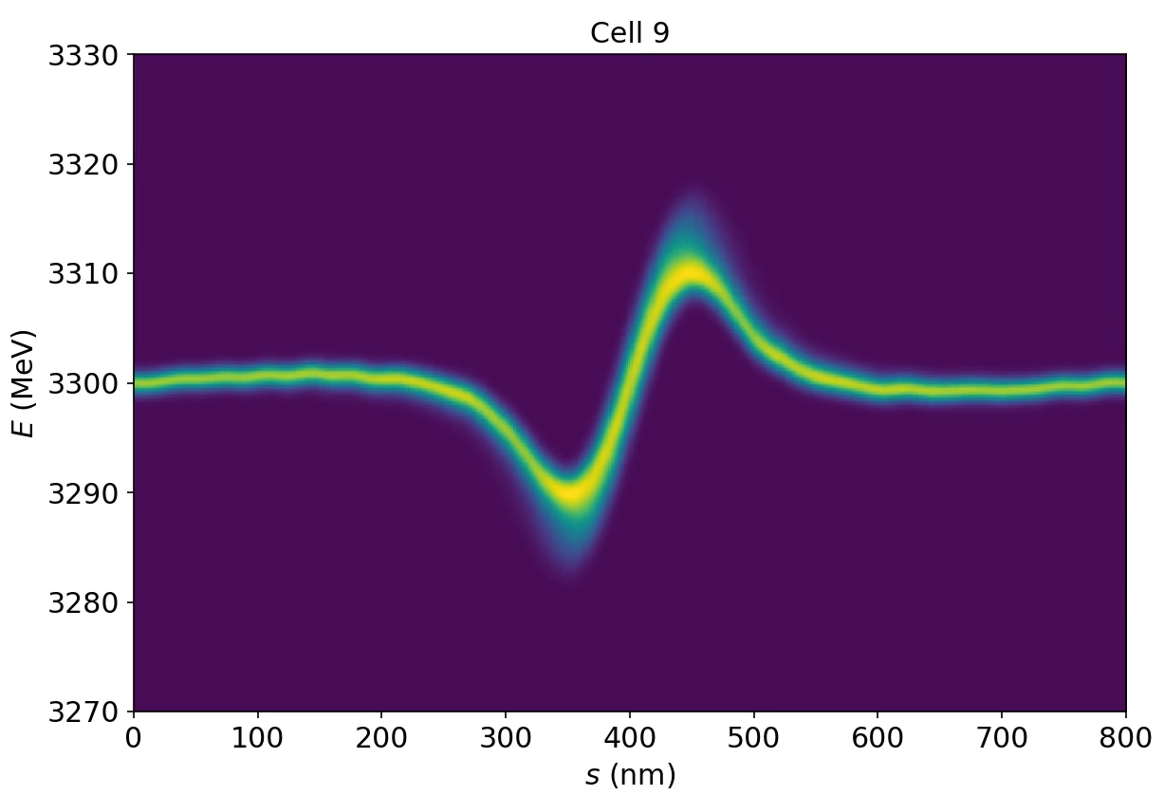
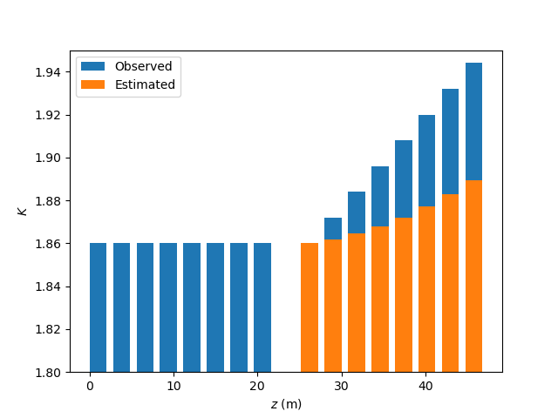
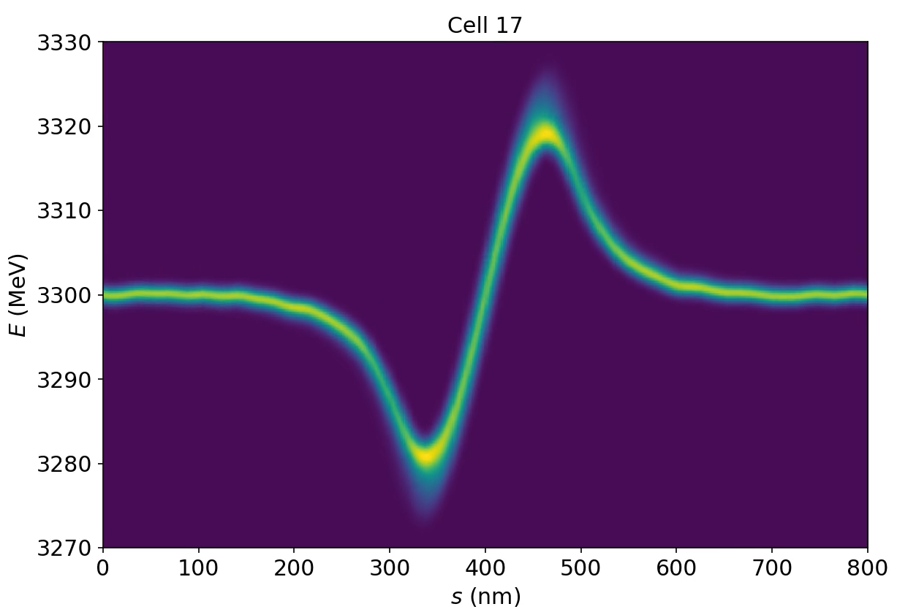
IV.2 – Taper Gradient
Idea: Spike is generated at back of the ESASE current spike and slips forward. A positive taper is needed to preserve the resonance condition
Maximum change in “effective” energy due to slippage is 33 MeV:
Change in resonance condition: 2 %, compensated by
mostly linear taper with an additional quadratic component
Observed taper gradient changes K-value over 8 modules is 4.5 %
Change in resonance condition: 6 %
Same value also for the overall shift in spectrum
Start Lasing
ΔE=-11 MeV
Possible origin of spike
Taper Gradients
End Lasing
ΔE=22 MeV
Path of
Slippage
Lasing Disabled

Slide 15
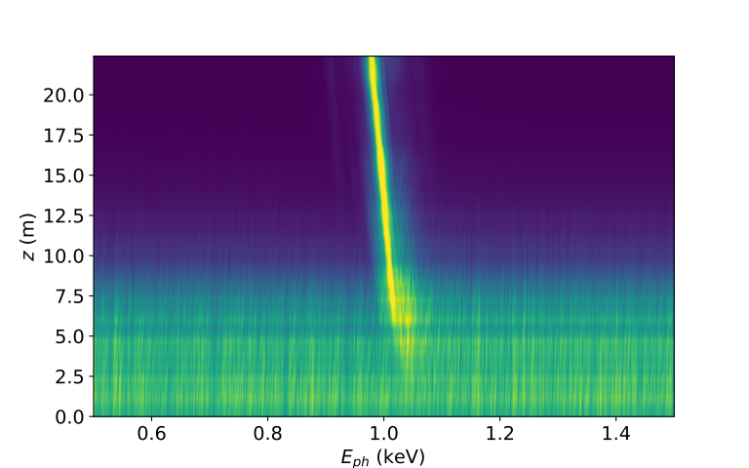
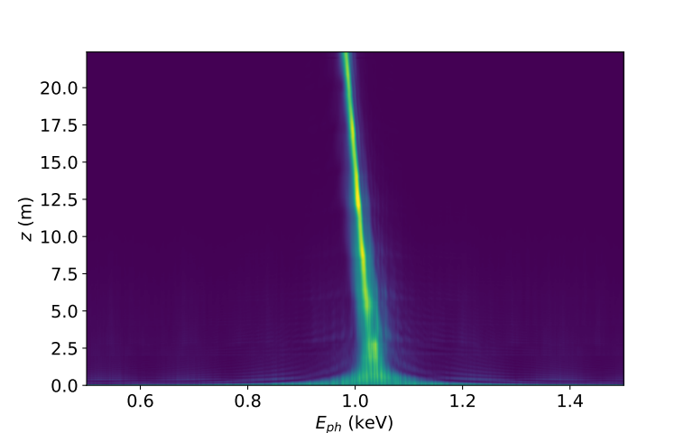
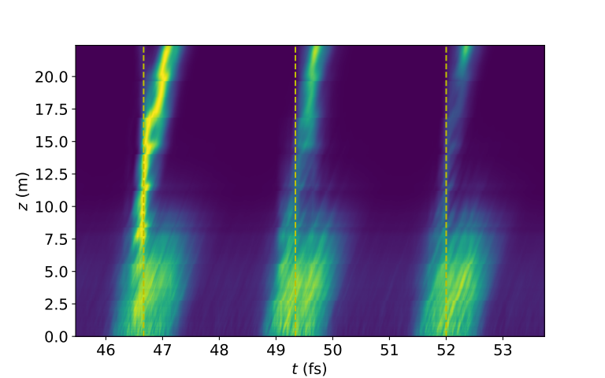
IV.3 – Understanding the Results
Bunching
Simulation shows an adiabatic shift in resonant signal towards lower photon energies.
This corresponds to a gradual elongation between the micro bunching due to the increase in the current spike duration
Together with the broadening of the micro bunching there is also a change in the micro bunching phase, depending on the location with respect to the chirp.
Ahead of current spike center the bunching is pushed slightly into emission phase (Ponderomotive phase Δθ > 0) and performs better than behind the current spike, where the bunches are pushed more into the absorption phase (Δθ < 0)
Radiation
Slippage in Simulation
Two microbunches:
Ahead of current spike (ΔE > 0)
Δθ
Saturation
Behind the current spike (ΔE < 0)
−Δθ

Slide 16
V – Summary
ESASE demonstrated at soft X-ray beamline Athos at SwisSFEL, showing strong space charge effect
Measurements demonstrate the prediction that the effective space charge field depends on the undulator field strength (higher K-value → stronger field)
Current spikes can elongate within the undulator if space charge field is strong enough to have noticeable run-time differences
The elongation is a mechanism which can adiabatically shift the resonance wavelength

Slide 17
V – Acknowledgment
ESASE Team at SwissFEL:
S. Reiche, E. Prat, A. Dax, M. Huppert, S. Nepple, A. Trisorio, C. Vicario, and E. Ferrari
Many thanks to the technical groups: diagnostics, photon diagnostics, X-ray optics and insertion devices
This work was funded by the European Research Council under the European Union’s Horizon 2020 research and innovation program, within Grant Agreement 810451 (HERO)
Work accepted for publication at PRAB

