Slide 1

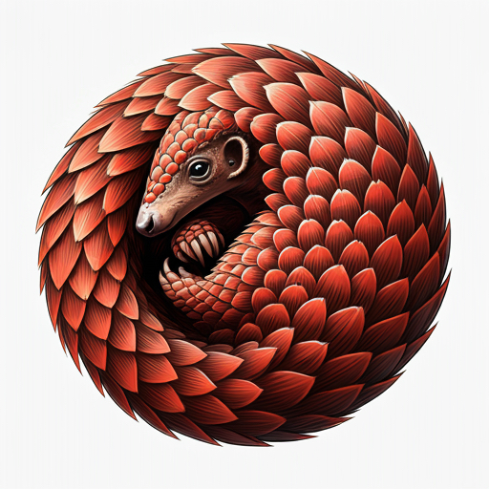
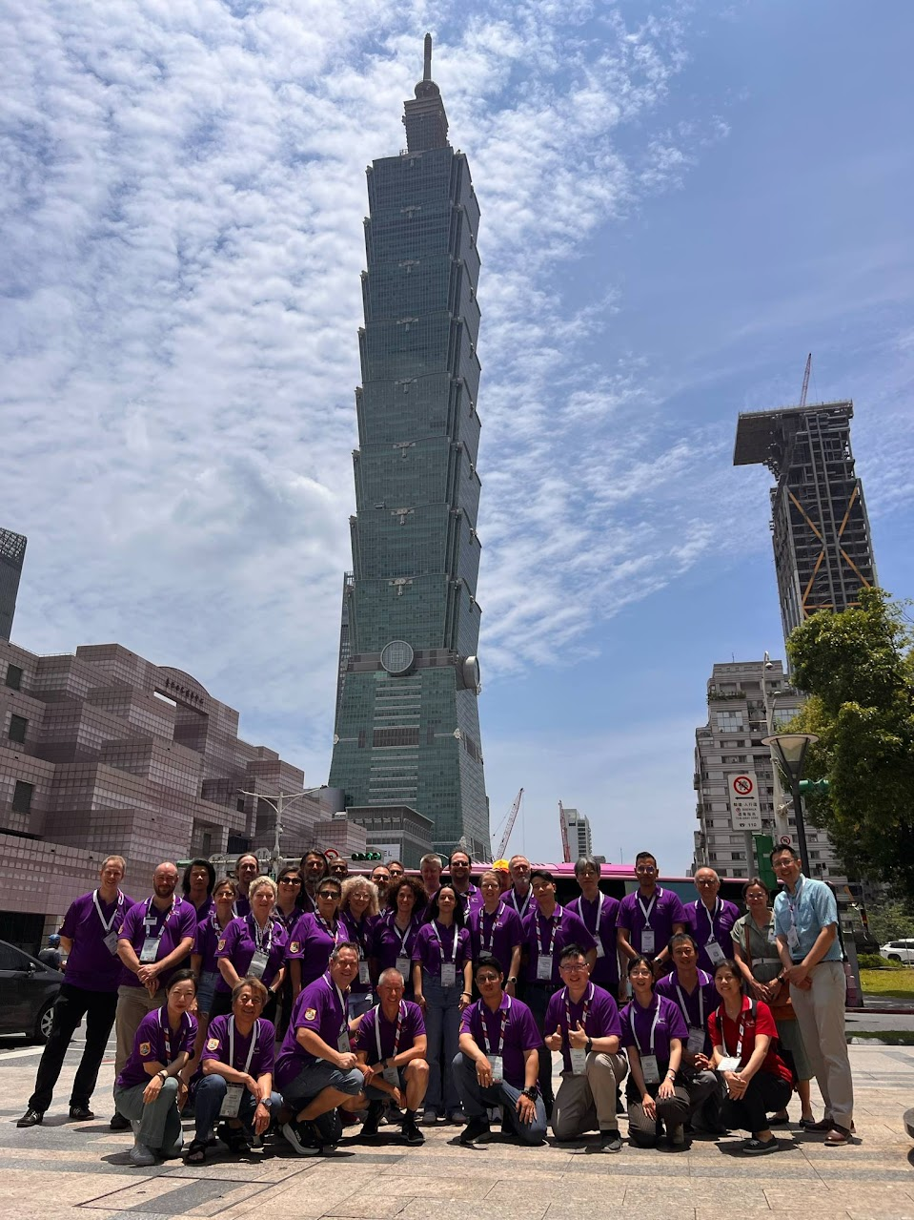
IPAC 2025 Proceeding Office Taiwan
Chief Editor: | David Button | ANSTO
Local Team :
Ping-Shun Chuang | NSRRC |  | Editor | Experienced
Nuan-Ya Huang | NSRRC |  | Editor | Experienced
Yung-Sen Cheng | NSRRC |  | Editor | Experienced
Chin-Kang Yang | NSRRC |  | Presentation | Improving
Team Composition | 35.3
Chief Editor | 1
Trainee Editors | 6.3
Improving Editors | 3
Experienced Editors | 17
Author Reception | 3
Trainee Presentation | 1
Presentation | 2
Tools Support (Indico/CatScan/Ref) | 2
International Team :
Adriana Rossi | CERN |  | Editor | Trainee
Akihiro Shirakawa | KEK |  | Editor | Experienced
Ana Štajminger | ELI Beamlines Facility |  | Editor | Trainee
Charline LeCourtillet (IPAC’26) | GNAIL |  | Editor | Trainee
Cynthia Duarte | TRIUMF |  | Author Reception | Improving
Darren Hunter | CLSI |  | Editor | Improving
Dong Eon Kim | Postech |  | Editor | Experienced
Guillaume Lalaire (IPAC’26) | GNAIL |  | Editor | Improving
Ivan Andrian | Elettra |  | Editor | Experienced
Jan Chrin | PSI |  | Editor | Experienced
Jana Thomson | TRIUMF |  | Author Reception | Experienced
Joele Mira | iThemba LABS |  | Editor | Experienced
Johan Olander | ESS |  | Editor | Experienced
Josh Peters | ANSTO (Contractor) |  | Software Dev
Julien Pivard (IPAC’26) | GNAIL |  | Editor | Trainee
Kritsada Kittimanapun | SLRI |  | Editor | Experienced
Lu Li | IMPCAS |  | Editor | Experienced
Magdalena Montes | SLAC |  | Author Reception | Experienced
Maurizio Montis | INFN-LNL |  | Editor | Experienced
Michel Succar | CERN (Indico) |  | Indico Developer
Narender Kumar | Liverpool University |  | Editor | Improving
Nicolas Delerue (IPAC’26) | GNAIL |  | Editor | Trainee
Petr Anisimov | LANL |  | Editor | Experienced
Raphael Mueller | GSI |  | Editor | Experienced
Ruth Rudolph | DESY |  | Presentations | Trainee
Staffan Benedictsson | MAX IV |  | Editor | Trainee
Stefano Deiuri | Elettra |  | Editor | Experienced
Takashi Kosuge | MAX IV |  | Presentations | Experienced
Thakonwat Chanwattana | SLRI |  | Editor | Experienced
Volker RW Schaa | GSI (Retired) |  | Editor | Experienced
Note: IPAC’24 Team Size 39
Region Representation
Asia |  | 11
Europe |  | 19
North America |  | 5
Gender
Female | 10
Male | 26
Not Specified | 0
Note: 3 trainees self supported accommodation and per-diem

Slide 2
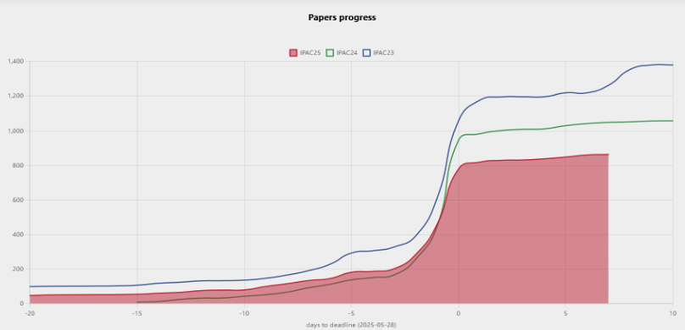
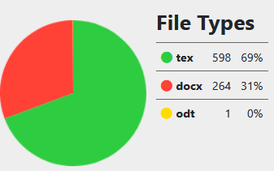
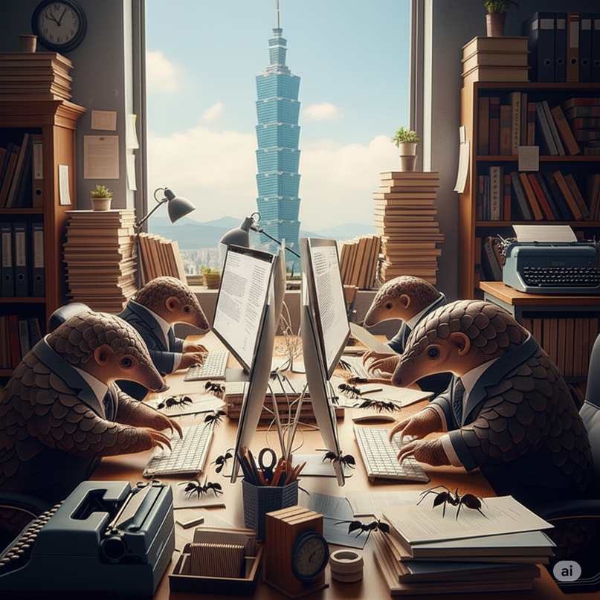
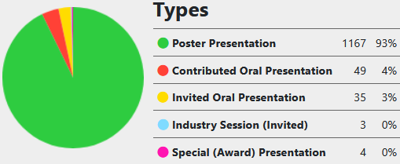
IPAC 2025 Proceeding Office Taiwan
Challenges with Predictability of Submission Numbers
 | Initial Abstracts | Published Papers | Reduction
IPAC’23 | 2,270 | 1,402 | 38%
IPAC’24 | 1,691 | 1,050 | 38%
IPAC’25 | 1,735 | ≈ 870 | 49%

Slide 3
IPAC 2025 Proceeding Office Taiwan
IPAC’25 Challenges
Major Indico upgrades during the conference life cycle, creating bugs and re-work
Change in the Word Template and PDF production method 4 weeks out before conference
Release of the new LaTeX JACoW class file 1 week before conference
Inability for editors to gain access to travel funds and approval to join the team

Slide 4
IPAC 2025 Proceeding Office Taiwan
IPAC’25 Development Contributions
Multiple Affiliation Support in Indico and Proceedings Production
CatScan Integration into Indico Workflow
Maintenance and improvements to Reference Search and Generation Tool
Hosting of JACoW Team Meeting 2023
Basic LaTeX CatScan Checks and Reports
Support attendance of Indico and Software Developer to IPAC’25

Slide 5
IPAC 2025 Proceeding Office Taiwan
Advice for future IPAC’s
QA workflow adjustments to be made in Indico to allow cleaner concurrent QA’ing
Development of a concurrent workflow for Title Author Checks by author reception and others
Opportunities
Expansion of CatScan LaTeX papers tests
Improvements to CatScan Word report
CatScan and Reference Search Tool integration, provide reference suggestions
Improving non-JACoW paper search in reference tool (BibTex)
Indico CatScan media check intergration

Slide 6
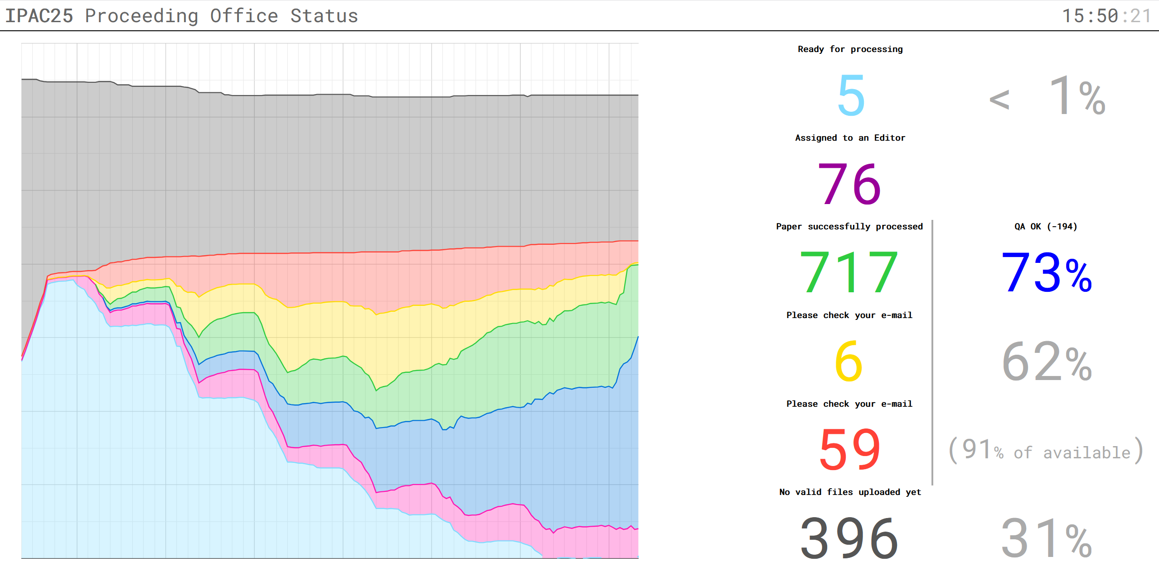
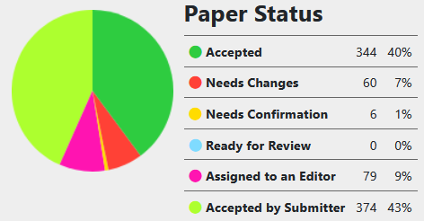
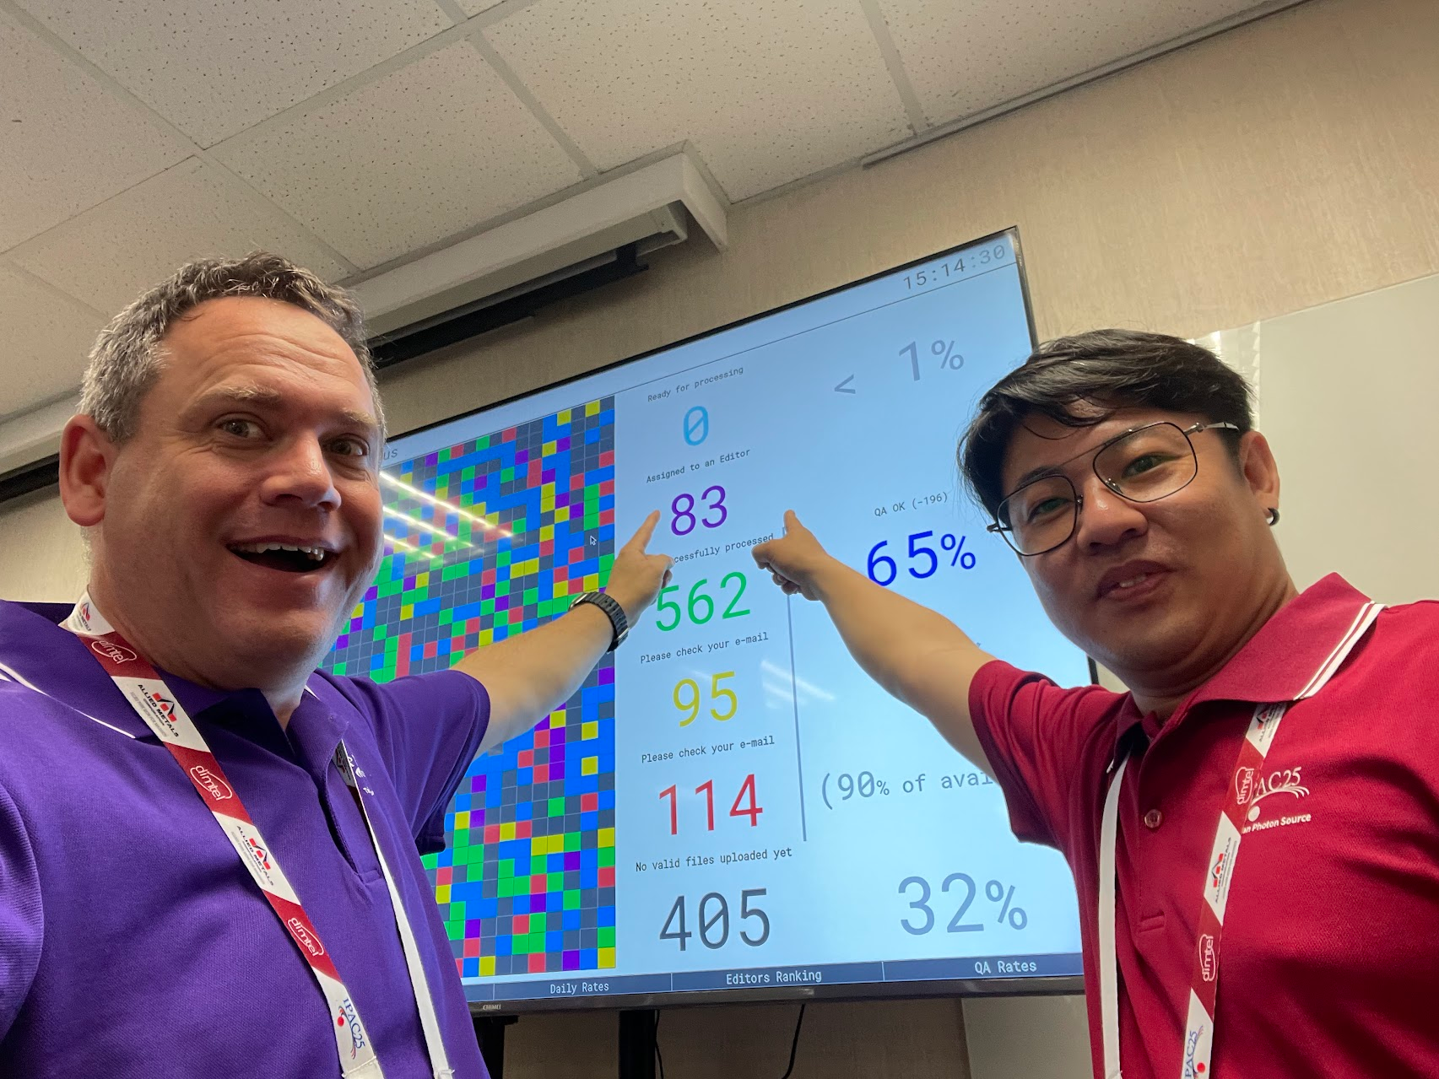
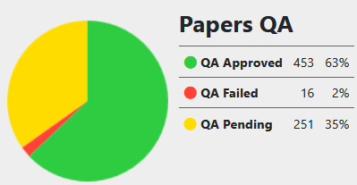
IPAC 2025 Proceeding Office Taiwan
Performance of team
As of 3:00pm
Wednesday 3:40pm

Slide 7
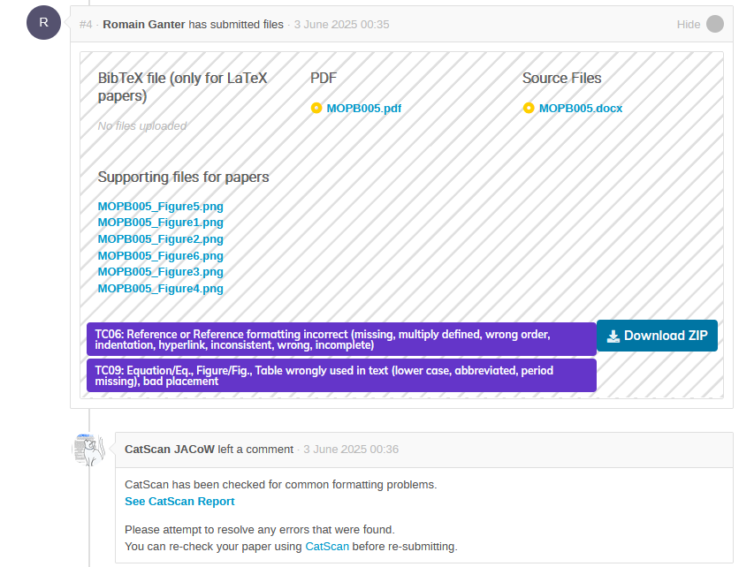
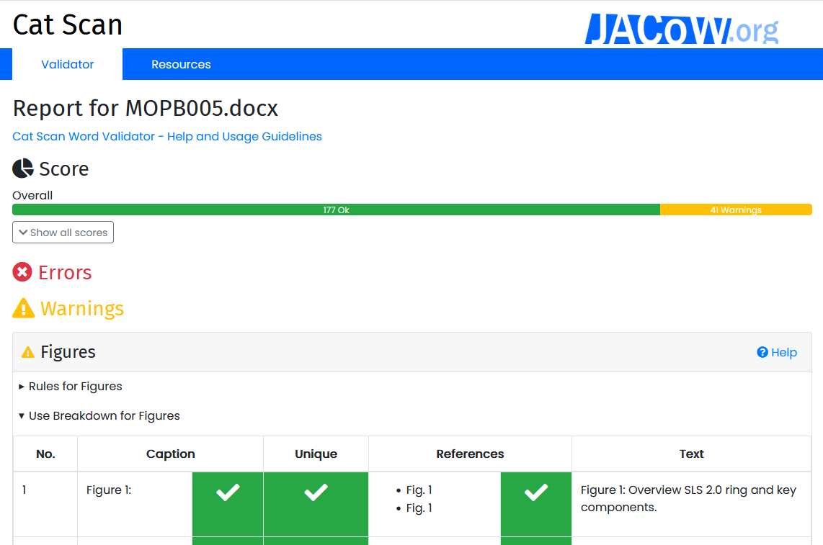
IPAC 2025 Proceeding Office Taiwan
CatScan Stats
Word
42% or Word contributions replied with uploads to the CatScan Editor resolving 4,636 errors
LaTeX
38% of LaTeX contributors replied with upload to the CatScan resolving 1,053 errors

