Slide 1
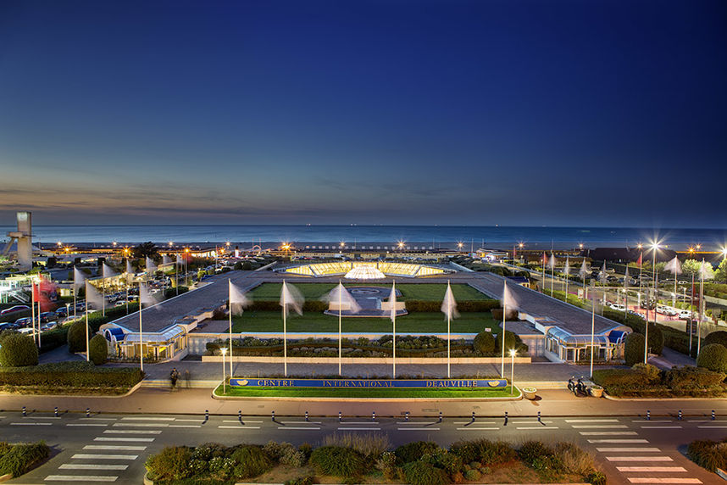






IPAC’26
Deauville
Sunday 17th – Friday 22nd May, 2026
Peter McIntosh (STFC Daresbury Laboratory) – Organising Committee Chair
Rogelio Tomas (CERN) – Scientific Programme Chair
Hanna Franberg-Delahaye (GANIL) – Local Organising Chair

Slide 2
IPAC’26 Organising Committee (OC)
Peter McIntosh (STFC Daresbury Laboratory) – OC Chair
Members Europe |  | Members Asia | Members Americas
Nuria Catalan Lasheras (CERN) | Jordi Marcos (CELLS) | Rohan Dowd (ANSTO/AS) | Wolfram Fischer (LANL)
Enrica Chiadroni (La Sapienza) | Atoosa Meseck (HZB) | Jie Gao (IHEP) | Marco Marchetto (TRIUMF)
Nicolas Delerue (IJCLab) | Marie Helene Moscatello (CEA/GANIL) | Toru Hara (Riken) | Pietro Musumeci (UCLA)
Mamad Eshraqi (ESS) | Eduard Prat (PSI) | Prapong Klysubun (SLRI) | Fulvia Pilat (ORNL)
Alessandro Fabris (Elettra) | Adriana Rossi (CERN) | Tadashi Kosecki (KEK) | Soeren Prestemon (LBNL)
Ralf Gebel (FZJ & GSI) | John Thomason (STFC) | Ming-Chyuan Lin (NSRRC) | Yine Sun (ANL)
Gianluca Geloni (Eu-XFEL) | Rogelio Tomas Garcia (CERN) | Seunghwan Shin (POSTECH/PAL) | Alexander Valishev (FNAL)
Victor Malka (Weizmann Inst. of Science) | Adriana Wawrzyniak (Solaris) | Liangting Sun (IMP) | Jie Wei (FRIB)
Ex-Officio: Ralph Assmann (GSI) | LOC Co-Opted: Hanna Franberg-Delahaye (Ganil)
Remote
Many thanks: Tor Raubenheimer (Americas) and Yoichi Sato (Asia) for OC representatives
Many thanks: Tor Raubenheimer (Americas) and Yoichi Sato (Asia) for OC representatives

Slide 3
IPAC’26 Scientific Programme Committee (SPC)
Rogelio Tomas (CERN) – SPC Chair
MC | Members Europe | Members Asia | Members Americas
1 | Adriana Rossi (CERN) |  | Alexander Valishev (FNAL)
2 | Jordi Marcos (CELLS) |  | Yine Sun (ANL)
3 | Marie Helene Moscatello (CEA/GANIL) |  | Pietro Musumeci (UCLA)
4 | Eduard Prat (PSI) | Liangting Sun (IMP)
5 | Mamad Eshraqi (ESS) | Seunghwan Shin (POSTECH/PAL)
6 | Marie-Helene Moscatello (CEA) | Toru Hara (Riken)
7 | Adriana Wawrzyniak (Solaris) |  | Soeren Prestemon (LBNL)
8 | John Thomason (STFC) | Prapong Klysubun (SLRI)
 | Ralph Assman (GSI) – Ex Officio |  | Sarah Cousineau (ORNL) Observer
Additional Co-Opted EMEA Members
Nicolas Delerue (IJCLAB) – Editor In Chief
Hanna Franberg-Delahaye (GANIL) – LOC Chair
Gianluca Geloni (EuXFEL) – Ligh Peer Review
Sabrina Lecerf (GANIL) – Scientific Secretary
Peter McIntosh (STFC) – OC Chair
Atoosa Meseck (HZB) – Equal Opportunities
Eduard Prat (PSI) – Student Tutoring
Remote
Many thanks: Tor Raubenheimer (Americas) and Yoichi Sato (Asia) for SPC representatives

Slide 4
IPAC’26 Local Organising Committee (LOC)
Hanna Franberg-Delahaye (GANIL) – SPC Chair
Scientific Secratariat | Sabrina Lecerf (GANIL) : Scientific Secretary Isabelle Côme (IJCLab): Conference Assistant | Poster Session Manager | Angie Orduz (GANIL)
Editor in Chief | Nicolas Delerue (IJCLab) | Industry and Sponsoring | Jean-Luc Revol (ESRF) – Lead Keihan Tavakoli (SOLEIL) Cécile Barthe-Dejean (GANIL) Nicolas Berton (CEA) Benoit Joly (ESRF) Laurent Nadolski (SOLEIL) Adrien Neyret (K.I.T Group France) Lionel Quettier (GANIL)
Student Managers | Julien Michaud (IJClab) Marc-Hervé Stodel (GANIL) | Social Events and Logistics | Solène Clement (K.T.T Group France) Sebastien Gautrot (GANIL) Alexandre Gognat (GANIL) Jérôme Gueret (GANIL) Adeline Jeanne (K.I.T Group France) Pierre Leduc (GANIL) Alexis Lefevre (GANIL) Magali Tencé (GANIL) Matteo Voiturier (GANIL)
Poster Session Manager | Angie Orduz (GANIL) | IT/Web | Laurent Fortin (GANIL) Guillaume Lalaire (GANIL)

Slide 5
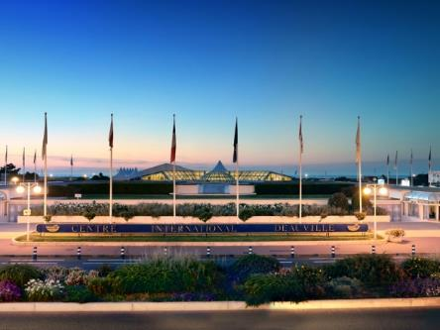
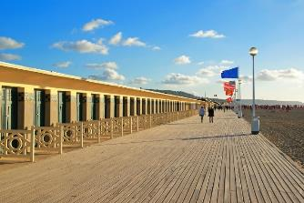
Deauville, Normandy in France
An Truly Beautiful Destination!
Amazing scenery and tranquility on Côte Fleurie (or Flowery Coast).
Conference venue situated on the seafront, close to all local amenities.
Easy access from Paris by car or train.
Deauville is a walkable city (at <4 km²)
www.Ipac26.org

Slide 6
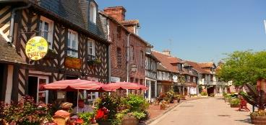
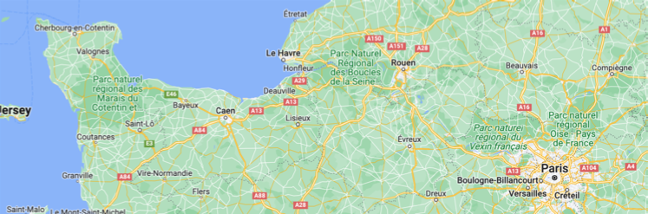
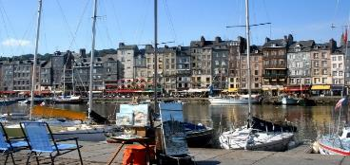
IPAC’26 Organisation
Local organisation led by GANIL, with strong support from CEA, CNRS, SOLEIL & ESRF:
1500 participants & 100 industry booths.
2 parallel sessions & 440 posters/day.
Student Tutoring, Light Peer Review & Equal Opportunity programmes included.
IPAC’26
GANIL

Slide 7
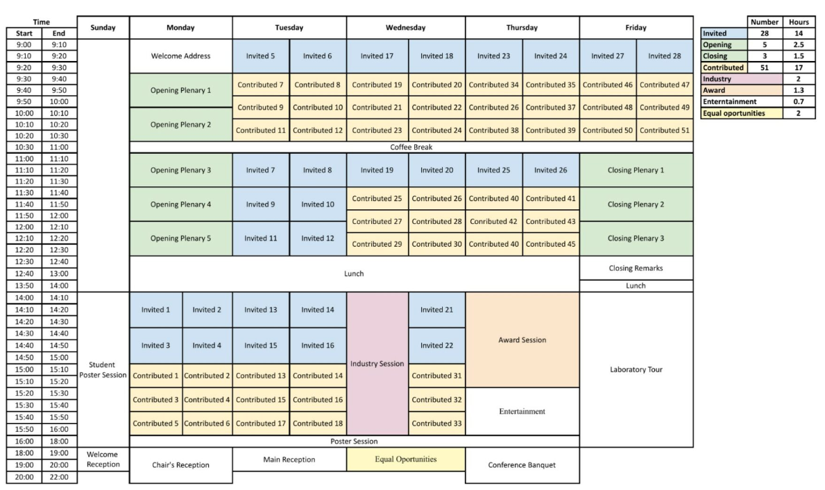
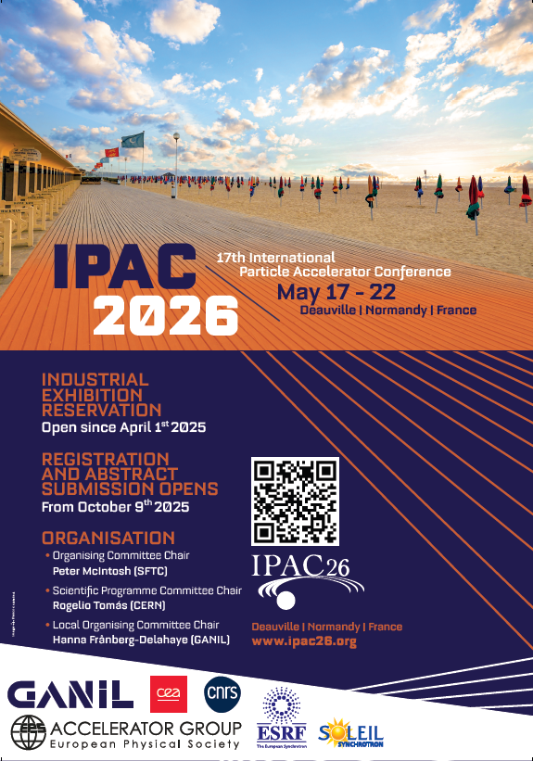
IPAC’26 Programme
Standard European IPAC configuration

Slide 8

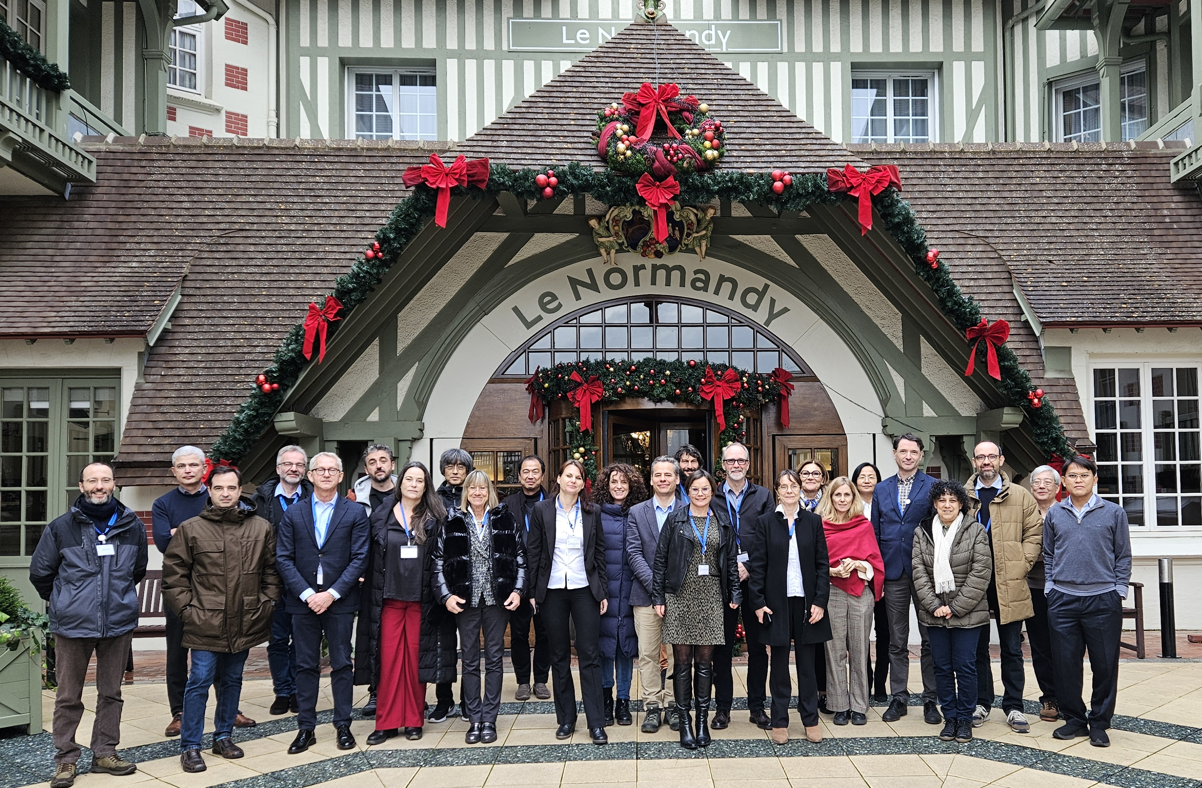
Schedule for SPC & OC Meetings
OC1/SPC1 At IPAC’26 location (Deauville) Dec 2024
SPC2 During IPAC’25 in Taipei, Taiwan Jun 2025 – this week
SPC3 At IPAC’29 location (Liverpool) Jan 2025
OC2 During IPAC’26 in Deauville May 2026
Invited Talks
Contributed Talks
OC1/SPC1 in Deauville, Dec 2024

Slide 9
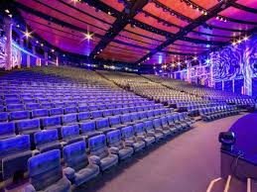
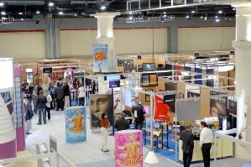
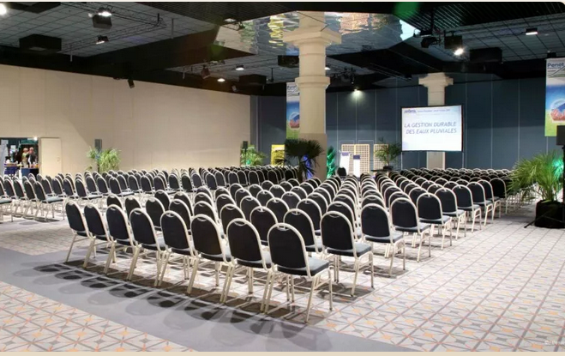
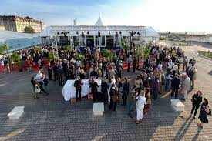
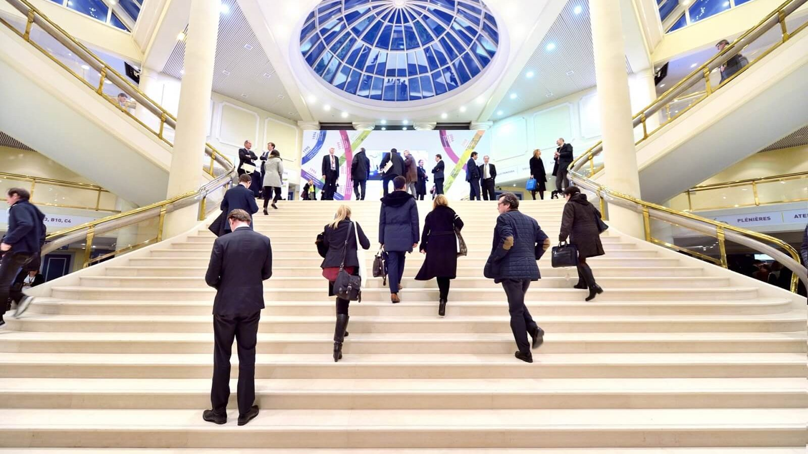
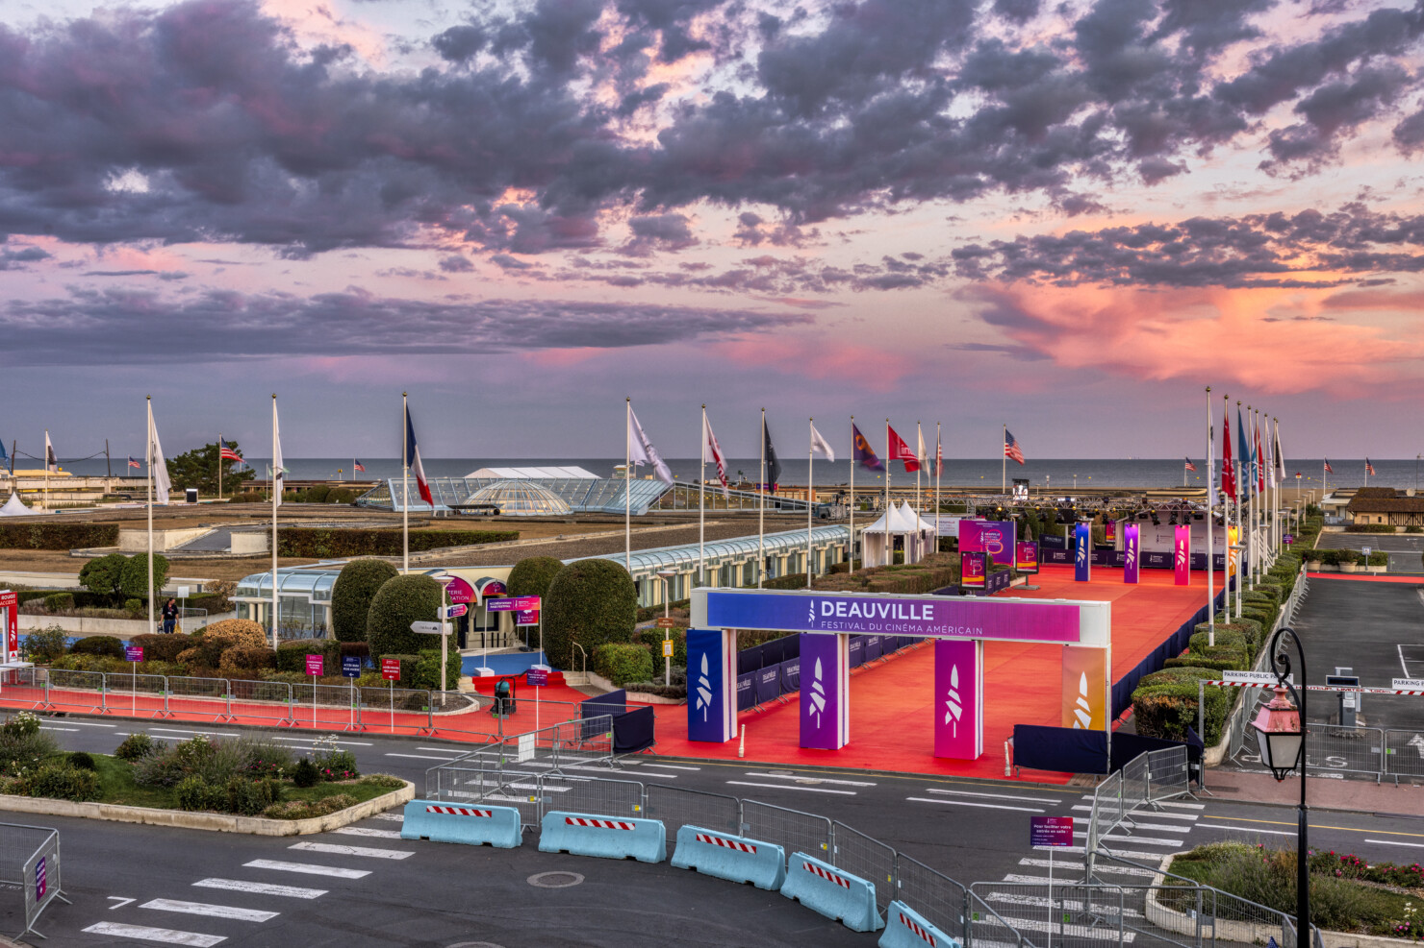
Centre International de Deauville (CID)

Slide 10
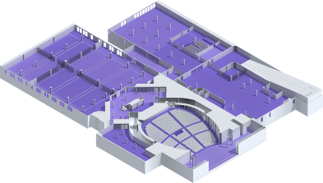
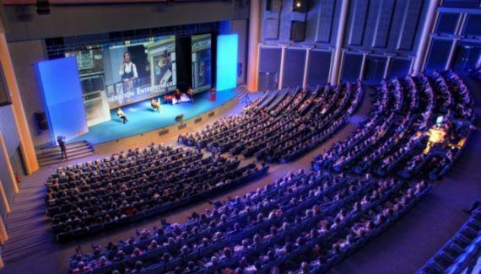
CID Conference Venue
2 main auditoriums.
1 auditorium for larger group meetings.
Industrial exhibition.
Poster sessions.
Coffee breaks.
Lunch distribution.
IT services.
AV installations:
  in-person event only (for local Tx only).
Everything in one building.
All on single floor.

Slide 11
Industry Exhibition and Poster Sessions

Slide 12
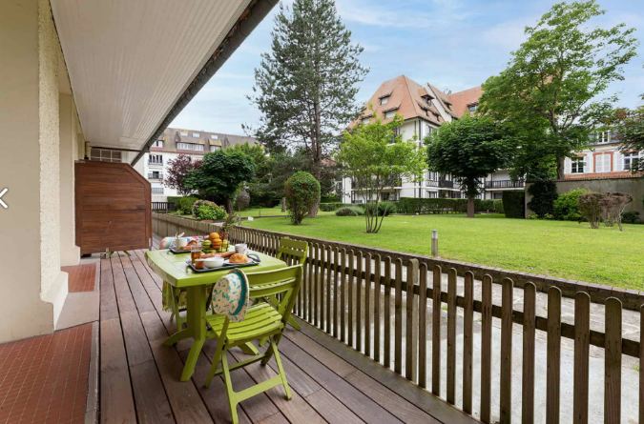
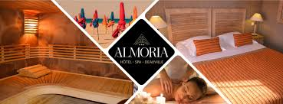
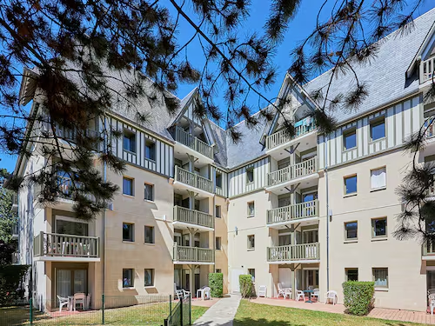
Hotel Preparations
Hotels for Students:
Residencies with kitchen:
  2 persons ~ 120 €/apartment
  2 persons ~ 142 €/apartment
In total 70 apartments = 140 students
Hotels for Editors:
  Hotel and SPA Almoria
Hotels for Participants:
880 rooms negotiated:
  2* - 5* hotels: 118€ - 384€.

Slide 13
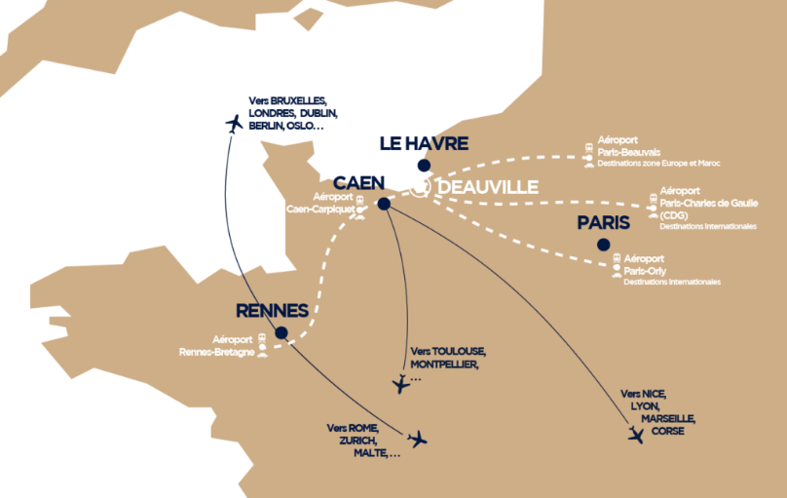
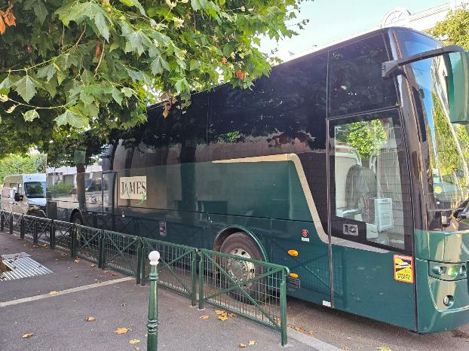
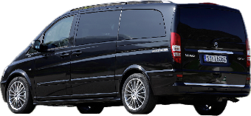
Delegate Transportation Provision
Distance from Paris: ~ 215km
Distance from Caen: ~ 50km - 50min
Distance from Le Havre: ~ 40 km - 45min
Bus Shuttles Proposed
CDG Paris to Deauville: 3 h
Orly Paris to Deauville: 2,30 h
Train-station Paris to Deauville: 3hours

Slide 14
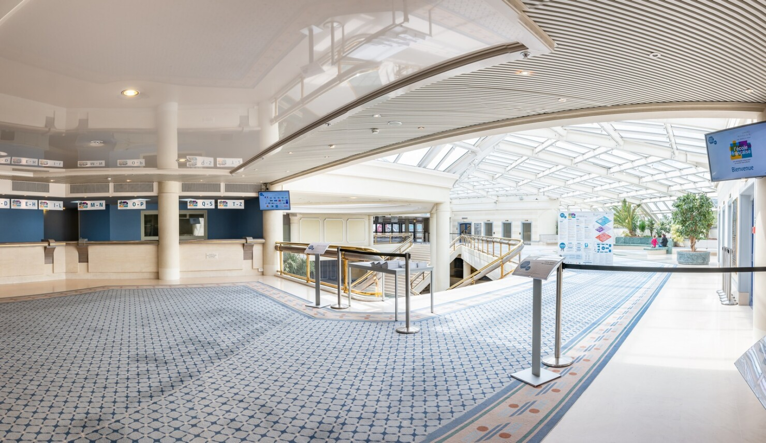
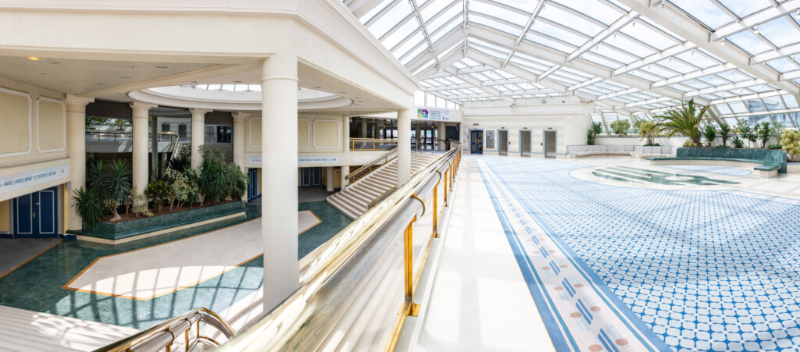
Student Poster Session (Sunday 14h - 18h)
Issue:
Exhibition location not accessible - installation work on Sunday.
Solution:
Large upper-level entrance space, close to Exhibition & Reception entrance.
Poster boards to be relocated during Reception on Sunday evening.

Slide 15
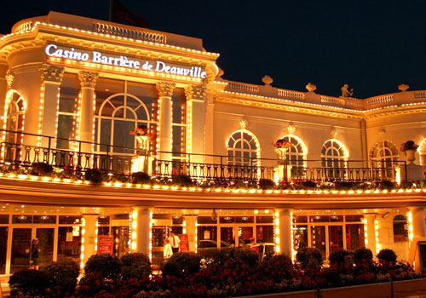
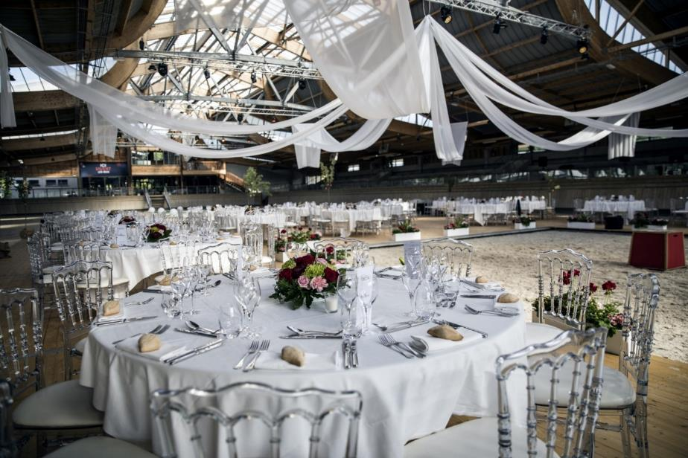
Event Venues Confirmed
Three event venues are organised.
Welcome Cocktail (Sunday at CID), Main Reception (Tuesday) and the Conference Banquet (Thursday).
Main Reception
Conference Banquet
Across the street from CID
Transport to be provided from CID

Slide 16
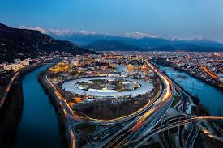
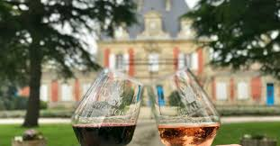

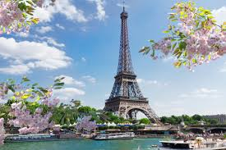
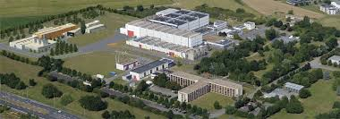
Laboratory Visits (Fri/Sat)
ESRF in Grenoble
Departure on Friday by bus
Friday: Wine and dinner + hotel
Saturday: arrival in Grenoble and visit
Free week-end to visit Grenoble and the mountains
Workshops and meetings early following week
SOLEIL south of PARIS
Departure on Friday by bus + visit
Visits to Paris afterward.
GANIL 1 hr by bus
Visit on Friday afternoon

Slide 17
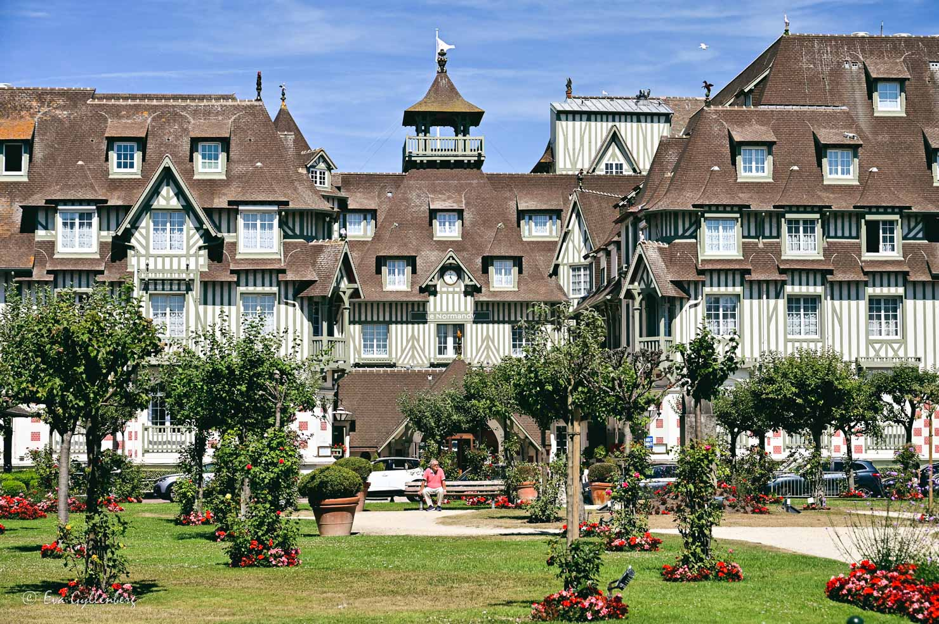
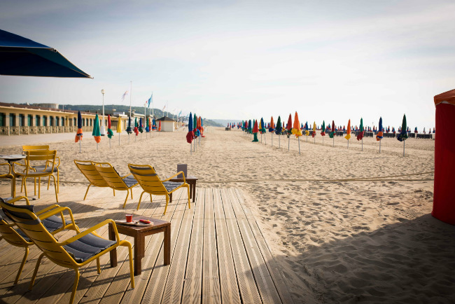
Looking forward to welcoming you to Deauville!
Sunday 17th – Friday 22nd May, 2026

