Slide 1
IPAC’25 LOC Report
Jui-Che Huang ,
Chair of Local Organizing Committee

Slide 2
Participant Statistics
Hall A – 1st Floor
Parallel session
Closing and Award Ceremony
REGISTERED PARTICIPANTS |  | 1000
Granted students |  | 79
Students- paying |  | 91
Participants |  | 607
Fee waived | 7
Early bird | 450
Full fee | 152
LOC and JACoW |  | 36+27
Exhibitors (included in booth fee) |  | 129
Exhibitors extra pass |  | 10
Accompany |  | 19

Slide 3
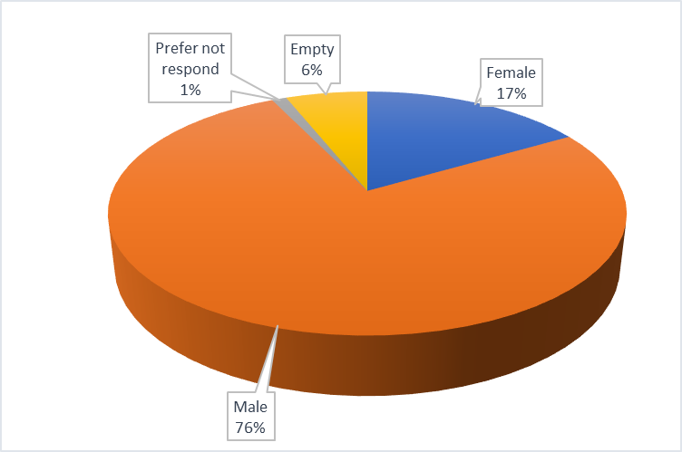
Participant Statistics
REGISTERED PARTICIPANTS | TOTAL | 1000
Female |  | 190
Male |  | 731
Prefer not respond |  | 12
Empty |  | 67

Slide 4
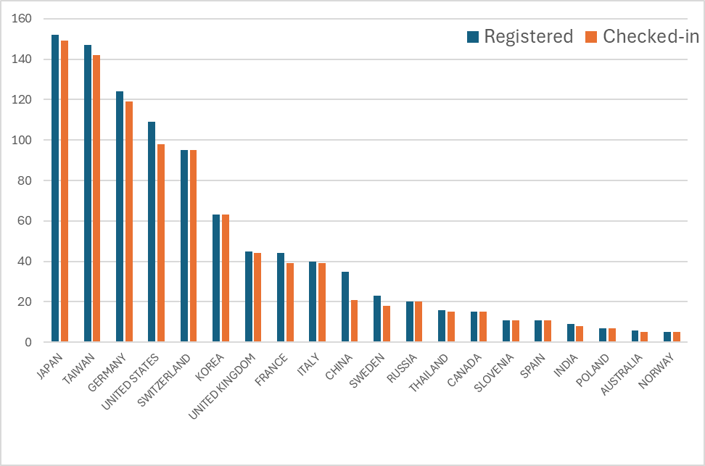
Participant Statistics

Slide 5
Industrial Participation
70 companies (inc. Taiwan consortium of 9, 8 booths )
3 Media Partners (Cern Courier , PRAB/APS Journal, IOP)
4 Free-of-charge institutional exhibitors: Elettra, JUAS, IPAC’26, IPAC’27
Total income from industry: > 450.000 USD (out of ~ 1.080.000 USD total)
Sponsorship Summary
Sponsorship Summary
Sponsorship Levels
• 1 Platinum Sponsorship – NSRRC-TPS
• 6 Gold Sponsorships
• 3 Silver Sponsorships
Additional Notes
• 3 booths unable to attend
• 12 booth-less sponsors
Company Presentations
• 4 companies (e.g., Cosylab, ALD Vacuum, ...)
Item Sponsorships
• Lanyards – Dimtel / Allied Metals
• Notepads – Microwave Techniques LLC
• Conference Bag Logos – NSRRC-TPS
• All-in-One Adapters – Instrumentation Technologies

Slide 6
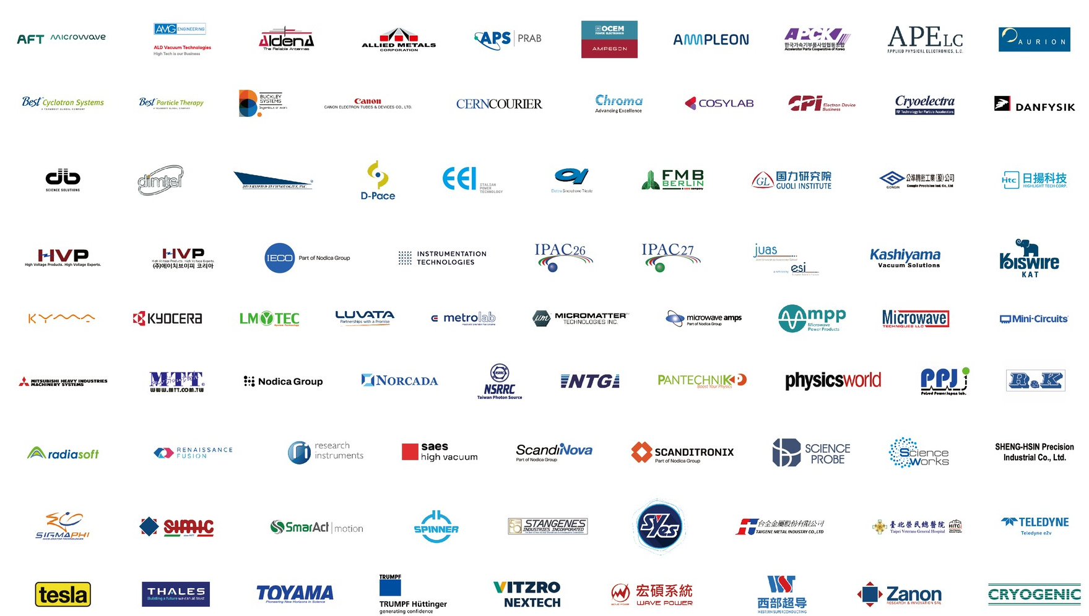

Slide 7
Number of Exhibition Booths sold

Slide 8
LESSON LEARNED
Poster Limit Policy and Additional Charges for IPAC’25
  Each editor can handle approximately 5 to 8 papers per day. So it is important to keep the poster presentation limit per delegate to ensure a manageable workflow and smooth review process.
  For IPAC’25, an extra charge will apply for exceeding the poster limit: Each delegate may present up to four posters. An additional fee of USD 200 will be charged for each poster beyond this limit.
  We have identified 15 registrants who are presenting more than four posters each.
REGISTRATION
  The participation of attendees from some countries remains highly uncertain; we have issued more than 100 refunds.
  For on-site registration, we have 40 attendees registered on-site.

Slide 9
LESSON LEARNED
Referee Challenges in Light Peer Review (LPR)
  Referee issue, we have many referees , many volunteers , but in the reality , many rejections to review the paper.
  Few people are abuse the LPR, one presenter take 4 LPRs from different authors.
  Clear policy is needed.
Email Delivery Issues Due to Enhanced Security Measures
  Due to heightened information security and cybersecurity controls at many institutions, meeting notifications and communications have become increasingly restricted, resulting in reduced efficiency in email delivery.
  Emails from the IPAC Scientific Secretariat are sometimes flagged as spam and are frequently blocked by mail servers in the United States and Europe. In several cases, recipients have only discovered our emails after checking their spam folders.
Indico related issue
  The major upgrade was done in March, which highly affect the poster assign and session assign.
  Highly suggest it should upgrade not during IPAC conference, many authors involved.

Slide 10
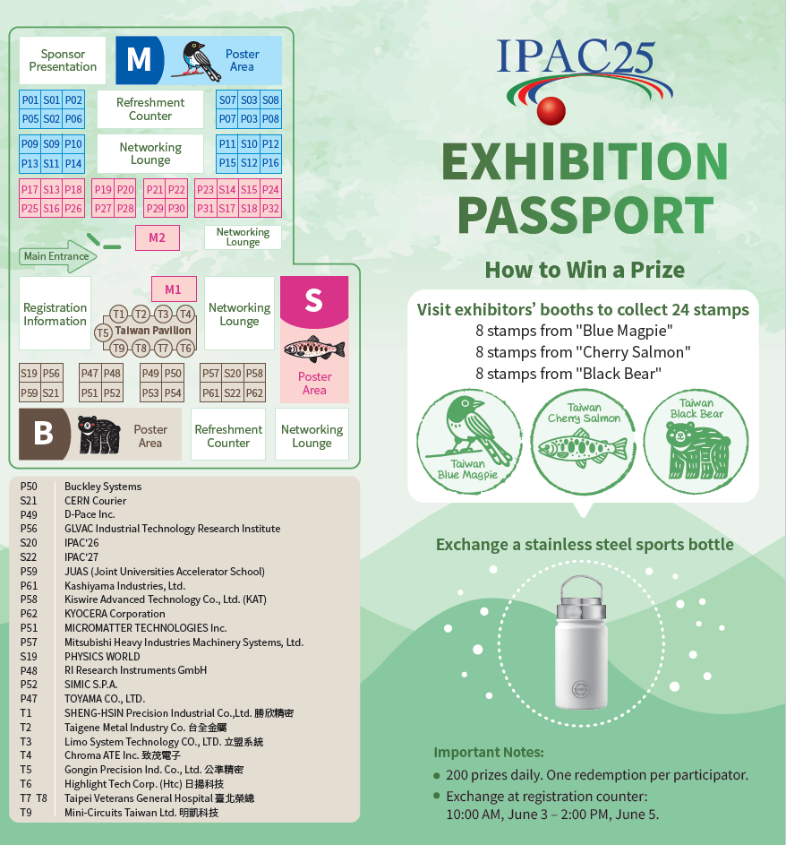



Interaction with Exhibition
IPAC’25, we are not offering high-value prizes such as iPhones. Instead, we’ve chosen practical gifts that attendees can use in their daily lives.
A sport bottle not only serves a functional purpose but also helps reduce the use of paper cups during the conference - promoting sustainability.

