Slide 1

IPAC’25 Scientific Program
Yoichi Sato (KEK/J-PARC), IPAC ’25 SPC Chair
IPAC’25 OC2
2025-Jun-04, Taipei

Slide 2


IPAC’25 SPC composition
Proposals from:
Yoichi Sato, Ming-Chyuan Lin (Asia),
Peter McIntosh, Rogelio Tomas (Europe),
Fulvia Pilat, Wolfram Fischer (Americas)
MC | Description | Coordinators (Asia) | Deputies (America/Europe)
1 | Colliders and Related Accelerators | Jie Gao, IHEP | Jie Wei, FRIB/MSU
2 | Photon sources and electron accelerators | Toru Hara, RIKEN/Spring-8 | Nicolas Delerue, CNRS
3 | Novel particle sources and acceleration techniques | Hong-Wei Zhao, IMP | Enrica Chiadroni, La Sapienza
4 | Hadron accelerators | Hiroshi Imao, RIKEN/Nishina | John Lewellen, LANL
5 | Beam dynamics and EM fields | Seunghwan Shin, Korea-4GSR/KBSI | Rogelio Tomas, CERN
6 | Beam instrumentation, controls, feedback and operational aspects | Thapakron Pulampong, SLRI | Eliana Gianfelice-Wendt, FNAL
7 | Accelerator technology and sustainability | Zong-Kai Liu, NSRRC | Ralf Gebel, FZJ and GSI
8 | Applications of accelerators and Engagement for Industry and Society | Ceri Brenner, ANSTO | Cameron Geddes, LBNL
 | Ex-officio | Ming-Chuang Lin, NSRRC: OC Chair Yoichi Sato, KEK/J-PARC: SPC Chair
 | Co-opted members | Jui-Che Huang, NSRRC: LOC Chair David Button, ANSTO: Chief Editor Stella Su, NSRRC: Scientific Secretary (Not yet / Yoichi Sato): Industry session (Mika Masuzawa / Yoichi Sato): EQO session Huang-Hsiu Tsai, NSRRC: Student program
These descriptions needed
very-long-discussion in OC1/SPC1
though start from the copy of IPAC’24

Slide 3
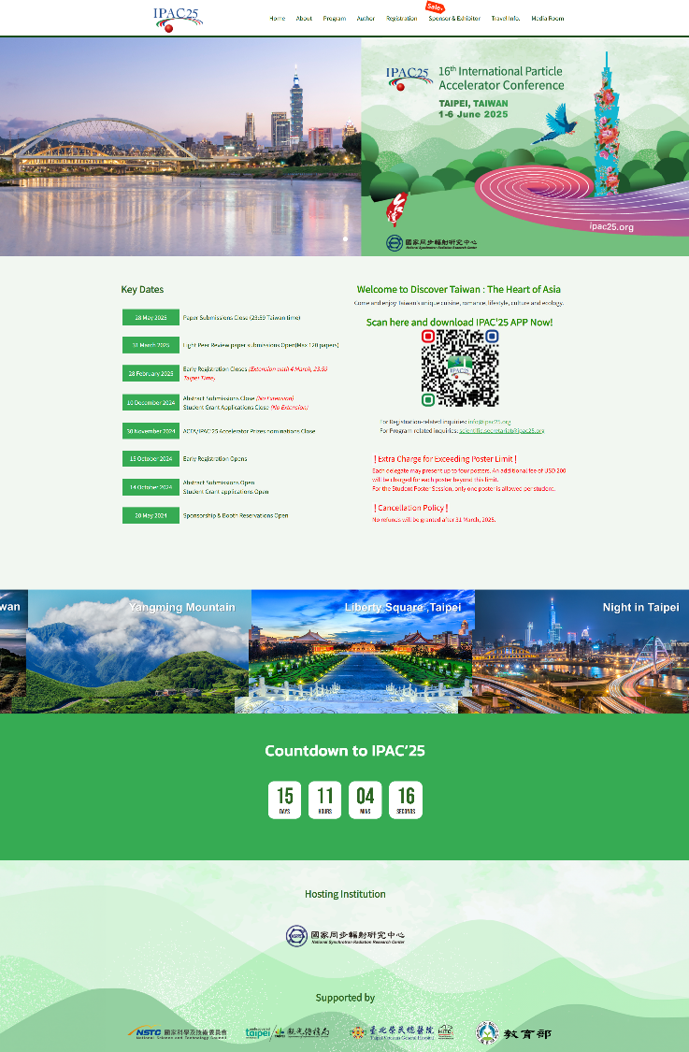
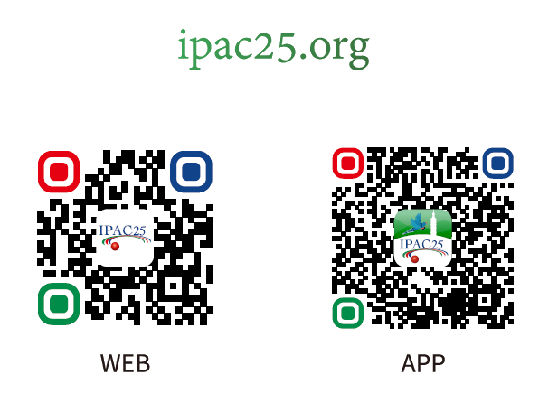
IPAC’25 SPC timeline and expected tasks
✔
SPC1: 2023-DEC-4,5 Taipei, Taiwan
Review and finalize Main Classifications (MCs) and Sub classifications
Allocate oral sessions amongst the MCs
Establish the program structure and draft synoptic table
Agree on constitution of the Scientific Advisory Board (SAB) – can trigger submission
SPC2: 2024-MAY-24,25, Nashville, USA
Select invited orals from proposals by SPC/SAB/OC – balance topics, labs, countries etc.
Select Opening and Closing plenary topics and speakers
SPC3: 2025-JAN-6,7, Tokyo, Japan ----VENUE for IPAC’28
Select contributed orals from submitted abstracts.
Select session chairs from OC/SPC.
Select Industry (Special) topics and speakers – LOC to determine.
Finalize any outstanding program issues.
During Conference: 2025-JUN-1-6, Taipei, Taiwan --- IPAC’25
Evaluate posters during Student Poster session.
Identify papers with potential for PRAB publication.
Provide feedback on conference organization –post event.
✔
✔

Slide 4
Nomination Policy of Invited Orals
Priority distribution in each MC,
Avoiding duplication of talks presented in IPAC'23 and IPAC'24 (see also the list of talks presented previously),
Good balance over 3 regions, countries in the region, fields/component systems, and gender, since this is an Asian-organized IPAC, so we are targeting 50% for Asia, 25% for the Americas, and 25% for Europe.
Voting results are guidance, which should be respected as much as possible, as long as other criteria is also respected. If needed, selection can deviate from the ranking by votes in order to define a fair, inclusive and excellent scientific program,
Speaker must not be member of OC and SPC (but can be a member of the SAB),
For the MC session chairs, the MC coordinators should each chair a session. In case of more than 2 sessions for a MC, either a MC coordinator can chair two sessions or we take another member of the OC. If no adequate person for this in OC, we can also take from SAB somebody suited who we know will attend. As a last resort: any other person deemed appropriate.

Slide 5
SPC criteria for contribution talk priorities
IPAC’25 in SPC2 MAY 2024
MC Coordinators should try to:
Select major, significant, timely topics
demonstrated results better than promise to create a result
Provide a balance over MC research fields
Avoid duplication with invited talks presented in IPAC’23, ’24,
or invited talk at IPAC’25 - either speaker or topic
Ensure a suitable regional and institutional balance
Regional balance basically AS:EMEA:AM ~= 2:1:1 for Asian-IPAC
Ensure strong gender balance --- considering the balance of invited oral speakers
Not select OC or SPC members as speakers
SAB members can give talks.
Provide candidates for allocated slots, and reserve talks

Slide 6
Proposed contribution talk policy
IPAC’25 in SPC2 MAY 2024
Invited speakers MUST present their talk in person,
no option for remote presentations to be made available
If speaker cannot, then it will be replaced with an alternative speaker or alternative talk
need to discuss if remote talk allowed
if selected speaker cannot obtain visa (*)
(*) OC/LOC point that Option of Online-Discussion is TOO expensive to allow in the view of budget.
-> A No-Visa speaker needs to find his/her representative as a speaker on site.

Slide 7
IPAC’25 SPC Decisions
IPAC’24, May 2024, Nashville, US
  Adopt Synoptic Table close to IPAC’22, ’23 format “2 parallel session”
  No LPR (due to America’s PAC OC bylaws)
  No Student tutoring for IPAC’24 (done for NA-PACs in Americas), but Student poster session was held
Future IPAC conferences
  IPAC’26, Deauville, France (near GANIL)
  IPAC’27, Detroit, US (near FRIB/MSU)
  IPAC’28, Tokyo, Japan (near KEK, RIKEN-Nishina)
Modifications on the Main Classifications. --- Big modifications in MC8.
Light Peer Review
  Do again for IPAC’25, but limited for early-career-people
No option for remote presentations
Set number of poster limit
  Free up to 4 posters. More than 4, 200 USD/poster
Set Actual Speakers beyond SPC2 and SPC3 discussion
  Many nominated US/PRC speakers could not attend IPAC’25 in person.
  Some of them decided to gave up presentation even in this April.
Modify Equal Opportunity Session → Productive Research Environment Session
  Session including EqO, WISE concepts
Industry Session 2 hours -> 1 hour
  Only for the views from Academic to Industry
Student poster session
  Keep on Sunday.

Slide 8
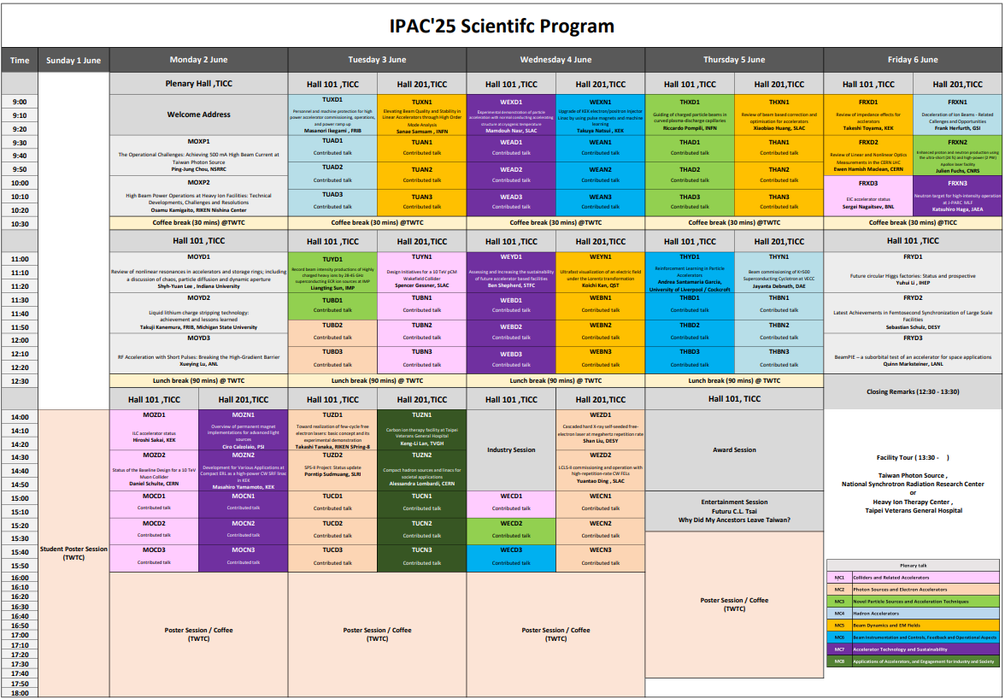
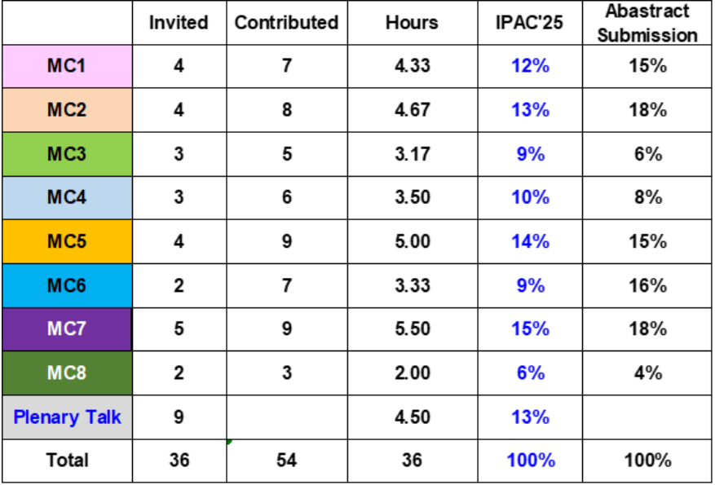
IPAC’25 SPC plan right after SPC2 MAY-JULY 2024
Industrial Session
was compressed from
2 to 1 hours,
to increase contribution orals
MC talk-slots were balanced
considering the impact of proposed/submitted topics.
Industry
Session
Laboratory
tours
Welcome
Receptions
Chair’s reception
(invitation only)
Equal
Opportunity
Session
(all welcome)
IPAC’25
OC2
Conference
Banquet
Notes:
MC talk numbers were balanced considering the impact of proposed/submitted topics. # of MC6 invited orals became 3 to 2, because of the reason.

Slide 9
IPAC’25 Plenary talk plan right after SPC2
Opening (Strategic, broad impact)
The Operational Challenges:
Achieving 500 mA High Beam Current at Taiwan Photon Source Ping-Jung Chou, NSRRC
High Beam Power Operations at Heavy Ion Facilities:
Technical Developments, Challenges and Resolutions Osamu Kamigaito, RIKEN Nishina
Review of nonlinear resonances in accelerators and storage rings;
including a discussion of chaos, particle diffusion and dynamic aperture Shyh-Yuan Lee, IU
Liquid lithium charge stripping technology: achievement and lessons learned Takuji Kanemura, FRIB/MSU
RF Acceleration with Short Pulses: Breaking the High-Gradient Barrier Xueying Lu, ANL
Closing (Impactful, applications, future-looking, outreach)
Future circular Higgs factories: Status and prospective Yuhui Li, IHEP
Latest Achievements in Femtosecond Synchronization of Large Scale Facilities Sebastian Schulz, DESY
BeamPIE - a suborbital test of an accelerator for space applications Quinn Marksteiner, LANL
Notes:
Q Rogelio: Regional balance is not good in opening plenary talks
A: I prioritized MC balances than regional balances for plenary talks. Regional balance of plenary was considered in sum of Opening/Closing plenary talks. Set better regional balance to choose alternative topic of IHEP talk → set CERN talk.

Slide 10
IPAC’25 Plenary talk finalized May 2025
Opening (Strategic, broad impact)
The Operational Challenges:
Achieving 500 mA High Beam Current at Taiwan Photon Source Ping-Jung Chou, NSRRC
High Beam Power Operations at Heavy Ion Facilities:
Technical Developments, Challenges and Resolutions Osamu Kamigaito, RIKEN Nishina
Review of nonlinear resonances in accelerators and storage rings;
including a discussion of chaos, particle diffusion and dynamic aperture Shyh-Yuan Lee, IU
Liquid lithium charge stripping technology: achievement and lessons learned Takuji Kanemura, FRIB/MSU
RF Acceleration with Short Pulses: Breaking the High-Gradient Barrier Xueying Lu, ANL
Closing (Impactful, applications, future-looking, outreach)
Future circular Higgs factories: Status and prospective Yuhui Li, IHEP
→ In late March Dr. Li told us not to join IPAC2025. All people recommended by Dr. Li could not be
his representative speaker along w IPAC policy (No multiple orals/person, NO OC/SPC be speaker).
I had to set a CERN talk (F. Zimmermann) as its alternative topic, but keeping MC1 category in MAY 2025.
Latest Achievements in Femtosecond Synchronization of Large Scale Facilities Sebastian Schulz, DESY
BeamPIE - a suborbital test of an accelerator for space applications Quinn Marksteiner, LANL
Notes:
Q Rogelio: Regional balance is not good in opening plenary talks
A: I prioritized MC balances than regional balances for plenary talks. Regional balance of plenary was considered in sum of Opening/Closing plenary talks. Set better regional balance to choose alternative topic of IHEP talk → set CERN talk.

Slide 11
IPAC’25 invited talks right after SPC2 MAY-JULY 2024
MC1: Colliders and Related Accelerators
EIC accelerator status
ILC accelerator status
Design Initiatives for a 10 TeV pCM Wakefield Collider
Status of the Baseline Design for a 10 TeV Muon Collider
MC5: Beam Dynamics and EM Fields
Review of Linear and Nonlinear Optics Measurements in the CERN-LHC
Review of impedance effects for accelerators
Review of beam based correction and optimisation for accelerators
Elevating Beam Quality and Stability in Linear Accelerators through High Order Mode Analysis
Ultrafast visualization of an electric field under the Lorentz transformation
MC2: Photon Sources and Electron Accelerators
Toward realization of few-cycle free electron lasers: basic concept and its experimental demonstration
Cascaded hard X-ray self-seeded free-electron laser at megahertz repetition rate
SPS-II Project: Status update
LCLS-II commissioning and operation with high-repetition-rate CW FELs
MC6: Beam Instrumentation and Controls, Feedback and Operational Aspects
Upgrade of KEK electron/positron Injector Linac by using pulse magnets and machine learning
Reinforcement Learning in Particle Accelerators
MC7: Accelerator Technology and Sustainability
Experimental demonstration of particle acceleration with normal conducting accelerating structure at cryogenic temperature
Overview of permanent magnet implementations for advanced light sources
Assessing and Increasing the sustainability of future accelerator based facilities
Development for Various Applications at Compact ERL as a high-power CW SRF linac in KEK
Neutron target for high-intensity operation at J-PARC MLF
MC3: Novel Particle Sources and Acceleration Techniques
Enhanced proton and neutron production using the ultra-short (24 fs) and high-power (2 PW) Apollon laser facility
Record beam intensity productions of Highly charged heavy ions by 28-45 GHz superconducting ECR ion sources at IMP
Guiding of charged particle beams in curved plasma-discharge capillaries
MC8: Applications of Accelerators, and Engagement for Industry and Society
Carbon ion therapy facility at Taipei Veterans General Hospital​
Compact hadron sources and linacs for societal applications
MC4: Hadron Accelerators
Beam commissioning of K=500 Superconducting Cyclotron at VECC
Personnel and machine protection for high power accelerator commissioning, operations, and power ramp up
Deceleration of Ion Beams - Related Callenges and Opportunities
SPC3 allows for further balancing of topics, regions, labs, speakers, …
NOTE: No Invited Talks from Korea
→ Increased Contribution Talks from Korea

Slide 12
IPAC’25 invited talks finalized in April 2025
MC1: Colliders and Related Accelerators
EIC accelerator status
ILC accelerator status
Design Initiatives for a 10 TeV pCM Wakefield Collider
Status of the Baseline Design for a 10 TeV Muon Collider
MC5: Beam Dynamics and EM Fields
Review of Linear and Nonlinear Optics Measurements in the CERN-LHC
Review of impedance effects for accelerators
Review of beam based correction and optimisation for accelerators
Elevating Beam Quality and Stability in Linear Accelerators through High Order Mode Analysis
Ultrafast visualization of an electric field under the Lorentz transformation
MC2: Photon Sources and Electron Accelerators
Toward realization of few-cycle free electron lasers: basic concept and its experimental demonstration
Cascaded hard X-ray self-seeded free-electron laser at megahertz repetition rate
SPS-II Project: Status update
LCLS-II commissioning and operation with high-repetition-rate CW FELs
MC6: Beam Instrumentation and Controls, Feedback and Operational Aspects
Upgrade of KEK electron/positron Injector Linac by using pulse magnets and machine learning
Reinforcement Learning in Particle Accelerators
MC7: Accelerator Technology and Sustainability
Experimental demonstration of particle acceleration with normal conducting accelerating structure at cryogenic temperature
Overview of permanent magnet implementations for advanced light sources
Assessing and Increasing the sustainability of future accelerator based facilities
Development for Various Applications at Compact ERL as a high-power CW SRF linac in KEK
Neutron target for high-intensity operation at J-PARC MLF
MC3: Novel Particle Sources and Acceleration Techniques
Enhanced proton and neutron production using the ultra-short (24 fs) and high-power (2 PW) Apollon laser facility
Record beam intensity productions of Highly charged heavy ions by 28-45 GHz superconducting ECR ion sources at IMP
Guiding of charged particle beams in curved plasma-discharge capillaries
MC4: 3->2 --- EXTRA ORDINALY CASE
But considering 2 Plenary talk from MC4
MC8: Applications of Accelerators, and Engagement for Industry and Society
Carbon ion therapy facility at Taipei Veterans General Hospital​
Compact hadron sources and linacs for societal applications
MC4: Hadron Accelerators
Beam commissioning of K=500 Superconducting Cyclotron at VECC [No Res]
Personnel and machine protection for high power accelerator commissioning, operations, and power ramp up
Deceleration of Ion Beams - Related Callenges and Opportunities
SPC3 allows for further balancing of topics, regions, labs, speakers, …
NOTE: No Invited Talks from Korea
→ Increased Contribution Talks from Korea
I had to decide to set many alternative speakers/topics
even after SPC3.

Slide 13
IPAC’25 SPC activities after SPC3, JAN-APR 2025
SPC3: 2025-JAN-6,7, Tokyo, Japan ----VENUE for IPAC’28
Select contributed orals from submitted abstracts.
Select session chairs from OC/SPC.
Select Industry (Special) topics and speakers – LOC to determine.
Finalize any outstanding program issues.
January – March, 2025
We tried to set all Contribution Orals, based on SPC3, but many nominated US/PRC speakers declined.
some understandable.
We set alternative speakers and topics under Email problem (→ Jui-Che’s)
March – April, 2025
Closing to the end of March (withdraw due of 80% refund )
Many people gave up to join IPAC25 in person,
including 1 INVITED PLENARY.

Slide 14
IPAC’25 Cancelled Asian orals nominated for IPAC'25
(excluding the topics
with alternative speakers)
[Plenary/Invited]
(P-1) AS/PRC: MC1->MC0, Future circular Higgs factories: Status and prospective, Yuhui Li, IHEP
NO-SHOW notice w/o available-alternative in late March 2025
[Invited]
(I-1) AS/India: Beam commissioning of K=500 Superconducting Cyclotron at VECC, Jayanta Debnath, DAE
NO RESPONSE since Aug. 2024
[Contributed] Asked in January 2025, Accepted once, but NO-SHOW notice w/o alternative in late March.
(C-1) AS/PRC: MC1, Commissioning of BEPCII-U, Huiping Geng, IHEP
(C-2) AS/PRC: MC2, An ultrafast strong-field terahertz light source to characterize quantum functional materials, Tong Zhang, U Science and Tech of China
(C-3) AS/PRC: MC3, Development of the sub-nanosecond grid-controlled electron source for Hefei Advanced Light Facility injector, Feng-lei Shang, U Science and Tech of China
(C-4) AS/PRC: MC4, Upgrade progress for the CSNS-II RCS, Ming-Yang Huang, IHEP
(C-5) AS/PRC: MC6, Machine learning-based orbit correction in the RCS of CSNS, Xiaohan Lu, IHEP
(C-6) AS/PRC: MC7, Design and implementation of ridge waveguides for dual-mode microwave structure, Xiaoxia Huang, Shanghai Sync Rad F
NOTE: From PRC, many IMP people are in IPAC2025
Hongwei’s comment: IMP started action to take VISA in JAN.2025

Slide 15
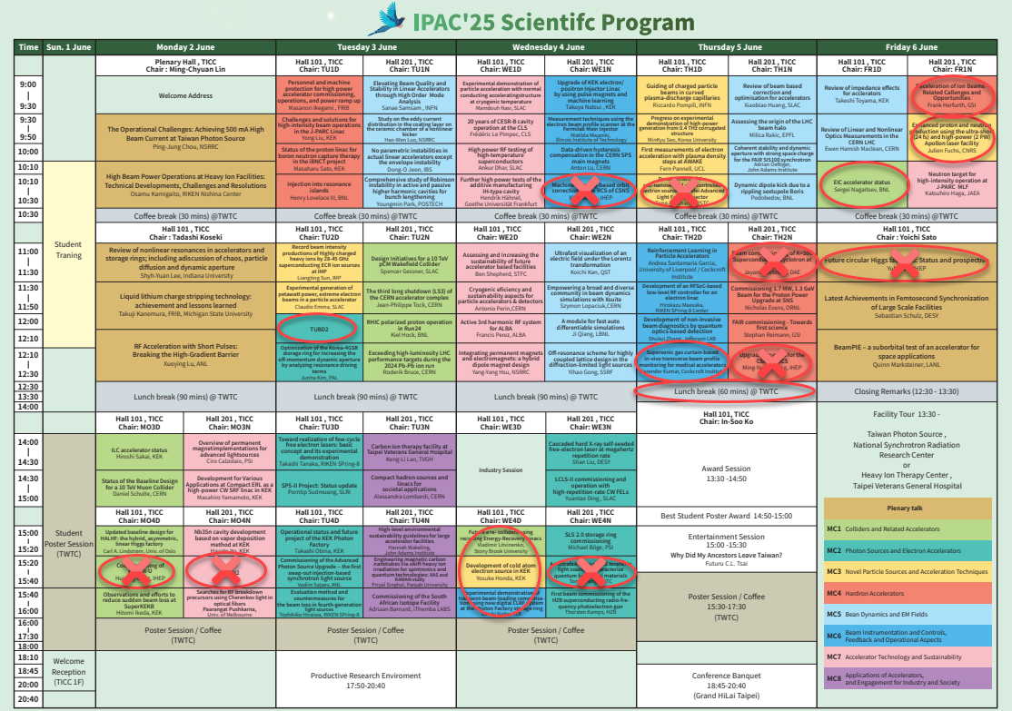
IPAC’25 SPC plan after SPC3 → RED mark in this Feb – May 1st week
The participation of attendees from the United States and China remains highly uncertain, resulting in some last-minute cancellations and increasing the difficulty of scheduling the program.
Due to increased Information security and cybersecurity controls most institutions, meeting notifications and communications have been restricted, leading to decreased efficiency in email delivery.
Notes:
Reduced 90 talks to 84 talks.
Last minutes cancellation, mis/inefficient-communications in e-mail were happened.
Therefore, some alternative speakers/topics were set only agreed among SPC/OC/LOC chairs only.
Q from Rogelio: How to manage different slot numbers?
A: Time slots were modified: Longer Lunch Break on Thursday, Friday morning session parallel to single.

Slide 16
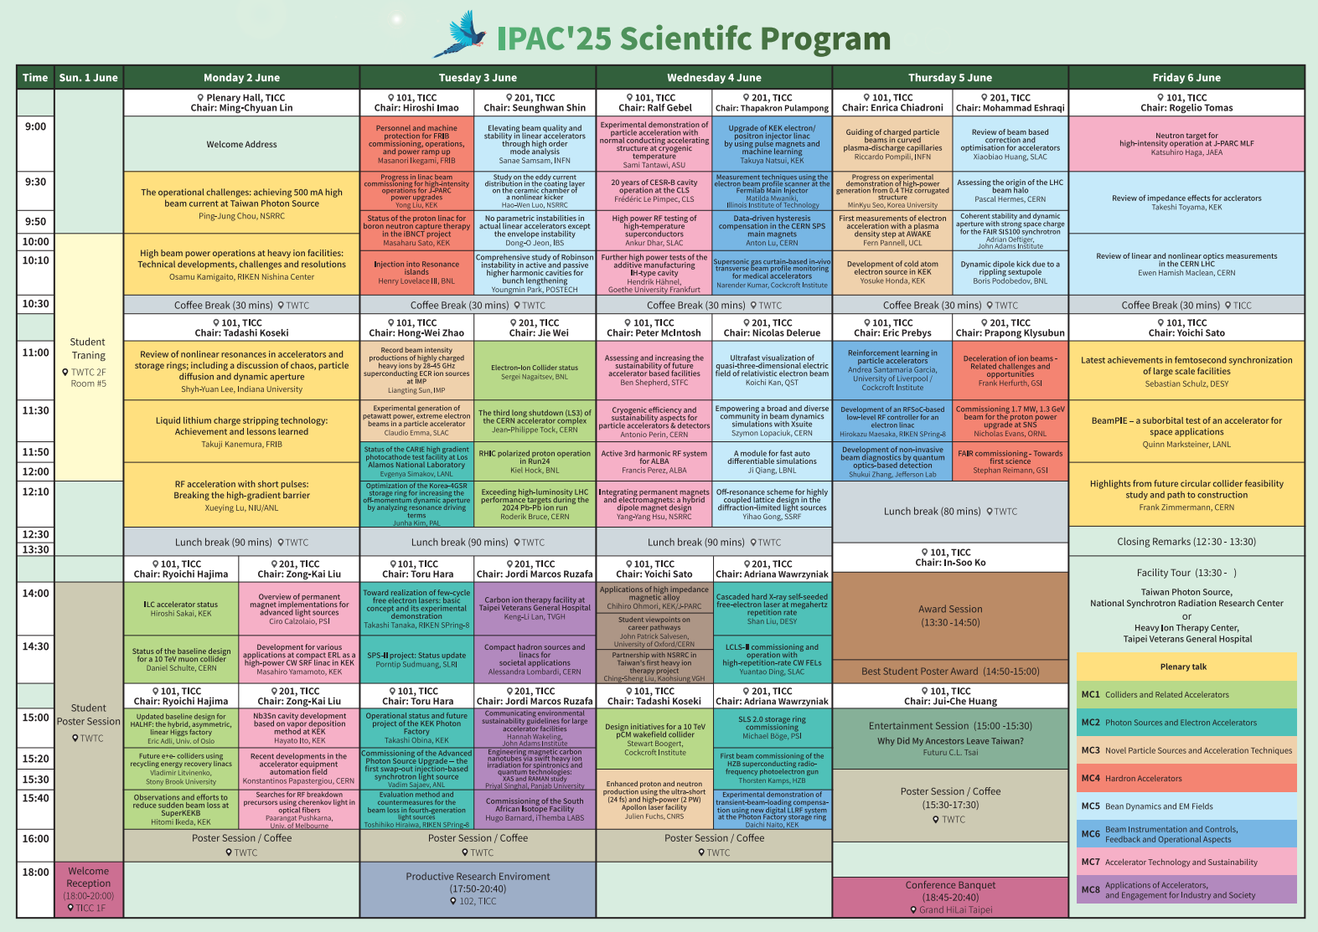
IPAC’25 SPC Final
Reduced 90 talks to 84 talks,
though adopting alternative topics
Time slots were modified: Longer Lunch Break on Thursday, Friday morning session parallel to single.
Thank many speakers
accepting my urgent request
to be oral presenters
Notes:
Reduced 90 talks to 84 talks.
Last minutes cancellation, mis/inefficient-communications in e-mail were happened.
Therefore, some alternative speakers/topics were set only agreed among SPC/OC/LOC chairs only.
Q from Rogelio: How to manage different slot numbers?
A: Time slots were modified: Longer Lunch Break on Thursday, Friday morning session parallel to single.

Slide 17
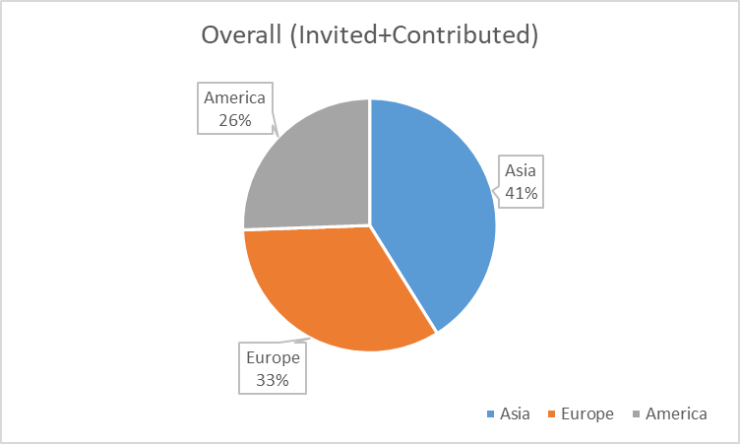
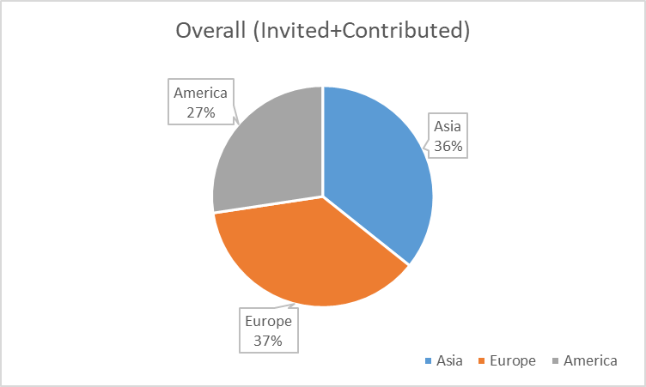
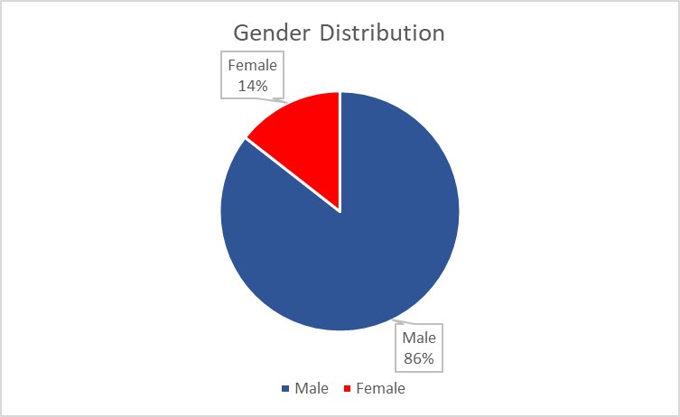
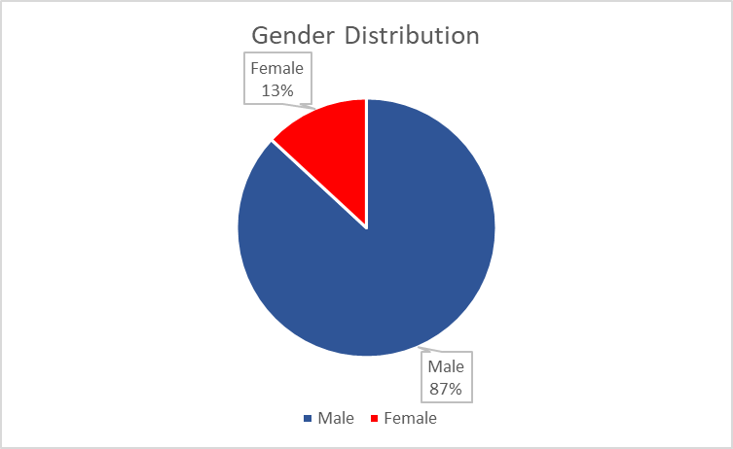
IPAC’25 Oral Presentations
Contributed and Invited Orals (90 Talks)
Expected right after SPC3
Contributed and Invited Orals (84 Talks)
Real in IPAC’25
Notes:
Last minutes cancellation from PRC made 41% to 36% in oral presenters.
Keeping American ratio though cancellation of US DOE facilities, because Non-US AM and US Univ. members became alternative speakers.
Female/Male balance is not good. I think it comes from “Asian-IPAC”.
As the SPC chair, I prioritized regional/facility balances than gender balances, especially seeking half talks from Asia.
Q&A with Peter Mcintosh: Korean talks are not in invited oral, but we set many Korean talks as contribution orals.

Slide 18
IPAC’25 Participants
The participation of attendees from the United States and China remains highly uncertain,
resulting in some last-minute cancellations and increasing the difficulty of scheduling the program.
Heavy effects from Political/Natural environments.
IPAC’25
939 people paid registration fee among 1153 registrations
(we had to refund.)
Projected deficit: EXPECTED 0.1 ~ 0.2 M USD → Found OK
However, still financial risk exists in future IPACs
MEASURES?
Notes:
200 cancelations and refunds caused financial deficit
In coming IPAC’25 OC2, we will address the necessary of counter measures to financial risks from Political/Natural reasons, to keep Academic independences in our accelerator community.

Slide 19
IPAC’25 Satellite Meetings
Date | Time | Meeting Name | Open/Closed | Room
Saturday, 31 May | 08:30–17:00 | Insertion Devices for Future Light Sources Workshop (ID25) | By Registration | TWTC 2F, Room A+
Sunday, 1 June | 08:30–12:30
Tuesday, 3 June | 08:30–10:30 | APS/PRAB Authors’ Tutorial | OPEN | TICC 3F, South Lounge
 | 12:30–14:00 | IPAC Coordination Committee Meeting and Lunch | By Invitation | TICC 1F, Room 106
 | 14:00–16:00 | ACFA Meeting | By Invitation | TICC 1F, Room 106
 | 17:50–20:30 | “Meet the APS/PRAB Editors" Reception | OPEN | TICC 1F
 |  | Productive Research Environments Reception | OPEN | TICC 1F, Room 102
 | 18:00–20:00 | IPAC’26 Exhibitor Reception | By Invitation | TICC 4F, VIP Room
Wednesday, 4 June | 12:30–14:00 | JACoW Stakeholders Meeting | By Invitation | TWTC 2F, Room A+
 | 18:00–20:30 | Electron Ion Collider (EIC) Accelerator Collaboration | OPEN | TICC 1F, Room 102
 | 18:00–20:30 | IPAC25 Organizing Committee Dinner | By Invitation | Grand Hyatt Hotel, 1F
Friday, 6 June | 13:30–17:00 | IPAC’26 Scientific Programming Committee | By Invitation | TWTC 2F, Room A+

Slide 20
IPAC’25 PRE (Productive Research Environment) Session
Key objectives:
Share effective approaches and research environments that lead to productive outcomes.
Attract younger and mid-career professionals to the accelerator community.
Enhance productivity and contribute more effectively to society by leveraging a strong pool of human resources.
Introduction from Coordinators
PRE pre-survey to check World Leaders’ attitude
Pre-session questionnaire to: OC/SPC/SAB committee members in IPAC’22 - ’25.
Survey for Manager/Leader class people.
Presenters, panelists
Share ideas for more productive research environment based on your career advancement experiences
propose any strategies you may have.
Free discussion

Slide 21
Coordinators, Presenters, Panelists
PRE Coordinators:
Dr. Yoichi Sato - KEK / J-PARC AS
Dr. Mika Masuzawa - KEK / SuperKEKB AS
PRE Presenters and Panelists:
Dr. Mika Masuzawa - KEK / SuperKEKB AS
Dr. Somjai Chunjarean - Synchrotron Light Research Institute AS
Dr. Angeles Faus-Golfe - Universite Paris-Saclay, CNRS/IN2P3, IJCLab EMEA
Additional Panelist:
Dr. Francis Perez - ALBA Synchrotron EMEA
Dr. Ryoichi Hajima - National Institutes for Quantum Science and Technology AS
Dr. Raffaella Geometrante - Kyma SpA EMEA
ANNOUNCEMENT
After the session, Coordinators, Presenters, Panelists will report
the summary of this PRE to IPAC’26 in the form of proceedings.

Slide 22
IPAC25 PRE pre-survey
Pre-session questionnaire to: OC/SPC/SAB committee members in IPAC’22 - ’25.
Survey for Manager/Leader class people.
Demographic Information; Gender* Region*
Section A
Please answer the following questions reflecting on the first 10 years of your research career.
Q1.To what extent were you satisfied
with your working environment?*
5: Completely satisfied
4: Mostly satisfied
3: Neutral
2: Mostly dissatisfied
1: Completely dissatisfied
Q2.Have you ever wondered
whether you should continue with your job?*
5: Never
4: Seldom
3: Sometimes
2: Often
1: Almost always
Q3. To what extent were you motivated to take on a managerial role?*
5: Strongly motivated
4: Moderately motivated
3: Neutral
2: Somewhat reluctant
1: Strongly opposed
Section B
Please answer the following questions reflecting on your current situation.
Q4.To what extent are you satisfied with the adequacy of staffing levels in your group?
2
5: Very satisfied
4: Satisfied
3: Neutral
2: Dissatisfied
1: Very dissatisfied
Q5.What is the level of interest among young researchers in building their careers in your group?
5: Very high
4: Above average
3: Average
2: Below average
1: Very low
Q 6.Please outlie the key factors you consider essential for fostering a productive research environment (approx. 50 words).
---

Slide 23
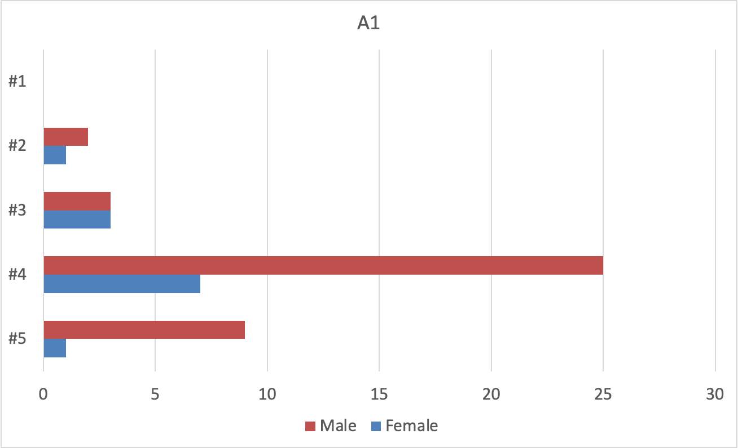
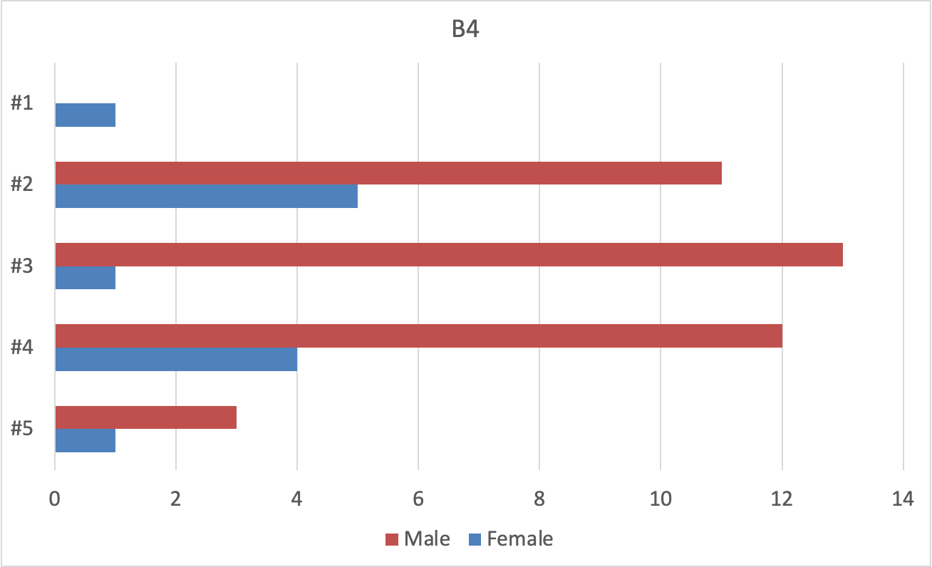
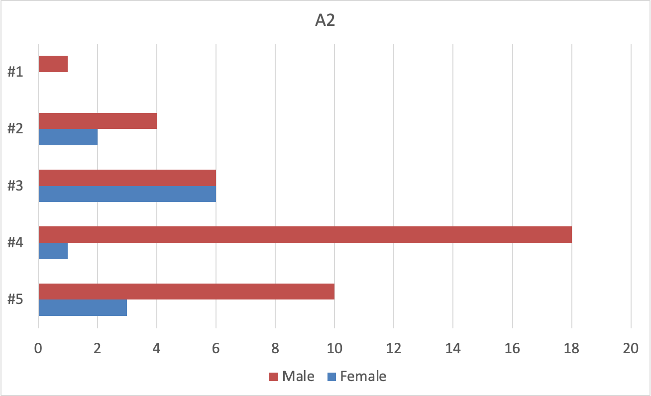
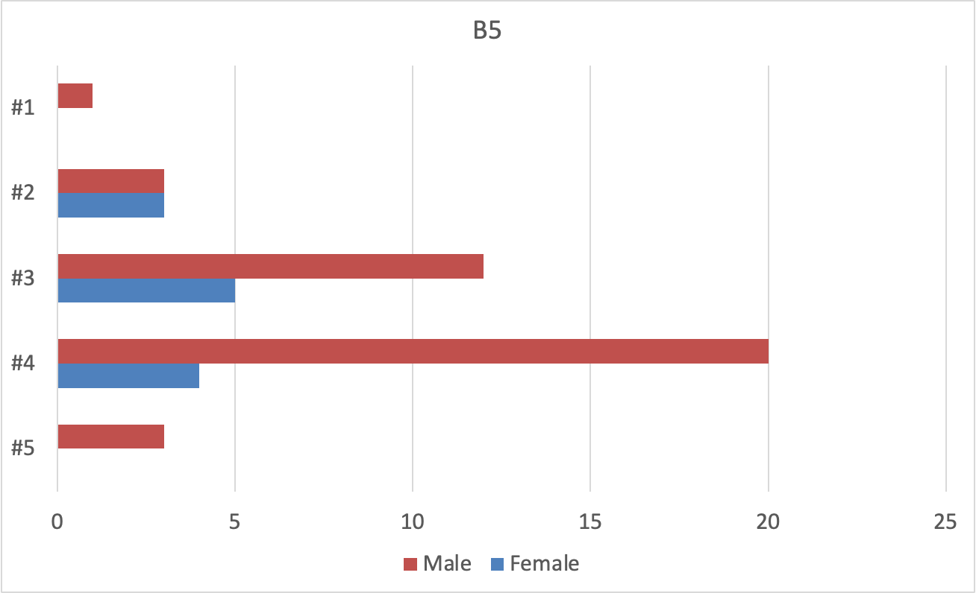
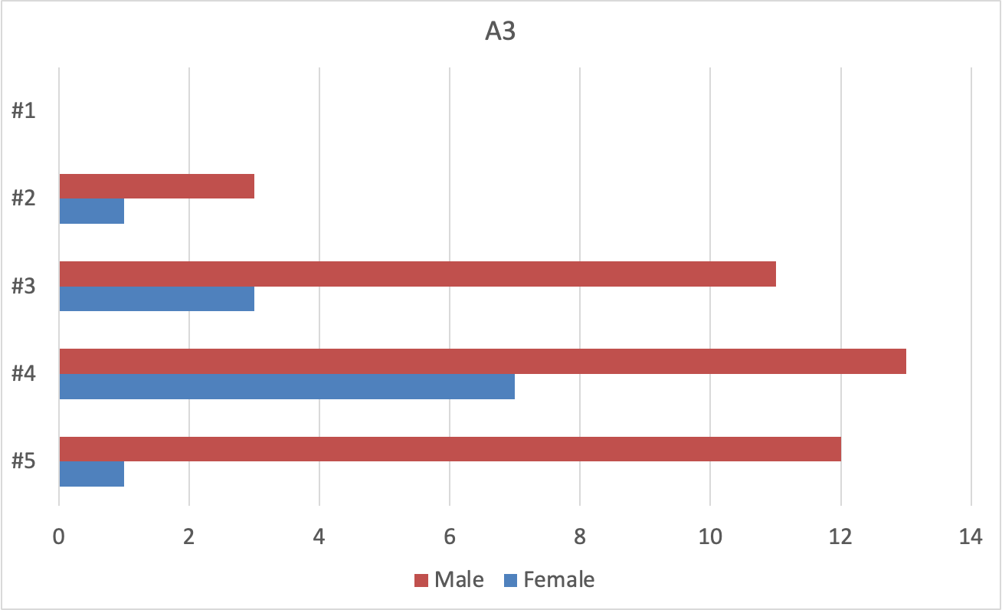
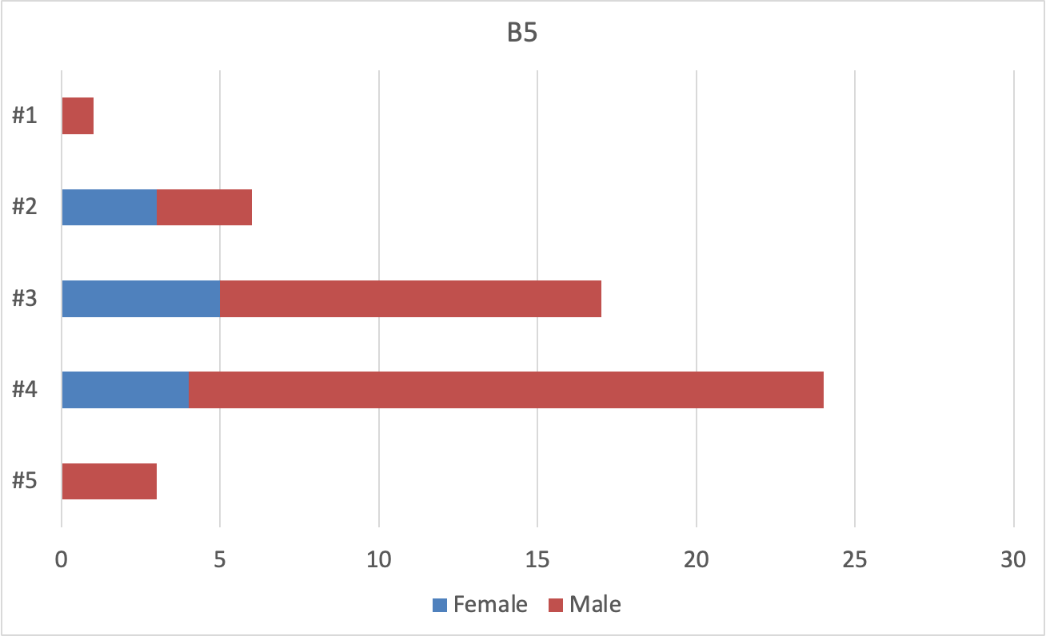
Section A
Please answer the following questions reflecting on the first 10 years of your research career.
Section B
Please answer the following questions reflecting on your current situation.
Q4.To what extent are you satisfied with the adequacy of staffing levels in your group?
PRE pre-survey
to OC/SPC/SAB
in IPAC’22 – ‘25
Q1.To what extent were you satisfied
with your working environment?
Q5.What is the level of interest among young researchers in building their careers in your group?
Q2.Have you ever wondered
whether you should continue
with your job?
Q3. To what extent were you motivated to take on a managerial role?

Slide 24
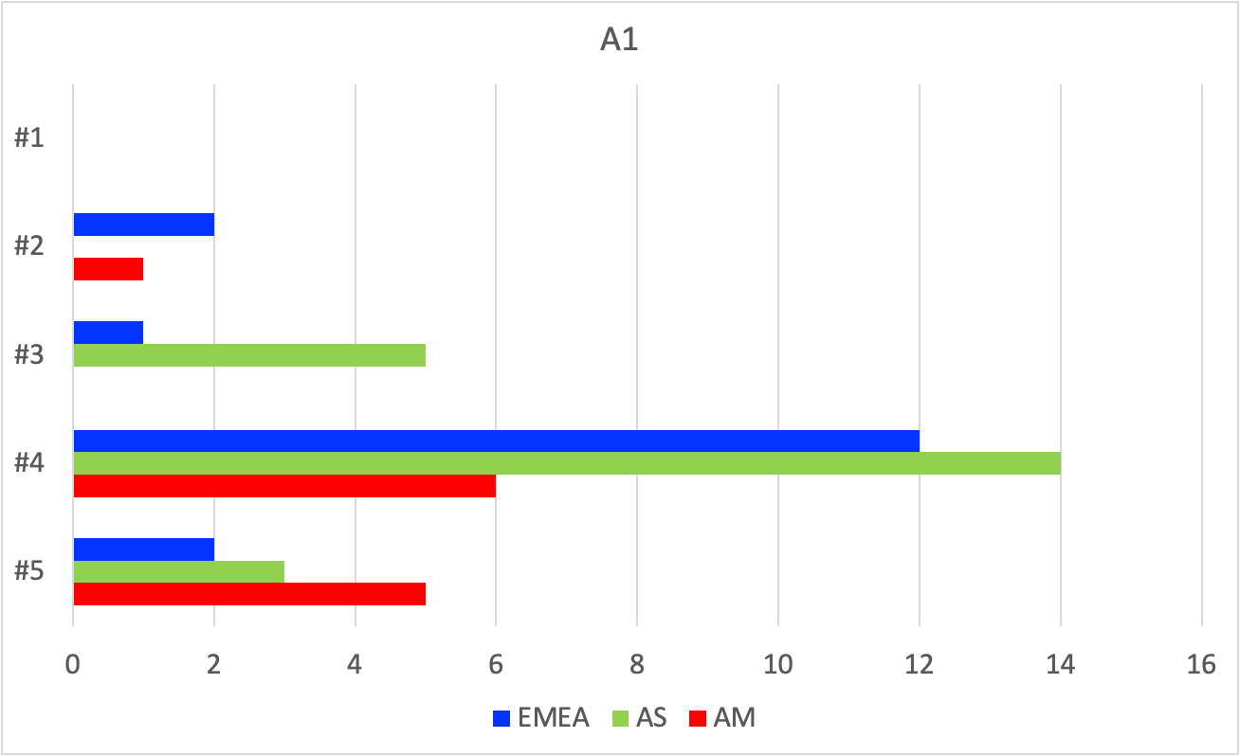
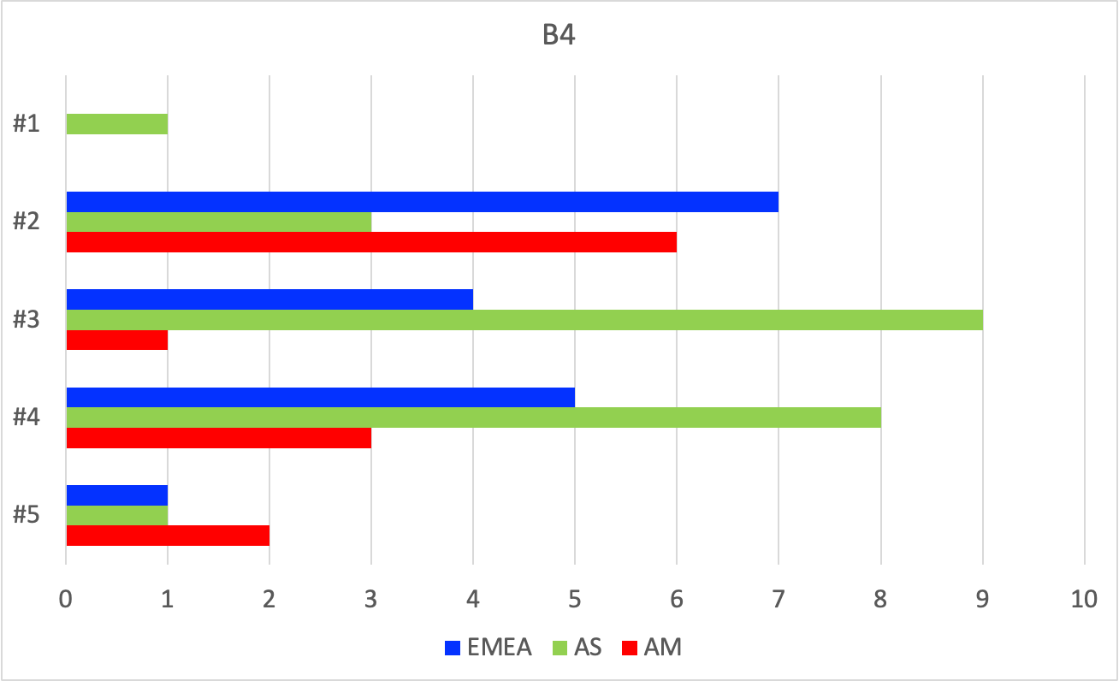
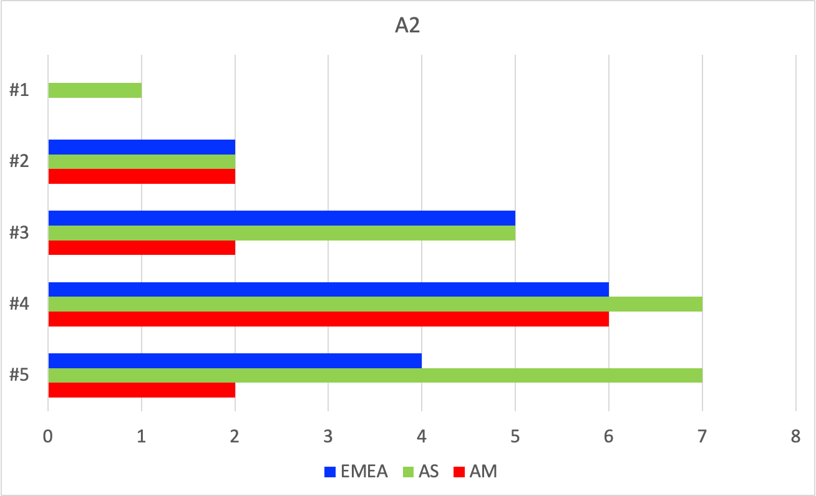
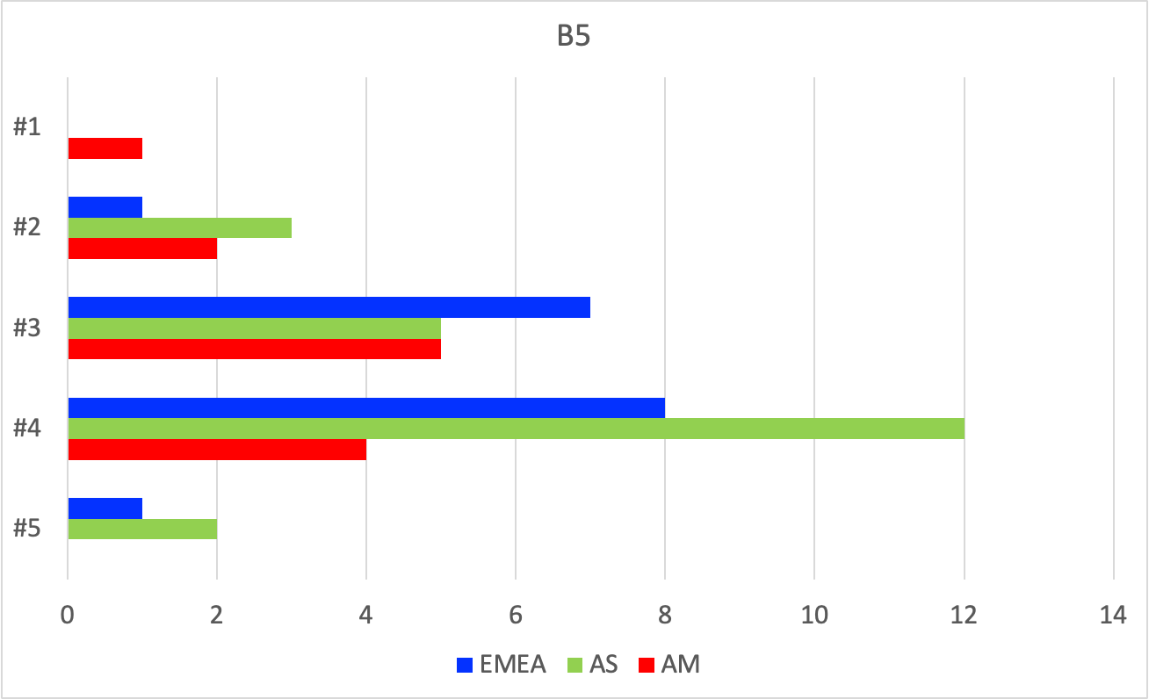
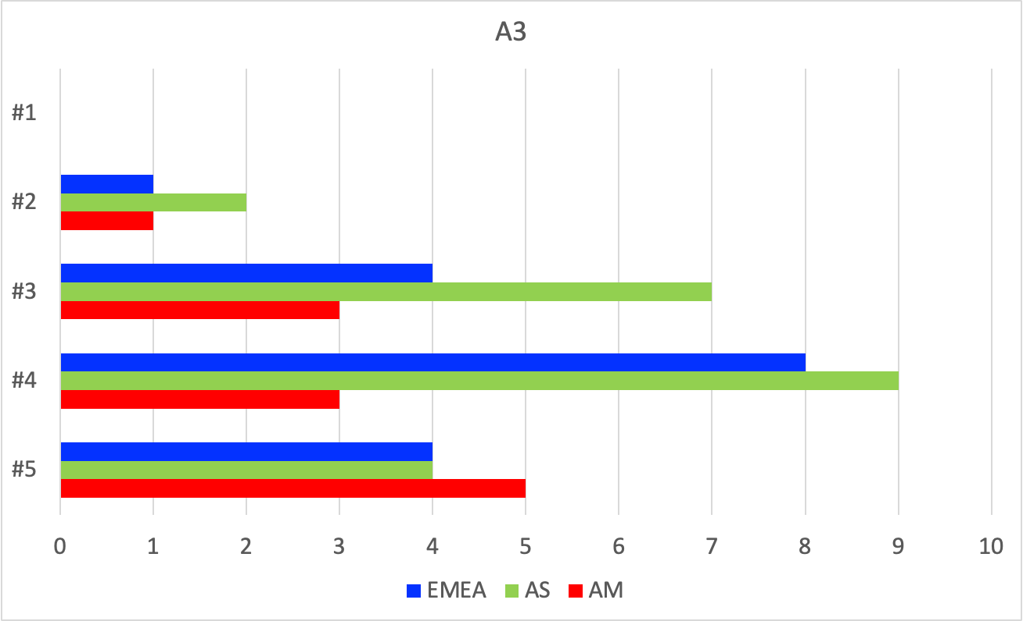
Section A
Please answer the following questions reflecting on the first 10 years of your research career.
Section B
Please answer the following questions reflecting on your current situation.
Q4.To what extent are you satisfied with the adequacy of staffing levels in your group?
PRE pre-survey
to OC/SPC/SAB
in IPAC’22 – ‘25
Q1.To what extent were you satisfied
with your working environment?
Q5.What is the level of interest among young researchers in building their careers in your group?
Q2.Have you ever wondered
whether you should continue
with your job?
Q3. To what extent were you motivated to take on a managerial role?

