Slide 1
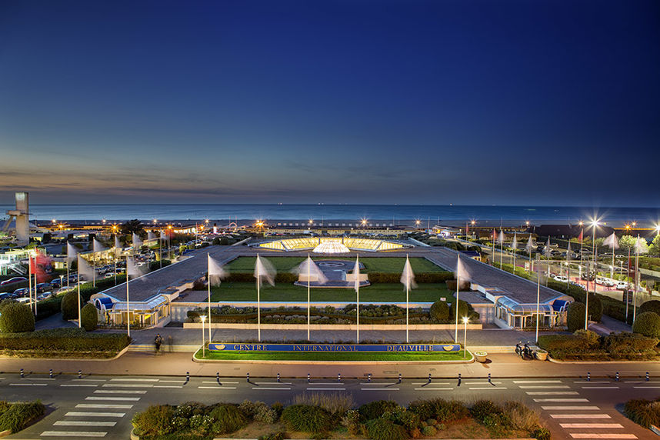
Voting procedure
Nicolas DELERUE
IPAC’26 Editor in Chief

Slide 2
Votes for the SPC2
Thank to all of you (and the OC and SAB members) for suggesting a total of 448 abstracts.
With the help of the MC coordinators we have removed those that were duplicates or those that were not compatible with IPAC rules (eg: speaker who already spoke at a recent IPAC, industry speakers, …). Some abstracts were moved to a different MC.
After cleaning there are ~342 abstracts left.
Now the SPC need to selects its favourite abstracts.
Reminder: All SPC2 members are invited to vote for their favourite abstracts in all MC.
For each MC each SPC member can cast 5 “1st choice” votes and 5 “2nd choice” votes (that is a total of 80 votes out of 342 abstracts).
To avoid low statistics it is important that you vote in all MC.
Please cast your votes by Sunday 4th May noon

Slide 3
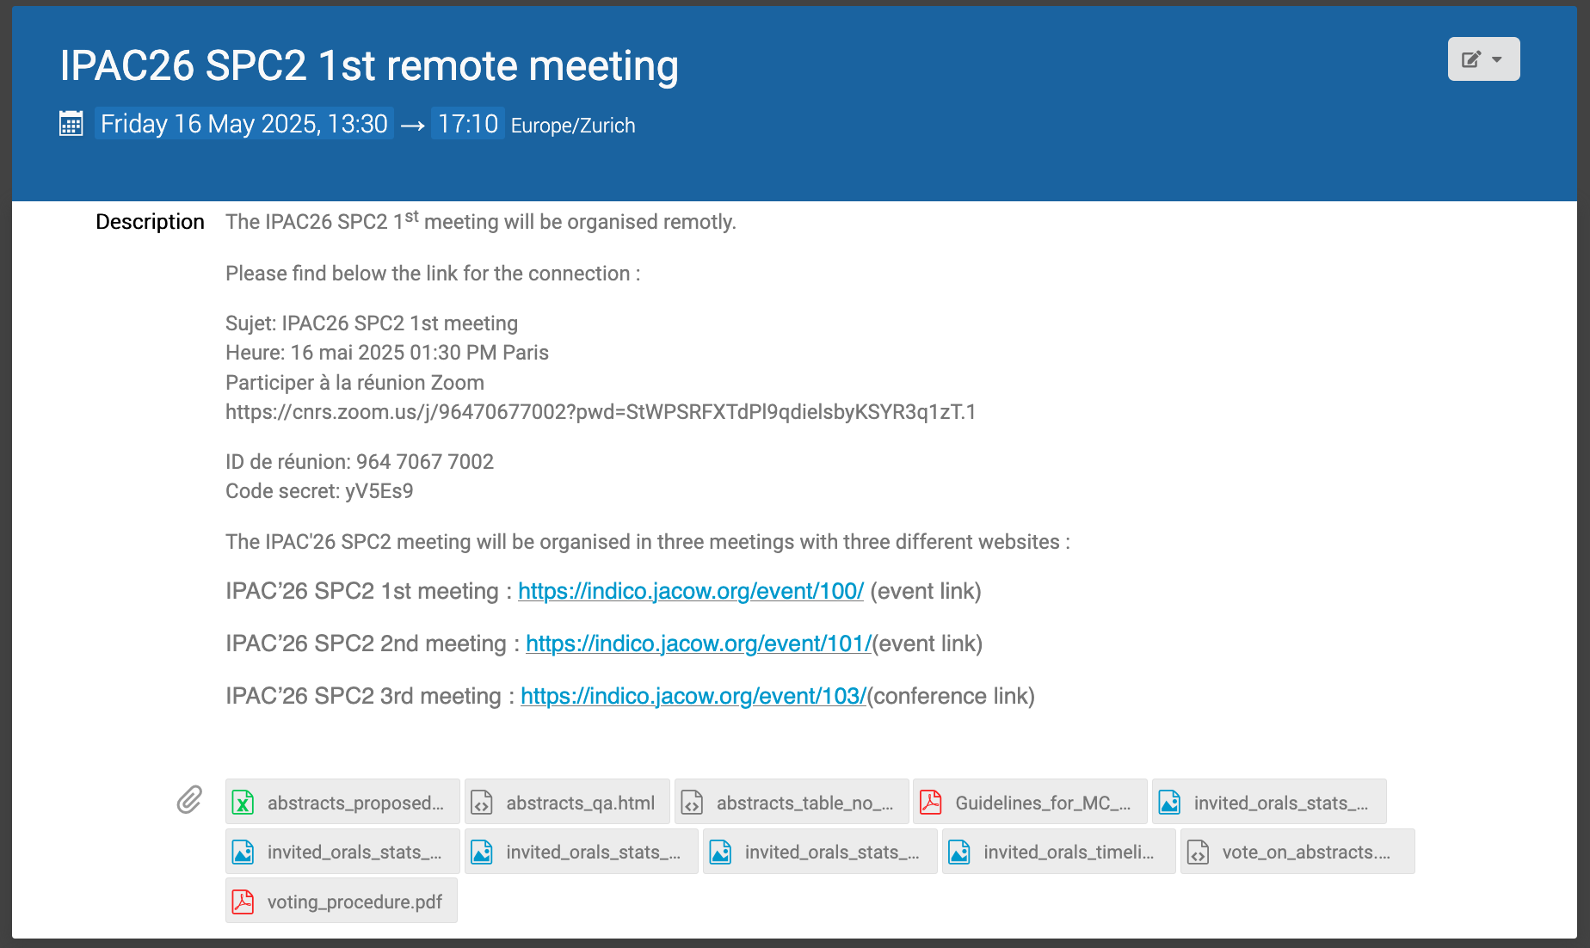
How to vote?
2 possibilities:
Standard indico voting procedure
Improved voting procedure
The two procedures are compatible. You can swap between the two as you wish.
To help you with your selections you can find a list of all the abstracts in an excel file at https://indico.jacow.org/event/100/ file: abstracts_proposed_orals.xlsx
https://indico.jacow.org/event/100/attachments/775/4730/abstracts_proposed_orals.xlsx

Slide 4
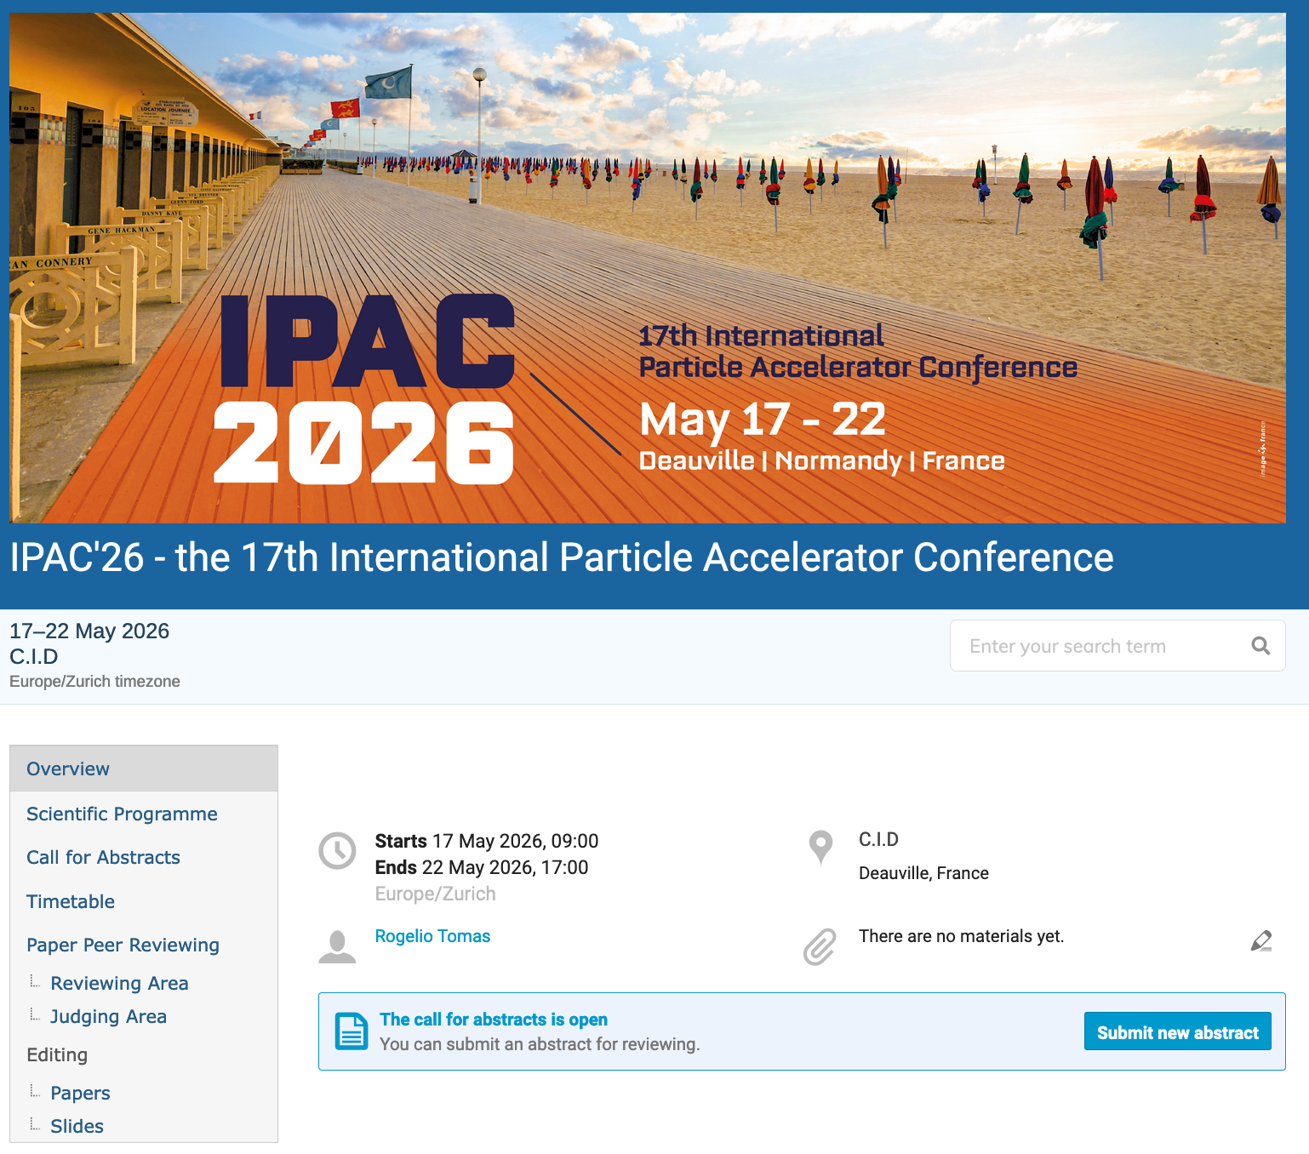
Invited orals voting procedure [1/2]
Detailed explanations are given here: https://ipac-docs.jacow.org/InvitedOrals/SPCprioritization/
Go to https://indico.jacow.org/e/IPAC26
Go to the reviewing area
For each MC you will see a list of abstracts to be reviewed.

Slide 5
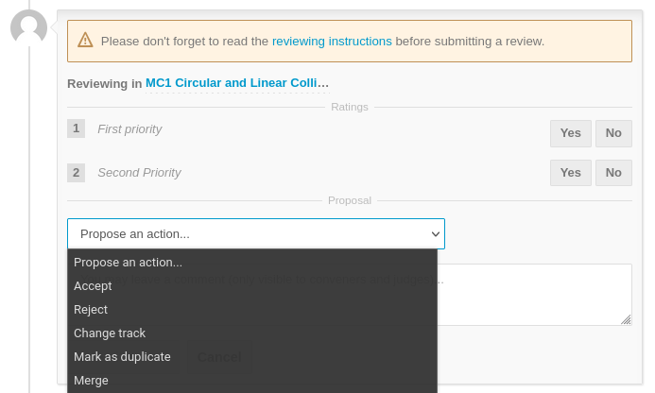
Invited orals voting procedure [2/2]
Detailed explanations are given here: https://ipac-docs.jacow.org/InvitedOrals/SPCprioritization/
For each abstract you want to vote for, at the bottom of the page, you will find a voting form.
Please assign either “first priority”or “second priority” then in “Propose an action” select “accept” and finally click on “Submit review”

Slide 6
Improved voting procedure (1)
Go to https://indico.jacow.org/event/100/
Select “vote_on_abstracts.html”
This page requires javscript

Slide 7
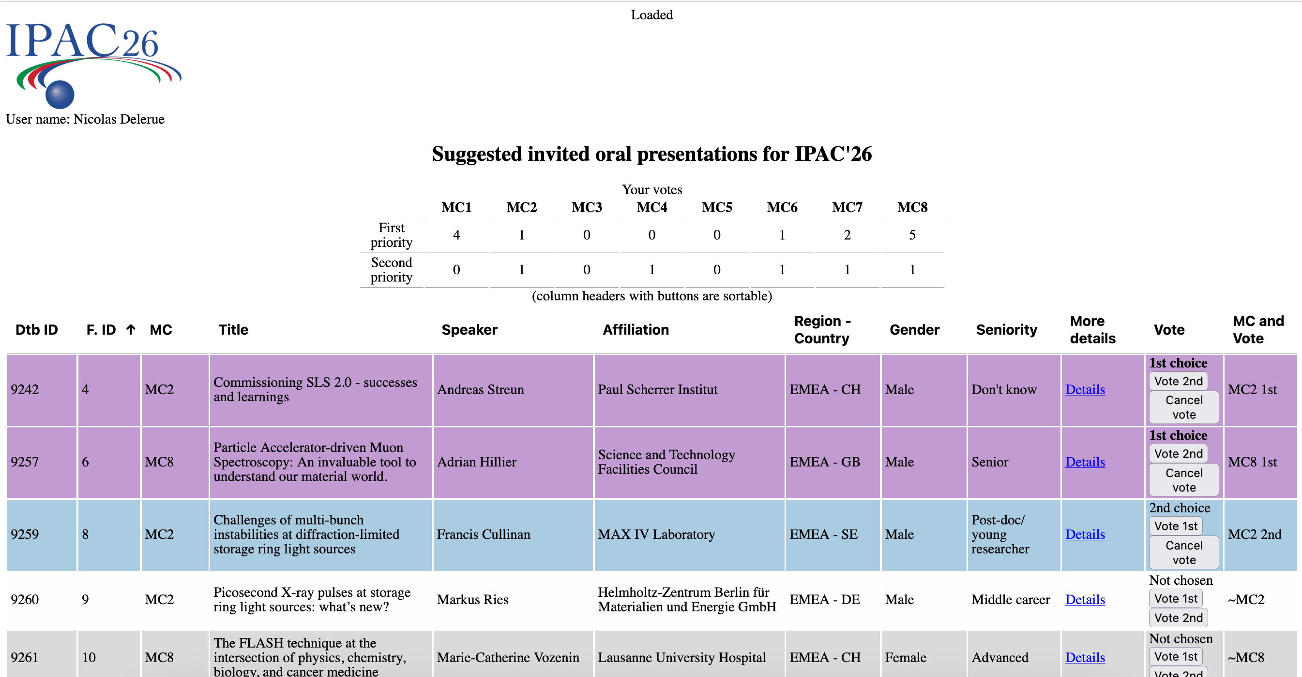
Improved voting procedure (2)
You arrive in the voting page (based on javascript)
Your JACoW user name
Summary of your votes
Column to sort by MC and then choice
Click for more details
Abstracts titles
Buttons to votes

Slide 8
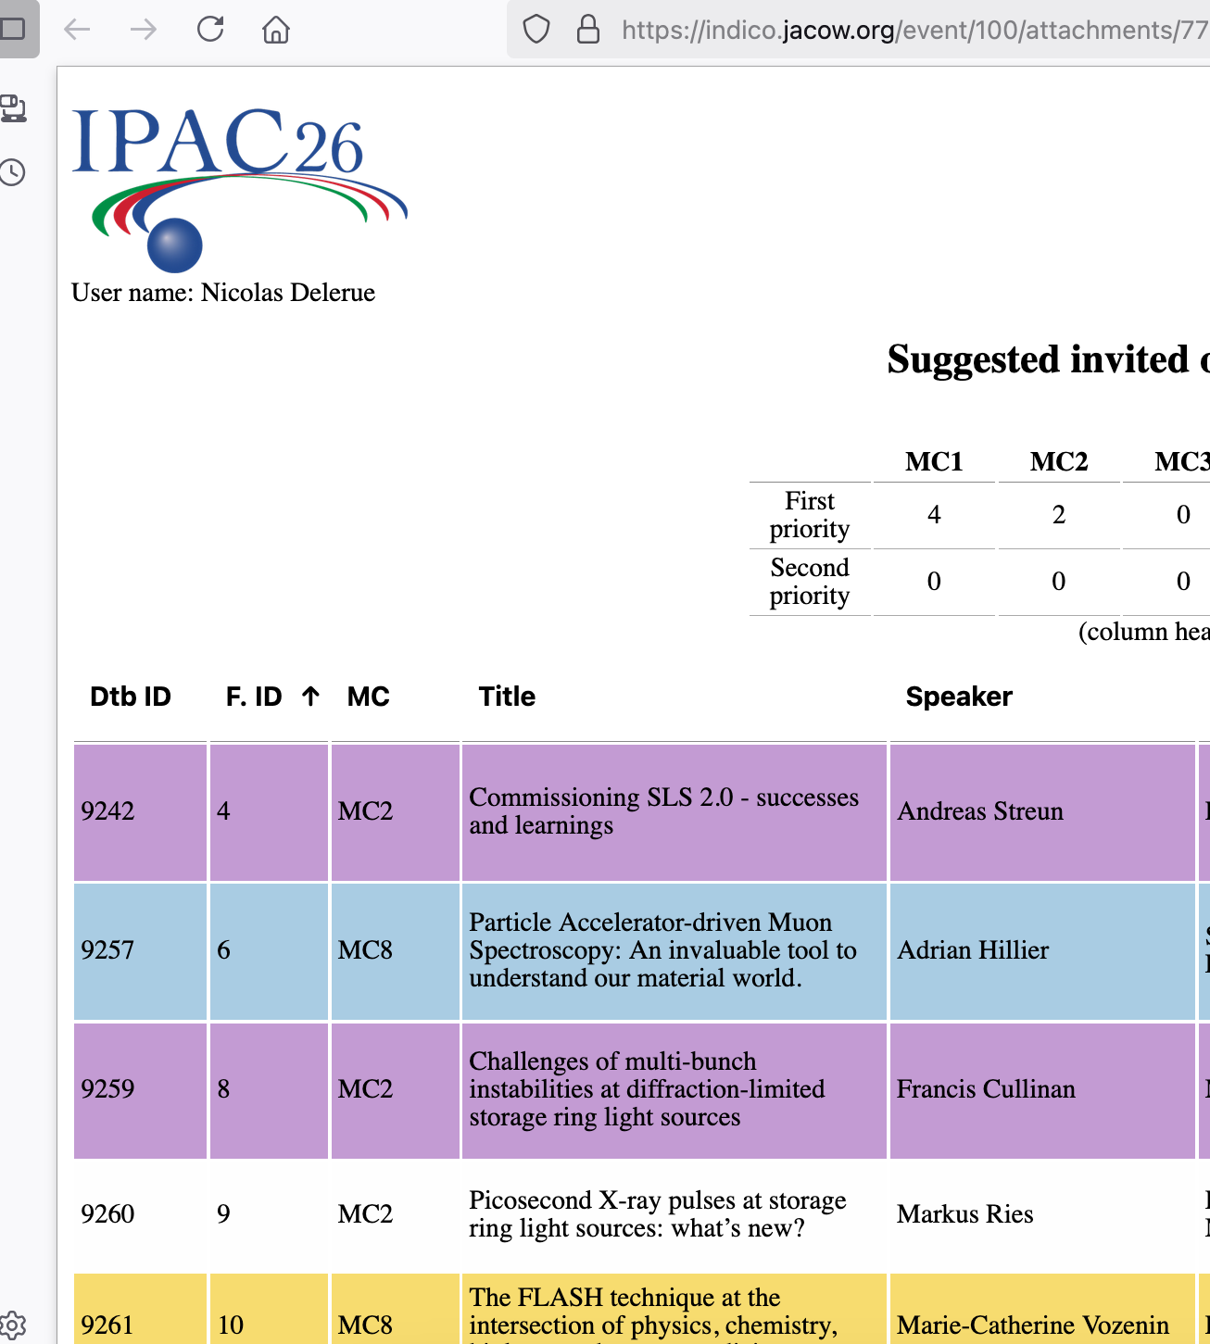
Improved voting procedure (3)
When you vote on an abstract, its colour change:
White/Grey: no vote on this abstract
Yellow (button pressed)
Green = loading (if it remains green for more than 5 second reload the page, you won’t loose your changes)
Magenta (1st choice vote)
Blue (2nd choice vote)
Once you have voted.
When the line turns Magenta or blue it means that the vote is recorded in indico.

Slide 9
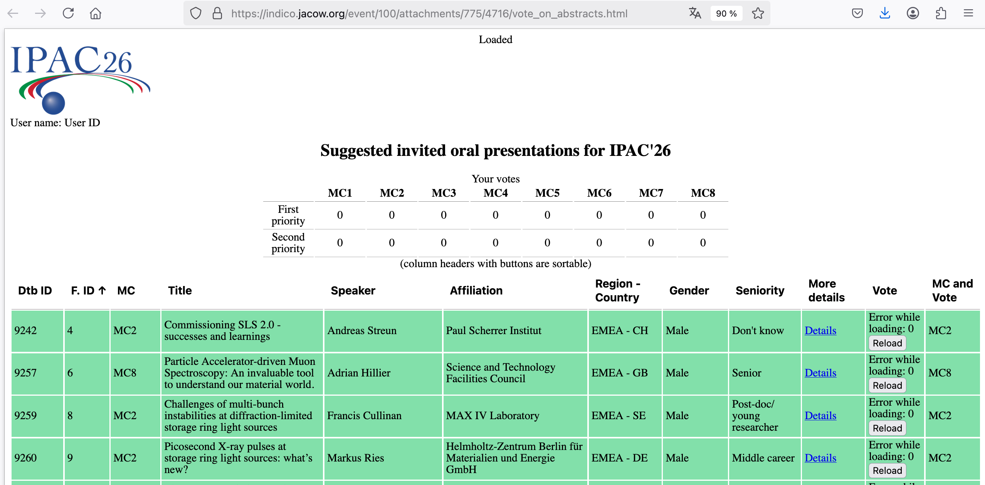
Improved voting procedure (4)
Troubleshooting: if the abstracts remain green and/or your name does not appear below the IPAC logo, it means that there is a connectivity problem with JACoW/indico or that Javascript is not activated. => Check your network connection => Try to activate Javascript => Try to log out and log in again at https://indico.jacow.org/event/100/

Slide 10
IPAC’26 Centre International de Deauville Sunday 17th – Friday 22nd May, 2026

