Slide 1
Short summary of JTM 2025

Slide 2

Report from 2025 and summary of pre-TM
Completion of transition from SPMS
In place ➔ JACoW conference series organised via Indico (since 2023)
NEW ➔ JACoW Central Repository entirely on Indico
NEW ➔ JACoW Mailing from CERN to private (paying) provider Brevo
NEW ➔ Privacy Policy with CERN legal service (still ongoing)
NEW ➔ JACoW Proceedings publishing moved to Electra (September 2025) where NEW Proceeding Search Engine has been developed
NEW ➔ Proceedings search engine to be released soon
NEW ➔ www.jacow.org being restyled – work in progress
Mobile App WG – work completed, WG dissolved
Template WG
Documentation & Wiki WG
IT tools WG – NEW
Central Repository Manager WG – NEW
Proceeding publication WG – NEW
CERN hosted international collaboration set-up WG – NEW
WG composition and mandate will be published on website
Working Groups ➔

Slide 3
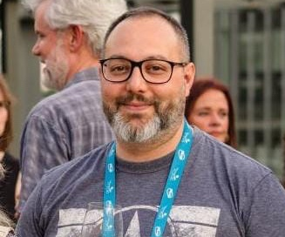
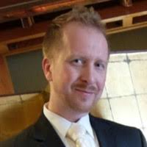
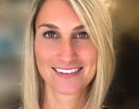
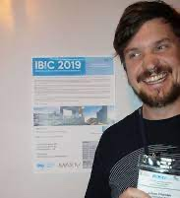
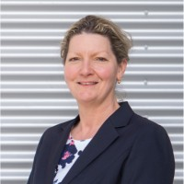
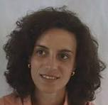
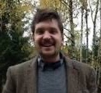
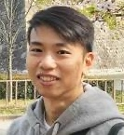
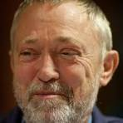
JACoW Board of Directors
DChair resigned, interim Dchair
2 new co-opted members (2026-2029)
3 members coming to end of mandate will remain until next elections
2025-2027
Johan Olander ESS
Maurizio Montis INFN
Petr Anisimov LANL
Caitlin Hoffman, BNL
Jana Thomson TRIUMF
Adriana Rossi CERN
Volker Schaa GSI
Johan Olander ESS
Thakonwat Chanwattana
SLRI

Slide 4
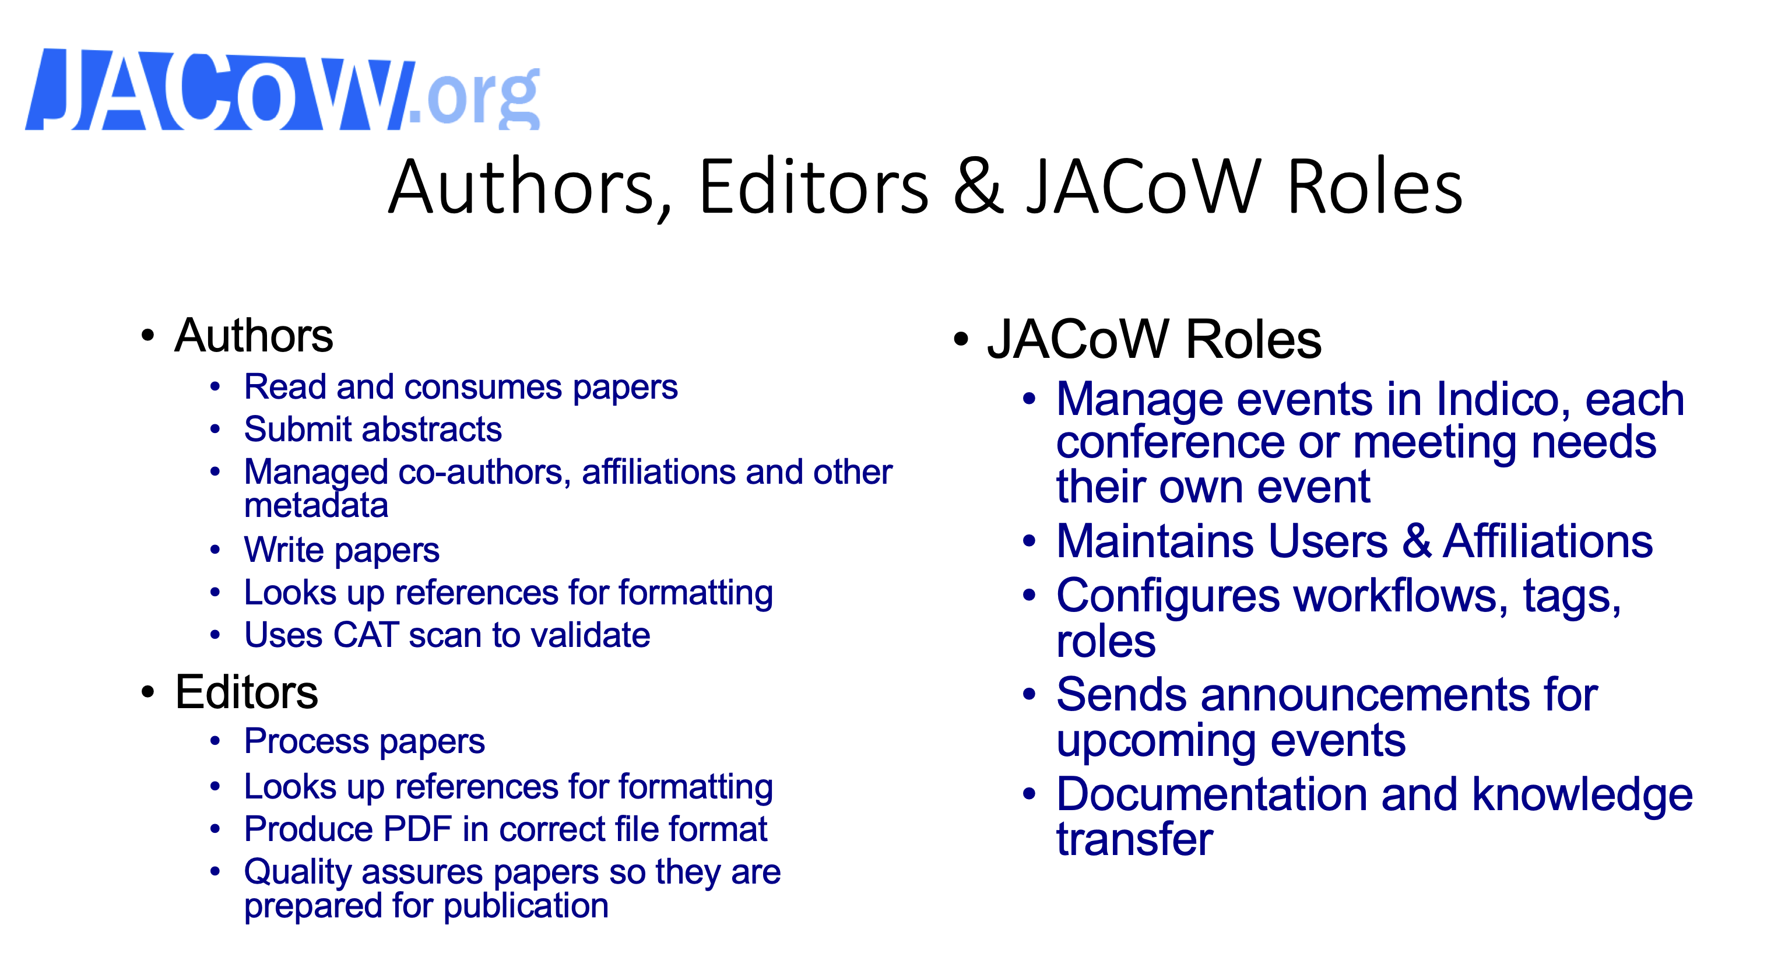
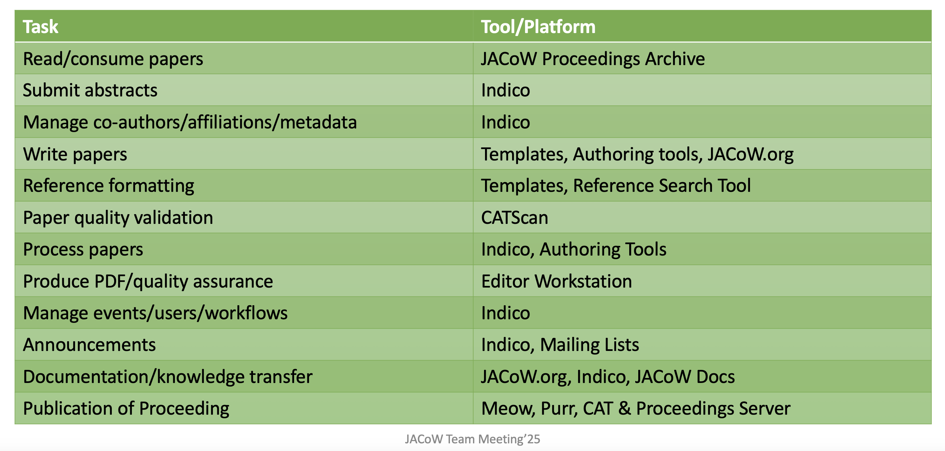
JACoW workflow examples (IPAC) and roles

Slide 5
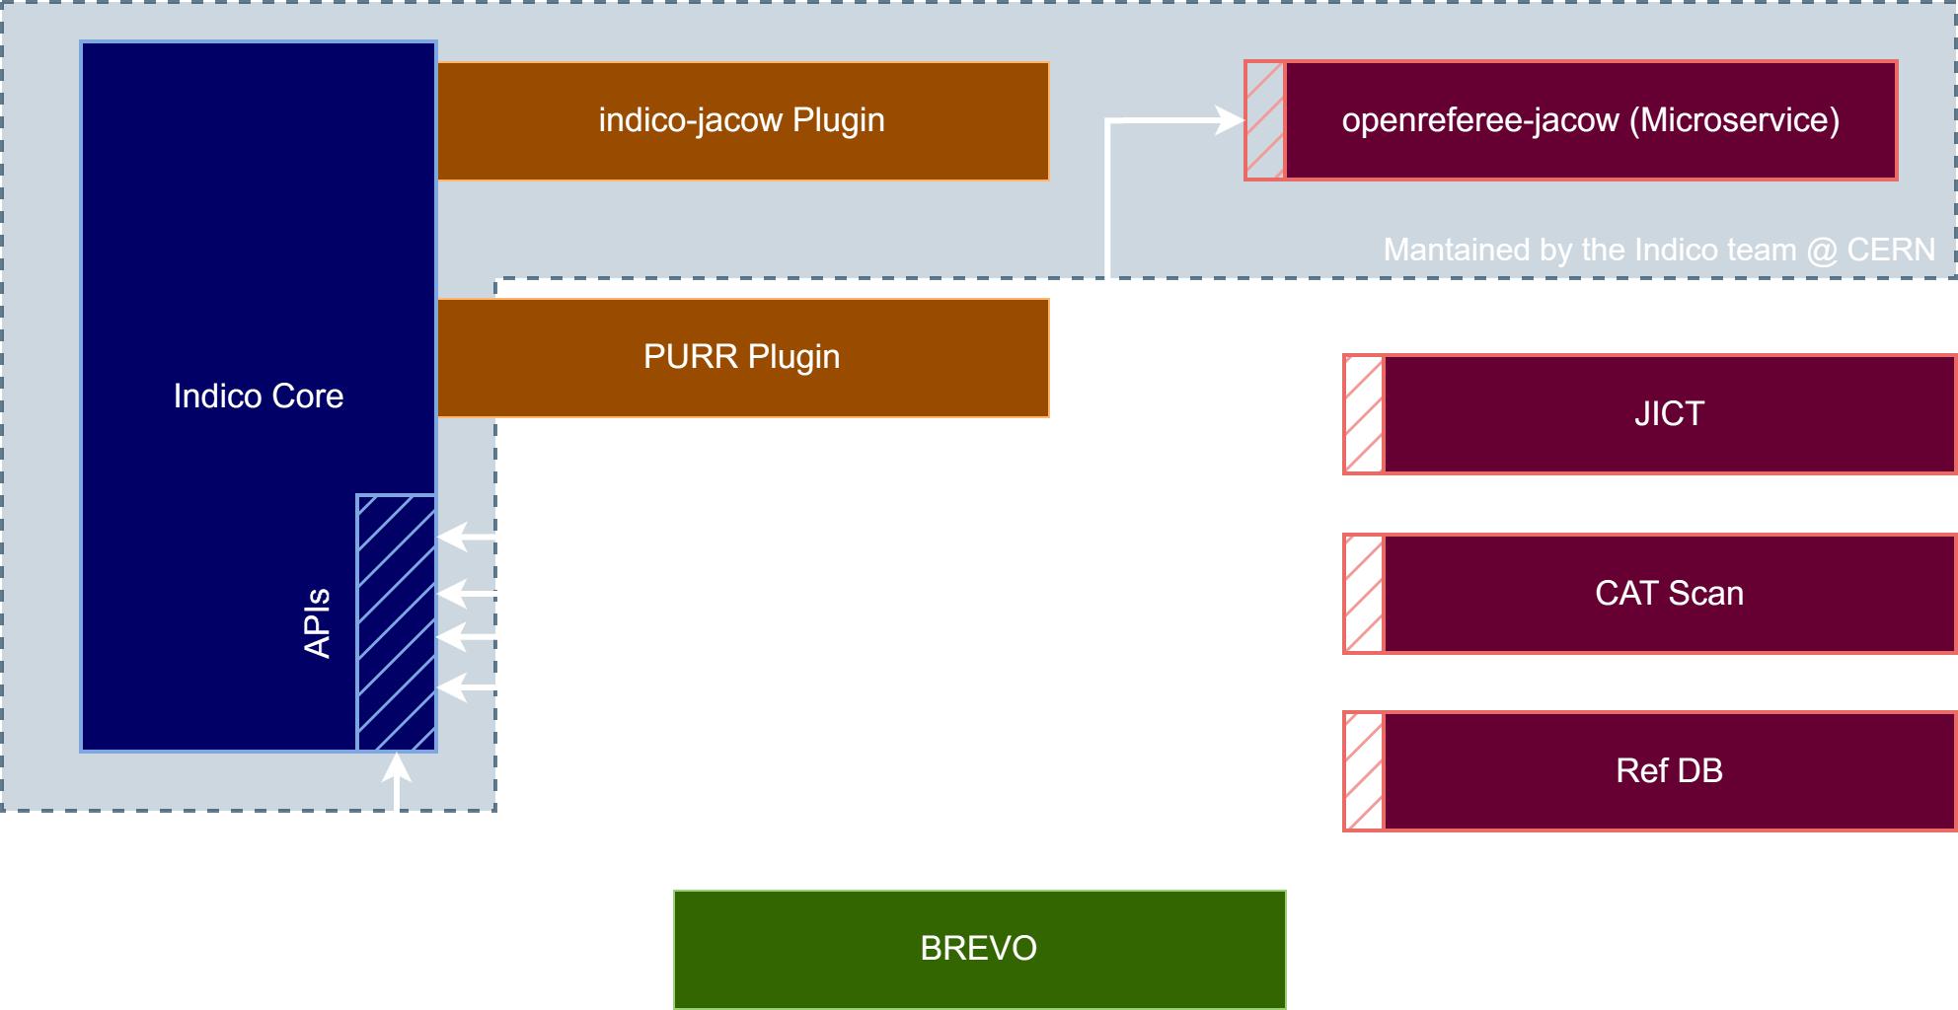
Indico-JACoW

Slide 6
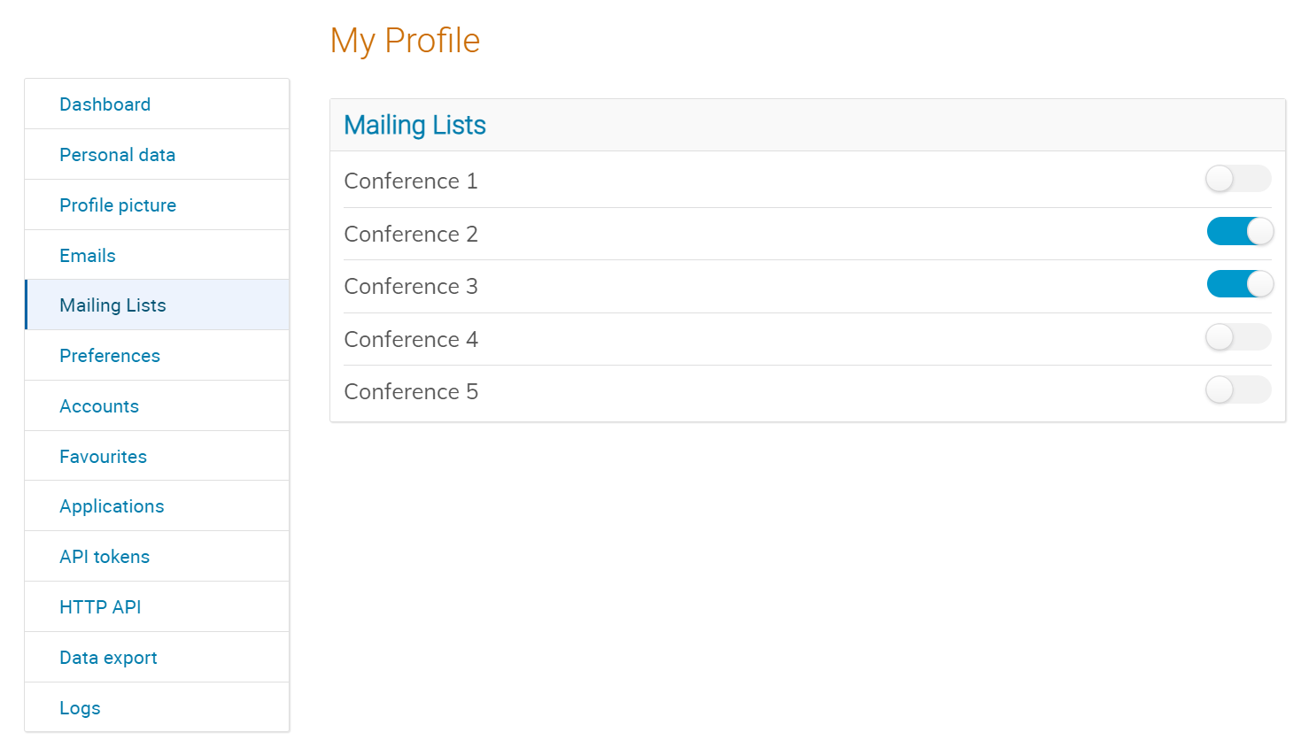
Indico-JACoW
Mailing Integration (Brevo)
+ MULTIPLE AFFILIATIONS

Slide 7
Indico-JACoW
Plans for the future
Peer Review Module improvements
Greater Accessibility (a11y)
UI Improvements and legacy code removal
React-based timetable
User Interfaces
Improvements in material editor (e.g. better drag and drop)
Responsive interfaces that work OK on mobile
More user-centric home page
More info in our roadmap (https://getindico.io/roadmap/)

Slide 8
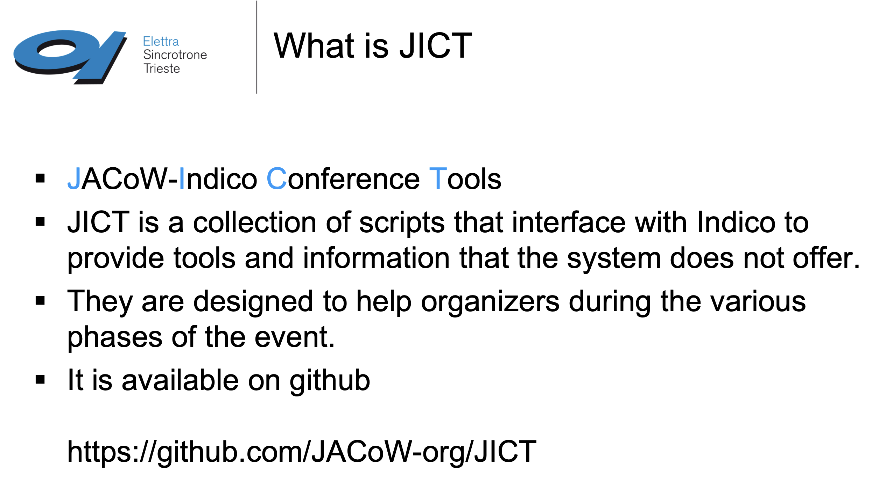
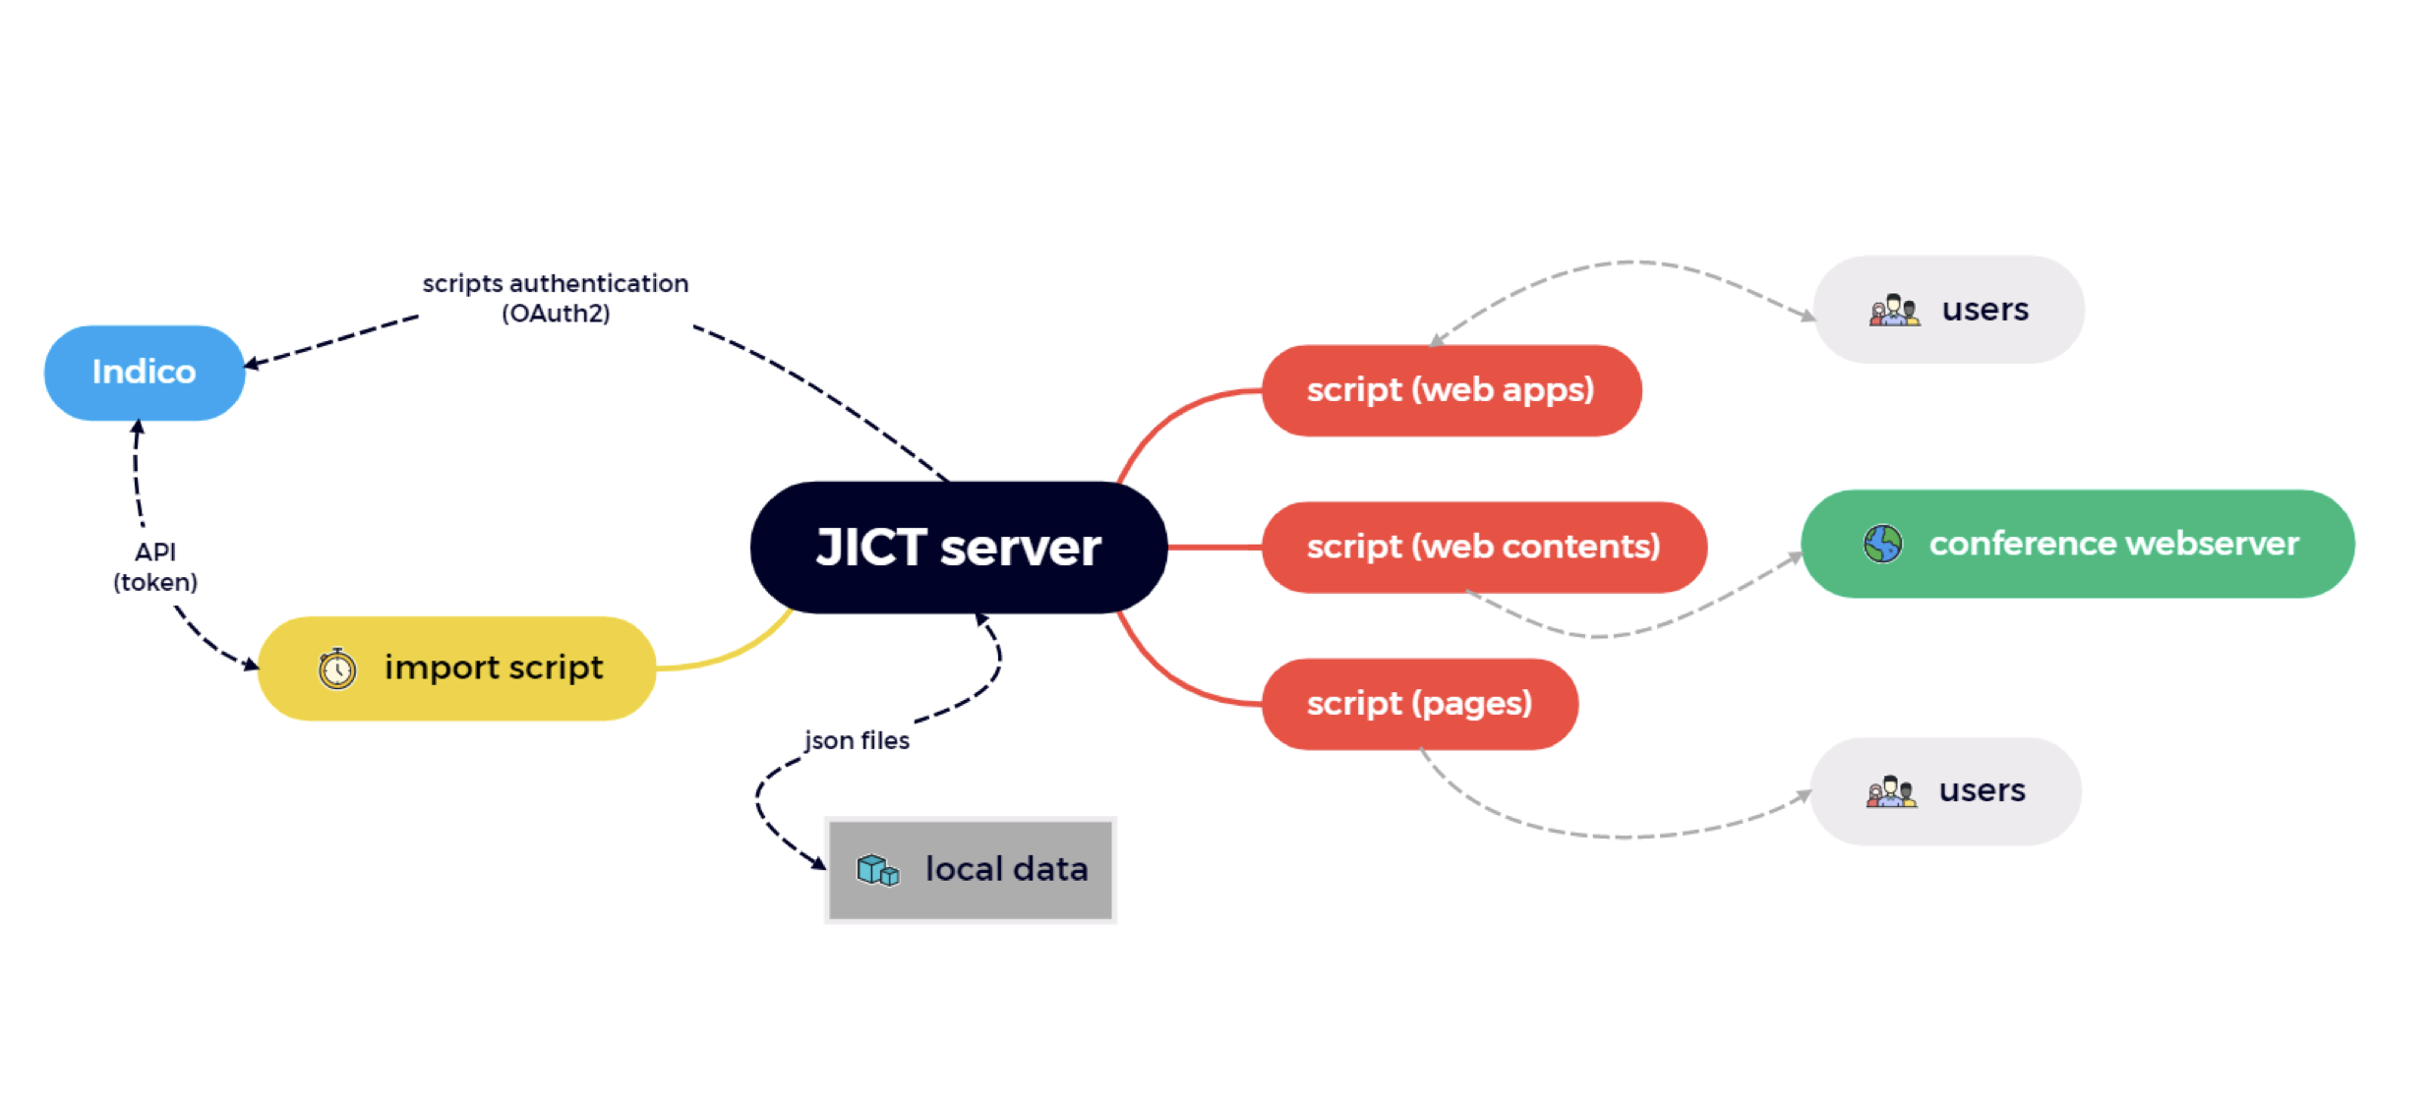
JICT
See presentation, perfect training

Slide 9
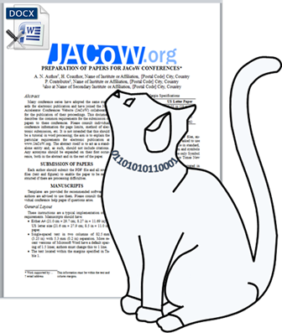
Plugging CatScan into INDICO @IPAC’25
Word:
At 278 Word contributions in Indico. 110 (42%) have subsequent uploads with improvements by authors.
In total, authors addressed 4,636 identified by CatScan
LaTeX:
At 419 LaTeX (non BibTex) contributions in Indico. 163 (38%) have subsequent uploads with improvements by authors.
In total, authors addressed 1,053 identified by CatScan

Slide 10
CatScan
LaTeX Check (new)
Word Check
Notified by Indico of a new upload
Reads document
Checks for common issues (common issue codes on the right)
Produces detailed report
AI used to summarise report as a comment
Posted comment on paper (or displays on website)
Notified By Indico of a new upload
Reads document
Produces detailed report
Posted comment on paper with a link to the report (new)
Authors and Editors can click the link to quickly access a CatScan report
We achieved the dream from 2019!
On upload CatScan performs the check and provides feedback in a comment
Author’s can address issues themselves!

Slide 11
RefSearch https://refs.jacow.org/
What’s new
What it does
Creation of public search API
Improvements to external search (journal lookup, and doi search)
Introduction of hyperlinks to DOIs for latex (using \doi command) and word
Conference status on list page
CatScan integration - Reference cross-checking
Widely used free web application for authors and editors
Outputs LaTeX / BibTex and Word references in the JACoW format
Search index of all published and unpublished JACoW papers (~76,000)
Indexes for unpublished papers including for the current conference
Now also searches external papers
NEXT: Automatic Conference Population - During and Post Conference
BibTeX Database
Integration with Single-Sign On from Indico

Slide 12
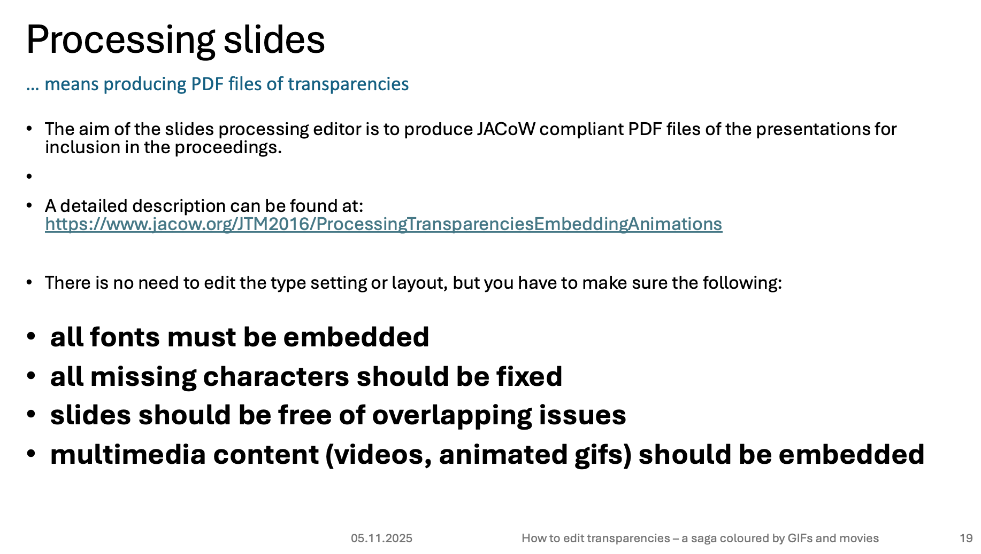
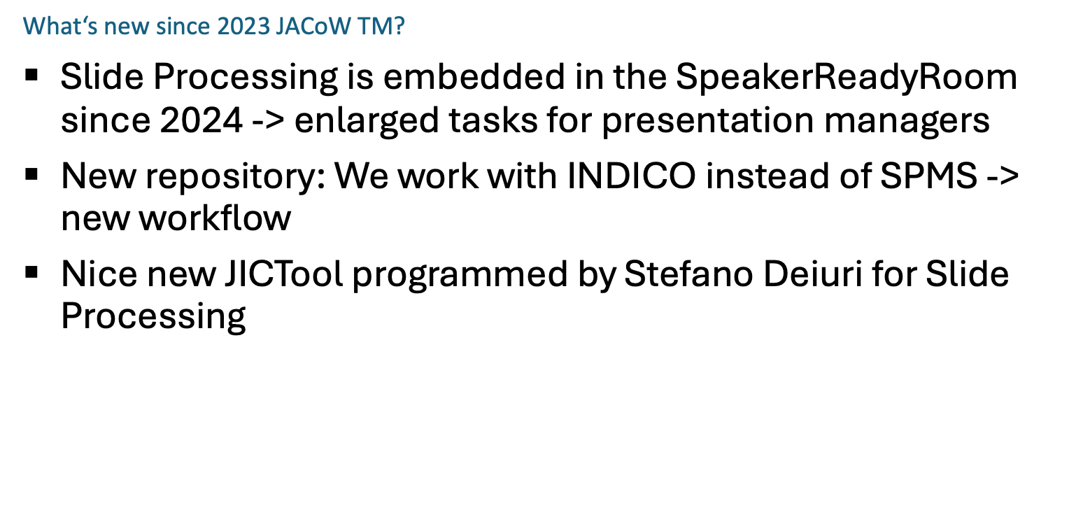
Thorough manual walk through
Notes:
What is slide processing? Differs quite a lot from paper editing

Slide 13
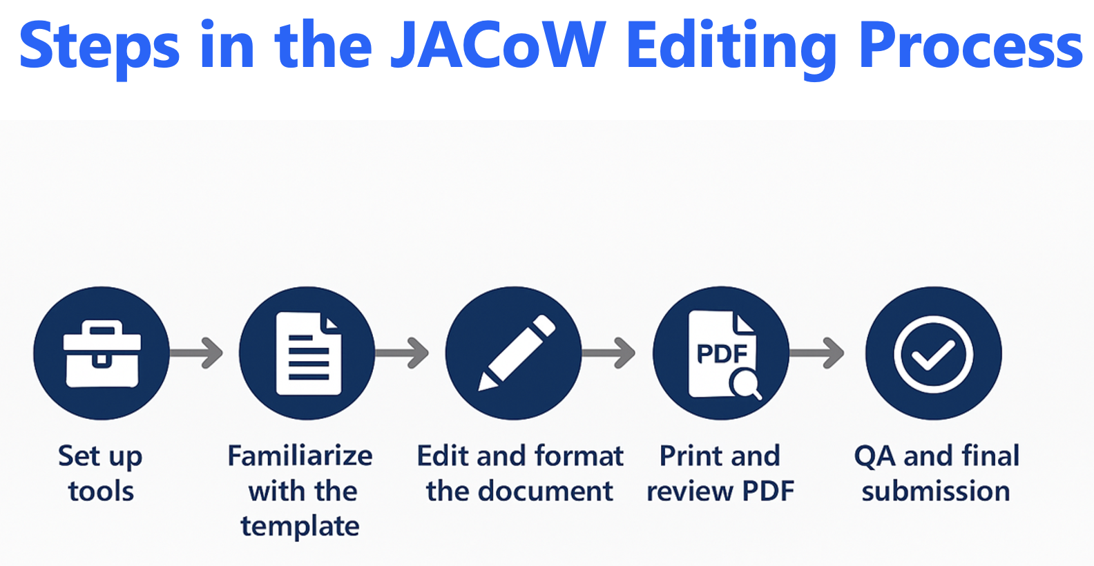
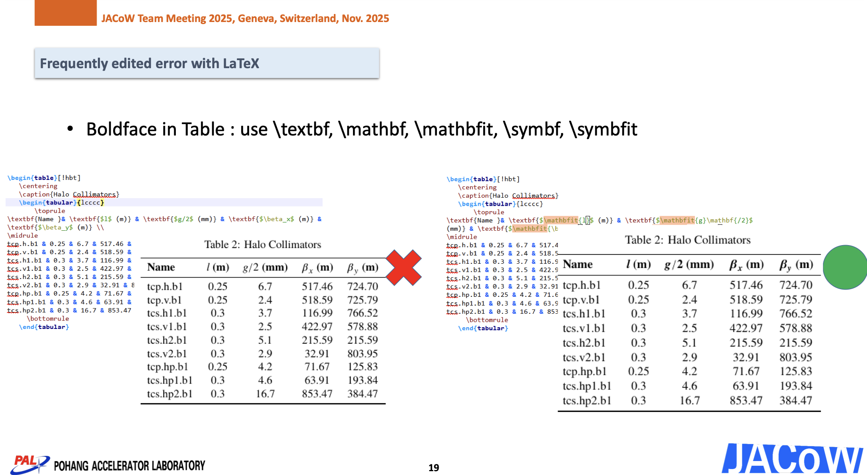
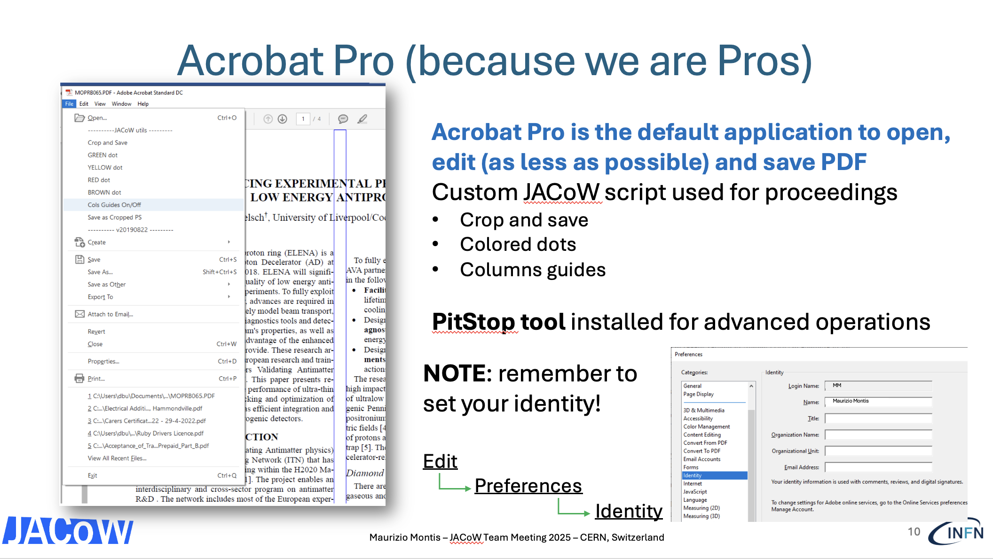
Editing with Word, Latex and PDF
Manuals with tricks and suggestions

Slide 14
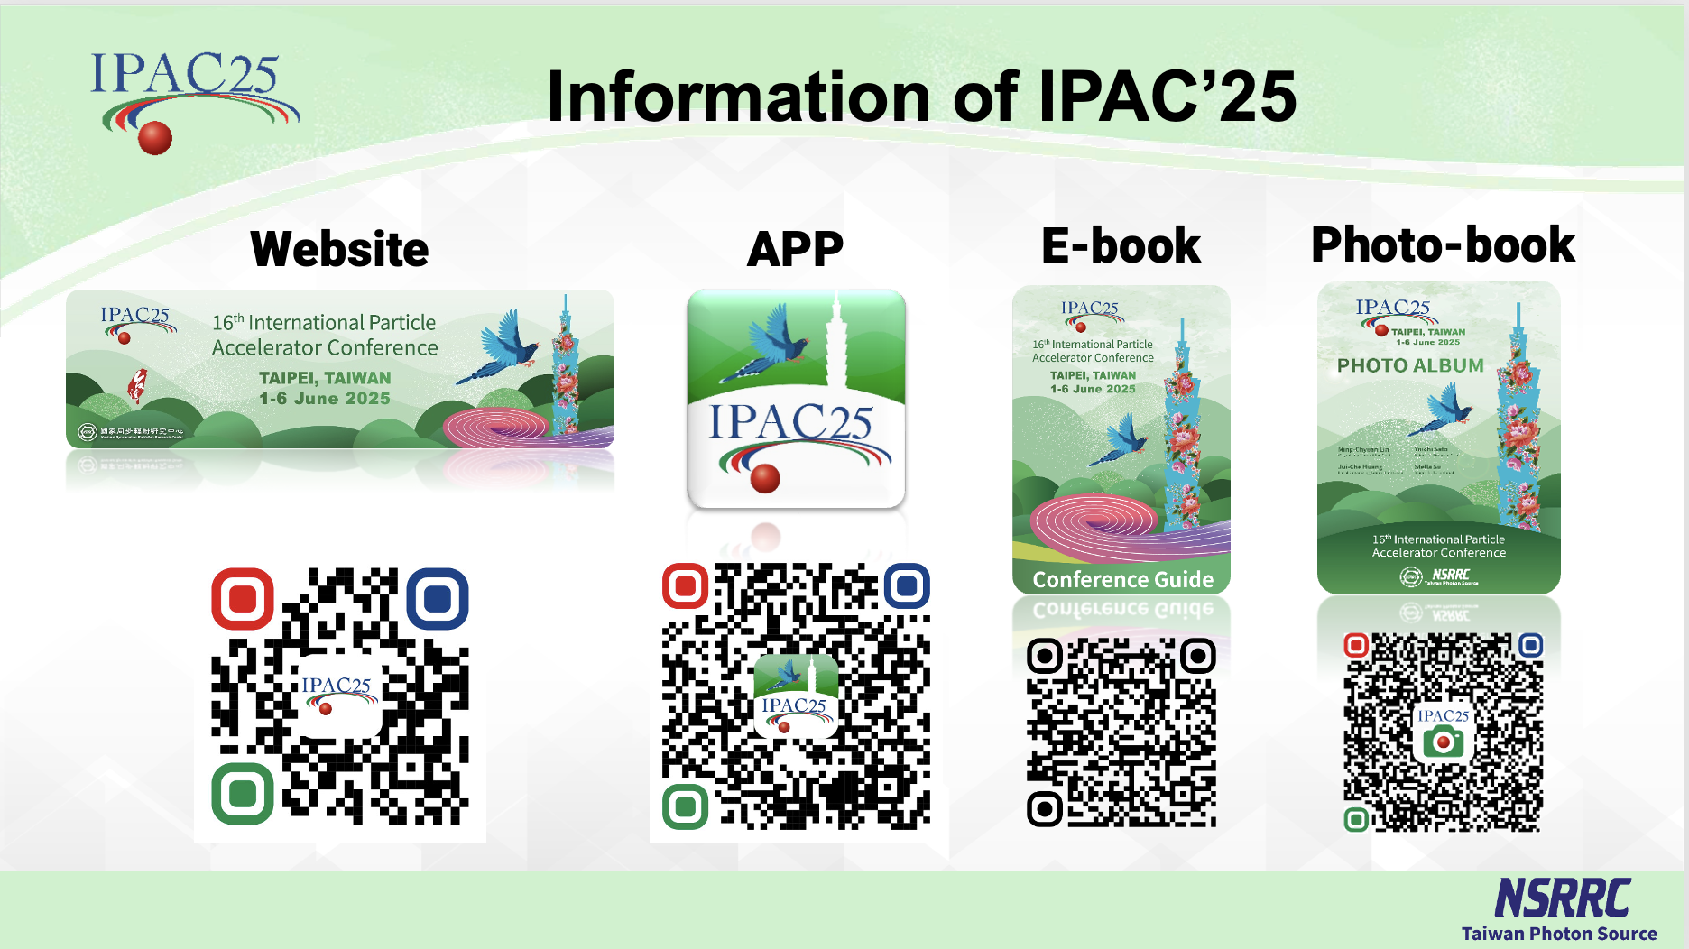

Slide 15
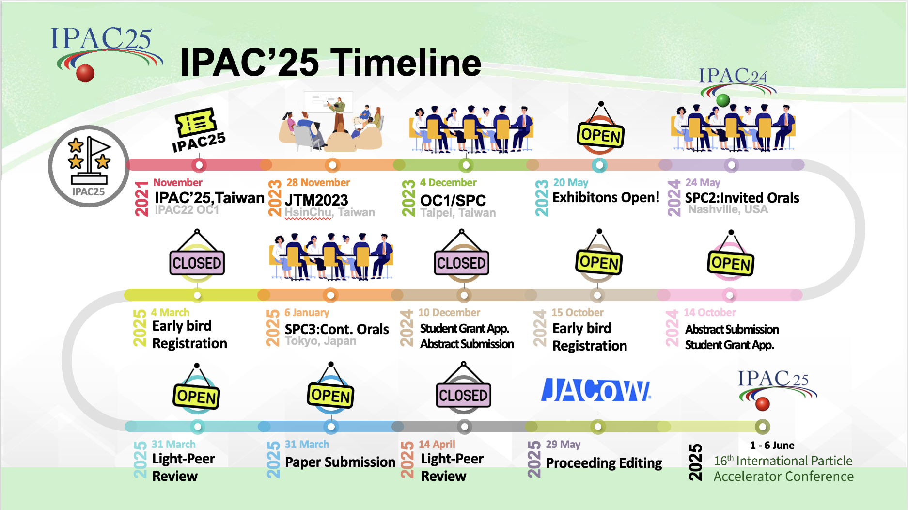
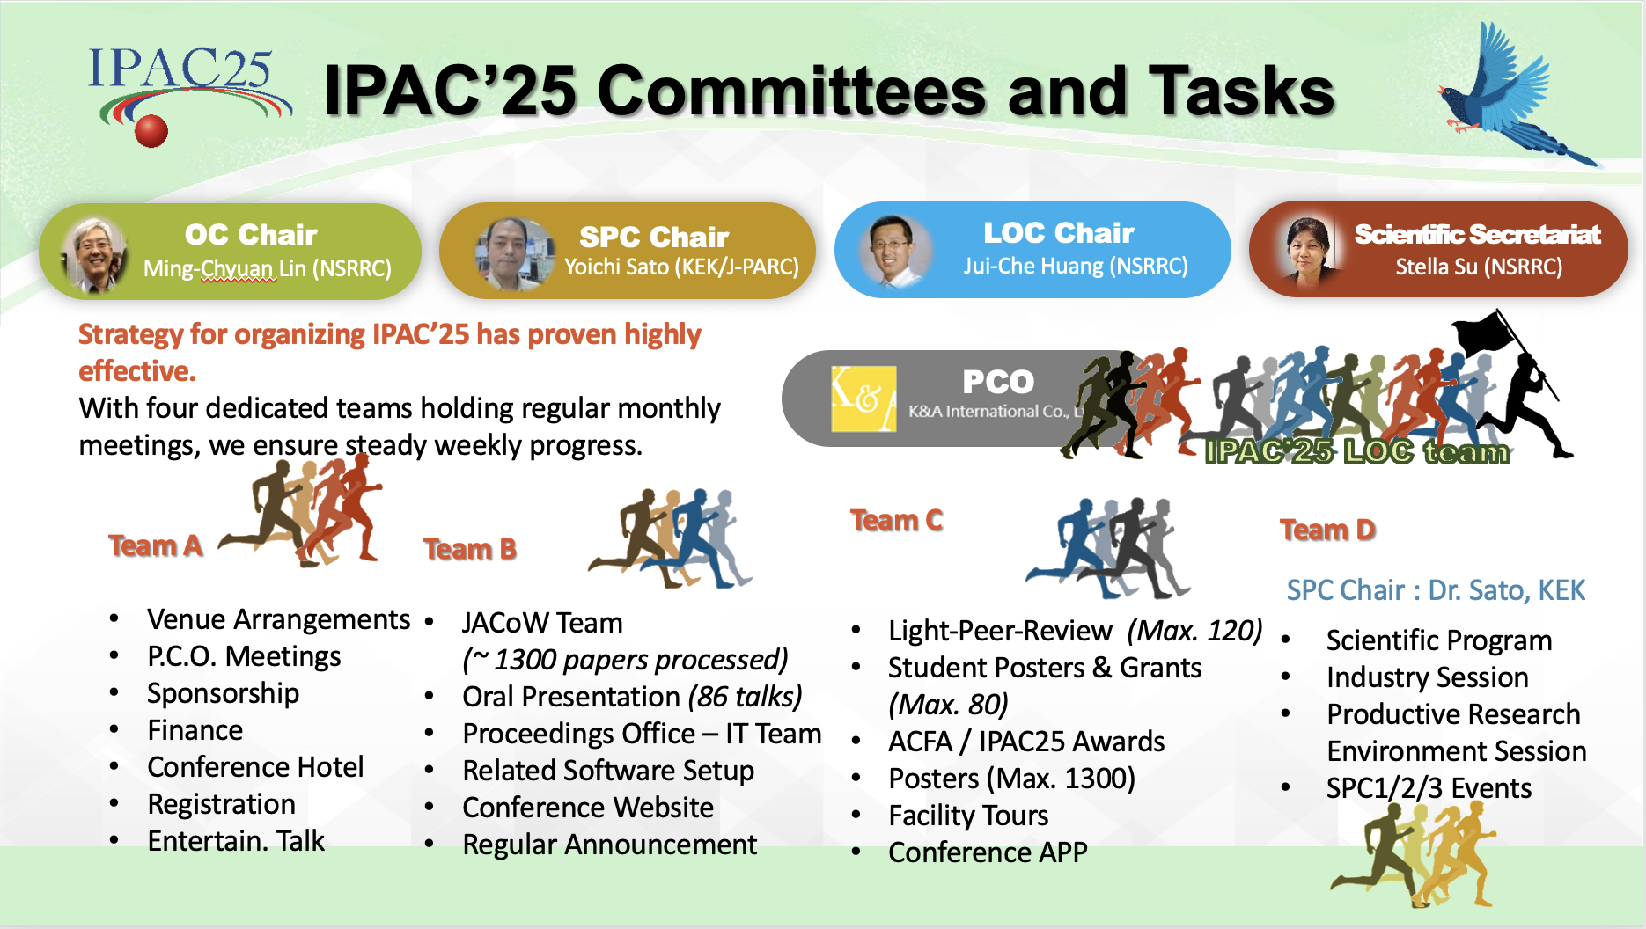
IPAC’25 Workflow

Slide 16
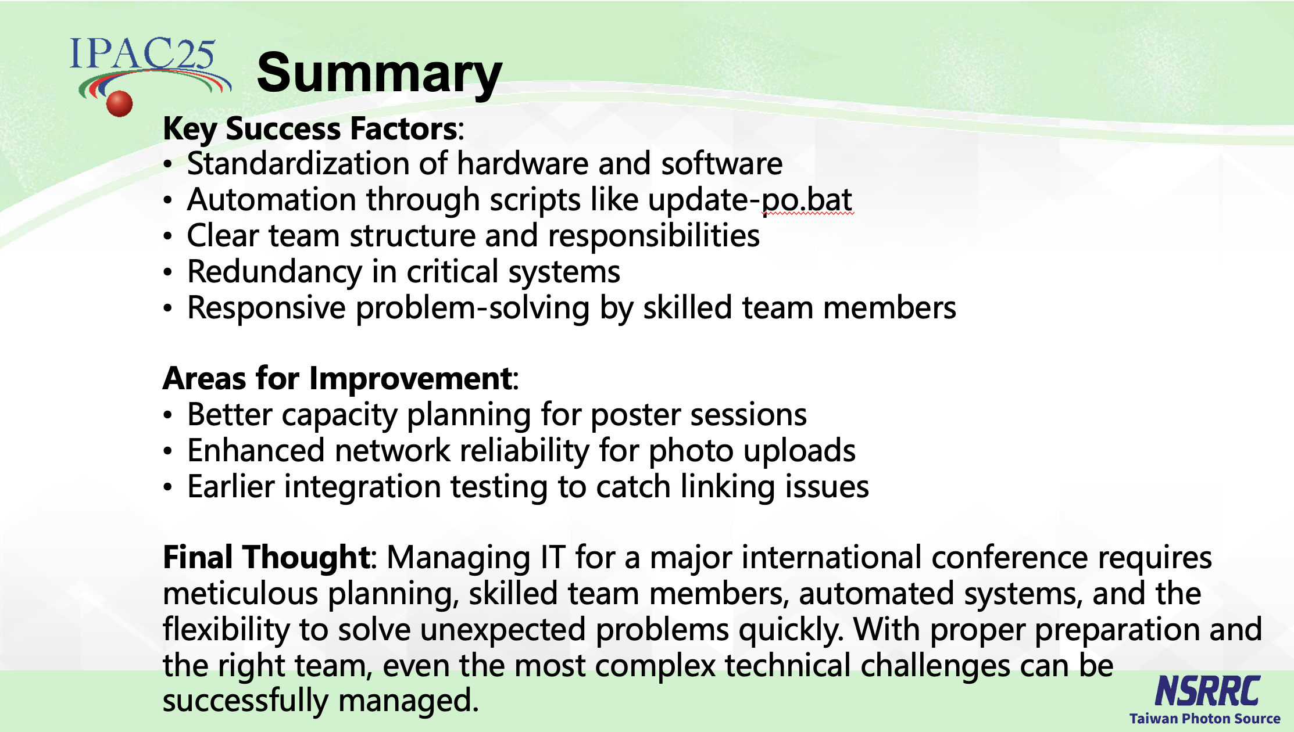
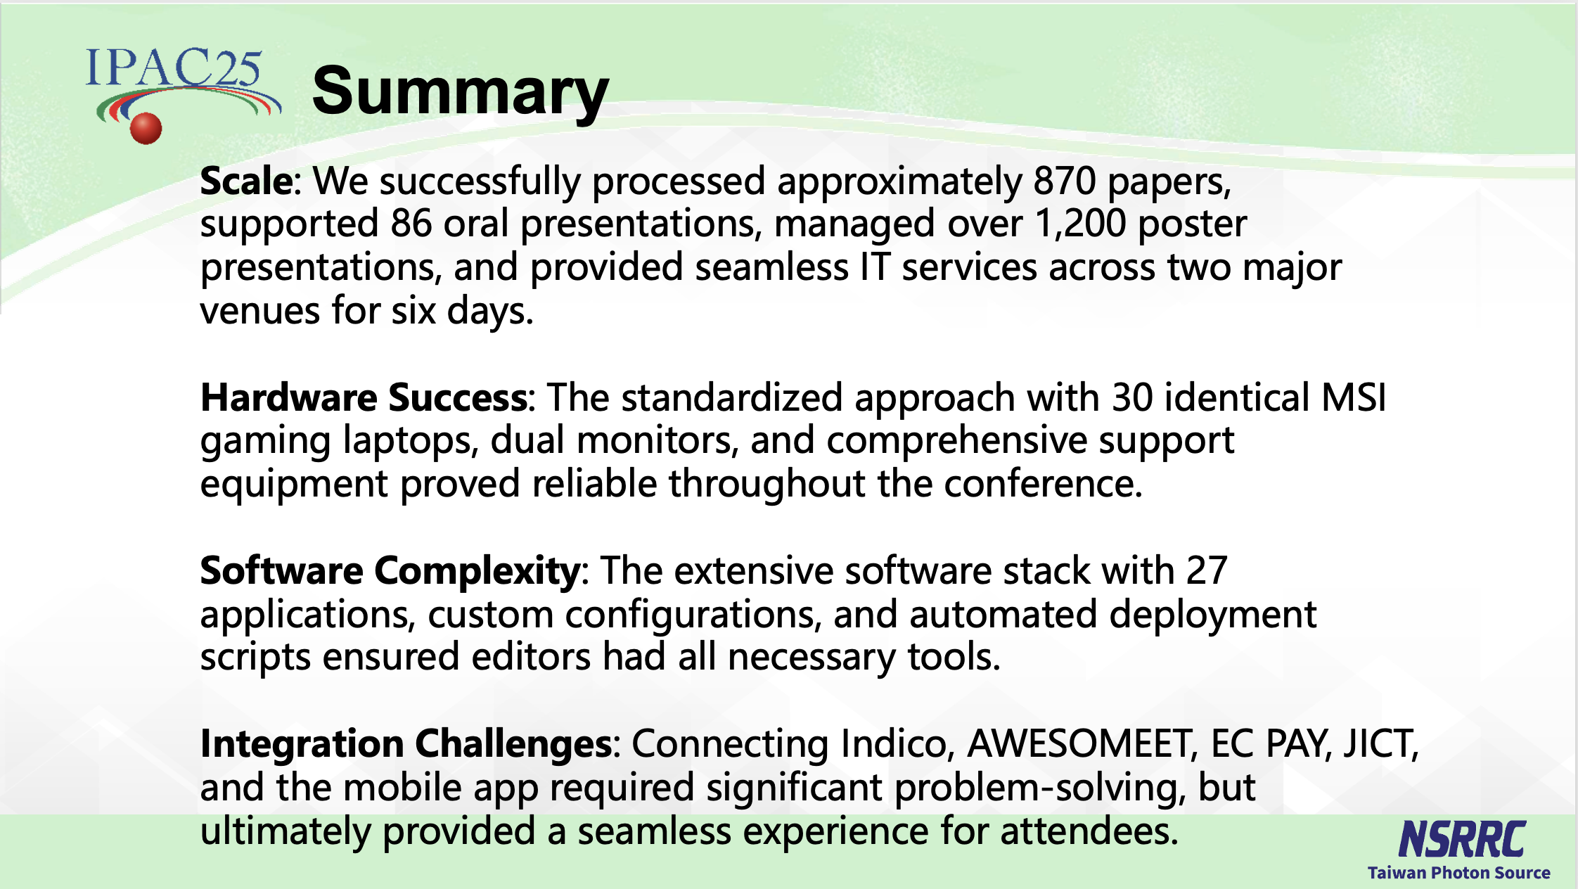
IT support for JACoW @ IPAC’25

Slide 17
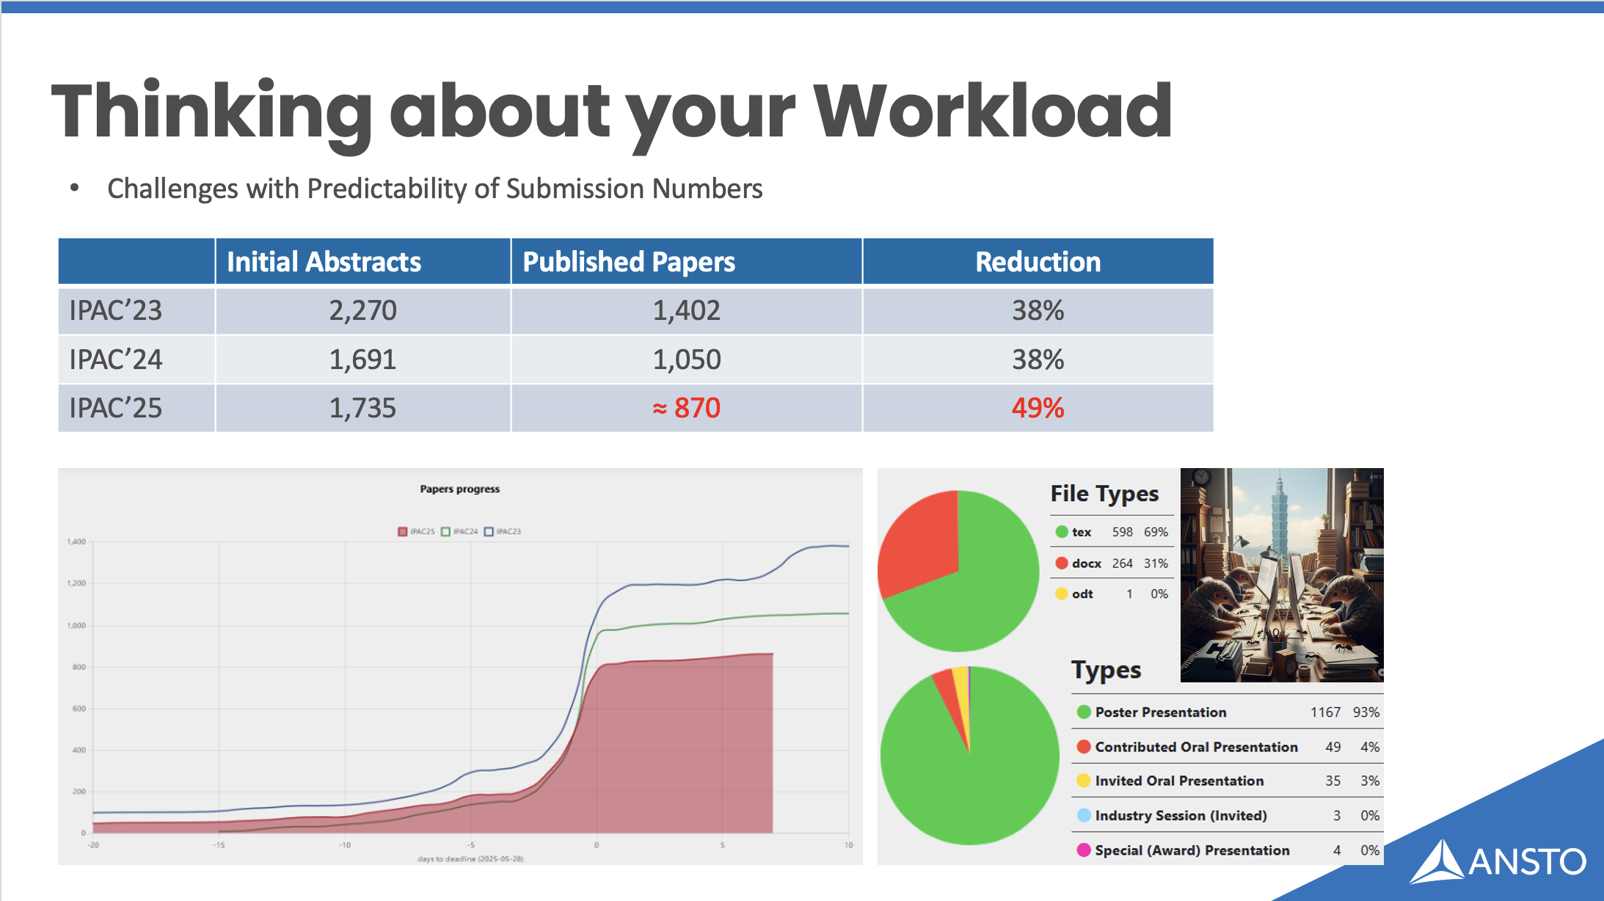
Role | IPAC’24 | IPAC’25
Editor in Chief | 1 | 1
Editor + QA | 27 | 21
Presentation Management | 4 | 3
Author Reception | 4 | 3
Support/Development | 2 | 2
 | 38 | 30
Reduction |  | 21%
IT Support | 1 | 1

Slide 18
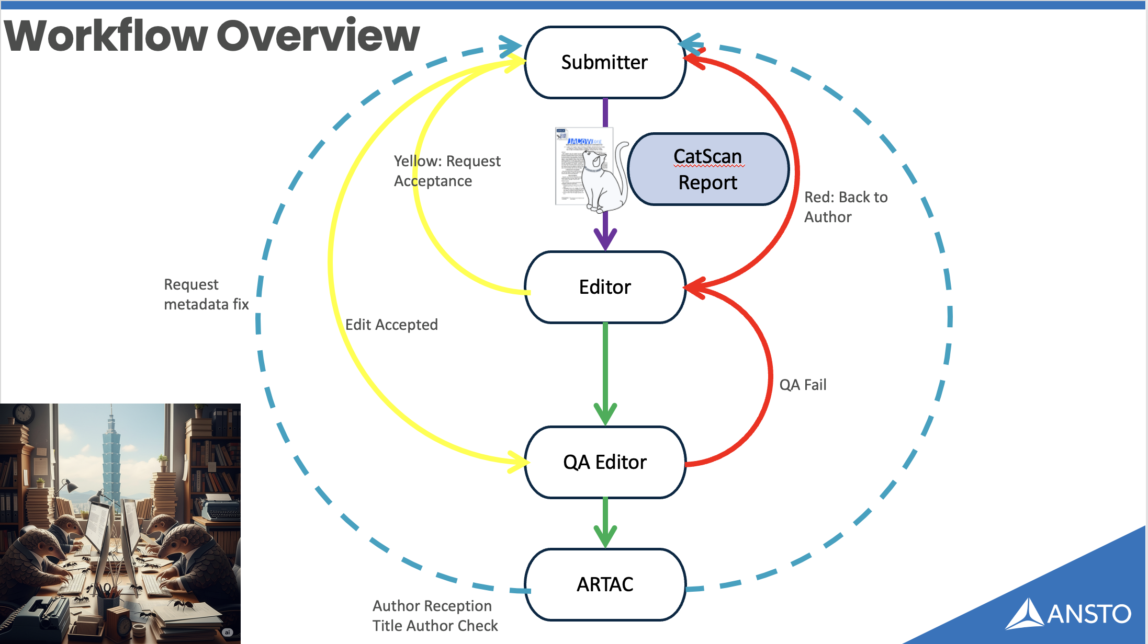
See presentation, full of goof insights

Slide 19
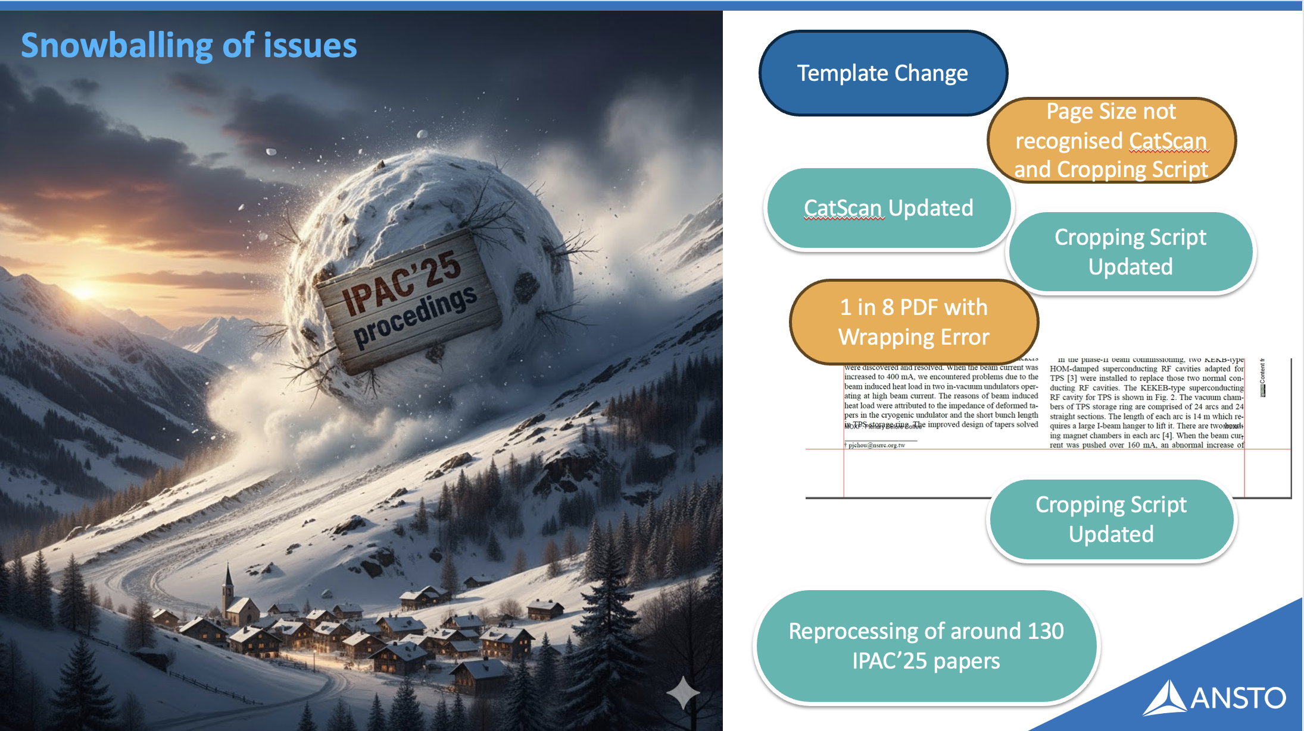
Reinforcing idea that new template should be run through full tests before release

Slide 20

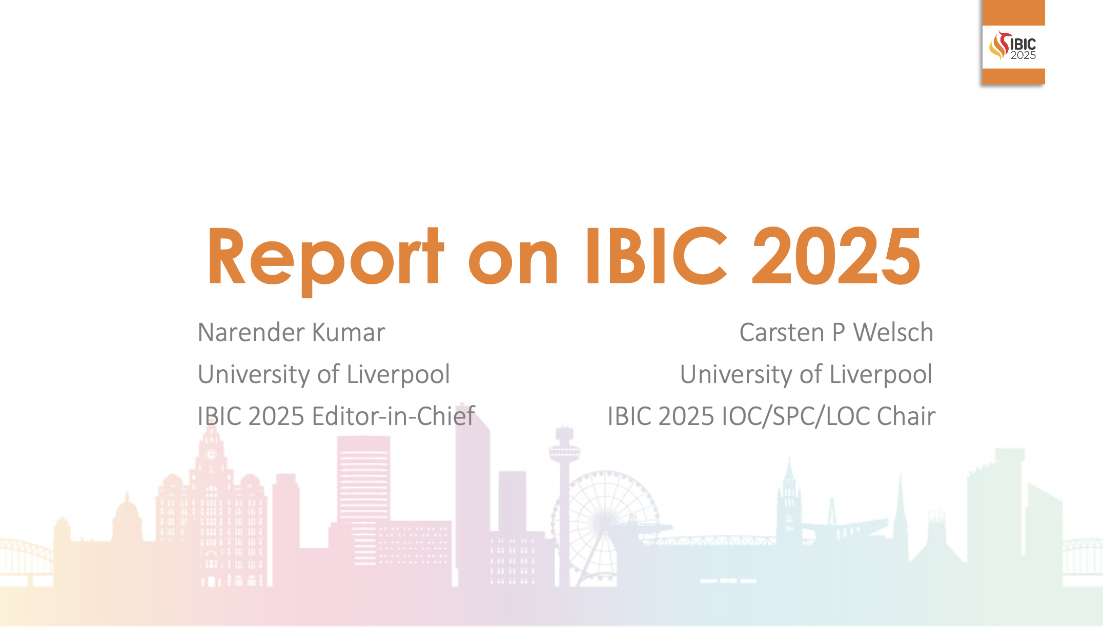
Takeaways from SRF and IBIC 2025

Slide 21
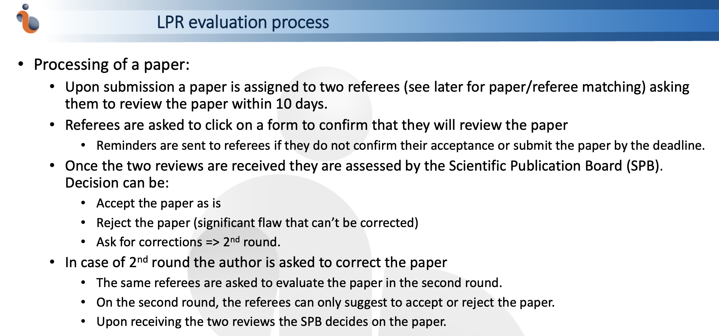
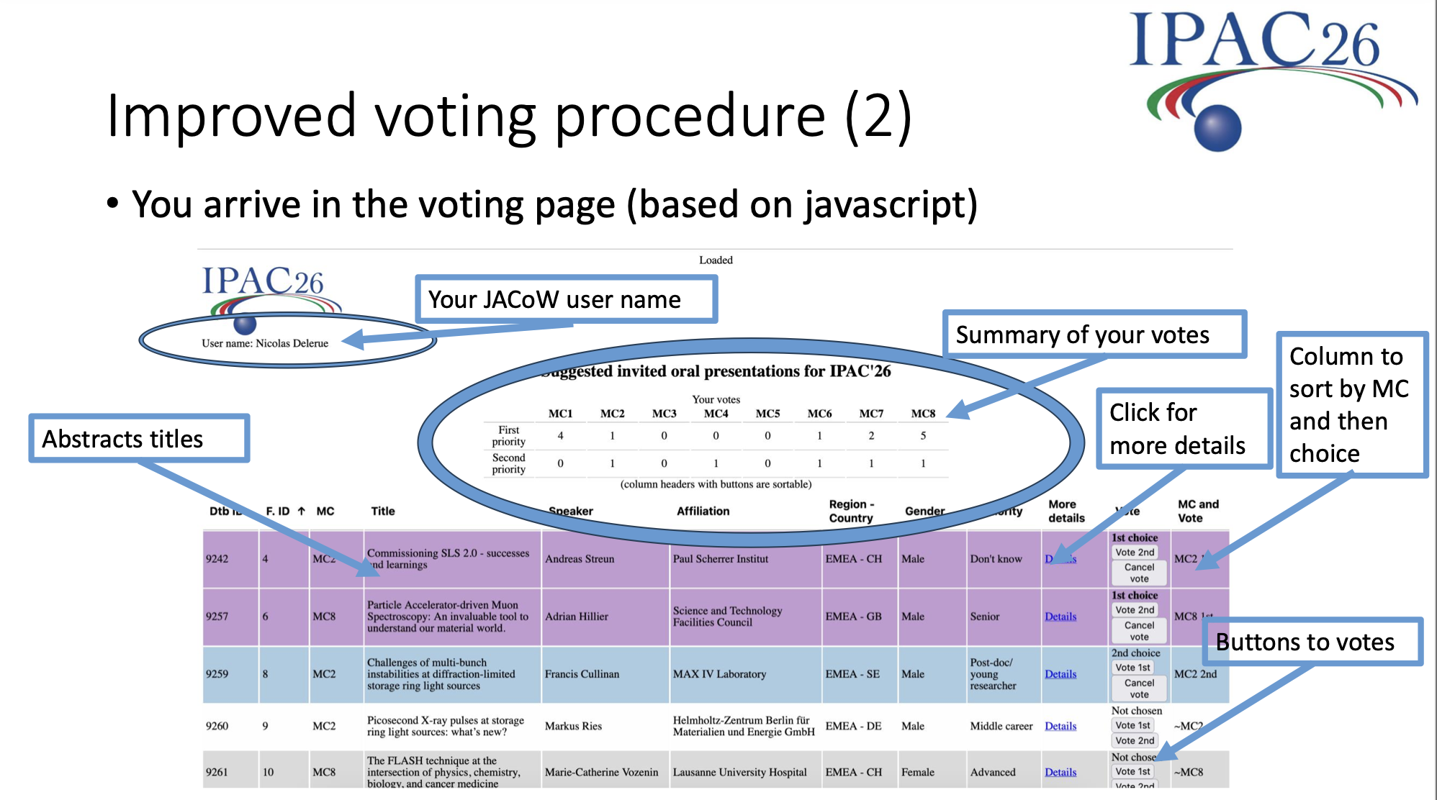
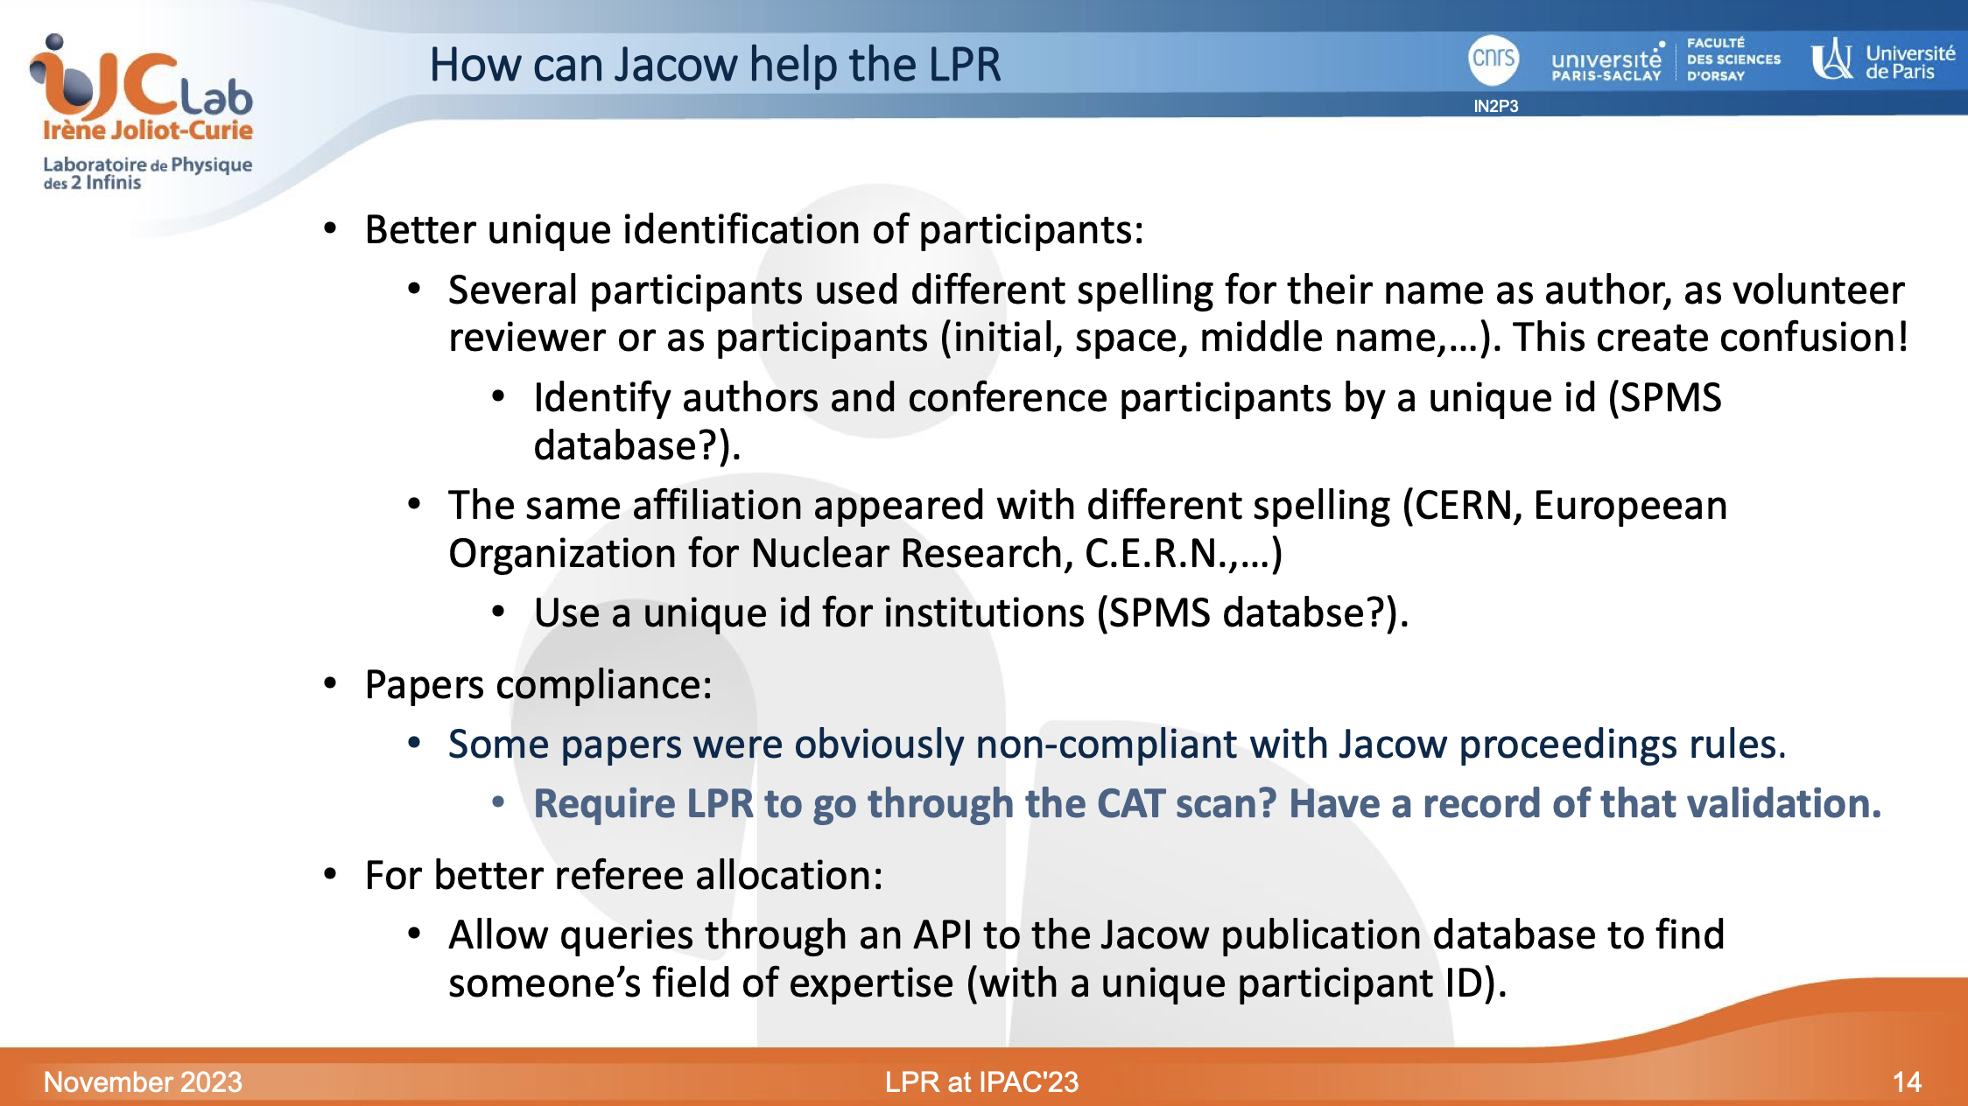
JAVA script by N. Delerue --- Indico??
Work on going with Indico

Slide 22
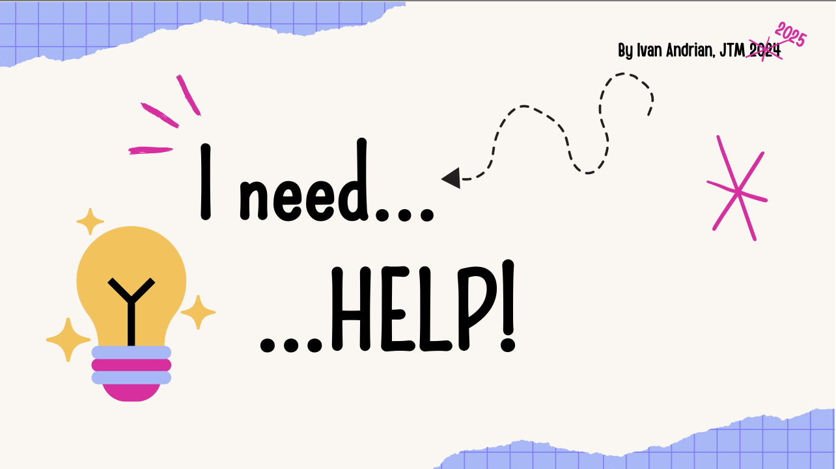

Slide 23
Thank you
For participating to the JACoW Team Meeting
&
For your present and future contribution

