Slide 1
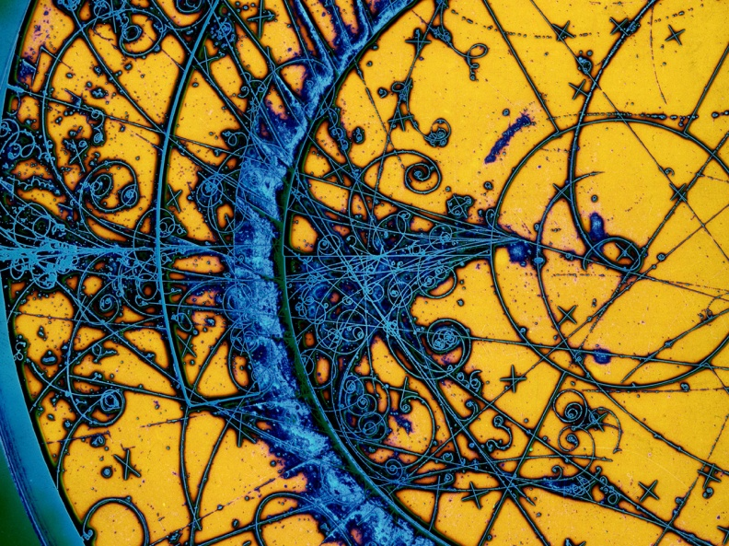
(The Ancient Art of) Editing PDF
JACoW Team Meeting 2025 – CERN, Switzerland
November, 06 2025
Maurizio Montis

Slide 2
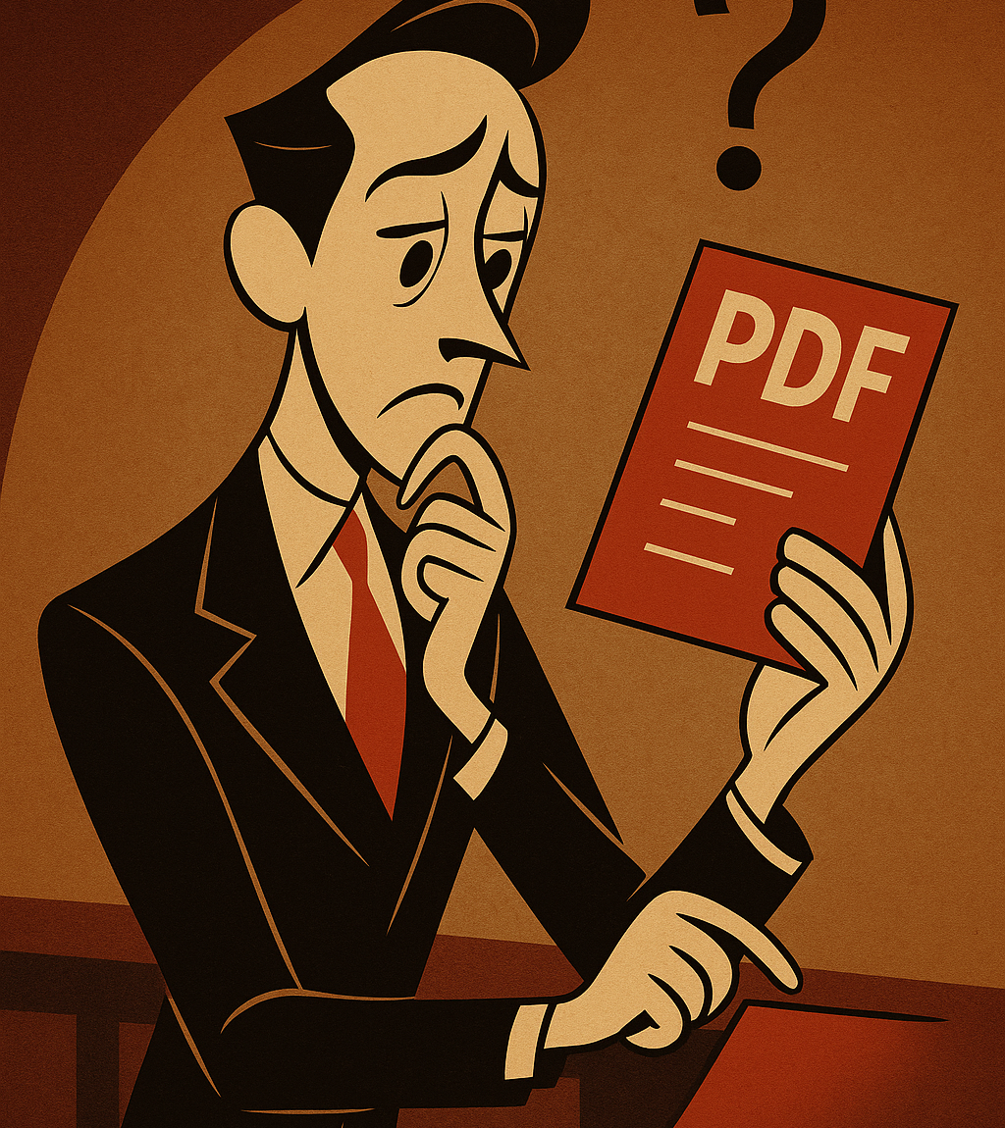
Summary
The PDF in the workflow
Working with the PDF
Before Working with the PDF
Lessons Learned

Slide 3

What is PDF for an editor?
PDF
Maurizio Montis – JACoW Team Meeting 2025 – CERN, Switzerland

Slide 4
What is PDF for an editor?
PaperDefectFinder
Maurizio Montis – JACoW Team Meeting 2025 – CERN, Switzerland

Slide 5


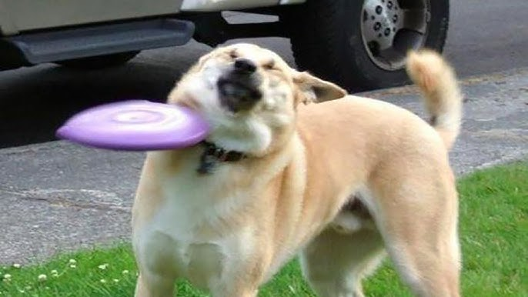
What is PDF for an editor?
PleaseDon’tFail …
Maurizio Montis – JACoW Team Meeting 2025 – CERN, Switzerland

Slide 6
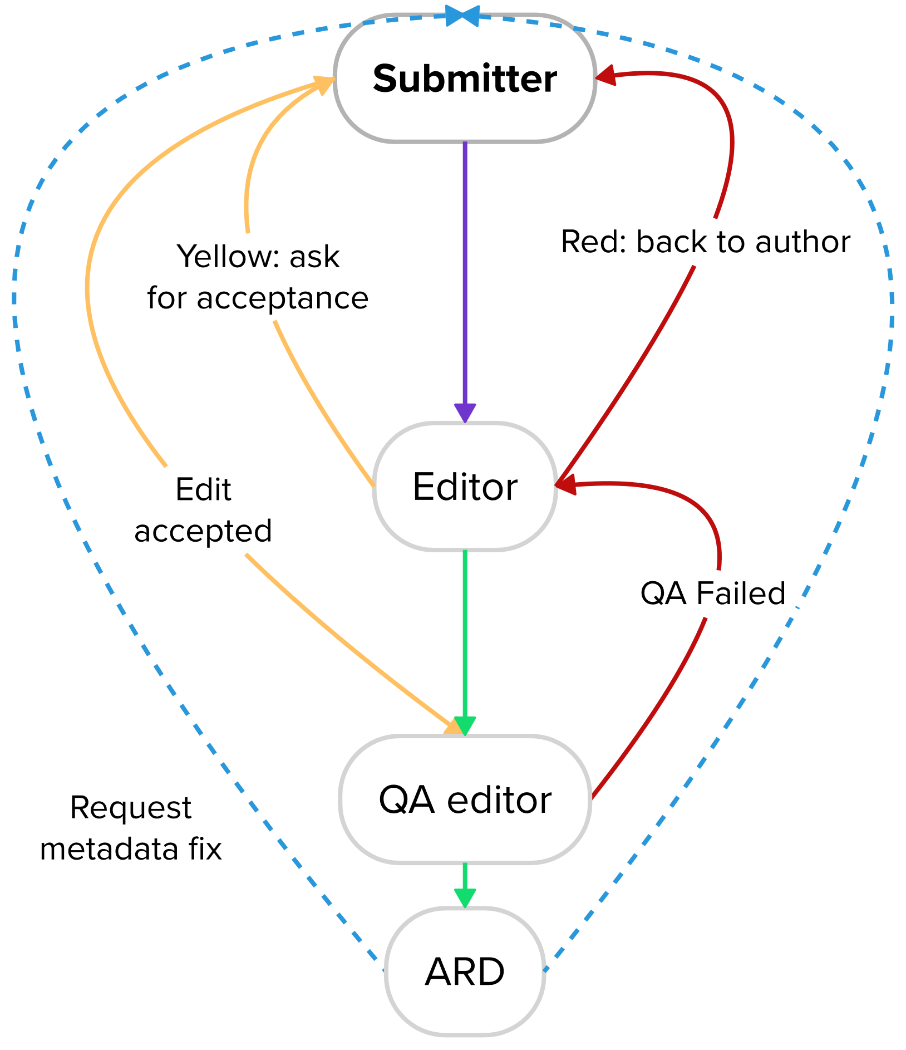

The PDF in the workflow
What an Editor must keep in mind
Time is crucial
Speed VS Accuracy
The final output of proceeding are PDFs
The PDF is the first bet for an editor
If everything is ok (about 0.05% of the time), the paper can be directly processed (from editor to QA editor)
If there are big mistakes, you can directly contact the author(s)
Maurizio Montis – JACoW Team Meeting 2025 – CERN, Switzerland

Slide 7
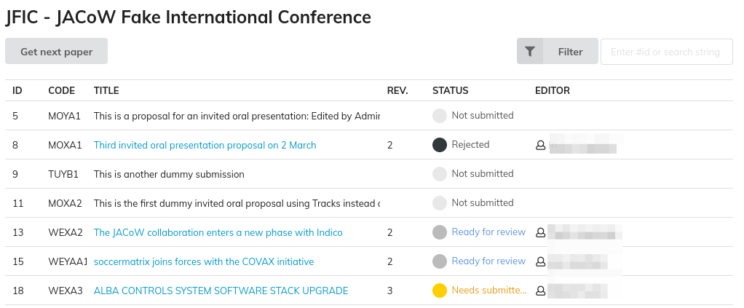
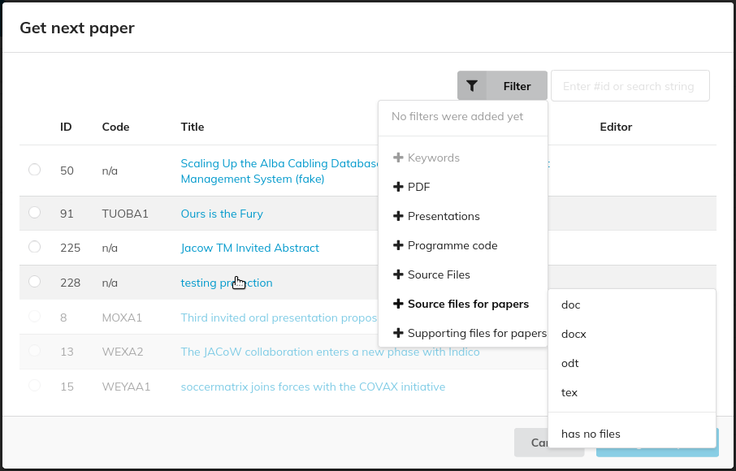
The Indico interface
From the Editor perspective – main page
List of all contributions
Additional info available: Code, Title, Status, Editor
Select the “Get next paper” button
From the Get Next Paper page
Filters available to detect contributions
Select a paper → open the dedicated paper page → assign the paper to yourself
Maurizio Montis – JACoW Team Meeting 2025 – CERN, Switzerland

Slide 8
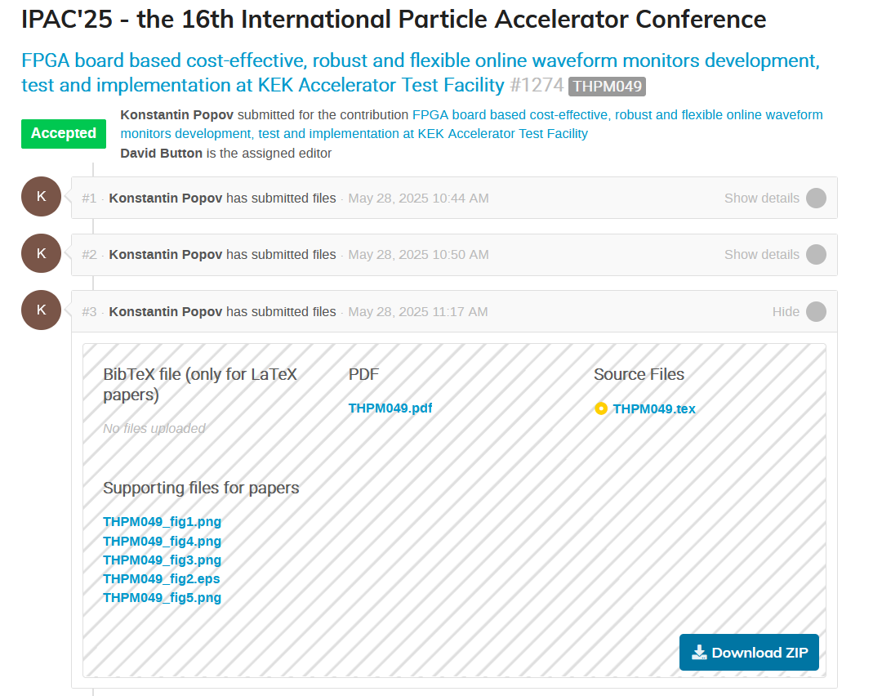
The Indico interface – Paper Contribution
In this example:
The PDF is uploaded by the author
The original source file is Latex
Figures uploaded in the supporting files area (mandatory for latex, optional for word)
No Bibtex files in this contribution
What must I do?
Download everything! (Download ZIP button)
Maurizio Montis – JACoW Team Meeting 2025 – CERN, Switzerland

Slide 9
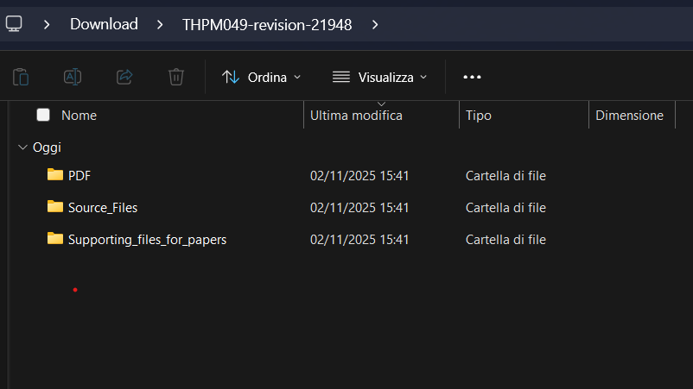
The Indico interface – Paper Contribution
What must I do?
Download everything! (Download ZIP button)
The extracted folder contains everything → organize the folder according to your preferences
Suggestion: 7-zip Extract flat
Maurizio Montis – JACoW Team Meeting 2025 – CERN, Switzerland

Slide 10
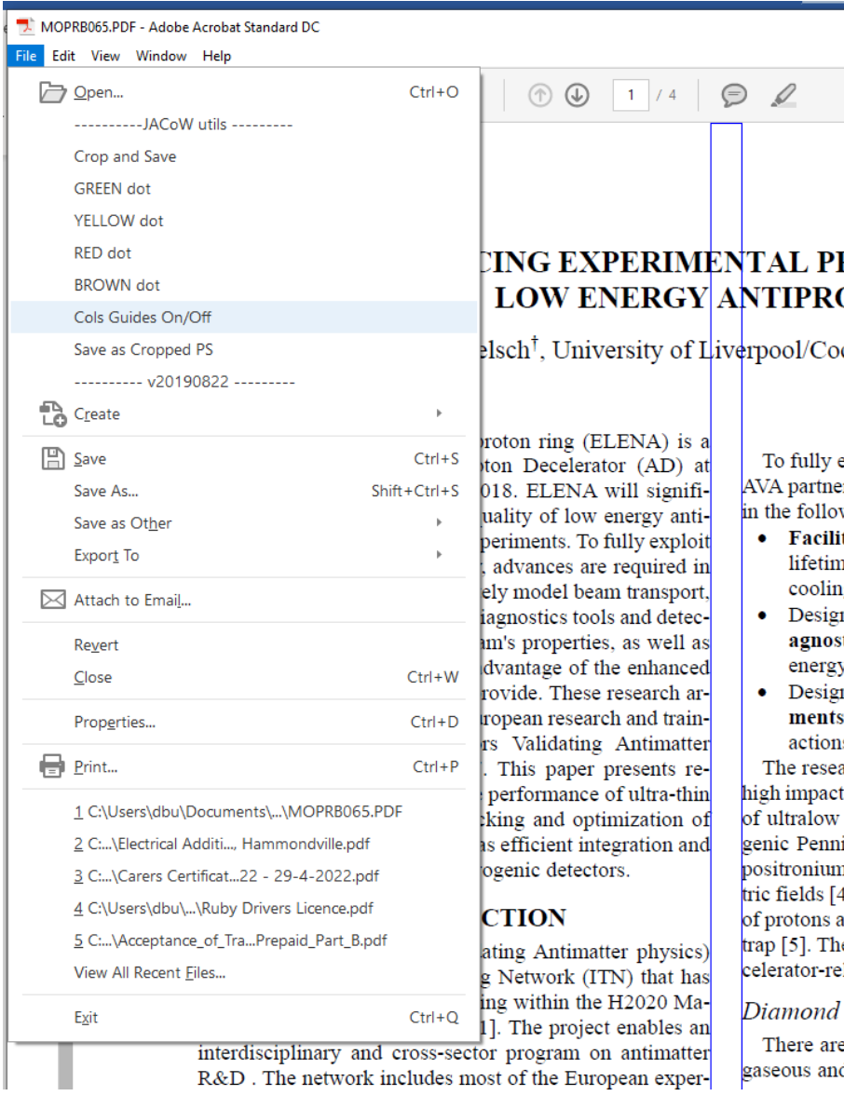
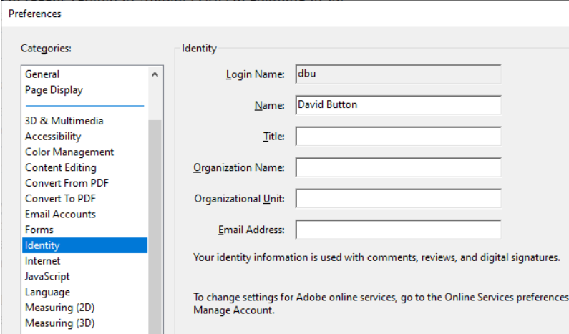
Acrobat Pro (because we are Pros)
Acrobat Pro is the default application to open, edit (as less as possible) and save PDF
Custom JACoW script used for proceedings
Crop and save
Colored dots
Columns guides
PitStop tool installed for advanced operations
NOTE: remember to set your identity! Edit
Preferences Identity
MM
Maurizio Montis
Maurizio Montis – JACoW Team Meeting 2025 – CERN, Switzerland

Slide 11
Let’s Play with the PDF!
Maurizio Montis

Slide 12
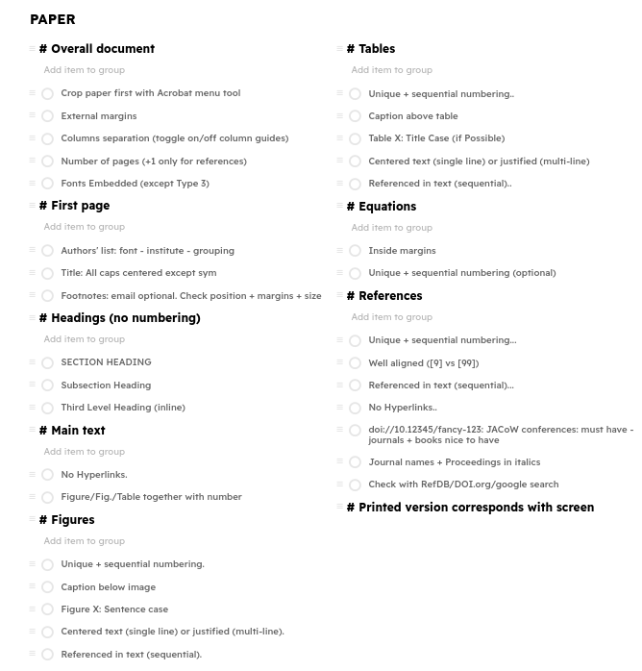

What an Editor must check
Major Aspects
Number of Pages
Embedded Fonts
Check Readability and Display Time
Margins
Page Size
Headings
Figures, Tabs, Equations
References
Remember to apply the JACoW Crop Box (sometimes it is required)
Many aspect to verify! Evaluate carefully the time required for a single paper!
Maurizio Montis – JACoW Team Meeting 2025 – CERN, Switzerland

Slide 13
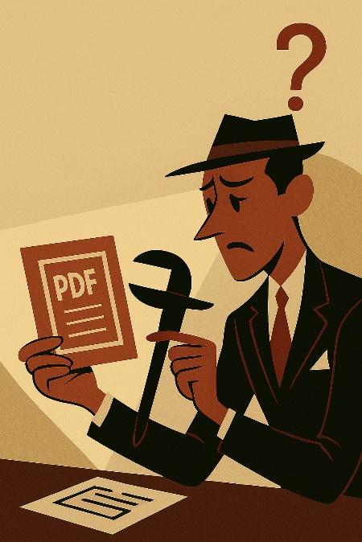
Crop the Paper
By default, the new templates provide the final JACoW page size
Hybrid size: 21 x 27 cm or 595 x 792 pt
If the Author have not used the last/correct version of the templates (sooo many stories), you must check the correct page size
JACoW scripts installed in Acrobat Pro provide the Crop and Save command that execute this operation!
Maurizio Montis – JACoW Team Meeting 2025 – CERN, Switzerland

Slide 14
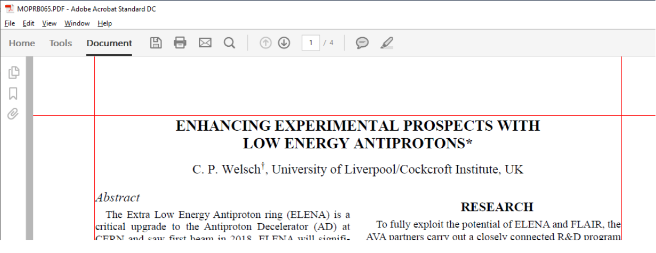
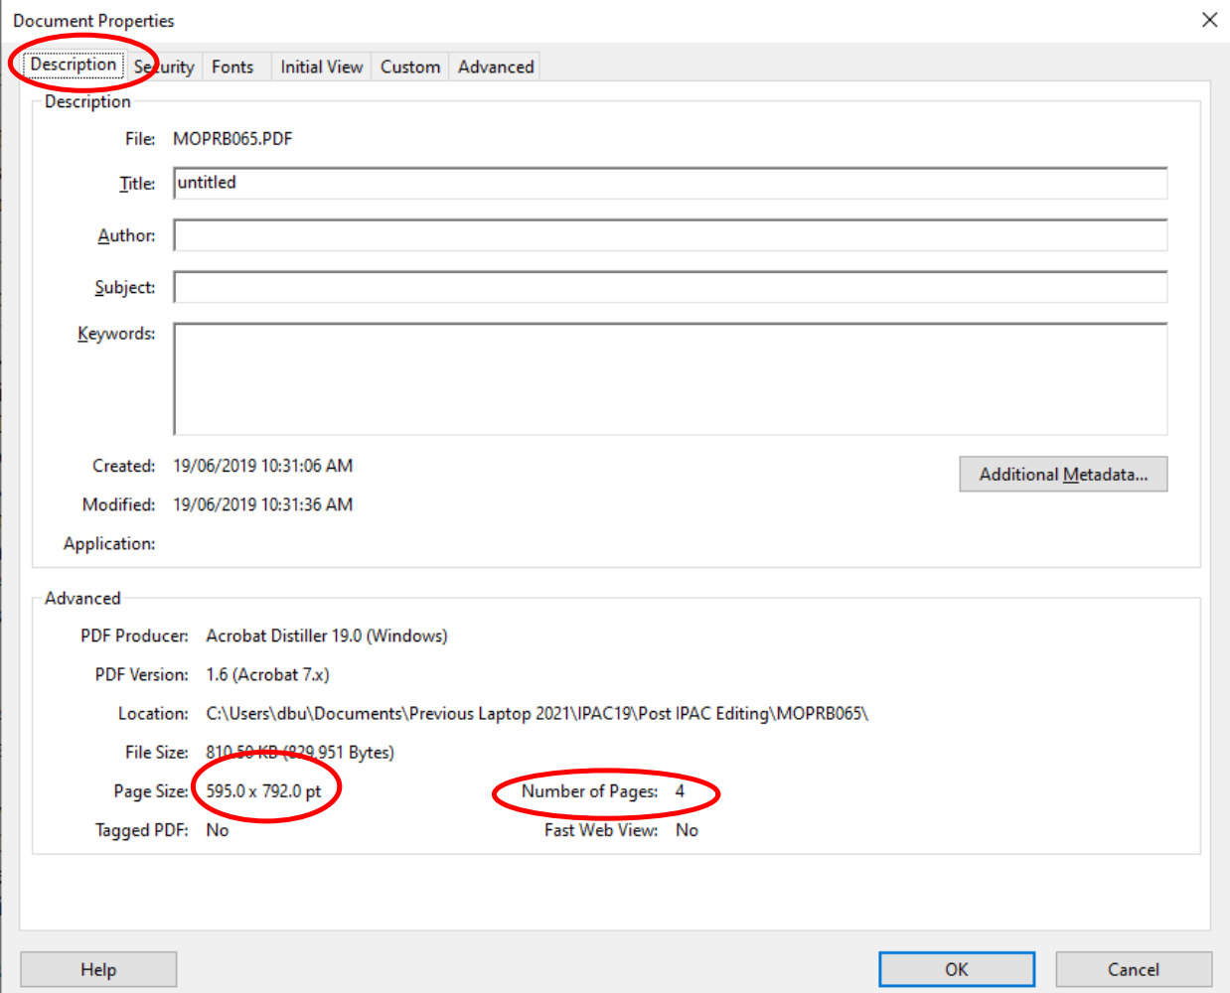
Margins, Number of Pages, Page Size
Margins:
Toggle margins with Ctrl+U
Check that text, figures, tables, etc. stays inside of the grid
Number of Pages & Page Size:
Open Display Document Properties (Ctrl+D) Under Description Tab you can find:
Page size (default: 595.0 x 792.0 pt)
Number of Pages
Note:
Max number of pages depends on:
type of contribution
the conference series
Maurizio Montis – JACoW Team Meeting 2025 – CERN, Switzerland

Slide 15
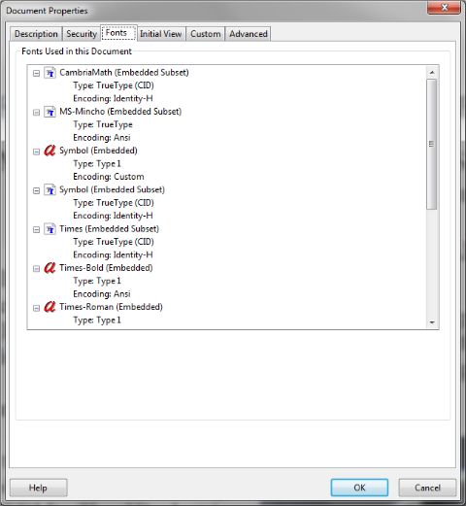
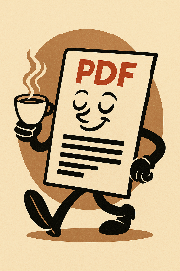
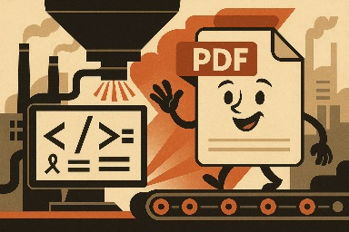
Embedded Fonts
Rule: All the fonts used to create the PDF must be embedded
To check the fonts:
Press Ctrl+D in Acrobat
Open “Fonts” tab
Check if every font used is embedded
Possibilities:
All the fonts are embedded → Coffee Break!
There are missing fonts:
Regenerate the PDF from the source (pay attention to PDF figures!)
Use advanced tools in Acrobat
Maurizio Montis – JACoW Team Meeting 2025 – CERN, Switzerland

Slide 16
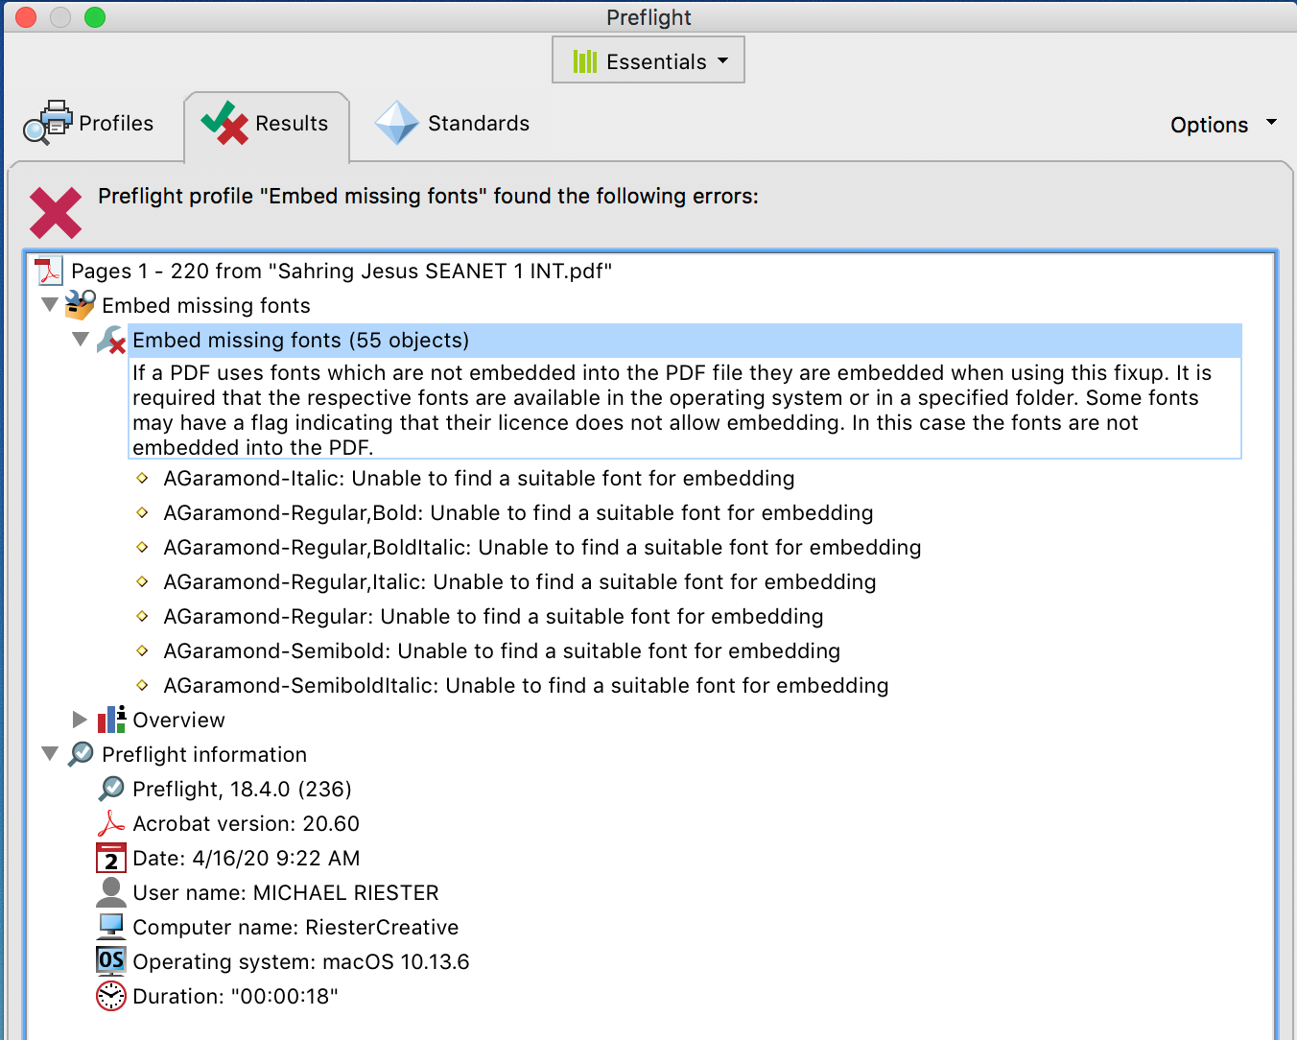
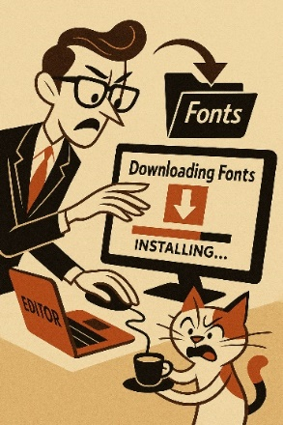
Embedded Fonts - Preflight
To check the fonts:
Press Ctrl+Shift+X in Acrobat
In the list under Profiles, select the “PDF fixups” and select “Embed missing fonts”
Click “Analyze and Fix” button
Notes (for editors and IT team):
Preflight is provided by Acrobat Pro Version, but it is not installed by default!
Sometimes you must find and install the missing font in your OS to fix the “opportunity”
Maurizio Montis – JACoW Team Meeting 2025 – CERN, Switzerland

Slide 17
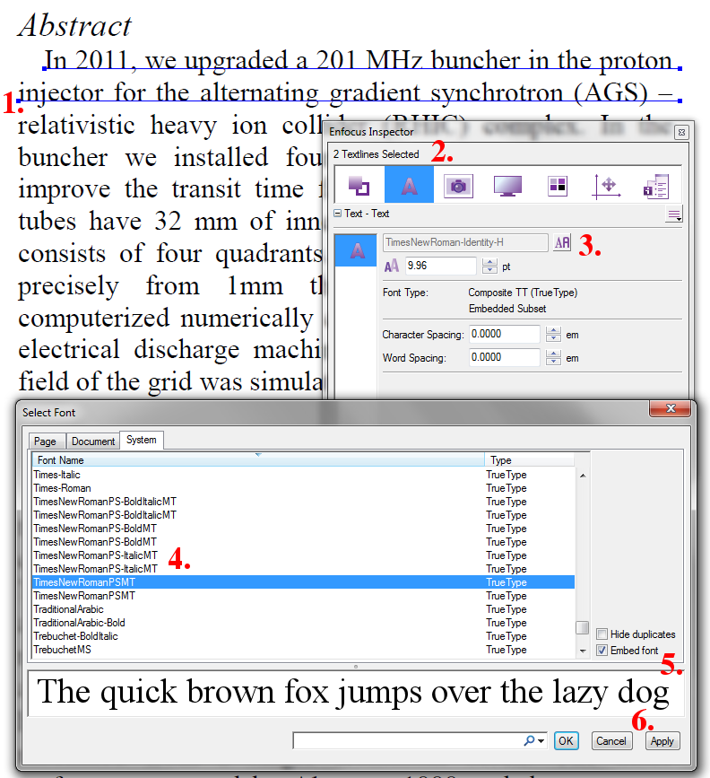
Embedded Fonts - PitStop
Advanced way to embed fonts: use of PitStop
Enfocus PitStop is a suite of tools (plugin for Acrobat Pro) for preflighting, editing, and correcting PDF files to ensure they are print-ready and meet production standards.
Procedure:
Open the Inspector (Ctrl+Alt+I) and select the text you want to change with the PitStop selection tool
Select the Text panel in the inspector
Press on the "select font" button (the small one with the two letters on it)
Select the font you want to use for the selected part of the text
Check the "Embed font" box so that your font is embedded into the document
Press apply to finish your changes
Maurizio Montis – JACoW Team Meeting 2025 – CERN, Switzerland

Slide 18
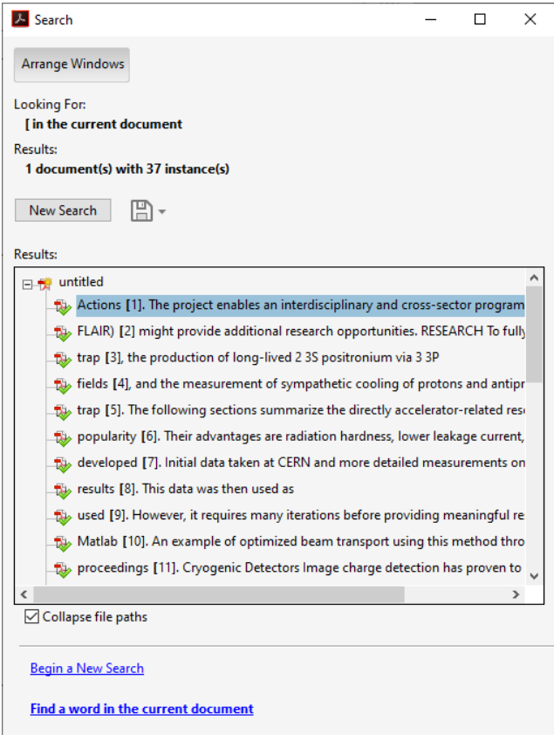
Figures, Tables, Equations, References
For these checks, optimize your time
The Acrobat Advance Search is your Alley!
Open the Search window: Ctrl + Shift + F
Rules and Tricks:
Check Figures: search for “Fig”
Match Figure (start of sentence) and Fig. (in text)
Check Tables: search for “Tab”
Match Table and underline wrong “Tab.” citations
Check Equations: search for “Eq”
Match Equation (start of sentence) and Eq. (in text)
Check References: search for “[“
Match all references (and more), but you can identify the sequence, missing citations, etc.
Maurizio Montis – JACoW Team Meeting 2025 – CERN, Switzerland

Slide 19
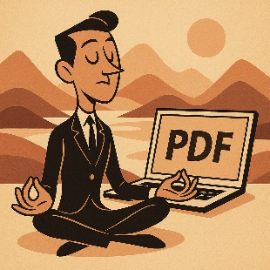
Figures, Tables, Equations, References
Wisdom through editing:
For missing citation → red dot and send the paper back to the author
For wrong sequences in citation → try to re-arrange the list of references and set a yellow dot…..if it does not take you too much time!
For wrong sequence in figures and/or Tables:
evaluate to modify the figure / table position → yellow dot
In Latex files, figure / table position cannot be precisely predicted → sometimes you have to accept it
Maurizio Montis – JACoW Team Meeting 2025 – CERN, Switzerland

Slide 20
(Good to Know) Before Editing
Maurizio Montis

Slide 21
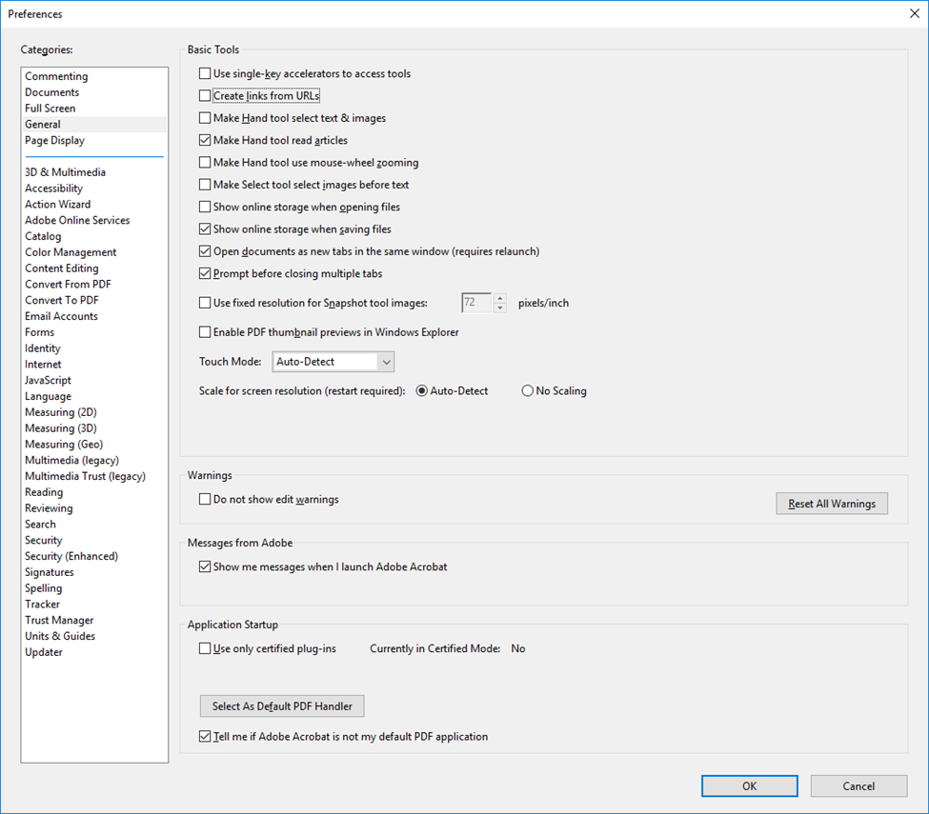
Info and Setup for Acrobat Pro
Dedicated configurations required once the application has been installed.
Main checks:
Uncheck Create links from URLs
Uncheck Use Local Fonts
Uncheck Enable Artificial Bold/Italic Font Style
Set Fallback font for Editing, Default font for Add Text and Font Size
Embedded fonts under Convert from PDF
Check Enable menu items JavaScript execution privileges
Set units and guides
Maurizio Montis – JACoW Team Meeting 2025 – CERN, Switzerland

Slide 22
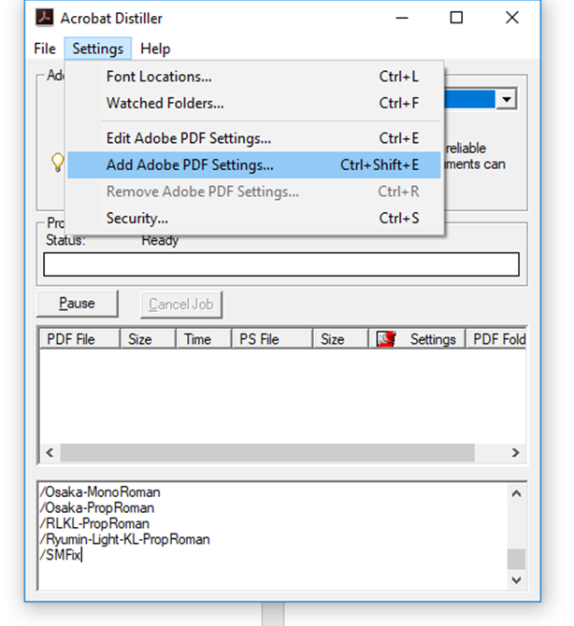
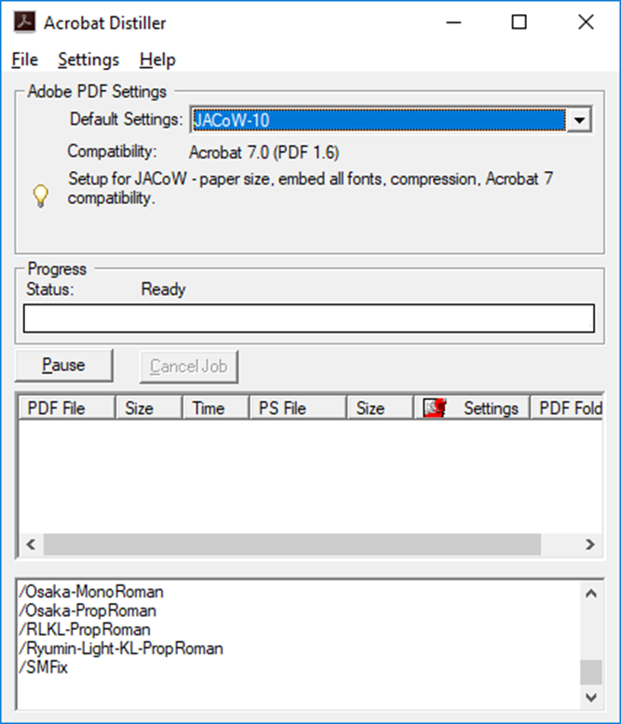
Info and Setup for Acrobat Pro
Acrobat Distiller required to setup JACoW fonts and workflow.
Main checks:
Uncheck Create links from URLs
Uncheck Use Local Fonts
Uncheck Enable Artificial Bold/Italic Font Style
Set Fallback font for Editing, Default font for Add Text and Font Size
Embedded fonts under Convert from PDF
Check Enable menu items JavaScript execution privileges
Set units and guides
Maurizio Montis – JACoW Team Meeting 2025 – CERN, Switzerland

Slide 23
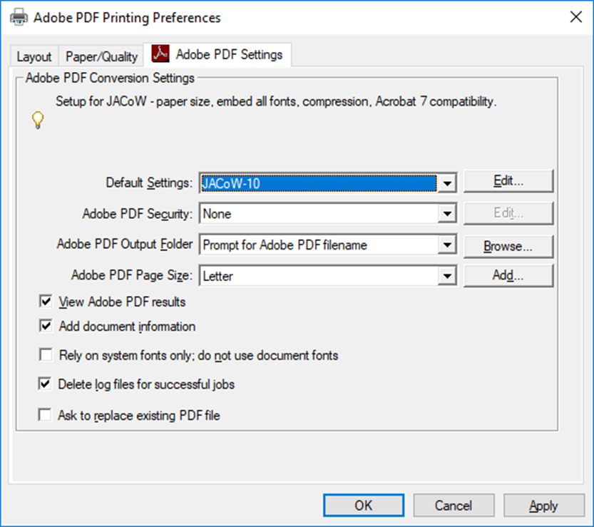

Info and Setup for Acrobat Pro
Additional Setup required for word and Latex (outside the scope of this presentation)
Maurizio Montis – JACoW Team Meeting 2025 – CERN, Switzerland

Slide 24
Lessons Learned
Maurizio Montis

Slide 25

Lessons Learned
PDF is the final output from a paper contribution, and the first file you will verify
Proceeding Office / Editor Office will be your home for about 8 days → everything should (must) work properly and smoothly
Tools developed by JACoW to assist and simplify PDF editing → take advantage of them
Many ways to solve “opportunities” → find your way according to Chief-in-Editor indications
Editing (PDF) is only a part of the entire proceeding process → time is critical
Don’t be shy to assign Red Dots → good communication with Author(s) can save you effort and time
Learn from the Community, share with the Community
→ every lesson learned counts
Maurizio Montis – JACoW Team Meeting 2025 – CERN, Switzerland

Slide 26

Lessons Learned
Don’t forget documentation and tools:
Documentation:
https://docs.jacow.org/
https://ipac-docs.jacow.org/
https://ipac-docs.jacow.org/Paper/intro/
https://cat-docs.jacow.org/
https://purr-docs.jacow.org/
https://meow-docs.jacow.org/
https://www.jacow.org/Authors/HomePage
Tools:
https://scan.jacow.org/
https://refs.jacow.org/
Maurizio Montis – JACoW Team Meeting 2025 – CERN, Switzerland

Slide 27

CREDENTIALS thanks to the JACoW community for all the material provided for this presentation https://jacow.org

