Slide 1
Introduction to Word Editing for JACoW Papers
Ana Stajminger, ELI Beamlines, ELI ERIC
JACoW Team Meeting 2025, Geneva, Switzerland
November 2025

Slide 2
Outline
Recent changes
Why Word editing matters
CatScan
Opening a PDF
Formatting
Creating a PDF
Quality Assurance
Take home

Slide 3

Goal
Ensure consistent, high-quality papers aligned with JACoW Word templates

Slide 4
Recent changes
DOI hyperlink encouraged
New Word paper size A4 US letter hybrid (as in LaTeX – no need to crop)
Alignment of references when > 10 etc.

Slide 5
Why Word Editing Matters
Ensures consistency across papers
Saves time in proceedings production
Improves readability and professionalism
Notes:
Consistency across papers from different conferences saves time and prevents issues in proceedings production. Good formatting ensures readability and professionalism.

Slide 6
The JACoW Style Guide and Template
Style Guide details the formatting of the manuscript to be submitted by authors
One page Word Template exemplifies the use of the Template
Document template (.dotx file) is to be used by the authors
Enforce the JACoW style
Includes preset margins, fonts, spacing etc.

Slide 7
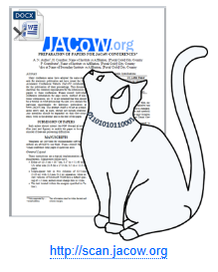
CatScan
Run it early in the review process by author and editors
Guidance for corrections
Catch common formatting/template errors, reduce rework
Formatting and style compliance

Slide 8
Opening a PDF
Seach facility: Ctrl + Shift + F
Figure references (type ‘Fig.’)
Are all the references cited and sequential? (type ‘[‘)
Table references (search for ’Table’)
Check number of pages does not exceed the page limit
Red dot?
Make sure you send a clear feedback to the author preferably in point form

Slide 9
Assigning the Appropriate Dot/Judge Status
🟢Green → Fully compliant with JACoW standards, no further action needed pdf accepted → QA
🟡Yellow → Minor issues (spacing, alignment, font, references) editor modifies the source file→ author should review and accept or reject changes
🔴Red → Major formatting or content errors, details which can not be determined by the editor → author should resubmit

Slide 10

Word editing
Basic tools:
Apply corrections consistent with the JACoW Style Guide
Helpful tool for reference generation (refs.jacow.org)
Please take notes while checking for submission to the author, these should be captured in Indico timeline.
Common Formatting Issues:
Reference Formatting
Figure/Table/Reference not referenced
Incorrect Title, Authors or Affiliation formatting
Section heading formatting

Slide 11
Checklist for Paper Review
First page (Authors list, Affiliation)
Headings (Idented)
Main text
Figures (centered/justified)
Tables
Equations
Upright units (GeV, mm·rad)
References
Printed version matches the on-screen layout
Notes:
Demonstrate how to modify styles correctly and explain why manual formatting causes inconsistency. Mention 'Update Style to Match Selection' for efficiency.

Slide 12
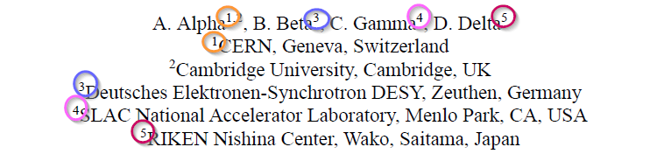
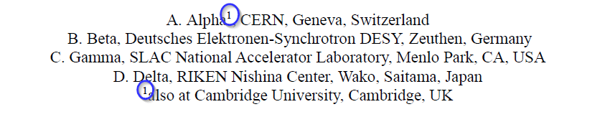
Formatting Authors list and Affiliation
Grouped by Author
- alphabetical order and carry a superscript number to refer to the institute
Grouped by Affiliation
- all authors of the same institute are grouped, the main author starts, further institutes are listed in alphabetical order If multiple affiliations, indicated with a superscript

Slide 13
Formatting Title
Centered, bold uppercase letters
Letters may be lowercased to avoid misinterpretation (e.g., Au, mW, GeV, SPring-8, SwissFEL)
Wrap title at esthetically pleasing line brake points with Shift + Enter
Avoid hyphenated words broken across lines

Slide 14
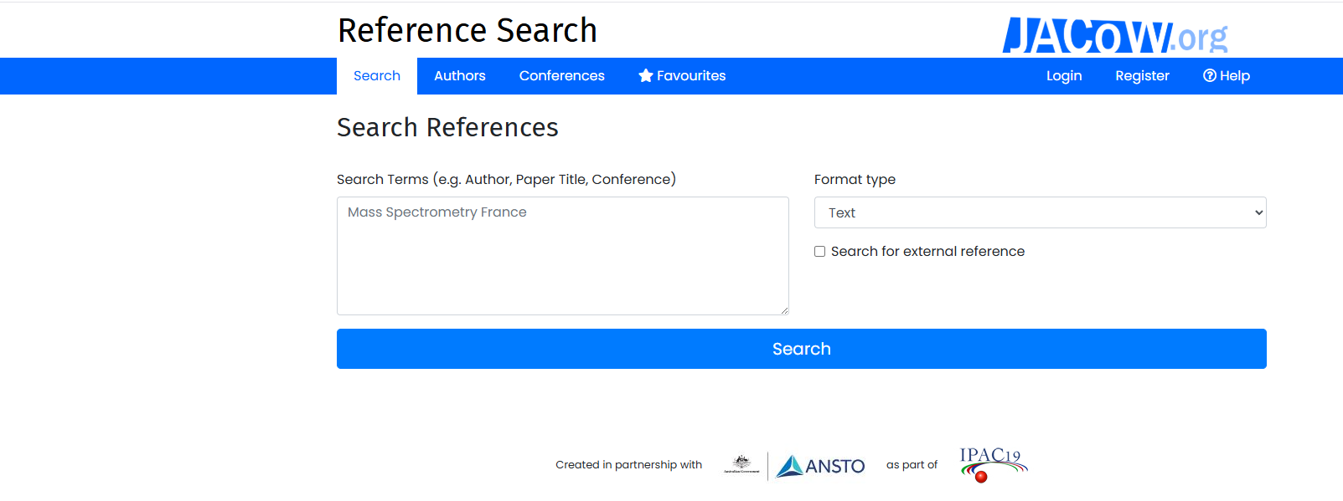
References
Annex B of JACoW style guide
First check the format of the references
Reference search tool (refs.jacow.org)

Slide 15
References
Annex B of JACoW Style Guide
DOIs and URLs – LiberationMono font 8
Hyperlinks only for DOIs
Unpublished Paper from a Previous Conference
Paper Presented at the Current Conference
Published in a Periodical
Citations to Books etc.

Slide 16
Creating a PDF
Always use the PDF Maker native in Word located on the ribbon menu with JACoW settings (only way to preserve DOI hyperlinks)
Crop and Save if necessary in Acrobat
Check all fonts are embed Ctrl+D (pre-flight Ctrl+Shift+X can be used to embed all fonts tool)
Assign a dot by Judging in Indico
Notes:
Explain how Track Changes helps during collaboration and review. Encourage a quick final review before generating the PDF.

Slide 17
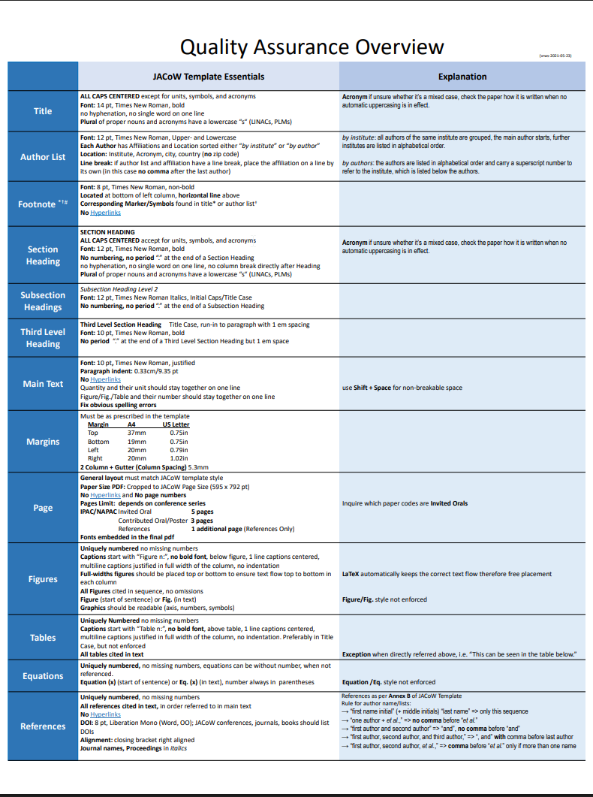
Technical accuracy
Compliance with JACoW Submission Standards
https://ipac-docs.jacow.org/PaperEditing/Editing/material/Editor_Quality_Matrix.pdf

Slide 18
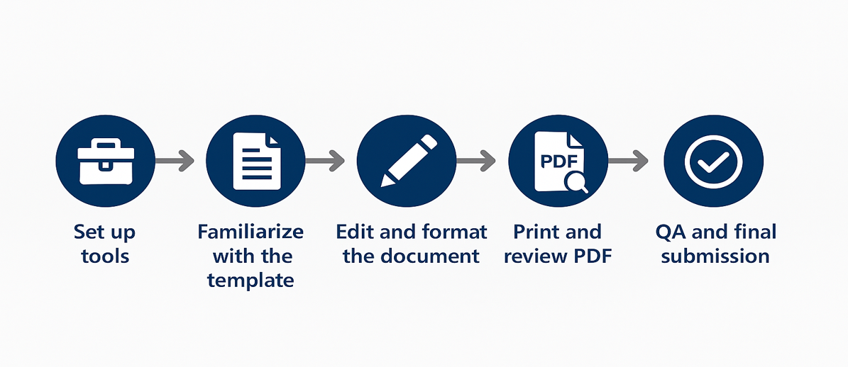
Steps in the JACoW Editing Process

Slide 19
Resources
• JACoW Template download: JACoW / Authors / MS Word
• Word Editing Guidelines: JACoW / Editors / Word Prerequisites
MS Word - JACoW - Running an IPAC
Introduction - JACoW - Running an IPAC
JACoW - Running an IPAC
Hands on experience as a member of a proceedings office
Notes:
Provide references to resources and contacts for additional help. Mention any internal links or shared drives.

Slide 20
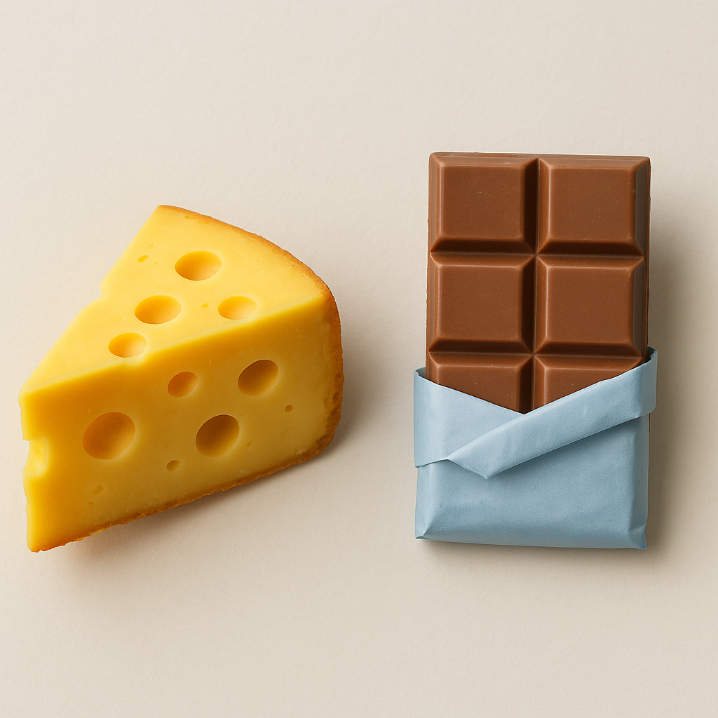
Q&A / Discussion
Questions, comments, editing tips from your experience?
May your edits be as smooth as chocolate and as sharp as cheese!

