Slide 1

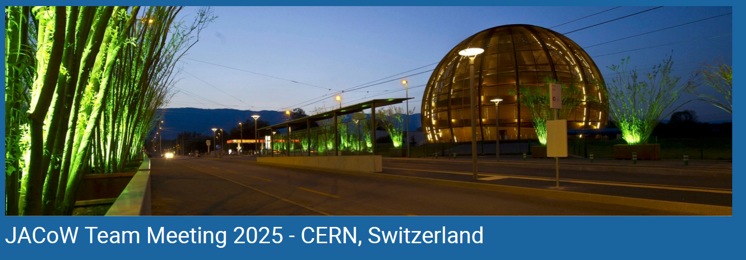
How to edit transparencies
A saga coloured by GIFs and movies
Ruth Rudolph
JACoW Slideprocessor
05.11.2025
Notes:
Thank you very much for having a presentation here at the TM

Slide 2
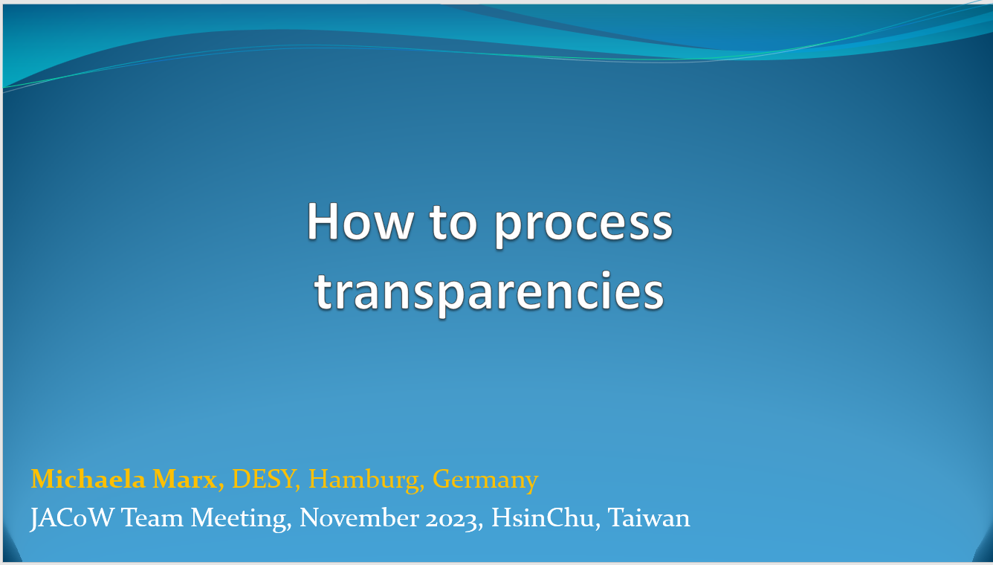

Processing slides
This presentation is based on the presentation of Michaela Marx "How to process transparencies“ held on the JACoW teammeeting 2023
Most of the slides from that presentation are taken / included here. I added the topic Presentation Management in the SpeakerReadyRoom.
She is an expert on slide processing and produced help content over the years to assist with the processing of slides.
The existing repository of information can be found at Guidelines for Processing Slides
Michaela Marx has maintained a document manual Slides_Processing_Manual_V4.pdf, Version 4.0, September 2016.
Contact: Michaela.marx@desy.de
Notes:
This is a topic that only slidprocessors are dealing with but not less important. So I have the heavy duty to awake you from the soup coma – perhaps this topic is not enough exciting. So if I bore you just take your seat and relax!

Slide 3
Processing slides
… means producing PDF files of transparencies
The aim of the slides processing editor is to produce JACoW compliant PDF files of the presentations for inclusion in the proceedings.
A detailed description can be found at: https://www.jacow.org/JTM2016/ProcessingTransparenciesEmbeddingAnimations
There is no need to edit the type setting or layout, but you have to make sure the following:
all fonts must be embedded
all missing characters should be fixed
slides should be free of overlapping issues
multimedia content (videos, animated gifs) should be embedded
Notes:
What is slide processing? Differs quite a lot from paper editing

Slide 4
Processing slides
What‘s new since 2023 JACoW TM?
Slide Processing is embedded in the SpeakerReadyRoom since 2024 -> enlarged tasks for presentation managers
New repository: We work with INDICO instead of SPMS -> new workflow
Nice new JICTool programmed by Stefano Deiuri for Slide Processing
Notes:
I decided to share my experiences about the situation that Presentation Management combines Slide Editing and the tasks in the SpeakerReadyRoom.

Slide 5
Contents of this talk
Prerequisites
Presentation management in the SpeakerReadyRoom
Processing PDF slides (check and fix missing fonts)
Processing PowerPoint slides and “HOW TOs” (presentation of Michaela Marx "How to process transparencies“ held on the JACoW teammeeting 2023)

Slide 6
Prerequisites
What to do before you start? – created by Michaela Marx and updated by Ruth Rudolph on Nov 25
The conference organizer is responsible for the PC set-up, but for processing slides some extra work is required.
Install:
video transcoders and other useful software products
(Handbrake, Virtual Dub, Convertio)
Lightshot (tool for making screenshots)
◆ PPspliT (PowerPoint Add-in)
◆ PowerPoint print options: print slides in High Quality
the latest JACoW.joboptions file (needed for Acrobat distiller and Adobe PDF printer), JACoW-12.joboptions, November’23
Notes:
Before you start with your work at the conference please check that the necessary tools are installed – this is also important if you e.g. get a new pc and will edit or train remote.

Slide 7




Software you need: Video transcoder, a screen capture tool
Virtual Dub
VLC media player
Handbrake (video transcoder to convert avi and wmv files to MPEG-4and reduce sice)
HandBrake-1.10.2-x86_64-Win_GUI.exe
Virtual Dub (free video capture/video processing utility)
https://sourceforge.net/projects/virtualdub/
other useful tools
VLC Media Player (free cross-platform multimedia player)
https://sourceforge.net/projects/vlc/
Lightshot (to take customizable screenshots)
https://app.prntscr.com/en/index.html
Notes:
If you intend to insert a video in Adobe – this has to have the right format: Handbrake or Virtual Dub to reduce the size of extracted mpeg-4 files just use Handbrake and convert from mpeg-4 to mpeg-4 ☺

Slide 8

Software you need: an online tool for converting animations to mp4 videos
Powerful file converter https://convertio.co/de
► mp4 is the compatible format for videos supported by Adobe Acrobat
► Convertio converts animated gifs directly to mp4 online & free through the web browser
https://convertio.co/gif-mp4/
Why should we use Convertio?
► faster than using VirtualDub and Handbrake as it takes two steps to convert from gif to mp4

Slide 9


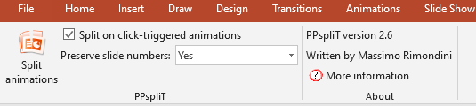
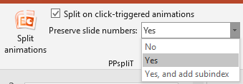
PPspliT - A PowerPoint Add-in to split animations and overlaps
Massimo Rimondini has written a split animations macro for PowerPoint which is very useful for processing slides.
Download the PPsplitT installer from his web page at the following URL and use the supplied password “ppsplit” to unzip the file (latest version is v2.6 March 2024). http://www.maxonthenet.altervista.org/ppsplit.php
After the add-in has been installed PowerPoint offers a new tab named PPspliT. To run the add-in select the slides where you want to split the overlapping content and hit the Split animations button on the left.
hint: slide numbers should be preserved!
Notes:
We need this to split the overlapping – examples follow in chapter „How to“

Slide 10
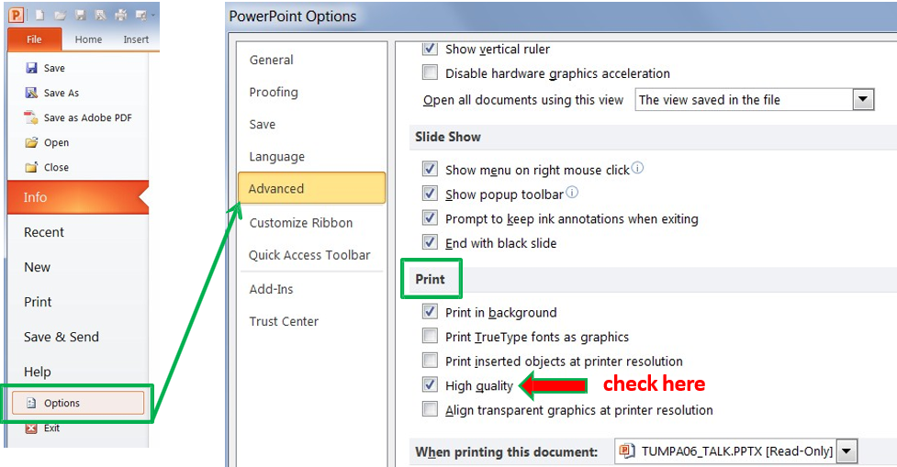
PowerPoint: How to enable the High Quality Print Option

Slide 11
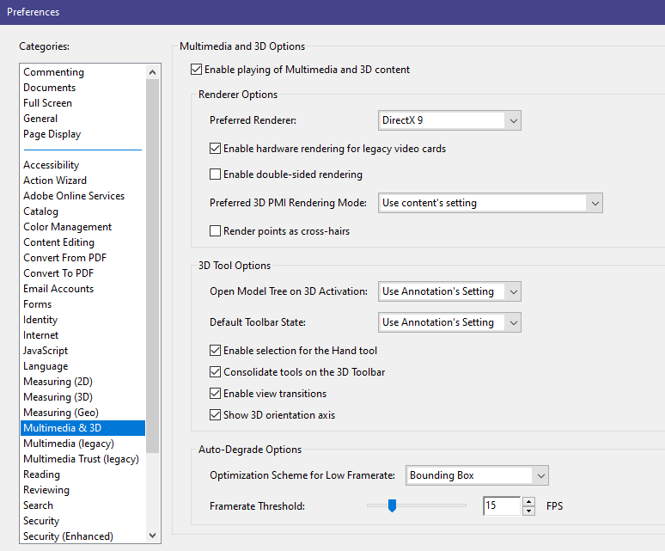
Acrobat settings to play embedded videos
►in Acrobat go to Edit -> Preferences -> General -> select Multimedia & 3D
to enable playing of multimedia content
menu differs for different Acrobat versions
Notes:
Mackintosh Fonts were no longer a problem since 2023 – furthermore there might be problems with copyright is that true??

Slide 12
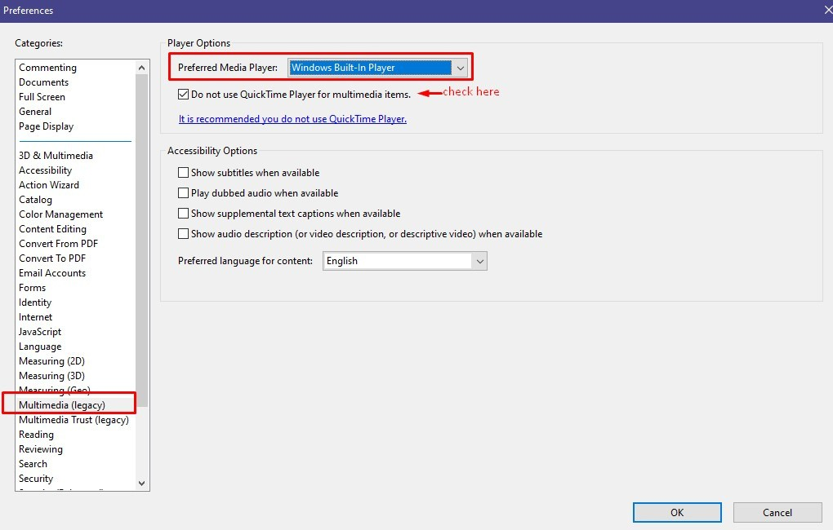
Acrobat settings to play embedded videos
change Player Options to Windows Built-in Player

Slide 13
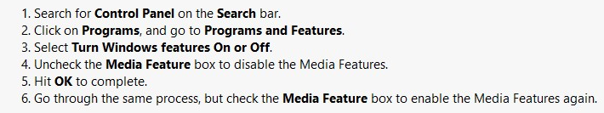
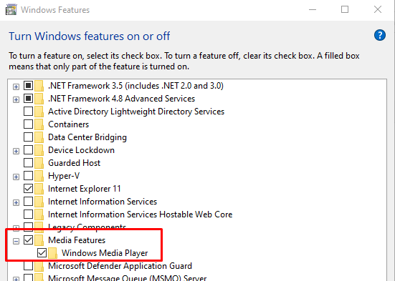
Enable media features on a Windows computer
► just in case videos do not play on a Windows PC check if Media Features are enabled

Slide 14
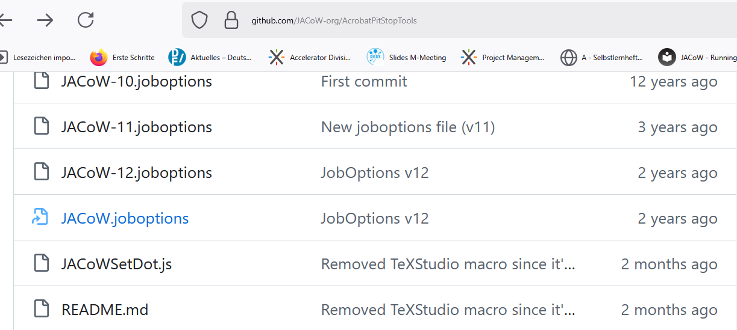
JACoW joboptions (latest JACoW-12.joboptions are from November 2023)
► joboptions file contains necessary settings for Acrobat distiller and Adobe PDF printer
► download the latest version from the github web page: https://github.com/JACoW-org/AcrobatPitStopTools
► copy the file into the Acrobat | Settings folder (C:\ProgramData\Adobe\AdobePDF\Settings)
or import via Distiller via the "Settings | Add Adobe PDF Settings..." menu entry

Slide 15


Presentation Management
Source: Presentation Ardian I., „proceedings office workflow, a story of sweat and blood“
Notes:
Just a few words about what is new and the combination of Slide processing and presentation management

Slide 16
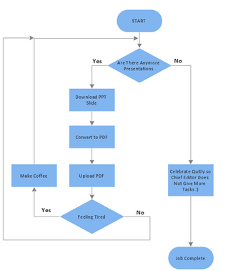
Former workflow Slide Processing
It seemed to be so cozy ;-)
Since the combination with the SpeakerReadyRoom in 2024 it became bit more complicated and stressful.
No more time to prepare coffee – hard to find time even for drinking coffee.
IPAC 2025: Thanks to Michaela working remote in the background on the really nasty problems
Ching-Kang, Takashi and me managed not to starve.
The SpeakerReadyRoom has to be staffed during the opening hours.
There should be 3-4 editors for presentation management for an IPAC.
Source: JACoW.org author: unknown
Notes:
But I liked.

Slide 17
SpeakerReadyRoom
Tracking speaker review and release for publication
We want to track the activity of the speaker in the speaker ready room, in particular two important facts:
whether the speaker has successfully tested his/her presentation at the venue
if the speaker agrees with the publication of the presentation in the proceeding

Slide 18
SpeakerReadyRoom
After talks are fully checked, they are PUSHED from the Speaker Ready room to Auditorium laptops
A shared network folder is created on the desktop of the laptops in the auditoriums
NOTE: Speakers are not allowed to load talks on auditorium laptops by USB stick. This is a serious security risk and by not allowing it, helps to prevent any potential showstoppers from happening.
Notes:
Oral Presentation Management Talk given by Vincent Mitts JACoW Teammeeting Santos, Brazil Also description of the Hard- and Software
As we have to deal with these problems I‘d like to do some remarks about that

Slide 19
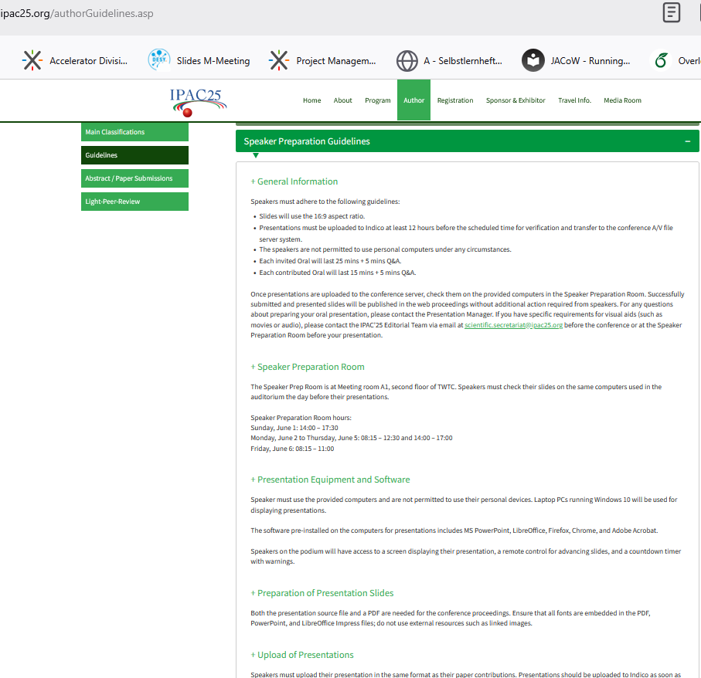
SpeakerReadyRoom
Also useful: check the Speaker Preparation Guidelines of the conference
eg. Ensure that the room is staffed during the announced opening hours
Problems of the speaker might be caused by misunderstanding or not considering the guidelines

Slide 20
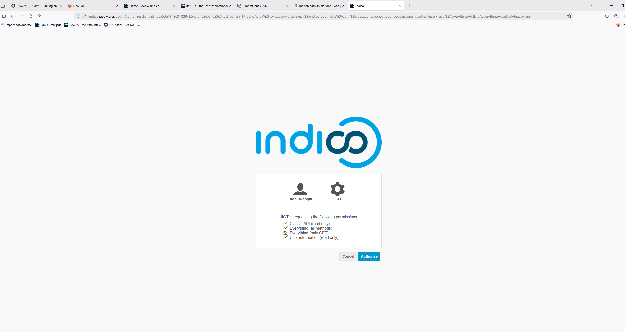
Presentation Management, JICT
log into Indico – the conference you are working on
Notes:
Check that everyone has the slides processing privileges to see the link for editing slides in the Indico module (Indico Access)

Slide 21
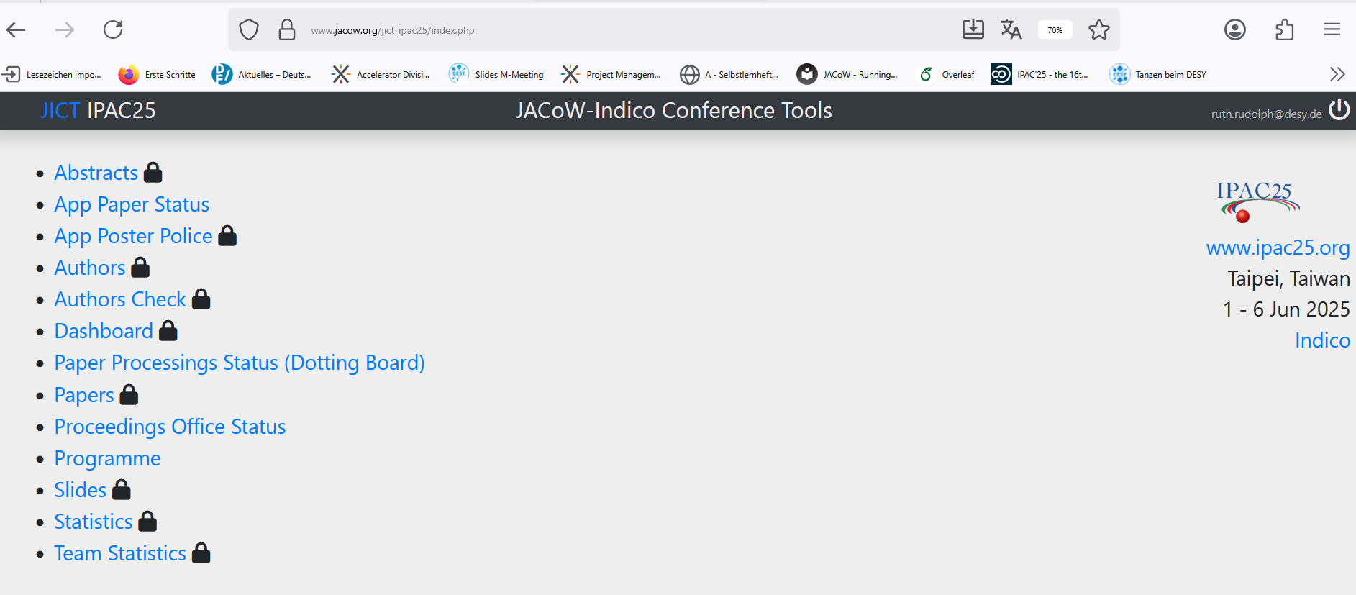
Presentation Management, JICT
This is the JICT Index page. Choose “Slides” and tool will open
e.g.: https://www.jacow.org/jict_ipac25/page_slides/index.php?day=2025-06-02
click

Slide 22
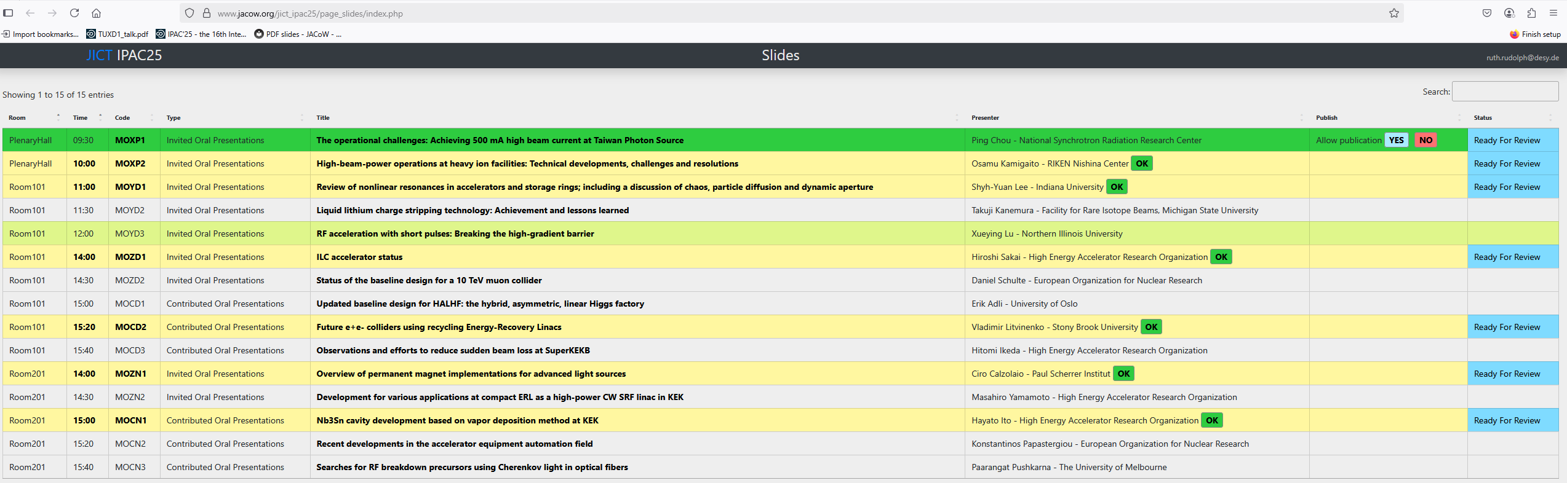
Presentation Management, JICT
This special tool (JICT by Stefano) was programmed for easy download of the talks.
It produces one sheet containing all Conferences oral presentations sorted by date and time and status. Missing papers can be sorted out quickly.
It´s perfect for follow up and workflow as it is always current.
Notes:
Does this tool already include the new Indico function: impede that one slide has been grapped by two editors for editing?

Slide 23
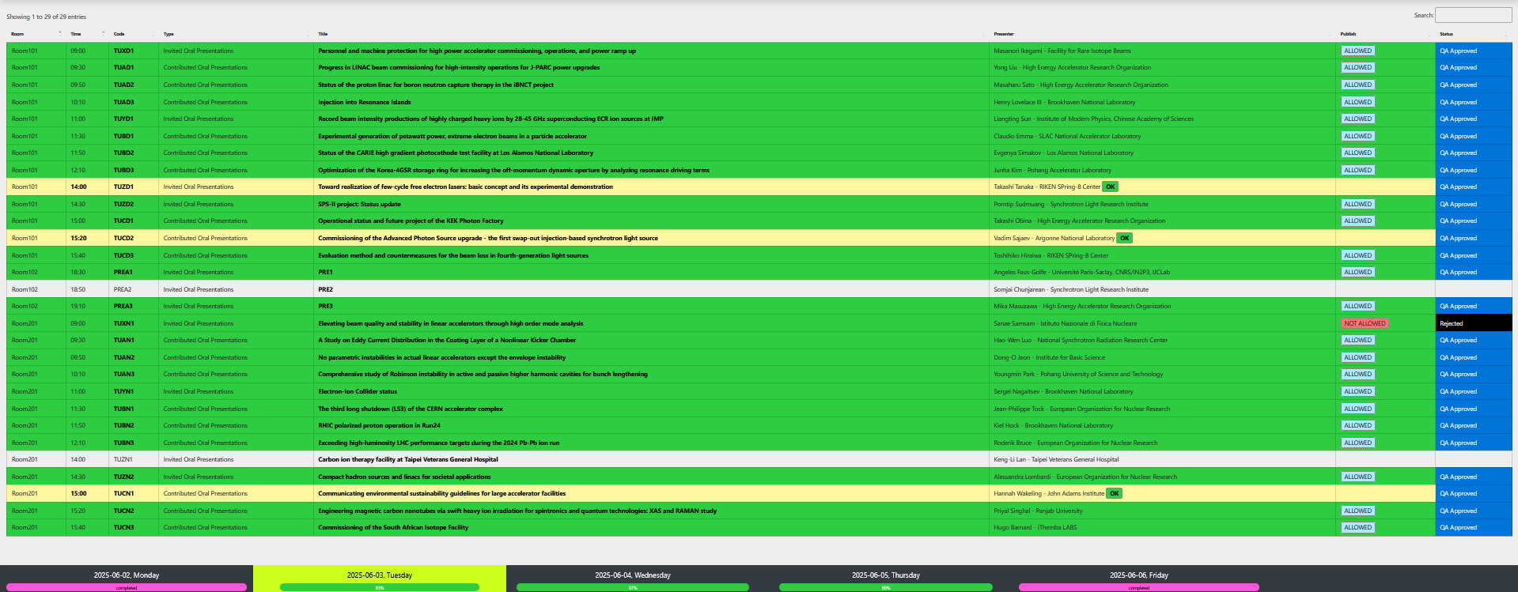
Presentation Management, JICT
At the end of the conference ideally each paper position should have switched to green. That means: All papers edited and ready for publication.

Slide 24
Presentation Management
Speakers come for checking: we download the presentation via clicking on the time, copy it from the download folder into the Conference-folder.
Recommended: to check each presentation before the Speaker comes to the Ready Room: check the Presentations that all embedded features are starting within the presentation and don’t have to be started manually (there might be no device to do so).
When everything is fine, Slide Manager downloads the file via Stephanos tool (the right naming of the file is done automatically) and uploads it in the shared directory / subfolder room -> Room-number can be taken from the filename.
Don’t forget to ask / select “Allow publication YES/NO. Sometimes the presenters want to have removed several Slides.

Slide 25
Presentation Management - problems
Problem: Author says, has no permission to upload. That might happen if the author is not marked as the uploader (marked with arch brace in INDICO).
In this case you should provide the author with the uploading rights as well.
Problem: Author uploaded once in INDICO and is not able to do it a second time
Apparently INDICO allows no further uploads after it has been signed to an editor. To solve this problem the author should come to the Prep Room. A Slide Processing Manager has to go into INDICO and open the file of the presentation. Sign it to oneself and give a red dot. Then the presentation can be uploaded again by the author. Having done this the Slide Processing Manager must reassign it.
Notes:
These Problems were explained by Ivan this morning

Slide 26
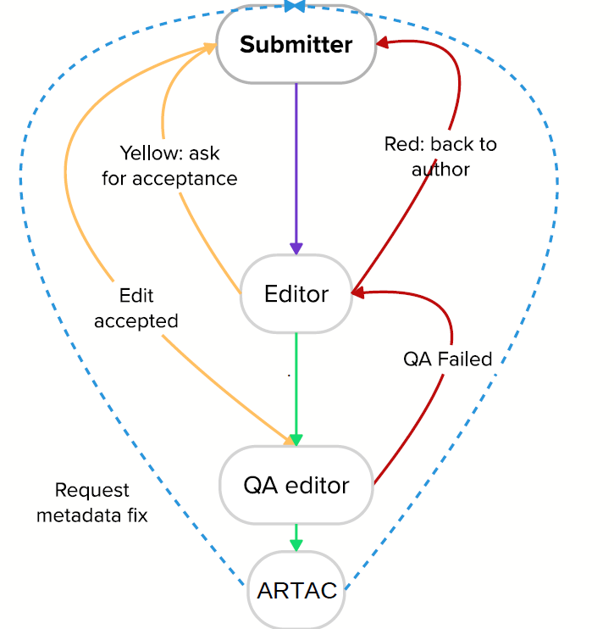
INDICO environment
Workflow
„Presentation managers are slides editors
Same basic editing process as paper editing
Indico comments document the process“
Source: Presentation Ardian I., „proceedings office workflow, a story of sweat and blood“

Slide 27
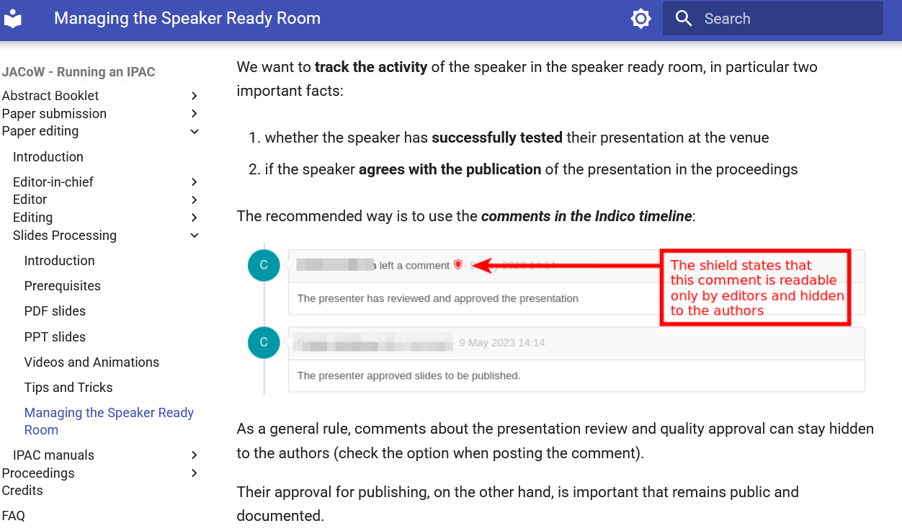
INDICO environment
After the presentation was given the slide processor can start the editing process.
Things to be done in Indico:
Excellent description of the Indico-workflow:
https://ipac-docs.jacow.org/PaperEditing/Slides/7_SpeakerReadyRoom/

Slide 28
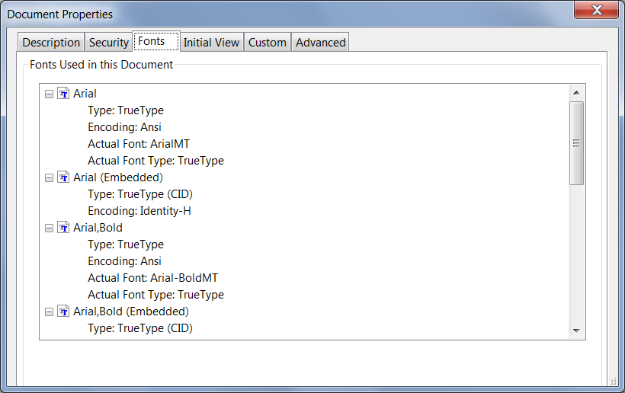

Processing PDF slides
◆ If the author uploaded a PDF slides file … great ☺
◆ download the PDF slides file, do a visual inspection and
check for missing fonts in Acrobat Pro with CTRL-d
CTRL-d
Notes:
Here we come back to the point, where the oral presentation is held and no more changes are requested by the author. In case he already uploaded the pdf just check missing fonts

Slide 29
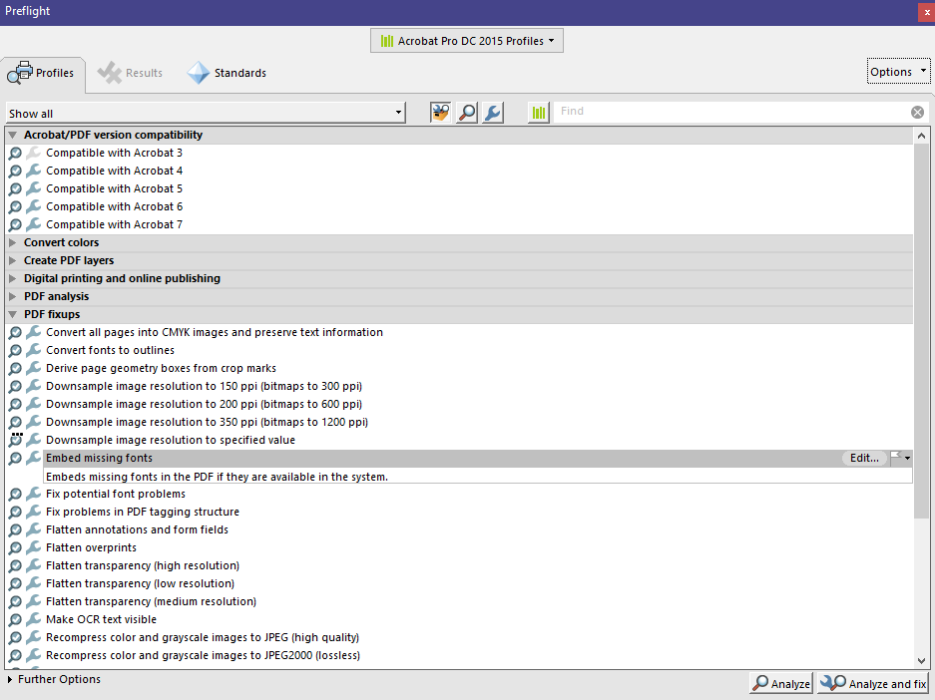
Processing PDF slides: how to embed missing fonts
◆ in Acrobat Pro (example is version 2017) do SHFT-CTRL-x
◆ look under PDF fixups for ‘Embed missing fonts’ and click the ‘Analyze and fix’ button
save the PDF file, upload it to the database, leave a comment – and you are done ☺

Slide 30
Now the challenge: processing PowerPoint slides
If the author uploaded PPT (PowerPoint) slides only …
◆ download the PPT slides file, start the slide show (press F5) for a visual inspection
and check for:
 overlapping images or text
 bad or missing characters
 animations and embedded videos
 the slides format (4:3, widescreen or whatever)
◆ in case everything looks fine, convert the PPT slides to PDF and upload them to Indico
◆ in case you detect overlaps or animations some extra work is needed before the slides can be converted to PDF

Slide 31
for overlaps or animations some extra work is needed before the slides can be uploaded
Excellent documentation, Guidelines, tutorials and instructions are available on the JACoW-Wiki pages: https://www.jacow.org/JTM2016/ProcessingTransparenciesEmbeddingAnimations
And the Indico-page of TM 2023: https://indico.jacow.org/event/65/contributions/3152/
How to fix overlaps with PPspliT
How to fix embedded videos and animated gifs in PDF files
How to extract media files like videos and animated gifs from PowerPoint
How to deal with motion path animations
How to insert mpeg-4 videos in PDF documents
How to insert videos in PDF documents
How to deal with Missing characters
How to deal with Shapes or captions covering videos
How to fix embedded video in a PDF document that appears with a fragmented black frame
How to convert PowerPoint slides to PDF
How to adjust the slides format

Slide 32
Remember: Processing transparencies
… means producing PDF files of transparencies
The aim of the slides processing editor is to produce JACoW compliant PDF files of the presentations for inclusion in the proceedings.
There is no need to edit the type setting or layout, but you have to make sure the following:
all fonts must be embedded
all missing characters should be fixed
slides should be free of overlapping issues
multimedia content (videos, animated gifs) should be embedded
Notes:
Presentation of Michaela follows

Slide 33
How to process transparencies
Michaela Marx, DESY, Hamburg, Germany
JACoW Team Meeting, November 2023, HsinChu, Taiwan

Slide 34

Processing slides:
How to convert PowerPoint slides to PDF?

Slide 35
Processing slides: how to convert PPT to PDF
There are different ways to convert PPT slides to PDF – but there is only one way recommended:
◆ print the slides to the Adobe PDF printer
Exception: Use Save As type PDF when printing to Adobe PDF failed, e.g. when images look strange or colors have changed
◆ only this way makes sure to embed all fonts

Slide 36
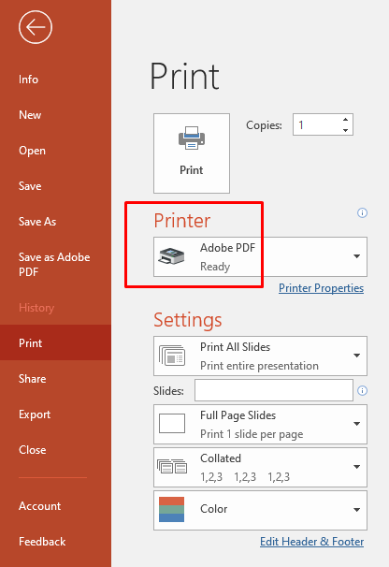
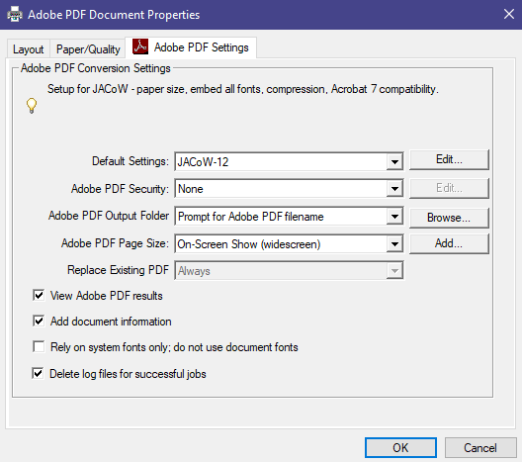

Print the slides to the Adobe PDF printer for conversion to PDF
Printer Properties
◆ select the JACoW-12 options
◆ choose the correct Adobe PDF Page Size based on the slides format
uncheck here
◆ the JACoW-12 options make sure that all fonts will be embedded
◆ for the widescreen format select On-Screen Show (widescreen) from the list of available page sizes

Slide 37
Processing slides:
How to adjust the slides format

Slide 38

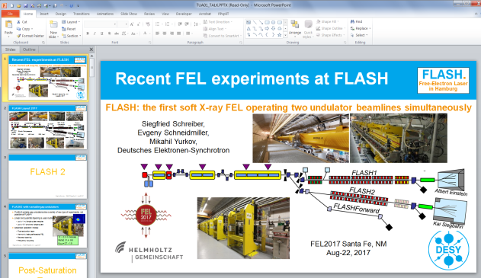

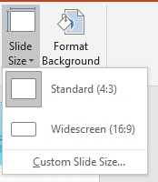
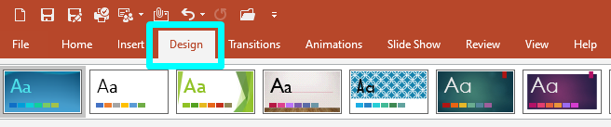
Processing slides: different formats
Standard (4:3) Widescreen (16:9) Custom Slide Size
◆ to check the format → select Design → Slide Size
◆ the slide size is highlighted in grey,
if not, click on Custom Slide Size to
get the size

Slide 39
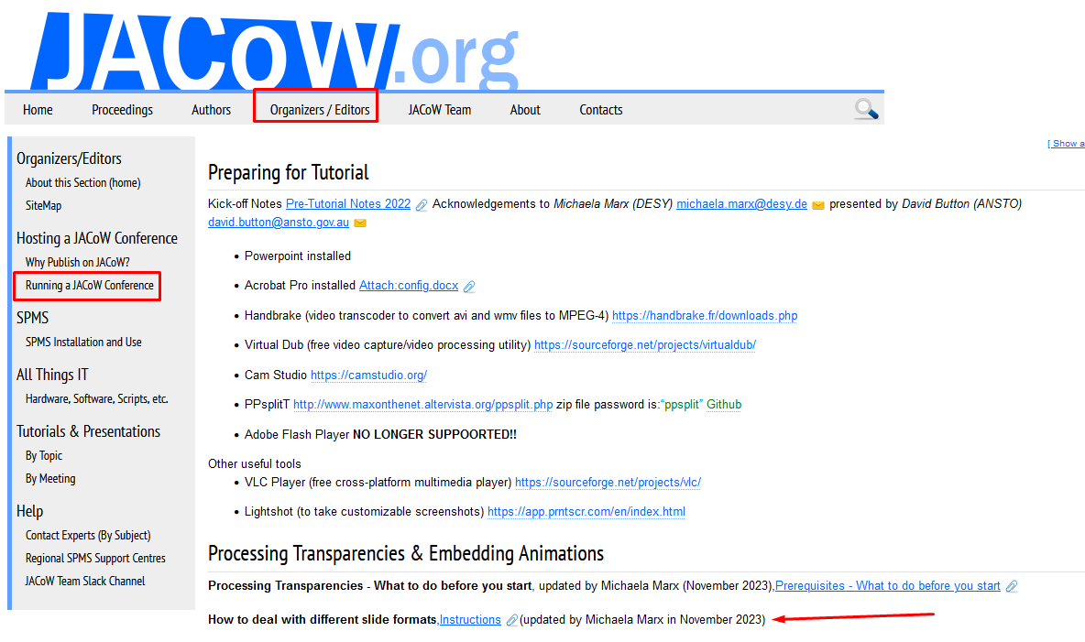
Processing slides: how to deal with different formats
► look at the JACoW-Wiki pages for further instructions:
https://www.jacow.org/JTM2016/ProcessingTransparenciesEmbeddingAnimations

Slide 40
Processing slides:
Fixing overlaps with PPspliT

Slide 41

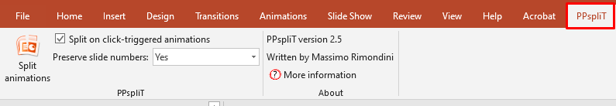
Fixing overlaps using PPspliT
◆ the PowerPoint Add-in named PPspliT is used to separate overlapping content
◆ the installation of the Add-in is described in the Prerequisites on the JACoW Wiki pages:
https://www.jacow.org/JTM2016/ProcessingTransparenciesEmbeddingAnimations
◆ after the add-in has been installed PowerPoint offers a new tab named PPspliT.
To run the add-in select the slides where you want to split the overlapping content and hit the
Split animations button on the left.
◆ slide numbers should be preserved!
41
Notes:
And is mentioned at the beginning of the talk

Slide 42
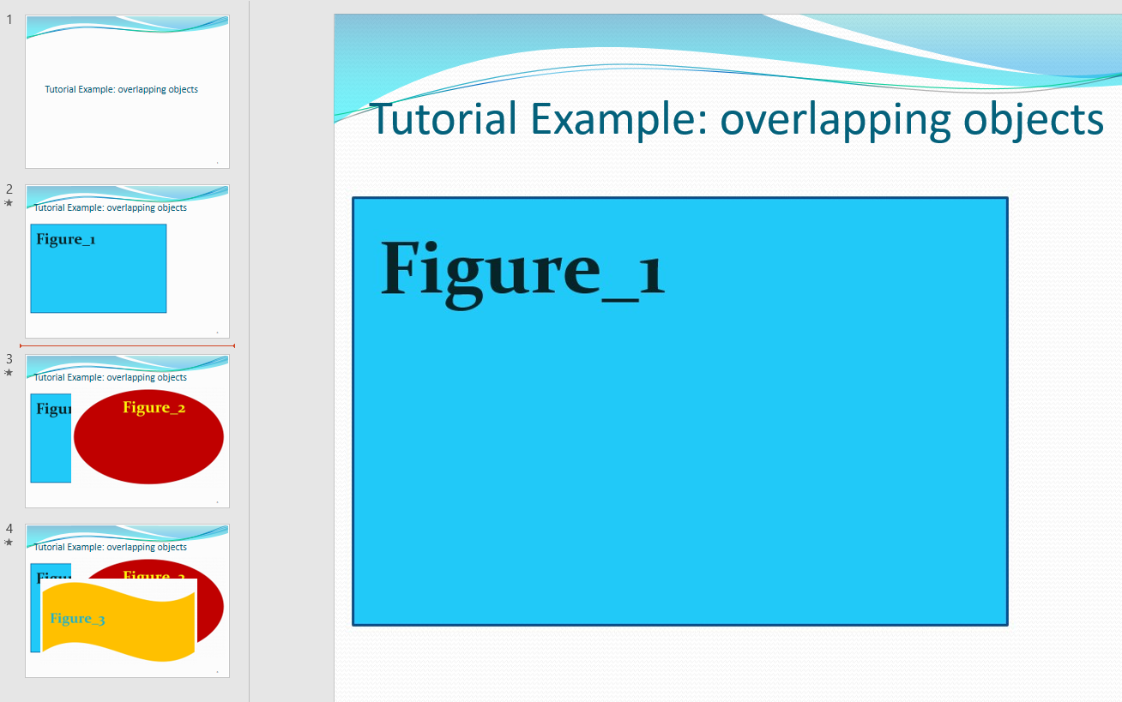
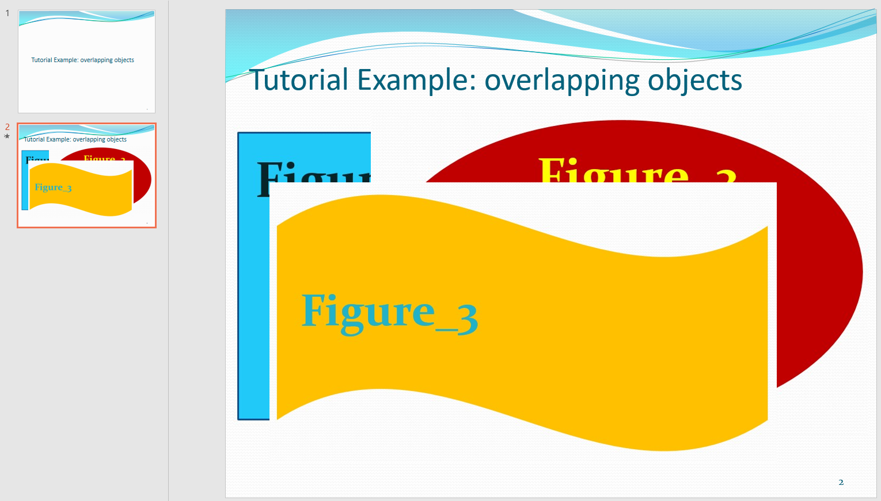
Fix overlaps using PPspliT: Example
◆ in this example the macro separated the overlaps and split one slide into three
► save the split slides as <filename>_TALK_split.pptx
and do not forget to upload the split file to the Indico well as the converted PDF file

Slide 43

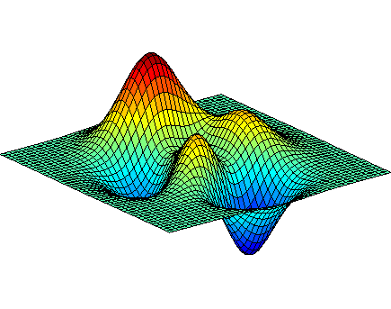
Processing slides:
Embedding videos and
animated gifs in PDF files

Slide 44

Embedding videos and animations in PDF files
If the PowerPoint presentation contains videos or animated gifs …
◆ extract the media files
◆ transform video files (*.avi) to MPEG-4 (*.mp4) which is the supported Acrobat video format
transform animated gifs to MPEG-4 directly with Convertio
◆ convert the PPT slides to PDF by printing to Adobe PDF
◆ after all these steps, open the PDF slides file and embed the videos and animations
Notes:
Transform with convertio, handbrake… How-to follows

Slide 45
Processing slides:
How to extract media files like videos and animated gifs from PowerPoint

Slide 46
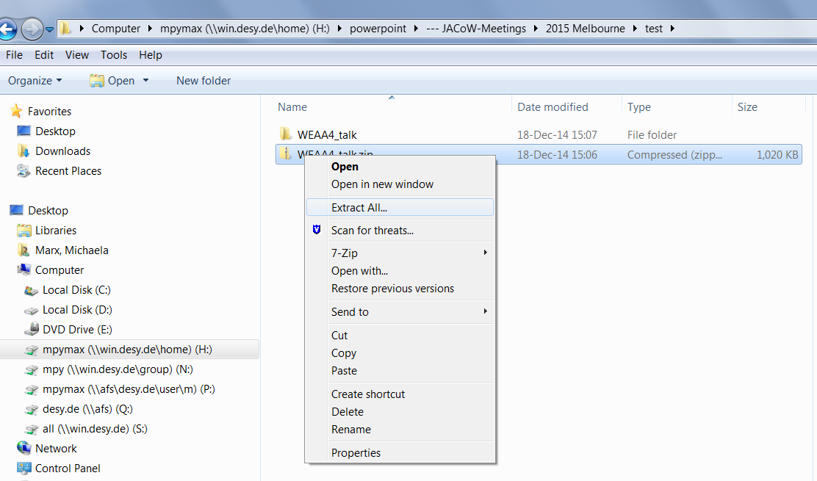
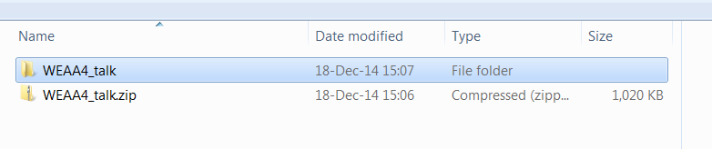
How to extract Media Files from PowerPoint Presentations
In PowerPoint go to File and click Save As. Make sure you choose the .pptx format
Go to the directory where you saved the presentation and rename the .pptx file to .zip
Use an archive extractor tool, e.g. 7-zip, WinZip or (easier) just do a
right-mouse-click to extract the .zip file contents
new folder

Slide 47
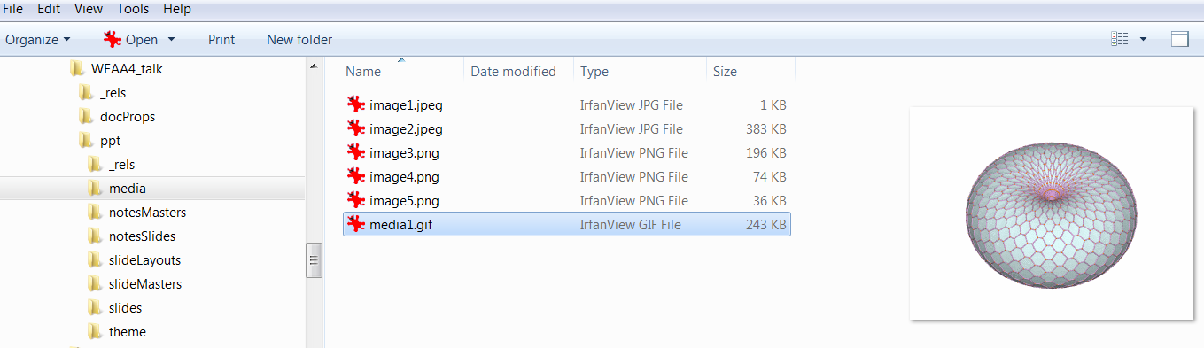
How to extract Media Files from PowerPoint Presentations
All images, videos and animated gifs are saved in a subfolder named media:
► these media files (.gif, .avi, .wmv or whatever) must be converted to mpeg-4 for embedding in the PDF file
► Note: to reduce the size of extracted mpeg-4 files just use Handbrake and convert from mpeg-4 to mpeg-4 ☺

Slide 48
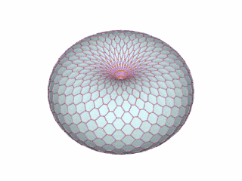


animated gifs
Example
Reference:
http://visualizingmath.tumblr.com/post/52743559077/a-torus-consists-of-a-central-axis-with-a-vortex
an animated gif is a type of gif image that can be animated by combining several images into a single file, like a flip-book
https://www.labbe.de/blog/Mond-Daumenkino

Slide 49
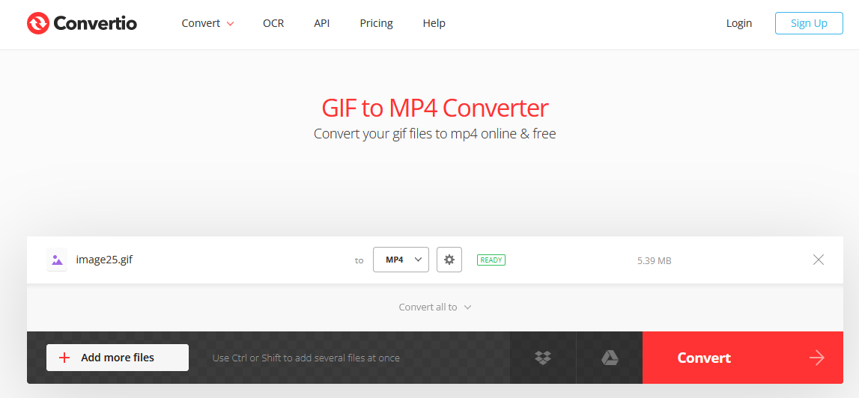
Transforming animated gifs to mp4 using Convertio
is a powerful file converter
► converts animated gifs directly to mp4 online & free through the web browser
https://convertio.co/gif-mp4/
► faster then using VirtualDub and Handbrake (which takes two steps to convert from gif to mp4)

Slide 50
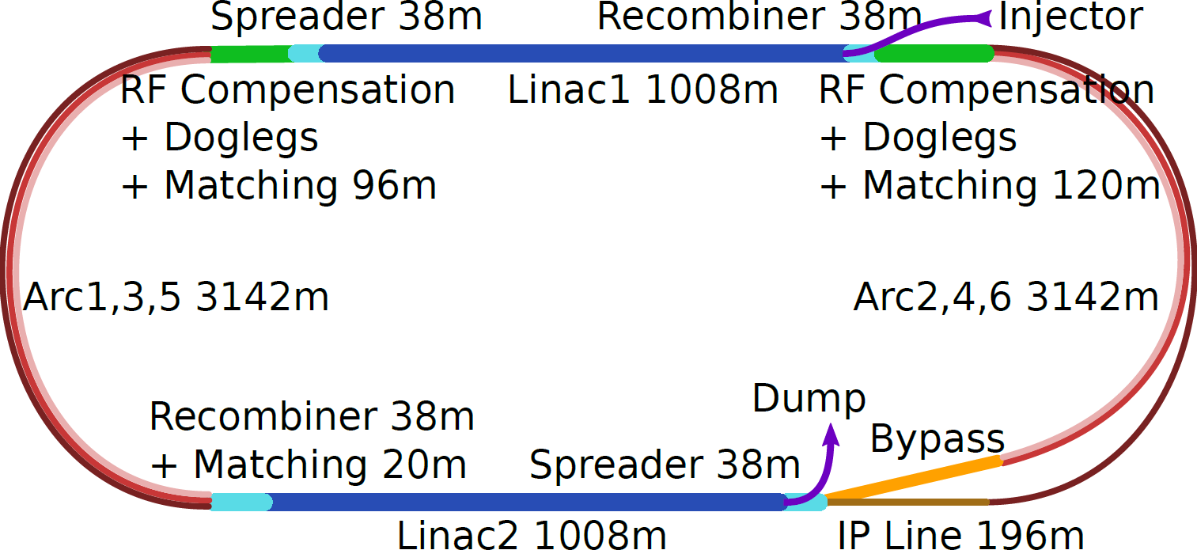
Processing slides:
How to deal with motion path animations

Slide 51
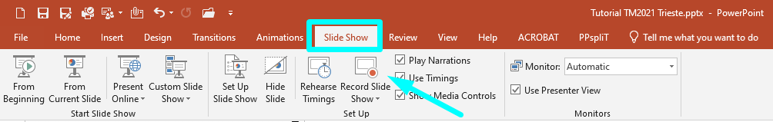
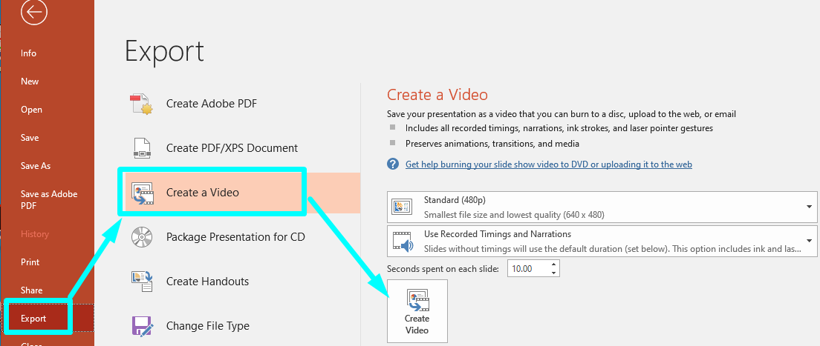
Motion Path Animations
◆ motion path animations are a very special visual gimmick in PowerPoint presentations
◆ for embedding in PDF files they can be recorded and saved as a video file
◆ PowerPoint can record a slide show
◆ After the slide has been recorded, click on File/Export and select ‘Create a Video’.
Save as type MPEG-4 video and embed the video in the PDF file.

Slide 52
Processing slides:
How to insert mpeg-4 videos
in PDF documents
Notes:
Videos can be embedded in PDF Files with Acrobat Pro only – the simple Reader does not provide that functionality

Slide 53
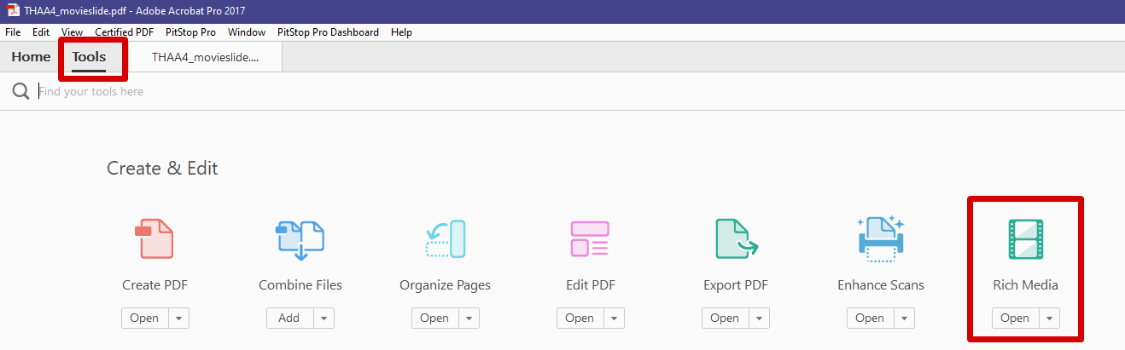
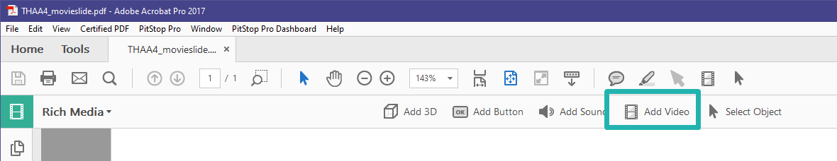
How to insert videos in PDF documents
◆ in Acrobat Pro click on Tools and select Rich Media
◆ click on ‘Add Video’
Notes:
Rich Media enables the embedding of media files

Slide 54
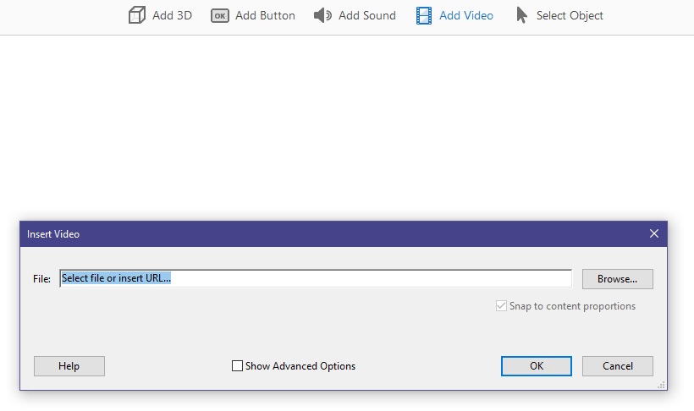
How to insert videos in PDF documents
draw a place marker on the PDF slide or double-click the page to open the ‘Insert Video’ dialog box
rectangular place marker
Notes:
Browse the video file which is stored on your PC. Check the box named „Snap to content proportions“ to maintain the original size of the video. Check the box named „Show Acvanced Options“ to configure the appearande and the behaviour of the video

Slide 55
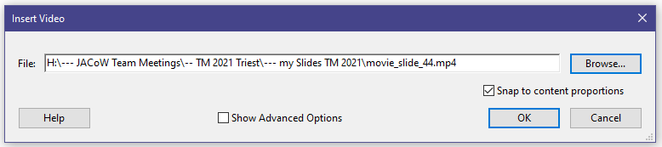
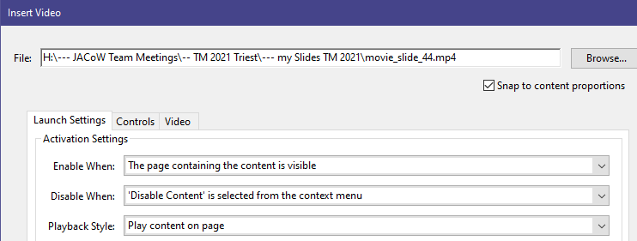
How to insert videos in PDF documents
browse the file
Select Snap to content proportions to maintain
the movie’s original size
Show Advanced Options to configure the appearance and behavior of the video.
Notes:
Possibly (IPHINE: MOV) you have to change the video format to MP3 or SWF or code to H.264 with ?? To modify the position or the size of the video use the Select Object tool from the Acrobat menu.

Slide 56
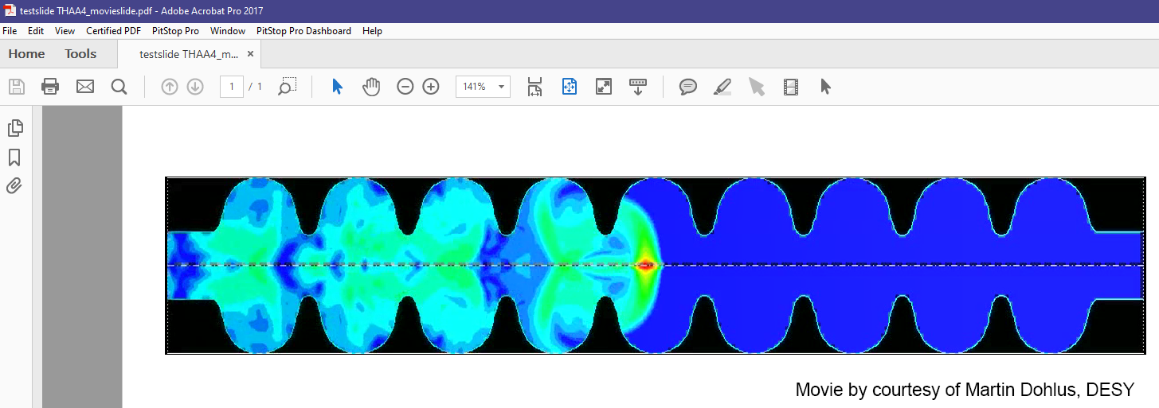


Modify videos in PDF documents
►to modify the position or the size of the video use the Select Object tool
Notes:
In some cases the embedded videos do not behave as expected. The following tricks can be useful to make life easier.
It could happen that captions or text boxes are overlapping an embedded video in a PowerPoint presentation. They are not part of the video and will disappear after conversion to PDF

Slide 57

Processing Slides: Trouble-Shooting

Slide 58
Processing Slides: Trouble-Shooting Missing characters

Slide 59
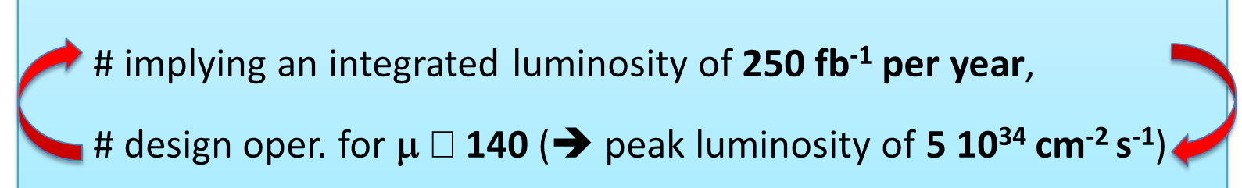

Example: PPT slide containing text, symbols and numbers
◆ when running PowerPoint, not embedded characters appear as a blank box which is a
placeholder for a missing font - quite hard to detect!
◆ when you are not sure how to fix it, set status to RED and contact the author. The missing character in this example was a less than or equal sign!
Notes:
By the way: if you not sure how to fix: 1) ask your neighbor 2) ask the Collaboration 3) ask the author

Slide 60
Processing slides: Trouble-Shooting
Shapes or captions covering videos

Slide 61
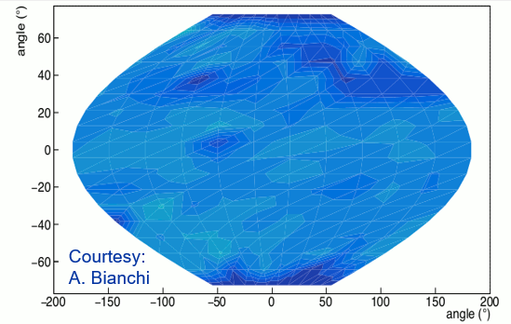
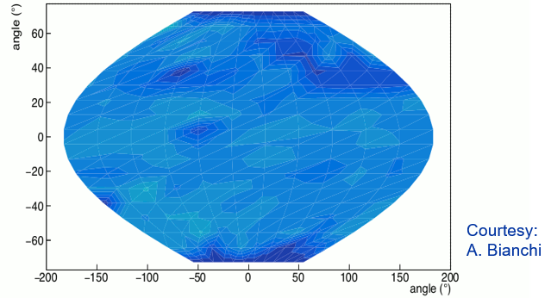
Example: Shapes or captions covering videos
► it could happen that captions or shapes on a PPT slide are covering the video
– they are not part of the video and will disappear after the conversion to PDF
► to fix this issue just move the text box before conversion from PPT to PDF
◆ in this example the text box covering the animation has been moved to the right side
Example taken from A. Bianchi et al, “Temperature Mapping on a Niobium-Coated Copper Superconducting Radio-Frequency Cavity”, arXiv:2305.09597 [physics.acc-ph], 2023

Slide 62
Processing slides: Trouble-Shooting
Embedded video in a PDF document appears with a fragmented black frame

Slide 63
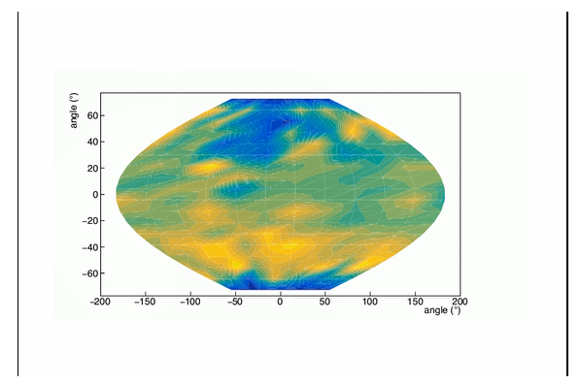
Example: Black lines around an embedded video
► after a video has been embedded in the PDF file you see black lines surrounding the video
… this is a bug in Acrobat - Adobe is not able or not willing to fix it ☹
► try to get rid of the lines by changing the size of the video – sometimes it works, sometimes not
☹
☹
Example taken from A. Bianchi et al, “Temperature Mapping on a Niobium-Coated Copper Superconducting Radio-Frequency Cavity”, arXiv:2305.09597 [physics.acc-ph], 2023

Slide 64
Kontakt
  Ruth Rudolph
  Telefon: +49 (0)40 8998-2468
  E-Mail: ruth.rudolph@desy.de
Deutsches Elektronen-Synchrotron DESY
  Accelerator Division
  Notkestraße 85
  22607 Hamburg
  www.desy.de
Notes:
I am happy to iterate the HOW TOS and like to encourage you to get in contact with me. I‘d like collect more problems and solutions, keep the documentation up to date and improve

