Slide 1

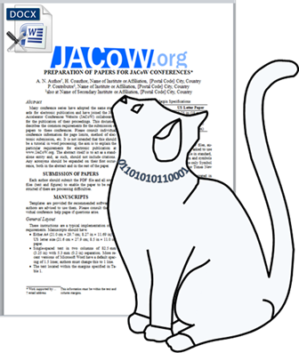
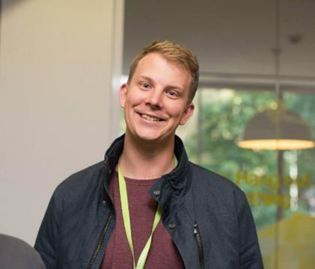



JACoW TM 2025
JACoW CatScan Editor
Ref Search
https://scan.jacow.org
https://refs.jacow.org
Now in some

Slide 2
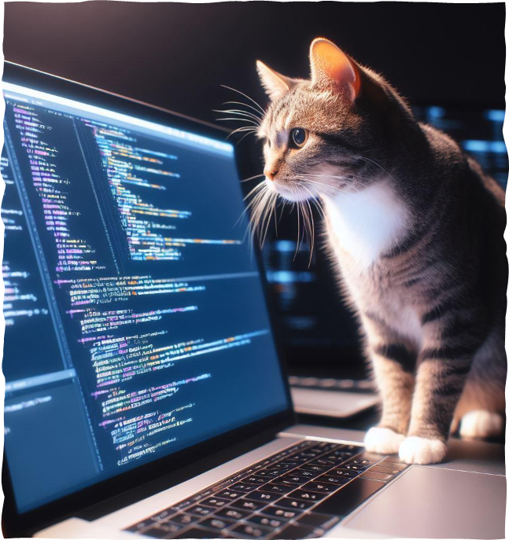
Why CatScan?
Best effort editor, it’s not purrrfect can have false positives, but can be a powerful alliance of authors and editors
Authors become editors for standard detectable errors, and learn from the feedback
Consistent review which doesn’t get tired and start overlooking errors or focused on one type
Give editors back more time to focus on other aspects of proceedings production, or reduce need for as many editors for conferences

Slide 3


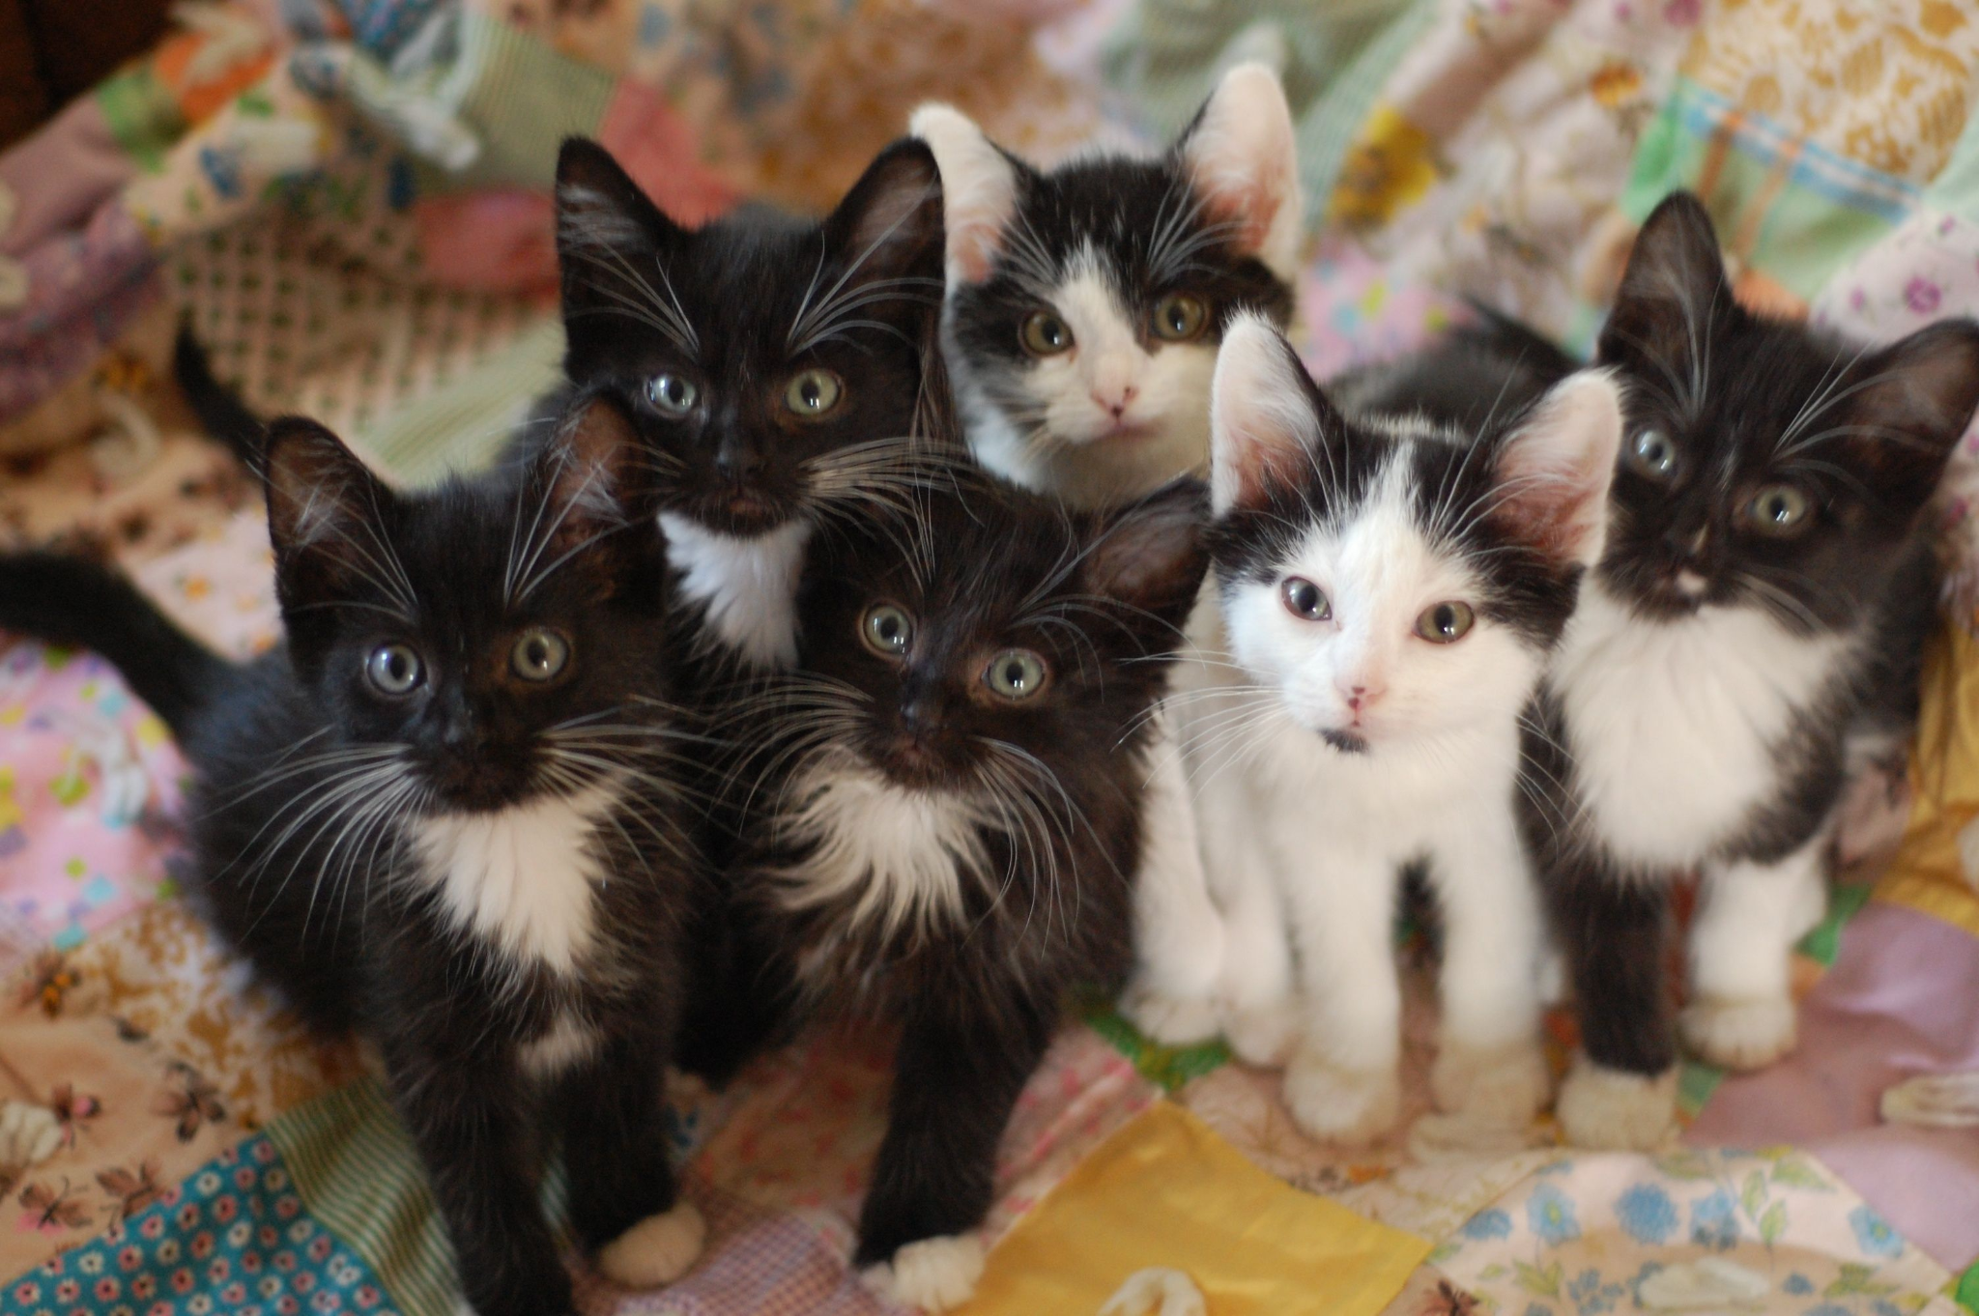
Changes for IPAC’25
Creation of some initial LaTeX checks
AI Summary of LaTeX results
Formatting of LaTeX results on scan.jacow.org\
Automatic results (as comments) for
IPAC’25 and NaPAC’25
Introduce new pagesize word template format check
Work Required (Litter of Kittens)
Automation of CatScan availability for all future conferences
Introduction of new latex checks
Missing figures, table not referenced, etc…
Removal of “Warnings” on word checks unsure about issues
Projects of deliverables or Litter of Kittens
Sponsors and contributors are welcomed :)

Slide 4


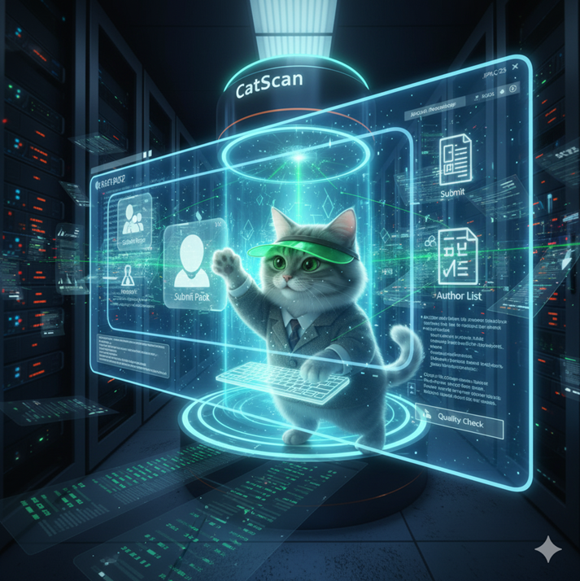
Plugging CatScan into IPAC’25
Word:
At 278 Word contributions in Indico.
110 (42%) have subsequent uploads with improvements by authors.
In total, authors addressed 4,636 identified by CatScan
LaTeX:
At 419 LaTeX (non BibTex) contributions in Indico.
163 (38%) have subsequent uploads with improvements by authors.
In total, authors addressed 1,053 identified by CatScan

Slide 5

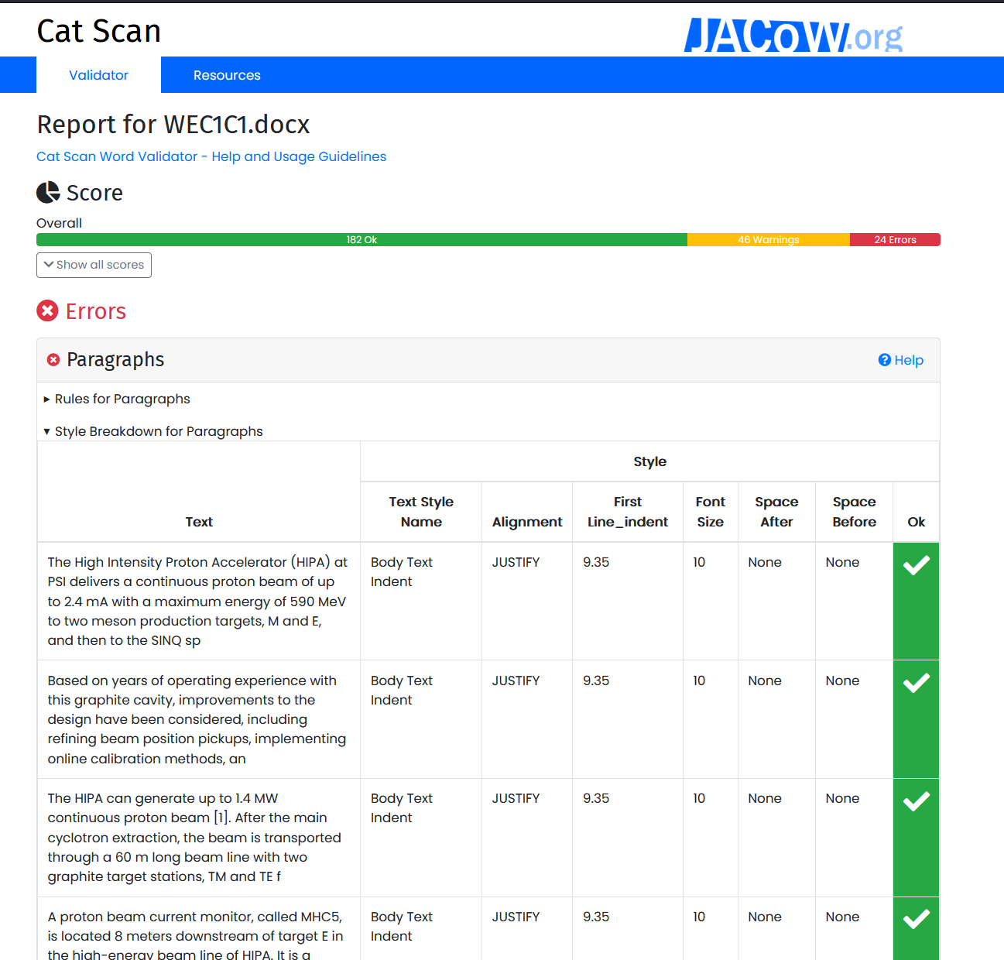
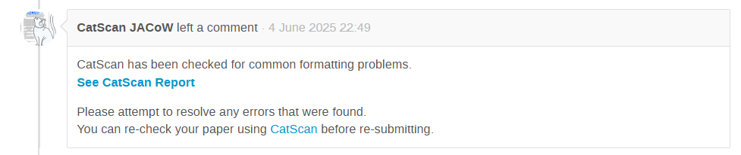
Word Check
Notified By Indico of a new upload
Reads document
Produces detailed report
Posted comment on paper with a link to the report (new)
Authors and Editors can click the link to quickly access a CatScan report

Slide 6

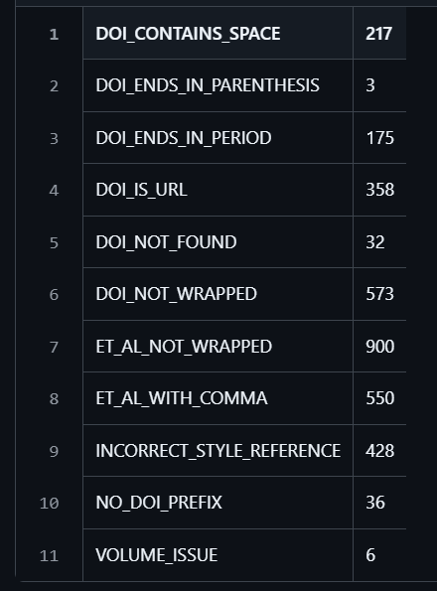
LaTeX Check (new)
Notified by Indico of a new upload
Reads document
Checks for common issues
(common issue codes on the right)
Produces detailed report
AI used to summarise report as a comment
Posted comment on paper
(or displays on website)
Example issue detection summary from initial paper submissions for IPAC’25

Slide 7
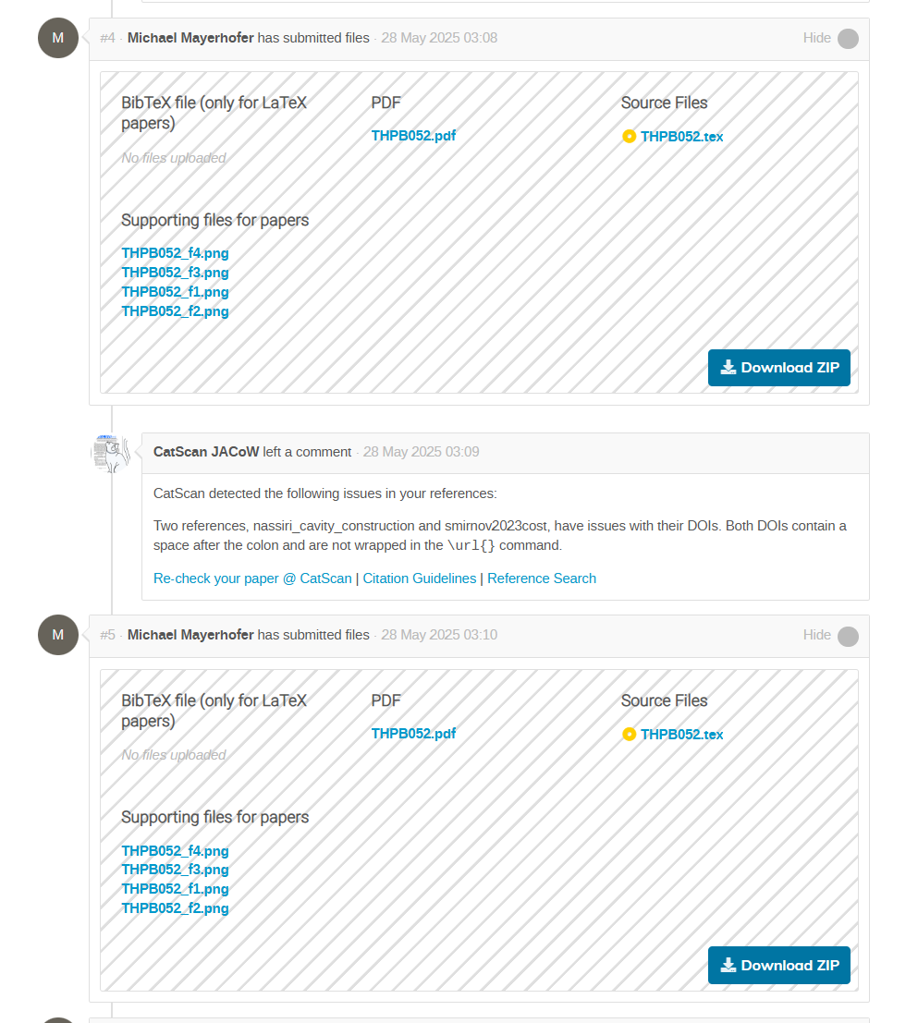
We achieved the dream from 2019!
On upload CatScan performs the check and provides feedback in a comment
Author’s can address issues themselves!
🥳🎉

Slide 8
Reference Search
https://refs.jacow.org/

Slide 9
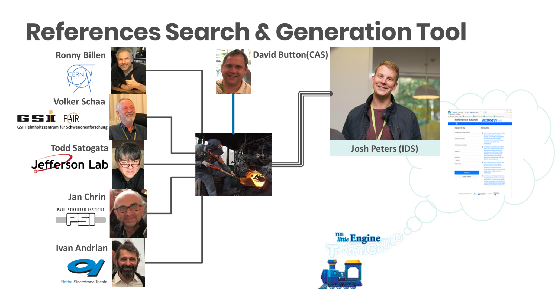

Slide 10
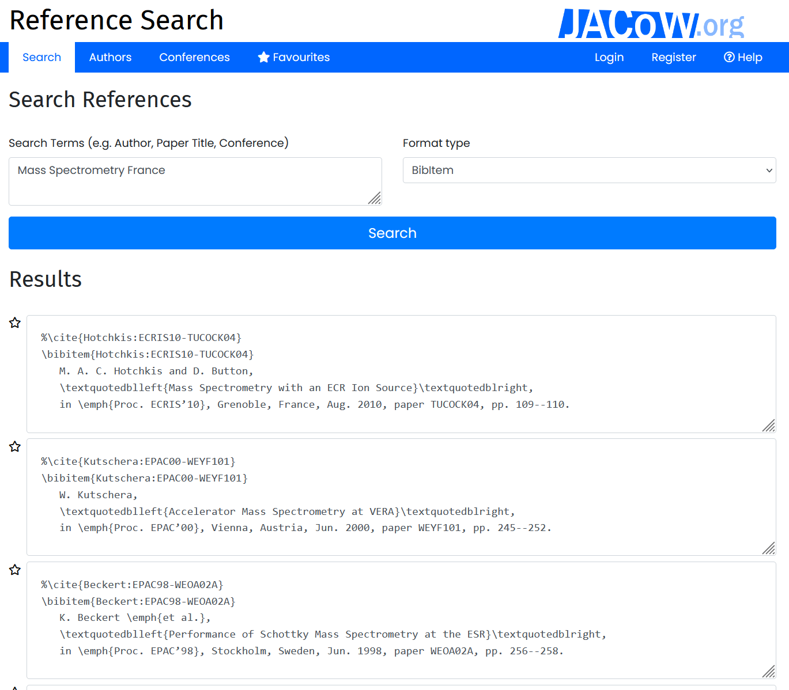
What is it?
https://refs.jacow.org/
Widely used free web application for authors and editors
Outputs LaTeX / BibTex and Word references in the JACoW format
Search index of all published and unpublished JACoW papers (~76,000)
Indexes for unpublished papers including for the current conference
Now also searches external papers

Slide 11
What’s New?
Creation of public search API
Improvements to external search (journal lookup, and doi search)
Introduction of hyperlinks to DOIs for latex (using \doi command) and word
Conference status on list page
CatScan integration - Reference cross-checking

Slide 12
What’s Next?
Automatic Conference Population - During and Post Conference
BibTeX Database
Integration with Single-Sign On from Indico

