Slide 1
IT management for a conference: software requirements, setup, and installation specifications (IPAC25)
Ping Shun (David) Chuang
Notes:
Good morning everyone. My name is Ping Shun David Chuang, and today I'm going to share with you our experience managing the IT infrastructure for IPAC'25 - the International Particle Accelerator Conference that took place in Taipei in June 2025.
This presentation will cover the comprehensive software requirements, hardware setup, and installation specifications that we implemented for this major international conference. We'll walk through the challenges we faced and the solutions we developed for managing over 1,300 papers and supporting hundreds of participants across multiple venues.

Slide 2
IPAC’25 Timetable
JUNE , 2025
S
Student Poster
Registration
Welcome Reception
Parallel Scientific Sessions
Exhibitions, Posters
Session for Industry
1
4
Opening Plenary Talks
Chair’s Cocktail
Parallel Scientific Sessions
Awards Ceremony /Entertainment Talk
Exhibition, Posters
Conference Banquet
2
5
Parallel Scientific Sessions
Exhibition, Posters
Parallel Scientific Sessions
Posters, Exhibition
PRE Session
Plenary Talks
Closing Remarks
Facility Tour
3
6
Notes:
Let me first give you an overview of the conference schedule. IPAC'25 was a six-day event running from June 1st through June 6th, 2025.
Day 1 began with student poster registration and a welcome reception. Days 2, 4, and 5 featured parallel scientific sessions with exhibitions and posters running throughout. We had an opening plenary session with the Chair's Cocktail on Day 4, and an awards ceremony with entertainment on Day 2, followed by the conference banquet.
Day 3 included a special PRE session - that's Productive Research Environment session - along with continued parallel sessions. And finally, Day 6 concluded with plenary talks, closing remarks, and facility tours.
This packed schedule meant our IT systems needed to be operational and reliable for the entire six-day period, supporting multiple simultaneous activities across different venues.

Slide 3
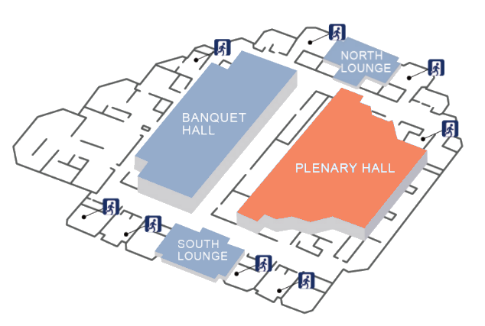

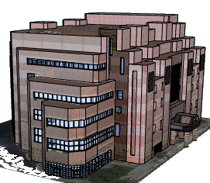
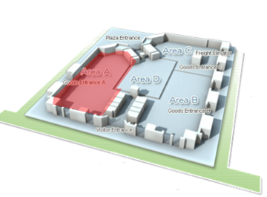
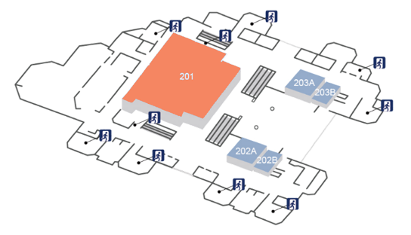
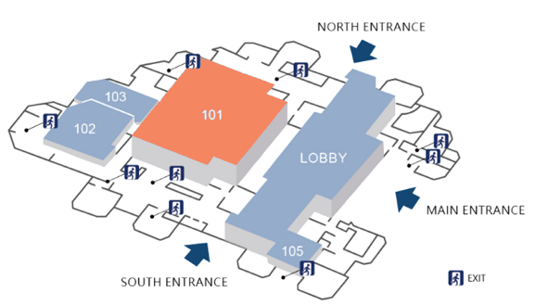
IPAC25 Venues
3rd Floor
Conference Venue
Taipei International Convention Centre
Plenary Hall Opening Ceremony
Exhibition Hall
Taipei World Trade Center
2nd Floor
Room 201
Scientific Session (Parallel B)
1st Floor
Room 101
Scientific Session (Parallel A)
Closing and Award Ceremony
Registration
Exhibitions
Posters
Coffee break & Lunch
Notes:
We operated across two main facilities in Taipei. Let me show you the layout.
The Taipei International Convention Centre served as our primary conference venue. On the 1st floor, we had the Plenary Hall for opening ceremony, registration areas, exhibitions, posters, and the coffee break and lunch areas.
The 2nd floor housed Room 101 for Scientific Session Parallel A.
The 3rd floor contained Room 201 for Scientific Session Parallel B, and this was also where we held the closing and award ceremony.
Our second venue was the Taipei World Trade Center Exhibition Hall. This was critically important because it housed our Proceedings Office and additional exhibition space.
This dual-venue setup presented interesting IT challenges - we needed to ensure seamless connectivity and consistent systems across both locations, which were separate buildings. Network reliability between venues became a key concern that we had to address early in our planning.

Slide 4


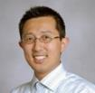
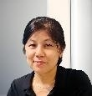




IPAC’25 Committees and Tasks
OC Chair
SPC Chair
LOC Chair
Scientific Secretariat
Ming-Chyuan Lin (NSRRC)
Yoichi Sato (KEK/J-PARC)
Jui-Che Huang (NSRRC)
Stella Su (NSRRC)
Team C
Light-Peer-Review (Max. 120)
Student Posters & Grants (Max. 80)
ACFA / IPAC25 Awards
Posters (Max. 1300)
Facility Tours
Conference APP
Team D
Scientific Program
Industry Session
Productive Research Environment Session
SPC1/2/3 Events
Team A
Venue Arrangements
P.C.O. Meetings
Sponsorship
Finance
Conference Hotel
Registration
Entertain. Talk
Team B
JACoW Team (~ 1300 papers processed)
Oral Presentation (86 talks)
Proceedings Office – IT Team
Related Software Setup
Conference Website
Regular Announcement
SPC Chair : Dr. Sato, KEK
Notes:
The conference was led by three chairs: Dr. Yoichi Sato from KEK/J-PARC as SPC Chair, Dr. Ming-Chyuan Lin from NSRRC as OC Chair, and Dr. Jui-Che Huang from NSRRC as LOC Chair. Stella Su from NSRRC served as Scientific Secretariat.
The work was organized into four teams:
Team A handled venue arrangements, PCO meetings, sponsorship, finance, conference hotel management, registration, and the entertainment talk.
Team B - and this is where I focused most of my attention - was responsible for the JACoW Team processing approximately 1,300 papers, coordinating 86 oral presentations, running the Proceedings Office IT Team, all related software setup, the conference website, and regular announcements.
Team C managed the light peer-review process for up to 120 papers, student posters and grants for up to 80 students, ACFA and IPAC25 awards, the general poster sessions with up to 1,300 posters, facility tours, and the conference app.
Team D, under SPC Chair Dr. Sato, coordinated the scientific program, industry session, the Productive Research Environment session, and SPC events.
This clear division of responsibilities was essential. Each team knew their domain, and we had regular coordination meetings to ensure all systems worked together seamlessly.

Slide 5
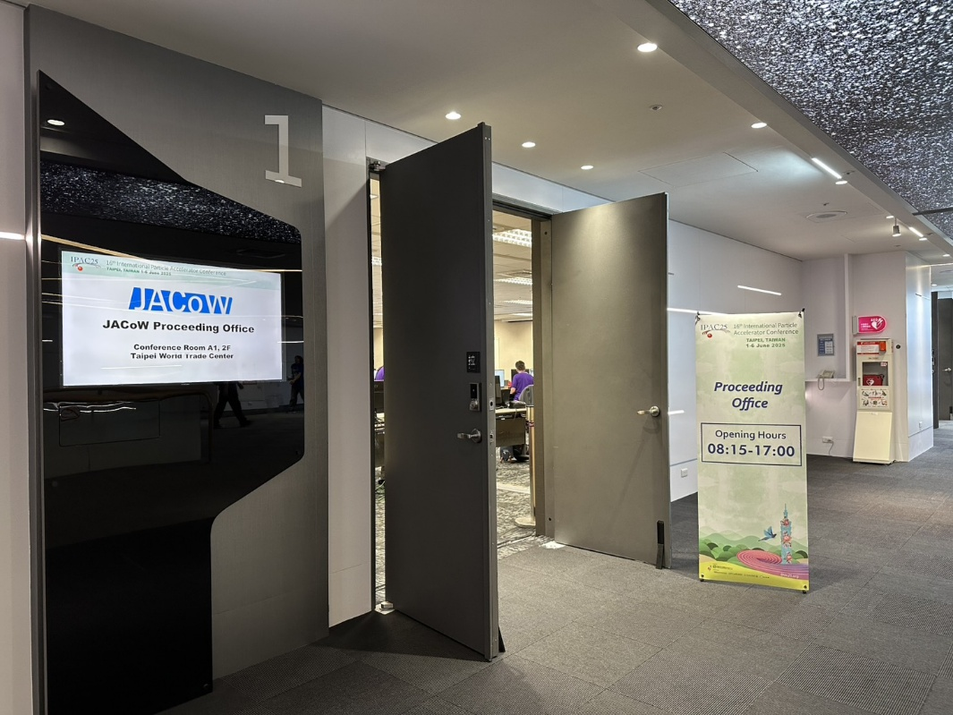
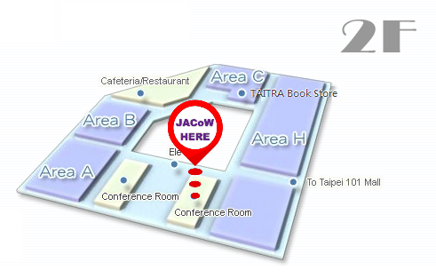
Proceeding Office
TICC – Conference (7 computers)
TWTC –Area A and Proceedings office (45 computers)
Exhibition Hall
Taipei World Trade Center
Opening Hours
08:15-17:00
Notes:
This is what our Proceedings Office looked like at the Taipei World Trade Center Exhibition Hall. As you can see, we had rows of workstations, each equipped with dual monitors for editors to work efficiently.
The office was open from 8:15 AM to 5:00 PM daily throughout the conference. We had two locations: seven computers at the TICC Conference venue, and 45 computers at the TWTC in Area A and the Proceedings office.
This centralized setup allowed us to provide consistent support, maintain standardized configurations, and quickly address any technical issues that arose. The dual-monitor setup was particularly important for editors who needed to reference source documents while editing PDFs simultaneously.

Slide 6
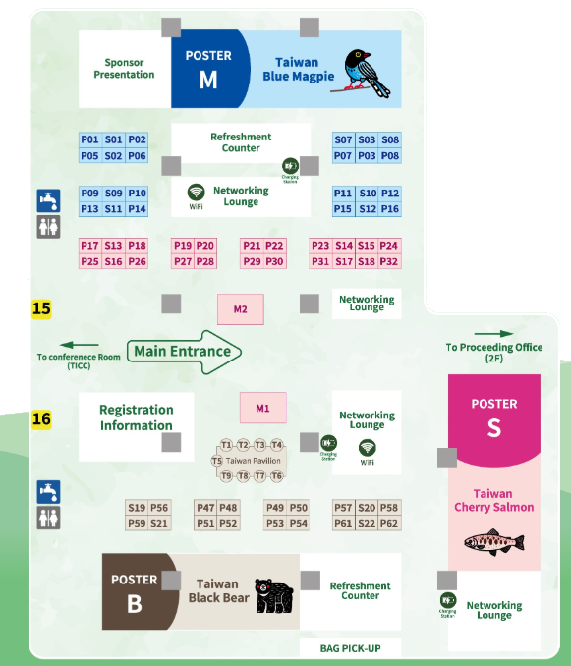

WiFi
The conference venue was provided.
Our goal is for participants to be fully engaged with the scientific sessions.
Attendees are encouraged to visit the exhibition hall for internet access.
Reliable Wi-Fi is essential to ensure our exhibitors are satisfied.
Speed : ≧1G
Location: North and South Lounge, JACoW proceeding office, meeting room
Notes:
Network connectivity was absolutely critical to our operation. Let me explain our WiFi strategy.
We required minimum speeds of 1 Gigabit, with coverage in the North and South Lounges, the JACoW proceedings office, and meeting rooms.
Now, here's an interesting decision we made: The conference venue already provided WiFi infrastructure, and our goal was to keep participants fully engaged with the scientific sessions. So we actually encouraged attendees to visit the exhibition hall for internet access rather than providing extensive WiFi in all session rooms.
This served multiple purposes. First, it kept participants focused during scientific presentations without the distraction of being online. Second, it drove foot traffic to our exhibition hall, which made our exhibitors very happy. And third, by concentrating WiFi demand in specific areas, we could ensure reliable, high-quality connectivity where it mattered most.
For our exhibitors, reliable WiFi wasn't just a convenience - it was essential for their demonstrations, lead capture systems, and business operations. We made sure they had rock-solid connectivity throughout the event.

Slide 7
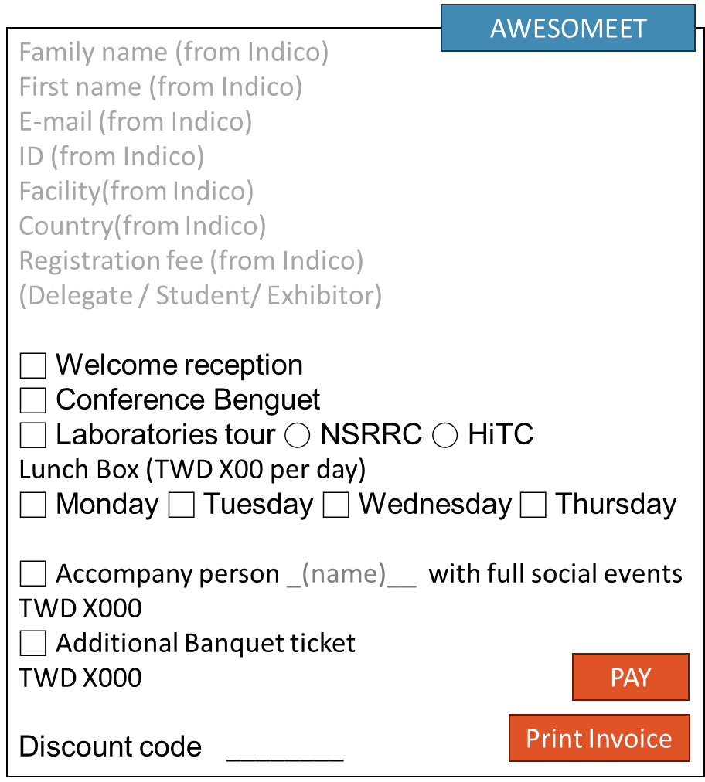
Registration Flow of IPAC’25
{event_id}→81 → IPAC’25 event
{registration_id}→17
{registration_db_id}→ 5896→ (everyone different)
{registration_form_id} →70→ Indico Registration Form Number
(PCO) pcoserver
https://pcoserver....../script.asp?code={event_id}.{registration_id}.{registration_db_id}.{registration_form_id}
paid status linked to Paymentsystem_ID
Example : https:// pcoserver....../ script.asp?code=81.17.5896.70
Sending register’s code
User information data
PCO
Indico
awesomeet
Indico
awesomeet
EC PAY
awesomeet
Indico
User information Request
PCO
API with codes
paid status linked to indico_userID
Send a GET request to indico
Indico
Once the payment is successful, send a POST request
Family name
First name
E-mail
Facility
Country
ID
Registration type
○ Full
○ Student
To get the information about the registration, send a GET request to https://indico.jacow.org/api/checkin/event/81/forms/70/registrations/{registration_db_id}
Send a POST request to https://indico.jacow.org/event/81/manage/registration/70/registrations/{registration_db_id}/toggle-payment,
ex: curl --request POST --url https://indico.jacow.org/event/81/manage/registration/70/registrations/5896/toggle-payment -H "Authorization: Bearer {indp_*********}" --form "pay=1"
Create API token generated from IPAC25 Registration manager account (IPAC25REG)
Authentication: Bearer {**********}
Notes:
Let me walk you through our registration system integration. This was one of the more complex technical challenges we faced.
We integrated three separate systems: Indico, which is JACoW's standard conference management platform; AWESOMEET, our PCO's registration system; and EC PAY for payment processing.
Here's how the flow worked:
First, users would register through Indico, providing their family name, first name, email, facility, country, and selecting their registration type - either full or student registration. Each registration received a unique ID.
Indico would then send the registrant's code to our PCO server. The URL structure encoded four pieces of information: the event ID (81 for IPAC'25), the registration ID, the registration database ID (unique for each person), and the registration form ID (70 for our form).
When payment was processed through EC PAY, and once the payment was successful, the system would send a POST request back to Indico. This would update the paid status linked to the Indico user ID.
We created an API token generated from the IPAC25 Registration manager account with Bearer authentication. This allowed secure communication between all three systems.
The beauty of this integration was that it was completely automated - once set up, registrations, payments, and confirmations all happened seamlessly without manual intervention.

Slide 8


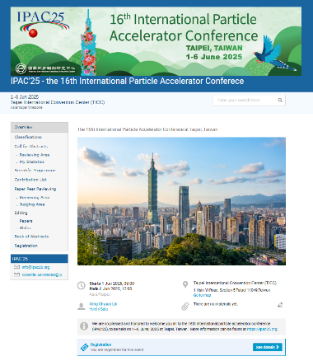
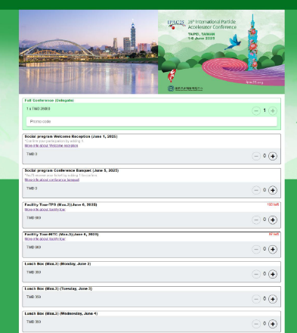
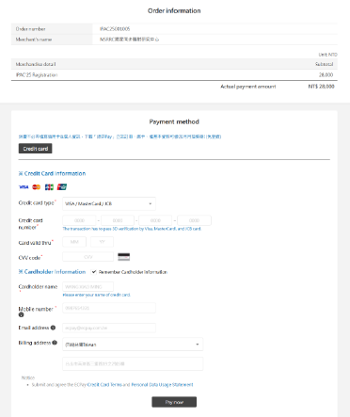
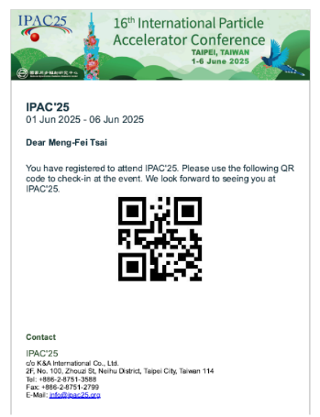
Registration Flow of IPAC’25
LOC
code
data
PCO
PCO
Indico
awesomeet
Indico
awesomeet
EC PAY
awesomeet
Indico
API with codes
PCO
Paid status linked to Indico_userID
Notes:
Let me get a bit more technical about the API implementation for those interested.
To retrieve registration information, we sent a GET request to the Indico API endpoint at indico.jacow.org with the specific event, form, and registration database ID.
To update payment status, we used a POST request to the toggle-payment endpoint. I'll show you an example: we used curl with the request POST method, included our Bearer token for authentication, and sent a form parameter "pay=1" to mark the registration as paid.
The PCO server acted as the intermediary, handling the communication between EC PAY payment confirmations and Indico status updates. User information requests flowed through this server, ensuring data consistency across all three platforms.
This might seem like a lot of technical complexity, but it was absolutely necessary to ensure accurate record-keeping and to prevent issues like duplicate registrations or payment discrepancies. The investment in proper integration paid off - we had virtually no registration problems during the conference.

Slide 9
Hardware List
Proceedings Office
30 x Windows laptops
30 x 27” 2k resolution monitors for dual monitor
2 floor-standing laser printers
Author Reception
3 Windows laptops
Speaker Preparation
4 PC Windows laptops
laptop setup should be identical to the Auditorium
Auditorium
4 laptops for each auditorium
1 Spare for each on-hand
2 x 27” floor-standing screens : one shows a timer, and the other simultaneously plays a slideshow
Satellite Meetings
2 Laptops
Projector or larger TV with stands as needed
Registration desk
4 Laptops
3 Self-service check-in machines
Dot Board/ conference information
3 Raspberry Pi (low-cost single-board computer)
3x 75” LED TVs with stands
Poster Police
18 x Apple iPad Air
Notes:
Now let's talk about hardware. The scale of equipment needed for this conference was substantial.
For the Proceedings Office, we deployed 30 Windows laptops, each paired with a 27-inch 2K resolution monitor for dual-monitor setups, plus 2 floor-standing laser printers.
Author Reception required 3 Windows laptops for checking in authors and handling questions.
Speaker Preparation needed 4 PC Windows laptops, and this was critical - the laptop setup had to be absolutely identical to what was in the auditoriums to ensure file compatibility.
At the Registration Desk, we had 4 laptops plus 3 self-service check-in machines to handle the volume of attendees efficiently.
For our Dot Board and conference information displays, we used 3 Raspberry Pi units - these are low-cost single-board computers that are perfect for digital signage - driving 3 75-inch LED TVs with stands.
For Poster Police - our team that photographed and documented posters - we equipped them with 18 Apple iPad Airs.
In each Auditorium, we installed 4 laptops with 1 spare unit on hand for each room, plus 2 27-inch floor-standing screens: one displayed a timer for speakers, and the other simultaneously played the slideshow.
And for Satellite Meetings, we provided 2 laptops and projectors or larger TVs with stands as needed.
In total, we're talking about approximately 80+ devices coordinated across multiple locations and purposes.

Slide 10
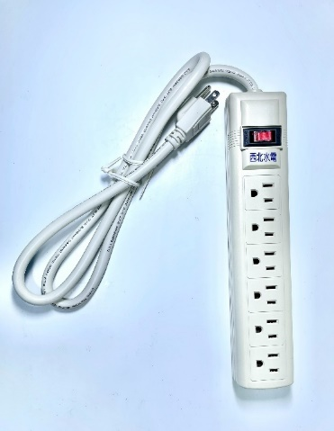
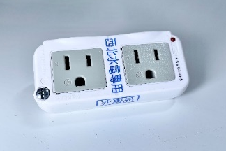
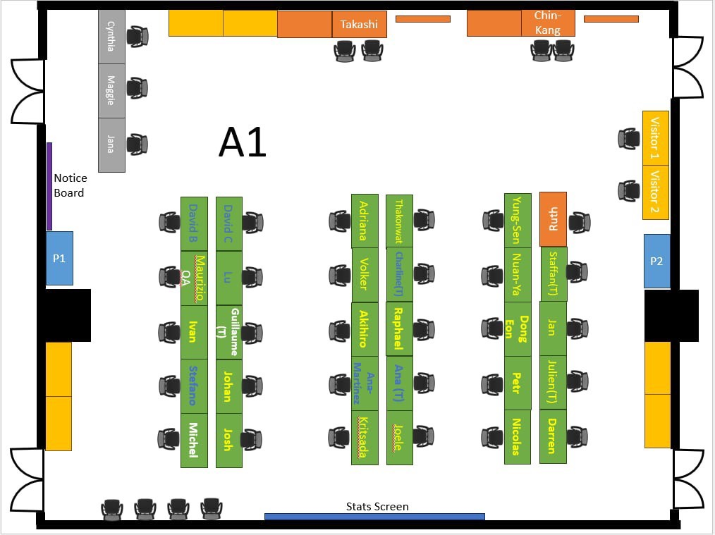






Proceeding Office Layout
Power outlet : 110V/5A
power extension cord
Power outlet : 110V/5A
Power outlet : 110V/15A
Power extension cord
Editors x26+1
Presentation Manager x3+1
Author Reception x3
Software x1
Indico x 1
Notes:
This diagram shows the physical layout of our Proceedings Office. Layout planning was crucial for operational efficiency.
We organized the space into distinct zones. We had 26 plus 1 editor workstations - that extra one being for the lead editor. Three plus one presentation manager stations. Three author reception stations for handling author questions and submissions. One dedicated software support station, and one Indico management station.
Power management was critical. We carefully mapped out 110V/5A and 110V/15A power outlets. You can see the power extension cords strategically placed throughout the room to ensure every workstation had adequate power without overloading circuits.
When you have 30 computers, 30 external monitors, printers, and other equipment all running simultaneously for 8-9 hours a day, power distribution becomes a real concern. We worked closely with the venue's electrical team to ensure we had sufficient capacity and proper load balancing.
The layout also facilitated workflow - editors could easily communicate with each other, presentation managers were positioned near the entrance to handle incoming presentations, and our support staff were centrally located to quickly respond to any technical issues.

Slide 11
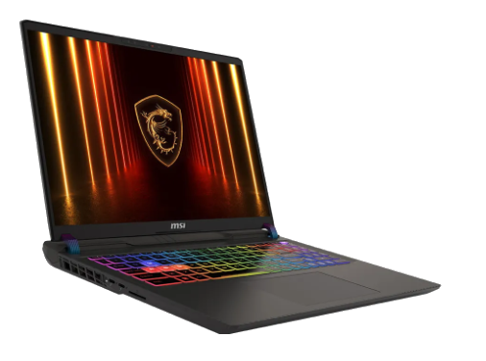
PC Hardware for Editing
Compact and no UPS is needed during the IPAC.
Laptop Specifications Brand: MSI Thin GF63 15.6
Processor: Intel i7 –i12650H
Memory: 32GB
RAMStorage: 512GB SSD × 2
Graphics Card: GPU RTX3050
Operating System: Windows 11
Office Software: Microsoft Office 2024
Accessories: Mouse and external keyboard
Maintenance Service: Includes troubleshooting and spare unit replacement
Display Support: Laptop must be able to connect to an external monitor
Ethernet: Wired 1Gbps
ExtraMonitor: 27 inch
MSI GF63 Gaming Notebook with High performance
Notes:
Let me detail the laptop specifications, because choosing the right hardware was critical for performance.
We standardized on the MSI Thin GF63 15.6 gaming notebook. Now, you might ask, why gaming laptops for a scientific conference? Let me explain.
Processor: Intel i7-12650H - powerful enough to handle intensive PDF processing and LaTeX compilation
Memory: 32GB RAM - essential when editors are working with multiple large documents simultaneously
Storage: Dual 512GB SSDs - this redundancy was important for data safety, and the speed made a huge difference in compilation times
Graphics: NVIDIA GeForce RTX 3050 GPU - helpful for PDF rendering and when dealing with graphics-intensive papers
Operating System: Windows 11 with Microsoft Office 2024 pre-installed
Each laptop came with a mouse and external keyboard for ergonomic work. We included maintenance service covering troubleshooting and spare unit replacement - this gave us peace of mind.
Display support was verified to ensure compatibility with external 27-inch monitors. And importantly, each had Gigabit Ethernet connectivity.
Why gaming laptops specifically? They're compact, incredibly powerful, they handle heat well with good cooling systems, and here's a key advantage - they have robust power management, so we didn't need UPS systems for each workstation. This simplified our power infrastructure considerably.
These laptops performed flawlessly throughout the six-day conference, handling everything we threw at them.

Slide 12
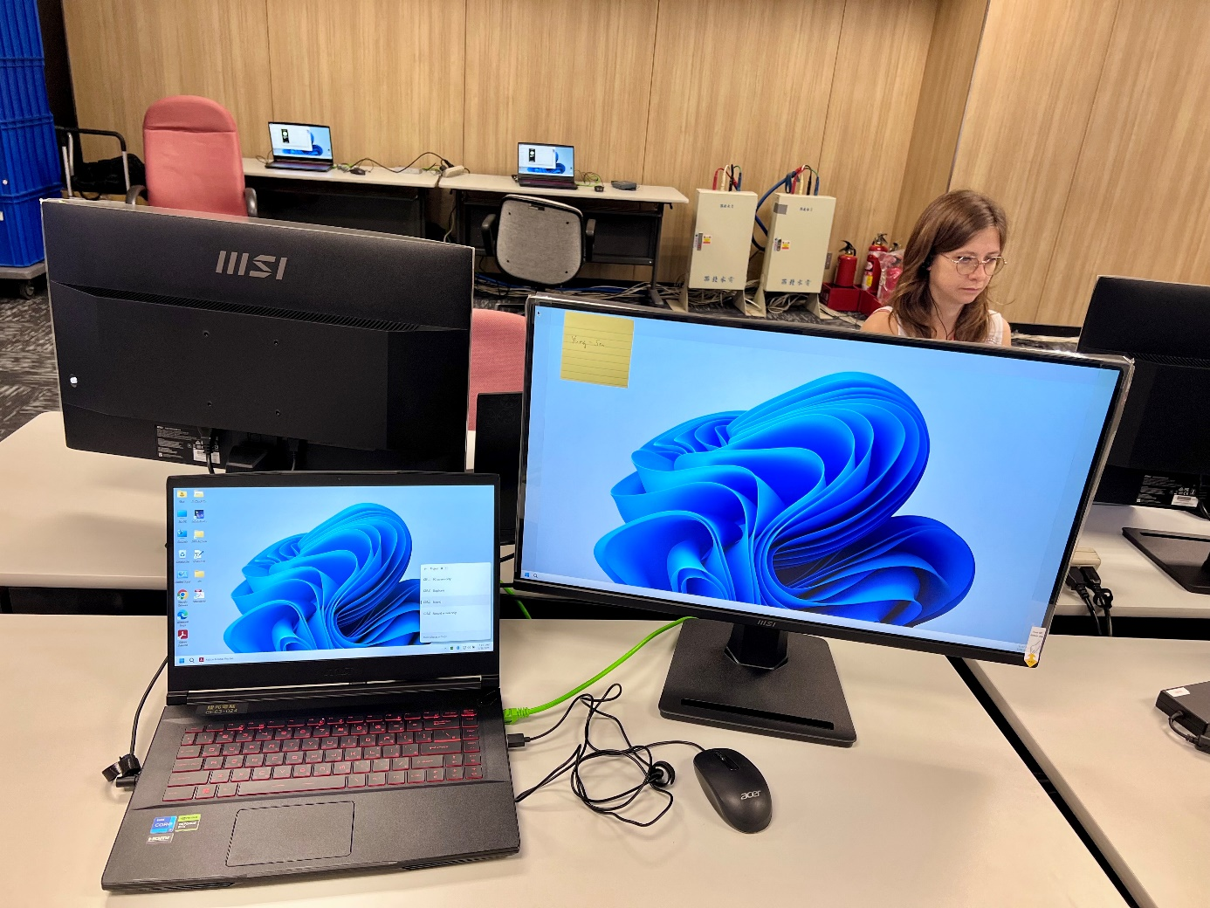
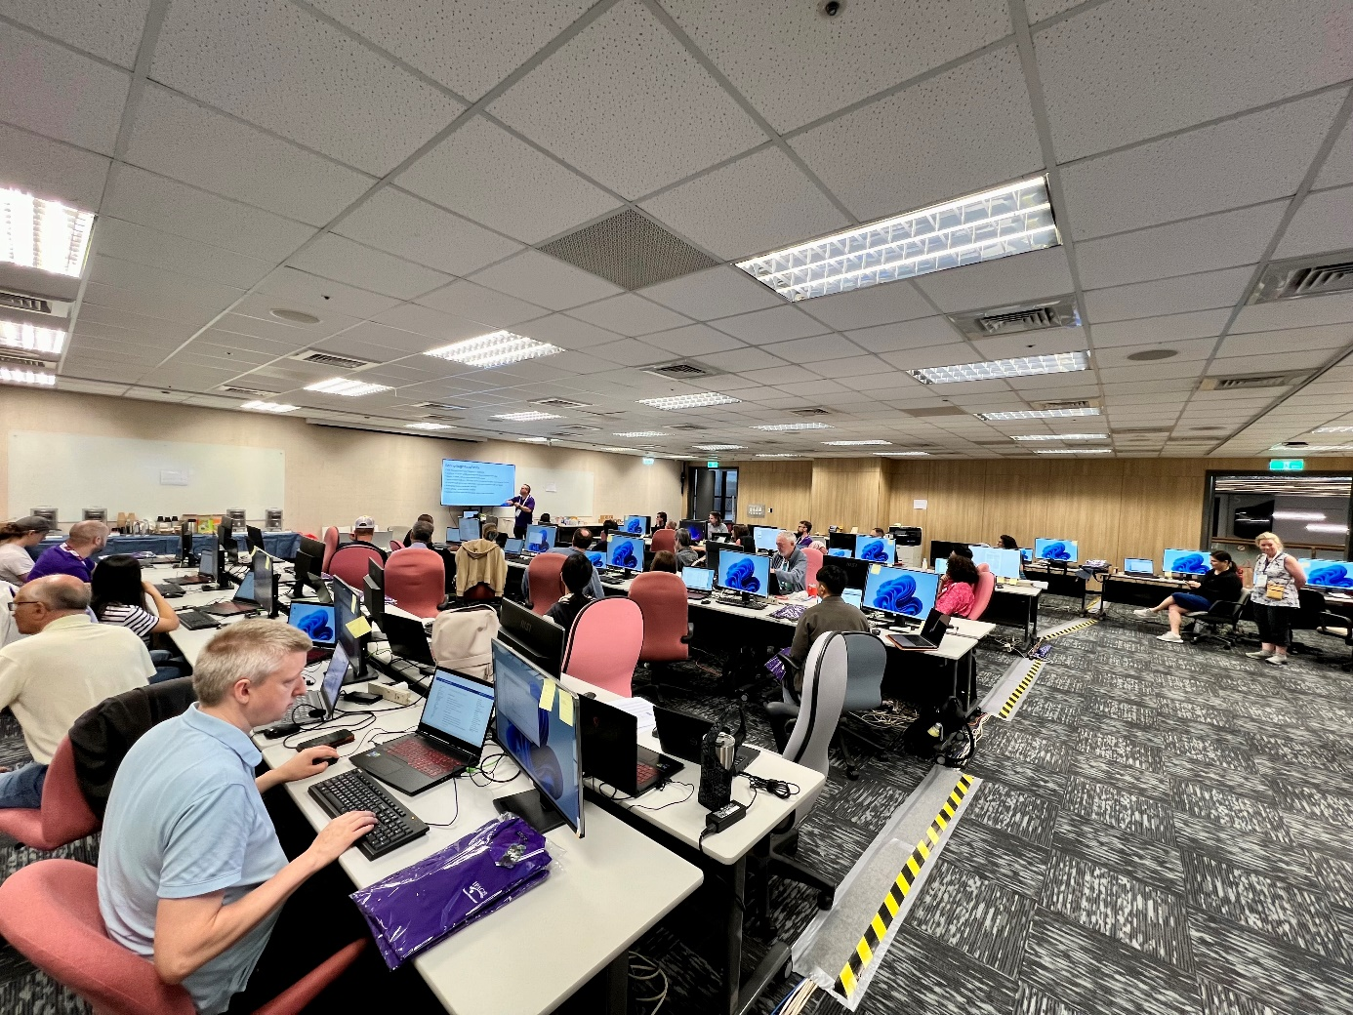
IPAC25 Proceeding Office
Notes:
Here's another view of the Proceedings Office in operation. You can see the dual-monitor setups in action, with editors working on their papers. The standardized configuration meant that if an editor had a question or needed help, any support staff member could immediately understand their setup and provide assistance.
The organized layout and consistent hardware made troubleshooting much faster. When every machine is identical, you eliminate a huge category of "it works on my machine but not yours" problems.

Slide 13
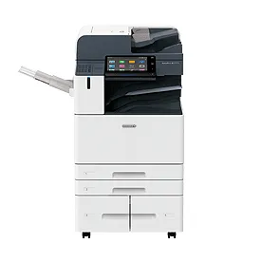
Cloud Storage and Printer
1.Multi-port 1Gbps Intranet switches + Rental Internet Router
2.Two NAS for routine backup
3.Two Floor-standing photocopier :(Copying speed: 30 pages per minute in black and white / 30 pages per minute in color / with fax, print, and scan functions)*
Printing Function
Memory: 4GB
Hard Drive: 160GB
Equipped with a dual paper feeder; even during duplex printing, speed is not reduced, greatly improving productivity.
Warm-up time: Within 24 seconds; first copy time — monochrome: 4.4 sec / color: 5.7 sec
Automatic duplex printing and output, simplifying operations and improving efficiency.
Built-in Controller
High-speed quad-core processor: Intel® Core™ i5 A4476F, 1.5 GHz
Print Resolution
1,200 × 2,400 dpi
FUJIFILM A7D3372X
Notes:
Our backend infrastructure had three key components:
First, multi-port 1Gbps Intranet switches plus a rental Internet router for external connectivity.
Second, two NAS units for routine backup. This redundancy was non-negotiable - we could not afford to lose any paper edits or submissions. The NAS units provided continuous backup throughout the conference.
Third, two FUJIFILM A7D3372X floor-standing photocopiers. Let me tell you about these machines because they were impressive pieces of equipment.
Printing specifications: 30 pages per minute in both black and white and color, with integrated fax, print, and scan functions.
The built-in controller had a high-speed quad-core Intel Core i5 processor at 1.5 GHz, 4GB of memory, and a 160GB hard drive.
Print resolution was 1,200 by 2,400 DPI - excellent quality for technical documents.
The warm-up time was within 24 seconds, and first copy time was only 4.4 seconds for monochrome and 5.7 seconds for color.
Here's why these machines were perfect for us: they were equipped with dual paper feeders, and even during duplex printing, the speed wasn't reduced. This greatly improved productivity when editors needed quick printouts for review.
Automatic duplex printing and output simplified operations. These printers handled hundreds of pages per day without issues.

Slide 14
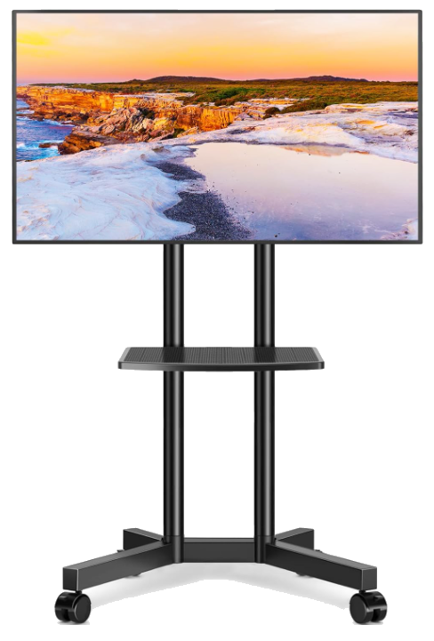

TV and IPAD
75-inch TVs
JACoW editing room
Dotting Board x3
Information board x1
Sponsor presentation x1
Apple iPad Air
Number：18
For Post Police
Connect to JICT
Notes:
For our mobile and display infrastructure, we deployed 18 Apple iPad Airs for our Poster Police team. These connected to JICT - that's JACoW's Integrated Conference Toolkit - allowing real-time upload of poster photographs to our database.
We also installed 75-inch LED TVs in several locations:
One in the JACoW editing room for displaying schedules and announcements
Three Dotting Boards showing poster locations and conference navigation
One information board for general conference updates
One for sponsor presentations
These large displays were visible from a distance and helped attendees navigate what was a very complex conference schedule. The 75-inch size ensured readability even in crowded areas.
The TVs were driven by those Raspberry Pi units I mentioned earlier - a very cost-effective solution that proved to be extremely reliable. We had zero display failures throughout the six days.

Slide 15
PC Software for Editing
OS: Windows 11 (English)
Office 365
Acrobat Pro DC (30-day trial version) with “JACoWSetDot.js”
MiKTeX 23.x with “jacow.cls”
TeXstudio 4.x
Pitstop Pro (30-day trial version)
Parameter setting: https://indico.jacow.org/event/84/attachments/595/2113/JTM2024 Computer Setup_JACoW Confereces-simplified.pdf
JACoW-12.joboptions
Notes:
Now let's talk about the software stack. This is where things get quite detailed.
Operating System: Windows 11 in English - we standardized on English to ensure compatibility with JACoW tools.
Office Suite: Office 365 for document processing.
PDF Processing: Adobe Acrobat Pro DC running on a 30-day trial version. This included a critical component called "JACoWSetDot.js" - a custom JavaScript that automates certain PDF formatting tasks specific to JACoW requirements.
LaTeX Environment: MiKTeX version 23.x with the "jacow.cls" class file properly installed. This is the official JACoW LaTeX class that ensures papers meet formatting standards. We used TeXstudio 4.x as the primary GUI for editing LaTeX documents.
Quality Control: Enfocus Pitstop Pro, also on a 30-day trial version. This tool is essential for PDF quality assurance, checking that documents meet exact specifications for printing and archival.
Configuration: We followed detailed parameter settings documented in the JACoW conference setup guide. Everything had to be configured exactly right, including the JACoW-12.joboptions file for PDF distiller settings.
Getting all of this software properly configured and working together was one of our biggest challenges during setup. But once we had a gold master configuration, we could replicate it across all 30 machines efficiently.

Slide 16
Software List
LibreOffice 7.6.5
Firefox
Google Chrome
JACoW Acrobat configuration
JACoW JobOptions(JACoW-11) properly installed in Acrobat DistillerEnfocus
Pitstop Professional 2022 licenses of 30 day trial (activate trial only before conference)
Notepad++
WinEdt (30 day trial)
EditPlus
Gvimfor Windows
7Zip
Ghostview, GSView, GhostScript
ssh client: e.g., PuTTY
IrfanView
XnView
MiKTex(User Mode install, not Admin install)
JACoW LaTeX classfile properly installed
TeXStudio(first choice) + TeXnicCenter/TeXmakeras a TeXGUI
Meld (for diff/merge)
VLC
GIMP
Paint.NET
DoubleCommander (OpenSource) or SpeedCommander (30-Day Trial)
Handbrake
VirtualDub
PPspliT-Microsoft Office must be installed before installing PPspliT
Adobe Acrobat Professional (one month subscription)
Notes:
Here's the complete software inventory for each workstation. This is quite extensive, so let me go through it systematically.
Office and Productivity: LibreOffice 7.6.5, plus the Office 365 we already mentioned.
Browsers: Firefox and Google Chrome - we needed both because different web tools performed better in different browsers.
JACoW-Specific Tools: Acrobat configuration with JACoW settings, JACoW-11 JobOptions properly installed in Acrobat Distiller, and Pitstop Professional 2022 on 30-day trial licenses - critically, we activated these trials only just before the conference to ensure they didn't expire during the event.
Text Editors: Multiple options including Notepad++, WinEdt on 30-day trial, EditPlus, and Gvim for Windows. Different editors had different strengths, and we let editors choose their preferred tool.
Utilities: 7Zip for compression, Ghostview, GSView, and GhostScript for PostScript handling, and PuTTY as our SSH client.
Image Processing: IrfanView and XnView for quick image viewing and basic editing.
LaTeX Environment: MiKTeX in User Mode install - importantly, NOT Admin install, as this could cause permission issues. The JACoW LaTeX class file properly installed, TeXStudio as first choice, with TeXnicCenter and TeXmaker as alternatives.
Comparison Tools: Meld for diff and merge operations when comparing document versions.
Multimedia: VLC media player.
Graphics: GIMP and Paint.NET for image editing.
File Management: Double Commander, which is open source, or Speed Commander on 30-day trial.
Video Processing: Handbrake and VirtualDub.
PowerPoint Tools: PPspliT - and note, Microsoft Office must be installed before installing PPspliT.
And finally, Adobe Acrobat Professional on a one-month subscription.
This comprehensive software suite ensured editors had every tool they might need for any type of document processing challenge.

Slide 17

Installing Fonts
barcode_font
Download: https://github.com/JACoW-org/AcrobatPitStopTools/tree/master/barcode_font
LiberationMono
tex-gyre-math
tex-gyre-terms
Notes:
Font installation was critical for proper document rendering. We installed three specific font families:
First, barcode_font, downloaded from the JACoW GitHub repository at github.com/JACoW-org/AcrobatPitStopTools. This font is used in the quality control process for document tracking.
Second, LiberationMono - a monospaced font that's essential for code listings and certain technical content.
Third, tex-gyre-math and tex-gyre-terms. These are high-quality mathematical and text fonts that provide consistent rendering of mathematical notation and scientific text across different systems.
Without these fonts properly installed, documents could render incorrectly, mathematical symbols might not display properly, and the quality control system wouldn't function correctly.
We included font installation in our automated setup script to ensure consistency across all workstations.

Slide 18

Final Check for Laptop Setup
Acrobat
1. Hamburger menu -> `Disable New Acrobat`
2. Update Acrobat to latest version (Help -> Check for updates)
3. Set `JACoW-12` joboptions in Distiller
4. Set Distiller preferences:
a. Ask for PDF file destination
b. View PDF when using Distiller
c. Ask to replace existing PDF files
d. Delete Log files for successful jobs
5. Acrobat settings:
a. Convert From PDF -> Encapsulated Postscript -> Font emitting: All fonts -> Edit settings -> Uncheck "Convert TrueType to Type 1".
b. Set the editor name in Identity panel
Notes:
Before the conference, we performed comprehensive final checks on every workstation. Let me walk through the Acrobat configuration checklist.
Step 1: From the hamburger menu, we disabled New Acrobat. The new interface wasn't compatible with some of our custom scripts, so we needed the classic interface.
Step 2: Update Acrobat to the latest version through Help → Check for updates. We wanted all security patches and bug fixes.
Step 3: Set JACoW-12 job options in Distiller. This is a custom PDF creation profile that ensures all PDFs meet JACoW specifications.
Step 4: Configure Distiller preferences. We enabled four critical settings:
Ask for PDF file destination - gives editors control over where files are saved
View PDF when using Distiller - immediate verification
Ask to replace existing PDF files - prevents accidental overwrites
Delete log files for successful jobs - keeps the workspace clean
Step 5: Acrobat application settings. In Convert From PDF options, under Encapsulated PostScript settings, we set font emitting to "All fonts" and - this is crucial - edited settings to uncheck "Convert TrueType to Type 1". This prevents font substitution issues that can cause rendering problems.
Finally, we set the editor name in the Identity panel so all edits are properly attributed.

Slide 19
Final Check for Laptop Setup(cont.)
Firefox
1. Set Firefox as default
2. Check updates, download if needed, restart to apply them
3. Install plugins:
a. Foxy gestures
b. uBlock origin
4. Set Acrobat as default PDF application
5. Set the default homepage to `https://ipac-docs.jacow.org/PaperEditing/IPACs/IPAC25/`
Notes:
For Firefox configuration:
Step 1: Set Firefox as the default browser. This ensured that when clicking links in Indico or other web-based tools, they opened in Firefox where our extensions were installed.
Step 2: Check for updates, download if needed, and restart to apply them. Security and stability were priorities.
Step 3: Install essential plugins:
Foxy Gestures - provides mouse gesture navigation, which dramatically speeds up browsing efficiency
uBlock Origin - blocks ads and trackers, improving page load times and reducing distractions
Step 4: Set Acrobat as the default PDF application so PDFs opened directly in Acrobat rather than in the browser.
Step 5: Set the default homepage to the JACoW paper editing documentation at ipac-docs.jacow.org. This meant editors immediately had access to guidelines and reference materials every time they opened the browser.
These configurations might seem minor, but they saved editors significant time over the course of the conference.

Slide 20
Final Check for Laptop Setup(cont.)
Word
1. Options:
a. Save -> Preserve fidelity when sahring this document -> check `Embed only the characters used in the document ...`
b. Advanced -> Display -> Show measurements in units of: `Points`
2. Acrobat -> Preferences -> Choose `JACoW-12` as PDFMaker conversion settings
Notes:
Microsoft Word also required specific configuration for JACoW compatibility.
In Word Options, under the Save tab, we enabled "Preserve fidelity when sharing this document" and checked "Embed only the characters used in the document". This ensures that when documents are converted to PDF, all fonts are embedded properly but file sizes remain reasonable by only including the characters actually used.
Under Advanced settings, Display section, we set "Show measurements in units of: Points". In scientific publishing, measurements are standardized in points rather than inches or centimeters, so this prevents conversion errors.
In Acrobat PDFMaker settings, which integrates into Word, we selected JACoW-12 as the PDFMaker conversion settings. This means when authors or editors use the "Create PDF" button in Word, it automatically uses the correct JACoW settings.
These configurations ensured that documents created or edited in Word would convert properly to PDF with all fonts embedded and formatting preserved exactly as intended.

Slide 21
Final Check (update-po.bat)
@echo off
echo.
echo update right click menu
reg.exe add "HKCU\Software\Classes\CLSID\{86ca1aa0-34aa-4e8b-a509-50c905bae2a2}\InprocServer32" /f /ve
taskkill /IM explorer.exe /F
explorer.exe
echo .
echo update miktek packages update JACoWSetDot.js
copy \\192.168.1.202\SharedFolder\JACoWSetDot.js "C:\Program Files\Adobe\Acrobat DC\Acrobat\Javascripts"
echo.
echo update miktek packages
miktex packages update
echo update miktek Qt packages
miktex packages update
echo.
echo update JACoW class file
mkdir "C:\Users\User\AppData\Local\Programs\MiKTeX\tex\latex\jacow"
copy \\192.168.1.202\SharedFolder\jacow.cls "C:\Users\User\AppData\Local\Programs\MiKTeX\tex\latex\jacow"
mktexlsr
texhash
Notes:
We created an automated batch script called update-po.bat to streamline updates across all 30 machines. Let me walk through what this script does.
First, it updates the Windows Explorer right-click context menu by adding a registry entry. This restores the classic context menu interface that some of our tools depend on.
Then it restarts Windows Explorer to apply this change.
Next, it copies the latest version of JACoWSetDot.js from our shared folder at 192.168.1.202 to the Acrobat JavaScript directory on each machine. This ensures all machines have the latest custom automation scripts.
The script then runs "miktex packages update" twice - we run it twice because sometimes the first update identifies packages that need updating, and the second run actually installs them. This two-pass approach ensures everything is current.
Finally, it updates the JACoW class file by creating the necessary directory in the MiKTeX installation, copying the latest jacow.cls file from the shared folder, and running mktexlsr and texhash to rebuild the LaTeX package database.
This single script, run on each machine, ensured that all 30 workstations had identical, up-to-date configurations. It saved us hours of manual work and eliminated configuration drift that could cause inconsistencies.

Slide 22
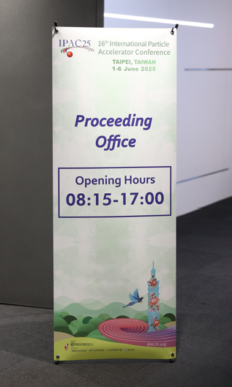
Presentation Office
🔹 Clear Signage Clearly display the Presentation Office hours and location.
🔹 Presentation File Check Speakers should verify their presentation files at least half a day before their session.
🔹 Identical Laptops Session room laptops are identical to test laptops to ensure smooth file playback.
🔹 Laser Pointers Same laser pointers will be used in all rooms. Speakers will be guided on usage.
Spare batteries must be available.
🔹 Devices Needed
6 laptops
1 large monitor
3 standard monitors
Signage
Notes:
The Presentation Office was our quality control checkpoint for speaker presentations. We implemented several key protocols:
Clear Signage: We prominently displayed the Presentation Office hours and location so speakers could easily find us.
Presentation File Check: We required speakers to verify their presentation files at least half a day before their scheduled session. This gave us time to fix any compatibility issues rather than discovering them minutes before a talk.
Identical Laptops: This was crucial - the test laptops in the Presentation Office were absolutely identical to the laptops in the session rooms. Same model, same software versions, same configurations. If a presentation worked on our test system, it would work in the auditorium.
Laser Pointers: We standardized on the same laser pointer model for all rooms and provided guidance to speakers on usage. We kept spare batteries available because the last thing you want is a dead laser pointer in the middle of an important presentation.
Devices Needed: We required 6 laptops total - some for testing, some for editing; 1 large monitor for shared viewing; and 3 standard monitors for individual workstations.
The signage was clear and professional, guiding speakers through the process efficiently.

Slide 23
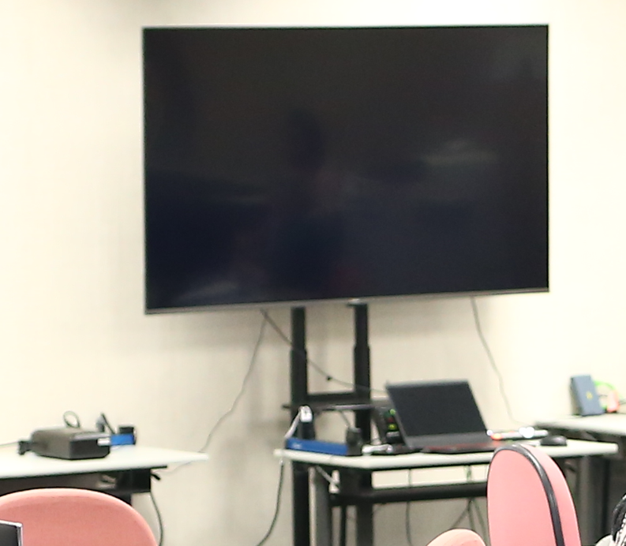
Presentation Office Preparation
Upload Station 1 computer is available for presenters to upload their files.
File Check Station 2 computers with 1 shared monitor for file testing. (Switchable setup to minimize wait time.)
Server Upload Files should be uploaded to the shared server in advance to counter last-minute changes before the session.
Editing Station 3 computers are available for on-site file editing.
Laptops and shared monitor for presentation file check
Notes:
We organized the Presentation Office into four distinct functional areas:
Upload Station: One computer where presenters could upload their files from USB drives or cloud storage. This was the entry point for all presentations.
File Check Station: Two computers sharing one monitor with a switchable setup. This minimized wait time - while one presenter's file was being checked, another could be loading theirs. The KVM switch allowed us to quickly toggle between systems.
Server Upload: As soon as files were verified, they were uploaded to our shared server in advance of the session. This meant that even if a speaker made last-minute changes, we had a backup version ready. It also allowed session chairs to preview presentations if needed.
Editing Station: Three computers available for on-site file editing. Sometimes speakers needed to make quick changes - fix a typo, update a figure, adjust timing. Having editing capability on-site saved speakers from having to return to their hotels or offices.
This workflow design minimized bottlenecks. Even during peak times before major sessions, we could handle multiple speakers simultaneously without creating long queues.

Slide 24
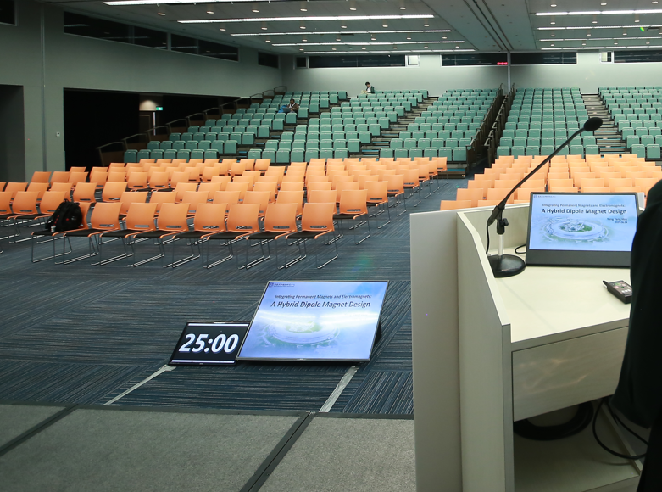
Auditorium Setup for Speakers
Timer A timer is provided for speakers to manage their presentation time.
Monitors Two monitors are available: – One displays the slides, allowing speakers to face the audience while presenting. – The other shows the transcript for speaker reference.
Monitors and the timer for speakers
Notes:
This photo shows our actual setup - you can see the multiple laptops arranged for efficient workflow, with the shared monitor visible in the center. The clean, organized layout helped speakers feel confident that their presentations were being handled professionally.
Notice the consistent hardware - this wasn't just for technical reasons, it also presented a professional image that reassured speakers their important work was in good hands.
In the auditoriums themselves, we provided presenters with a professional setup designed to help them deliver their best presentations.
Timer: A dedicated timer display helped speakers manage their presentation time. In a conference with 86 talks and tight schedules, keeping on time was essential. The visible timer gave speakers constant awareness without being distracting.
Two Monitor Setup:
Monitor One displayed the current slide, positioned so speakers could face the audience while presenting rather than turning their backs to look at the projection screen. This dramatically improved presentation quality and audience engagement.
Monitor Two showed the speaker notes or transcript, giving presenters a reference without having to look down at their laptop screen.
This setup is standard in professional conferences, but it requires careful configuration to work properly. The displays had to be arranged correctly in the display settings, and we verified the setup before each session.
The result was that speakers could deliver more confident, audience-focused presentations, which enhanced the overall quality of the conference.
Here you can see the actual monitor and timer setup in one of our auditoriums. The timer is clearly visible with large numbers - easy to see from the podium even without glasses. The speaker-facing monitor shows the current slide clearly, allowing the presenter to maintain eye contact with the audience while staying synchronized with their presentation.
This setup received consistently positive feedback from speakers who appreciated not having to turn around to see what was being projected.

Slide 25

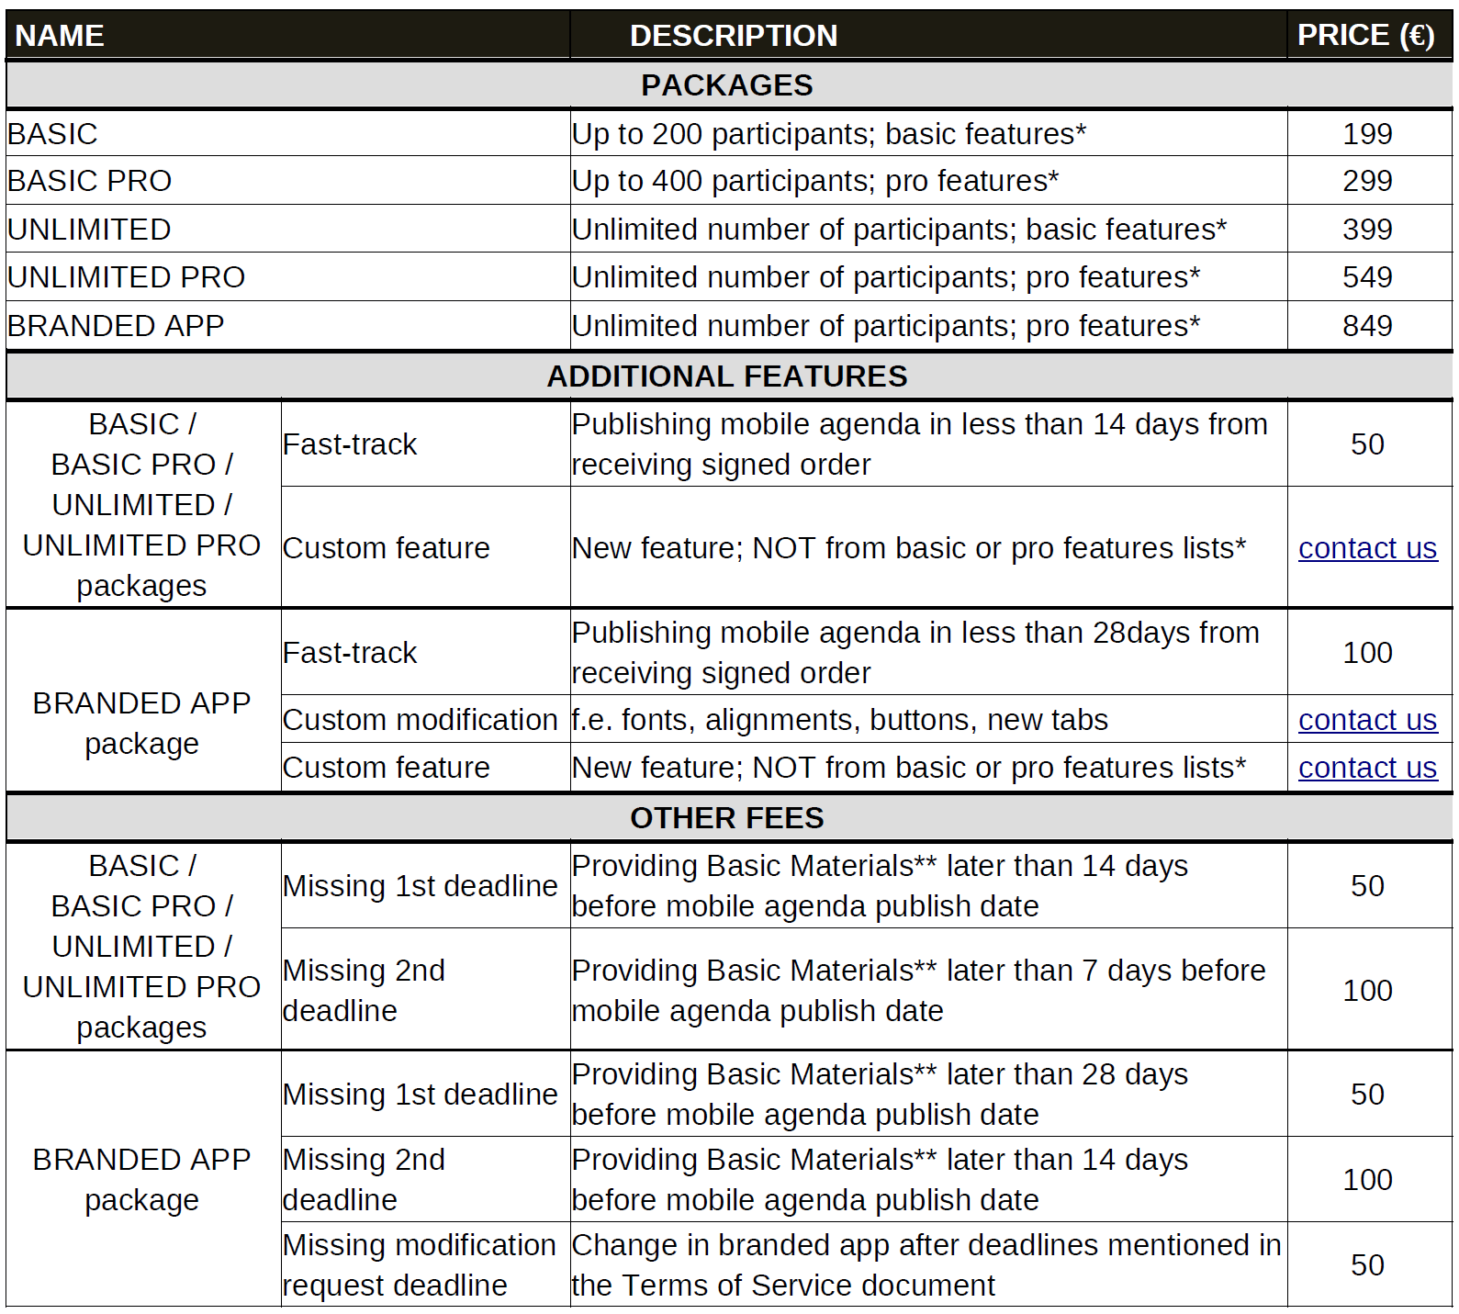
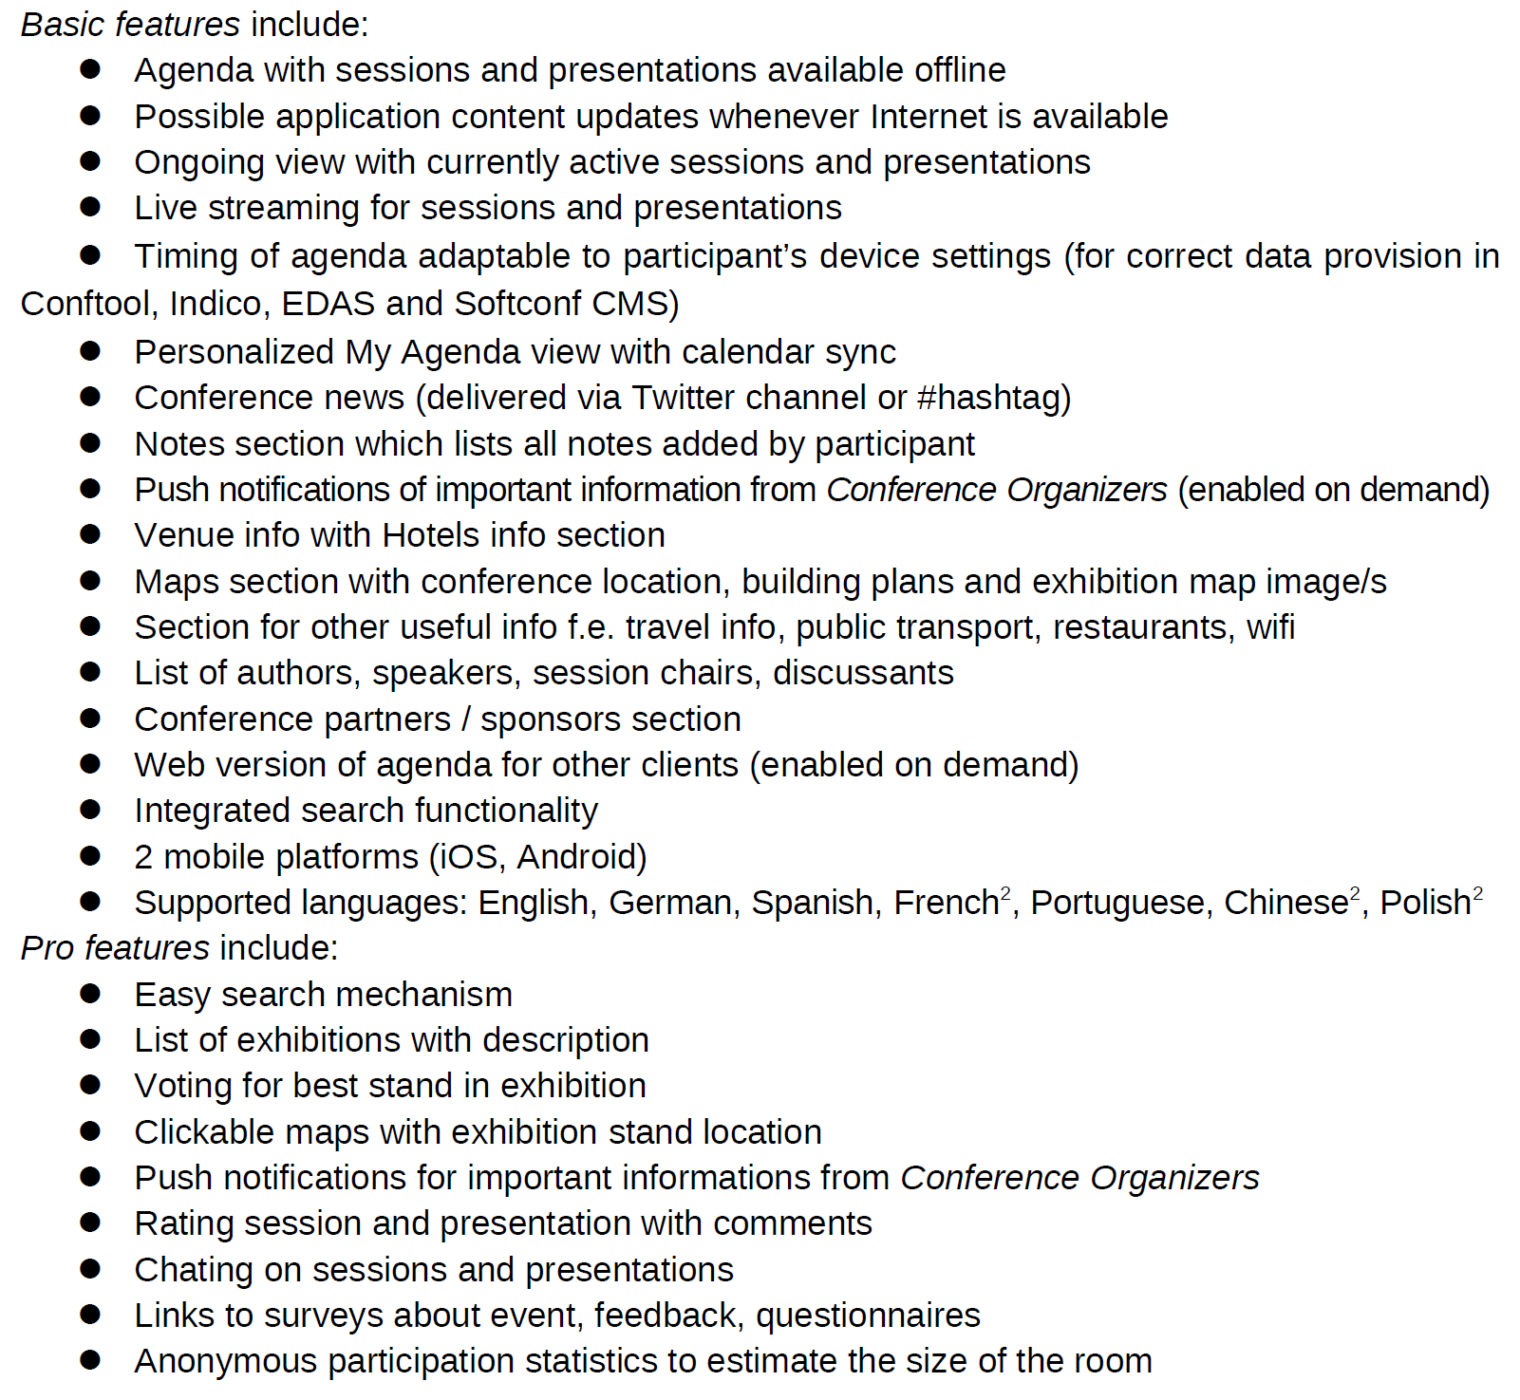
Conference APP
Contents of the purchased plan (IPAC25)
https://conference4me.psnc.pl/en/
Notes:
For the conference mobile app, we selected the Conference4Me platform. You can see their website at conference4me.psnc.pl.
This platform provided us with a comprehensive conference app solution that integrated with our Indico system. The app would pull schedule data, speaker information, and session details directly from Indico, ensuring everything stayed synchronized.
The platform supported both iOS and Android, which was essential given our international audience. Attendees could browse the program, set reminders for sessions they wanted to attend, view abstracts, and receive push notifications for important announcements.
One of the key advantages of using an established platform like Conference4Me was that the app infrastructure and servers were already proven and reliable. We didn't have to worry about server capacity or app stability - the platform had hosted numerous conferences before IPAC'25.
The integration process required API setup and data mapping, but the Conference4Me team provided excellent support throughout the implementation.

Slide 26
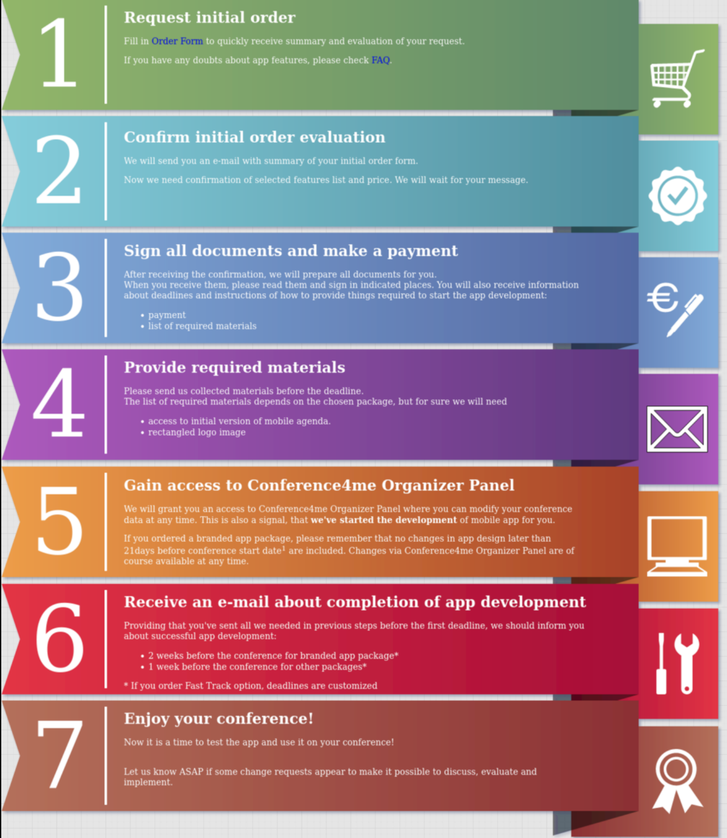



APP Milestones
Release on multiple platforms
IPAC25 Apple store
IPAC25 logo (Web)
Google play store
Notes:
The app development followed a structured timeline with specific milestones.
We successfully released the IPAC25 app on both the Apple App Store and Google Play Store, making it accessible to all attendees regardless of their device platform.
The app featured custom branding with the IPAC25 logo and color scheme, giving it a professional, conference-specific appearance rather than a generic look.
We also developed a web version accessible through browsers, so attendees could access the schedule and information even if they hadn't downloaded the app or if they were using a tablet or laptop.
The multi-platform release was important because in our pre-conference surveys, we found attendees split roughly evenly between iOS and Android devices, with a significant number also wanting to access information from their laptops during the conference.
Having the app available across all platforms ensured maximum adoption and utility for attendees.

Slide 27

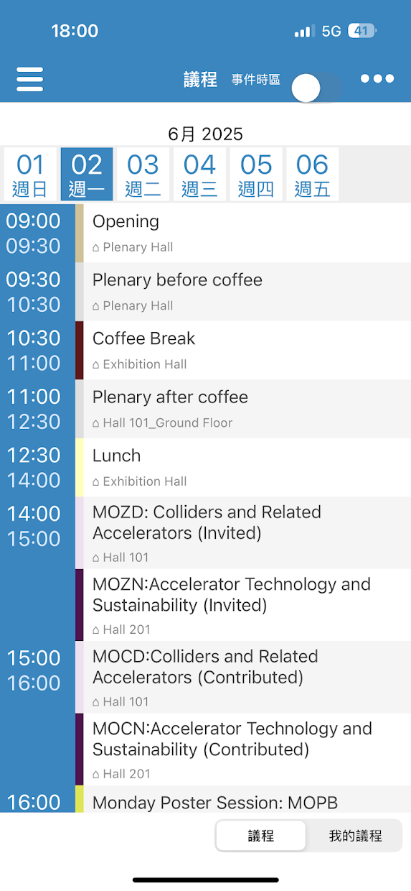
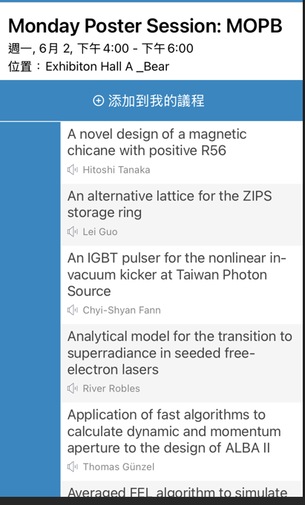
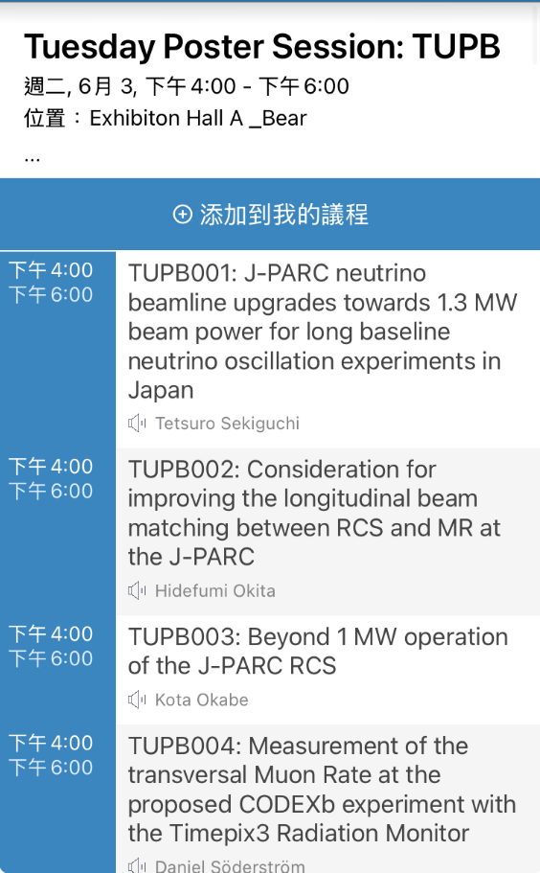
Add Poster ID Sequence
2025 after
2025 before
Notes:
Let me show you an important enhancement we made to the poster display system.
In the "before" screenshot from before 2025, you can see poster entries in the app showing title, authors, and session time, but without any physical location information. Attendees had to hunt through hundreds of posters to find the one they wanted.
In our "after" version for 2025, we added prominent numerical display showing the poster board number. For example, you can clearly see "TUPR25" and "TUPR26" displayed, making it immediately obvious where to find each poster in the physical exhibition space.
This seems like a small change, but when you're dealing with over 1,000 posters spread across a large exhibition hall, being able to quickly locate a specific poster is incredibly valuable. Attendees told us this feature saved them significant time and frustration.
The implementation required creating a custom agenda.php script that pulled poster assignments from JICT and formatted them for display in the app. This was completed on May 22nd, just about a week before the conference, which shows how we continued refining the system right up until the event.

Slide 28
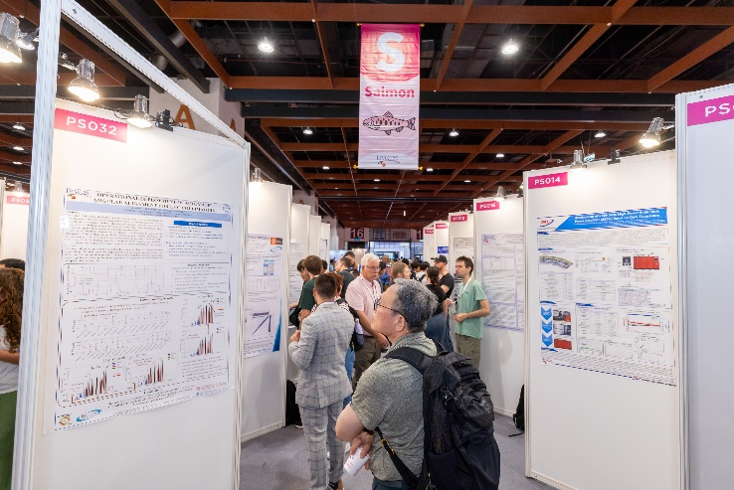
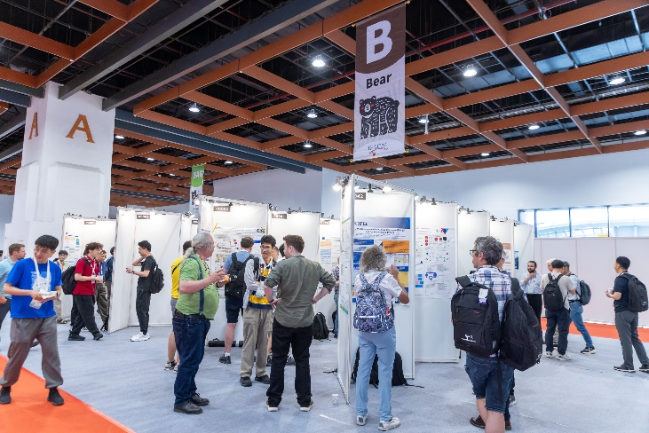
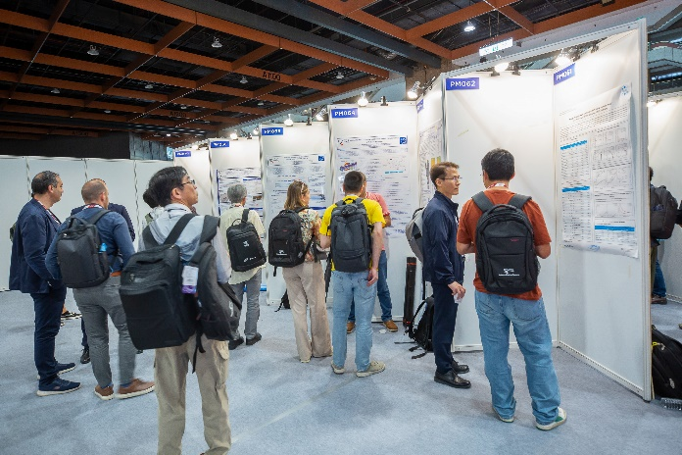
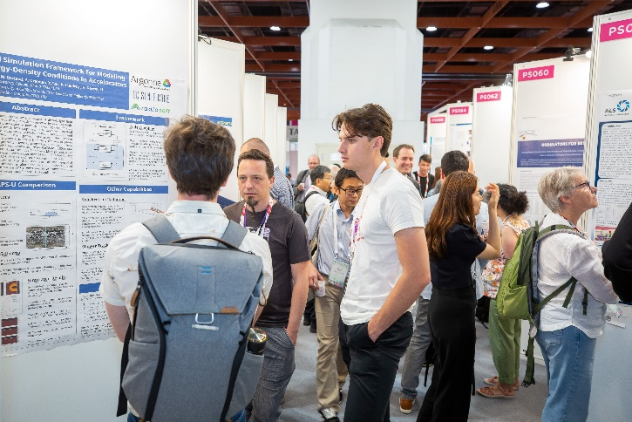
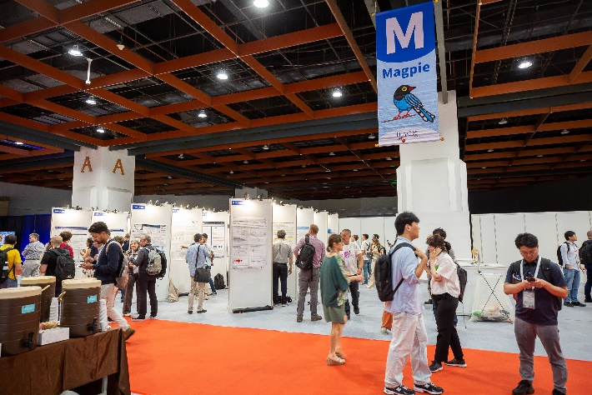
POSTER
250 posters per day
More than 1,000 posters
Notes:
Here you can see the scale of our poster sessions. The exhibition hall was filled with poster boards - initially we planned for 250 posters per day, but the actual demand exceeded this significantly, reaching more than 1,000 posters total across the conference.
The physical layout required careful planning to ensure good traffic flow and adequate viewing space for each poster. Attendees needed to be able to stand back and read posters without blocking others.

Slide 29
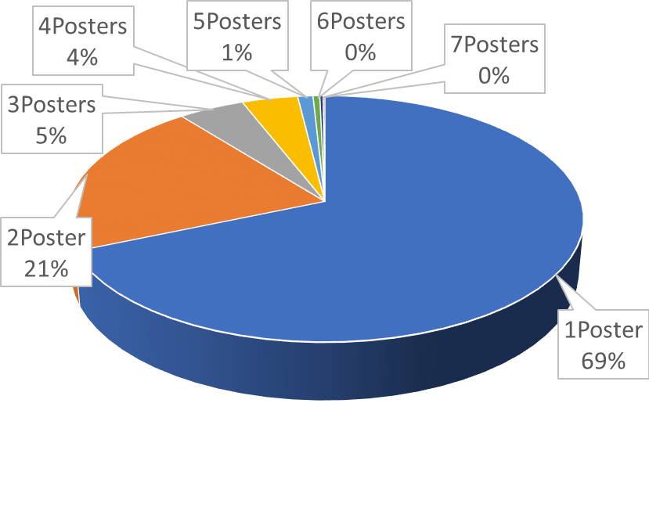
Posters
Editor Workload and Poster Presentation Policy
Each editor can handle approximately 5 to 8 papers per day. So it is important to keep the poster presentation limit per delegate to ensure a manageable workflow and smooth review process.
For IPAC’25, an extra charge will apply for exceeding the poster limit: Each delegate may present up to four posters. An additional fee of USD 200 will be charged for each poster beyond this limit.
Notes:
Managing the poster workload required clear policies and realistic capacity planning.
Editor Capacity: We determined that each editor can handle approximately 5 to 8 papers per day effectively. This became our constraint for planning. Beyond this number, quality starts to suffer and editors become overwhelmed.
Given this constraint, it was essential to keep the poster presentation limit per delegate reasonable to ensure manageable workflow and a smooth review process.
IPAC'25 Poster Policy: We implemented a policy where each delegate could present up to four posters without additional charge. However, an additional fee of USD 200 would be charged for each poster beyond this limit.
This policy served multiple purposes. First, it ensured we didn't exceed our editing capacity. Second, it encouraged presenters to be selective about which work they submitted, which actually improved overall quality. And third, the additional fee helped cover the extra resources needed to handle the increased workload.
This was a lesson learned from previous conferences where unlimited poster submissions created workflow bottlenecks and stressed the editing team beyond their capacity.

Slide 30
Timeline of Posters Setup
Indico time table missing contribution → unable to edit or display → cannot connect with JICT → Provided paper ID / Session_ID / session_block_ID / date (24 Mar)(Michel).
At the same time, because the JICT automatic-assignment function could not be used → assigned numbers manually (due to the light peer-review application deadline).
manual assignment was completed (29 Mar), organized by category and name, also classified by registration status.(Ivan)
Thanks to Michel for fixing the error of missing contribution (17 Apr).
Discovered an incorrect link between JICT and Indico, which caused student poster data to be missing.
student session blocks were reconfigured, and the linking issue was solved (23 Apr).(Ivan, Stefano)
JICT server setup (15 May). (Stefano)
agenda.php created, which enables poster numbers to be displayed in the mobile app (22 May). (Stefano)
Poster Police App optimized, improving photo upload speed, and adding new features — photo capture and photo deletion (31 May). (Stefano)
Notes:
Let me walk you through the timeline of challenges and solutions in our poster management system. This illustrates the kind of problem-solving required in complex conference IT.
March 24th: We discovered a critical issue - the Indico timetable was missing contributions. This meant papers couldn't be edited or displayed in the system, and we couldn't connect with JICT. Michel provided us with the paper IDs, session IDs, session block IDs, and dates to work around this issue.
March 29th: Because the JICT automatic-assignment function couldn't be used due to this problem, Ivan completed the manual assignment of all posters, organized by category and name, and classified by registration status. This was painstaking work.
April 17th: Michel successfully fixed the error of missing contributions in Indico. Thank you, Michel!
April 23rd: However, we then discovered an incorrect link between JICT and Indico, which caused student poster data to be missing. Ivan and Stefano reconfigured the student session blocks and solved the linking issue.
May 15th: Stefano completed the JICT server setup.
May 22nd: Stefano created the agenda.php script, which enabled poster numbers to be displayed in the mobile app - this was the enhancement I showed you in the previous slide.
May 31st: Just before the conference, Stefano optimized the Poster Police App, improving photo upload speed and adding new features including photo capture and photo deletion capabilities.
This timeline shows that integration projects rarely go smoothly on the first attempt. Having skilled team members like Michel, Ivan, and Stefano who could troubleshoot and solve problems quickly was absolutely essential to our success.

Slide 31
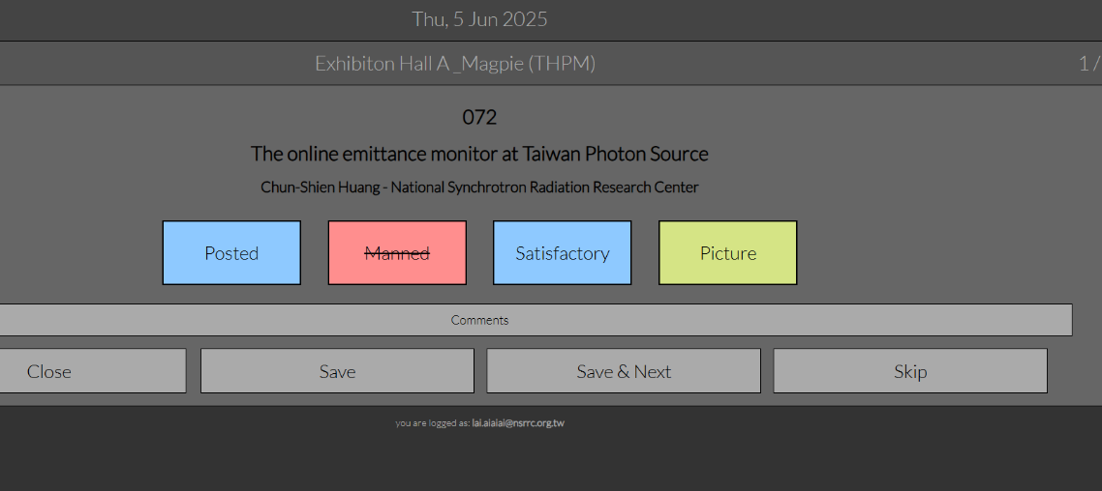
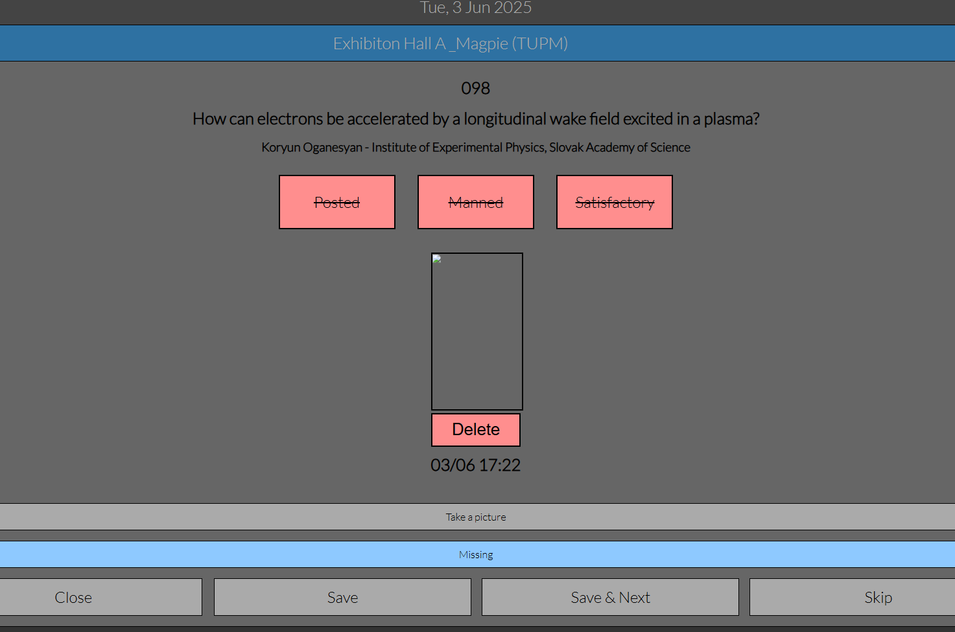
Poster Police JICT
After
Before
1. improving photo upload speed
2. adding new features — photo capture and photo delete caption
Notes:
Let me show you the improvements we made to the Poster Police App.
The "before" version had basic functionality, but we identified several limitations during testing.
The "after" version, optimized on May 31st, included three major improvements:
First, we significantly improved photo upload speed. The original version could be slow, especially when network connectivity was variable. The optimized version used better compression and more efficient data transfer protocols.
Second, we added a photo capture feature directly in the app. Previously, the Poster Police team had to use the iPad's camera app, then switch to our app to upload. Now they could capture photos directly within the app, streamlining the workflow.
Third, we added a photo deletion feature. If a photo was blurry, poorly framed, or captured the wrong poster, the team could delete it and retake immediately, rather than having to deal with incorrect photos in the database later.
These improvements came from actually watching the Poster Police team work during test runs. Observing the real workflow helped us identify friction points and address them before the conference.

Slide 32
Summary
Scale: We successfully processed approximately 870 papers, supported 86 oral presentations, managed over 1,200 poster presentations, and provided seamless IT services across two major venues for six days.
Hardware Success: The standardized approach with 30 identical MSI gaming laptops, dual monitors, and comprehensive support equipment proved reliable throughout the conference.
Software Complexity: The extensive software stack with 27 applications, custom configurations, and automated deployment scripts ensured editors had all necessary tools.
Integration Challenges: Connecting Indico, AWESOMEET, EC PAY, JICT, and the mobile app required significant problem-solving, but ultimately provided a seamless experience for attendees.

Slide 33
Summary
Key Success Factors:
Standardization of hardware and software
Automation through scripts like update-po.bat
Clear team structure and responsibilities
Redundancy in critical systems
Responsive problem-solving by skilled team members
Areas for Improvement:
Better capacity planning for poster sessions
Enhanced network reliability for photo uploads
Earlier integration testing to catch linking issues
Final Thought: Managing IT for a major international conference requires meticulous planning, skilled team members, automated systems, and the flexibility to solve unexpected problems quickly. With proper preparation and the right team, even the most complex technical challenges can be successfully managed.

