Slide 1


Workflow at IPAC’25
Presented by
David Button on behalf of IPAC’25
dbu@ansto.gov.au

Slide 2
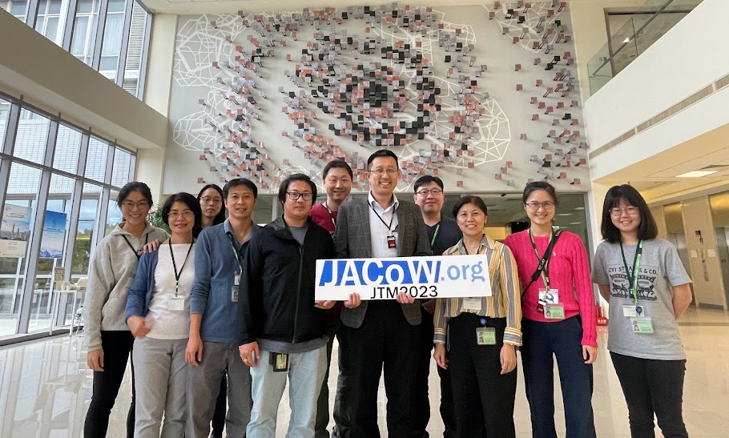

Big thank you to the NSRRC LOC Team

Slide 3
IPAC 2025 Development Contributions
Multiple Affiliation Support in Indico and Proceedings Production
CatScan Integration into Indico Workflow
Maintenance and improvements to Reference Search and Generation Tool
Hosting of JACoW Team Meeting 2023
Basic LaTeX CatScan Checks and Reports
Support attendance of Indico and Software Developer to IPAC’25

Slide 4

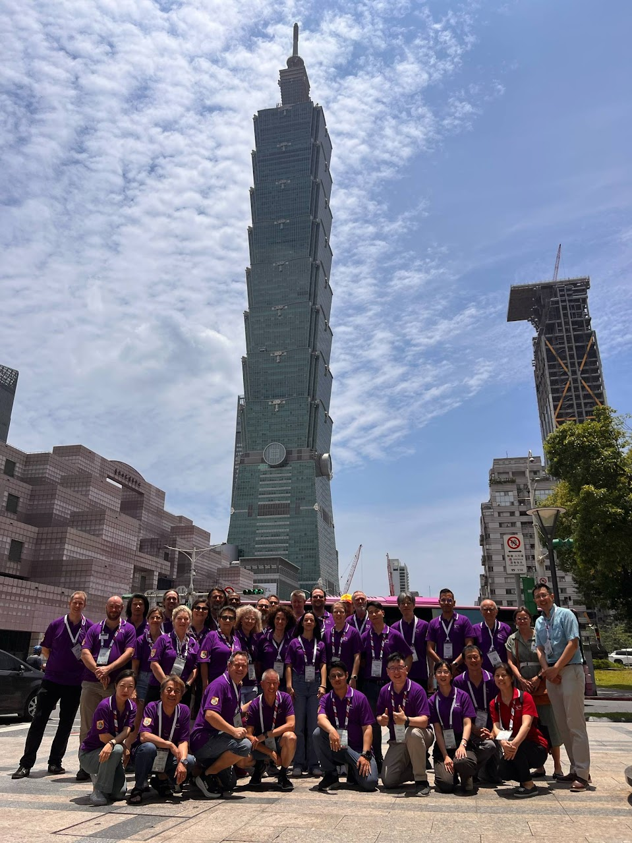
IPAC 2025 Proceeding Office Taiwan
Chief Editor: | David Button | ANSTO
Local Team :
Ping-Shun Chuang | NSRRC |  | Editor | Experienced
Nuan-Ya Huang | NSRRC |  | Editor | Experienced
Yung-Sen Cheng | NSRRC |  | Editor | Experienced
Chin-Kang Yang | NSRRC |  | Presentation | Improving
Team Composition | 35.3
Chief Editor | 1
Trainee Editors | 6.3
Improving Editors | 3
Experienced Editors | 17
Author Reception | 3
Trainee Presentation | 1
Presentation | 2
Tools Support (Indico/CatScan/Ref) | 2
International Team :
Adriana Rossi | CERN |  | Editor | Trainee
Akihiro Shirakawa | KEK |  | Editor | Experienced
Ana Štajminger | ELI Beamlines Facility |  | Editor | Trainee
Charline LeCourtillet (IPAC’26) | GNAIL |  | Editor | Trainee
Cynthia Duarte | TRIUMF |  | Author Reception | Improving
Darren Hunter | CLSI |  | Editor | Improving
Dong Eon Kim | Postech |  | Editor | Experienced
Guillaume Lalaire (IPAC’26) | GNAIL |  | Editor | Improving
Ivan Andrian | Elettra |  | Editor | Experienced
Jan Chrin | PSI |  | Editor | Experienced
Jana Thomson | TRIUMF |  | Author Reception | Experienced
Joele Mira | iThemba LABS |  | Editor | Experienced
Johan Olander | ESS |  | Editor | Experienced
Josh Peters | ANSTO (Contractor) |  | Software Dev
Julien Pivard (IPAC’26) | GNAIL |  | Editor | Trainee
Kritsada Kittimanapun | SLRI |  | Editor | Experienced
Lu Li | IMPCAS |  | Editor | Experienced
Magdalena Montes | SLAC |  | Author Reception | Experienced
Maurizio Montis | INFN-LNL |  | Editor | Experienced
Michel Succar | CERN (Indico) |  | Indico Developer
Narender Kumar | Liverpool University |  | Editor | Improving
Nicolas Delerue (IPAC’26) | GNAIL |  | Editor | Trainee
Petr Anisimov | LANL |  | Editor | Experienced
Raphael Mueller | GSI |  | Editor | Experienced
Ruth Rudolph | DESY |  | Presentations | Trainee
Staffan Benedictsson | MAX IV |  | Editor | Trainee
Stefano Deiuri | Elettra |  | Editor | Experienced
Takashi Kosuge | MAX IV |  | Presentations | Experienced
Thakonwat Chanwattana | SLRI |  | Editor | Experienced
Volker RW Schaa | GSI (Retired) |  | Editor | Experienced
Note: IPAC’24 Team Size 39
Region Representation
Asia |  | 11
Europe |  | 19
North America |  | 5
Gender
Female | 10
Male | 26
Not Specified | 0
Note: 3 trainees self supported accommodation and per-diem

Slide 5
Proceedings Office Activities
Suggested Staffing
Paper Editing
Author Reception
Title Author Check
Quality Assurance
Presentation Management
Slide Editing
Role | IPAC’24 | IPAC’25
Editor in Chief | 1 | 1
Editor + QA | 27 | 21
Presentation Management | 4 | 3
Author Reception | 4 | 3
Support/Development | 2 | 2
 | 38 | 30
Reduction |  | 21%
IT Support | 1 | 1
Estimated Paper Processing Power = papers per day x editors x workdays
= 5.5 x 21 x 8
= 924

Slide 6
Estimation of Papers
IPAC’24
  Initial Abstracts = 1,691 including 43 invited Abstracts
  Finial Papers Published 1,050
  USA very expensive
  VISA and travel issues may have also resulted in lower attendance.
IPAC’25
  Great degree of uncertainty, what is the LOC thinking?
  10th December Abstract Submissions Deadline
  Historically there is a 20% reduction in submitted abstracts, IPAC’24 saw a 38% reduction….
  Current processing power is representing a 12% reduction on IPAC’24
  IPAC’23 saw 22% reduction, it was suggested the 38% was due to some countries unable to travel to USA

Slide 7
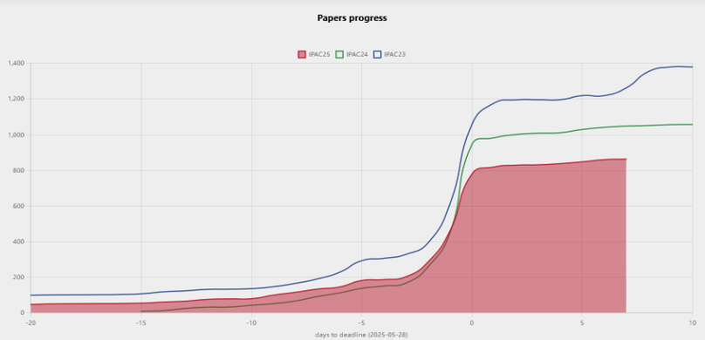
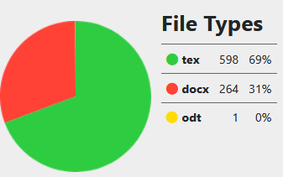
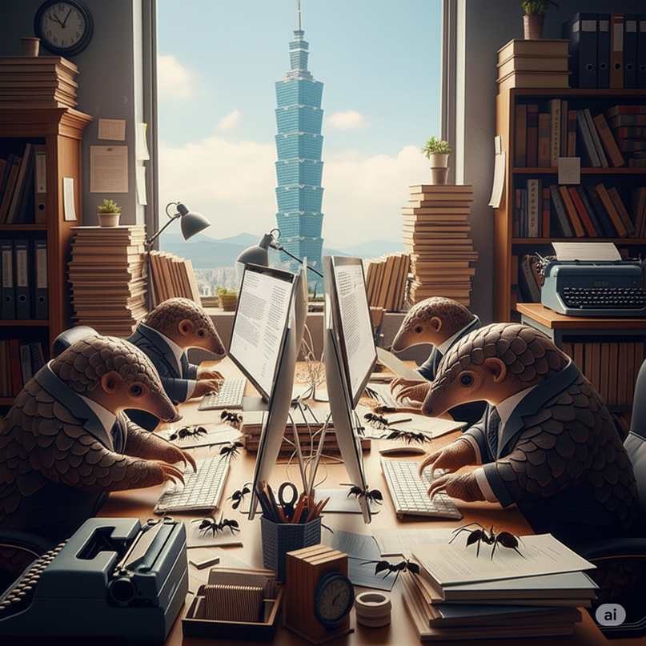
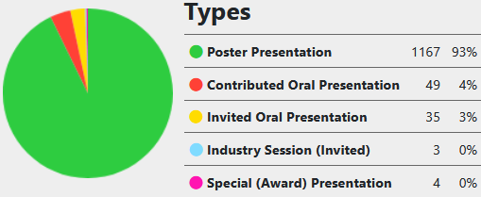
Thinking about your Workload
Challenges with Predictability of Submission Numbers
 | Initial Abstracts | Published Papers | Reduction
IPAC’23 | 2,270 | 1,402 | 38%
IPAC’24 | 1,691 | 1,050 | 38%
IPAC’25 | 1,735 | ≈ 870 | 49%

Slide 8
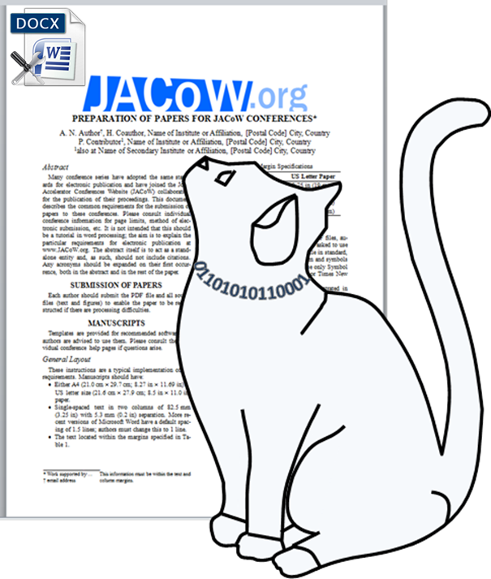

Workflow Overview
Submitter
Yellow: Request Acceptance
CatScan
Report
Red: Back to Author
Editor
Request metadata fix
Edit Accepted
QA Fail
QA Editor
ARTAC
Author Reception Title Author Check

Slide 9
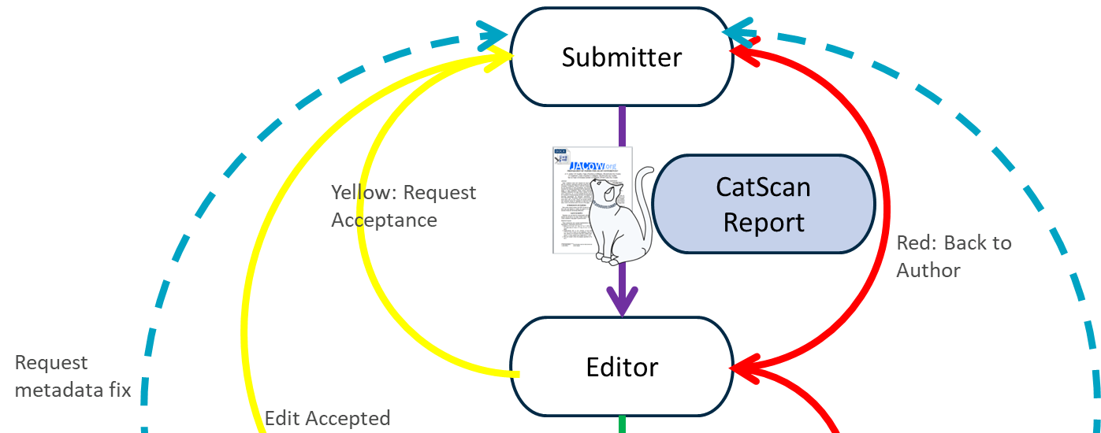
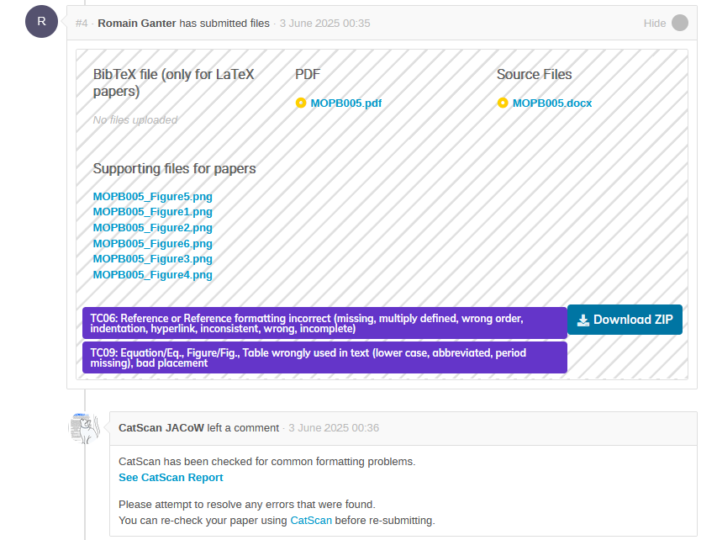
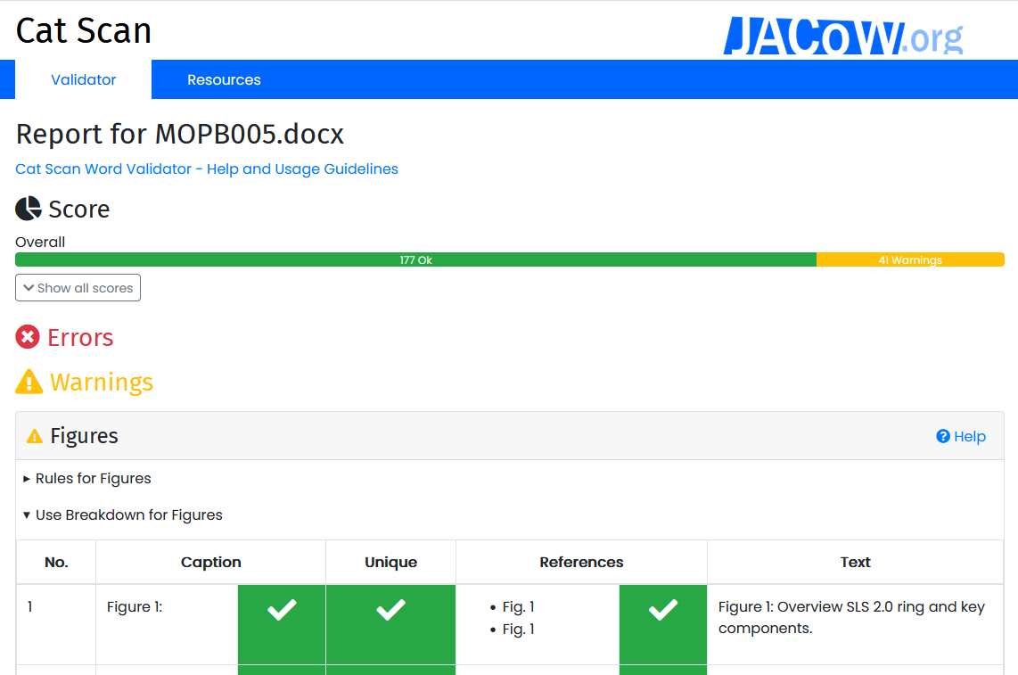
Early Red Dotting
Assign, Judge, then Unassign
CatScan Stats
Word
42% or Word contributions replied with uploads to the CatScan Editor resolving 4,636 errors
LaTeX
38% of LaTeX contributors replied with upload to the CatScan resolving 1,053 errors

Slide 10

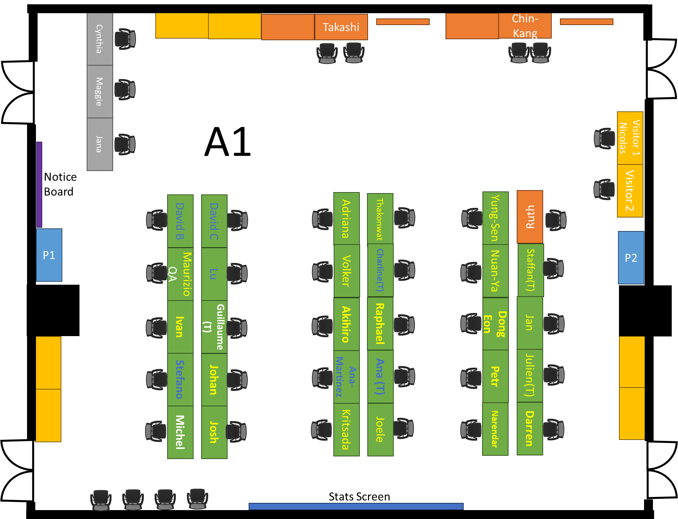
Proceedings Office Layout
ARTAC
Speaker Ready
Presentation Management
Editors
Combo
LaTeX
Word

Slide 11
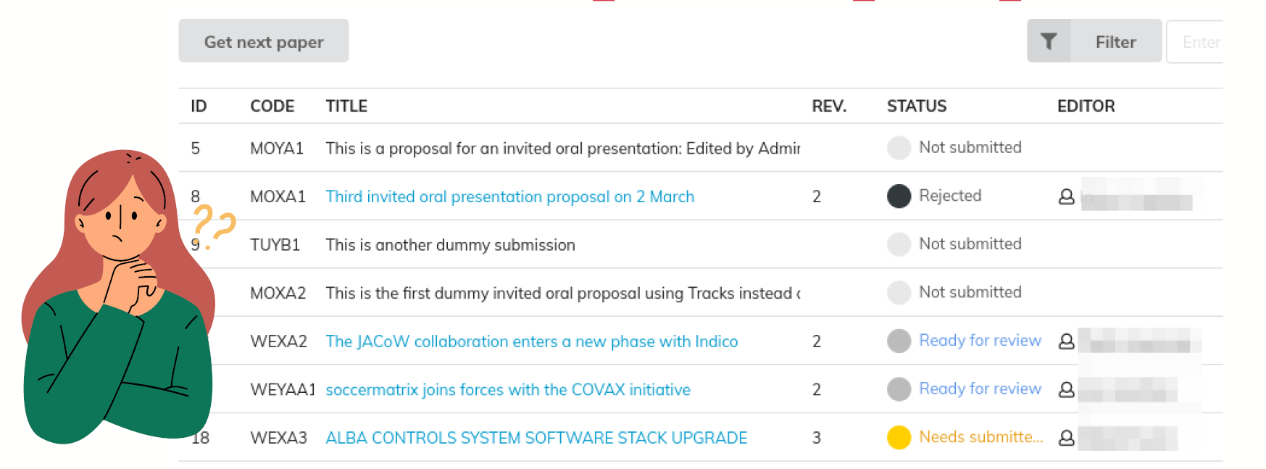
Pick-up a Paper (Thanks Ivan)
Note 1: Filters must be set for the type of source file you are processing.
Note 2: LaTeX able editors asked to only work on tex documents initially, otherwise Word editors will be depleted early.
Note 3: The traps of working on your own colleagues' papers.
https://ipac-docs.jacow.org/PaperEditing/Editor/assign/

Slide 12

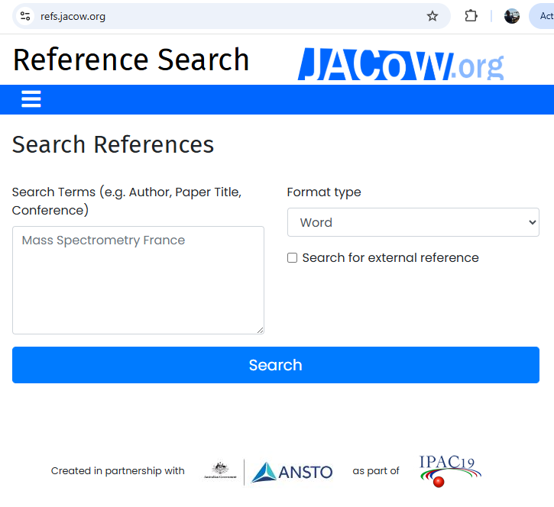

https://ipac-docs.jacow.org/PaperEditing/Editor/edit/

Slide 13
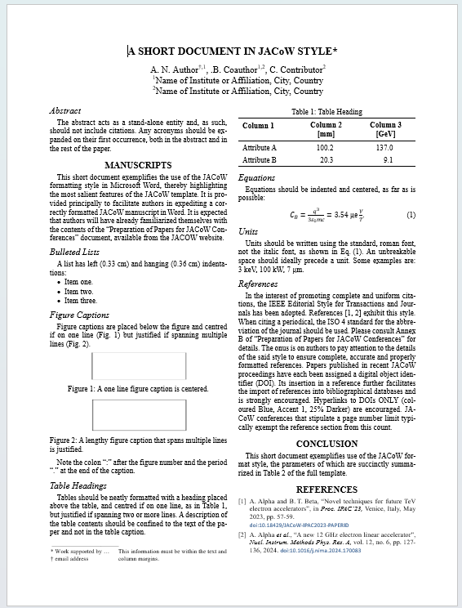
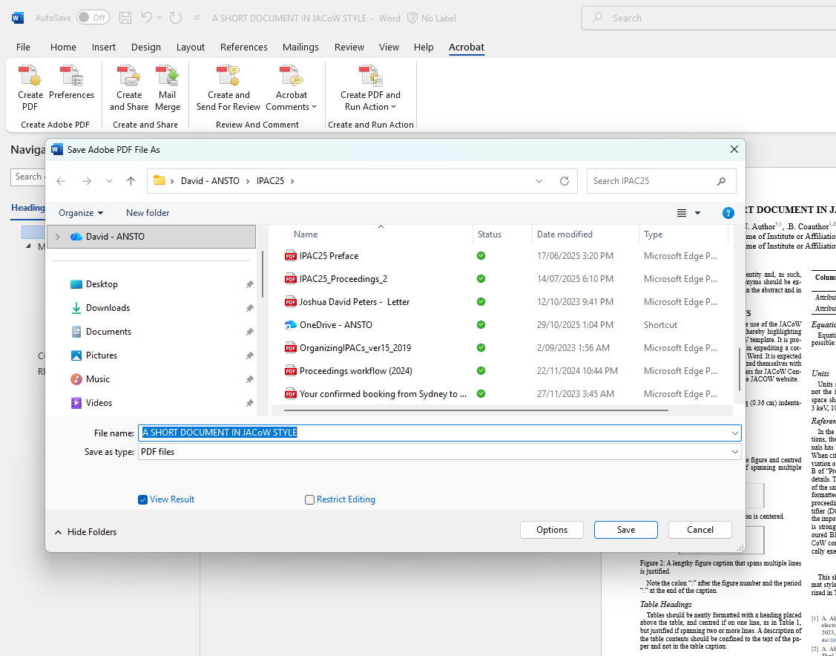
New Word Template & PDF Generation
Native JACoW Page Size
(Width A4, Height US Letter)
Generation of PDF using integrated Acrobat Ribbon in Word

Slide 14
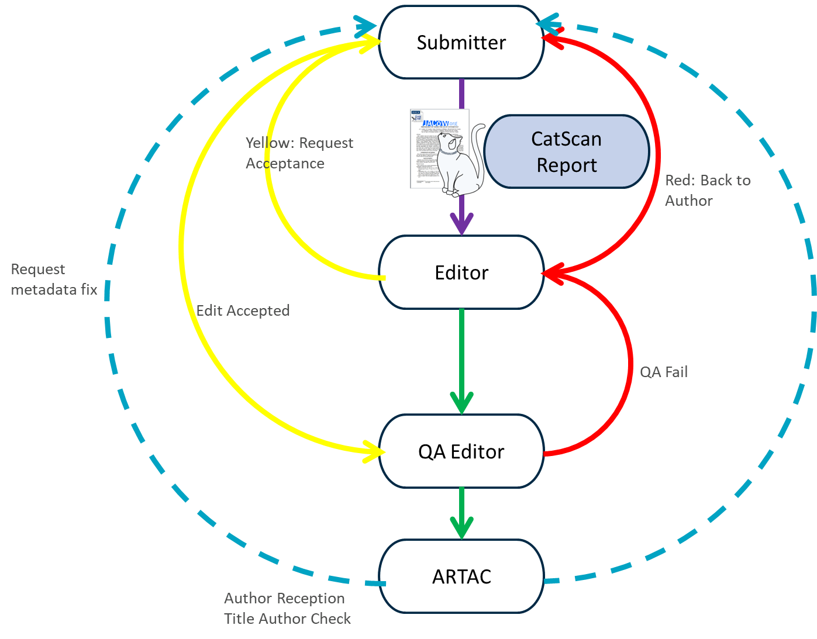
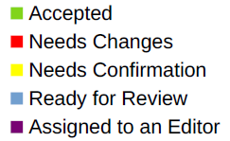
Judging paper
https://ipac-docs.jacow.org/PaperEditing/Editor/edit/#judging

Slide 15
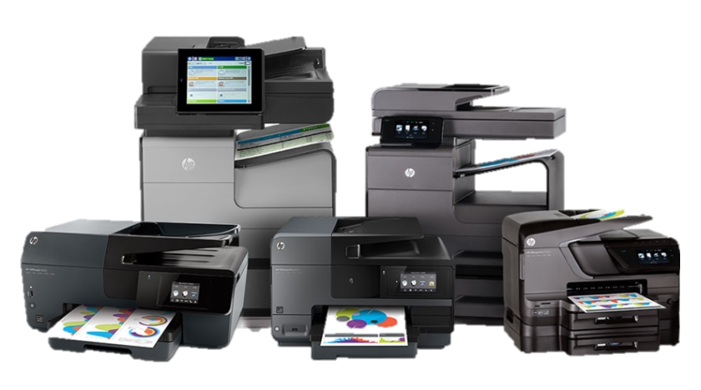
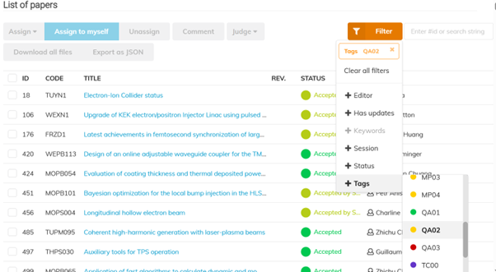
Paper QA
An adjustment to only QA Editor print papers
(Prevent duplicate and missing printouts)
QA Editor applying filter, Tag QA02
https://ipac-docs.jacow.org/PaperEditing/IPACs/IPAC25/#qa-editor
Future feature request for cleaner concurrent QA’ing, allow greater parallel processing

Slide 16
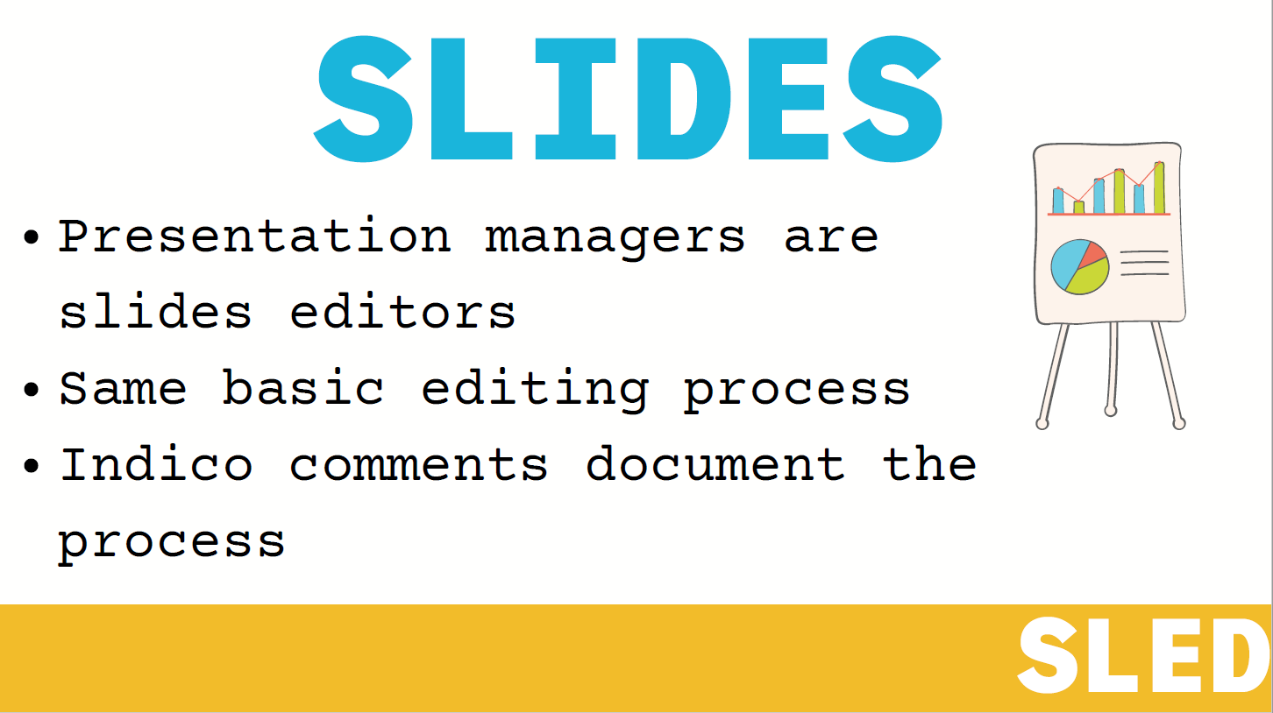
Presentation Processing
(IPAC’24 Approach Adopted)
https://ipac-docs.jacow.org/PaperEditing/Slides/1_Intro/

Slide 17
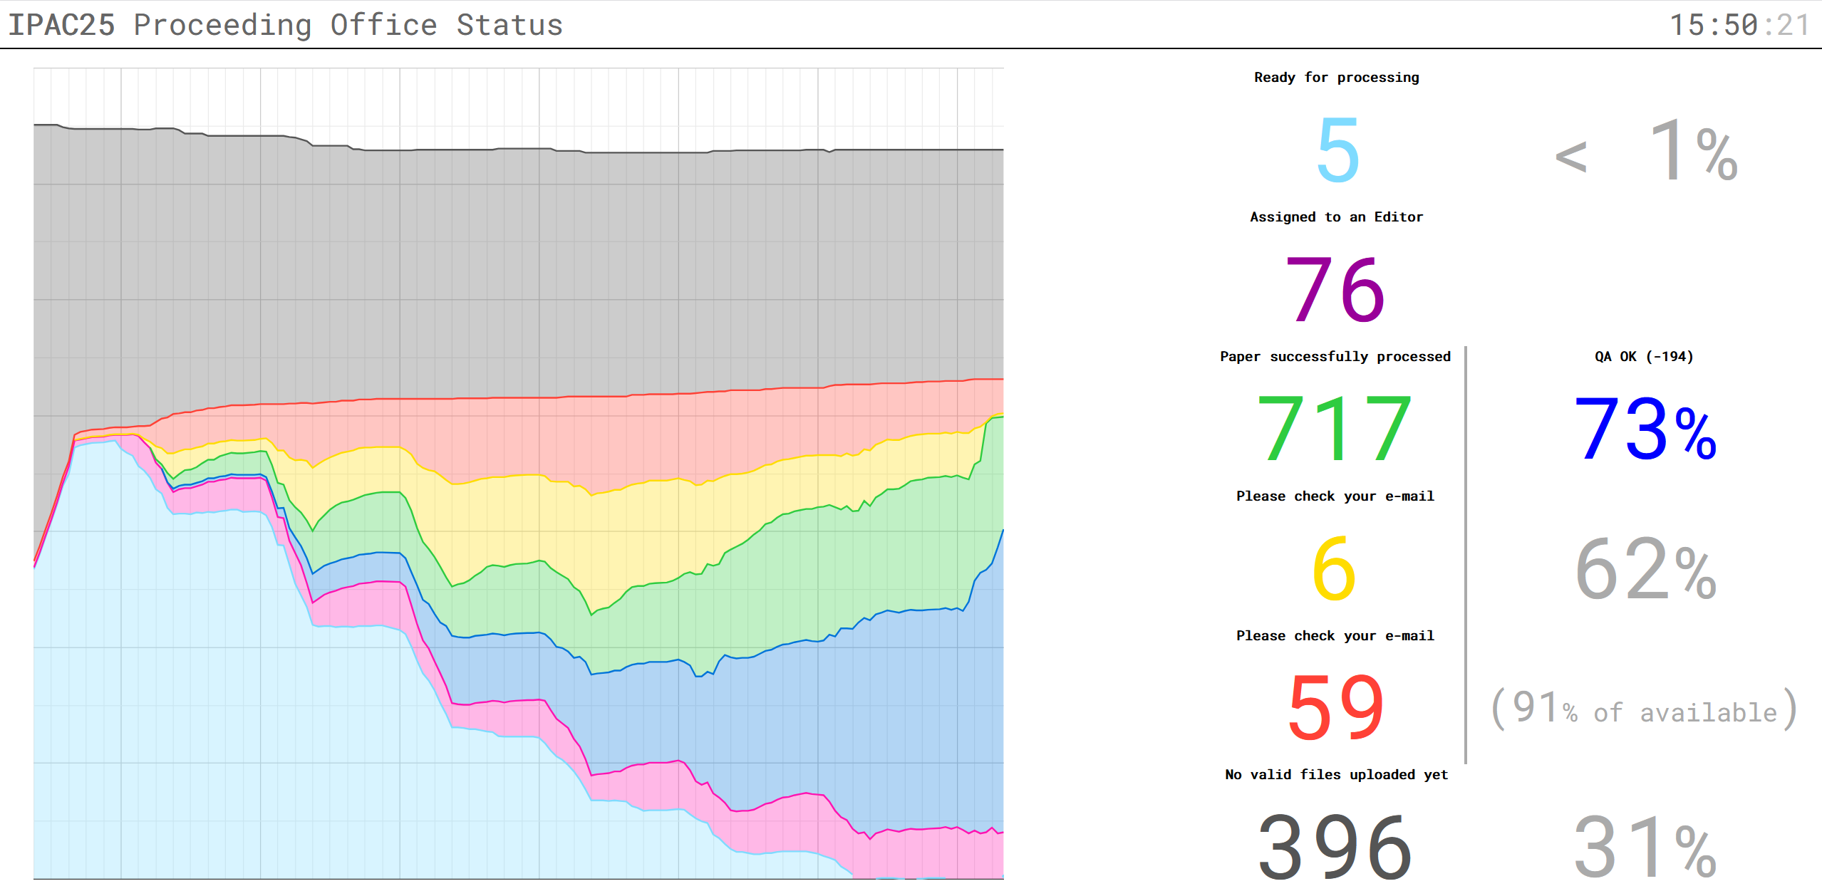
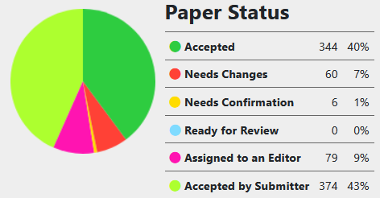
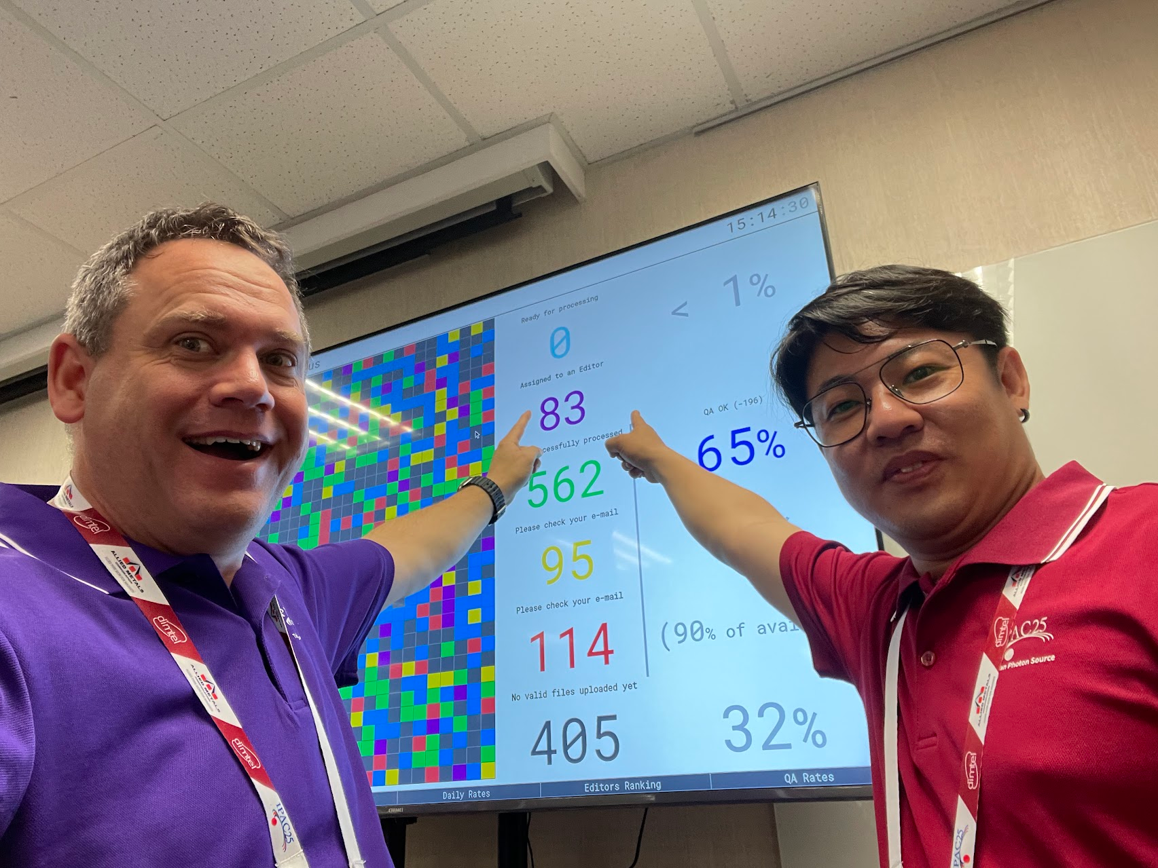
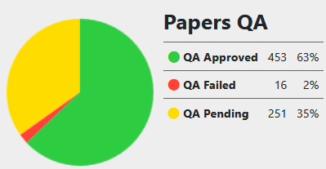
IPAC 2025 Proceeding Office Taiwan
Performance of team
As of 3:00pm
Wednesday 3:40pm
* All editors were able to have a day off

Slide 18
Some Points of Learning
Workflow – Roll Backs and Re-uploading as opposed to QA Failing papers
Hang over practice from the SPMS days, familiarisation on how to allow re-uploading.
Found that many editors were rolling back in many situations where fails are needed to allow upload again.
QA fail papers saw many editors trying to roll-back even though QA fail had been put in place which is a “human factor”.

Slide 19
Printing
Inconsistent printing practice, and not following printing instructions resulted in duplication, and absence of printed paper.
  This led to confusion and waisted time in QA and Author Title Check.
  Lost opportunity to process QA and Title Author.
  Confusion and problematic bespoke systems trying to track print papers which waists Author reception time, and can make a meal out of running tracking systems.

Slide 20
High Red Rates and Stockpiles of Papers
Some editors can fail papers Red too quickly resulting in a large backlog.
Stockpiling of papers of a particular type or particular organisation led to some editors with a big backlog.
EiC needed to start releasing some papers from some editors who had a large stockpile to allow underutilised editors to clear the work.

Slide 21
QA Workflow
Suggests
  QA from the start as much as possible, but Chief Editor will be very busy.
  QA Editor are the only editors who are to print papers.
  Indico to have the ability to assign QA paper to an Editor to lock out others.
  Workflow must enable concurrent QA editors without need to have alternative workflow management.

Slide 22
Missing Contribution Uploads – Email Trap
Indico treats everything in the program including prizes etc. as a contribution. Thus, using the sends message to missing contributions is a useless feature generating heaps of confusion especially for Student Session posters as currently there is no additional filtering.
This needs an Indico tweak to refine the feature to allow filtering include or exclude.
Email features can be evil if not understood…

Slide 23
Author Reception
Title Author Check
  Opportunities
    Verification check points in Indico to prompt authors before upload is enabled.
    Email out to all contributions suggesting prior to upload deadline to request all authors to update authors and affiliations in Indico and on the papers. (Also remined number of pages, and references only)
    System to manage this workflow needs to allow concurrent processing without separate paper systems.
  Permissions to change Title Authors not by default given with the role, this had to be changed under the protections I believe.

Slide 24
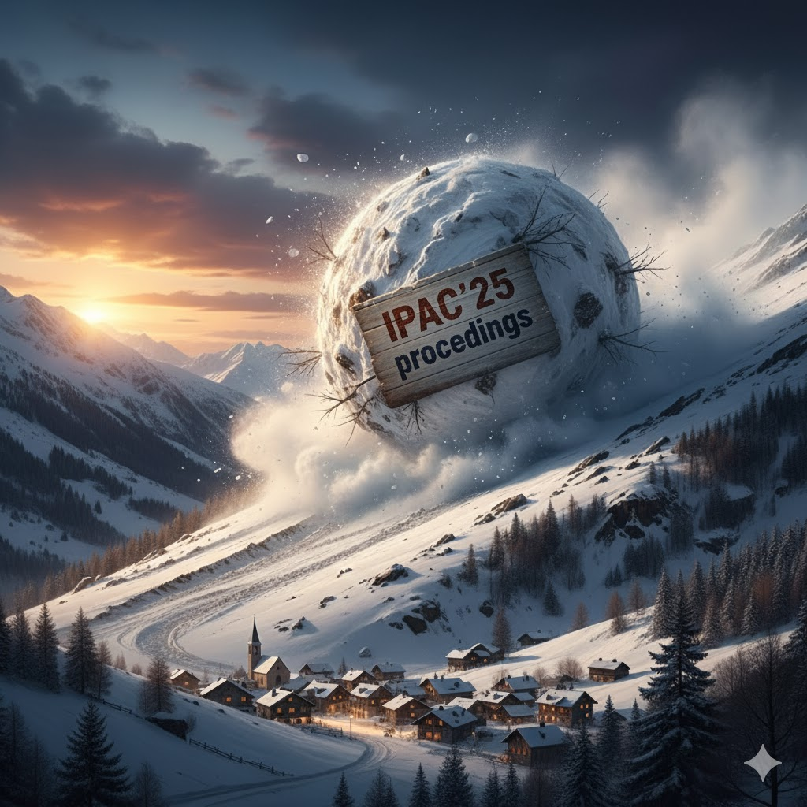
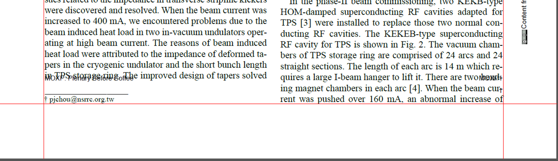
Snowballing of issues
Template Change
Page Size not recognised CatScan and Cropping Script
CatScan Updated
Cropping Script Updated
1 in 8 PDF with Wrapping Error
Cropping Script Updated
Reprocessing of around 130 IPAC’25 papers

Slide 25
User Errors
During IPAC’25 there was a contribution which was renamed after files had been uploaded
This led to the PURR tool encountering errors while trying to generate the final proceedings
As EiC don’t forget to assign all papers to yourself at the end of the conference

Slide 26
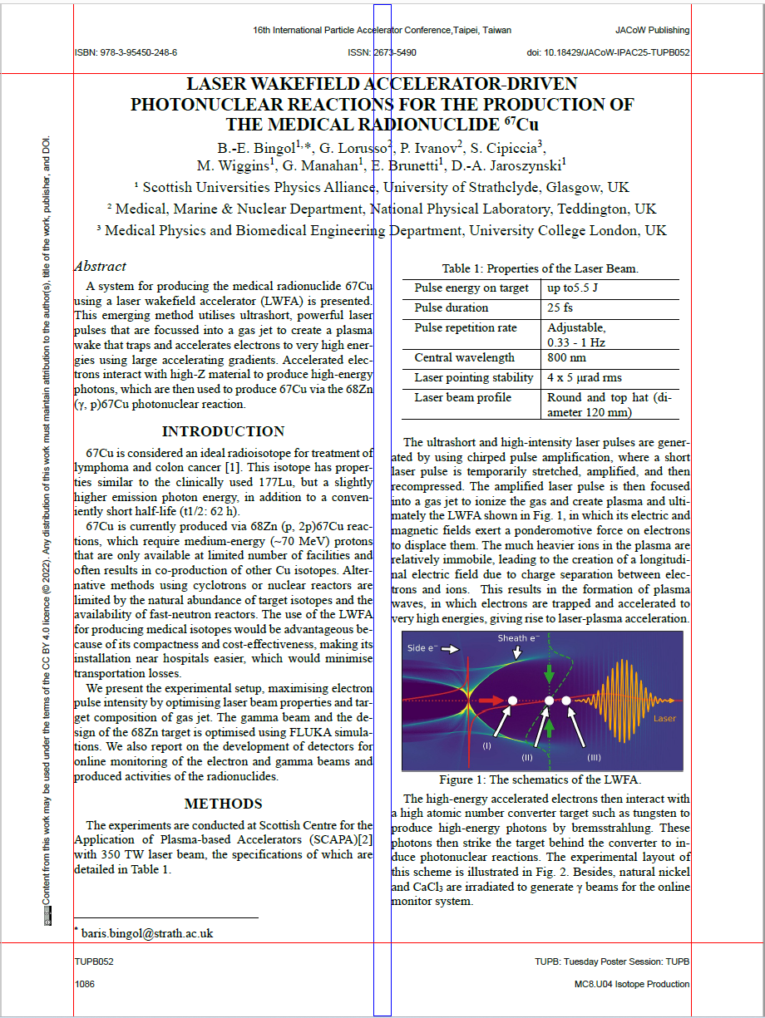
Visual Check of your Proceedings
Case Sensitive Searches on Final Proceedings
MHZ, GEV, MEV, KHZ, kHZ, KV, KEV, TEV, ete..
MHz, GeV, MeV, kHz, kHz, kV, keV, TeV, etc...
I was able to weed out numerous missed title errors using the search on the final proceedings.
In my experience to majority of inconstancies was the treatment of sub-section heads.

Slide 27
Coming Soon Advice on Proceedings PDF Optimisation
IT was noticed by Volker when doing a save as of the final proceedings volume to file reduced in size saving for IPAC’25 approximately 300MB.
Testing is currently being done to establish a stable tool and method to apply this optimisation which saves on data transfer.
More on this to come….

Slide 28

Questions

Slide 29
Thank you

Slide 30
Some Aspects to Touch on
01 | CatScan CatScan was integrated into Indico posting reports of Word and LaTeX paper EiC reviewed a sample of pre-scanned reports within finial day of uploads and set obvious Red status in advance |  | 05 | Sticking to lanes LaTeX editor were requested to only edit tex papers from the start, as to not deplete Word editor workload by processing any type of paper
02 | Authors Respond to CatScan feedback to self edit to a higher standard, and improve their knowledge |  | 06 | Author Reception Started same time editors, initial QA to feed author reception was underpowered with some author reception switching to QA
03 | Editors As per IPAC’24 one group all starting and mission together and finishing together |  | 07 | Changes Updates Indico, Templates, Tools These had flow on impacts to discussed
04 | QA and Printing Only when preforming a QA is the paper printed, emerged as we processed papers

