Slide 1
Organizing the IPAC’25 Conference
Jui-Che Huang , Chair of Local Organizing Committee
Notes:
Good morning everyone. I’m Jui-Che Huang, Chair of the Local Organizing Committee. Today, I’m happy to give you a short report about IPAC 2025, which was successfully held in Taipei, Taiwan. It was the 16th International Particle Accelerator Conference, hosted by the National Synchrotron Radiation Research Center. In this report, I’ll share some highlights, statistics, and feedback from this exciting event.

Slide 2
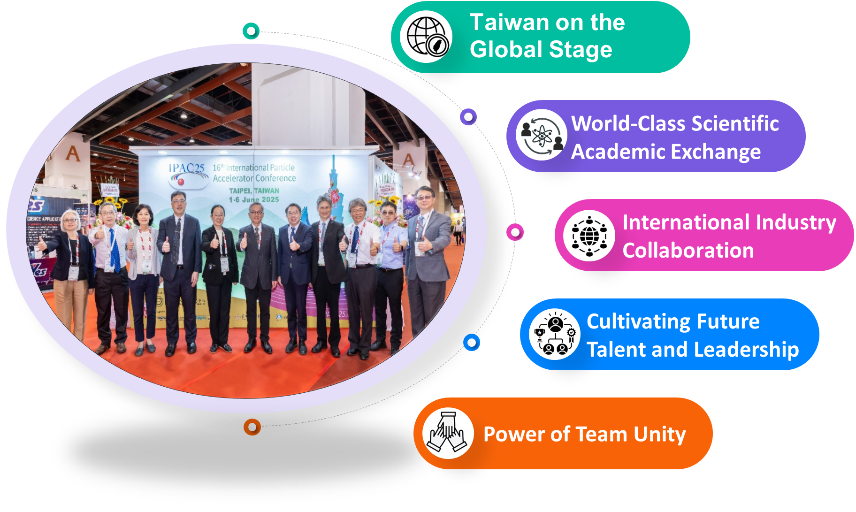
Taiwan Host Highlight
Notes:
Hosting such a big international conference brings many benefits. We gained valuable experience, built stronger global connections, and showed Tawin's innovation, teamwork, and excellence. Through this event, we strengthened international collaboration and inspired the next generation of talent.
Now, please join me as I share the story of IPAC 2025.

Slide 3
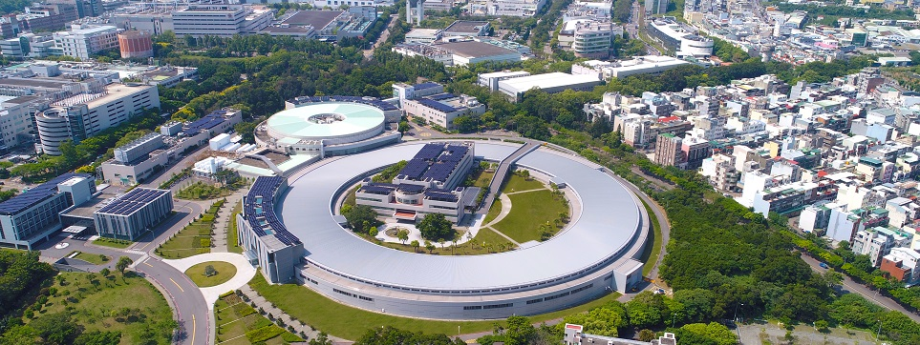

Host Institution
National Synchrotron Radiation Research Center (NSRRC)
NSRRC is a non-profit research institute, funded by the National Science and Technology Council (NSTC) in Taiwan. It is located in the Hsinchu Science Park, which is hailed as the “Silicon Valley of Taiwan,” home to many of the island’s largest IT and semiconductor companies.
Notes:
Next, I’d like to introduce our host institution — the National Synchrotron Radiation Research Center, or NSRRC. The center is located in Hsinchu Science Park, Here, many of semiconductor companies are based. The NSRRC operates the Taiwan Photon Source, shown in this picture.

Slide 4
IPAC’25 Timetable
JUNE , 2025
S
Student Poster
Registration
Welcome Reception
Parallel Scientific Sessions
Exhibitions, Posters
Session for Industry
1
4
Opening Plenary Talks
Chair’s Cocktail
Parallel Scientific Sessions
Awards Ceremony /Entertainment Talk
Exhibition, Posters
Conference Banquet
2
5
Parallel Scientific Sessions
Exhibition, Posters
Parallel Scientific Sessions
Posters, Exhibition
PRE Session
Plenary Talks
Closing Remarks
Facility Tour
3
6
Notes:
This is the timetable for IPAC 2025 in June. The conference ran for six days, starting with registration and the welcome reception. We had plenary talks, parallel sessions, poster exhibitions, and special events like the Chair’s Cocktail, the Industry Session, and the Conference Banquet. The meeting ended with closing remarks and a facility tour.

Slide 5
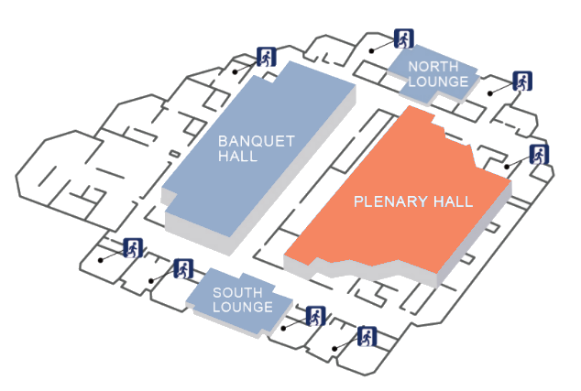

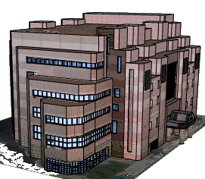
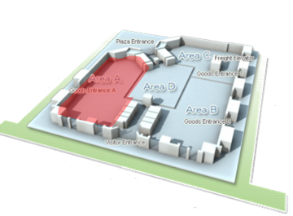
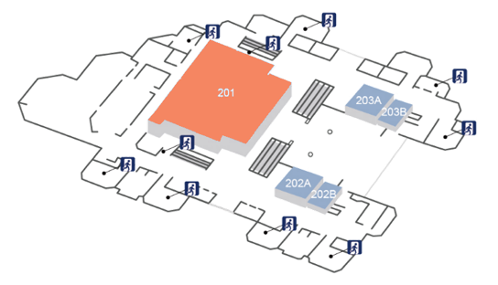
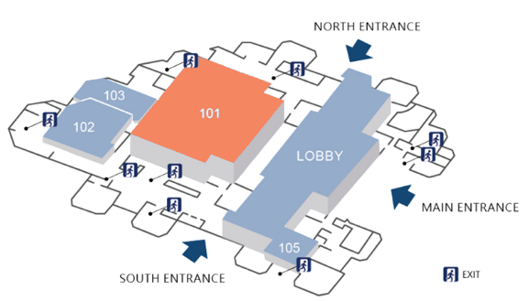
IPAC25 Venues
3rd Floor
Conference Venue
Taipei International Convention Centre
Plenary Hall Opening Ceremony
Exhibition Hall
Taipei World Trade Center
2nd Floor
Room 201
Scientific Session (Parallel B)
1st Floor
Room 101
Scientific Session (Parallel A)
Closing and Award Ceremony
Registration
Exhibitions
Posters
Coffee break & Lunch
Notes:
The IPAC 2025 conference took place at the Taipei International Convention Centre. The plenary sessions and opening ceremony were held in the main hall on the third floor. Scientific sessions were in Room 101 and 201. The exhibition, posters, and coffee breaks were at the Taipei World Trade Center, right next to the convention centre.

Slide 6
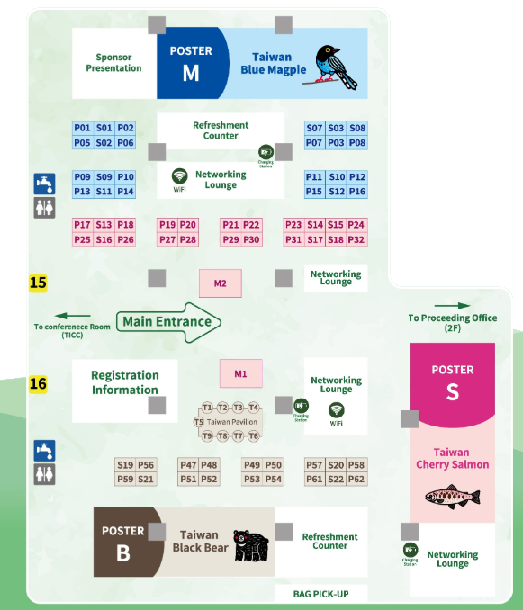



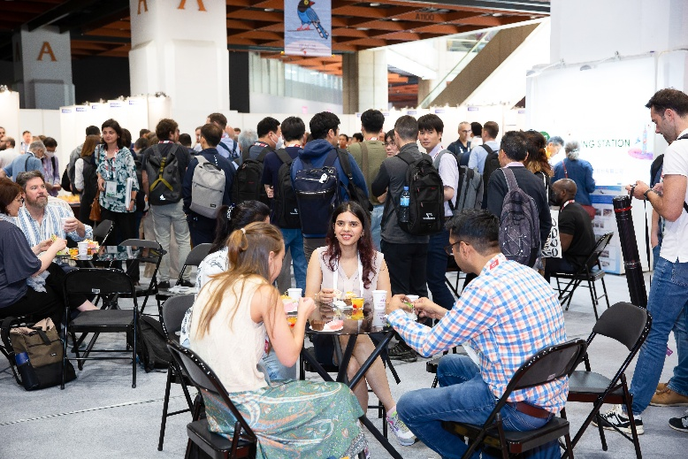
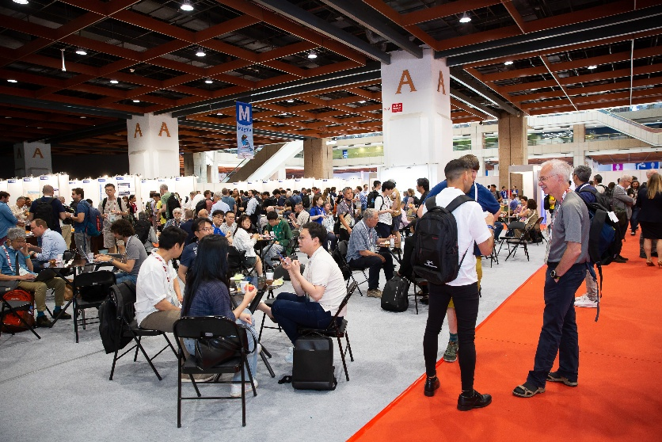
Exhibition, Posters and Coffee
Exhibition Hall — A Place for Networking: Connect with People and Wi-Fi!
Come and Talk with IPAC sponsors.
Notes:
The exhibition hall was not only for posters but also a great place for networking. Participants could meet people, talk with IPAC sponsors, and enjoy coffee together. With Wi-Fi and lounge areas, everyone stayed connected and relaxed between sessions. It was a lively space full of ideas and friendly conversations

Slide 7
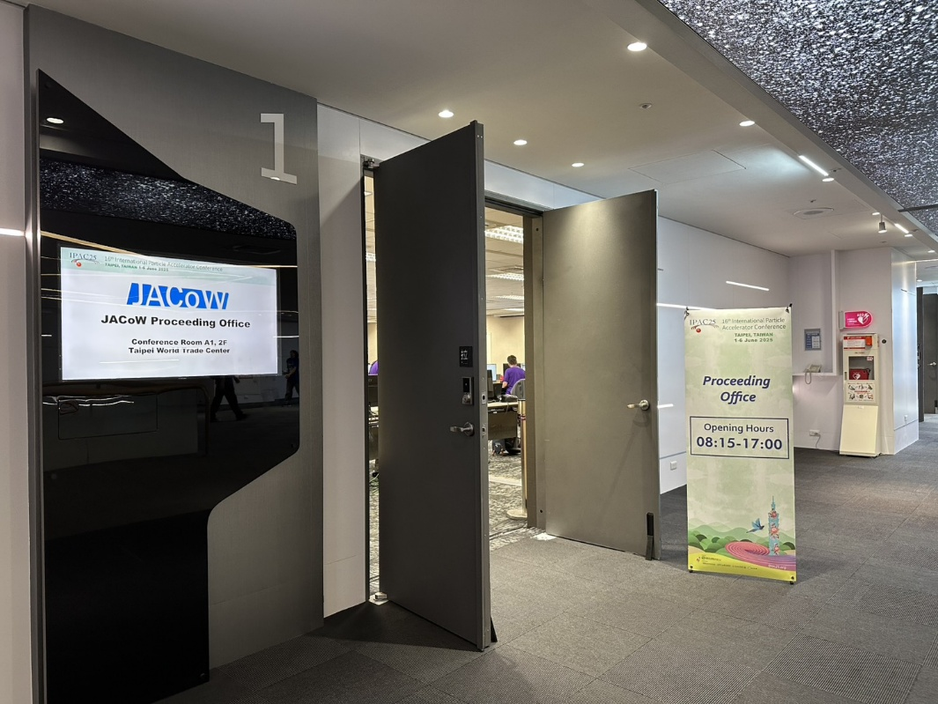
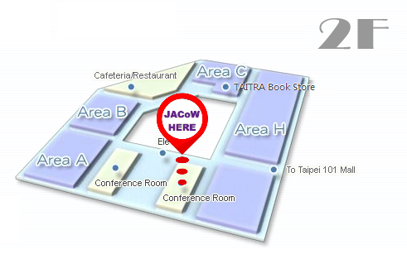
Proceeding Office
Exhibition Hall
Taipei World Trade Center
Opening Hours
08:15-17:00
Notes:
Another important place was the JACoW Proceeding Office. The office was open every day from 8:15 to 5:00. It was located on the second floor of the Taipei World Trade Center, just above the exhibition hall. We placed it there so it wouldn’t be too isolated. This setup encouraged participants to visit the exhibition hall often, and it also made it easy for the JACoW team to stay connected with everyone at IPAC’25.

Slide 8
Satellite Meetings
Date | Time | Meeting Name | Open/Closed | Room
Saturday, 31 May | 08:30–17:00 | Insertion Devices for Future Light Sources Workshop (ID25) | By Registration | TWTC 2F, Room A+
Sunday, 1 June | 08:30–12:30
Tuesday, 3 June | 08:30–10:30 | APS/PRAB Authors’ Tutorial | OPEN | TICC 3F, South Lounge
 | 12:30–14:00 | IPAC Coordination Committee Meeting and Lunch | By Invitation | TICC 1F, Room 106
 | 14:00–16:00 | ACFA Meeting | By Invitation | TICC 1F, Room 106
 | 17:50–20:30 | “Meet the APS/PRAB Editors" Reception | OPEN | TICC 1F
 |  | Productive Research Environments Reception | OPEN | TICC 1F, Room 102
 | 18:00–20:00 | IPAC’26 Exhibitor Reception | By Invitation | TICC 4F, VIP Room
Wednesday, 4 June | 12:30–14:00 | JACoW Stakeholders Meeting | By Invitation | TWTC 2F, Room A+
 | 18:00–20:30 | Electron Ion Collider (EIC) Accelerator Collaboration | OPEN | TICC 1F, Room 102
 | 18:00–20:30 | IPAC25 Organizing Committee Dinner | By Invitation | Grand Hyatt Hotel, 1F
Friday, 6 June | 13:30–17:00 | IPAC’26 Scientific Programming Committee | By Invitation | TWTC 2F, Room A+
Notes:
Several satellite meetings were held before and during IPAC 2025. These included workshops, tutorials, coordination and committee meetings, as well as receptions for editors and exhibitors. Some meetings were open to all participants, while others were by invitation.

Slide 9


Social Programs
Activity | Date | Time | Location | Remarks
JAcoW Team Dinner ID25 Dinner | Saturday, 31 May | 18:00-20:00 | UMAMI de Lebledor (金色三麥) | Dinner (By Invitation)
Welcome Reception | Sunday, 1 June | 18:00-20:30 | 1F, TICC Lobby (國際會議中心) | Reception
Chair's Cocktail | Monday, 2 June | 18:50-21:00 | 1F, ILLUME Taipei (茹曦飯店) | Dinner (By Invitation)
Joint PRE–PRAB Session | Tuesday, 3 June | 17:50- 18:00 | 1F, TICC (國際會議中心) | Reception with light snacks
2nd Organizing Committee Meeting | Wednesday, 4 June | 18:20-21:00 | 1F, Grand Hyatt Taipei (台北君悅酒店) | Dinner (By Invitation)
Conference Banquet | Thursday, 5 June | 18:45-20:40 | HOTEL GRAND HILAI (漢來大飯店) | Banquet
Notes:
IPAC 2025 had many social events, such as welcome and cocktail receptions, dinners, and the conference banquet. These programs followed the usual IPAC tradition and helped speakers , editors, participants relax, meet new friends, and enjoy Taipei together.

Slide 10




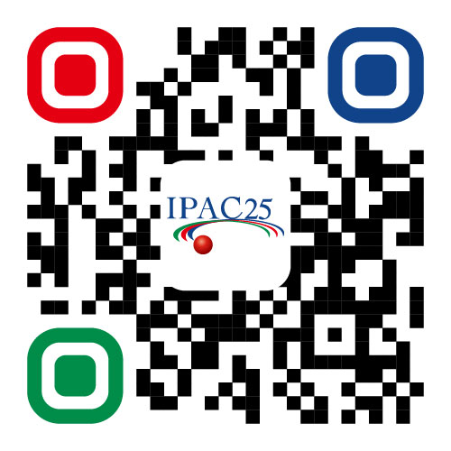
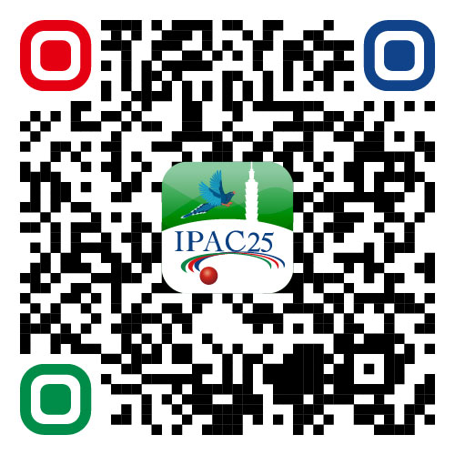

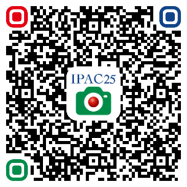
Information of IPAC’25
Website
APP
E-book
Photo-book
Notes:
To make information easy to access, IPAC 2025 provided a website, mobile app, e-book conference guide, and a photo book. Participants and you could simply scan the QR codes to get updates, program details, and event photos.

Slide 11
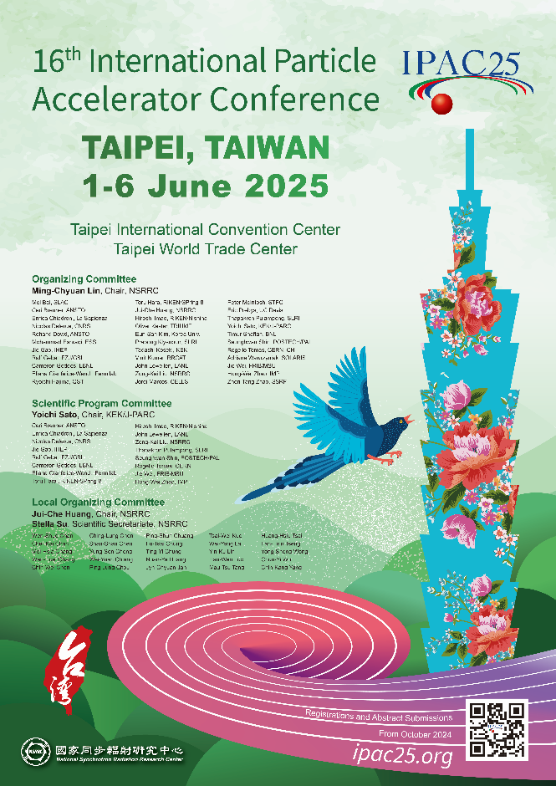

IPAC’25 Committees and Key Dates
Notes:
This slide shows the main committees and key dates for IPAC 2025. Important dates included registration, abstract submission, and paper deadlines, all leading to the event in June 2025.

Slide 12


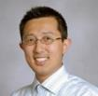
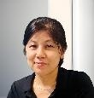







IPAC’25 Committees and Tasks
OC Chair
SPC Chair
LOC Chair
Scientific Secretariat
Ming-Chyuan Lin (NSRRC)
Yoichi Sato (KEK/J-PARC)
Jui-Che Huang (NSRRC)
Stella Su (NSRRC)
Strategy for organizing IPAC’25 has proven highly effective.
With four dedicated teams holding regular monthly meetings, we ensure steady weekly progress.
PCO
IPAC’25 LOC team
Team C
Light-Peer-Review (Max. 120)
Student Posters & Grants (Max. 80)
ACFA / IPAC25 Awards
Posters (Max. 1300)
Facility Tours
Conference APP
Team D
Scientific Program
Industry Session
Productive Research Environment Session
SPC1/2/3 Events
Team A
Venue Arrangements
P.C.O. Meetings
Sponsorship
Finance
Conference Hotel
Registration
Entertain. Talk
Team B
JACoW Team (~ 1300 papers processed)
Oral Presentation (86 talks)
Proceedings Office – IT Team
Related Software Setup
Conference Website
Regular Announcement
SPC Chair : Dr. Sato, KEK
Notes:
The strategy for organizing IPAC 2025 has proven highly effective. We divided our local organizing committee of about 20 people into four teams — Team A, B, C, and D. Each team had clear responsibilities, such as venue and finance, proceedings and IT, posters and awards, and scientific programs. We also worked closely with our professional conference organizer and the scientific program chair, Dr. Yoichi Sato from KEK. With four dedicated teams holding regular monthly meetings, we were able to make steady progress. As the IPAC’25 coordinator and together with the scientific secretariat, Stella Su, we joined every meeting. This allowed us to monitor each team’s work and make sure everything stayed on schedule. This teamwork system worked very well and helped us organize IPAC 2025 smoothly.

Slide 13
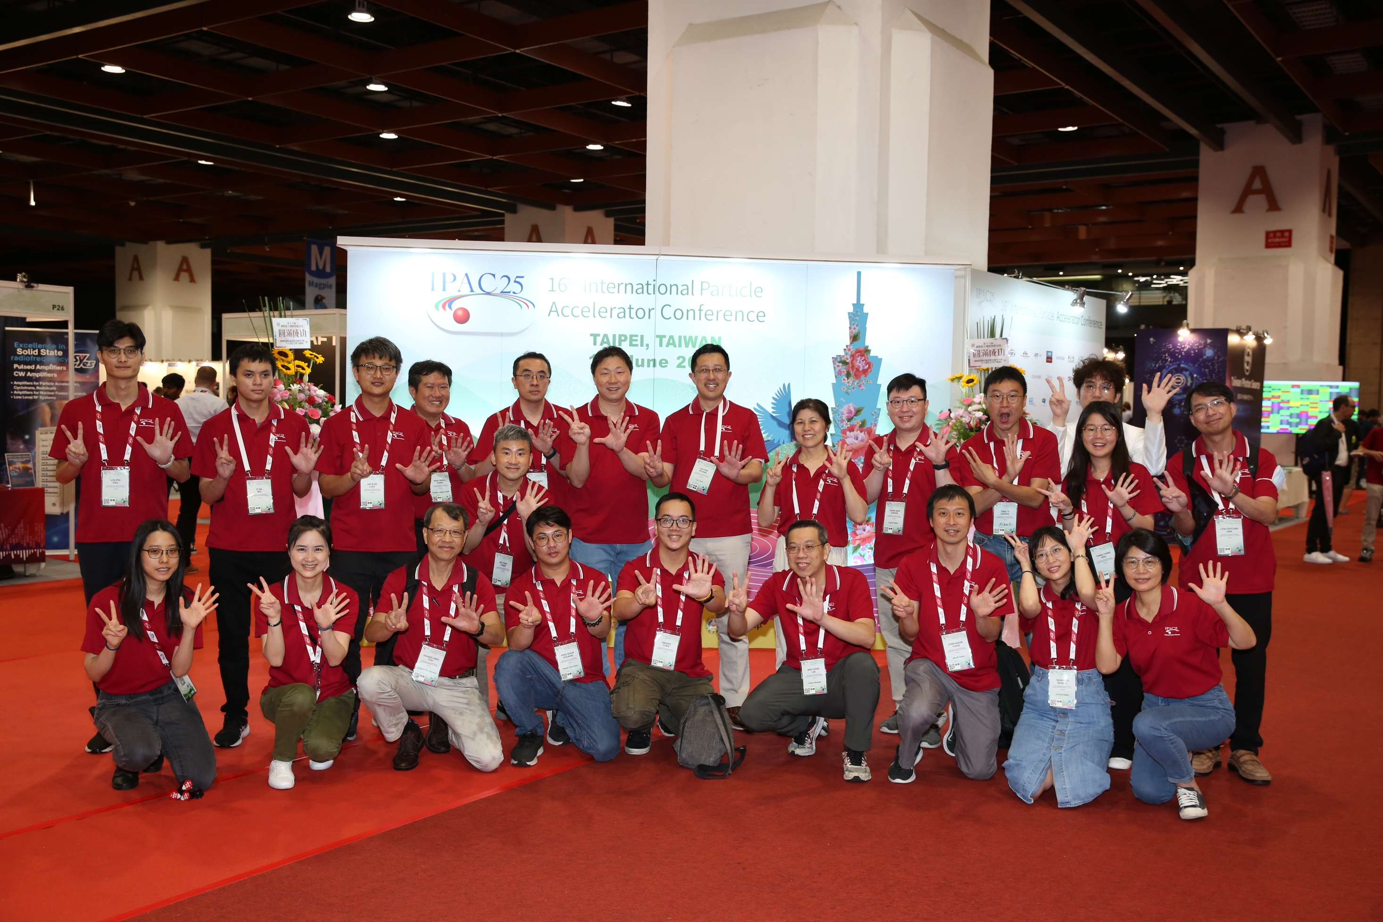
IPAC’25 LOC Team
Notes:
This is our IPAC 2025 Local Organizing Committee team. You may recognize many familiar faces here. Together with our PCO members, we had around 50 people providing on-site support during the conference.

Slide 14










IPAC’25 Timeline
IPAC25
November
28 November
4 December
20 May
24 May
2021
2023
2023
2023
Exhibitons Open!
IPAC’25,Taiwan IPAC22 OC1
JTM2023
HsinChu, Taiwan
2024
SPC2:Invited Orals
Nashville, USA
OC1/SPC
Taipei, Taiwan
4 March
6 January
10 December
15 October
14 October
2025
Early bird Registration
2025
2024
2024
Early bird Registration
2024
SPC3:Cont. Orals
Tokyo, Japan
Student Grant App.
Abstract Submission
Abstract Submission
Student Grant App.
31 March
31 March
14 April
29 May
1 - 6 June
2016
Light-Peer Review
2025
Paper Submission
2025
Light-Peer Review
2025
Proceeding Editing
2025
Notes:
This slide shows the preparation timeline for IPAC 2025. The planning started in 2021 and continued through several key meetings in Taiwan, Japan, and the United States. Step by step, we opened exhibition and registration, accepted abstracts, and reviewed papers. All teams worked closely to meet every important deadline, including paper submission and proceeding editing. Finally, everything came together for the IPAC 2025 conference in June in Taipei.

Slide 15
Abstract Submission
 | IPAC’25 | IPAC’24 | IPAC’23
Region | Asia | Americans | Europe
Total abstracts submitted* | 1735* | 1691 | 2219
Abstracts withdrawn | 512 | 366 | 477
Withdrawal rate | 29.5% | 21.6% | 21.5%
Contributions | 1223 | 1325 | 1742
Papers edited by the editorial team | 871 | ~1050 | ~1380
* including a few submitted after the deadline
Notes:
From here, I’d like to show some statistics and compare them with previous IPACs. For IPAC 2025, held in Asia, we received a total of 1,735 abstracts — slightly higher than IPAC 2024 in the Americas, but lower than IPAC 2023 in Europe. About 29.5 percent of abstracts were withdrawn, which is noticeably higher than in previous years. In total, we had 1,223 contributions, and around 870 papers were edited by our editorial team. So, you can say there was a small warning sign in IPAC 2025 — the higher withdrawal rate.

Slide 16
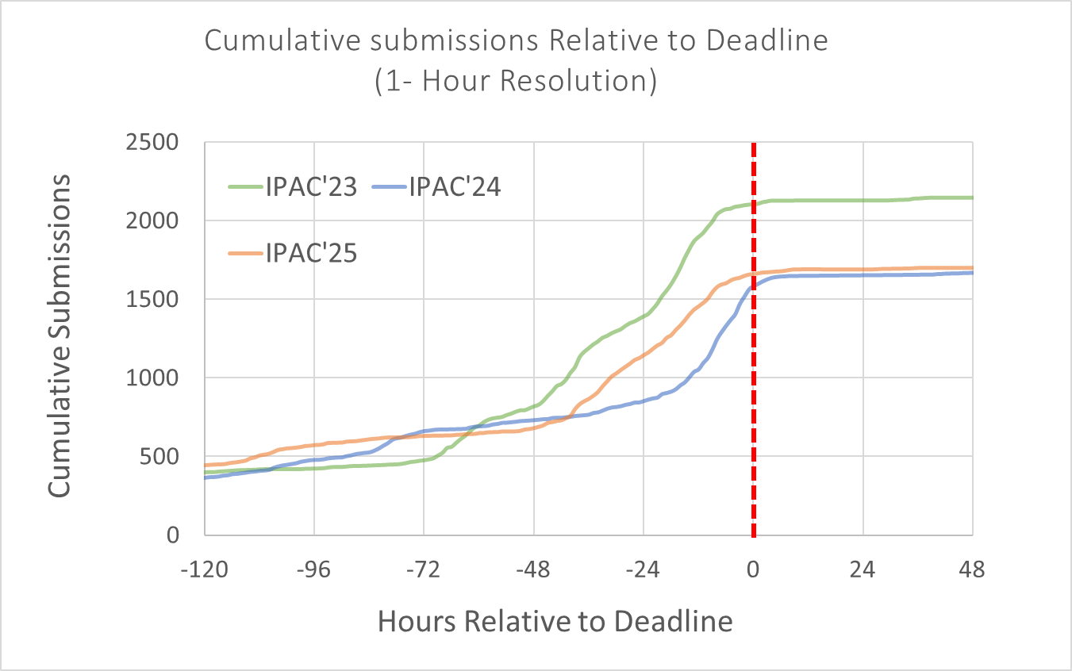
Submission of Abstracts
The plots of the cumulative submissions without taking withdrawal into account suggests that people submit by the deadline as usual.
2219
1735
1691
Notes:
As I mentioned, we had a pretty good beginning for IPAC 2025. By the submission deadline, we received 1,688 abstracts, which was quite encouraging. After the deadline, we also accepted around 50 special requests, bringing the total to 1,735 abstracts.

Slide 17
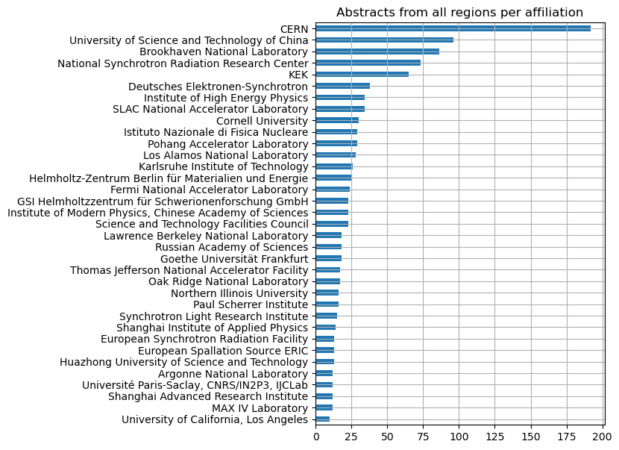
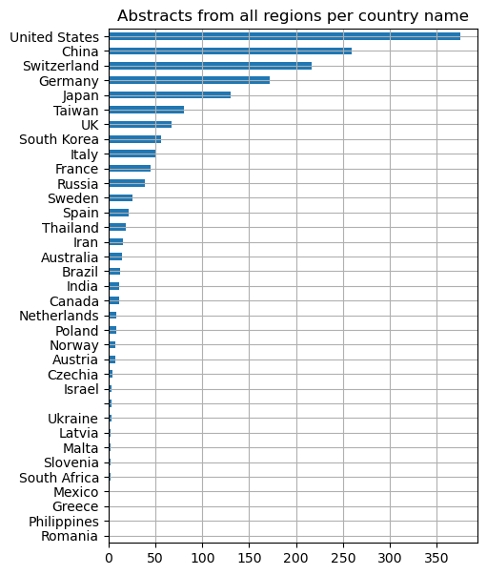
Distributions of Abstract Submissions
Notes:
This slide shows the distribution of abstract submissions by institution and by country.
CERN submitted the most abstracts, followed by the University of Science and Technology of China and Brookhaven National Laboratory.
By country, the United States leads, followed by China, Switzerland, Germany, and Japan. We can see strong participation from both Asia and Europe in IPAC 2025.

Slide 18
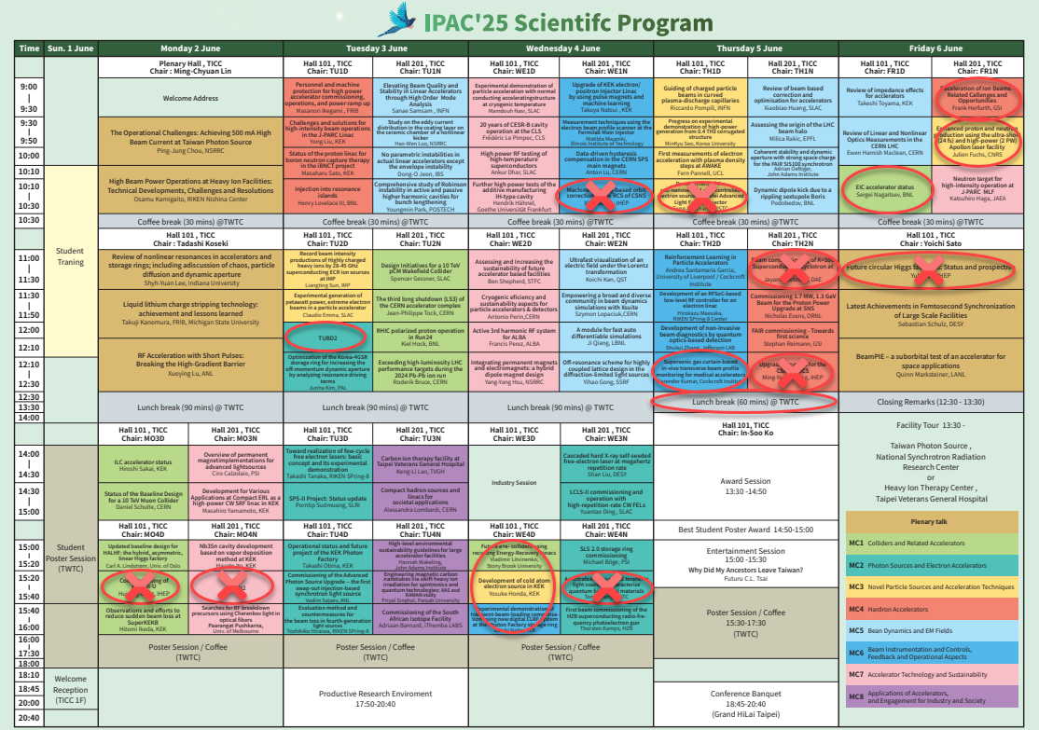
The participation of attendees from the United States and China remains highly uncertain, resulting in some last-minute cancellations and increasing the difficulty of scheduling the program.
Due to increased Information security and cybersecurity controls most institutions, meeting notifications and communications have been restricted, leading to decreased efficiency in email delivery.
Notes:
The real problem we faced was the uncertainty of participation from the United States and China. This caused several last-minute cancellations, making it very difficult to schedule the program. As you can see from the table, we had to find many substitute speakers from our backup list. Some presenters couldn’t get permission from their facilities, some couldn’t obtain visas, and one requested a change in the talk schedule.
For future conference organizers, please take note — due to tighter information security and cybersecurity controls in many institutions, meeting notifications and email communications were often delayed. This really affected coordination efficiency.

Slide 19
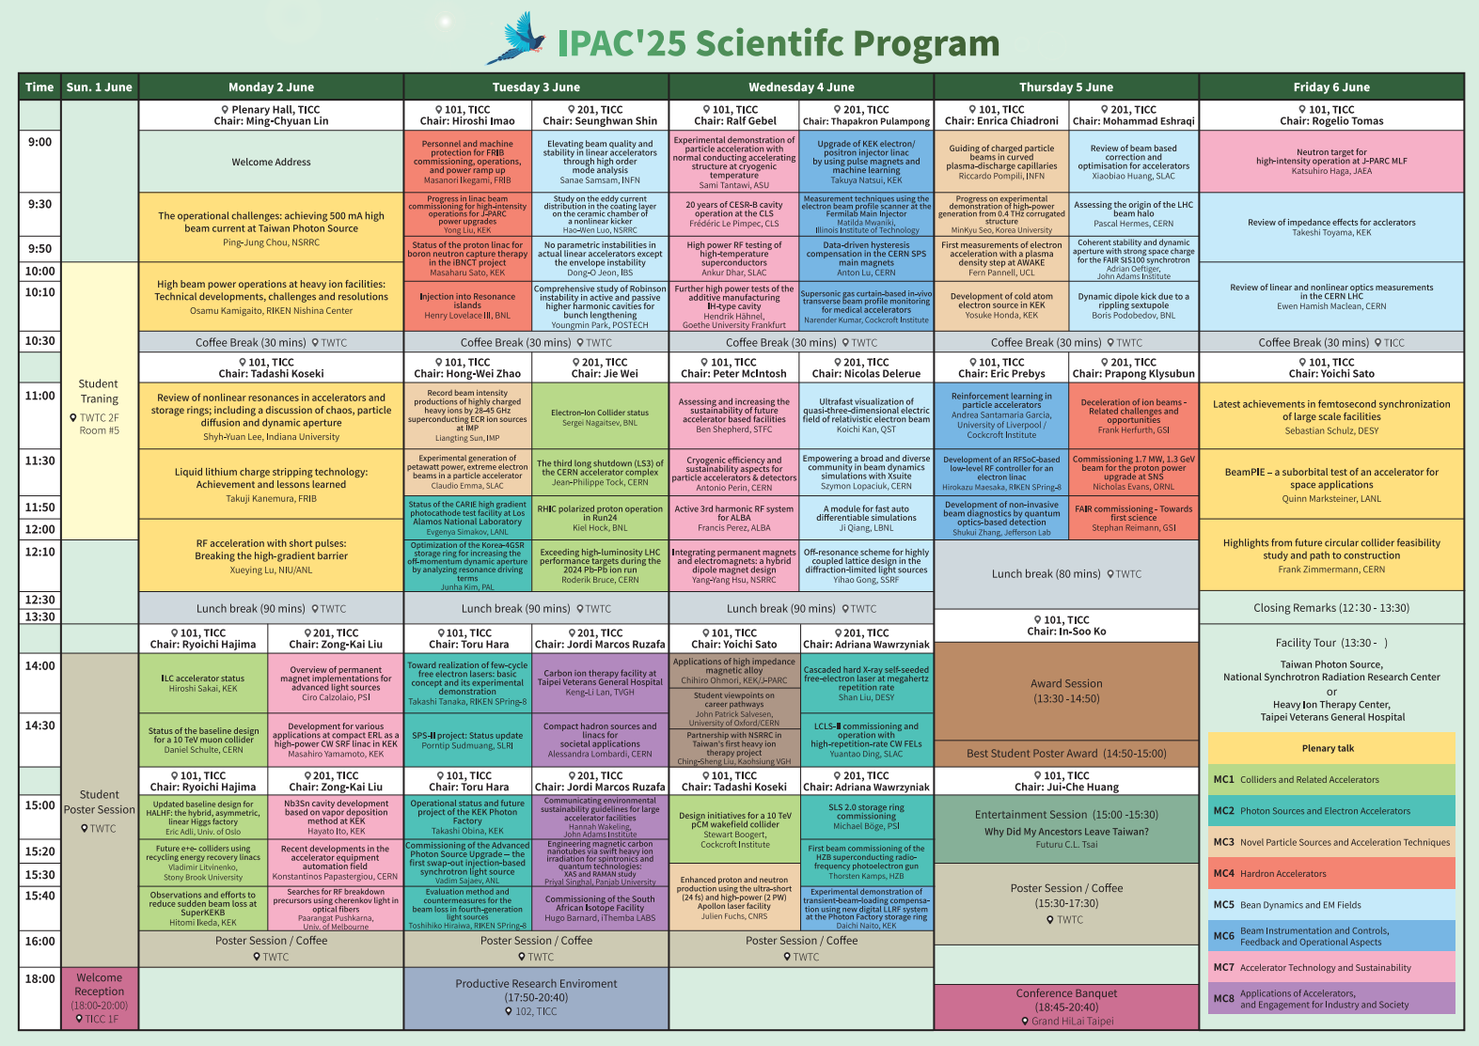
Notes:
This is the scientific program of IPAC 2025. The conference covered a wide range of topics, including accelerators, beam physics, and new technologies. The program was completed just before printing — it was challenging because of many last-minute changes and uncertainties.

Slide 20
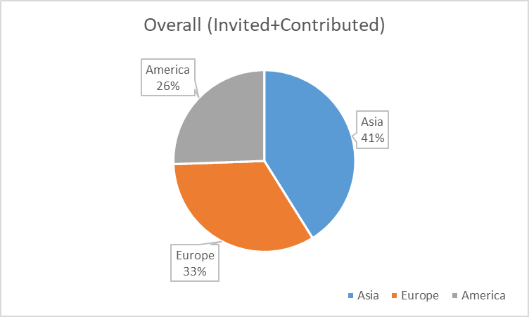
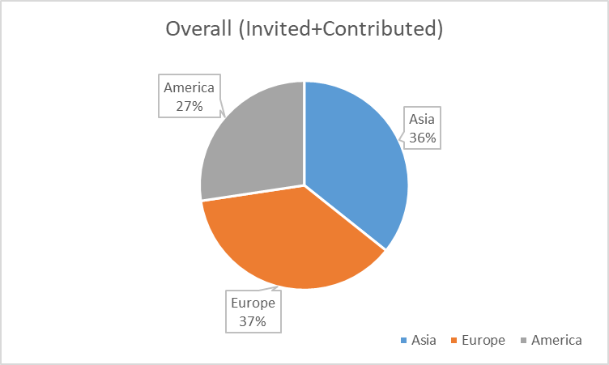
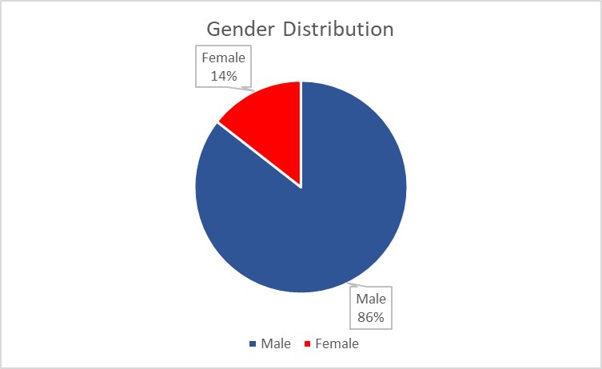
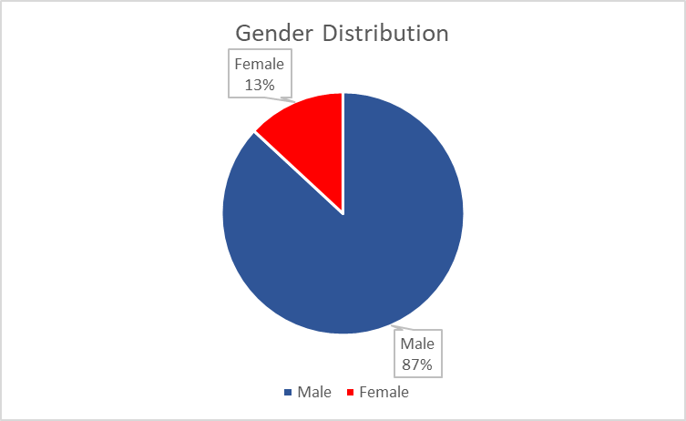
Oral Presentations
Contributed and Invited Orals (90 Talks)
Contributed and Invited Orals (84 Talks)
Notes:
For oral presentations, we originally had 90 talks, but after some withdrawals, the final number was 84. The regional distribution stayed balanced, with about 36 percent from Asia, 37 percent from Europe, and 27 percent from the Americas. Around 13 percent of the speakers were female. Because the program changed so often, keeping a perfect balance was not our first priority.

Slide 21
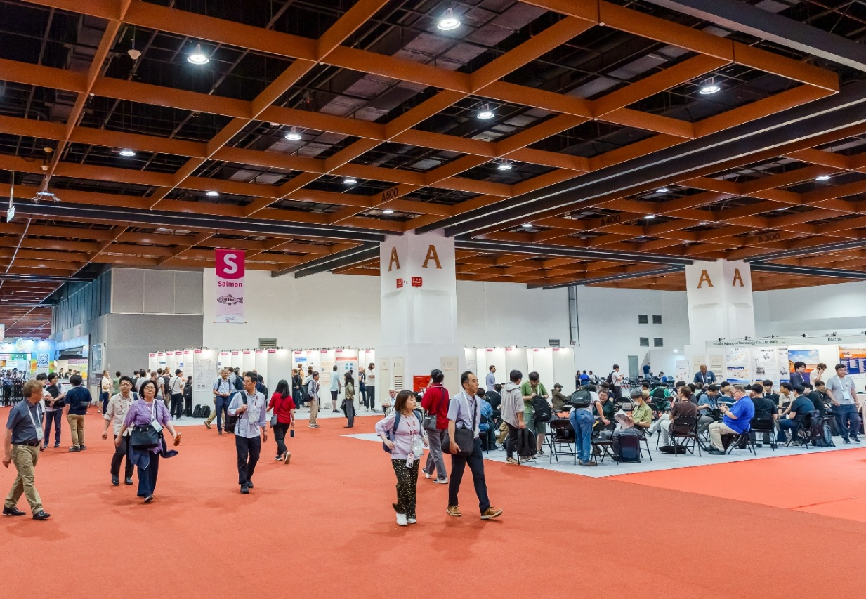
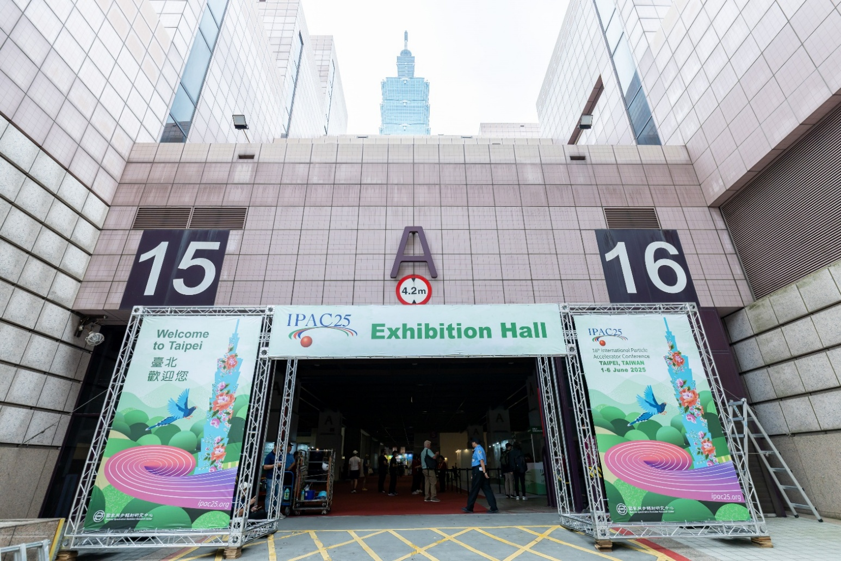
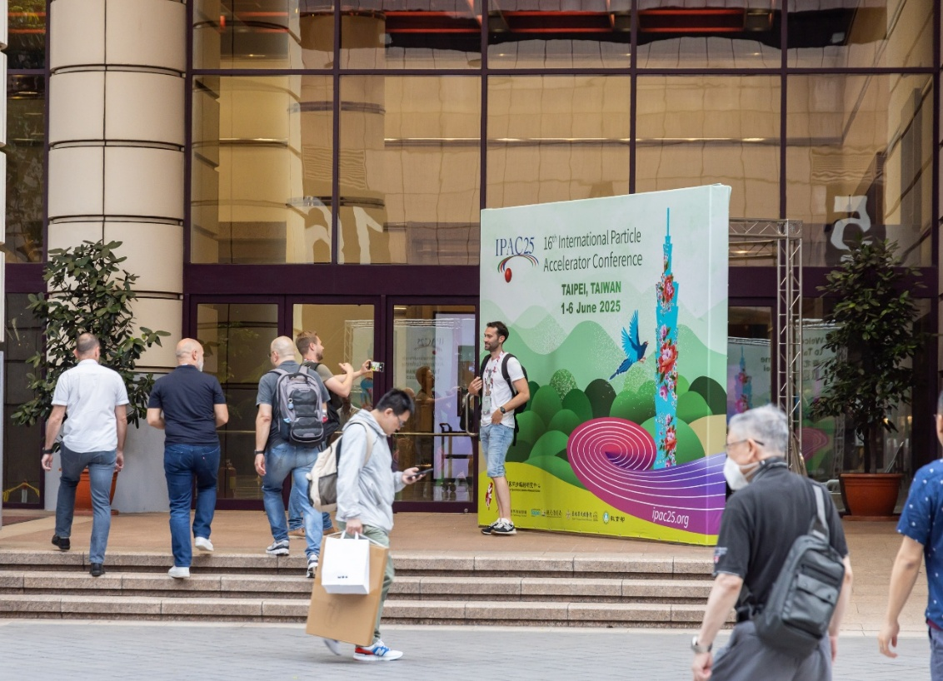
IPAC’25 Taipei International Convention center & Taipei World Trade Center ！
Notes:
IPAC 2025 took place at two fantastic venues — the Taipei International Convention Center and the Taipei World Trade Center! Right in the heart of Taipei, they offered great convenience and an exciting atmosphere for everyone.
It was the perfect setting for science, connection, and collaboration. Now, let’s take a closer look at some of the key conference statistics.

Slide 22
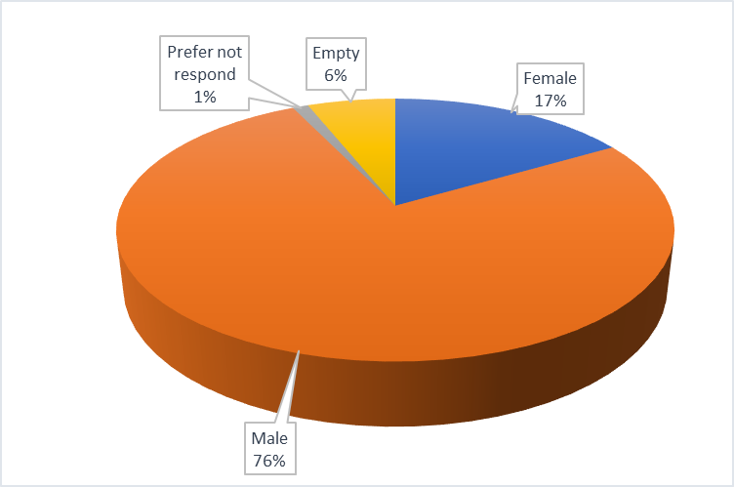
Participant Statistics
Hall A – 1st Floor
Parallel session
Closing and Award Ceremony
Over 1,000 participants from 37 countries, including around 900 international and 100 domestic attendees.
REGISTERED PARTICIPANTS | 1000
Granted students | 79
Students- paying | 91
Participants | 607
LOC and JACoW | 36+27
Exhibitors (included in booth fee) | 129
Exhibitors extra pass | 10
Accompany | 19
REGISTERED PARTICIPANTS | TOTAL | 1000
Female |  | 190
Male |  | 731
Prefer not respond |  | 12
Empty |  | 67
Notes:
IPAC 2025 brought together 1000 participants from 37 countries — a truly international gathering. Around 900 were international attendees, and about 100 came from Taiwan.
We had a diverse mix of students, researchers, and exhibitors — including 79 granted students, 91 paying students, and over 100 exhibitors.
It was exciting to see strong participation from across the accelerator community, even under today’s complex international situation.
In terms of gender balance, about seventy-six percent were male and seventeen percent were female — and we hope to see this number continue to rise in future IPACs.

Slide 23
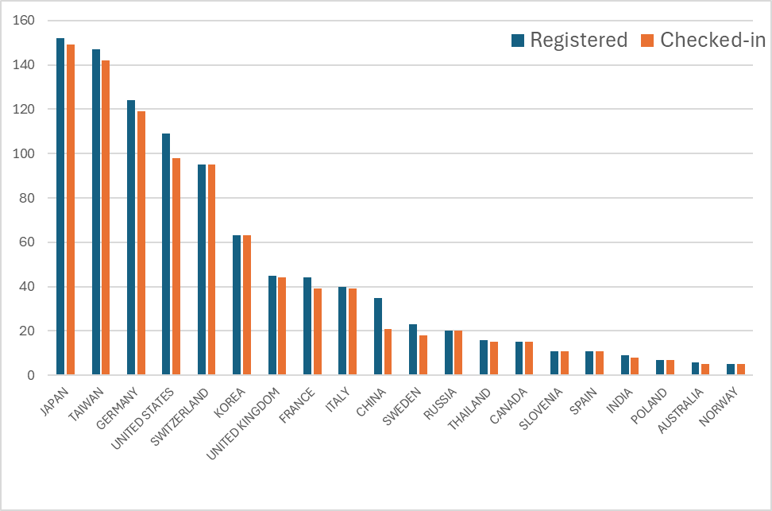
Participant Statistics
Number of Participants by Country
The count of Taiwanese participants includes VIPs and staffs.
Notes:
When we look into the details, we can see that the participation pattern at IPAC 2025 is quite different from previous years. Japan took the top spot this time, with 155 registered participants, followed closely by Taiwan with 147, and Germany with 124. The United States ranked fourth, and Switzerland fifth.

Slide 24
Industrial Participation
70 companies (inc. Taiwan consortium, 8 booths )
3 Media Partners (Cern Courier , PRAB/APS Journal, IOP)
4 Free-of-charge institutional exhibitors: Elettra, JUAS, IPAC’26, IPAC’27
Sponsorship Summary
Sponsorship Summary
Sponsorship Levels • 1 Platinum Sponsorship – NSRRC-TPS • 6 Gold Sponsorships • 3 Silver Sponsorships
Additional Notes • 3 booths unable to attend • 12 booth-less sponsors
Company Presentations • 4 companies (e.g., Cosylab, ALD Vacuum, ...)
Item Sponsorships • Lanyards – Dimtel / Allied Metals • Notepads – Microwave Techniques LLC • Conference Bag Logos – NSRRC-TPS • All-in-One Adapters – Instrumentation Technologies
Notes:
This year, IPAC 2025 had good industrial participation, with 70 companies joining the exhibition, including a Taiwan consortium with eight booths.
We also had three media partners — CERN Courier, PRAB/APS Journal, and IOP — and four institutional exhibitors , include future IPAC hosts.
In total, we secured one platinum, six gold, and three silver sponsors.
Even though a 3 booths couldn’t attend, the overall industry engagement was very positive.

Slide 25
Number of Exhibition Booths sold
Notes:
When we look at the booth sales trend, the growth was a bit slower this year compared with IPAC 2023 and 2024.
We reached sixty-five booths by May — lower than previous years — showing that it was not easy to sell in the current environment.
However, the feedback from vendors was very good.
They appreciated the local support, venue setup, and foods throughout the week.

Slide 26
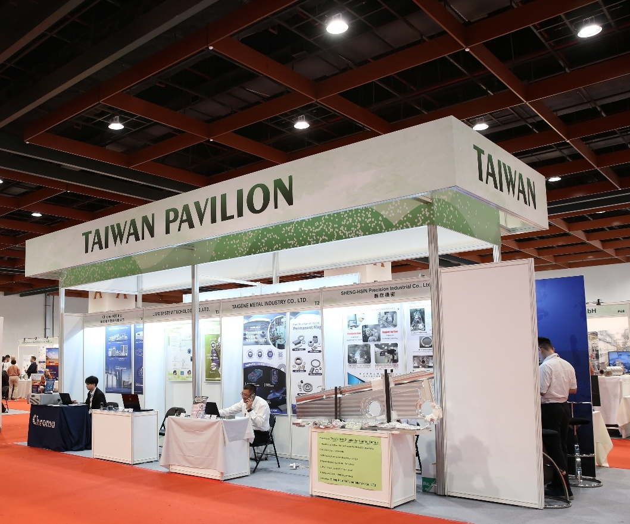
IPAC25 – Taiwan Pavillion
01
Showcasing Taiwan’s Strength and Industry Image
Showcase Taiwan’s accelerator expertise and teamwork, helping industries enter emerging global markets.
02
Embodying the MIT Spirit
Emphasize ‘Made in Taiwan’ as a key force in the global accelerator industry.
03
Becoming a Exhibition Highlight
A large pavilion and gathering, easily seen, attracting attention as a conference highlight..
04
Generating Financial Benefits to the conference
Taipei Veterans General Hospital Heavy Ion Cancer Therapy Center, Chroma ATE, Gong Jun Precision, Jiayang Technology, Tai Chuen Metal, Liming Systems, Minkai Technology, and Shengxin Precision.
Enhance overall conference revenue through the participation of Taiwanese companies.
Notes:
One of the important tasks for NSRRC in hosting IPAC 2025 was to help Taiwan’s industry enter the IPAC community. It was not easy at first, since most Taiwan companies are not familiar with the accelerator field — their main strength is in the semiconductor industry. Through our effort, nine companies joined together to form the Taiwan Pavilion. This pavilion showcased Taiwan’s industrial strength and teamwork, promoted the ‘Made in Taiwan’ spirit, and became one of the highlights of the exhibition — also bringing financial benefits to the conference.

Slide 27
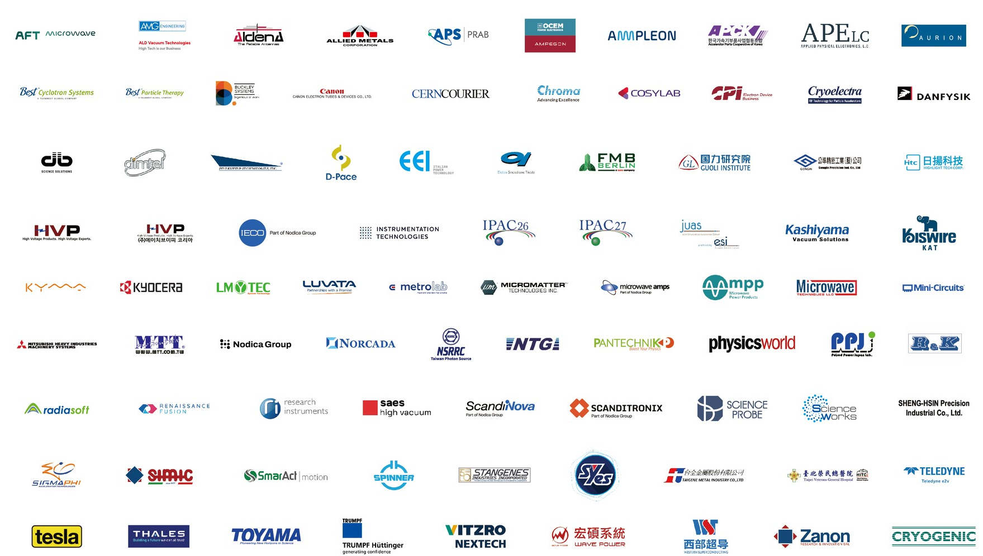
IPAC25 Sponsors
Notes:
Thank you very much to all our sponsors for their generous support.
This sponsor wall represents the many partners who helped make IPAC 2025 possible.
It was also one of our highest-risk tasks — we had to double- and triple-check every logo and name to ensure complete accuracy.
Thanks to the great teamwork, everything was finally correct and beautifully presented.

Slide 28
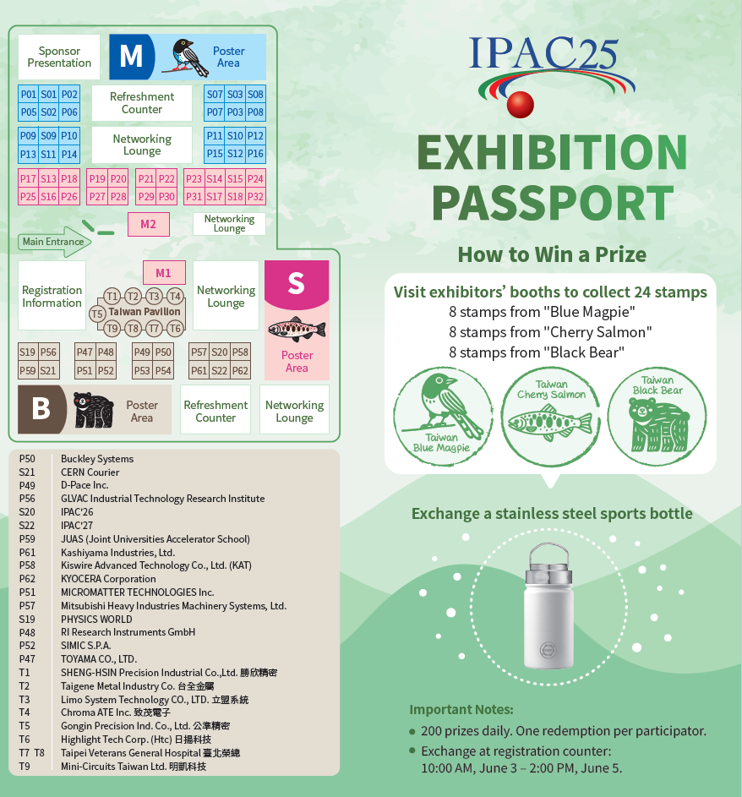
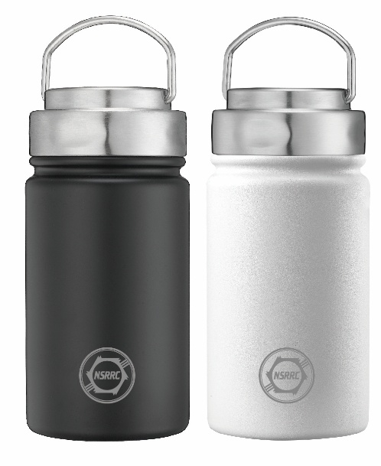
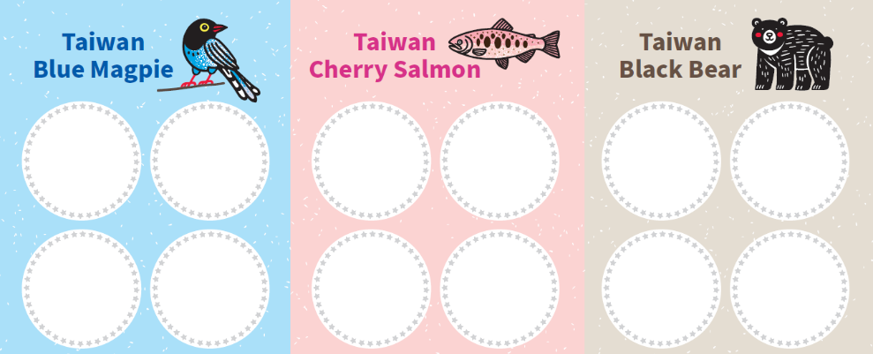

Interaction with Exhibition
Conference Gifts with Purpose - Not Luxury
IPAC’25 is not offering high-value prizes. Instead, we’ve chosen practical gifts that attendees can truly use.
Sustainability - Sports Bottle
A functional gift that supports sustainability by reducing the use of paper cups during the conference.
Notes:
For IPAC 2025, we focused on practical and meaningful conference gifts instead of luxury items. We introduced a stainless-steel sports bottle to promote sustainability and reduce the use of paper cups during the event.
To make the exhibition more engaging, we created the ‘Exhibition Passport’ — participants collected stamps by visiting booths.
At IPAC 2025, we featured Taiwan’s unique wildlife — the Blue Magpie, Cherry Salmon, and Black Bear — in our exhibition design.

Slide 29
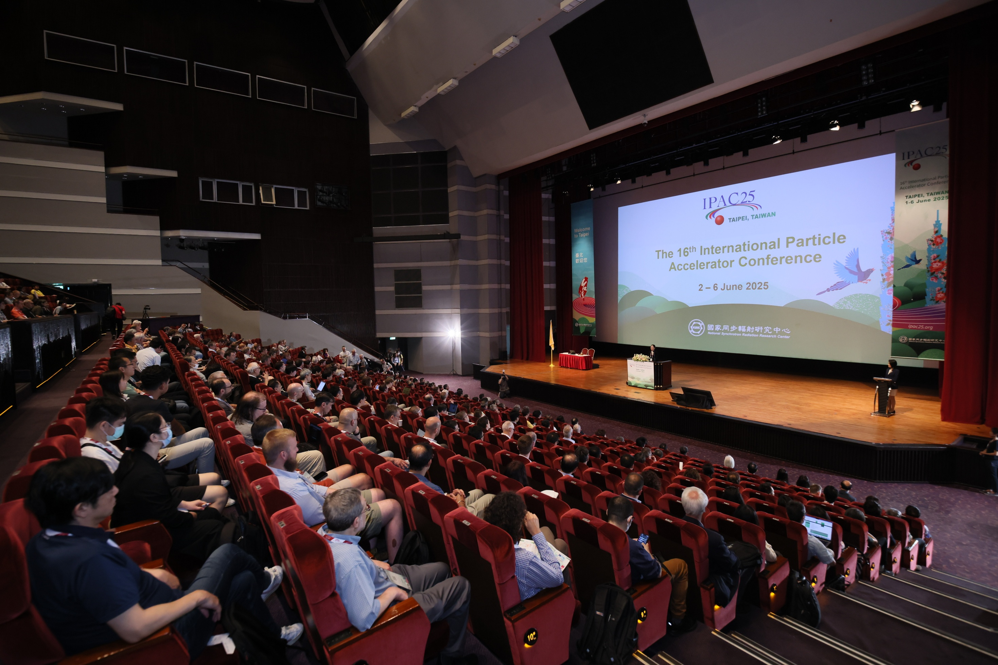
IPAC’25 — Welcoming the World to Taipei, Opening Ceremony
Notes:
On June 1st, 2025, IPAC’25 opened in Taipei.
We welcomed scientists and engineers from around the world — kicking off an inspiring week of innovation and collaboration!

Slide 30
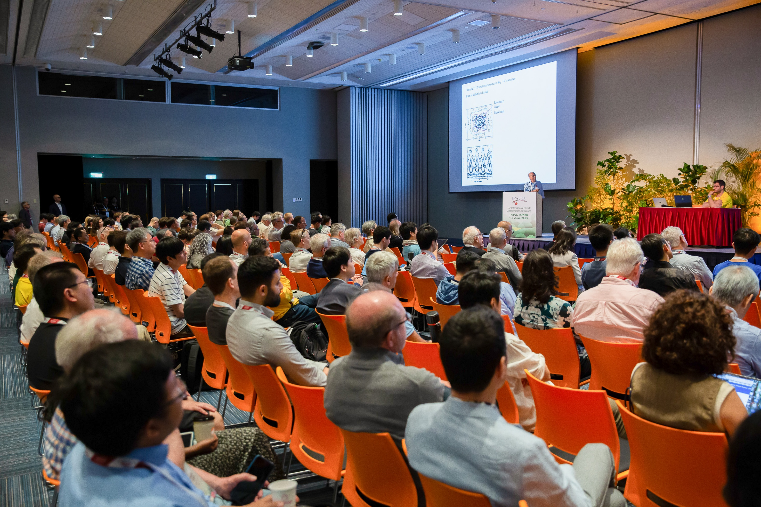

Conference Mode
Notes:
The conference is about taking off — please fasten your seatbelts… and switch your conference mode ON!

Slide 31
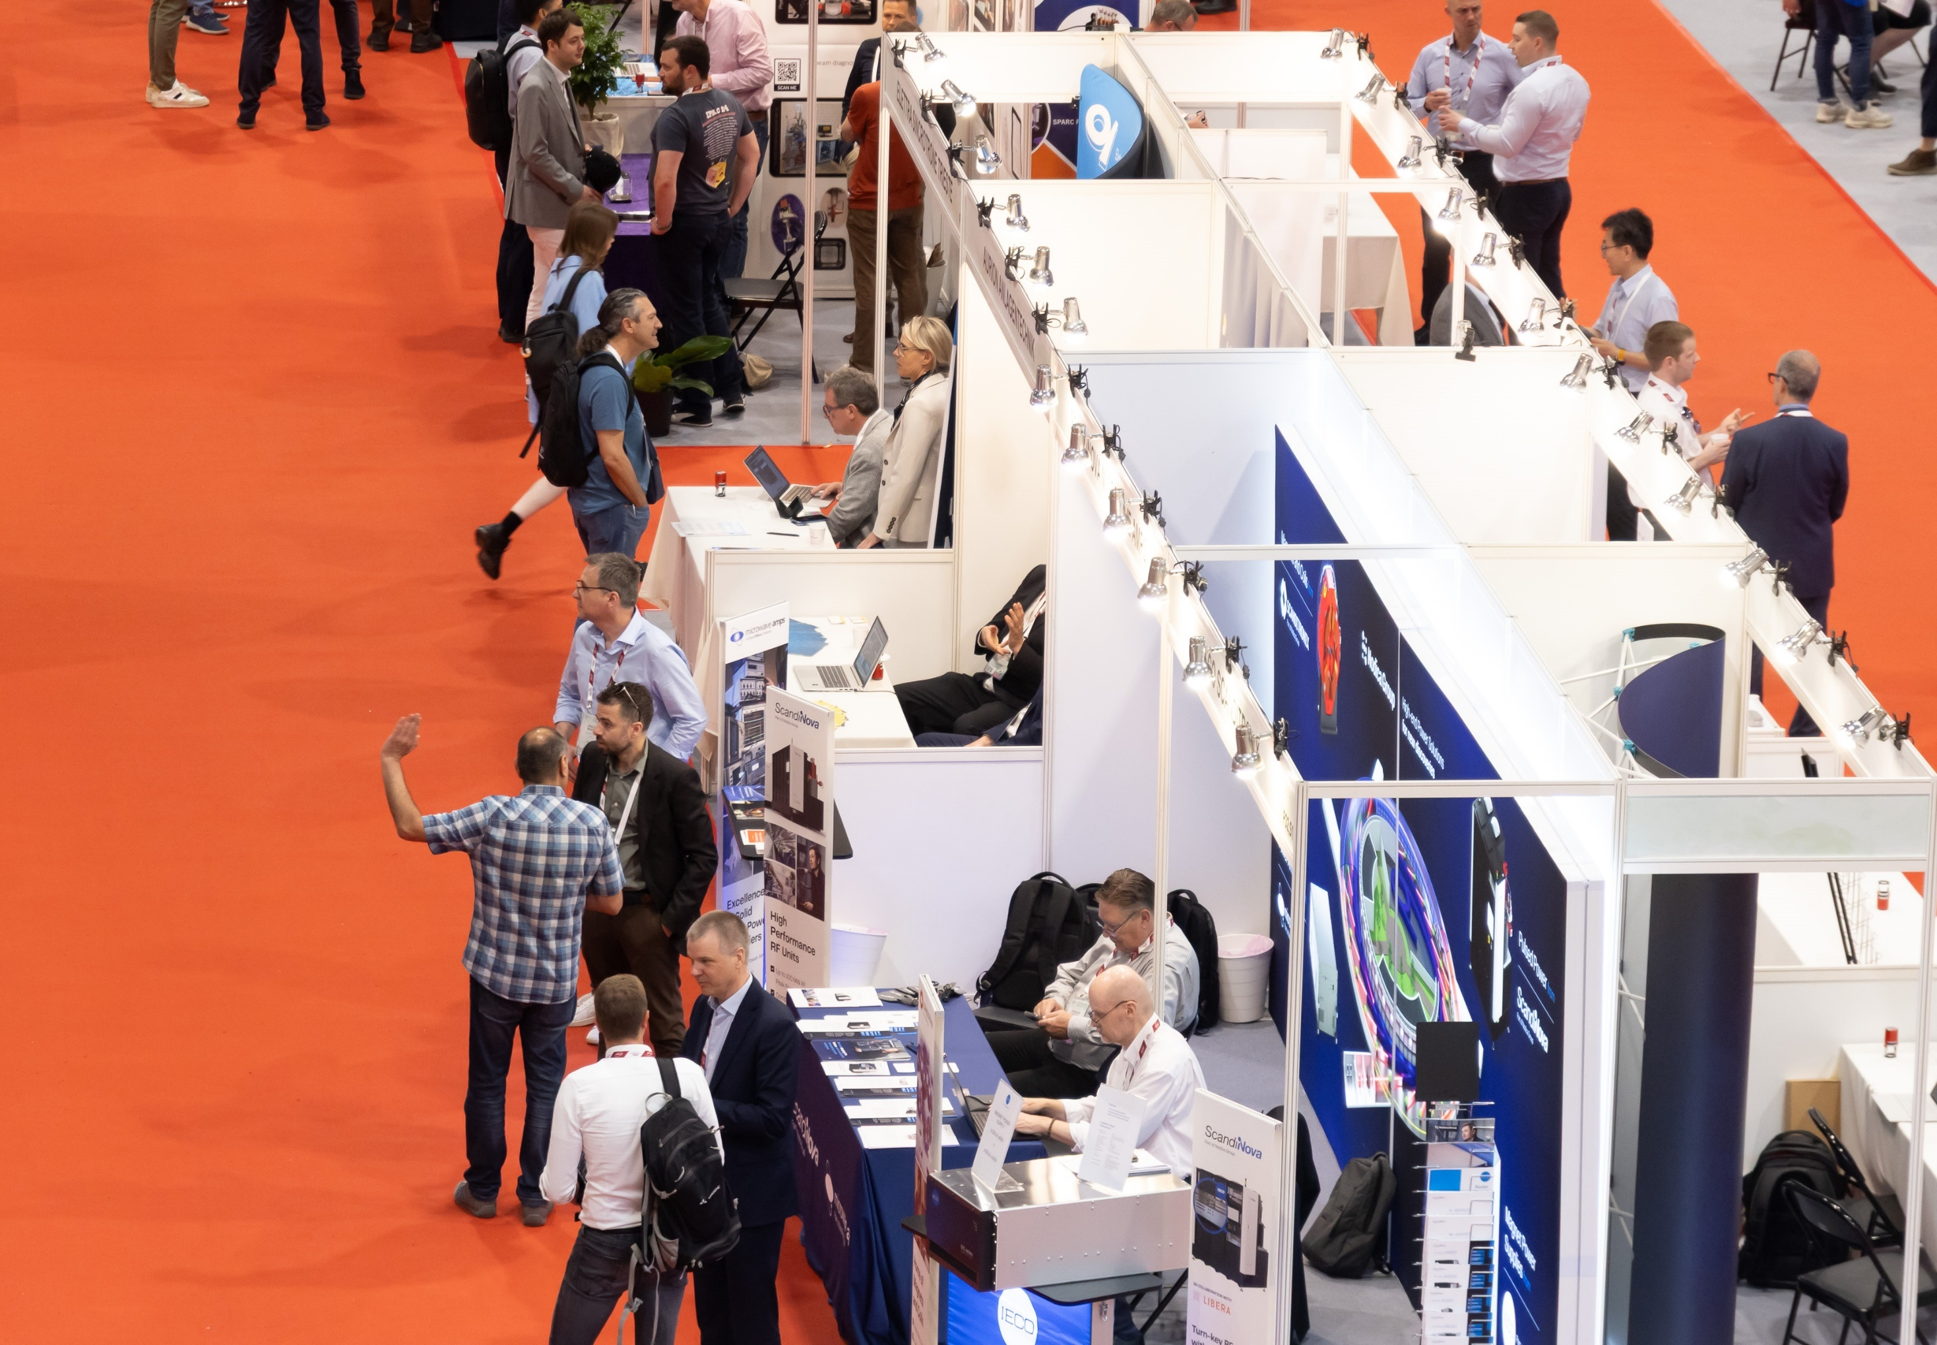
Exhibitions
Notes:
Welcome to the exhibition — where science meets business… and sometimes free coffee! Let’s explore the booths, meet the exhibitors, and collect those stamps for your IPAC gifts!

Slide 32
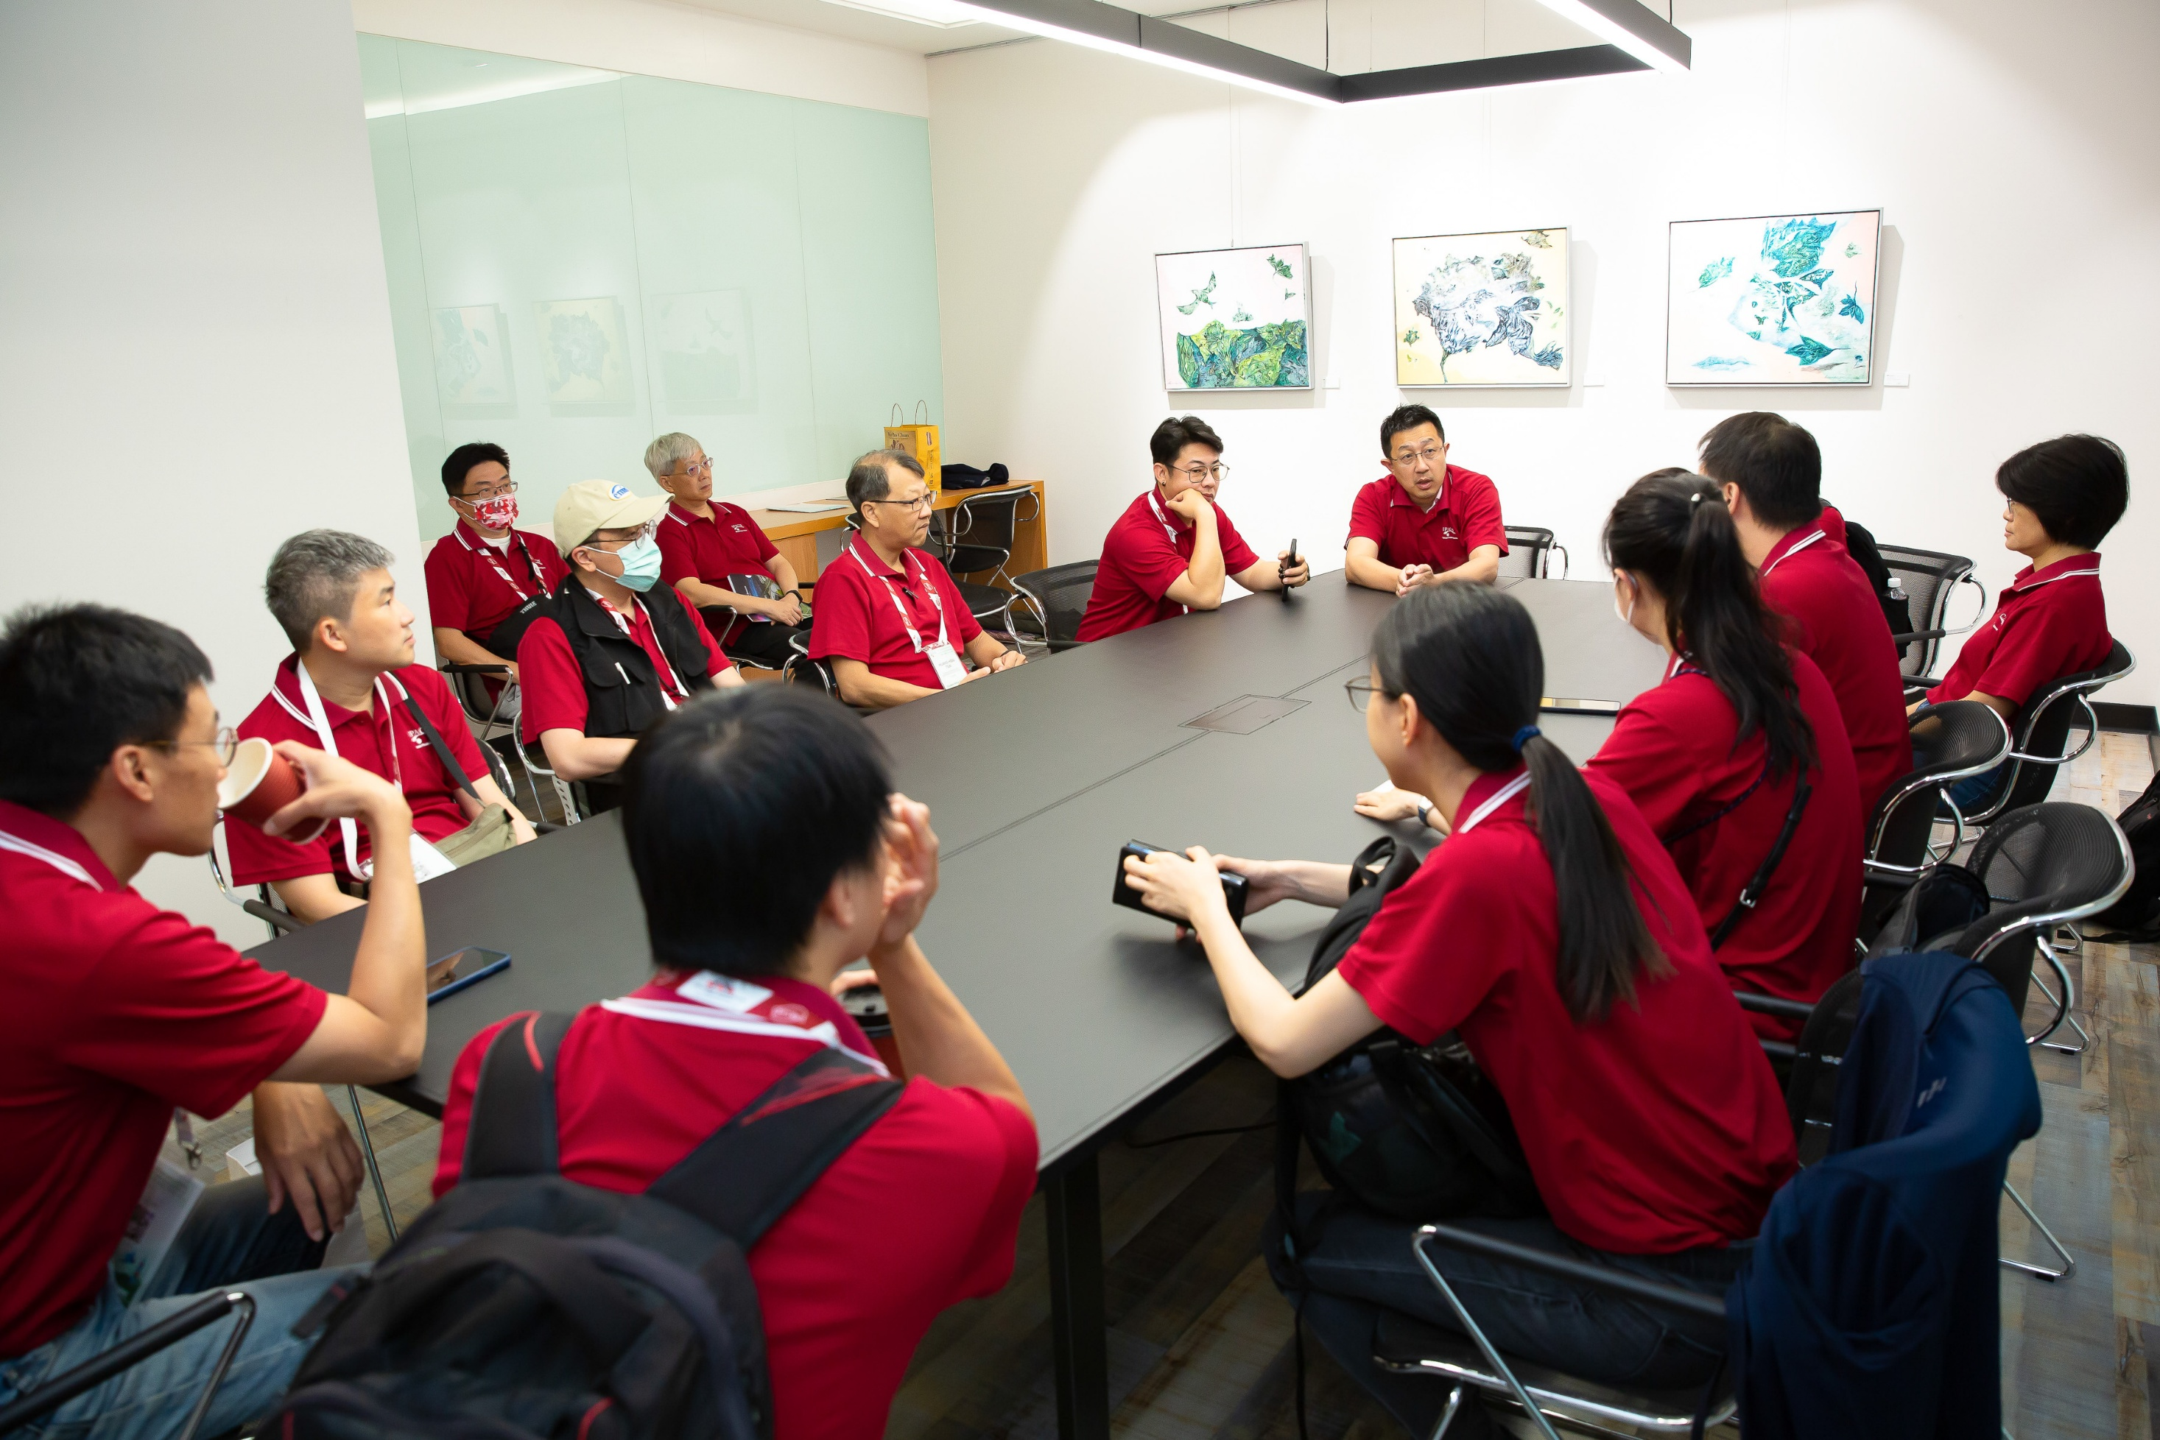
Morning pep talk !!
Notes:
In every war movie, before the battle begins, the general gives an inspiring speech.
Same here — it’s time for our morning pep talk! A few words to lift the team’s spirit…
No coffee in the picture and maybe a reminder to grab some coffee first!

Slide 33
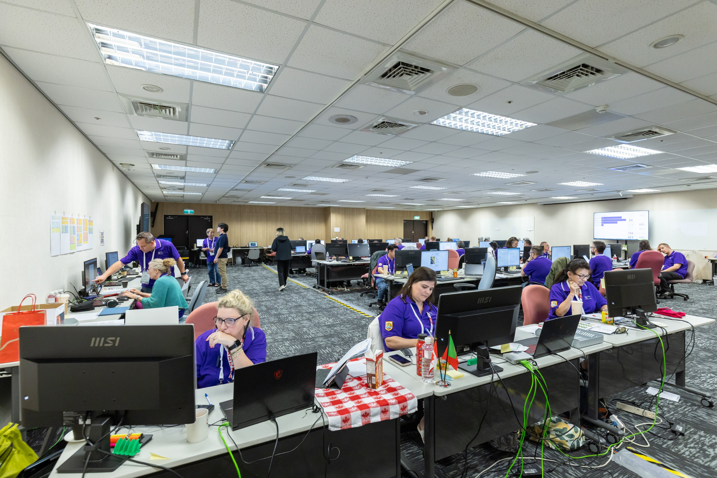
Proceeding Control Room : JACoW Team
Notes:
Here’s another control center — the JACoW team in action!
While others enjoy the conference, this crew works tirelessly behind the scenes to keep everything running smoothly.

Slide 34
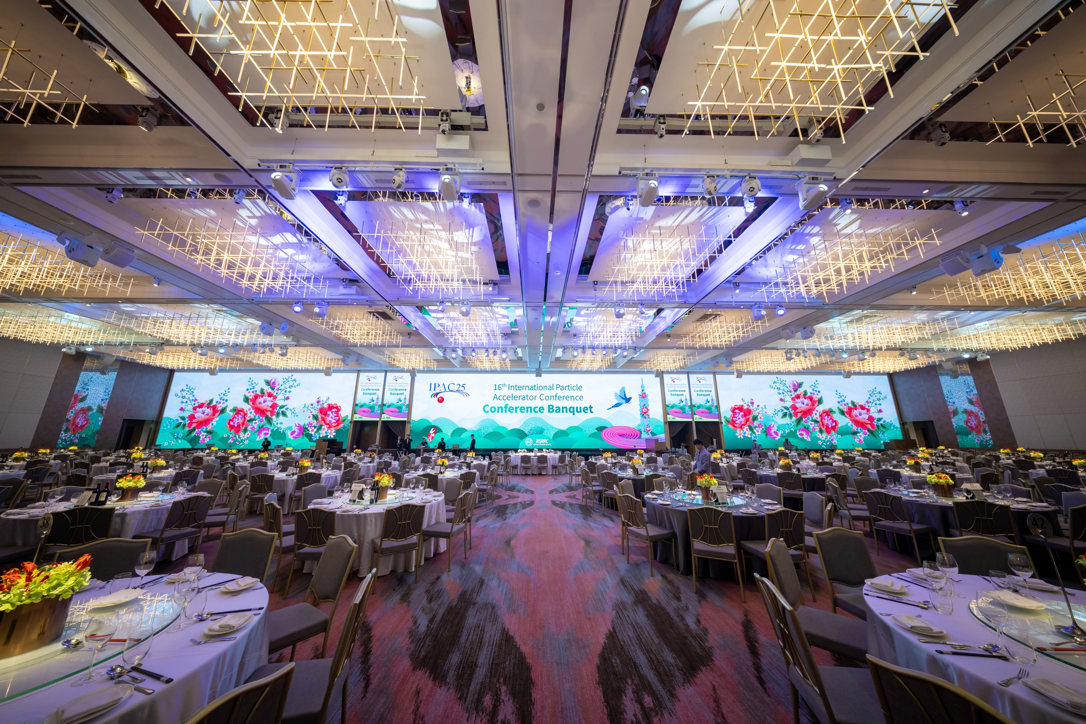
Conference Banquet 800 Guests
Notes:
I must say, this is my favorite part of IPAC! We put a lot of effort into creating the best dining experience for our distinguished 800 guests — a perfect evening to relax, connect, and celebrate together.

Slide 35
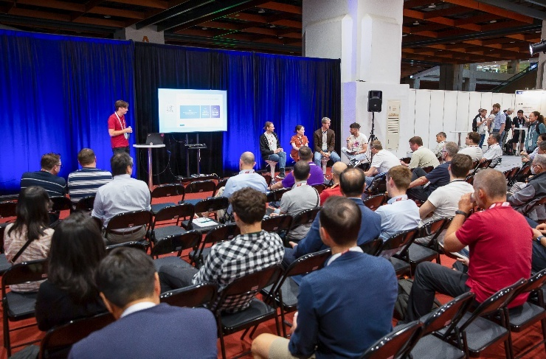
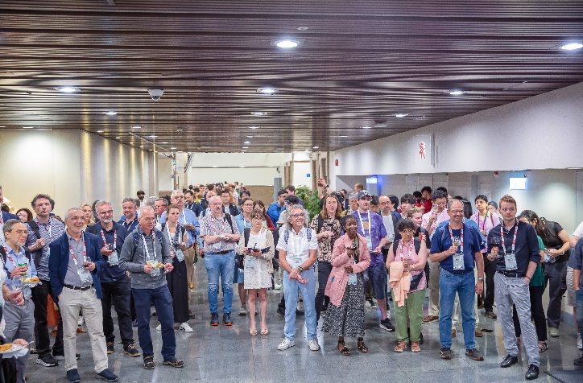
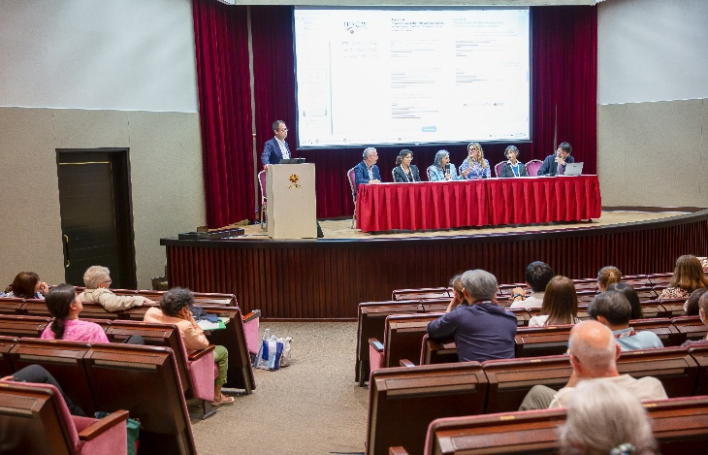
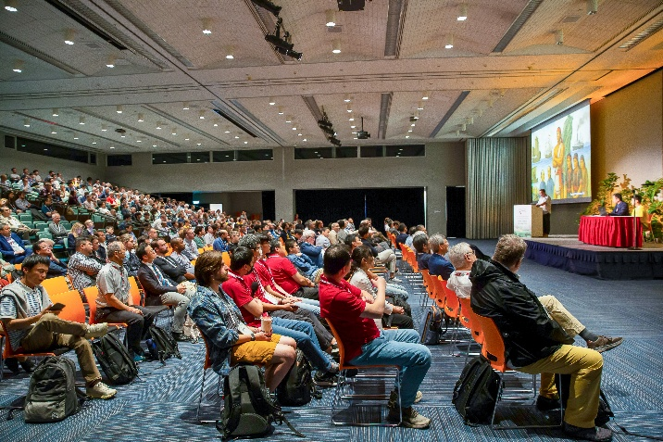
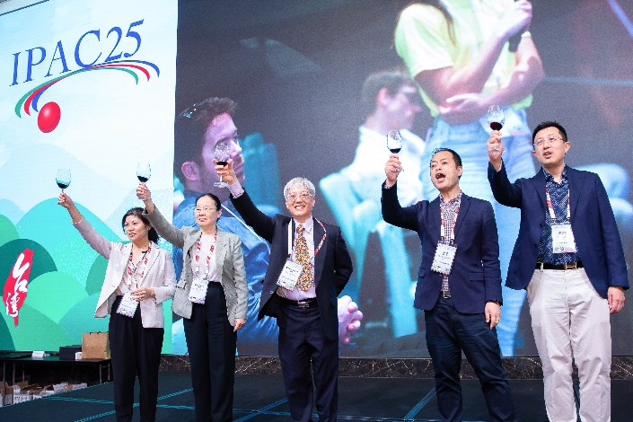
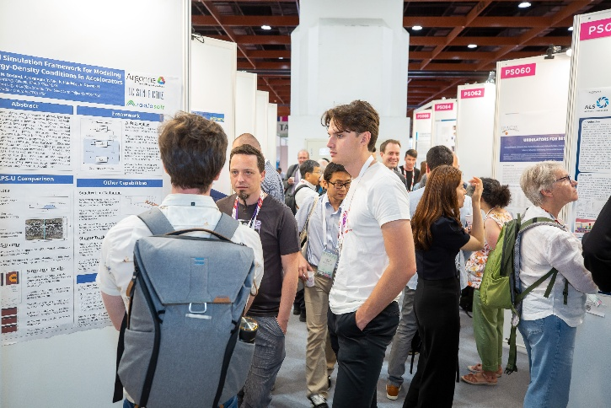
Snapshot of IPAC’25
Productive Research Environment Session
Sponsor Presentations
Satellite Meetings
Posters
Entertainment Talk
Conference Banquet
Notes:
Here’s a quick snapshot of IPAC’25 — a week full of energy and collaboration! We had productive research sessions, engaging satellite meetings, and lively sponsor presentations. The poster sessions were packed with great discussions, the entertainment talk added fun to the program, and of course — the conference banquet brought everyone together to celebrate in style!

Slide 36


Facility Tours
A half-day guided tour to discover ongoing innovations at the Taiwan Photon Source and in heavy-ion therapy applications at Taipei Veterans General Hospital. The fee of NT $ 600 is required to ensure attendance and minimize absences.
150 participants : visit the TPS to explore scientific and technological developments .
100 participants : visit to HiTC explore the accelerator, treatment rooms, and clinical applications.
Taiwan Photon Source Storage Ring
Heavy Ion Cancer Therapy Center
Notes:
IPAC’25 featured a half-day guided tour to explore Taiwan’s cutting-edge accelerator facilities.
Over 150 participants visited the Taiwan Photon Source to see the latest scientific and technological developments, while another 100 joined the Heavy Ion Cancer Therapy Center tour to learn about accelerator-based cancer treatment.
To ensure attendance, we introduced a small NT$600 fee — and it worked perfectly!

Slide 37
LESSON LEARNED
Poster Limit Policy and Additional Charges for IPAC’25
Each editor can handle approximately 5 to 8 papers per day. So it is important to keep the poster presentation limit per delegate to ensure a manageable workflow and smooth review process.
For IPAC’25, an extra charge will apply for exceeding the poster limit: Each delegate may present up to four posters. An additional fee of USD 200 will be charged for each poster beyond this limit.
We have identified 15 registrants who are presenting more than four posters each.
REGISTRATION
The participation of attendees from some countries remains highly uncertain; we have issued more than 100 refunds.
For on-site registration, we have 40 attendees registered on-site.
Notes:
Now let’s move on to the lessons learned from IPAC’25 — yes, the part where we realize what not to do next time!
First, about the poster policy — we learned that each editor can handle about five to eight papers a day, which sounds fine… until you multiply that by hundreds.
So, setting limits is key! For IPAC’25, each delegate could present up to four posters — and anyone going beyond that, well, had to pay a little ‘fee.’
We had 15 people who just want to pay and sharing their works!
Next, registration — some participants, especially from certain countries, had travel uncertainties, leading to over a hundred refunds.
But we also had 40 people who registered on-site — talk about last-minute decision-making!

Slide 38
LESSON LEARNED
Referee Challenges in Light Peer Review (LPR)
We had many referees and volunteers, but in reality, there were also many rejections to review papers.
A few individuals misused the LPR system — for example, one presenter took on four LPRs from different authors.
A clear policy is needed before opening the system in the future.
Email Delivery Issues Due to Enhanced Security Measures
Due to heightened information security and cybersecurity controls at many institutions, meeting notifications and communications have become increasingly restricted, resulting in reduced efficiency in email delivery.
Emails from the IPAC Scientific Secretariat are sometimes flagged as spam and are frequently blocked by mail servers in the United States and Europe. In several cases, recipients have only discovered our emails after checking their spam folders.
Indico related issue
The major upgrade was done in March, which highly affect the poster assign and session assign.
Highly suggest it should upgrade not during IPAC conference, many authors involved.
Notes:
On peer review, the Light Peer Review system worked well overall, but not perfectly.
We had many volunteers, but also many polite ‘no thank-yous.’
And a few people got too involved, taking on multiple papers — definitely a sign we need clearer rules next time.
And finally, email and system issues — our messages sometimes ended up in spam folders, especially in the U.S. and Europe. I sometimes use personal E-mail.
And just to top it off, a major Indico upgrade in March created some problems in poster assignments.
So, if possible, please no system upgrades during IPAC season!

Slide 39
Summary
1️⃣ Strong Team Collaboration Nearly 40 NSRRC colleagues worked seamlessly alongside the professional conference company, ensuring the smooth and successful execution of IPAC’25.
2️⃣ Financial Challenges Despite reduced attendance from major countries such as the United States and China, which brought financial uncertainty, the team’s dedication enabled us to reach a break-even outcome.
3️⃣ A Three-Year Commitment Realized IPAC’25 marked the culmination of three years of preparation. We express our sincere appreciation to SPC Chair Yoichi Sato (KEK) and Chief Editor David Button (ANSTO) for shaping an outstanding program and ensuring timely completion of the Proceedings.
4️⃣ A Good Achievement for a First-Time Host In hosting a 1,000-participant international conference for the first time, our team achieved what once seemed unattainable—supported by the generous guidance of IPAC’22/23/24 organizers and Indico team.
5️⃣ The Power Behind IPAC’25 (NSRRC is the biggest sponsor) We extend our deepest gratitude to NSRRC for its unwavering support — in financial resources, personnel, and leadership — which made it possible for us to successfully complete IPAC’25.
Notes:
Now, let’s take a look back at what made IPAC’25 possible.
First — Strong Team Collaboration. Nearly 30 NSRRC colleagues worked hand-in-hand with the professional conference company, ensuring everything ran smoothly from start to finish.
Second — Financial Challenges. Despite reduced attendance from major countries like the U.S. and China, which brought financial uncertainty, the team’s hard work and careful management helped us reach a break-even result — a great success in itself.
Third — A Three-Year Commitment Realized. IPAC’25 was the result of three years of preparation. We’re deeply grateful to SPC Chair Yoichi Sato from KEK and Chief Editor David Button from ANSTO for their outstanding leadership and dedication.
Fourth — An Extraordinary First-Time Achievement. Hosting a 1,000-participant international conference for the first time was no small feat, made possible with the kind support of the IPAC’22, ’23, and ’24 organizers, and the JACoW team.
And finally — The Power Behind IPAC’25. NSRRC, as the biggest sponsor, provided unwavering financial, personnel, and leadership support, allowing us to to successfully complete IPAC’25.
And if you ask — will Taiwan host IPAC again in the future? Yes, we can definitely do it again.

Slide 40






Taiwane Elements in IPAC’25
Geen cookies (乖乖) help your machine behave.
Photo’s best friend: a hand-held sign!
Buffet restaurants are everywhere in Taiwan
You can have sugar anytime!
The Kind Hearts of the Taiwanese People

