Slide 1


for JACoW
From SPMS to Indico only and Brevo
JACoW Team Meeting 2025
Michel Succar (CERN)

Slide 2
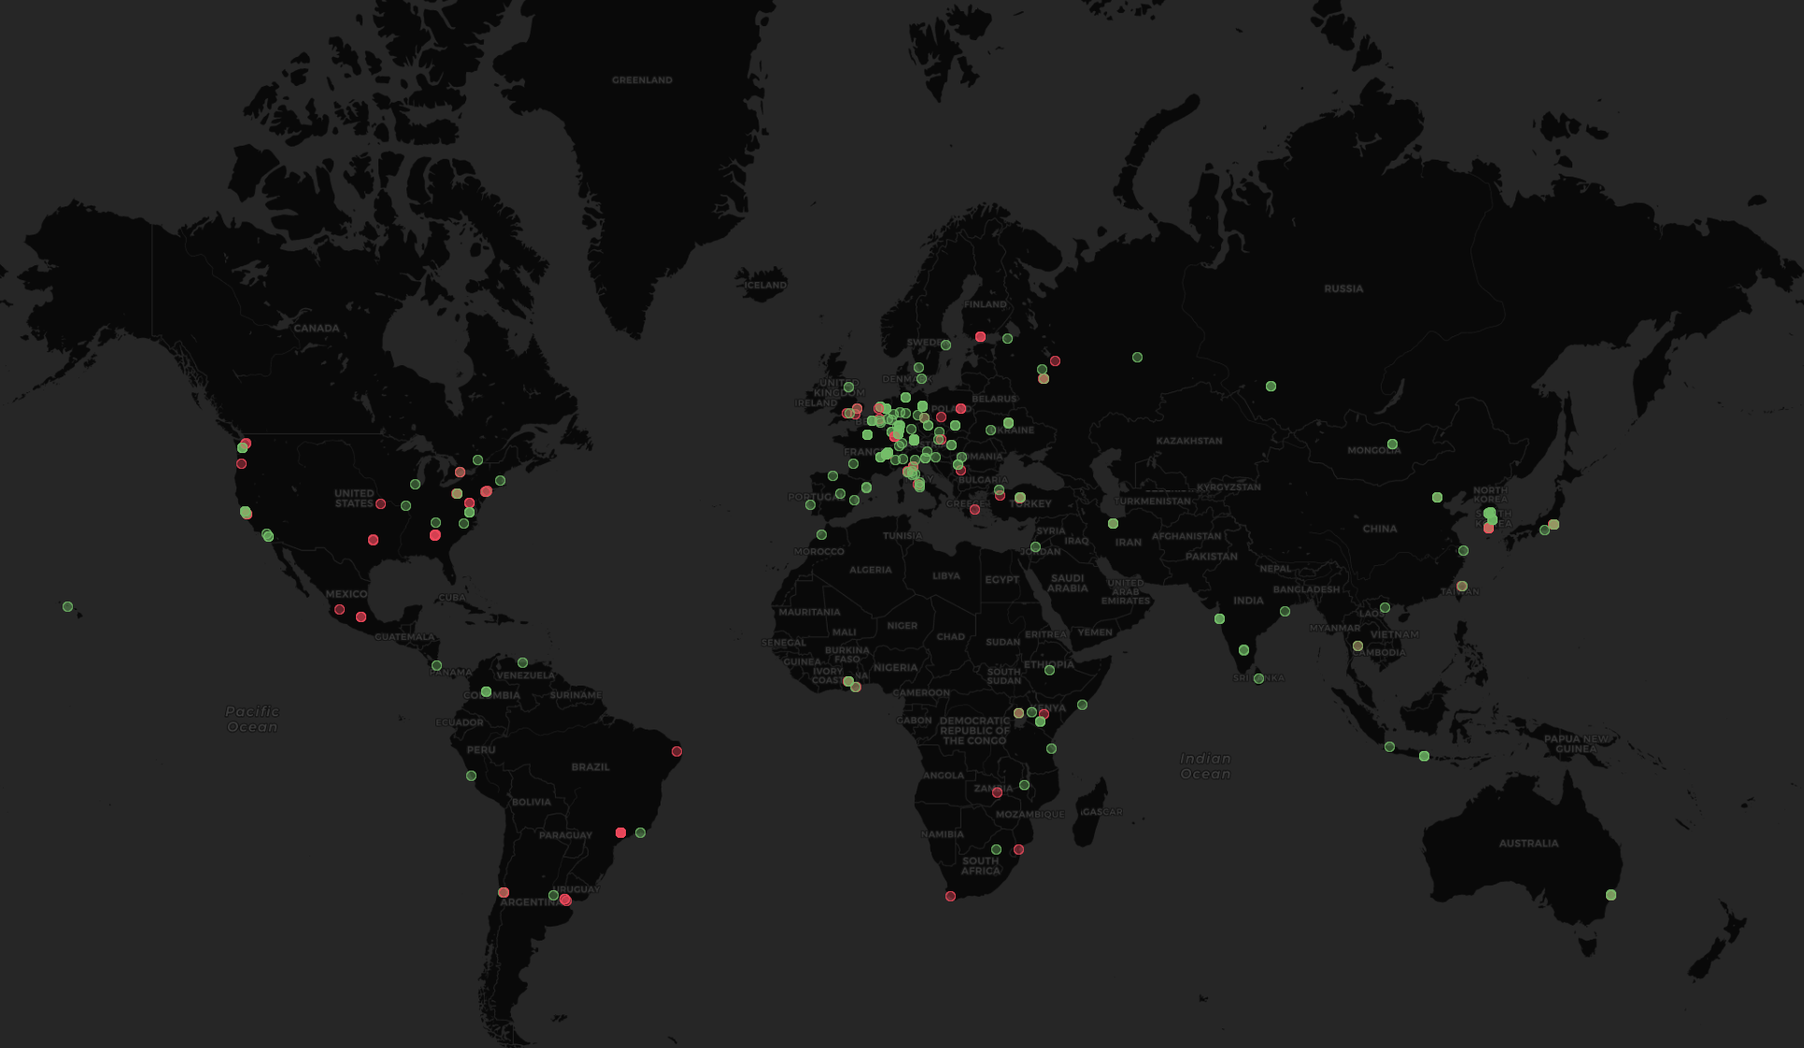
The most popular event management system you never heard about
300+ servers
> 350K users
  Initial growth in research, but growing beyond it
  indico.un.org
  events.canonical.org
  indico.gnome.org
  lpc.events

Slide 3

Event Management System
Collaborative effort - MIT License
Core Developed at CERN
With contributions from the United Nations, Max-Planck Institute for Physics and many others!
70+ developers over the years

Slide 4
1999 - CDS Agenda
2002 - EU Project
2004 - Indico in Production
2007 - Room Booking
2008 - Interface overhaul
2013 - First Workshop
2015 - The UN starts using it
2017 - Indico 2.0 (rewrite)
2021 - Indico 3.0 (Python 3)
2023 - 1 Million Events surpassed at CERN 🎉
2024 - 20 years!

Slide 5
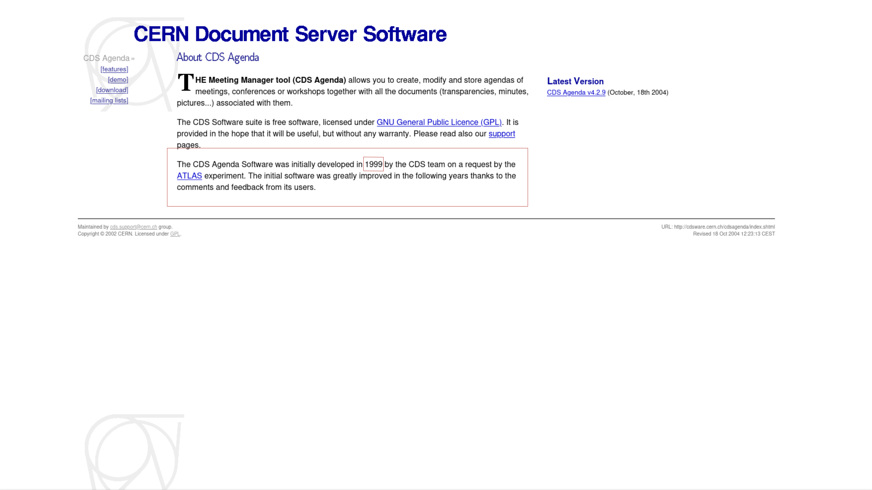
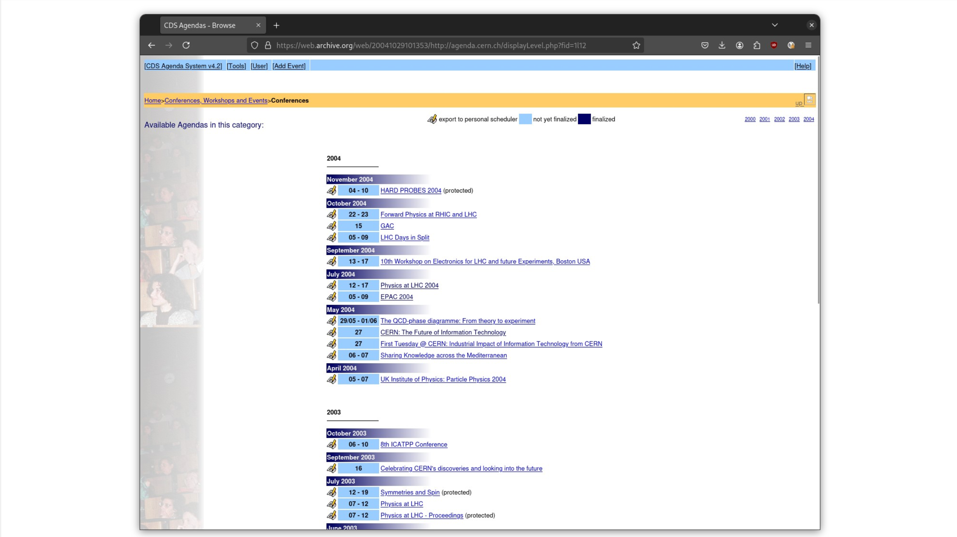
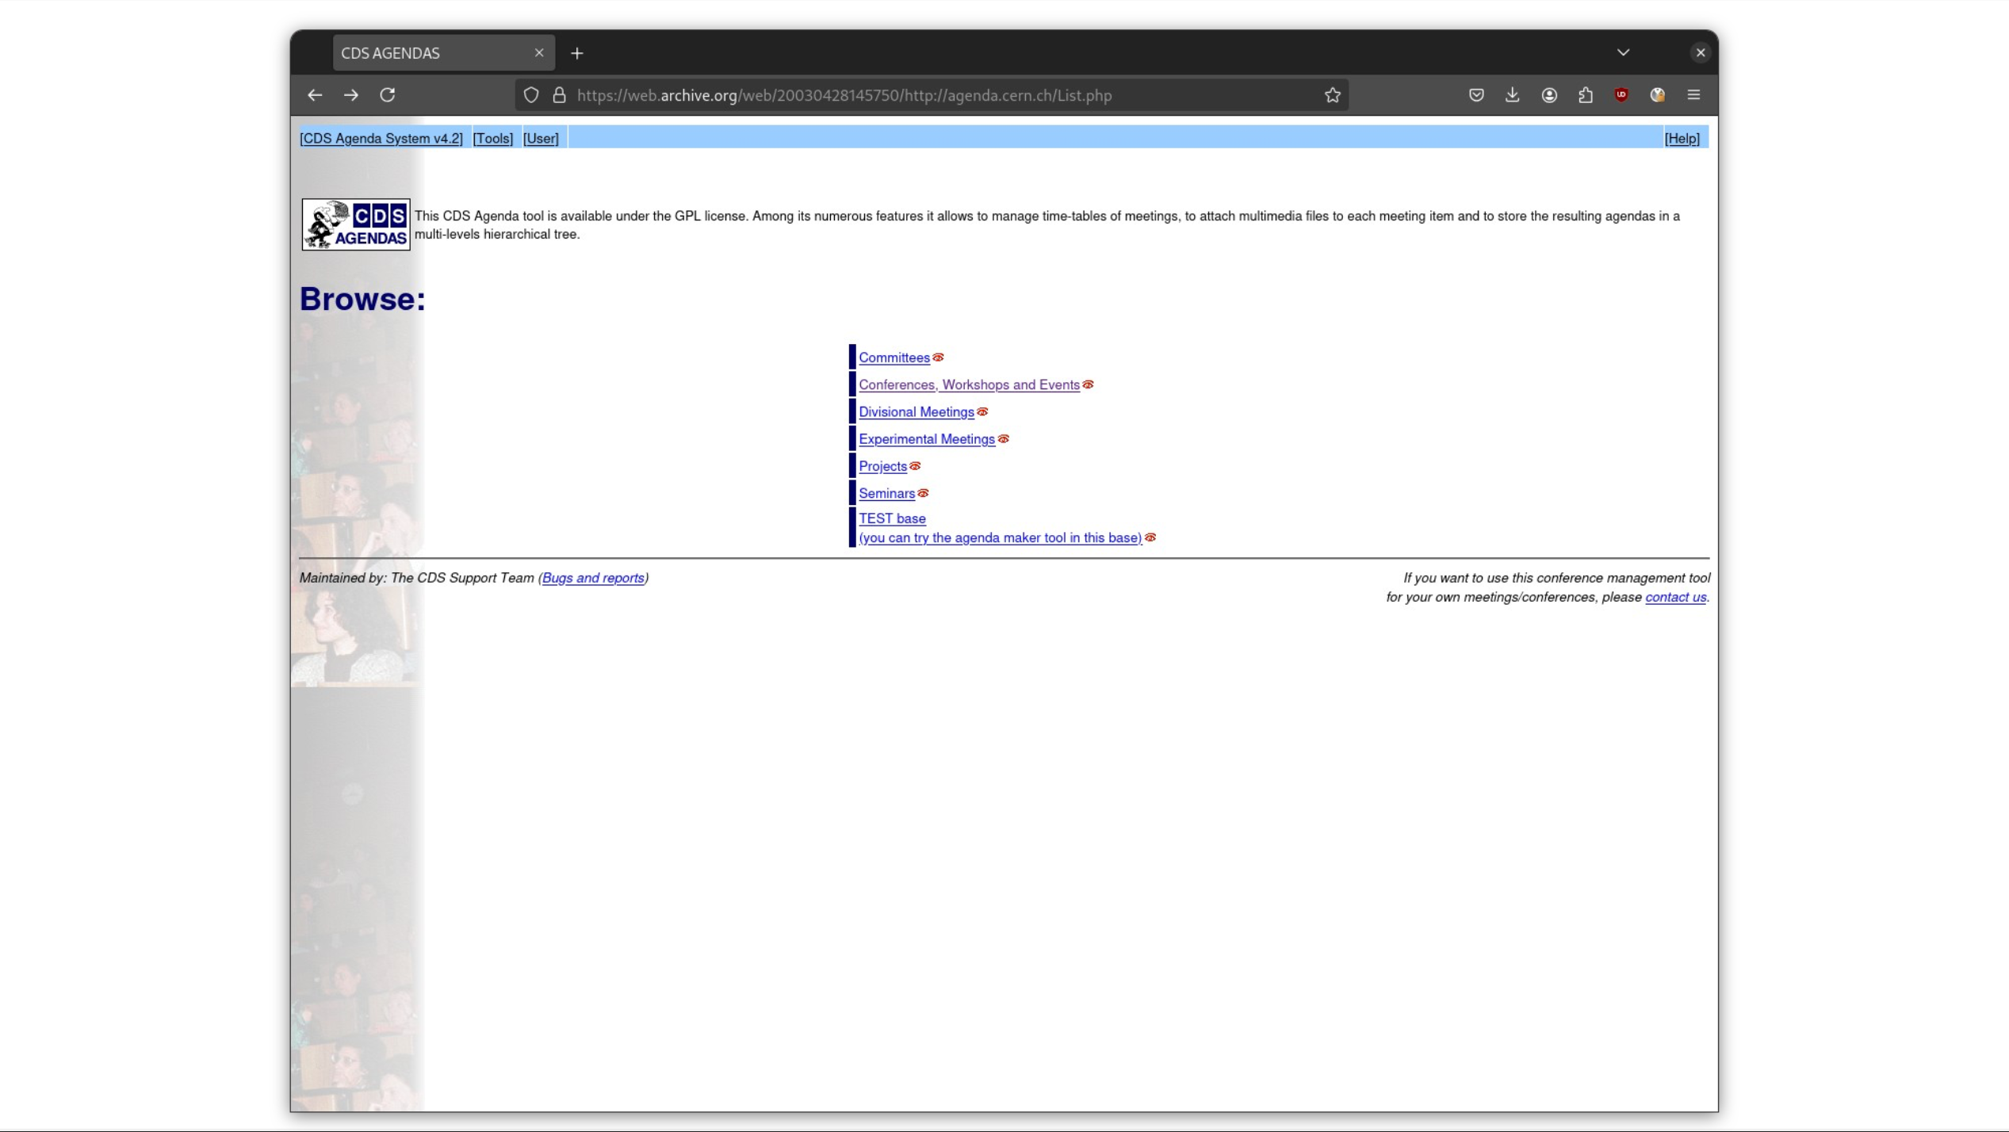
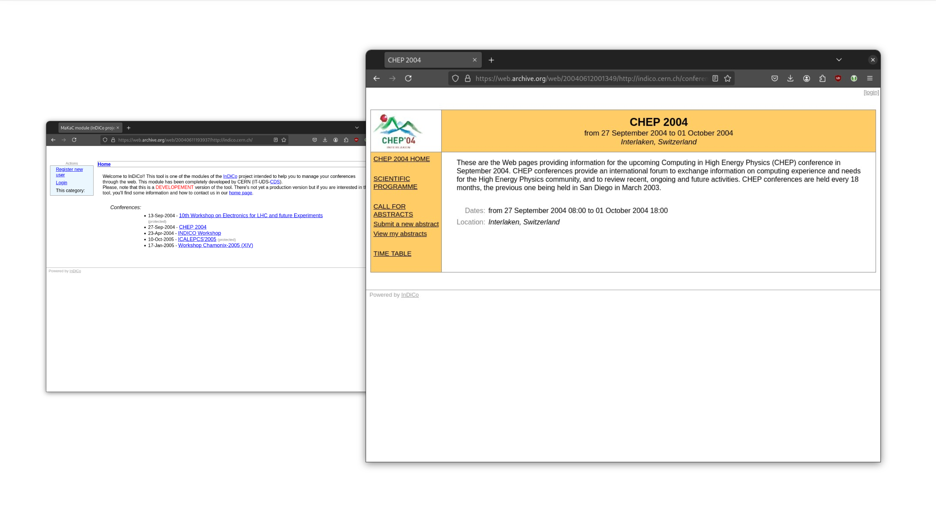

Slide 6
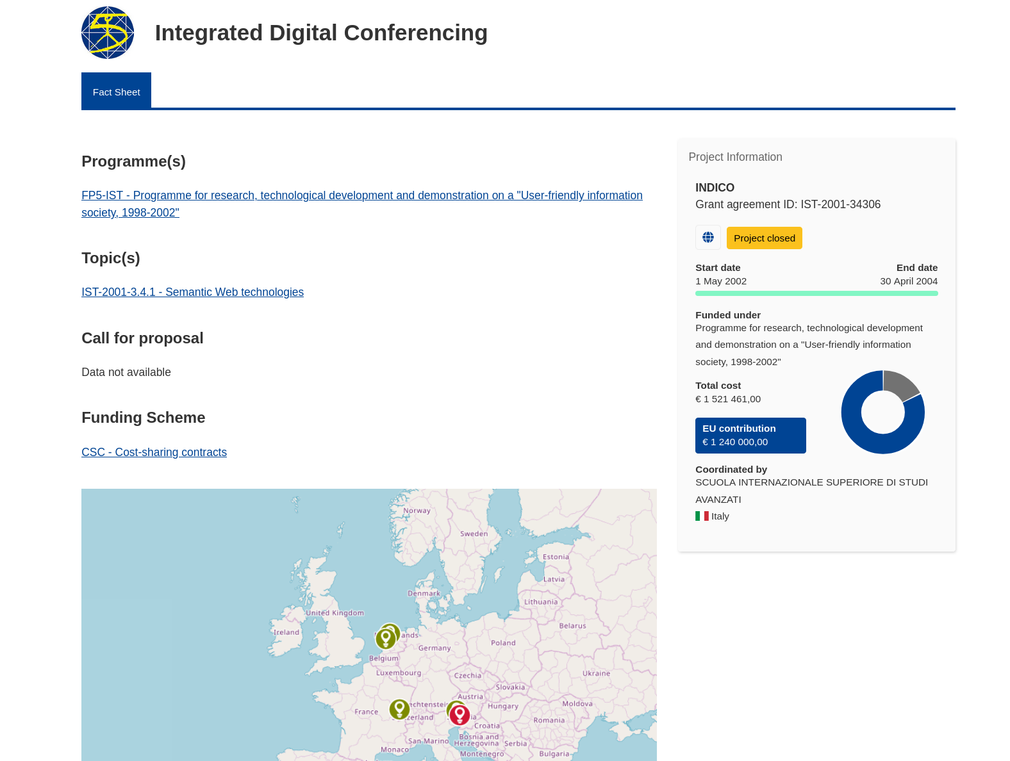

Slide 7
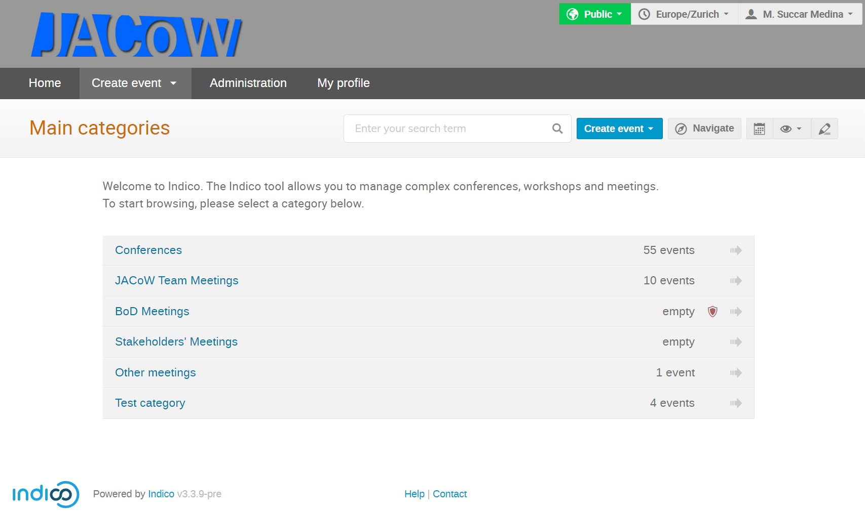

Slide 8
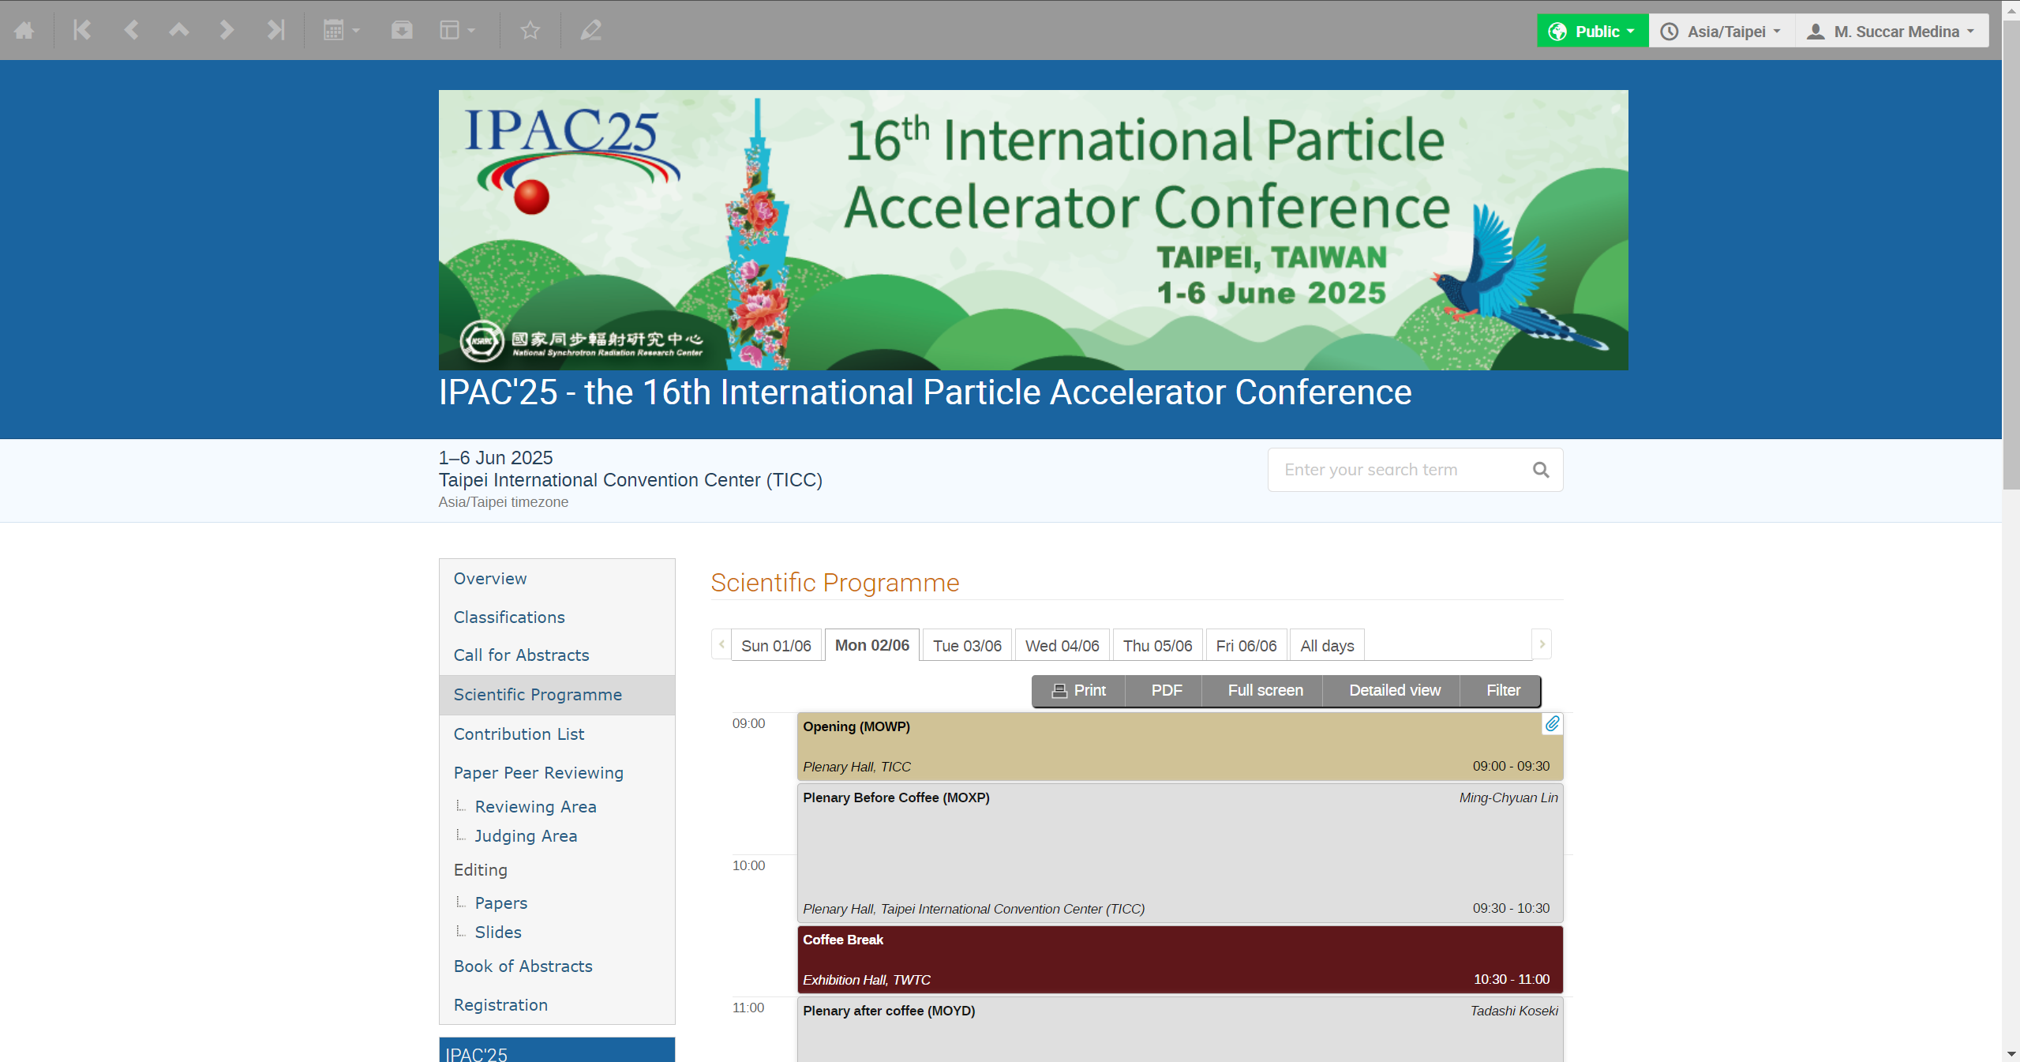

Slide 9
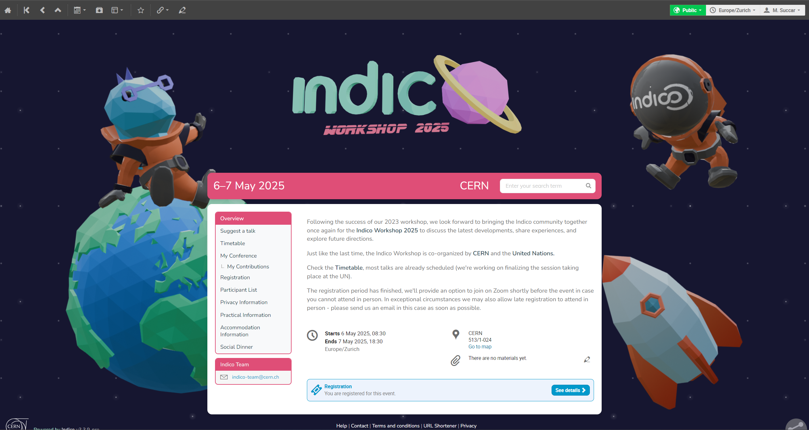

Slide 10
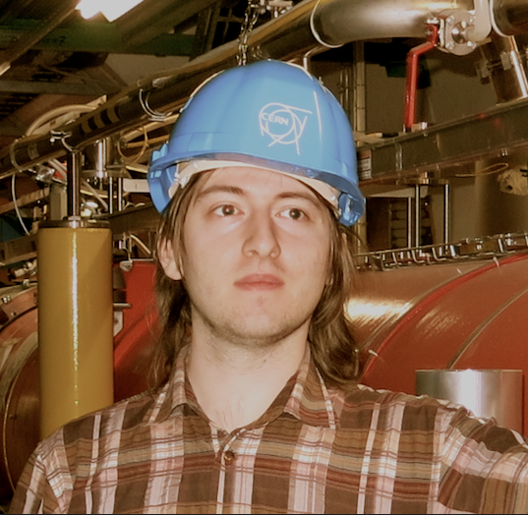







Current Team
Adrian Mönnich
Lead Developer
Tomas Roun
Developer
Dominic Hollis
Developer
Michel Succar
Developer
Ajob Kustra
Developer
Marina El Jaouhari
Developer
Pedro Ferreira
Section Leader IT-CA-CTE
Germán Cancio
Group Leader IT-CA

Slide 11
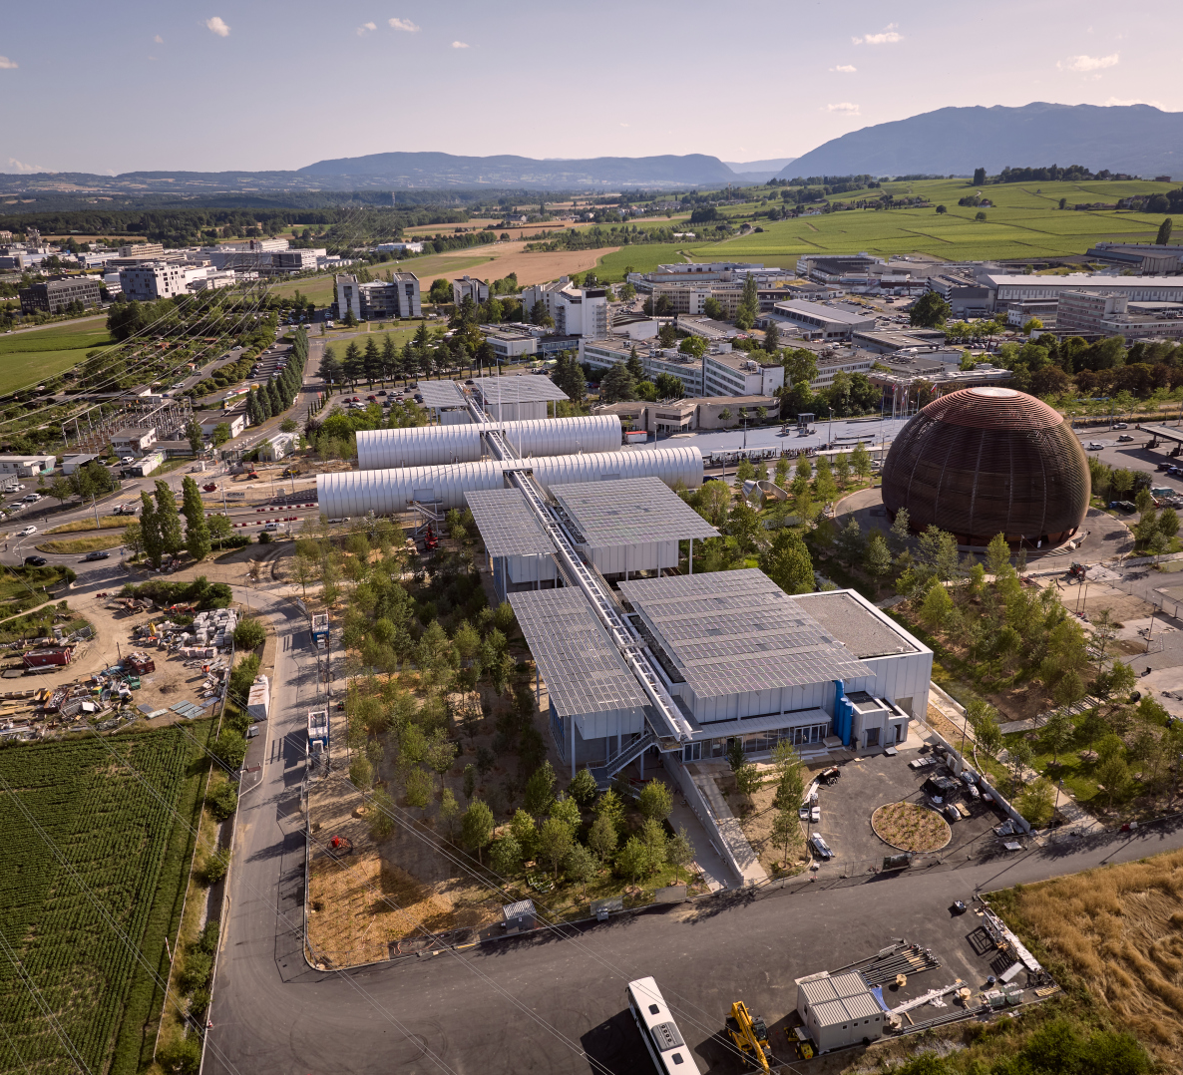
~17.000 people on campus
~230 meeting rooms
100.000+ events/year
  1.000.000+ events total
(Distributed) Meetings
Conferences, workshops

Slide 12
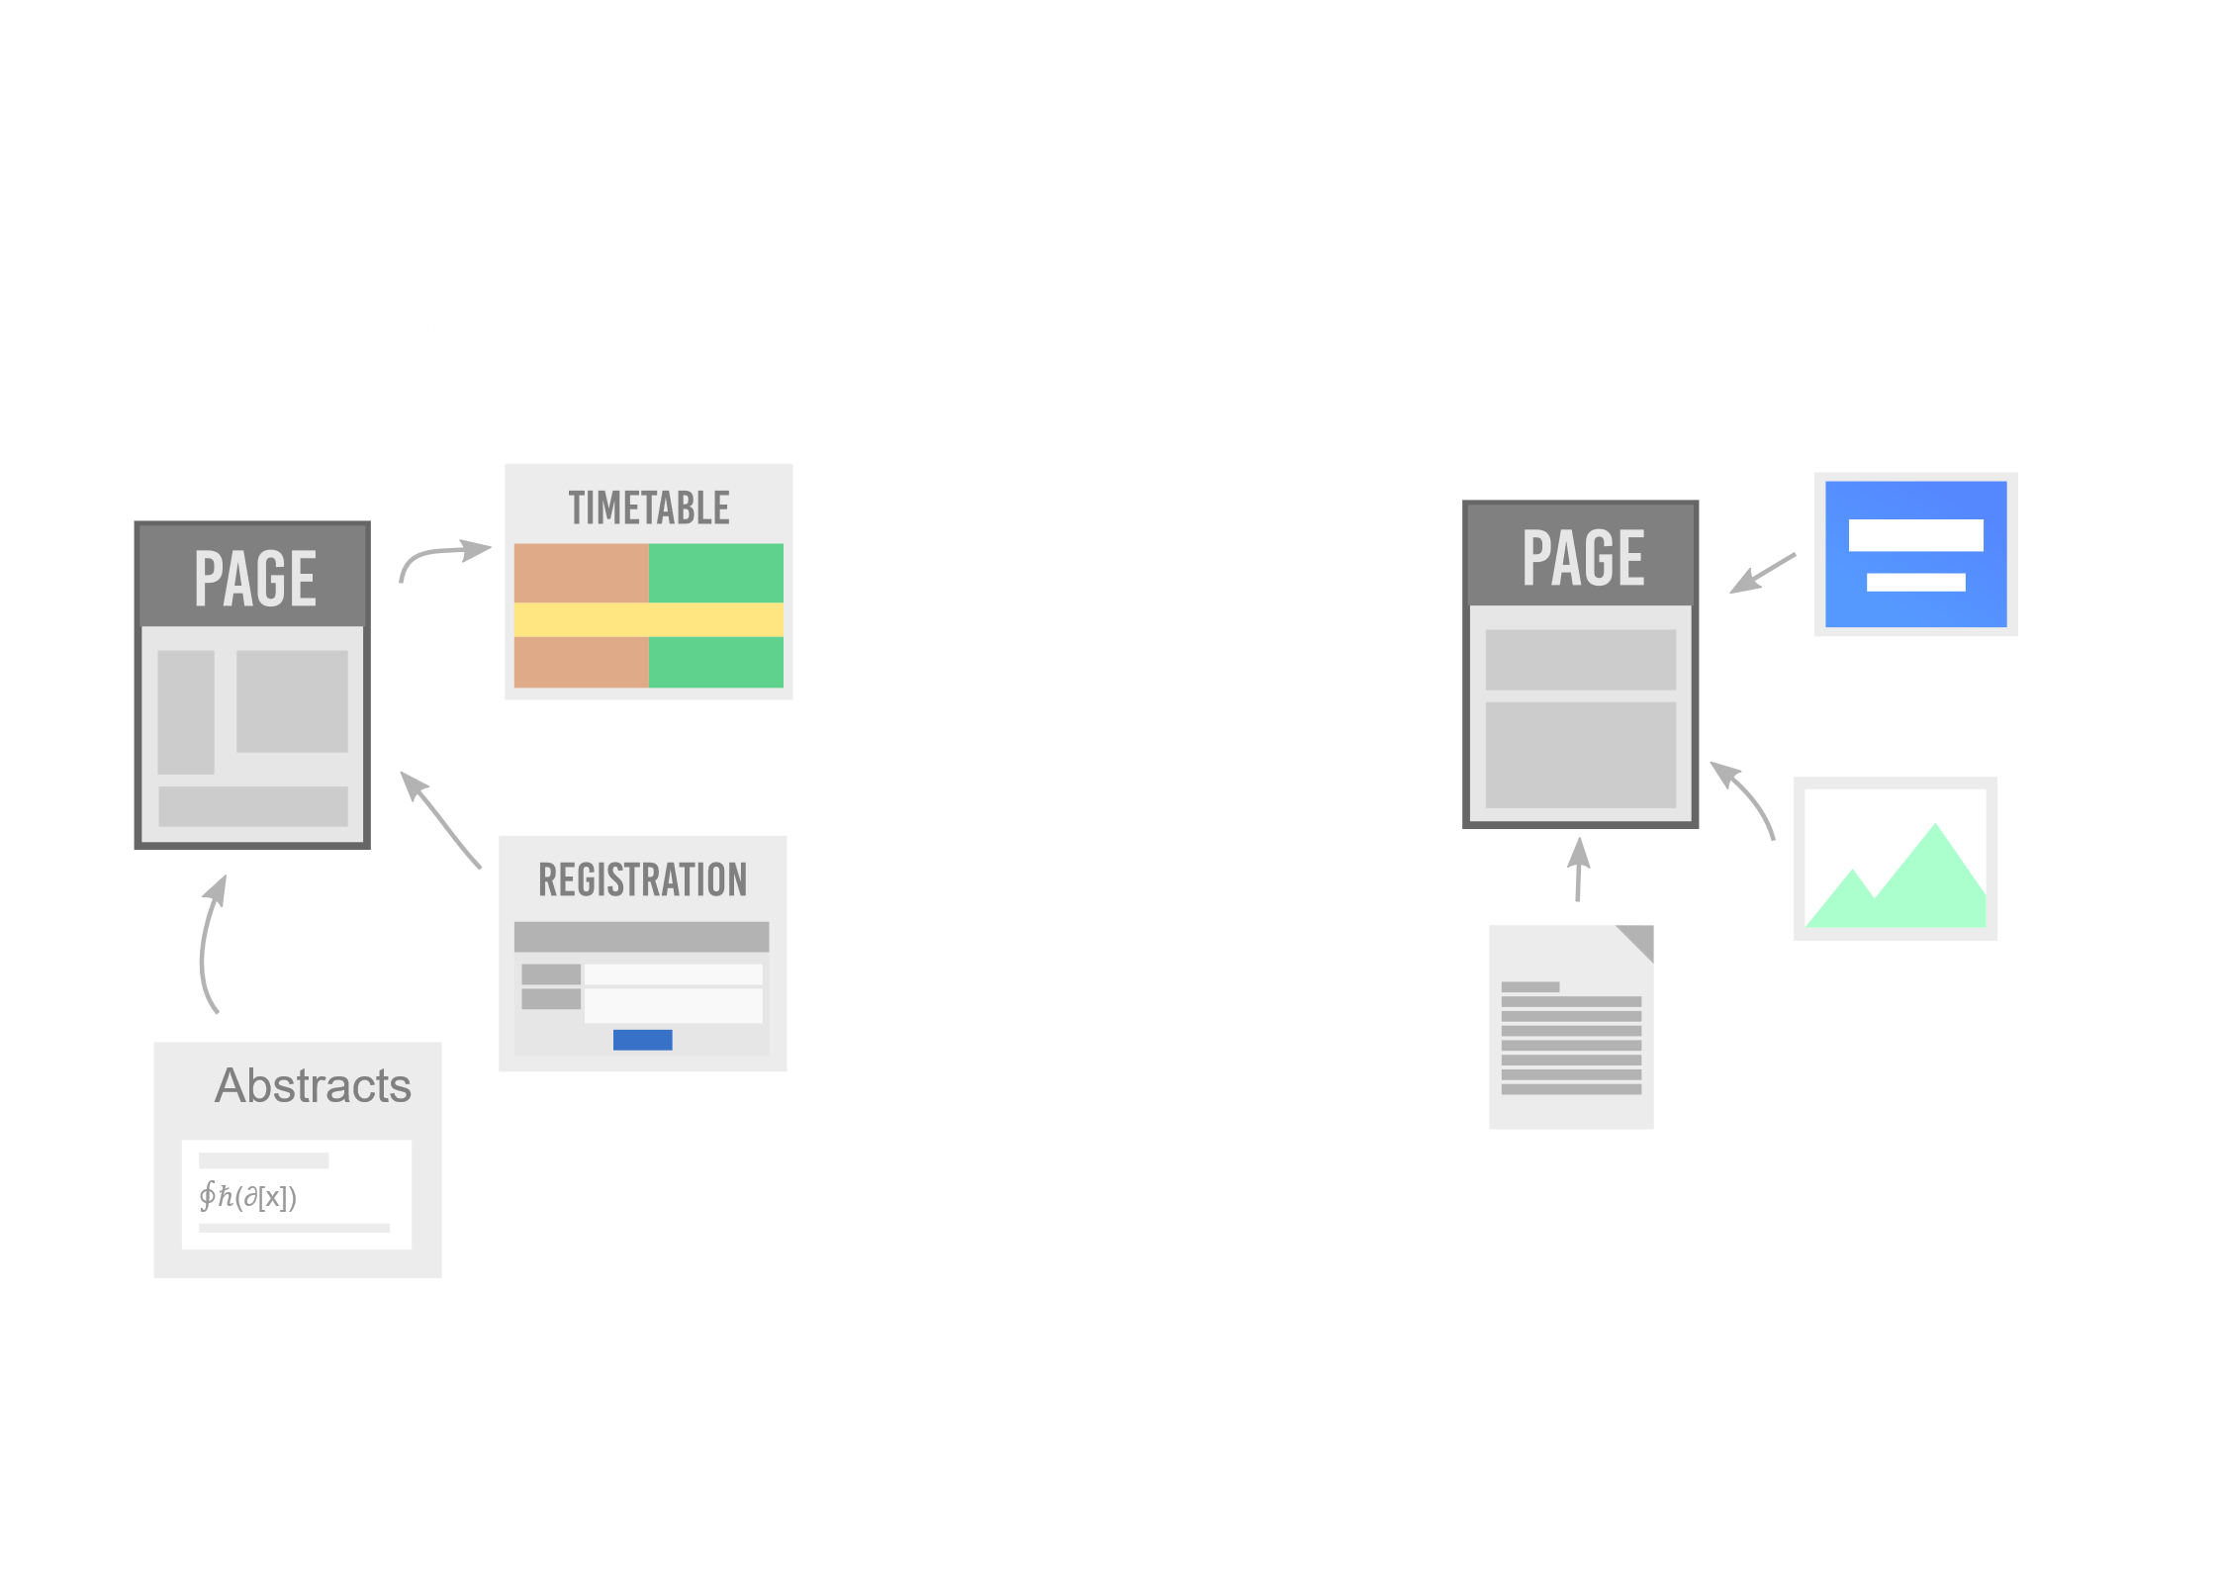

Slide 13
Under the hood
Python 3 🐍
PostgreSQL 🐘
Flask
Celery
SQLAlchemy
React
Semantic UI React

Slide 14
Extensions
Video conferencing 📹
Payment Systems 💰
Automatic conversion to PDF 🖨
Search 🔎
Storage 💾
URL Shortening 👉
Internal Workflows (e.g. recording, visitors)

Slide 15
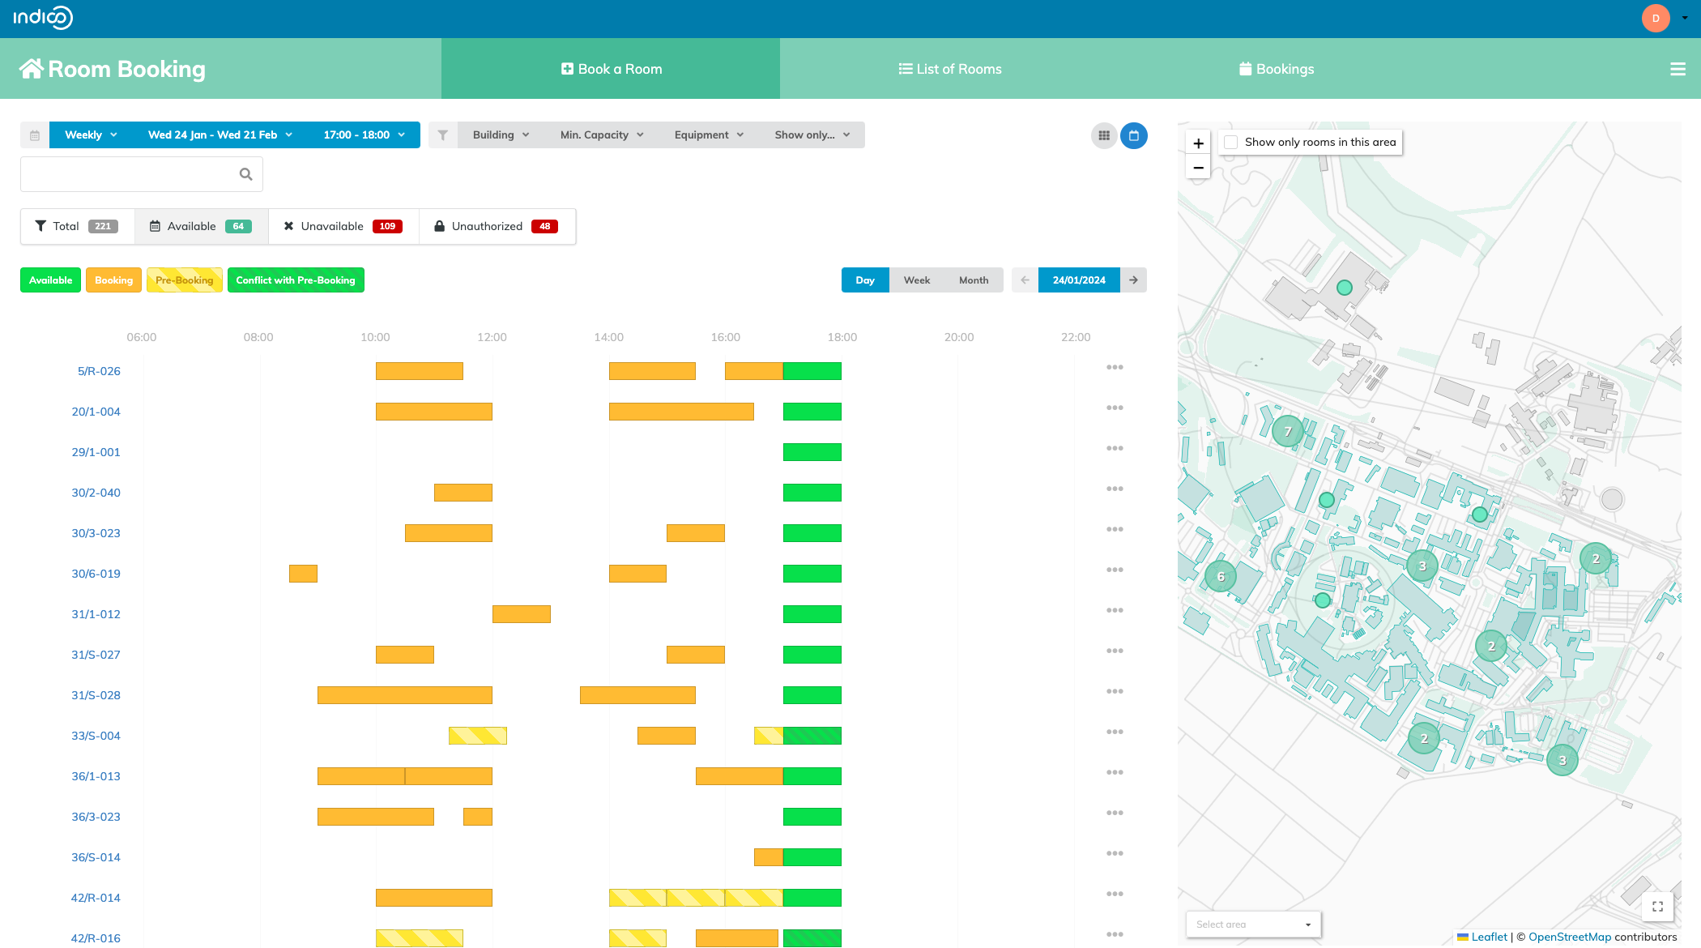
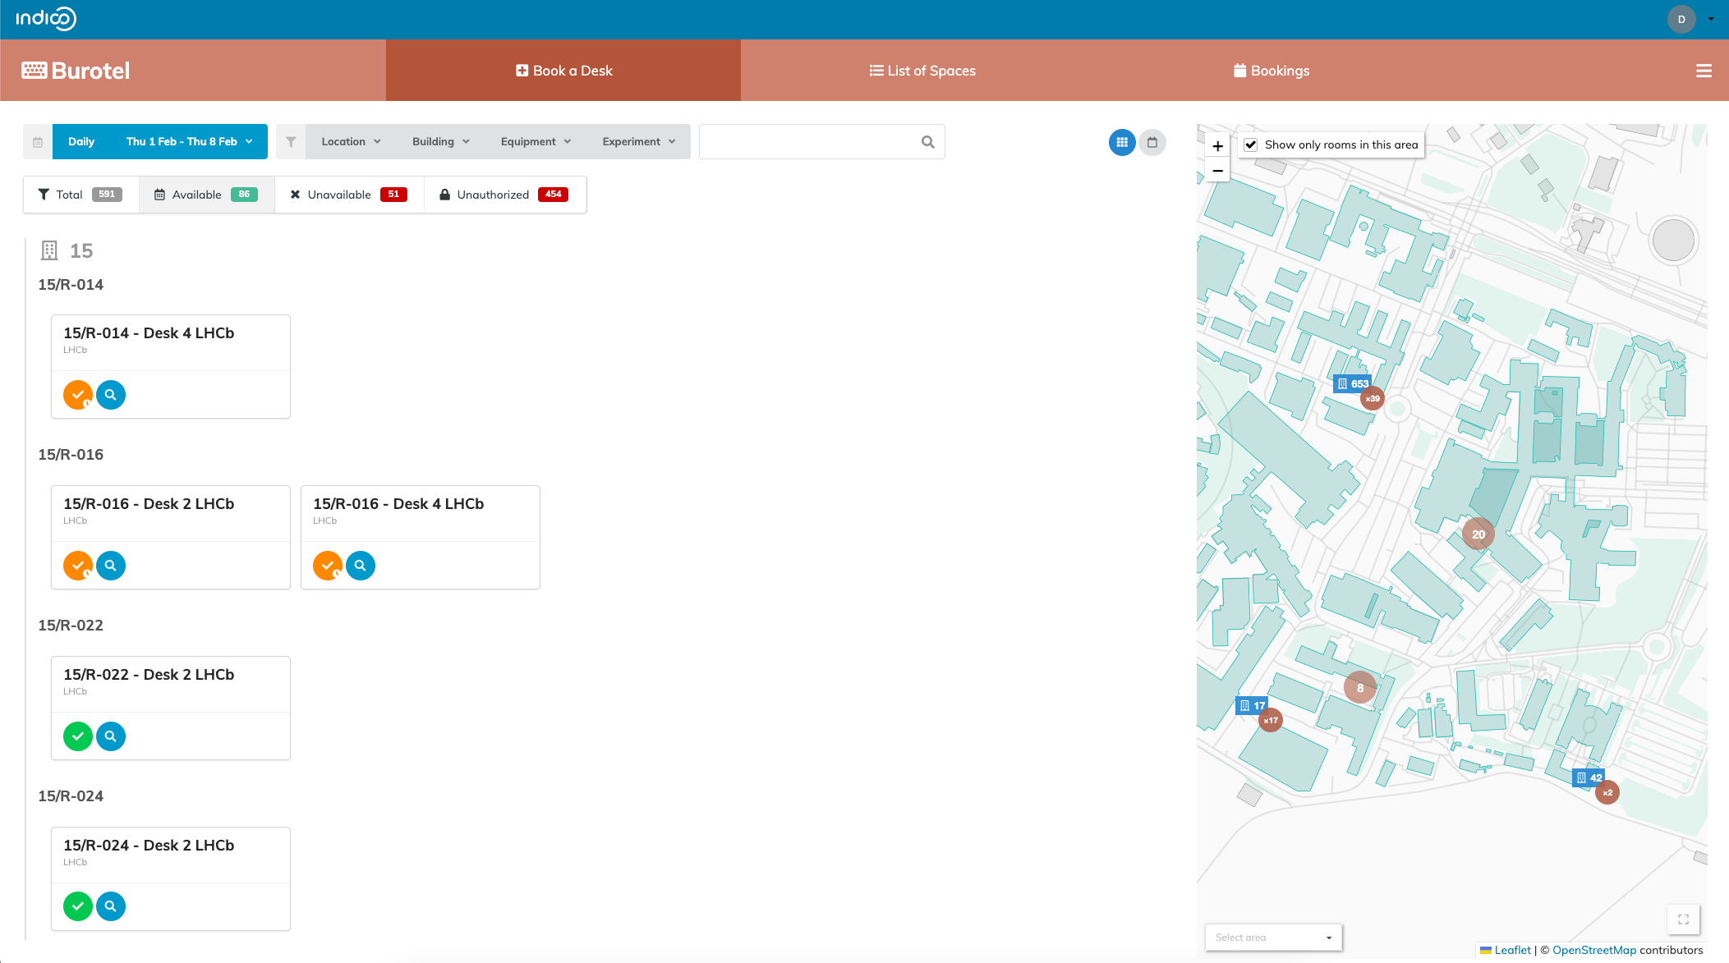

Slide 16
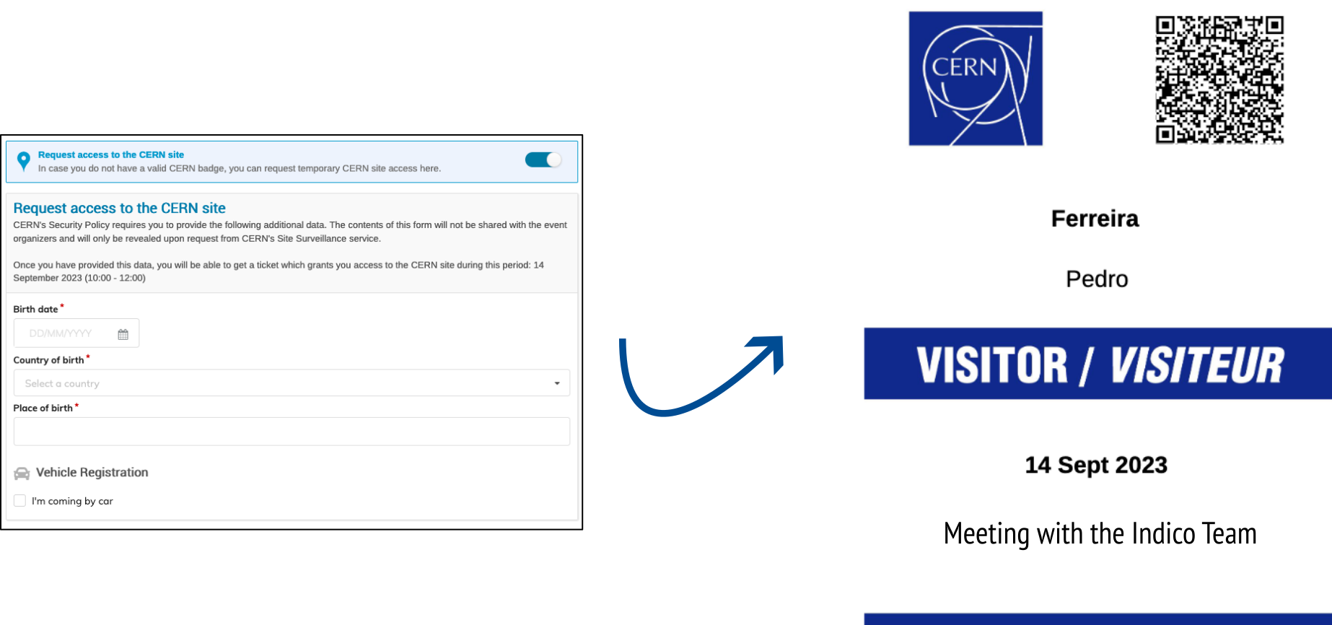

Slide 17
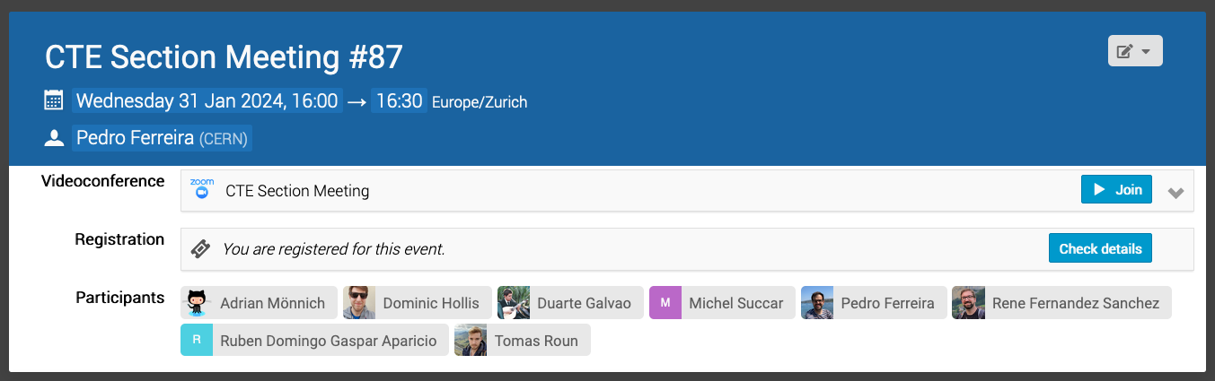
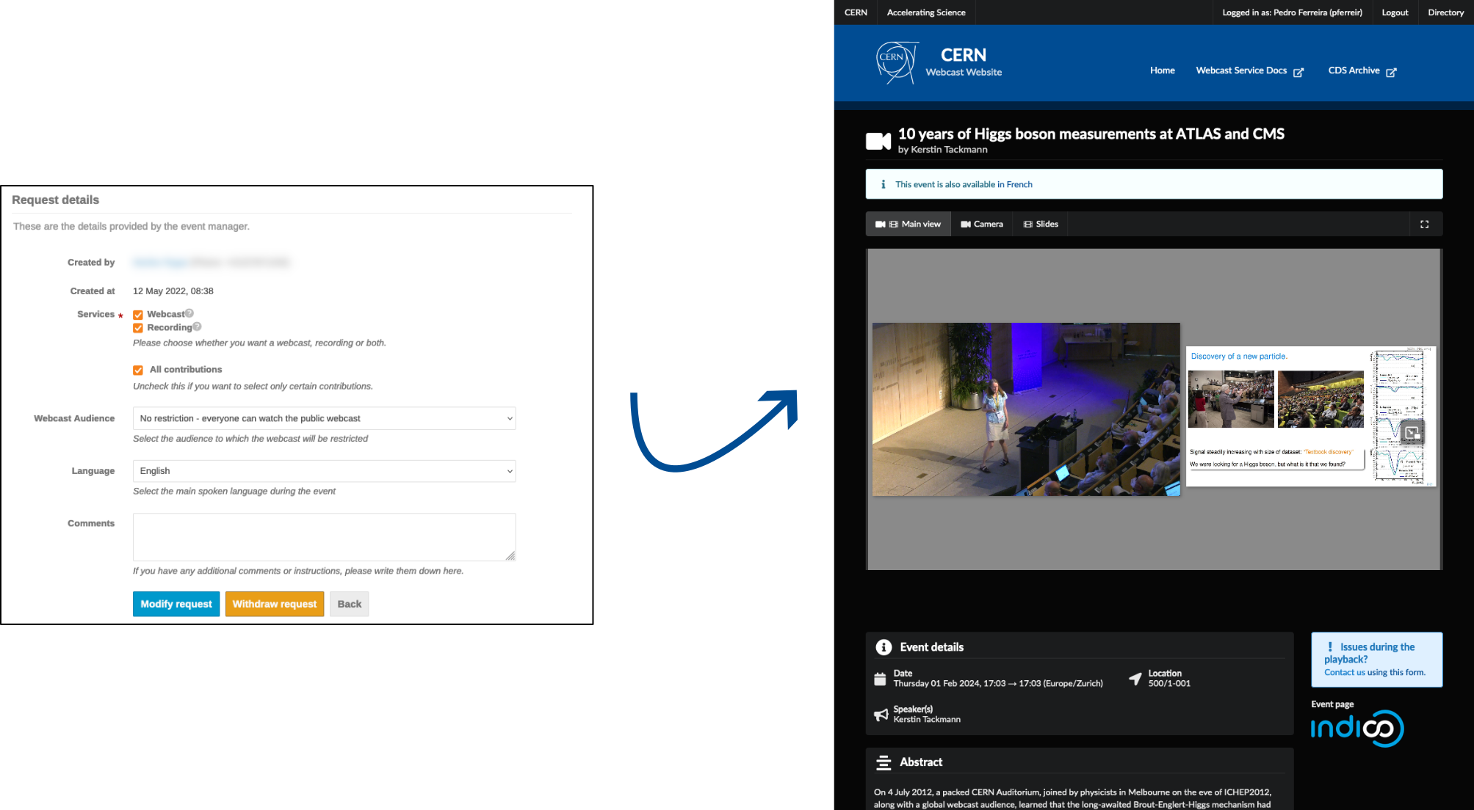

Slide 18
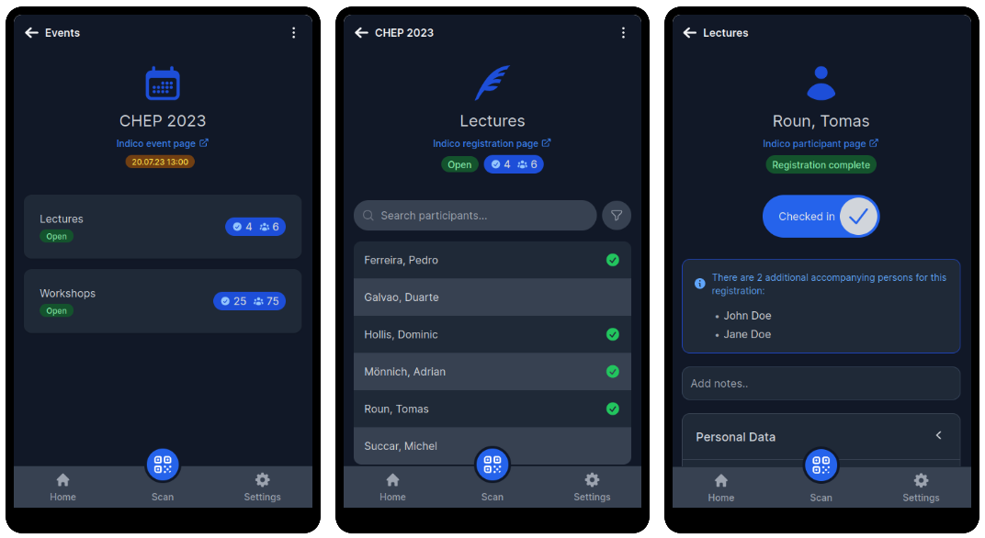

Slide 19
How to get your own indico?
🏃🏻 Option 1: run it yourself
Pros: full control, data sovereignty/privacy, cheap (if you have internal IT know-how)
Cons: may become expensive if there is no know-how
🖥️ Option 2: get someone to run it on your own infrastructure
Pros: full control, data sovereignty/privacy, cheap (if you have your own IT infrastructure)
Cons: you still need to have your own IT infrastructure
☁️ Option 3: get someone to host/run it for you (cloud)
Pros: most likely cheaper than running your own IT
Cons: data sovereignty/privacy

Slide 20
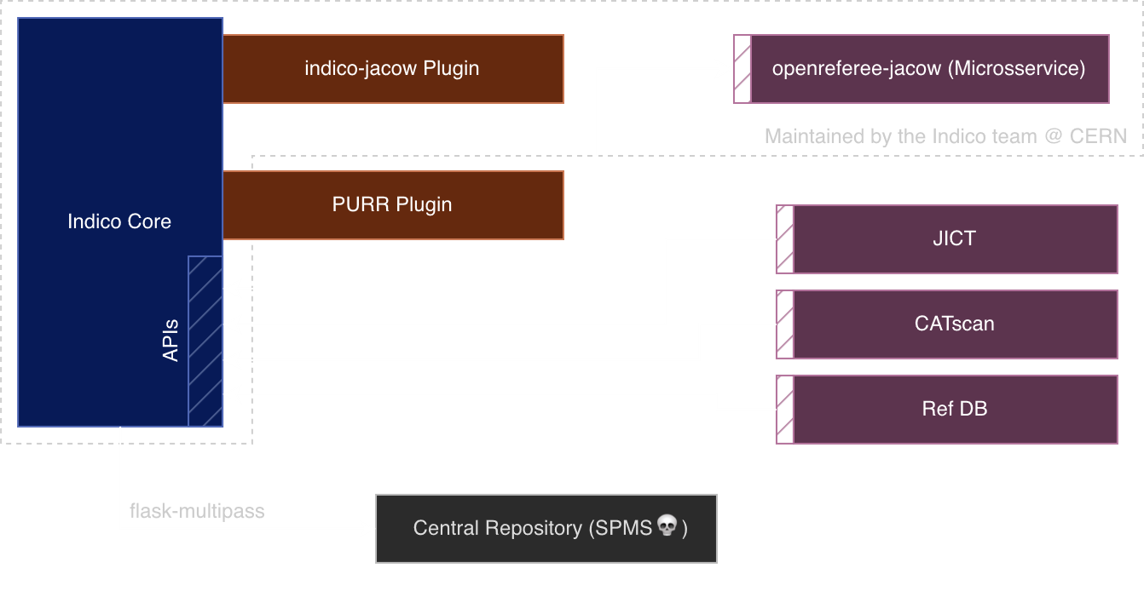
Indico-JACoW

Slide 21
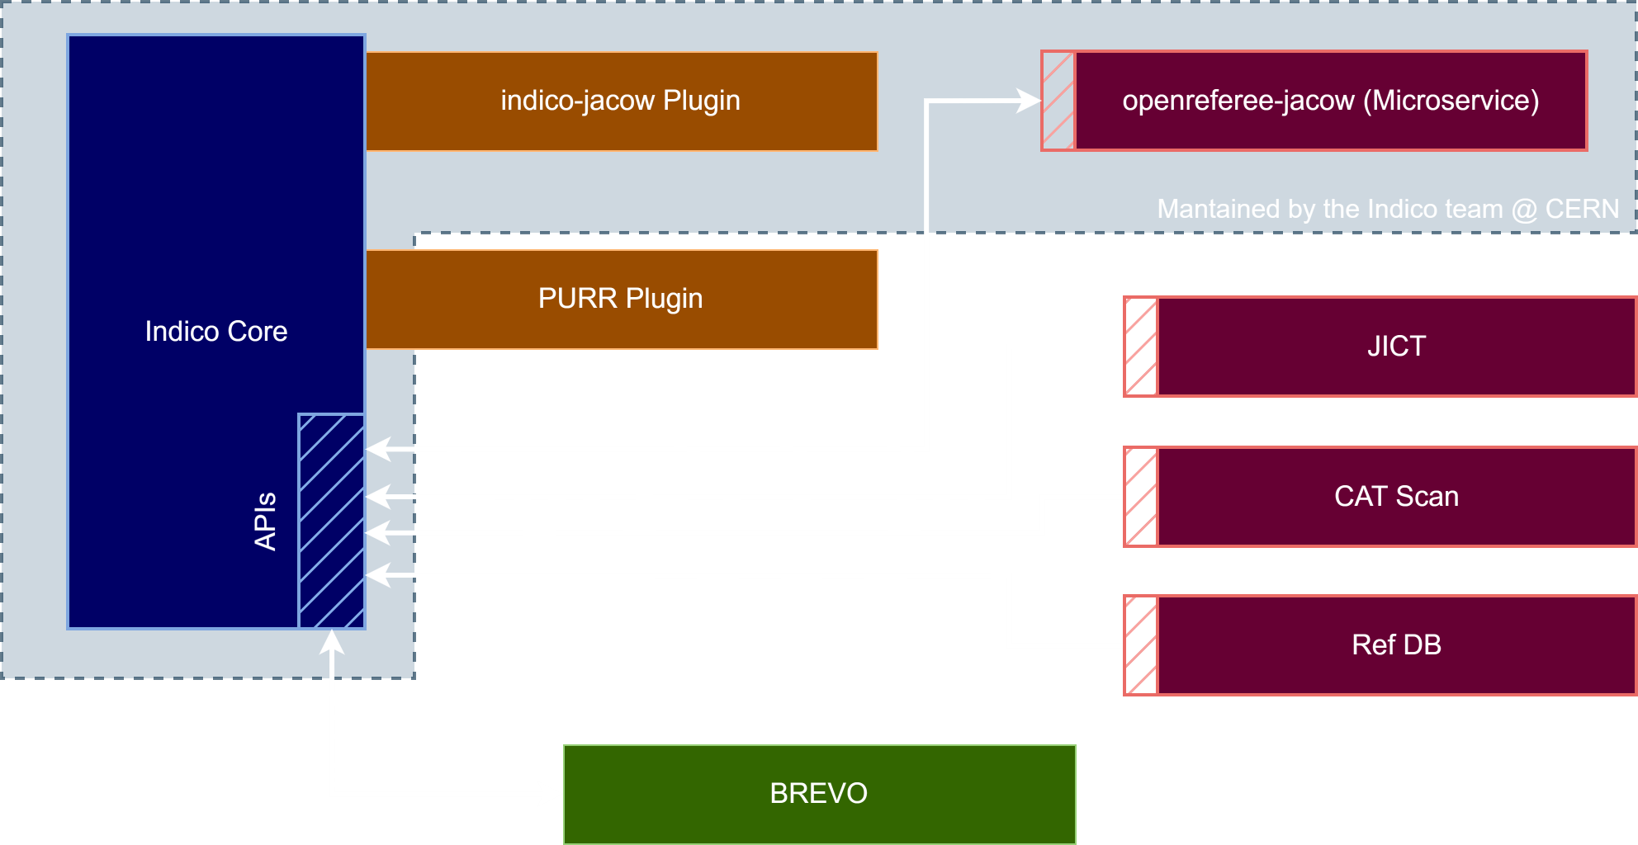
Indico-JACoW

Slide 22
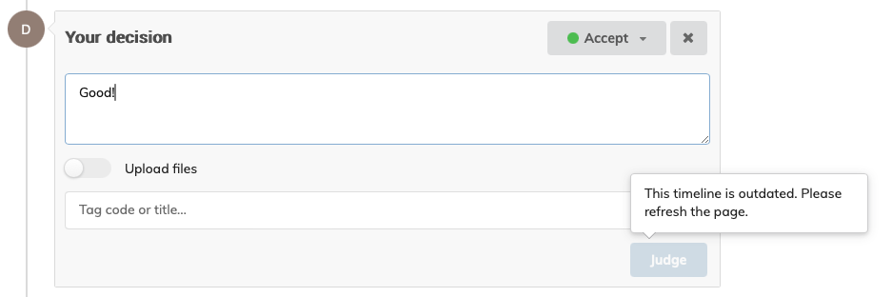
Disable judgements when timeline is outdated

Slide 23
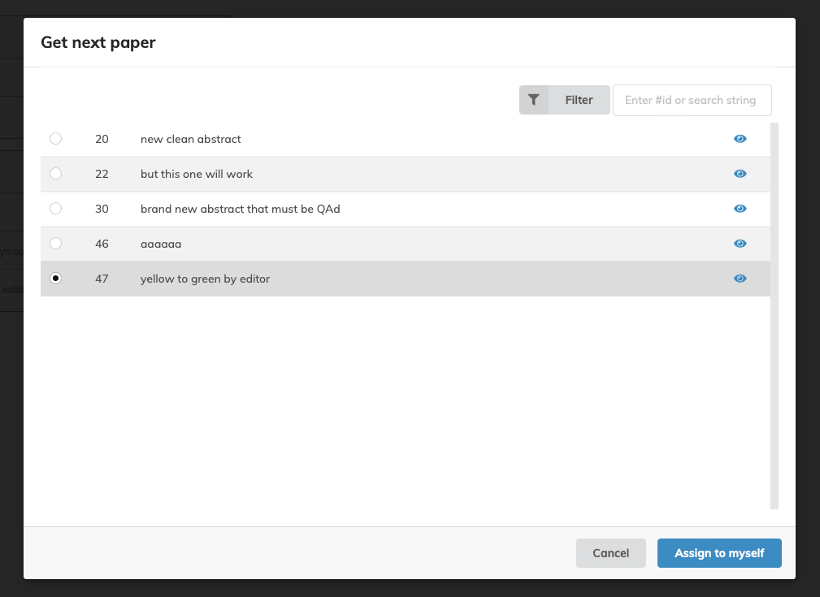
Improve get next editable UI

Slide 24
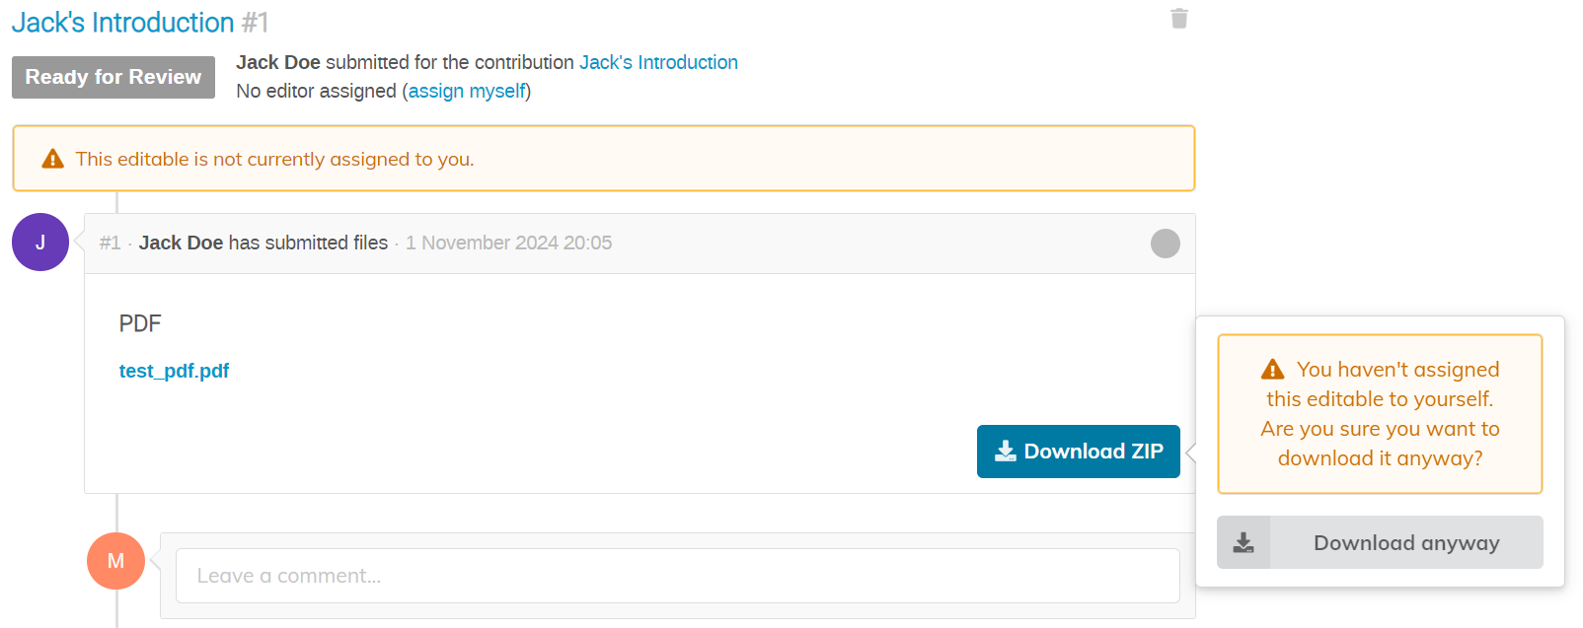
Add warning to unassigned editable

Slide 25
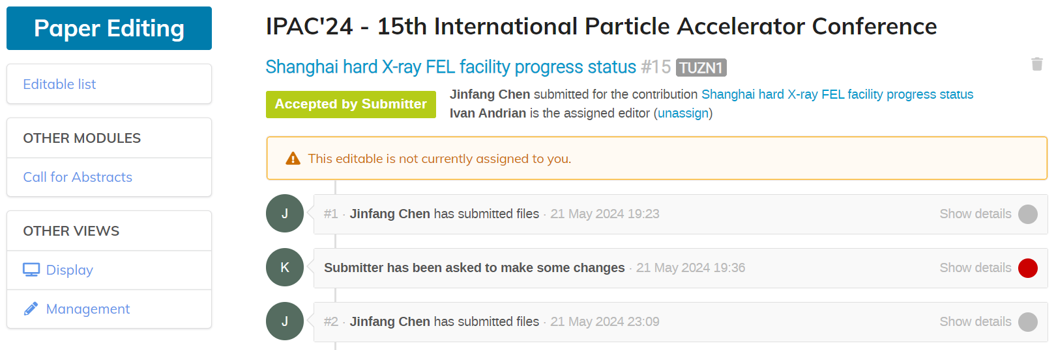
Add editable status 'Accepted by Submitter'

Slide 26
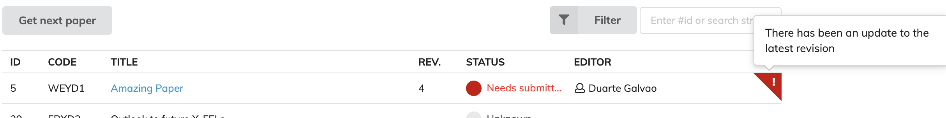
High light editable updates

Slide 27
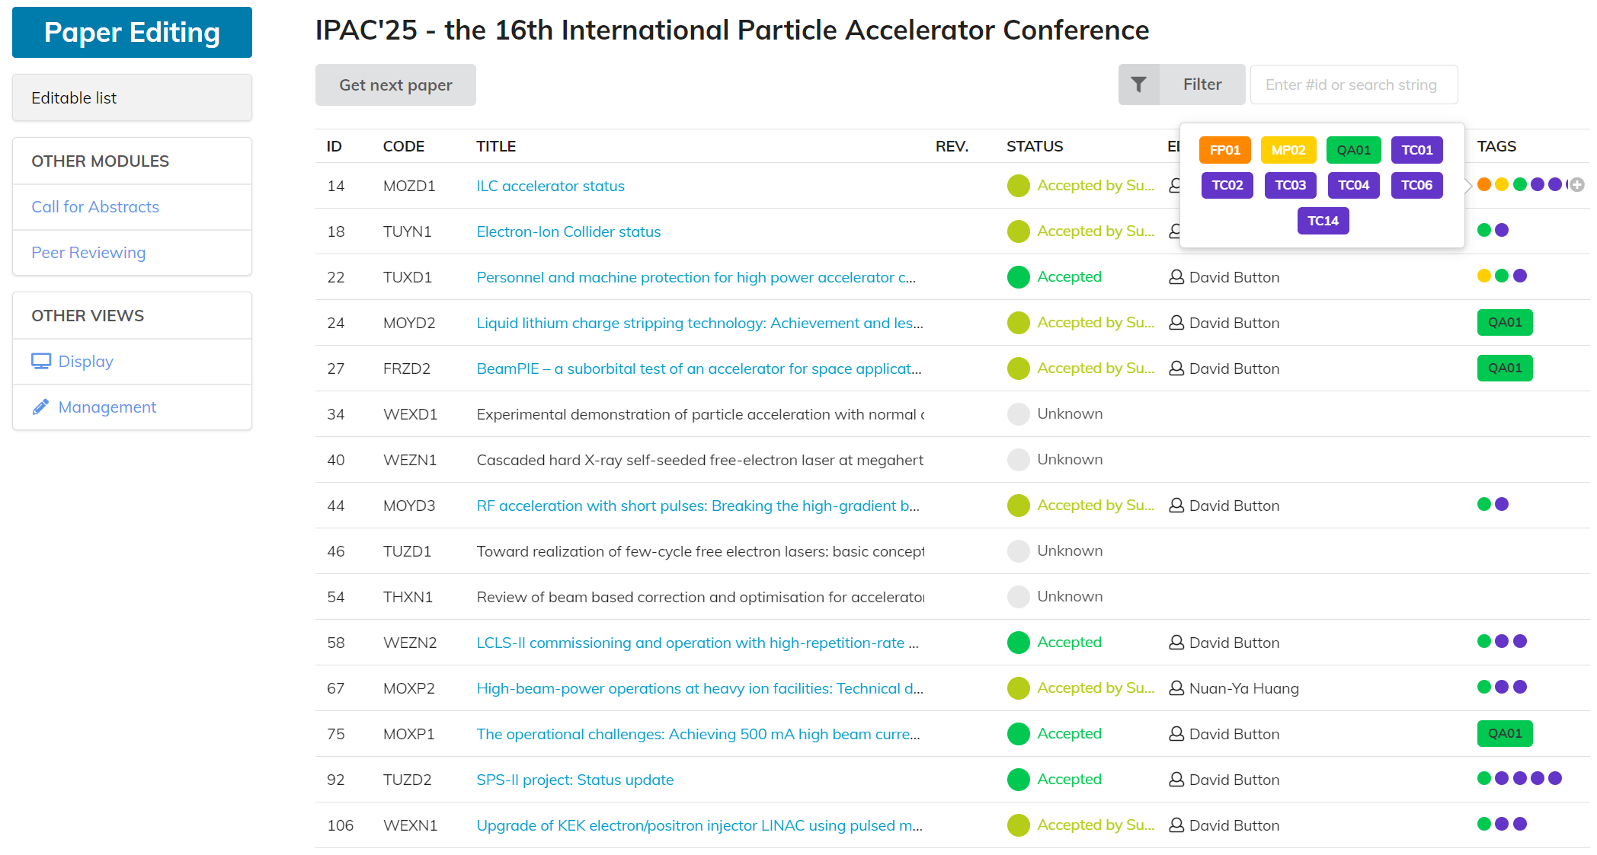
Tags column on the editable list

Slide 28
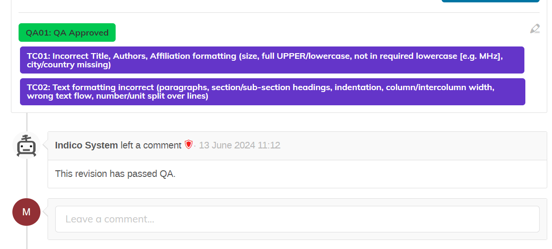
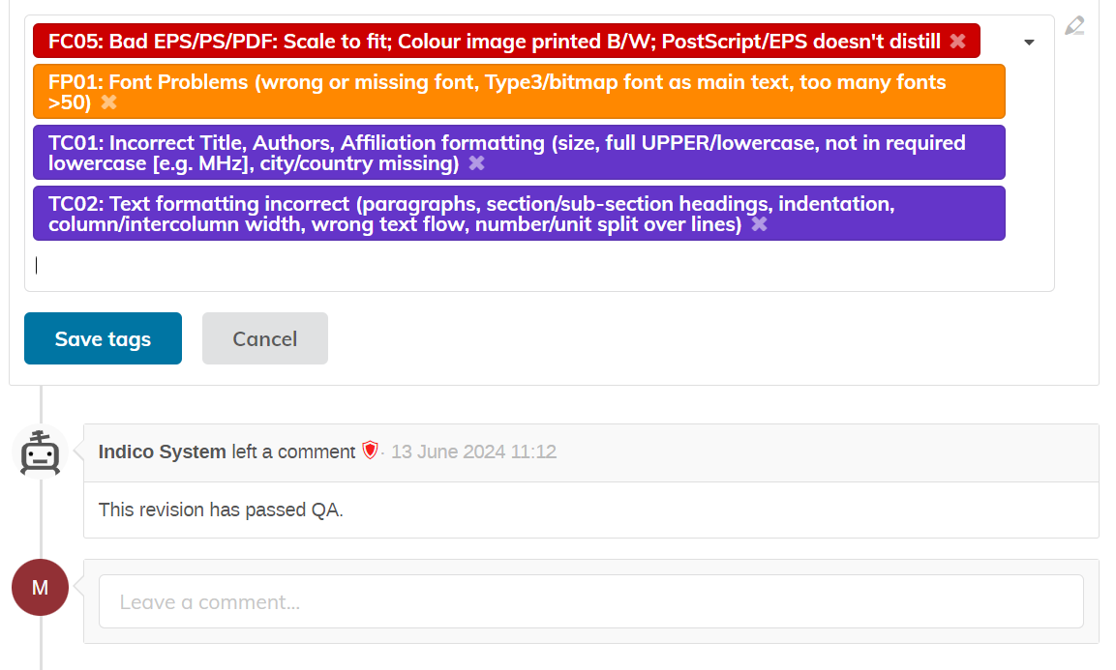
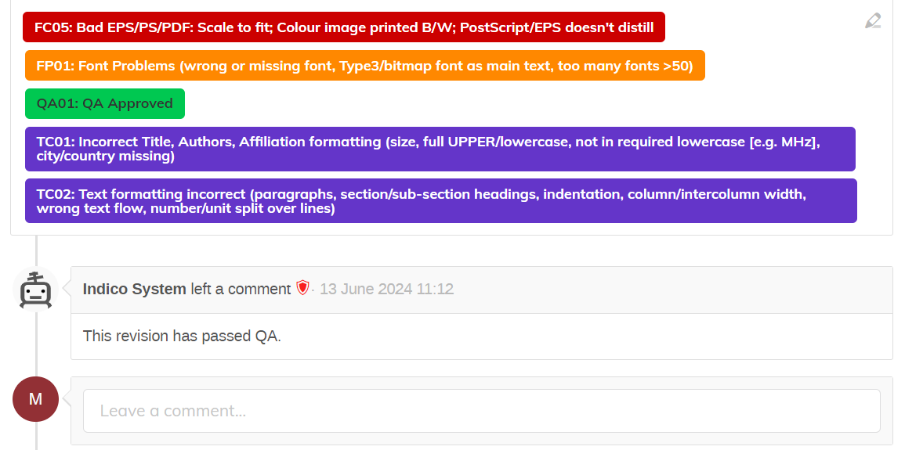
Edit tags on the last revision

Slide 29
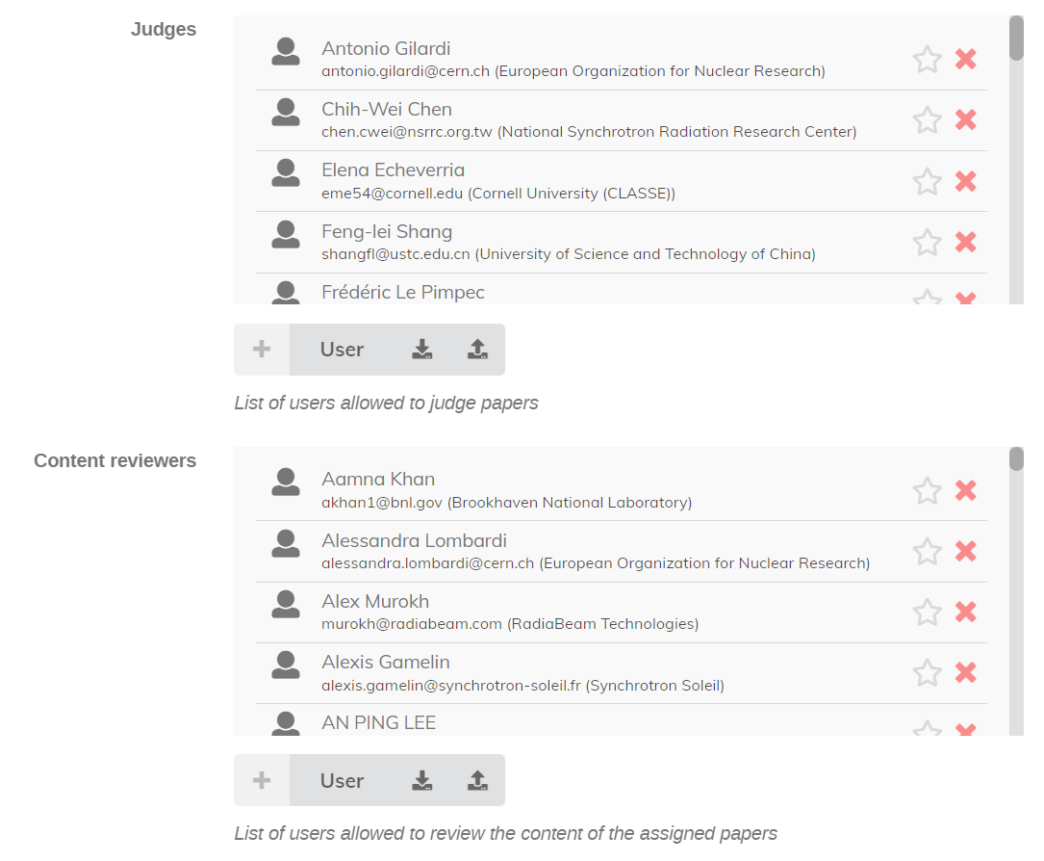
Import/Export Peer review teams

Slide 30
SPMS Shutdown

Slide 31
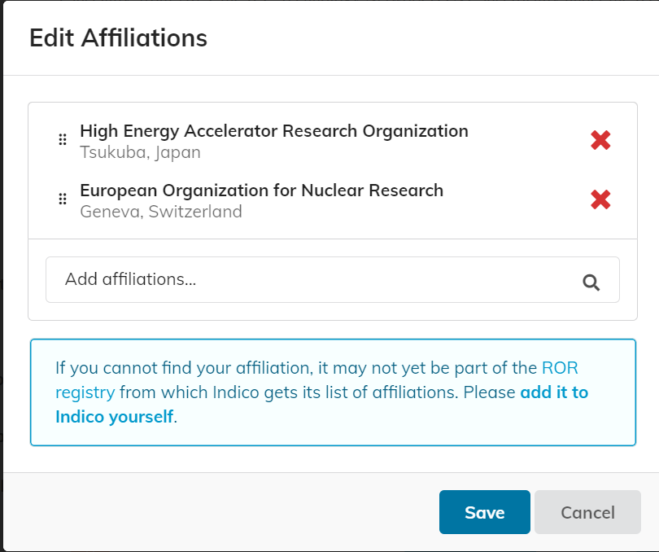
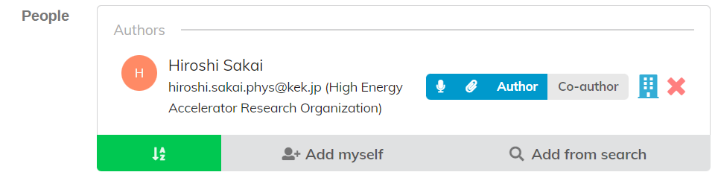
Multiple Affiliations
Only available at contribution level

Slide 32
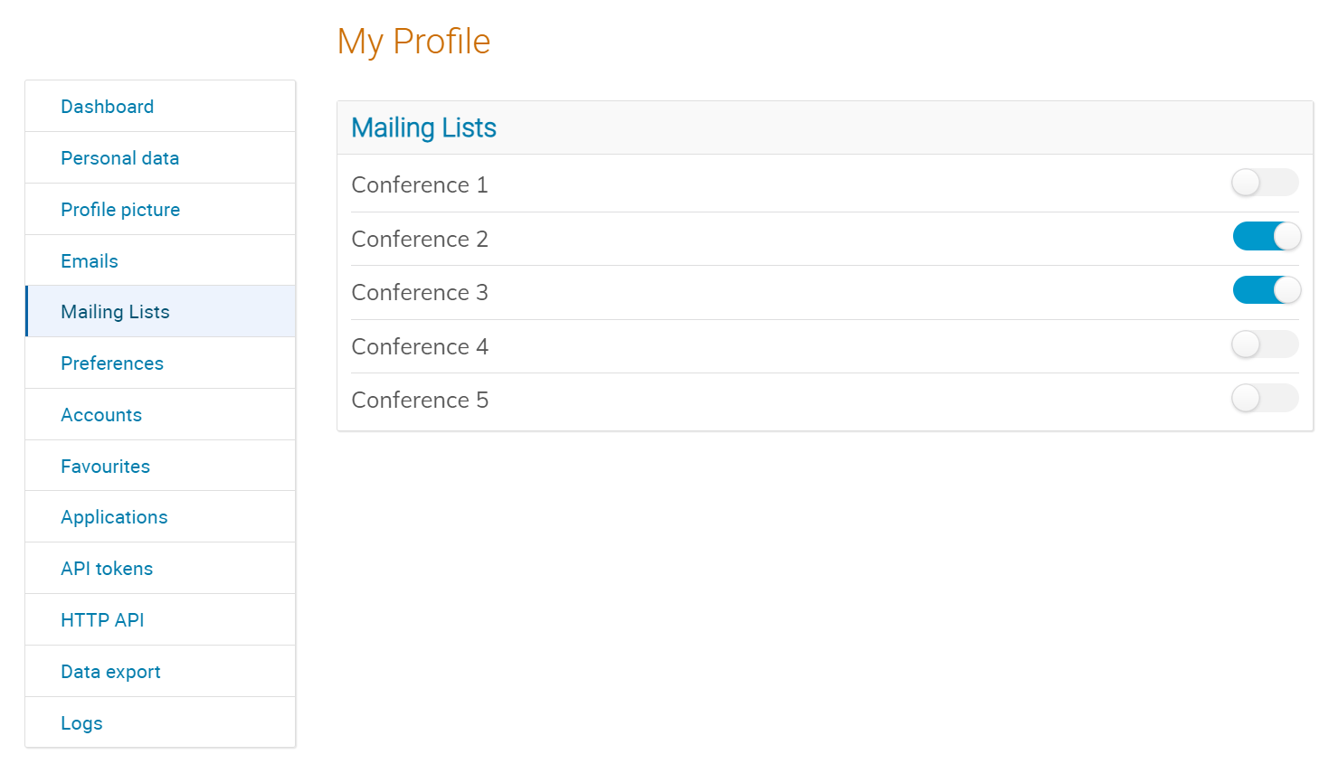
Mailing Integration (Brevo)

Slide 33
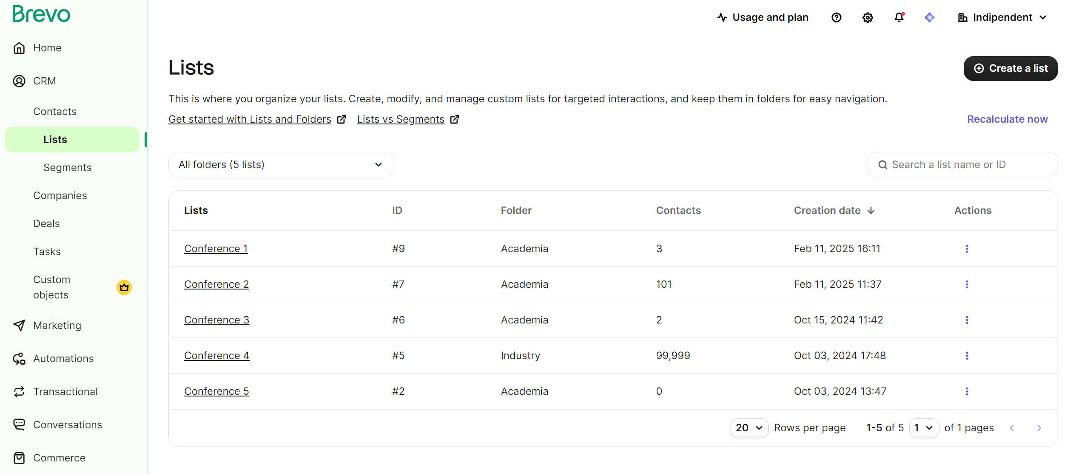

Slide 34
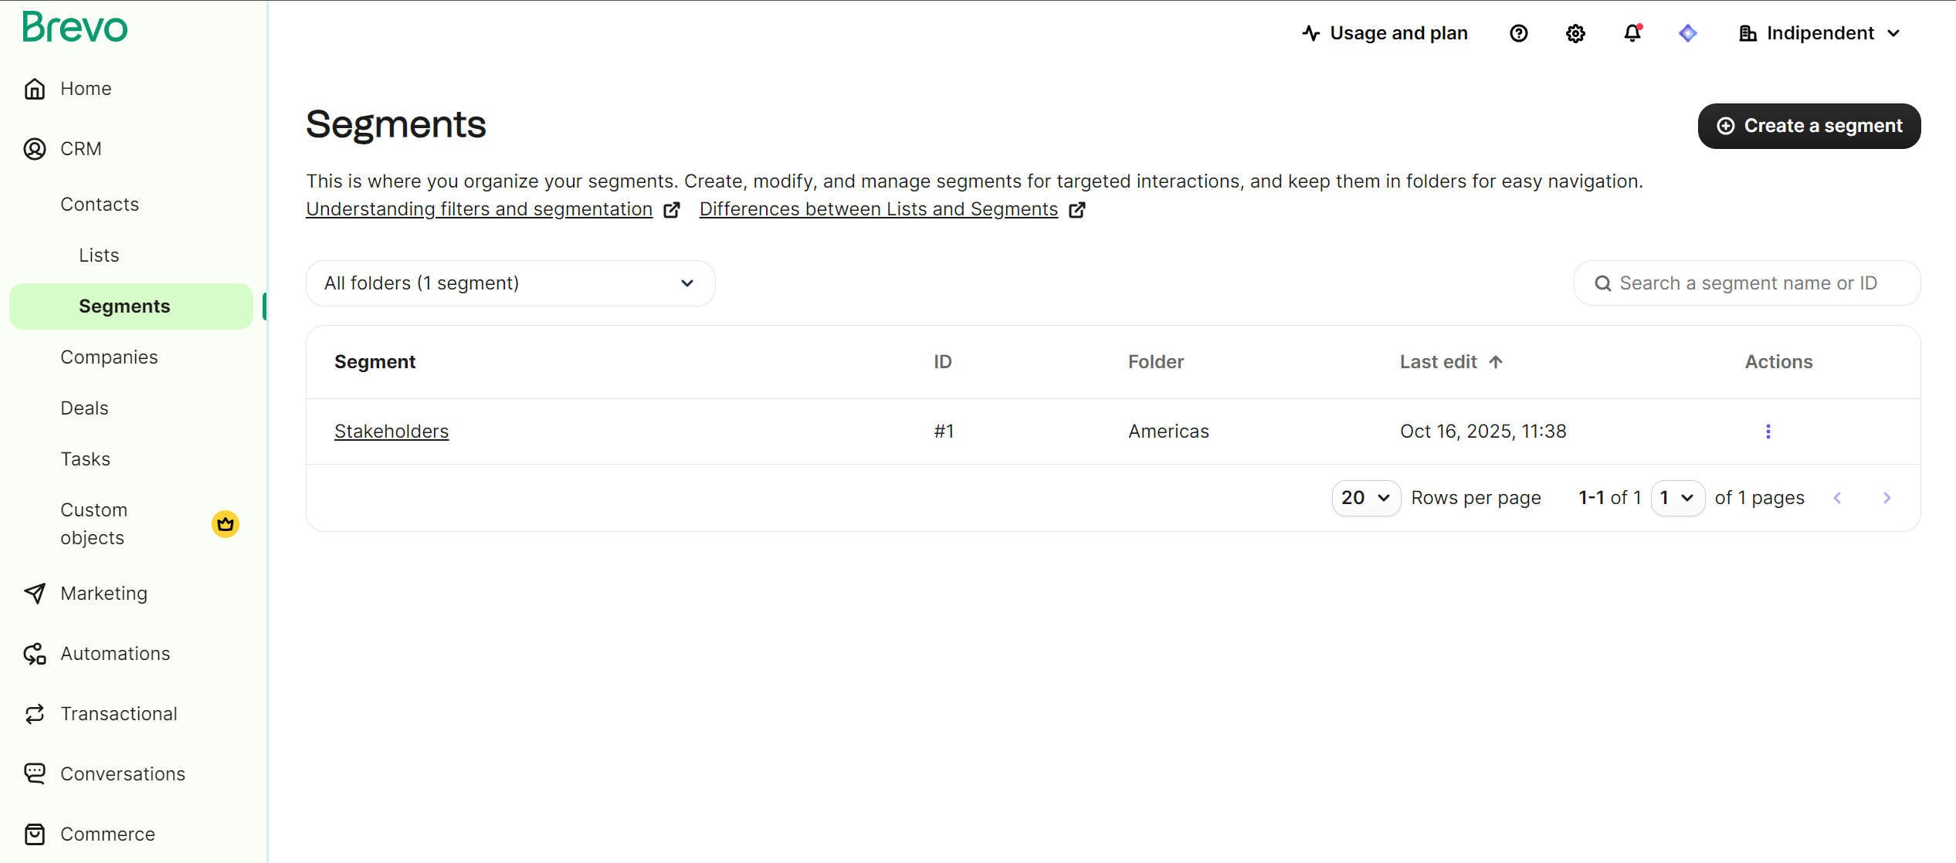

Slide 35
Plans for the future
Peer Review Module improvements
Greater Accessibility (a11y)
UI Improvements and legacy code removal
  React-based timetable
User Interfaces
  Improvements in material editor (e.g. better drag and drop)
  Responsive interfaces that work OK on mobile
More user-centric home page
More info in our roadmap (https://getindico.io/roadmap/)

Slide 36



Thank you!

