Slide 1
Welcome to the JTM25 and agenda
JACoW Team Meeting 2025 – CERN, 3-7 Nov. 2025
Adriana Rossi as 2025-27 JACoW Chair

Slide 2
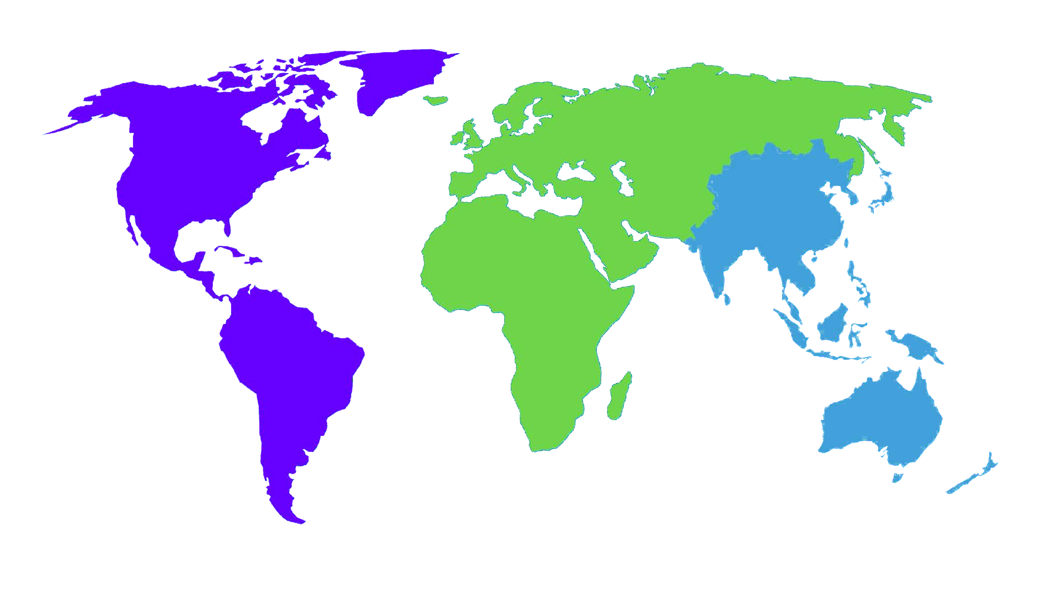
Welcome
Some words about the JACoW Collaboration
Practical information
Presentation of the agenda

Slide 3

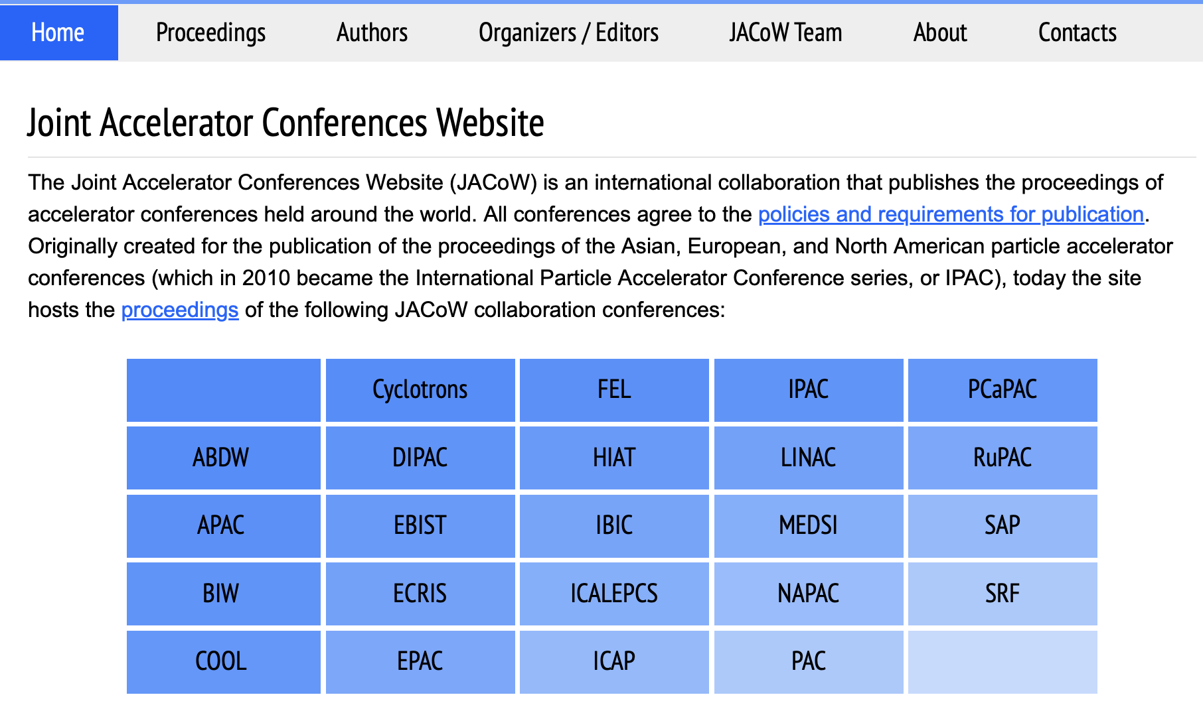
What is JACoW
19 members conference series:
IPAC (unifying PAC, EPAC, APAC from 2010)
NA-PAC (formerly PAC)
IBIC (Unifying DIPAC and BIW from 2012)
COOL, CYCLOTRONS, ECRIS, EIC, FEL, HIAT, ICAP, ICALEPCS, ICFA ABDW, LINAC, MEDSI, PCaPAC, RUPAC, SAP, SRF

Slide 4
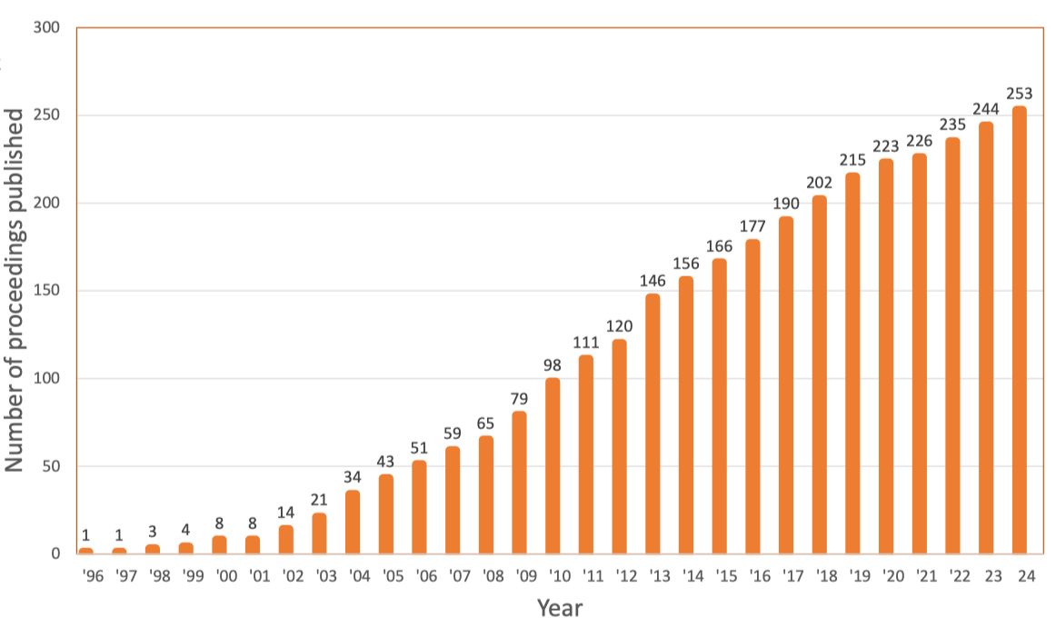
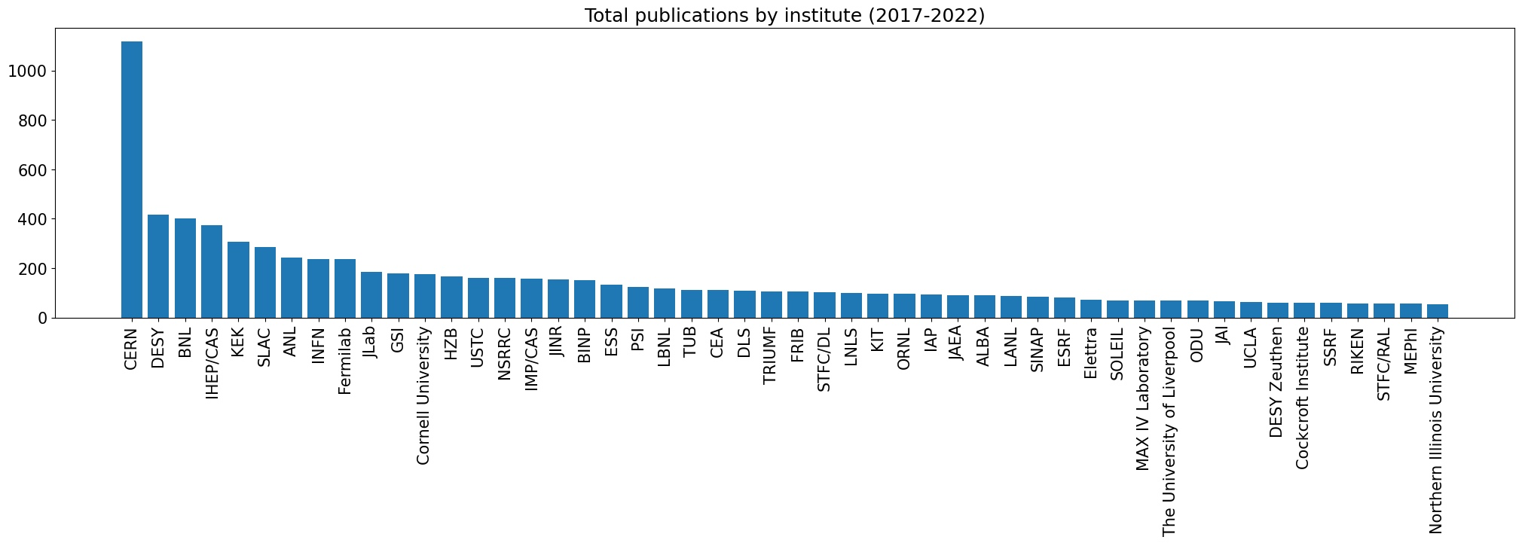
Volume of published papers
260 in 2025
9 conferences / y

Slide 5
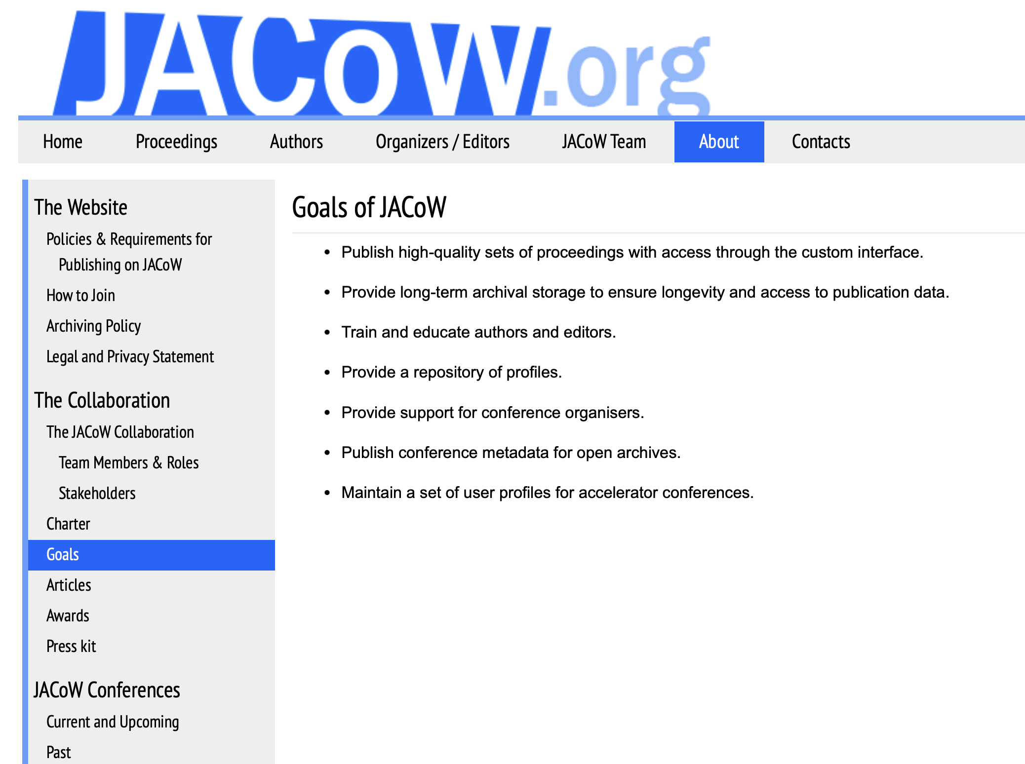
Goals
Publish high-quality conference proceedings – with JACoW Indico, from IPAC’23 – permitting wide dissemination and use.
Publish conference metadata for open archives.
Provide long-term archival storage to ensure longevity and (free) access to publication data.
Provide a repository of profiles – in JACoW Indico since March ’25 – and maintain a mailing lists for accelerator conferences.
Provide support for conference organisers – with JACoW Indico:
Conference logistics
Organizing scientific content of conferences
Paper submission and processing
Proceedings publication
Train and educate authors and editors, including on tools for proceedings production.
, now in JACoW Indico.

Slide 6
Stakeholders
A collaboration, NOT a service
Conference representatives
Institute representatives
BoD
Team
Users

Slide 7





Labs providing infrastructure and services
JACoW Indico
JACoW Central Repository (users profiles)
Back up of the proceedings
High Energy Accelerator Research Organization
Proceedings server ?
Proceedings Repository & Search
JACoW.org Website Hosting
JICT tools, CAT and MEOW tool
JACoW Indico documentation pages
European Physics Society
Software licenses
Software maintenance ?
Mailing system (Brevo)
Australian Nuclear Science and Technology
References’ search tool
CAT Scan Cloud Host
JICT – JACoW Indico Conference Toolbox
CAT – Conference Assembly Tool
MEOW – Machine Editor for cOnferences Website
Notes:
MEOW tool (online processor for CAT, hosted at Elettra)
Due to the technological obsolescence of the CERN/JACoW Search Engine, certain functionalities have disappeared (e.g. keyword search). More importantly, papers generated by the CAT tool are not found by the CERN/JACoW Search Engine
The use of the new CERN search engine for JACoW is under discussion

Slide 8
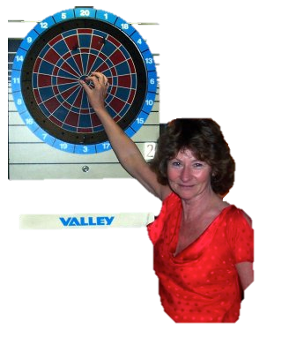
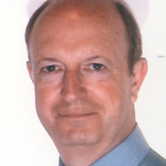
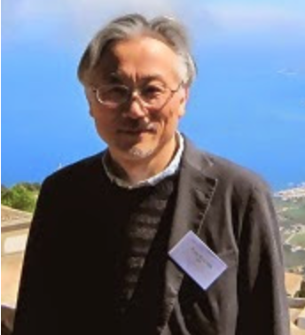
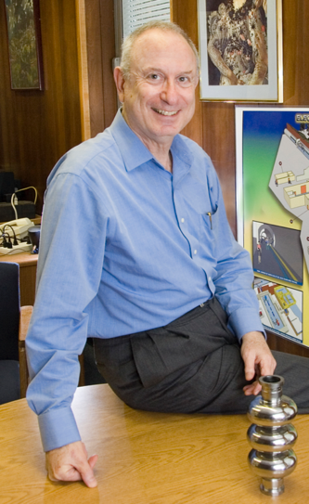
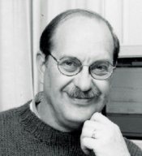
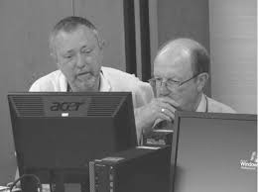
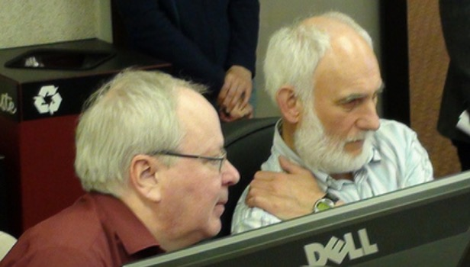
… and a confluence of personalities
Joint Accelerator Conferences [on the] Website
The Beginnings: In the mid-nineties, with the arrival of electronic publication, PAC'95 and EPAC'96 were the first accelerator conferences to try their hand at publishing proceedings themselves.
In 1997 the JACoW collaboration was created under the chairmanship of CERN's John Poole, with Christine Petit-Jean-Genaz as JACoW Coordinator and a member of the Board of Directors for many years (up to 2022).
Bob Siemann
Yong-Ho
Chin
Ilan
Ben-Zvi
John
Poole
PAC’95
APAC’98
Lief Liljeby
Martin
Comyn
Christine
Petit-Jean
Genaz
PAC’99
EPAC’96...
EPAC’98
PAC’97

Slide 9
Timeline of JACoW evolution and development
> 1997 Development of ‘JACoW model’, formation of the collaboration (EPAC’96, EPAC’98, APAC’98, PAC’99)
> 1998 JACoW paper size
> 2001 JACoW Steering Committee
> Development of JPSP (2004, continuing over many years)
> 2004 SPMS* (PAC’01, EPAC’02, EPAC’04) with further development of functionalities (FEL’04, FEL’05, IPAC, EPAC’08)
> Regional support centers
> 2007-08 first discussion about indexing JACoW proceedings
> 2012 JACoW charter adopted, Board of Directors formed
> 2012 ISBN numbers
> 2015 current version of JACoW charter adopted
> 2015 DOIs for all new papers
> 2017 Start of SPMS-Indico merge project
> Development of CATscan and reference search tool (IPAC’19)
> 2020 ISSN numbers for all conferences
> 2020 end of SPMS development support, closing of FNAL support center
> 2022 Last SPMS instance created
> First test of JACoW Indico (FEL’22)
> Beta test of JACoW Indico at IPAC’23, then production version rolled out
> Development of Indico proceedings module (IPAC’23, IPAC’24, IPAC’25)
> 2023 First two sets of proceedings (LINAC and IBIC) indexed in Scopus
> 2024 KEK SPMS server will be retired
> 2025 End of SPMS, with also Central Repository with JACoW Indico
*Scientific Programme Management System

Slide 10
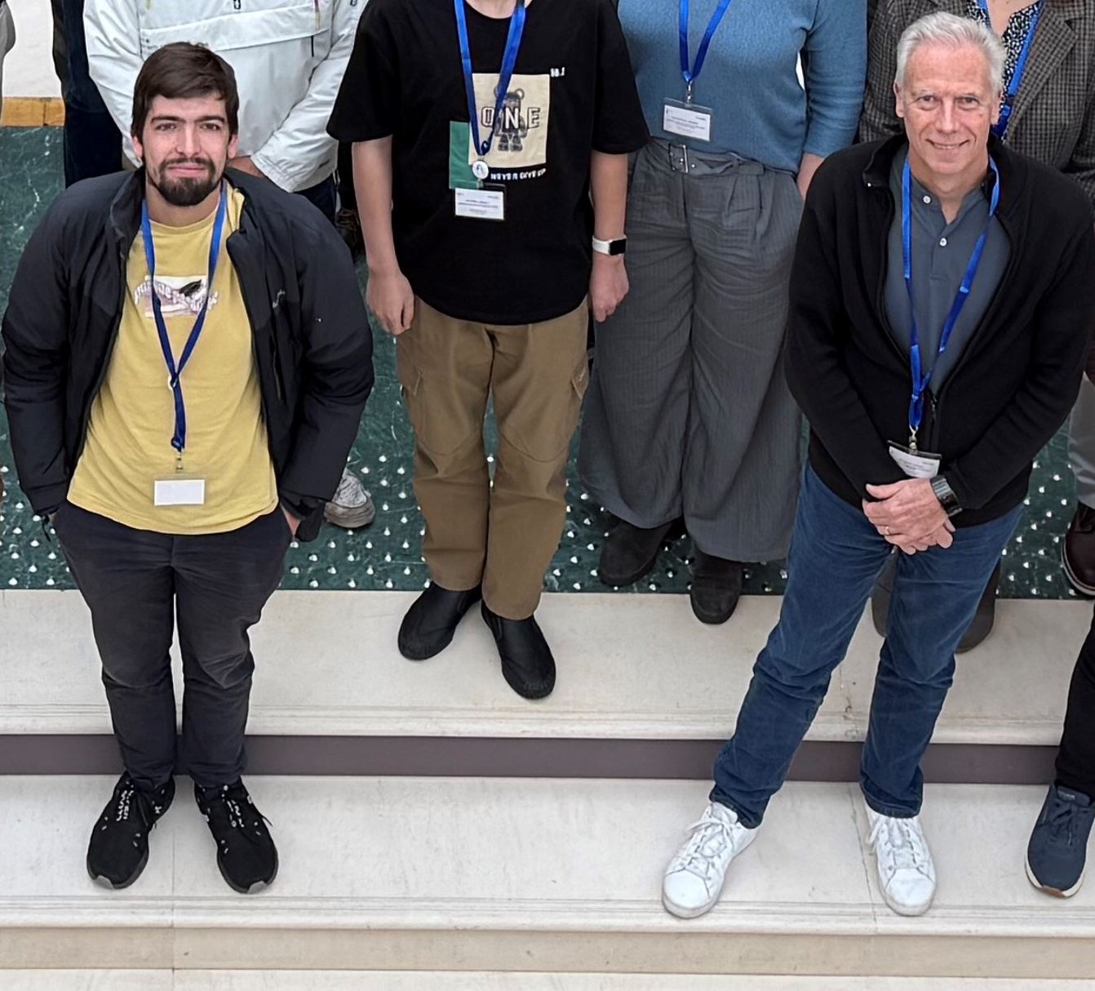

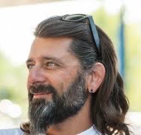
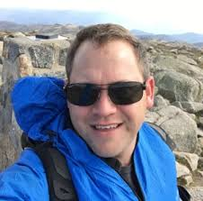

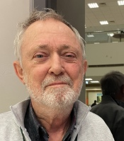
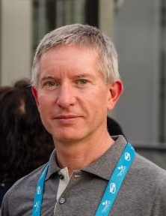
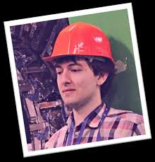
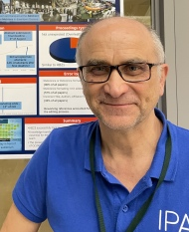
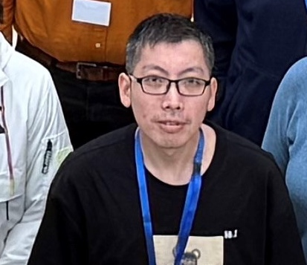
Duarte Galvão
Ronny Billen
Josh Peters
Volker Schaa
Ivan Andrian
David Button
Michel Succar
Adrian Monnich
Stefano Deiuri
Jan Chrin
Zhichu Chen (Ross)

Slide 11
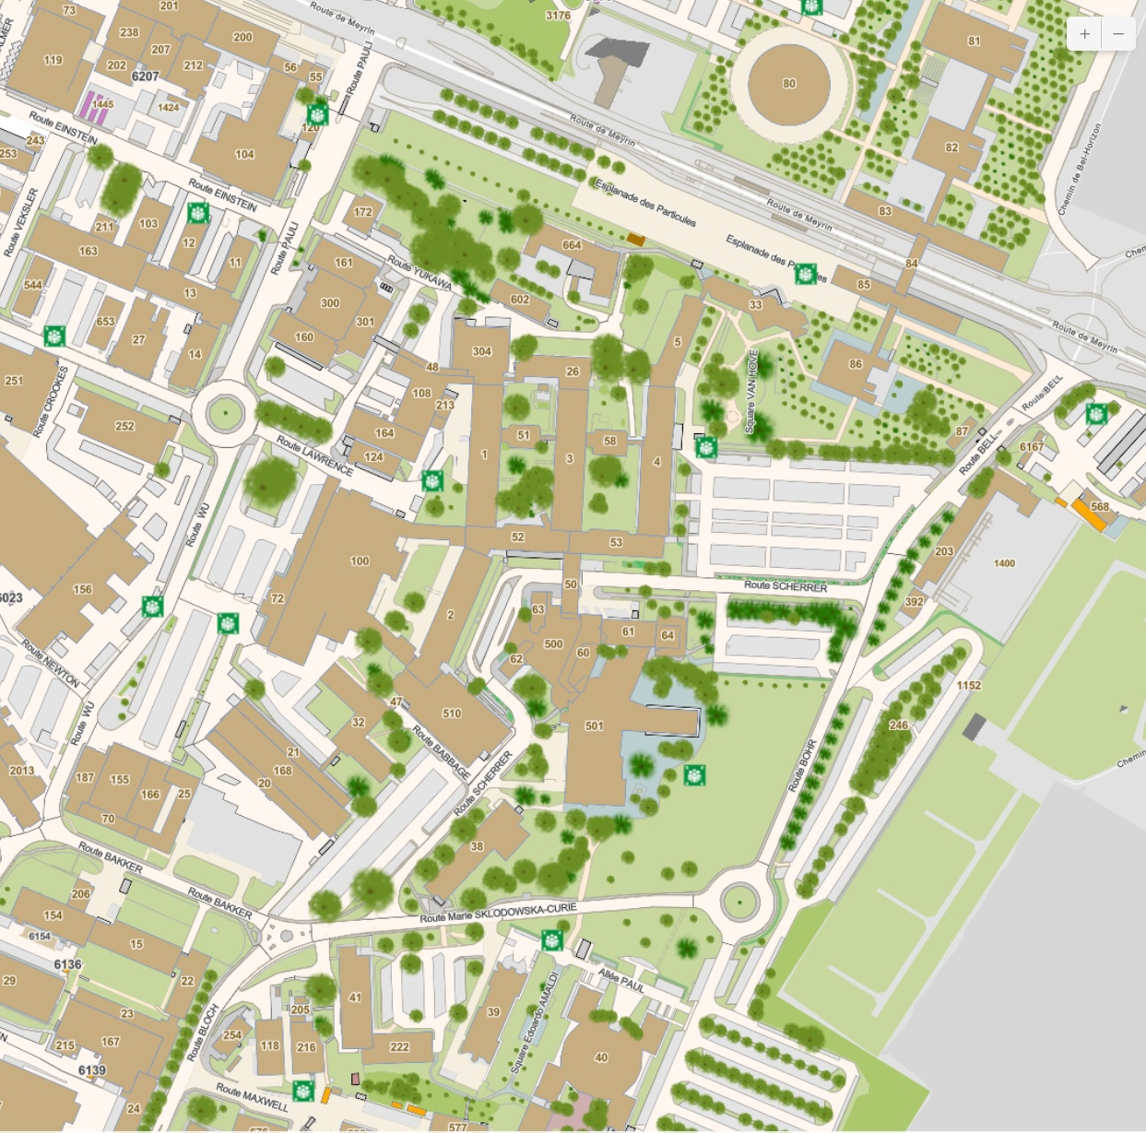
B
Tram 18
Access to CERN easily accessible from Tram line 18 (stop CERN)
Entrance B (main entrance)
Entrance A
Meeting in building 40 (bottom of picture)
Accommodations in b. 38 and 39
Meals in R1 (restaurant 1)
Free seat
Free choice (not included in JTM fees)
A
R1
Hostel - 38
Hotel - 39
40

Slide 12
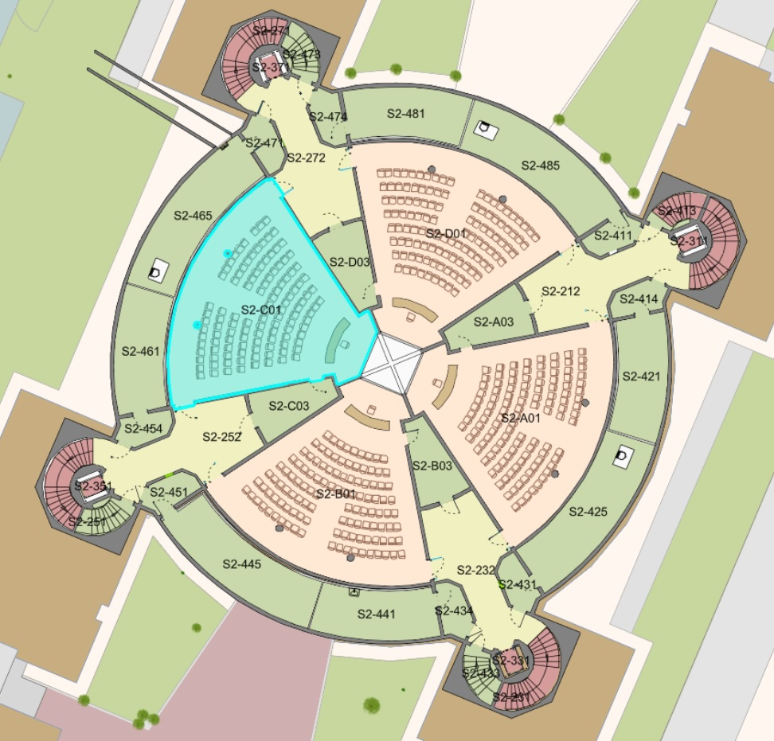
Pre-TM in building 40 S2 = -2, wings accessible from central part of the building
Monday 3 Nov.
08h to 13h – S2-C01
13h to 18h – S2-B01
Tuesday 4 Nov.
08h to 13h – S2-C01
13h to 16h – CERN visit
13h to 18h – S2-A01 (spare)
19h – Social dinner
Rooms are booked from 8h to 13h and from 13h to 18h so we have flexibility both at the pre-TM and TM
S2-C01
S2-A01
S2-B01

Slide 13
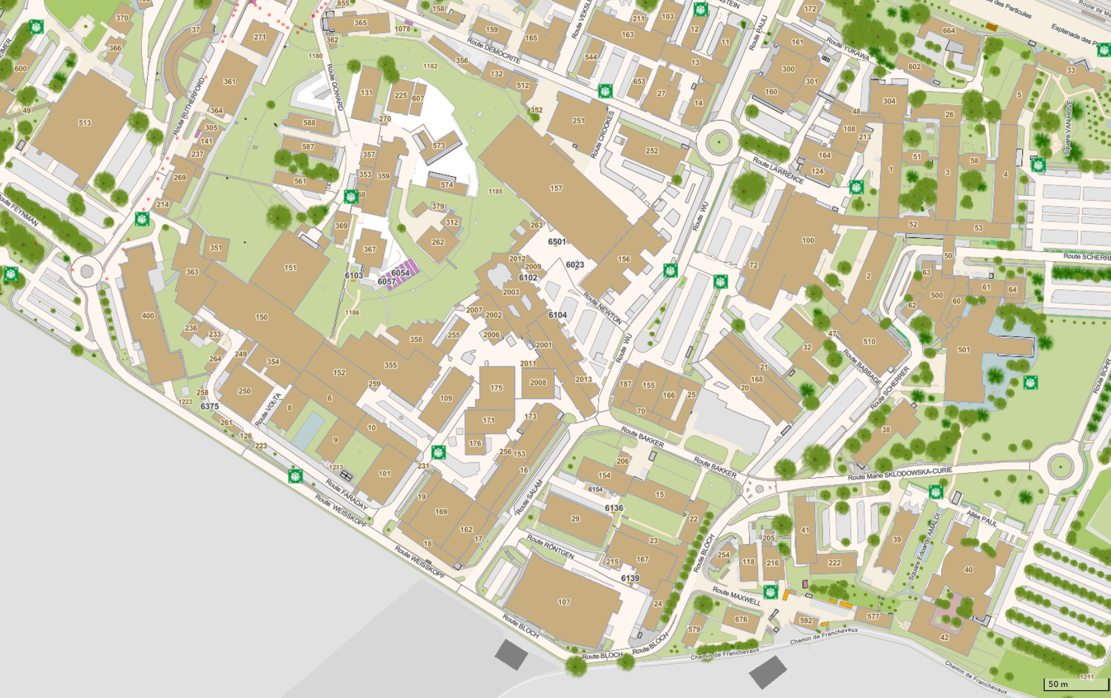
TM in building 40
Wednesday 5 Nov.
08h to 18h – S2-C01
Thursday 6 Nov.
08h to 15h – S2-C01
15h30 to 17h00 – R2* posters
Friday 7 Nov.
08h to 18h – S2-C01
* About 10 min walking distance from building 40
R2
40

Slide 14
Wednesday TM
General overview of JACoW process and tools
Indico for JACoW
Report on JACoW activity 2025
Pre-TM summary report
JACoW overview : who does what
JACoW Scientific Programme management (IPAC25)
IT management for a conference: software requirements, setup, and installation specifications (IPAC25)
Workflow at IPAC25
JACoW-Indico Conference Tools and information screens

Slide 15
Thursday TM
CATscan and RefSearch tutorial
Search tool (NEW) tutorial
Hands on
How to edit transparencies - a saga coloured by GIFs and movies (V)
Intro to Word Editing
Intro to Latex Editing
Editing PDF
Poster sessioon

Slide 16
Friday TM
Report on SRF25
Report on IBIC25
Hands on
JACoW Indico support - whom to ask for what
Proposal for JMT26
Summary from the rapporteur (IPAC26)
Closeout

